Slide 1
The Transformative Gospel
Mark 1:1

Slide 2
【1】
Introduction to the Gospel of Mark

Slide 3
【2】
What is the gospel?

Slide 4
Mrk 1:1 The beginning of the gospel
of Jesus Christ,
the Son of God.

Slide 5
【3】
This Gospel has transformative power

Slide 6
Mrk 14:51 And a young man followed him, with nothing but a linen cloth about his body. And they seized him,
52 but he left the linen cloth and ran away naked.

Slide 7
Act 15:36 And after some days Paul said to Barnabas, “Let us return and visit the brothers in every city where we proclaimed the word of the Lord, and see how they are.”37 Now Barnabas wanted to take with them John called Mark. 38 But Paul thought best not to take with them one who had withdrawn from them in Pamphylia and had not gone with them to the work.39 And there arose a sharp disagreement, so that they separated from each other.

Slide 8
2Ti 4:11
… Get Mark and bring him with you, for he is very useful to me for ministry.

Slide 9
【4】
God loves and uses weak and failing disciples.

Slide 10
The Gospel Transforms
molding us after the image of
Jesus Christ

Slide 11
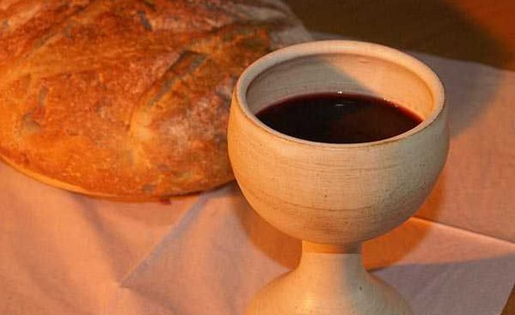
Holy Communion

Slide 12
(ESV) Joh 6:51 I am the living bread that came down from heaven. If anyone eats of this bread, he will live forever. And the bread that I will give for the life of the world is my flesh.”52 The Jews then disputed among themselves, saying, “How can this man give us his flesh to eat?”53 So Jesus said to them, “Truly, truly, I say to you, unless you eat the flesh of the Son of Man and drink his blood, you have no life in you.54 Whoever feeds on my flesh and drinks my blood has eternal life, and I will raise him up on the last day.55 For my flesh is true food, and my blood is true drink.56 Whoever feeds on my flesh and drinks my blood abides in me, and I in him.57 As the living Father sent me, and I live because of the Father, so whoever feeds on me, he also will live because of me.

