Slide 1
01 如何胜过试炼
01. How to Overcome Trials

Slide 2
雅各书 1:1.神和主耶稣基督的仆人雅各，向散居各地的十二支派问安。2.我的弟兄们，你们遭遇各种试炼的时候，都要看为喜乐；3.因为知道你们的信心经过考验，就产生忍耐。4.但忍耐要坚持到底，使你们可以完全，毫无缺乏。
James 1:1.James, a servant of God and of the Lord Jesus Christ, To the twelve tribes in the Dispersion: Greetings. 2.Count it all joy, my brothers, when you meet trials of various kinds, 3.for you know that the testing of your faith produces steadfastness.4.And let steadfastness have its full effect, that you may be perfect and complete, lacking in nothing.
1/2

Slide 3
雅各书 1:5.你们中间若有人缺少智慧，就当向那厚赐众人，而且不斥责人的 神祈求，他就必得着。6.可是，他应该凭着信心祈求，不要有疑惑；因为疑惑的人，就像被风吹荡翻腾的海浪。7.那样的人，不要想从主得到甚么；8.因为三心两意的人，在他的一切道路上，都摇摆不定。
James 1:5.If any of you lacks wisdom, let him ask God, who gives generously to all without reproach, and it will be given him.6.But let him ask in faith, with no doubting, for the one who doubts is like a wave of the sea that is driven and tossed by the wind.7.For that person must not suppose that he will receive anything from the Lord;8.he is a double-minded man, unstable in all his ways.
2/2

Slide 4
徒8:1 从这日起，耶路撒冷的教会大遭逼迫，除了使徒以外，门徒都分散在犹太和撒玛利亚各处。
Acts 8:1.And Saul approved of his execution. And there arose on that day a great persecution against the church in Jerusalem, and they were all scattered throughout the regions of Judea and Samaria, except the apostles.

Slide 5
01
遇见试炼时，
我们需要制服我们的心情
When we encounter trials, we need to bring our emotions under control.

Slide 6
2.我的弟兄们，你们遭遇各种试炼的时候，都要看为喜乐；3.因为知道你们的信心经过考验，就产生忍耐。
2.Count it all joy, my brothers, when you meet trials of various kinds, 3.for you know that the testing of your faith produces steadfastness.

Slide 7
罗马书5:3 不但如此，就是在患难中也是欢欢喜喜的；因为知道患难生忍耐，4 忍耐生老练，老练生盼望；
Romans 5:3.Not only that, but we rejoice in our sufferings, knowing that suffering produces endurance,

Slide 8
彼得前书 4:12.亲爱的，有火炼的试验临到你们，不要以为奇怪，好象是遭遇非常的事，13.倒要欢喜，因为你们既然在基督的受苦上有分，就在他荣耀显现的时候，可以欢喜快乐。
1 Peter 4:12. Beloved, do not be surprised at the fiery trial when it comes upon you to test you, as though something strange were happening to you. 13.But rejoice insofar as you share Christ's sufferings, that you may also rejoice and be glad when his glory is revealed.

Slide 9
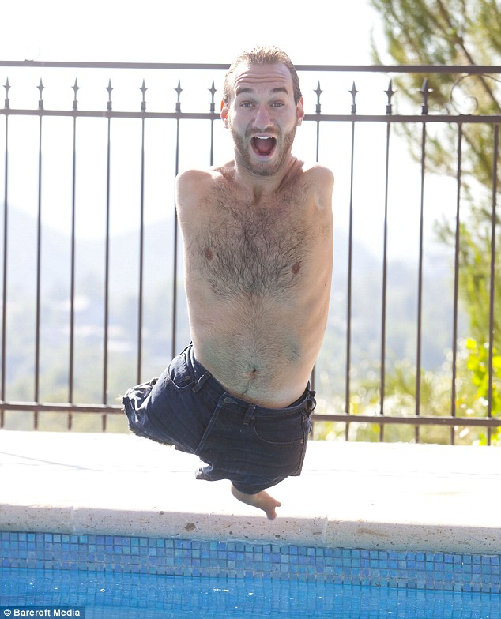
力克·胡哲
nick vujicic
自小没有手与脚

Slide 10
帖前5:16
要常常喜乐，17不住的祷告，18 凡事谢恩；因为这是神在基督耶稣里向你们所定的旨意。
1 Thessalonians 5:16. Rejoice always,18.give thanks in all circumstances; for this is the will of God in Christ Jesus for you.

Slide 11
民 14:1 当时，全体会众大声喧嚷；那夜众民都哭号。2 以色列人向摩西和亚伦发怨言；全体会众都对他们说：“但愿我们早死在埃及地，或死在这旷野。3 耶和华为什么把我们领到这地来，死在刀剑之下呢？我们的妻子和孩子要被掳掠。我们回埃及去，岂不更好吗？”4 于是他们彼此说：“我们另立一个首领，回埃及去吧。”
Numbers 14:1.Then all the congregation raised a loud cry, and the people wept that night. 2.And all the people of Israel grumbled against Moses and Aaron. The whole congregation said to them, "Would that we had died in the land of Egypt! Or would that we had died in this wilderness!3.Why is the Lord bringing us into this land, to fall by the sword? Our wives and our little ones will become a prey. Would it not be better for us to go back to Egypt?"4.And they said to one another, "Let us choose a leader and go back to Egypt."

Slide 12
民 14:26 耶和华吩咐摩西和亚伦说：27 “这恶会众向我发怨言要到几时呢？以色列人向我所发的怨言，我都听见了。28 你要对他们说：‘耶和华说，我指着我的永生起誓，我必照着你们所说给我听的，对待你们：29 你们的尸体必倒在这旷野；你们中间被数点过的，就是按着你们的数目，从二十岁以上，向我发过怨言的，30 都不得进入我起誓给你们居住的那地；只有耶孚尼的儿子迦勒和嫩的儿子约书亚才可以进去。
Numbers 14：26.And the Lord spoke to Moses and to Aaron, saying,27."How long shall this wicked congregation grumble against me? I have heard the grumblings of the people of Israel, which they grumble against me.28.Say to them, 'As I live, declares the Lord , what you have said in my hearing I will do to you:29.your dead bodies shall fall in this wilderness, and of all your number, listed in the census from twenty years old and upward, who have grumbled against me,30.not one shall come into the land where I swore that I would make you dwell, except Caleb the son of Jephunneh and Joshua the son of Nun.

Slide 13
02
主爱我们，所以允许患难使我们信心成长
The Lord loves us, so He allows trials to mature believers.

Slide 14
3.因为知道你们的信心经过考验，就产生忍耐。4.但忍耐要坚持到底，使你们可以完全，毫无缺乏。
3.for you know that the testing of your faith produces steadfastness.4.And let steadfastness have its full effect, that you may be perfect and complete, lacking in nothing.

Slide 15
03
患难中向主祈求智慧面对挑战
In times of affliction, ask the Lord for wisdom to face the challenges.

Slide 16
雅各书 1:5.你们中间若有人缺少智慧，就当向那厚赐众人，而且不斥责人的 神祈求，他就必得着。6.可是，他应该凭着信心祈求，不要有疑惑；因为疑惑的人，就像被风吹荡翻腾的海浪。7.那样的人，不要想从主得到甚么；8.因为三心两意的人，在他的一切道路上，都摇摆不定。
James 1:5.If any of you lacks wisdom, let him ask God, who gives generously to all without reproach, and it will be given him.6.But let him ask in faith, with no doubting, for the one who doubts is like a wave of the sea that is driven and tossed by the wind.7.For that person must not suppose that he will receive anything from the Lord;8.he is a double-minded man, unstable in all his ways.
2/2

Slide 17
04
祈求智慧的必要条件
The Prerequisite for Receiving Wisdom

Slide 18
6.可是，他应该凭着信心祈求，不要有疑惑；因为疑惑的人，就像被风吹荡翻腾的海浪。7.那样的人，不要想从主得到甚么；8.因为三心两意的人，在他的一切道路上，都摇摆不定。
.6.But let him ask in faith, with no doubting, for the one who doubts is like a wave of the sea that is driven and tossed by the wind.7.For that person must not suppose that he will receive anything from the Lord;8.he is a double-minded man, unstable in all his ways.

