Slide 1
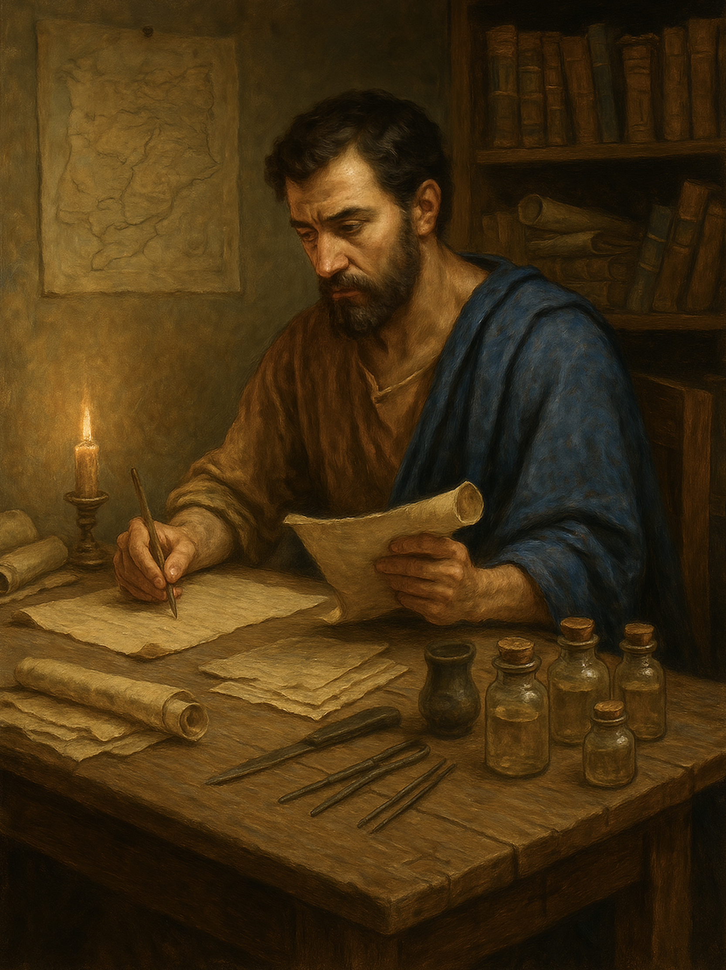
路加福音 Gospel of Luke
01 撒迦利亚与以利沙伯
路1章1至25
The Appearance of Jesus: Dispelling Sorrow, Fear, and Doubt

Slide 3
路1:1 尊敬的提阿非罗先生，因为有许多人，已经把在我们中间成就了的事，2.按照起初亲眼看见的传道人所传给我们的，编着成书；3.我已经把这些事从头考查过，认为也应该按着次序写给你，4.让你晓得所学到的道理，都是确实的。
Luke 1:1.Inasmuch as many have undertaken to compile a narrative of the things that have been accomplished among us,2.just as those who from the beginning were eyewitnesses and ministers of the word have delivered them to us,3.it seemed good to me also, having followed all things closely for some time past, to write an orderly account for you, most excellent Theophilus,4.that you may have certainty concerning the things you have been taught.
1/5

Slide 4
5.犹太王希律在位的日子，亚比雅班里有一个祭司，名叫撒迦利亚，他妻子是亚伦的后代，名叫以利沙伯。6.他们在神面前都是义人，遵行主的一切诫命规条，无可指摘，7.只是没有孩子，因为以利沙伯不生育，二人又都上了年纪。8.有一次，撒迦利亚在神面前按着班次执行祭司的职务，9.照祭司的惯例抽中了签，进入主的圣殿烧香。10.烧香的时候，众人都在外面祈祷。11.有主的使者站在香坛右边，向他显现。12.撒迦利亚一见就惊慌起来，十分害怕。
5.In the days of Herod, king of Judea, there was a priest named Zechariah, of the division of Abijah. And he had a wife from the daughters of Aaron, and her name was Elizabeth.6And they were both righteous before God, walking blamelessly in all the commandments and statutes of the Lord.7.But they had no child, because Elizabeth was barren, and both were advanced in years.8.Now while he was serving as priest before God when his division was on duty,9.according to the custom of the priesthood, he was chosen by lot to enter the temple of the Lord and burn incense.10.And the whole multitude of the people were praying outside at the hour of incense.11.And there appeared to him an angel of the Lord standing on the right side of the altar of incense.12.And Zechariah was troubled when he saw him, and fear fell upon him.
2/5

Slide 5
13.天使说：“撒迦利亚，不要怕，因为你的祈求已蒙垂听，你妻子以利沙伯要给你生一个儿子，你要给他起名叫约翰。14.你必欢喜快乐，许多人因他出生，也必喜乐。15.他在主面前要被尊为大，淡酒浓酒都不喝，未出母腹就被圣灵充满。16.他要使许多以色列人转向主他们的神。17.他必有以利亚的灵和能力，行在主的前面，叫父亲的心转向儿女，叫悖逆的转向义人的意念，为主安排那预备好了的人民。”
13.But the angel said to him, "Do not be afraid, Zechariah, for your prayer has been heard, and your wife Elizabeth will bear you a son, and you shall call his name John.14.And you will have joy and gladness, and many will rejoice at his birth,15.for he will be great before the Lord. And he must not drink wine or strong drink, and he will be filled with the Holy Spirit, even from his mothers womb.16.And he will turn many of the children of Israel to the Lord their God,17.and he will go before him in the spirit and power of Elijah, to turn the hearts of the fathers to the children, and the disobedient to the wisdom of the just, to make ready for the Lord a people prepared."
3/5

Slide 6
18.撒迦利亚对天使说：“我怎么能知道这事呢？我已经老了，我妻子也上了年纪。”19.天使回答：“我是站在神面前的加百列，奉差遣向你说话，报给你这好消息。20.看吧！到了时候我的话必要应验；因为你不信我的话，你必成为哑巴，直到这些事成就的那一天，才能说话。”21.众人等候撒迦利亚；因他在圣殿里迟迟不出来，觉得奇怪。
18.And Zechariah said to the angel, "How shall I know this? For I am an old man, and my wife is advanced in years."19.And the angel answered him, "I am Gabriel. I stand in the presence of God, and I was sent to speak to you and to bring you this good news.20.And behold, you will be silent and unable to speak until the day that these things take place, because you did not believe my words, which will be fulfilled in their time."21.And the people were waiting for Zechariah, and they were wondering at his delay in the temple.
4/5

Slide 7
22.等到他出来，却不能讲话，竟成了哑巴，不断地向他们打手式，他们就知道他在圣殿里见了异象。23.供职的日子满了，他就回家去。24.过了几天，他妻子以利沙伯怀了孕，隐藏了五个月，说：25.“主在眷顾的日子，这样看待我，要把我在人间的羞耻除掉。”
22.And when he came out, he was unable to speak to them, and they realized that he had seen a vision in the temple. And he kept making signs to them and remained mute.23.And when his time of service was ended, he went to his home.24.After these days his wife Elizabeth conceived, and for five months she kept herself hidden, saying,25."Thus the Lord has done for me in the days when he looked on me, to take away my reproach among people."
5/5

Slide 8
01
路加医生从头仔细考查了 福音的起源与经过。
Doctor Luke carefully investigated the origin and development of the Gospel from the beginning..

Slide 9
路1:1 尊敬的提阿非罗先生，因为有许多人，已经把在我们中间成就了的事，2.按照起初亲眼看见的传道人所传给我们的，编着成书；3.我已经把这些事从头考查过，认为也应该按着次序写给你，4.让你晓得所学到的道理，都是确实的。
Luke 1:1.Inasmuch as many have undertaken to compile a narrative of the things that have been accomplished among us,2.just as those who from the beginning were eyewitnesses and ministers of the word have delivered them to us,3.it seemed good to me also, having followed all things closely for some time past, to write an orderly account for you, most excellent Theophilus,4.that you may have certainty concerning the things you have been taught.

Slide 10
02
撒迦利亚是基督先锋的父亲。
Zechariah was the father of the forerunner of Christ.

Slide 11
5.犹太王希律在位的日子，亚比雅班里有一个祭司，名叫撒迦利亚，他妻子是亚伦的后代，名叫以利沙伯。6.他们在 神面前都是义人，遵行主的一切诫命规条，无可指摘，7.只是没有孩子，因为以利沙伯不生育，二人又都上了年纪。
5.In the days of Herod, king of Judea, there was a priest named Zechariah, of the division of Abijah. And he had a wife from the daughters of Aaron, and her name was Elizabeth.6And they were both righteous before God, walking blamelessly in all the commandments and statutes of the Lord.7.But they had no child, because Elizabeth was barren, and both were advanced in years.

Slide 12
03
神拣选他们来成就救恩计划
God graciously chose them to accomplish His plan of salvation.

Slide 13
8.有一次，撒迦利亚在 神面前按着班次执行祭司的职务，9.照祭司的惯例抽中了签，进入主的圣殿烧香。10.烧香的时候，众人都在外面祈祷。11.有主的使者站在香坛右边，向他显现。12.撒迦利亚一见就惊慌起来，十分害怕。
继续下一页
8.Now while he was serving as priest before God when his division was on duty,9.according to the custom of the priesthood, he was chosen by lot to enter the temple of the Lord and burn incense.10.And the whole multitude of the people were praying outside at the hour of incense.11.And there appeared to him an angel of the Lord standing on the right side of the altar of incense.12.And Zechariah was troubled when he saw him, and fear fell upon him.

Slide 14
13.天使说：“撒迦利亚，不要怕，因为你的祈求已蒙垂听，你妻子以利沙伯要给你生一个儿子，你要给他起名叫约翰。14.你必欢喜快乐，许多人因他出生，也必喜乐。15.他在主面前要被尊为大，淡酒浓酒都不喝，未出母腹就被圣灵充满。16.他要使许多以色列人转向主他们的 神。17.他必有以利亚的灵和能力，行在主的前面，叫父亲的心转向儿女，叫悖逆的转向义人的意念，为主安排那预备好了的人民。”
13.But the angel said to him, "Do not be afraid, Zechariah, for your prayer has been heard, and your wife Elizabeth will bear you a son, and you shall call his name John.14.And you will have joy and gladness, and many will rejoice at his birth,15.for he will be great before the Lord. And he must not drink wine or strong drink, and he will be filled with the Holy Spirit, even from his mothers womb.16.And he will turn many of the children of Israel to the Lord their God,17.and he will go before him in the spirit and power of Elijah, to turn the hearts of the fathers to the children, and the disobedient to the wisdom of the just, to make ready for the Lord a people prepared."

Slide 15
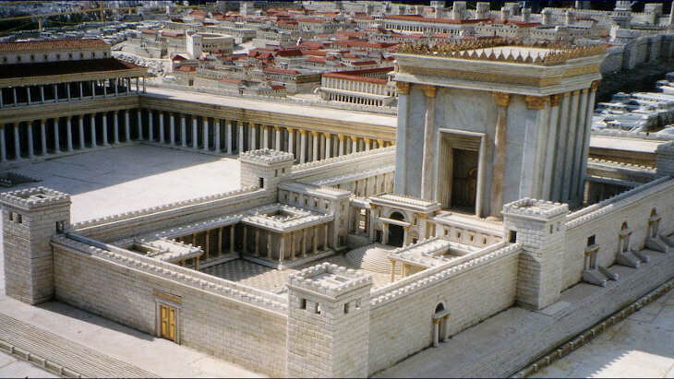
1/2

Slide 16
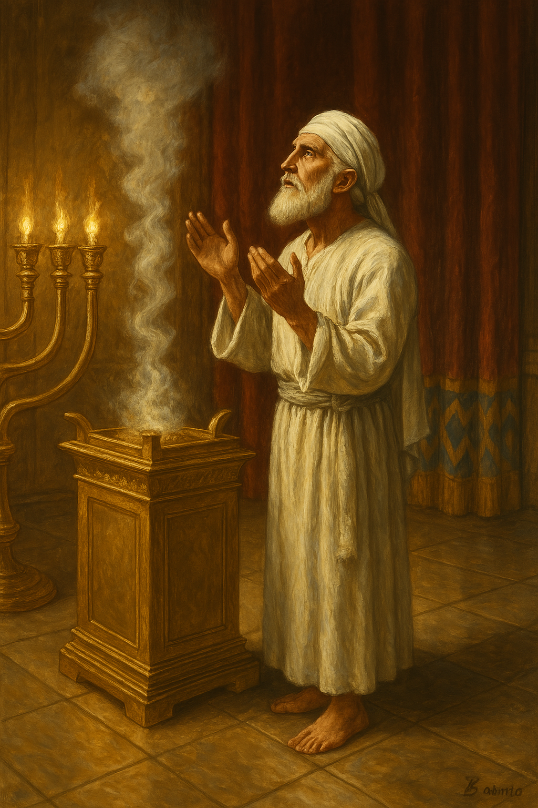
据《代上24:1–19》，祭司分为24班，每班每年轮值两次进圣殿。当时祭司人数众多，约瑟夫记载多达两万。按(米示拿 5.2），祭司一生仅有一次烧香机会，许多人终身未曾轮到。
1 Chron 24:1–19, the priests were divided into 24 divisions, each serving twice a year. With up to 20,000 priests (Josephus), the Mishnah (Tamid 5.2) notes that most had only one lifetime chance to offer incense, many never did have the opportunity

Slide 17
13....因为你的祈求已蒙垂听，你妻子以利沙伯要给你生一个儿子，你要给他起名叫约翰。14.你必欢喜快乐，许多人因他出生，也必喜乐。15.他在主面前要被尊为大，淡酒浓酒都不喝，未出母腹就被圣灵充满。
13....for your prayer has been heard, and your wife Elizabeth will bear you a son, and you shall call his name John.14.And you will have joy and gladness, and many will rejoice at his birth,15.for he will be great before the Lord. And he must not drink wine or strong drink, and he will be filled with the Holy Spirit, even from his mothers womb.

Slide 18
15....未出母腹就被圣灵充满。16.他要使许多以色列人转向主他们的神。17.他必有以利亚的灵和能力，行在主的前面，叫父亲的心转向儿女，叫悖逆的转向义人的意念，为主安排那预备好了的人民。”
15....and he will be filled with the Holy Spirit, even from his mothers womb.16.And he will turn many of the children of Israel to the Lord their God,17.and he will go before him in the spirit and power of Elijah, to turn the hearts of the fathers to the children, and the disobedient to the wisdom of the just, to make ready for the Lord a people prepared."

Slide 19
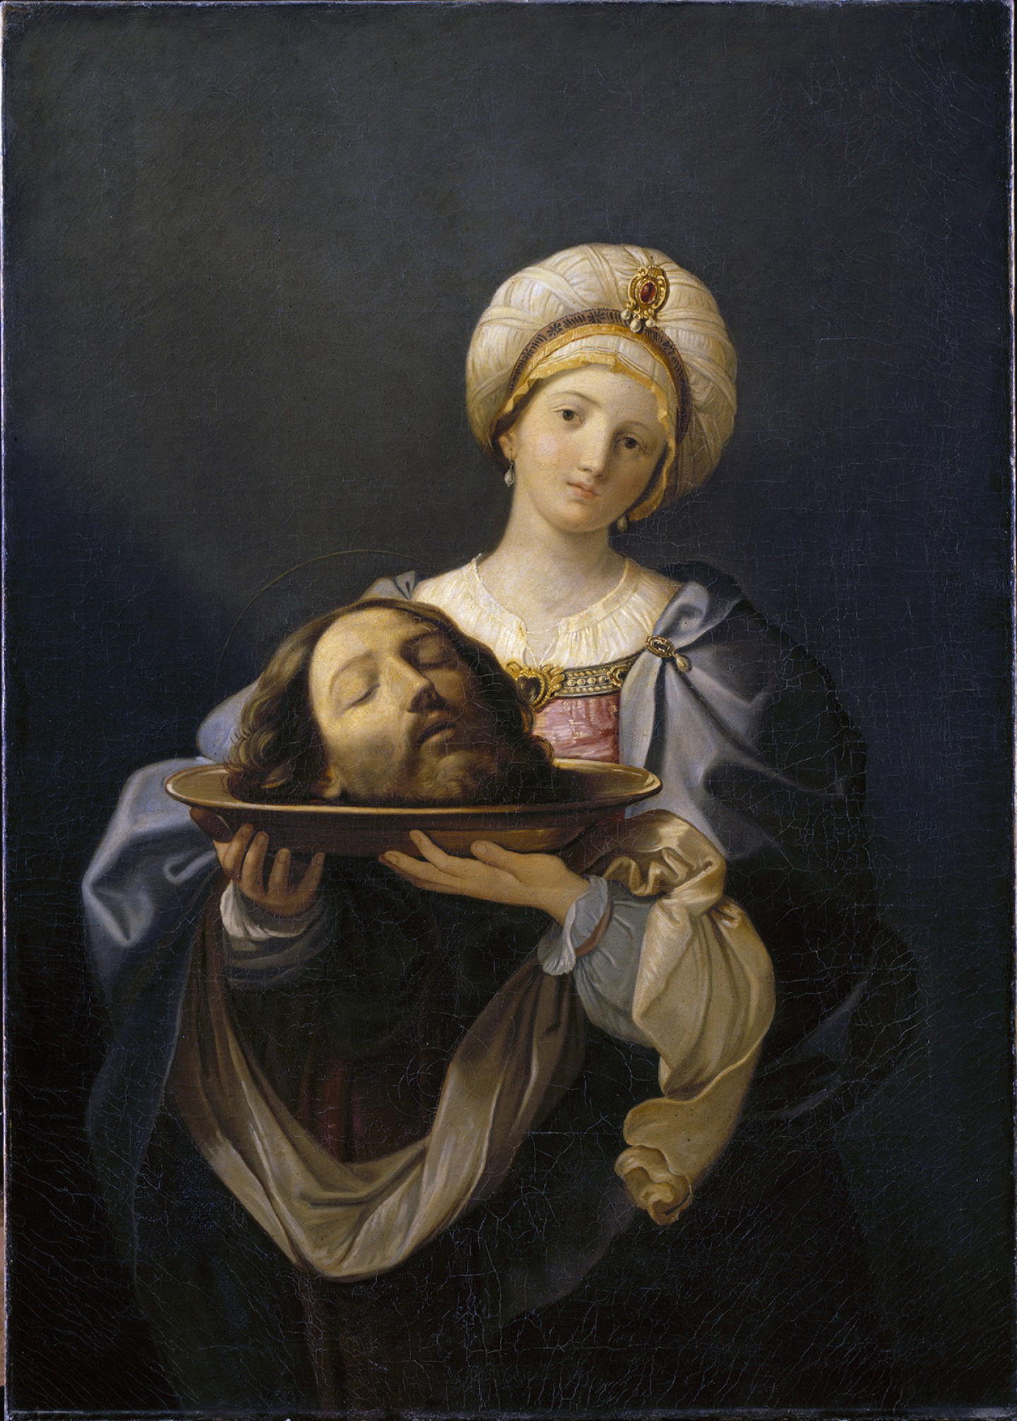
14.你必欢喜快乐，许多人因他出生，也必喜乐。
14. And you will have joy and gladness, and many will rejoice at his birth,

Slide 20
04
义人撒迦利亚不信神说他会得孩子
Righteous Zechariah did not believe God when He said he would have a child.

Slide 21
18.撒迦利亚对天使说：“我怎么能知道这事呢？我已经老了，我妻子也上了年纪。”19.天使回答：“我是站在 神面前的加百列，奉差遣向你说话，报给你这好消息。20.看吧！到了时候我的话必要应验；因为你不信我的话，你必成为哑巴，直到这些事成就的那一天，才能说话。”21.众人等候撒迦利亚；因他在圣殿里迟迟不出来，觉得奇怪。
18.And Zechariah said to the angel, "How shall I know this? For I am an old man, and my wife is advanced in years."19.And the angel answered him, "I am Gabriel. I stand in the presence of God, and I was sent to speak to you and to bring you this good news.20.And behold, you will be silent and unable to speak until the day that these things take place, because you did not believe my words, which will be fulfilled in their time."21.And the people were waiting for Zechariah, and they were wondering at his delay in the temple.

Slide 22
05
主能消除我们的羞耻
The Lord is able to remove our shame.

Slide 23
24.过了几天，他妻子以利沙伯怀了孕，隐藏了五个月，说：25.“主在眷顾的日子，这样看待我，要把我在人间的羞耻除掉。”
24.After these days his wife Elizabeth conceived, and for five months she kept herself hidden, saying,25."Thus the Lord has done for me in the days when he looked on me, to take away my reproach among people."

Slide 24
圣餐
Lord Supper

Slide 25
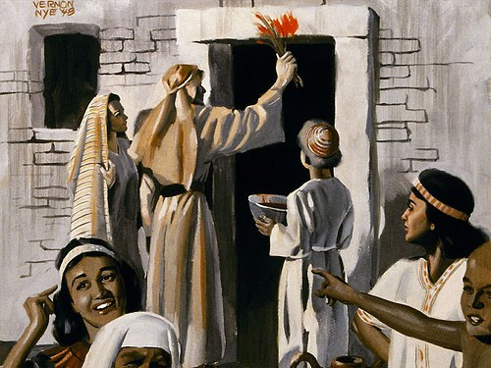
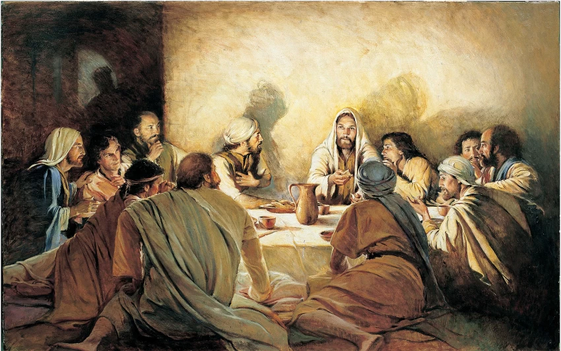
新约的圣餐取代了旧约的逾越节 Holy Communion replaces the passover meal

Slide 26
出12:21 于是，摩西把以色列的众长老召了来，对他们说：“你们要按着家族自己选取羊羔，把这逾越节的羊羔宰杀了。22要拿一把牛膝草，蘸在盆中的血里，然后把盆里的血涂在门楣上和两边的门柱上；你们谁也不可出自己的房门，直到早晨。23因为耶和华要走遍各处击打埃及人；他一看见门楣和两边的门柱上有血，就越过那门，不让那毁灭者进入你们的房屋来击杀你们。
Exo 12:21 Then Moses called all the elders of Israel and said to them, "Go and select lambs for yourselves according to your clans, and kill the Passover lamb. 22 Take a bunch of hyssop and dip it in the blood that is in the basin, and touch the lintel and the two doorposts with the blood that is in the basin. None of you shall go out of the door of his house until the morning. 23 For the LORD will pass through to strike the Egyptians, and when he sees the blood on the lintel and on the two doorposts, the LORD will pass over the door and will not allow the destroyer to enter your houses to strike you.

Slide 27
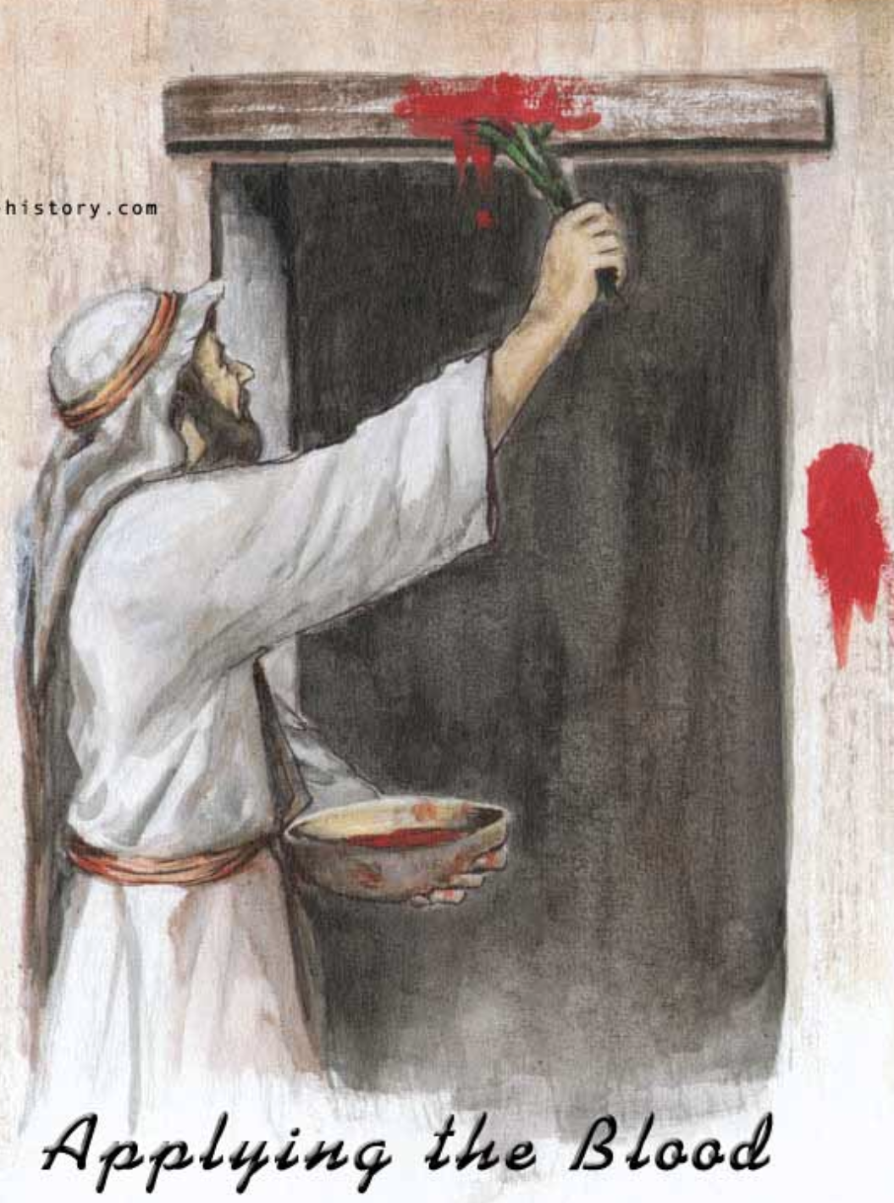
林前5:7 ...
我们逾越节的羊羔基督已经被杀献祭了。

Slide 28
因为主耶稣，上帝的审判越过我们
Because of what Lord Jesus has done for us , God’s judgment has pass over us

