Slide 1
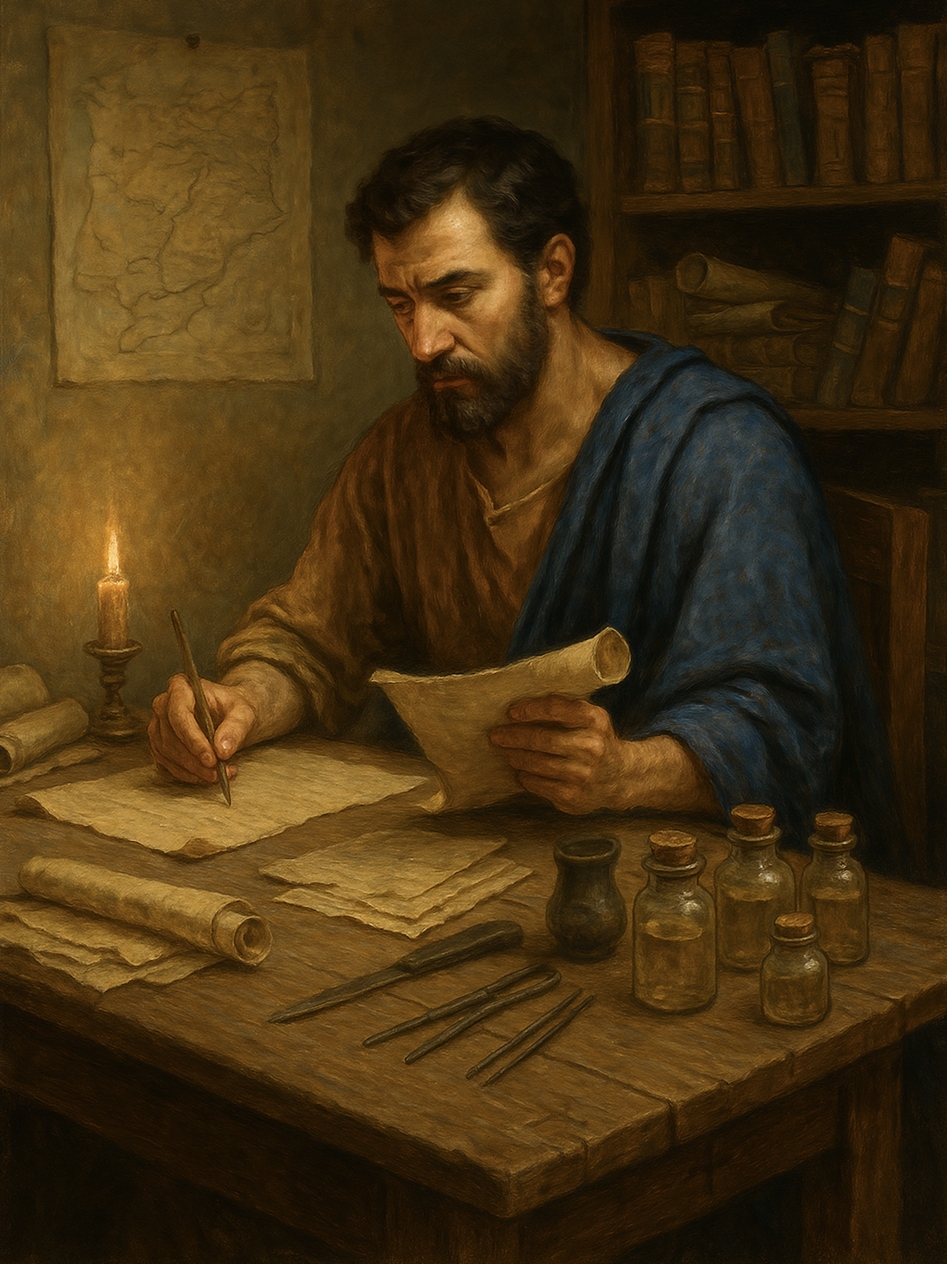
路加福音 Gospel of Luke
010 圣灵与火给你们施洗
路3章10至18
Baptize you with the Holy Spirit and fire.

Slide 2


爸！ 父！
Father!

Slide 3
路 3:10 群众问他：“那么，我们该作什么呢？”11 他回答：“有两件衣服的，当分给那没有的，有食物的也当照样作。”12 又有税吏来要受洗，问他：“老师，我们当作什么呢？”13 他说：“除了规定的以外，不可多收。”14 兵丁也问他：“至于我们，我们又应当作什么呢？”他说：“不要恐吓，不要敲诈，当以自己的粮饷为满足。”
Luk 3:10 And the crowds asked him, “What then shall we do?”11 And he answered them, “Whoever has two tunics is to share with him who has none, and whoever has food is to do likewise.”12 Tax collectors also came to be baptized and said to him, “Teacher, what shall we do?”13 And he said to them, “Collect no more than you are authorized to do.”14 Soldiers also asked him, “And we, what shall we do?” And he said to them, “Do not extort money from anyone by threats or by false accusation, and be content with your wages.”
1/2

Slide 4
15 那时众人正在期待，人人心里都在猜想会不会约翰就是基督。16 约翰对众人说：“我用水给你们施洗，但那能力比我更大的要来，我就是给他解鞋带都没有资格。他要用圣灵与火给你们施洗。17 他手里拿着簸bò 箕 jī ，要扬净麦场，把麦子收进仓里，却用不灭的火把糠 kāng 秕bǐ 烧尽。”18 他还用许多别的话劝勉众人，向他们传福音。
15 As the people were in expectation, and all were questioning in their hearts concerning John, whether he might be the Christ,16 John answered them all, saying, “I baptize you with water, but he who is mightier than I is coming, the strap of whose sandals I am not worthy to untie. He will baptize you with the Holy Spirit and fire.17 His winnowing fork is in his hand, to clear his threshing floor and to gather the wheat into his barn, but the chaff he will burn with unquenchable fire.”18 So with many other exhortations he preached good news to the people.
2/2

Slide 5
01
悔改信主后，我们该作什么呢？
After repenting and believing in the Lord, what should we do?”

Slide 6
路 3:10 群众问他：“那么，我们该作什么呢？”11 他回答：“有两件衣服的，当分给那没有的，有食物的也当照样作。”
Luk 3:10 And the crowds asked him, “What then shall we do?”11 And he answered them, “Whoever has two tunics is to share with him who has none, and whoever has food is to do likewise.”

Slide 7
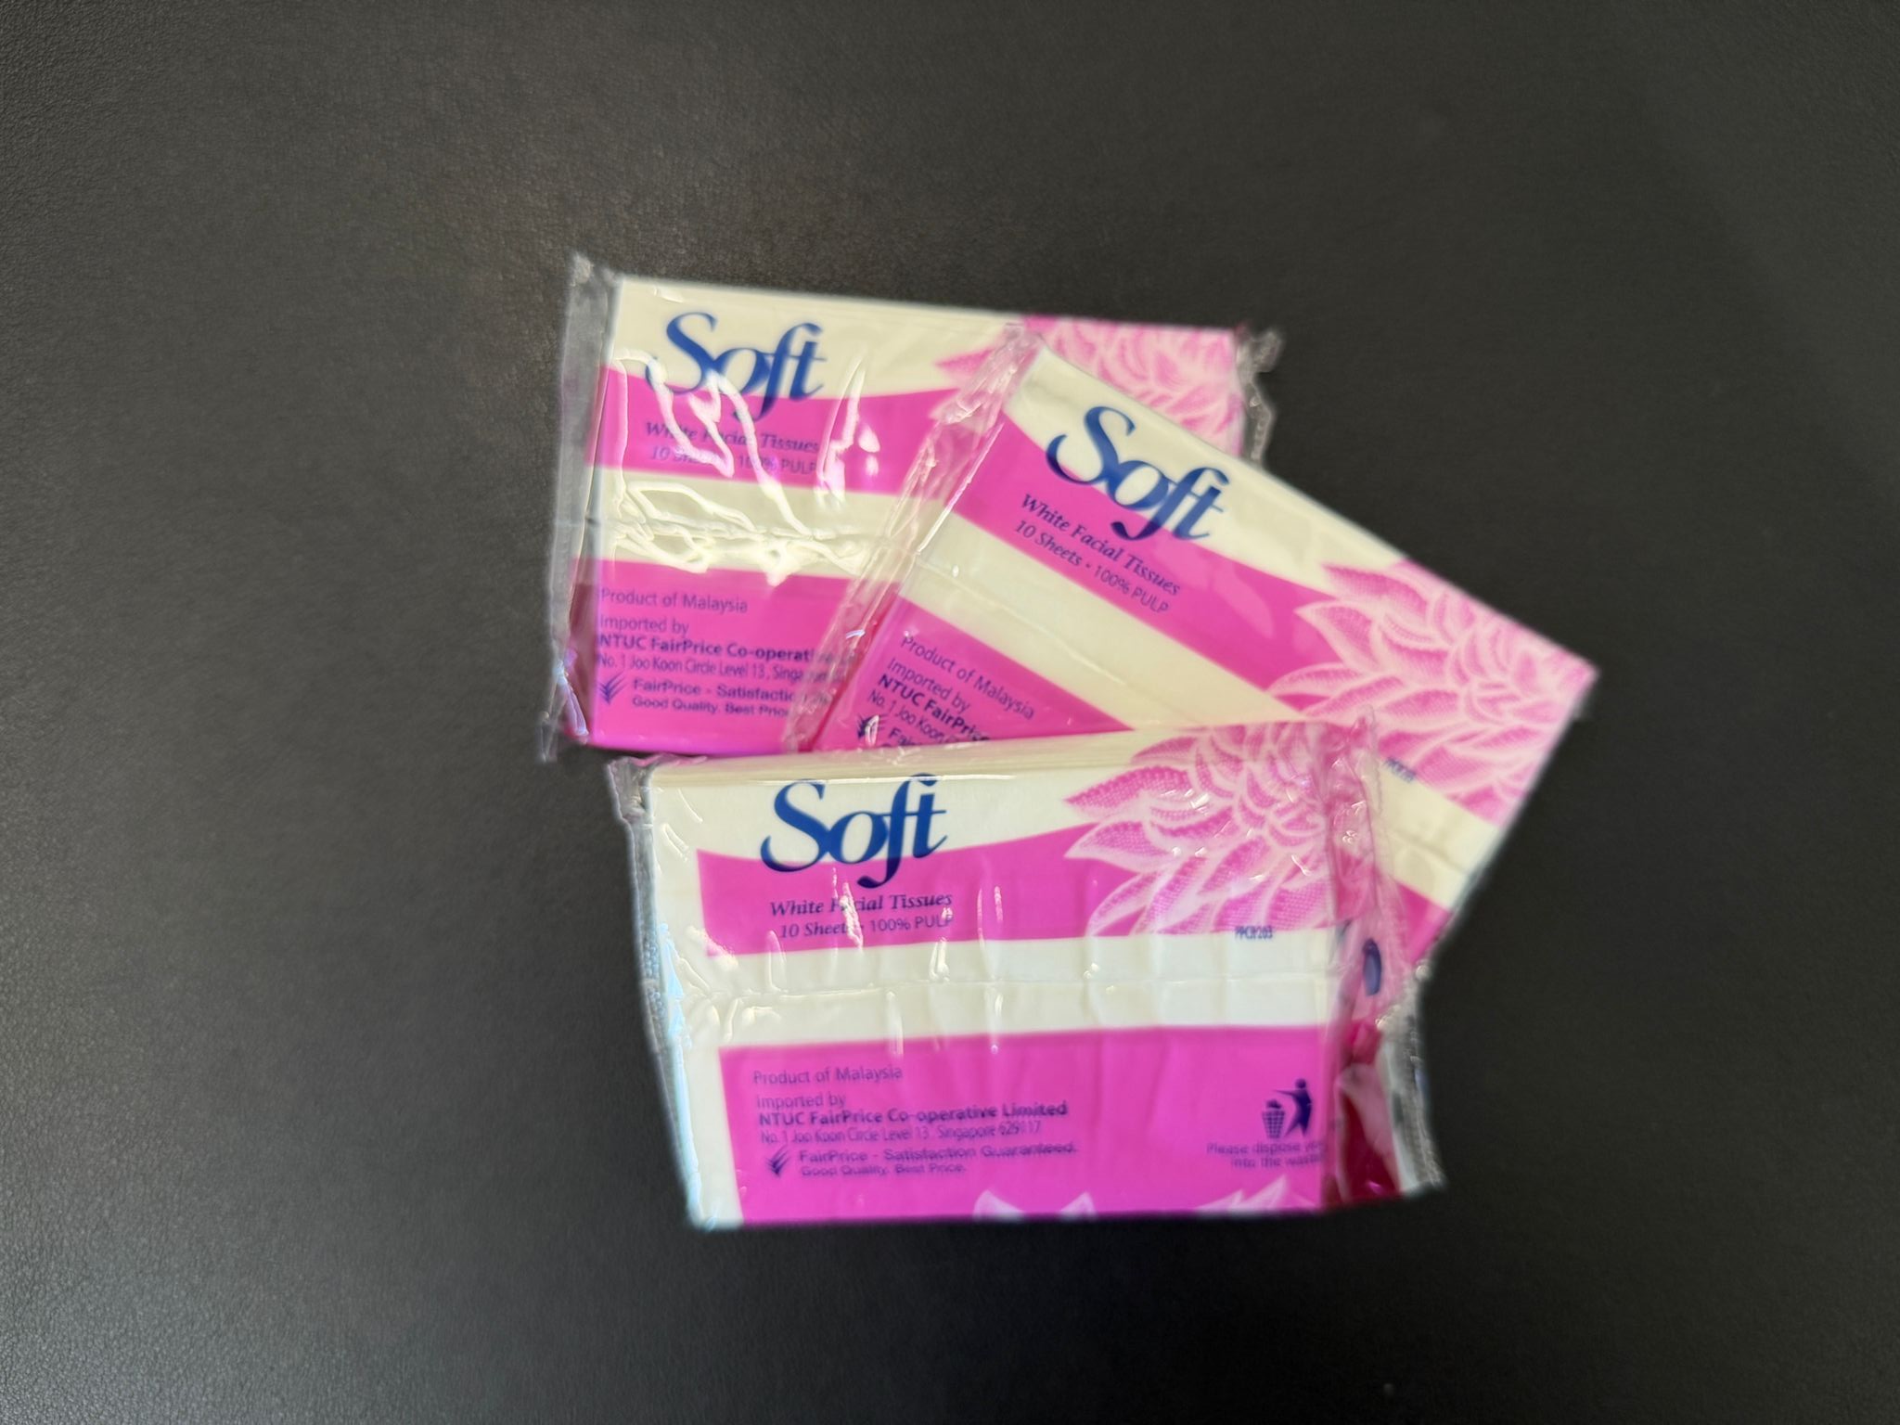

Slide 8
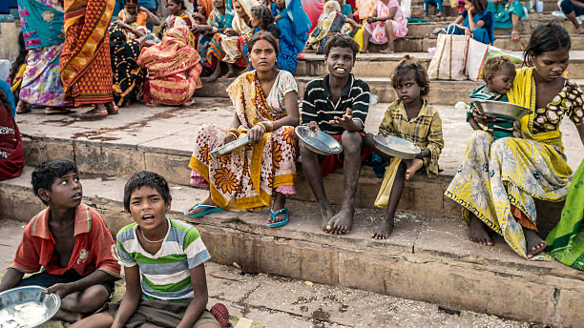

Slide 9
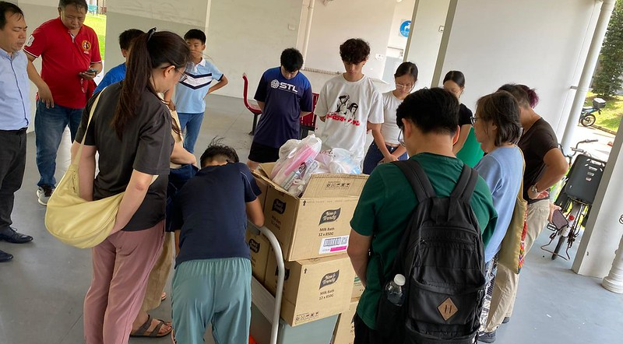
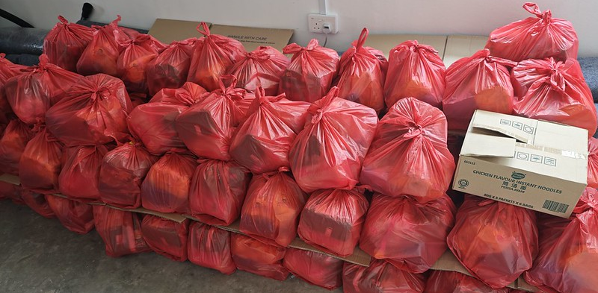
2024 怜悯事工开始

Slide 10
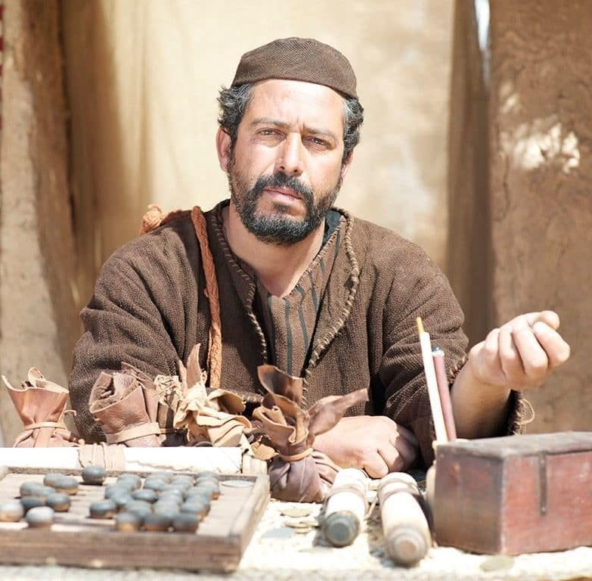
12 又有税吏来要受洗，问他：“老师，我们当作什么呢？”13 他说：“除了规定的以外，不可多收。”
12 Tax collectors also came to be baptized and said to him, “Teacher, what shall we do?”13 And he said to them, “Collect no more than you are authorized to do.”

Slide 11
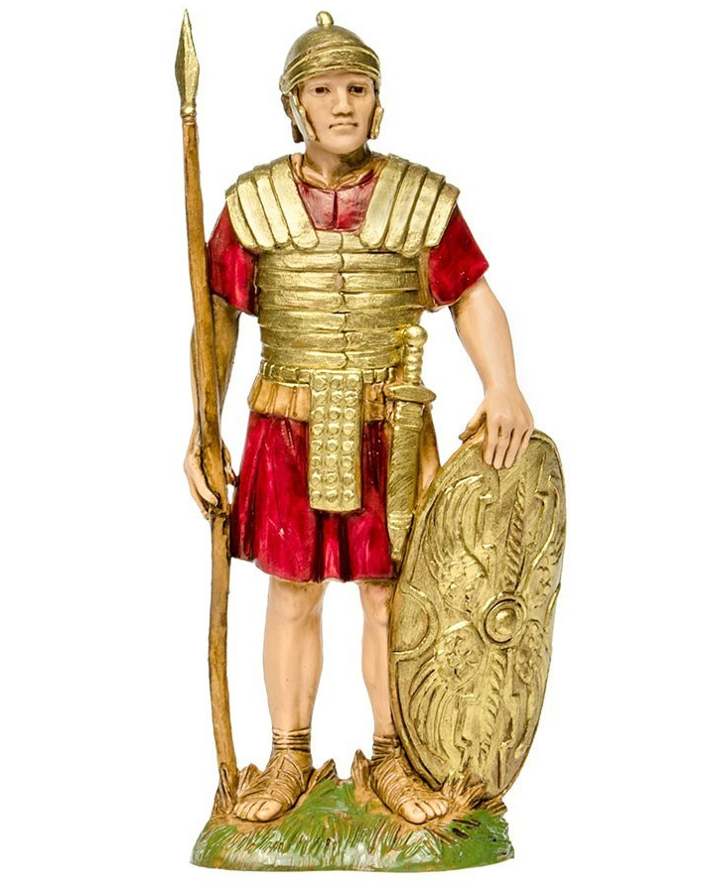
14 兵丁也问他：“至于我们，我们又应当作什么呢？”他说：“不要恐吓，不要敲诈，当以自己的粮饷为满足。”
14 Soldiers also asked him, “And we, what shall we do?” And he said to them, “Do not extort money from anyone by threats or by false accusation, and be content with your wages.”

Slide 12
02
我们给主耶稣解鞋带都没有资格
We are not even worthy to untie the sandal strap for the Lord Jesus.

Slide 13
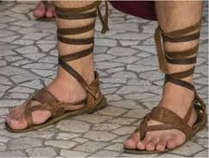
15 那时众人正在期待，人人心里都在猜想会不会约翰就是基督。16 约翰对众人说：“我用水给你们施洗，但那能力比我更大的要来，我就是给他解鞋带都没有资格。。。。
15 As the people were in expectation, and all were questioning in their hearts concerning John, whether he might be the Christ,16 John answered them all, saying, “I baptize you with water, but he who is mightier than I is coming, the strap of whose sandals I am not worthy to untie. 。。。

Slide 14
03
主耶稣用圣灵与火给我们施洗
The Lord Jesus baptizes us with the Holy Spirit and with fire.

Slide 15
16 约翰对众人说：“我用水给你们施洗，但那能力比我更大的要来，我就是给他解鞋带都没有资格。他要用圣灵与火给你们施洗。
16 John answered them all, saying, “I baptize you with water, but he who is mightier than I is coming, the strap of whose sandals I am not worthy to untie. He will baptize you with the Holy Spirit and fire.

Slide 16









主耶稣用圣灵与火给我们施洗 （路3:16、太3:11）
火的象征 fire
圣灵的炼净与洁净 purify
能力与审判 power and judgement
(出13:21、赛4:4、赛30:27、徒2:3-4、帖前5:19、启4:5)
water 水的象征
Cleansing 圣灵的洁净
Life giving 赐生命
(赛44:3、结36:25-27、约3:5、约7:38-39、多3:5)
风的象征 wind
圣灵的运行 activity
赐生命气息 life-giving breath
（赛30:27、结37:1-14、约3:8、约20:22、徒2:2）
旧约中常用风、气、水、火比喻圣灵
“In the Old Testament, wind, breath, water, and fire are often used as symbols of the Holy Spirit.”

Slide 17
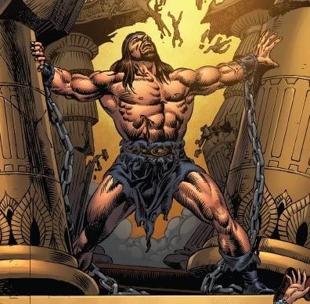
那在士师们里面的灵，如今也在我们里面
（徒1:5、徒11:15-17、林前12:13、弗1:13-14）
The Spirit who was in the judges is now also in us.
Acts 1:5; 11:15–17; 1 Cor. 12:13; Eph. 1:13–14

Slide 18
撒迦利亚书4:6
...万军之耶和华说：不是倚靠势力，不是倚靠才能，乃是倚靠我的灵方能成事。
Zec 4:6 ... Not by might, nor by power, but by my Spirit, says the LORD of hosts.

Slide 19
03
主耶稣回来时祂会审判世界
When the Lord Jesus returns, He will judge the world.

Slide 20
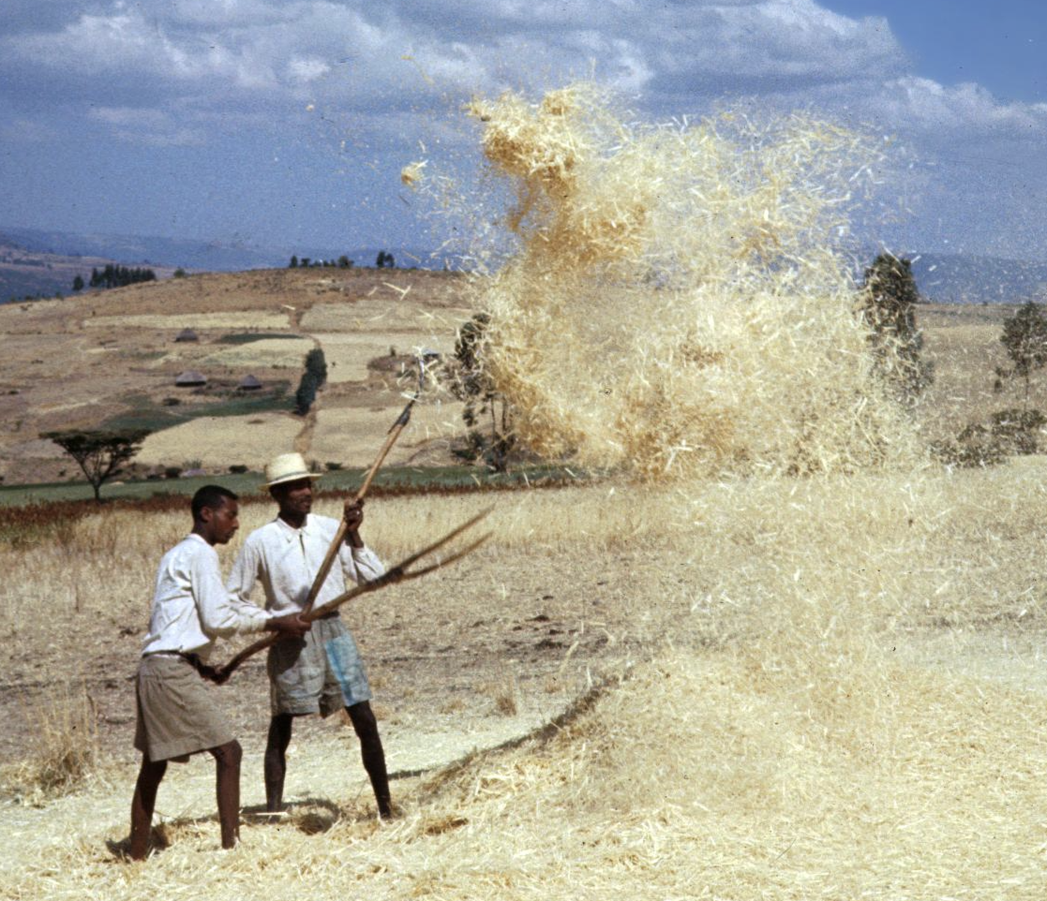
17 他手里拿着簸箕，要扬净麦场，把麦子收进仓里，却用不灭的火把糠秕烧尽。”
簸箕叉、扬场叉
winnowing fork
Luk 3:17 His winnowing fork is in his hand, to clear his threshing floor and to gather the wheat into his barn, but the chaff he will burn with unquenchable fire.”

Slide 21
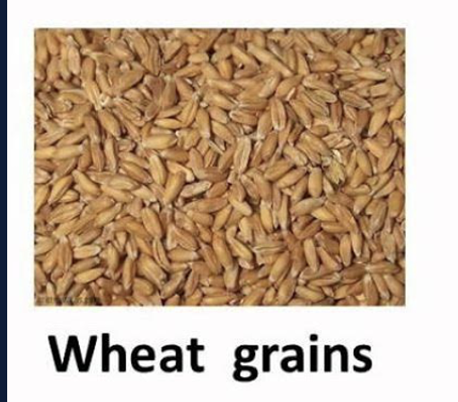
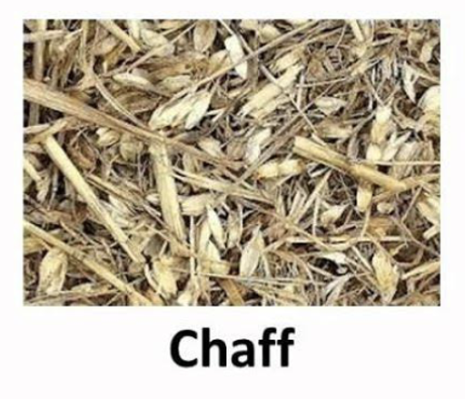
把麦子收进仓里，却用不灭的火把糠秕烧尽。
to gather the wheat into his barn, but the chaff he will burn with unquenchable fire.”
麦子象征属于
神的子民
糠秕象征恶人
焚烧的结局
（诗1:4、诗35:5、太13:49-50）
（太13:38、约12:24）
Wheat symbolizes those who belong to God.
Chaff symbolizes the wicked to be burned

Slide 22
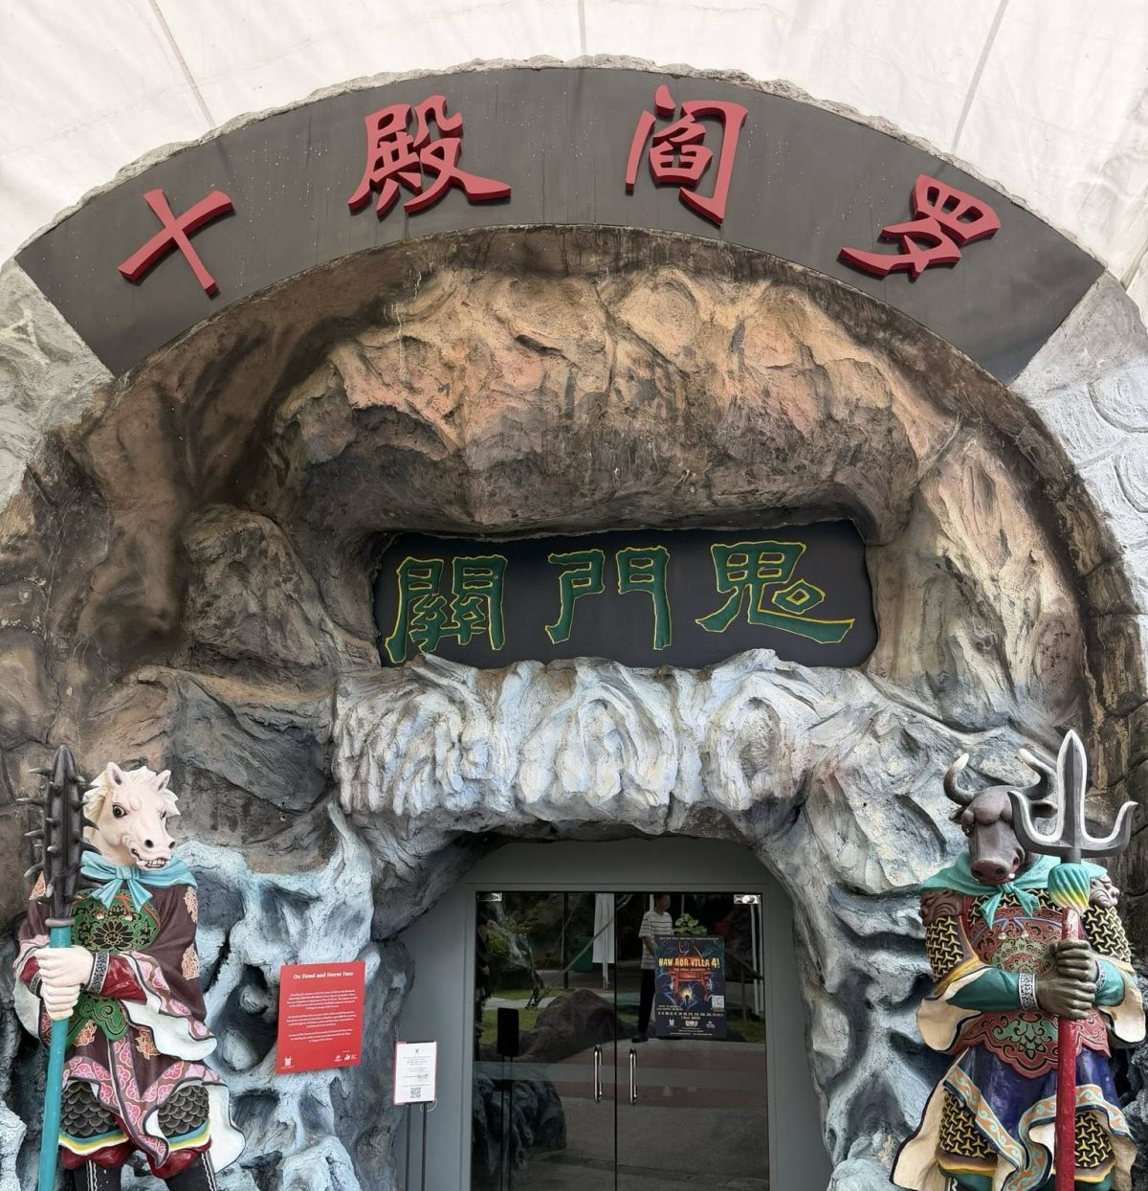
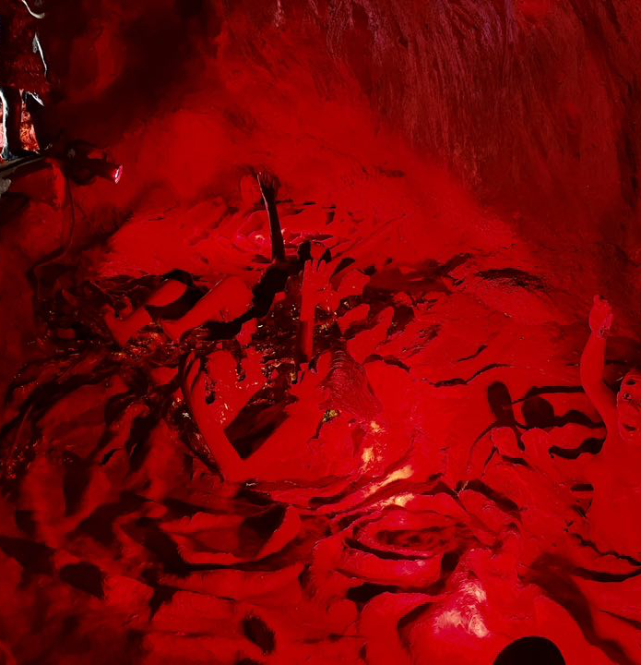
华人民间信仰的地狱与审判观

Slide 23
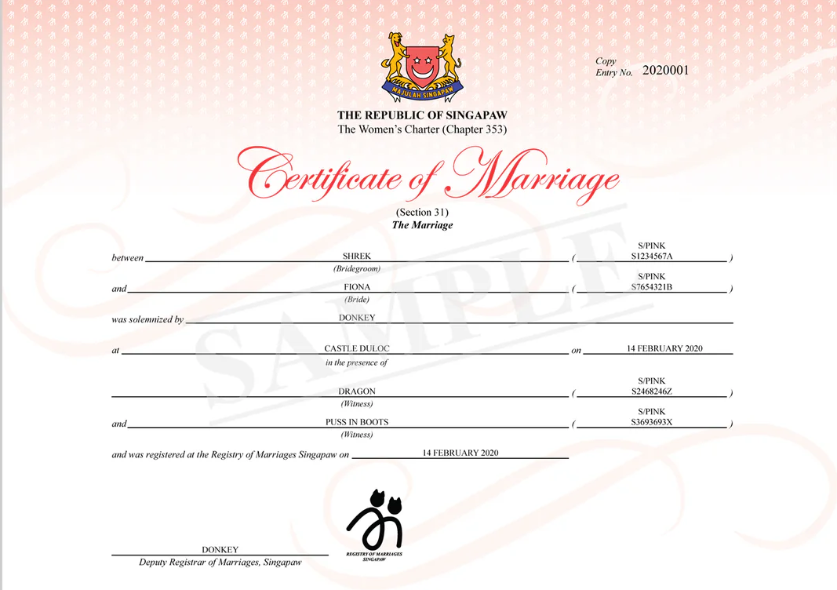
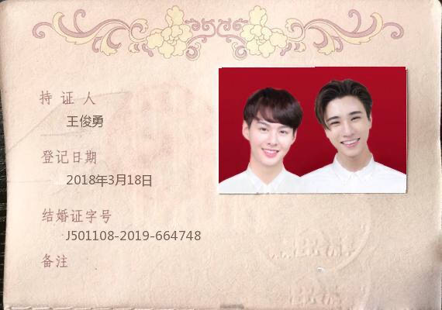

Slide 24
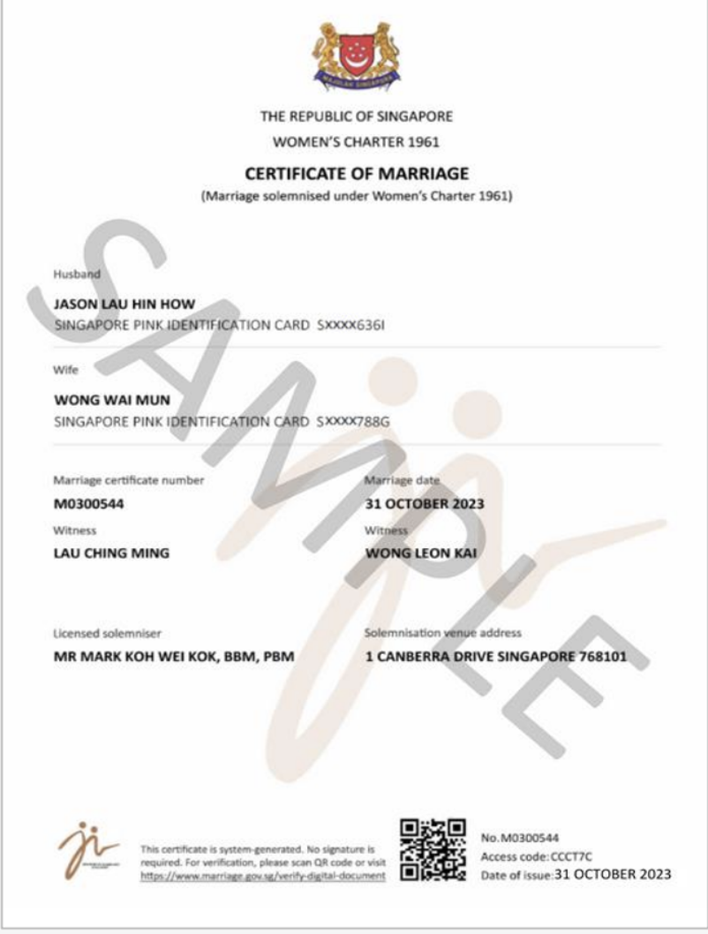

Slide 25
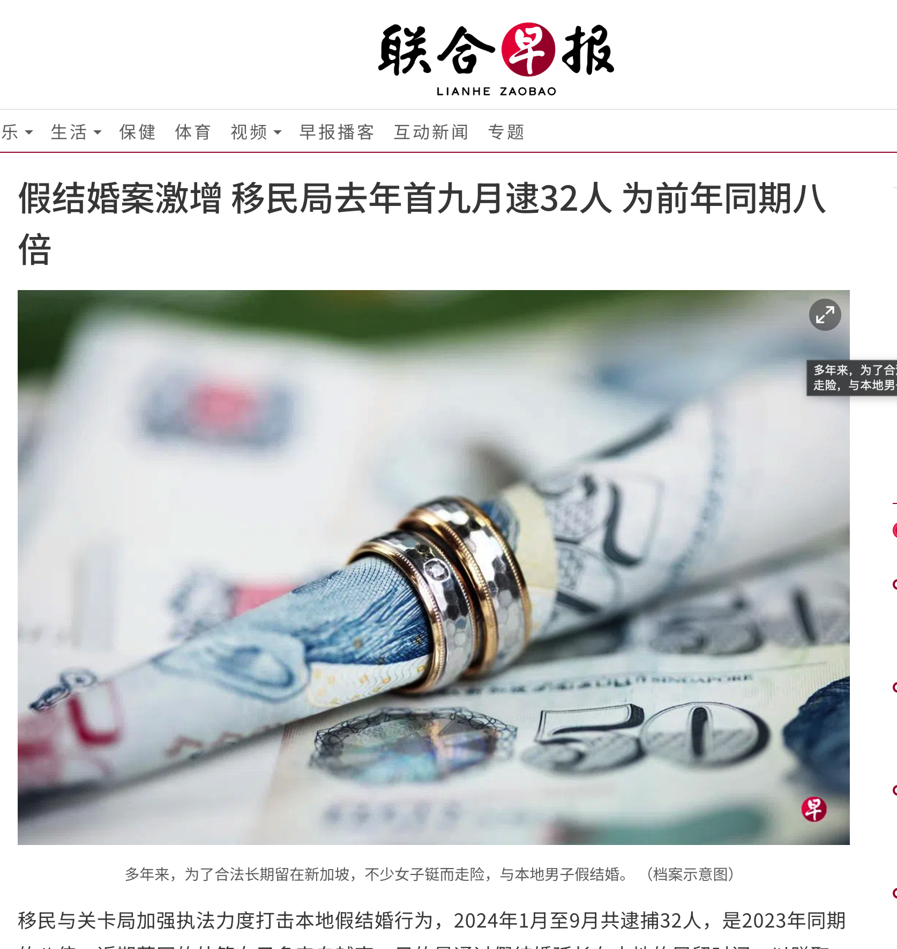

Slide 26
04
与悔改的心相称,结出果子
Bear fruit in keeping with repentance

Slide 27
8.应当结出果子来，与悔改的心相称；...
8.Bear fruits in keeping with repentance. ...

Slide 28
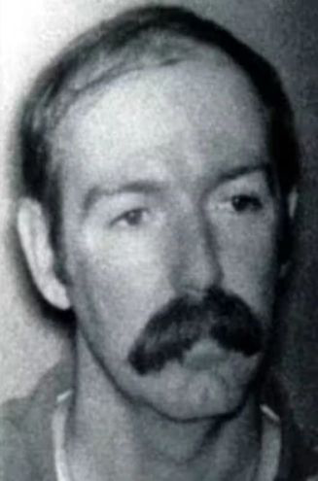
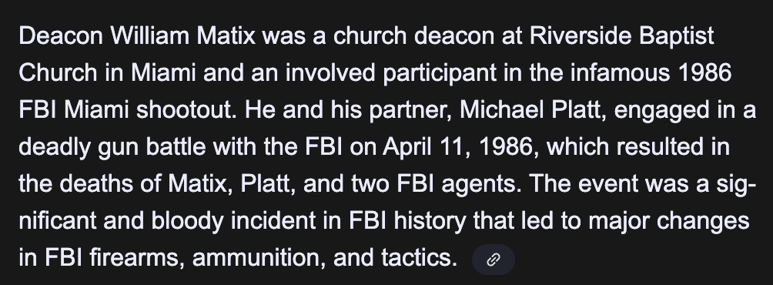
William Russell Matix
曾是教会的执事Riverside Baptist in Florida.
曾称自己是重生的基督徒
1984–1986 年与同伙 Michael Platt
涉及多起持枪抢劫，并至少一宗谋杀。
1986年枪战中杀害了 2名 FBI探员
1986年 FBI 枪战中被击毙。

Slide 29
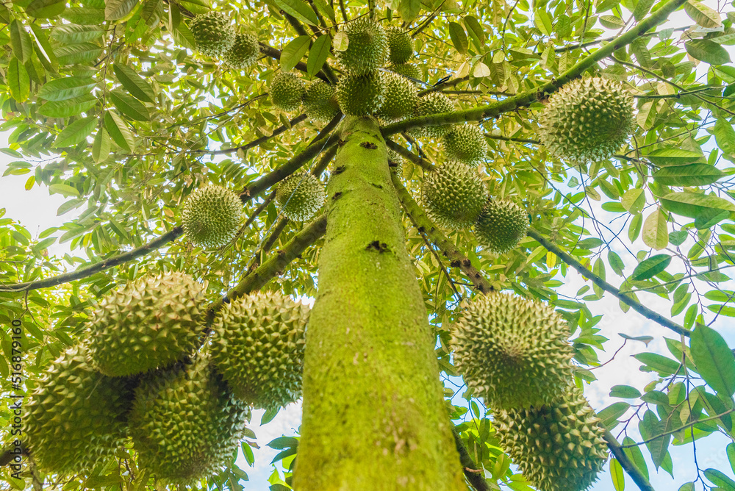
一颗有生命的好榴莲树，需要 8–15 年 才会开始结果

Slide 30
8....你们心里不要说:‘我们有亚伯拉罕作我们的祖宗。’我告诉你们，神能从这些石头中给亚伯拉罕兴起后裔来。
8.... And do not begin to say to yourselves, We have Abraham as our father. For I tell you, God is able from these stones to raise up children for Abraham.

Slide 31
加 3:7.
所以你们要知道，有信心的人，就是亚伯拉罕的子孙
Galatians 3
7.Know then that it is those of faith who are the sons of Abraham.

Slide 32
05
不结好果子的树丢在火里
Every tree that does not bear good fruit is thrown into the fire.

Slide 33
9.现在斧头已经放在树根上，所有不结好果子的树，就砍下来，丢在火里。”
9.Even now the axe is laid to the root of the trees. Every tree therefore that does not bear good fruit is cut down and thrown into the fire."

Slide 34
约15:7.你们若住在我里面，我的话也留在你们里面；无论你们想要甚么，祈求，就给你们成就。8.这样，你们结出很多果子，我父就因此得荣耀，你们也就是我的门徒了。
John 15:7. If you abide in me, and my words abide in you, ask whatever you wish, and it will be done for you.8.By this my Father is glorified, that you bear much fruit and so prove to be my disciples.

