Slide 1
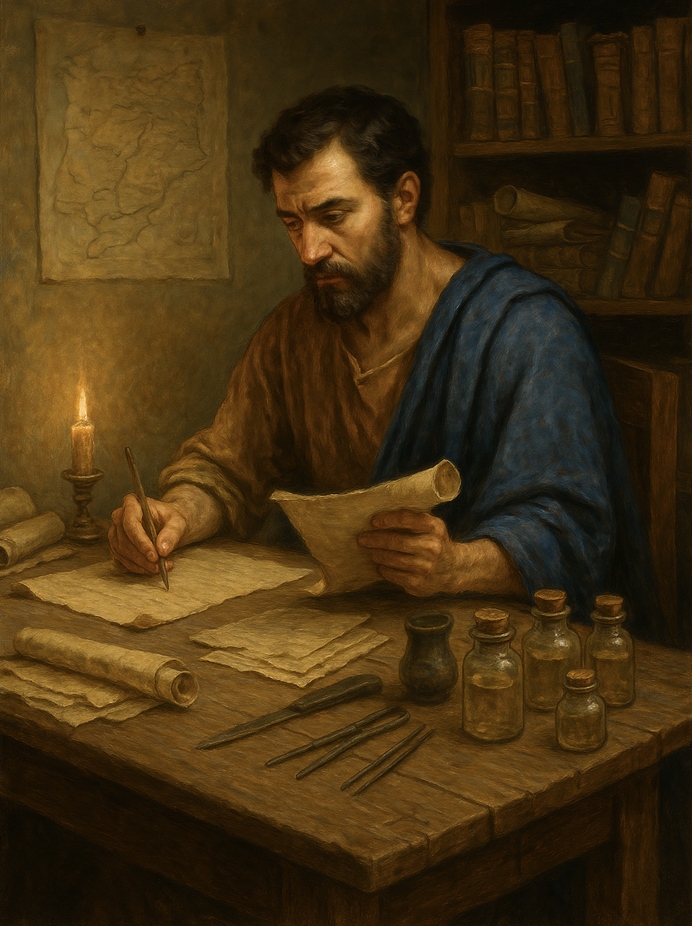
路加福音 Gospel of Luke
011父所喜悦的爱子
路3章19至22
The beloved Son in whom the Father is well pleased
.

Slide 2
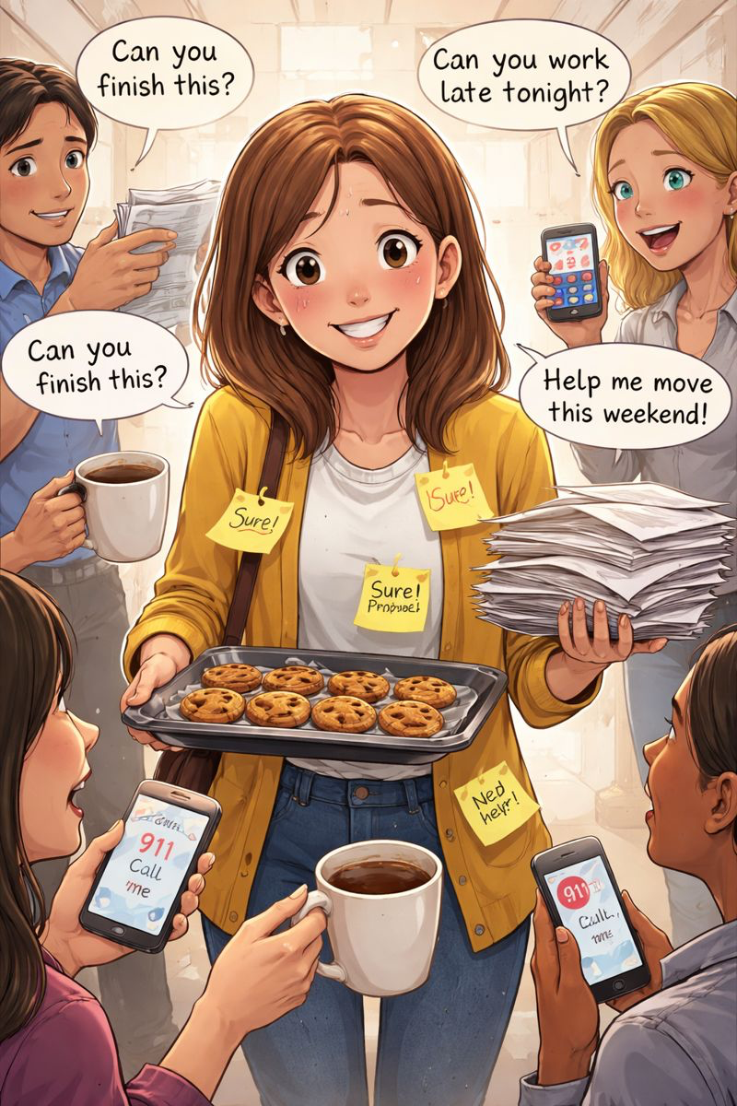

讨好型人格People Pleaser
自我中心型人格
Self Centered

Slide 3
路 3:19 分封王希律，因他弟弟的妻子希罗底，并因他自己所行的一切恶事，受到约翰的责备。20.他在这一切事以外，再加上一件，就是把约翰关在监里。21.众人受了洗，耶稣也受了洗。他正在祷告，天就开了，22.圣灵仿佛鸽子【形状仿佛鸽子】，有形体地降在他身上；有声音从天上来，说：“你是我的爱子，我喜悦你。”
Luk 3:19 But Herod the tetrarch, who had been reproved by him for Herodias, his brother's wife, and for all the evil things that Herod had done,20 added this to them all, that he locked up John in prison.21 Now when all the people were baptized, and when Jesus also had been baptized and was praying, the heavens were opened,22 and the Holy Spirit descended on him in bodily form, like a dove; and a voice came from heaven, “You are my beloved Son; with you I am well pleased.”

Slide 4
路 3:19
分封王希律，因他弟弟的妻子希罗底，并因他自己所行的一切恶事，受到约翰的责备。
Luk 3:19 But Herod the tetrarch, who had been reproved by him for Herodias, his brother's wife, and for all the evil things that Herod had done,

Slide 5
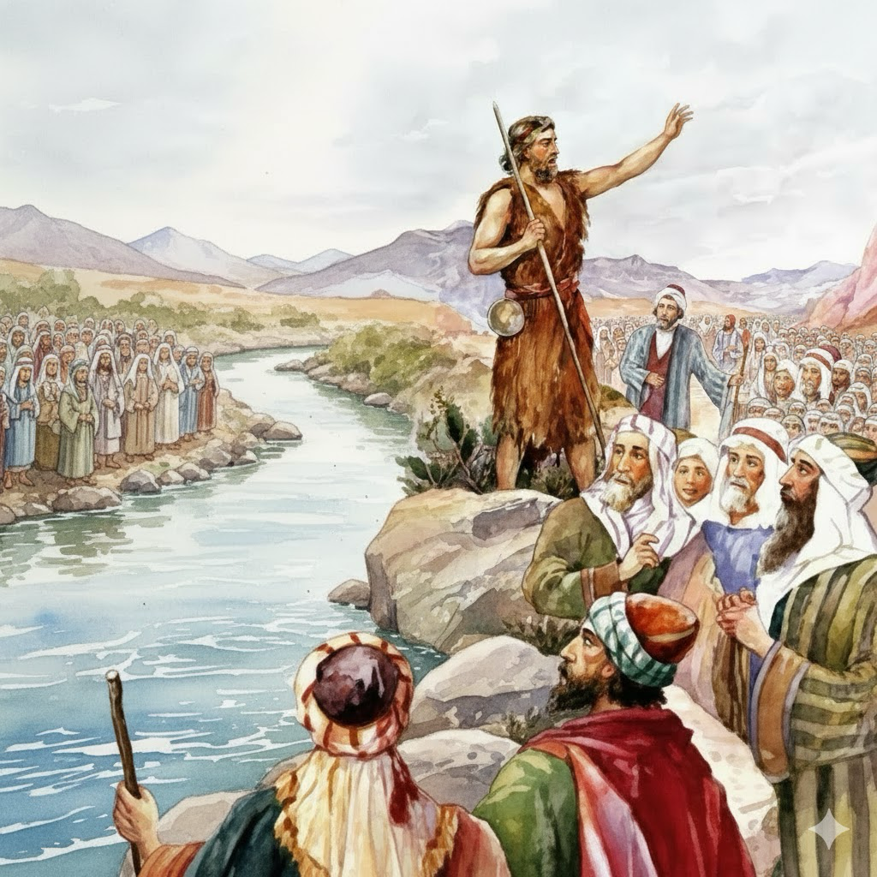

Slide 6
01
好色的王 希律·安提帕
The lustful king, Herod Antipas

Slide 7
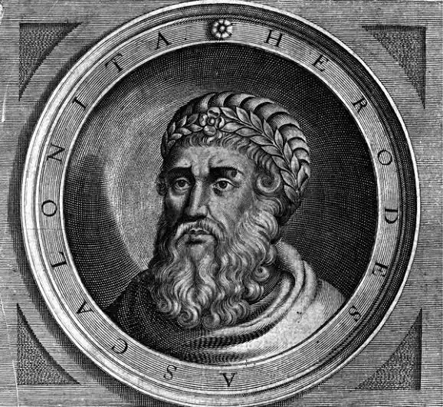
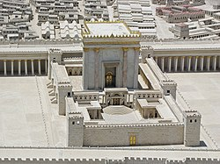
大希律
Herod the Great (c. 72 – c. 4 BCE)
马太福音 2:1。Matthew 2:1
3/6

Slide 8
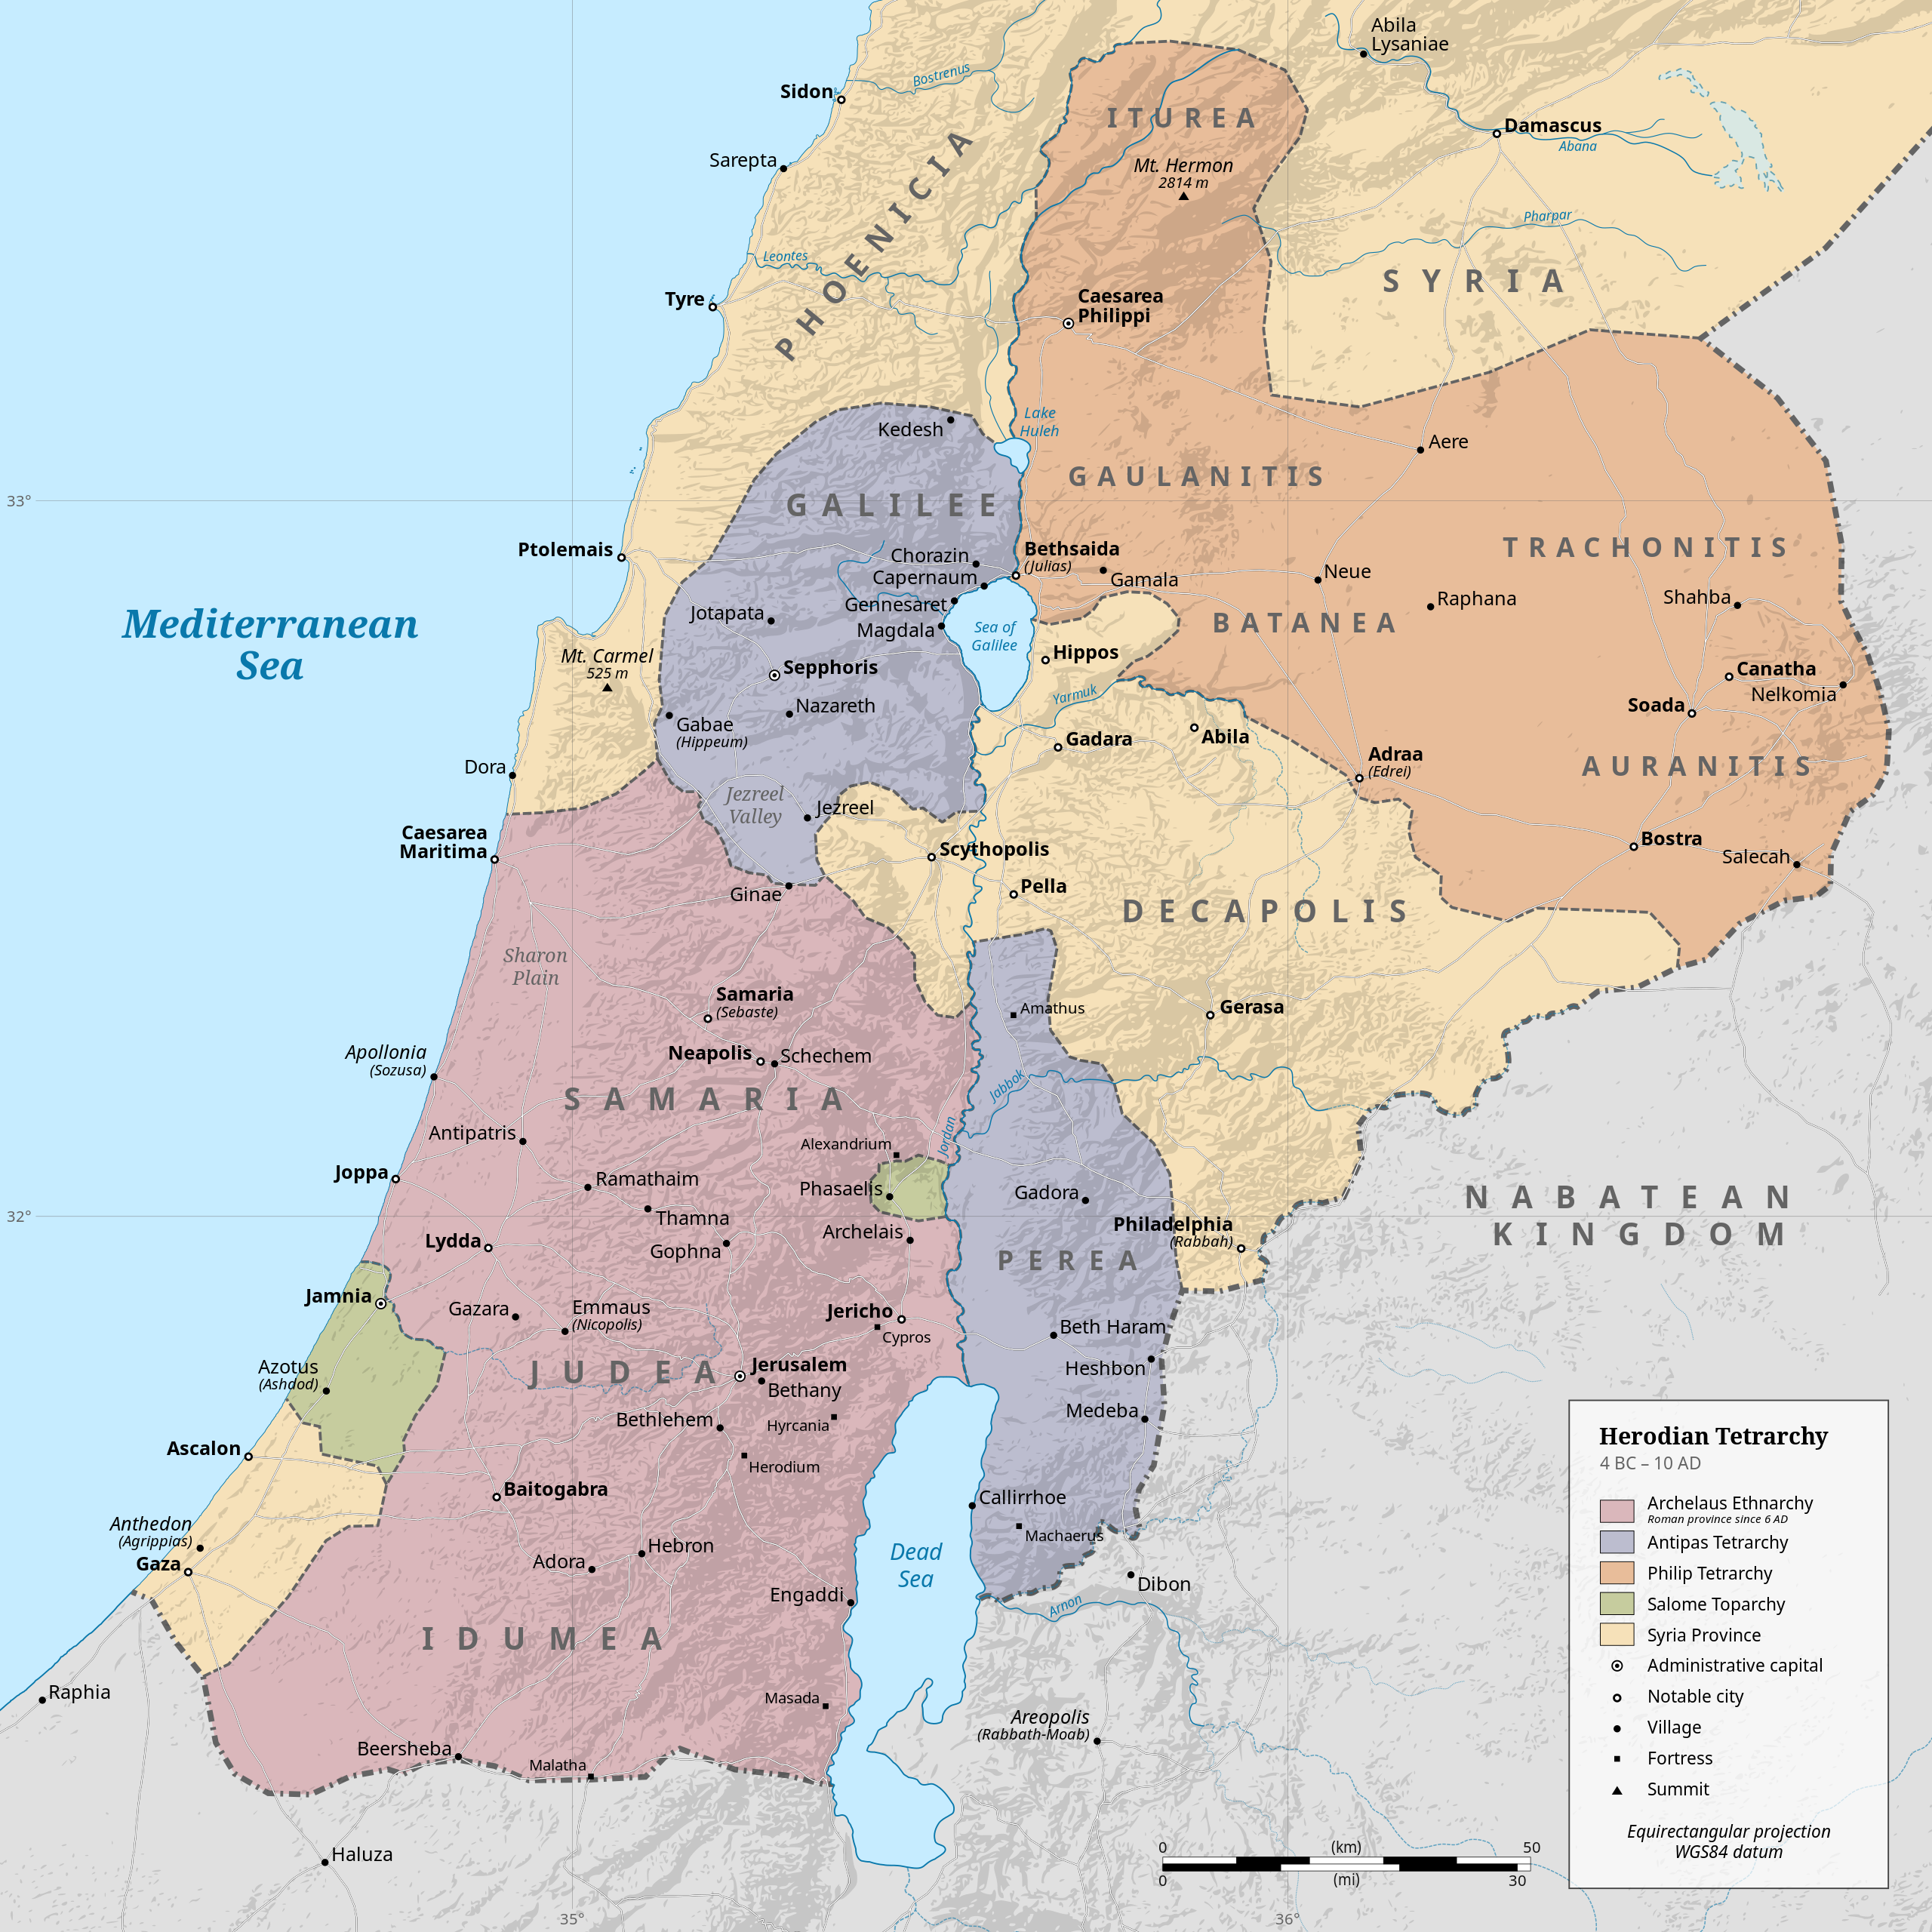
公元前4年
大希律死后国土分封
(Herod the Great’s Kingdom Divided after his death)
希律安提帕（Herod Antipas）
分封王：的权势地位像藩王（地方小王）。
Tetrarch: his power and status were like that of a feudal prince (a minor local ruler).
加利利 (Galilee)
比利亚 (Perea)
路9:9 杀害施洗约翰 killed John the Baptist
路23:11 审判耶稣基督 Judged Jesus
加利利
纳巴泰王国
比利亚
犹太

Slide 9
玛 2:16 耶和华以色列的神说：「休妻的事和以强暴待妻的人都是我所恨恶的！所以当谨守你们的心，不可行诡诈。」这是万军之耶和华说的。
Mal 2:16 For I hate putting away, saith Jehovah, the God of Israel, and him that covereth his garment with violence, saith Jehovah of hosts: therefore take heed to your spirit, that ye deal not treacherously.

Slide 10
02
施洗约翰责备希律
John the Baptist rebuked Herod.

Slide 11

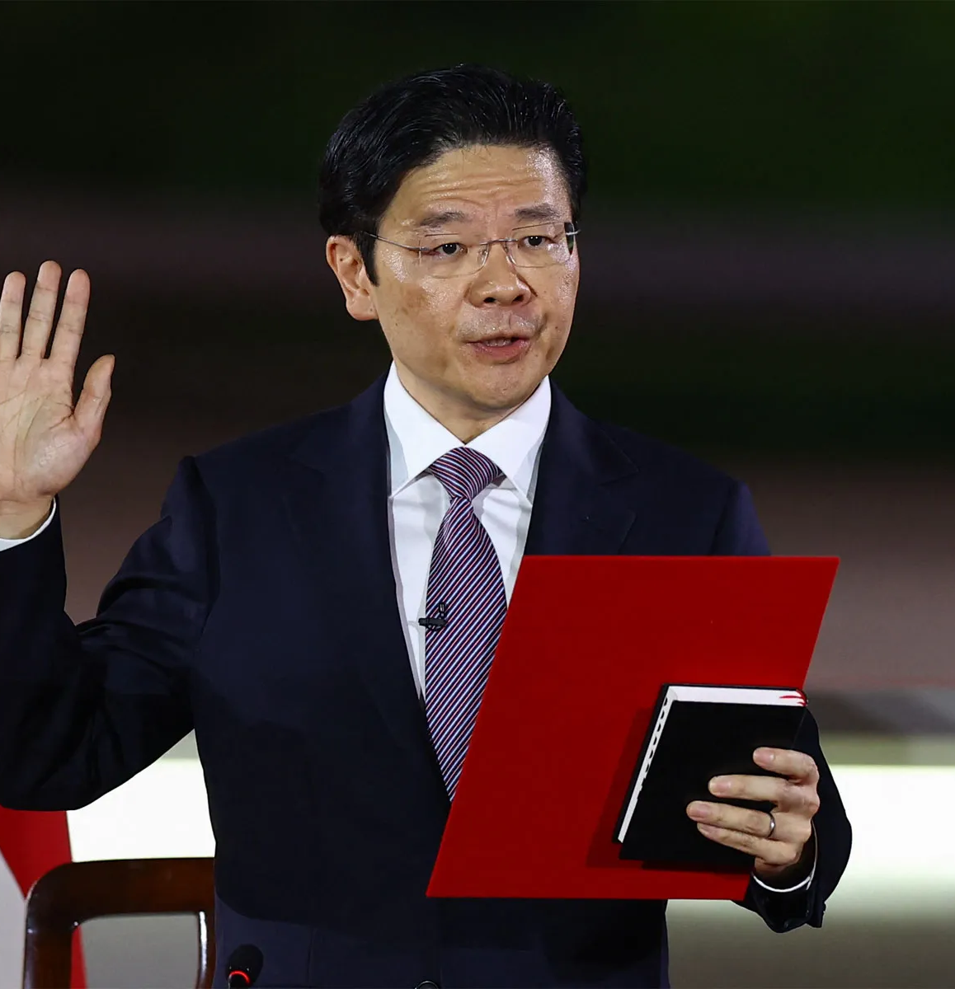
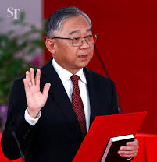
PM. Lawrence Wong（黄循财）
DPM. Gan Kim Yong（颜金勇）

Slide 12
20.他在这一切事以外，再加上一件，就是把约翰关在监里。
20 added this to them all, that he locked up John in prison.

Slide 13
03
主耶稣接受施洗约翰悔改的洗
The Lord Jesus received the baptism of repentance from John the Baptist.

Slide 14
21.众人受了洗，耶稣也受了洗。他正在祷告，天就开了
21 Now when all the people were baptized, and when Jesus also had been baptized and was praying, the heavens were opened,

Slide 15
04
三一神（父、子、灵）
The Triune God (Father, Son, and Spirit)

Slide 16
..他正在祷告，天就开了，22.圣灵仿佛鸽子【形状仿佛鸽子】，有形体地降在他身上；有声音从天上来，说：“你是我的爱子，我喜悦你。”
and was praying, the heavens were opened,22 and the Holy Spirit descended on him in bodily form, like a dove; and a voice came from heaven, “You are my beloved Son; with you I am well pleased.”

Slide 17
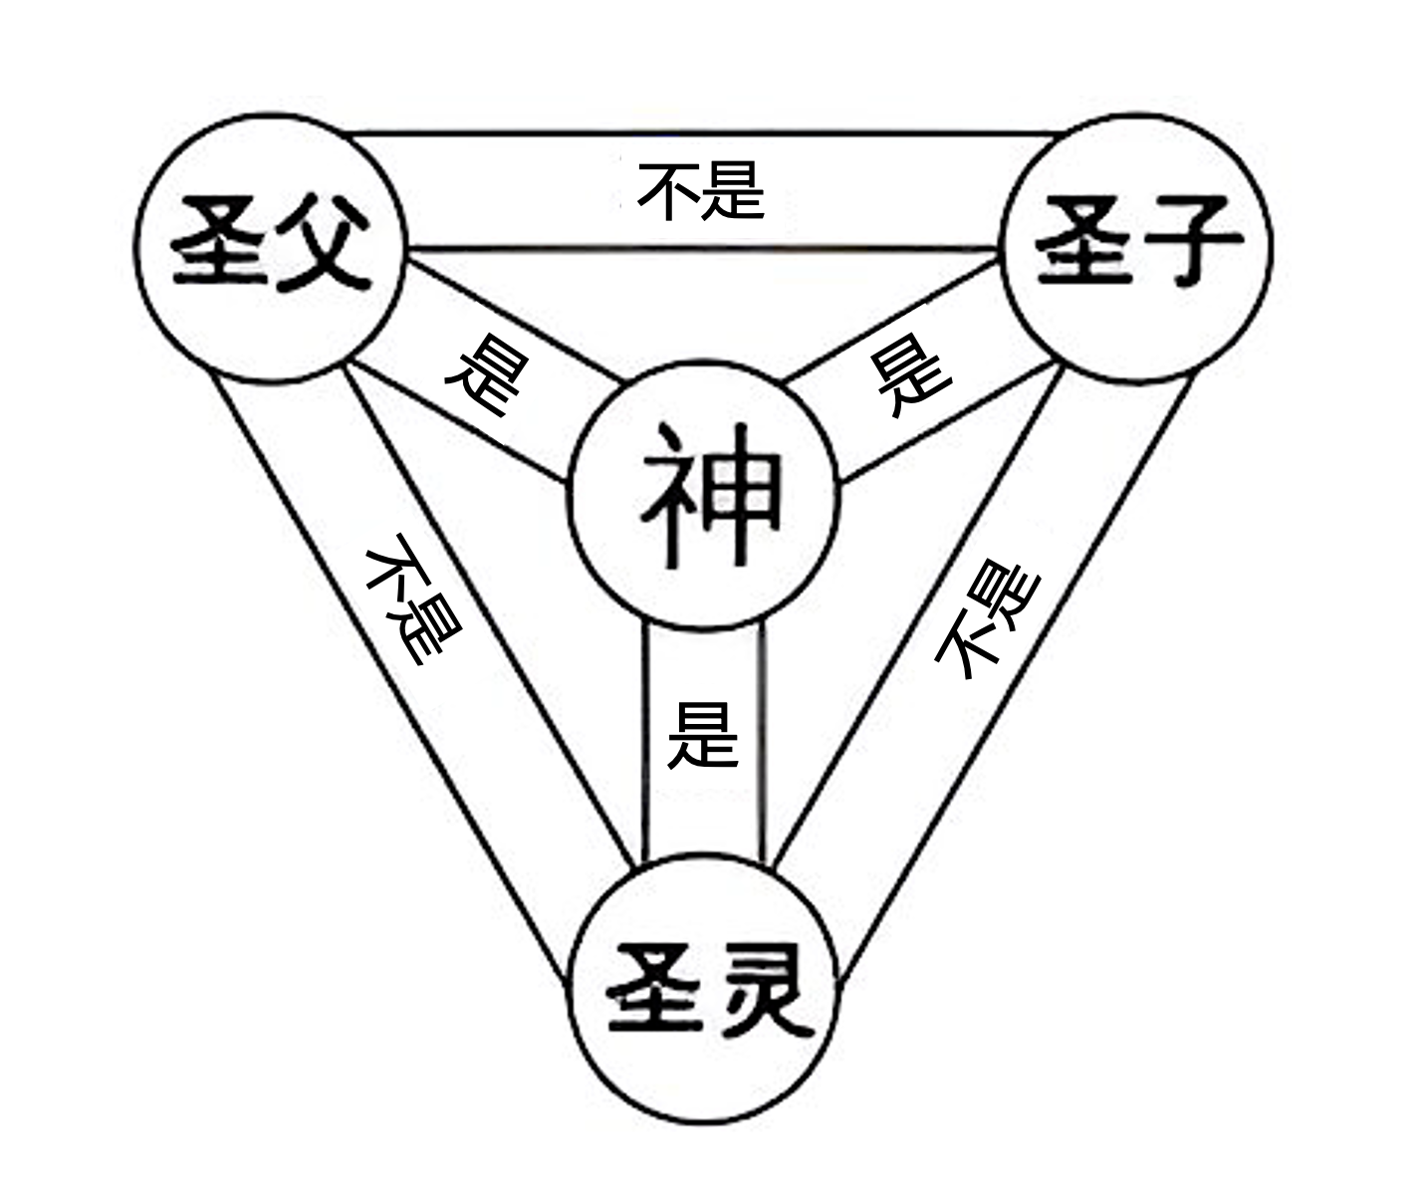

Slide 18
弗 1:13
你们既听见真理的道，就是那叫你们得救的福音，也信了基督，既然信他，就受了所应许的圣灵为印记。
Eph 1:13 in whom ye also, having heard the word of the truth, the gospel of your salvation,--in whom, having also believed, ye were sealed with the Holy Spirit of promise,

Slide 19
22.圣灵仿佛鸽子【形状仿佛鸽子】，有形体地降在他身上；有声音从天上来，说：“你是我的爱子，我喜悦你。”
22 and the Holy Spirit descended on him in bodily form, like a dove; and a voice came from heaven, “You are my beloved Son; with you I am well pleased.”

Slide 20
约 1:12
凡接待他的，就是信他名的人，他就赐他们权柄，作神的儿女。
Jhn 1:12 But as many as received him, to them gave he the right to become children of God, even to them that believe on his name:

Slide 21
西1:10
使你们行事为人对得起主，凡事蒙他喜悦; ...
Col 1:10 (NIV) so that you may live a life worthy of the Lord and please him in every way: ….

Slide 22
撒下 22:19 在我遭难的日子，他们来攻击我；但耶和华是我的支持。20 他又领我出去，到那宽阔之地；他搭救我，因为他喜悦我。
2Sa 22:19 They confronted me in the day of my calamity, but the LORD was my support. 20 He brought me out into a broad place; he rescued me, because he delighted in me.

Slide 23
约壹 3:22
凡我们所求的，就必从他得着，因为我们遵守他的命令，作他所喜悦的事。23 上帝的命令，就是要我们信他的儿子耶稣基督的名，并且照着他的吩咐彼此相爱 。
1Jn 3:22 and whatever we ask we receive from him, because we keep his commandments and do what pleases him.23 And this is his commandment, that we believe in the name of his Son Jesus Christ and love one another, just as he has commanded us.

