Slide 1
Only Jesus Christ
can baptize you with the Holy Spirit
Mark 1:1-8

Slide 2
Mrk 1:1.The beginning of the gospel of Jesus Christ, the Son of God.2.As it is written in Isaiah the prophet, "Behold, I send my messenger before your face, who will prepare your way,3.the voice of one crying in the wilderness: Prepare the way of the Lord, make his paths straight,"4.John appeared, baptizing in the wilderness and proclaiming a baptism of repentance for the forgiveness of sins.5.And all the country of Judea and all Jerusalem were going out to him and were being baptized by him in the river Jordan, confessing their sins.

Slide 3
6.Now John was clothed with camels hair and wore a leather belt around his waist and ate locusts and wild honey.7.And he preached, saying, "After me comes he who is mightier than I, the strap of whose sandals I am not worthy to stoop down and untie.8.I have baptized you with water, but he will baptize you with the Holy Spirit."

Slide 4
2.As it is written in Isaiah the prophet, "Behold, I send my messenger before your face, who will prepare your way,3.the voice of one crying in the wilderness: Prepare the way of the Lord, make his paths straight,"

Slide 5
【1】
The Forerunner of Christ: John the Baptist

Slide 6
4.John appeared, baptizing in the wilderness and proclaiming a baptism of repentance for the forgiveness of sins.5.And all the country of Judea and all Jerusalem were going out to him and were being baptized by him in the river Jordan, confessing their sins. 6.Now John was clothed with camels hair and wore a leather belt around his waist and ate locusts and wild honey.

Slide 7
【2】
The Messenger Points Toward Jesus Christ

Slide 8
7.And he preached, saying, "After me comes he who is mightier than I, the strap of whose sandals I am not worthy to stoop down and untie.

Slide 9
【3】
Only Jesus Can Baptize You with The Holy Spirit

Slide 10
8.I have baptized you with water, but he will baptize you with the Holy Spirit."

Slide 11
Mrk 1:1
The beginning of the gospel
of Jesus Christ,
the Son of God.

Slide 12
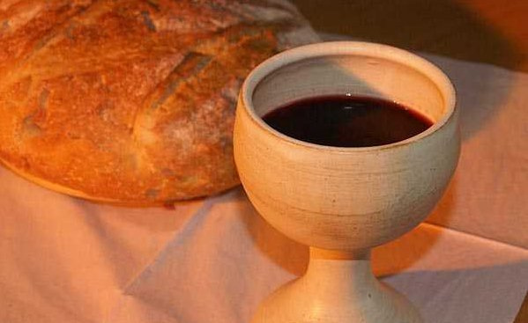
Holy Communion

Slide 13
(ESV) Joh 6:51 I am the living bread that came down from heaven. If anyone eats of this bread, he will live forever. And the bread that I will give for the life of the world is my flesh.”52 The Jews then disputed among themselves, saying, “How can this man give us his flesh to eat?”53 So Jesus said to them, “Truly, truly, I say to you, unless you eat the flesh of the Son of Man and drink his blood, you have no life in you.54 Whoever feeds on my flesh and drinks my blood has eternal life, and I will raise him up on the last day.55 For my flesh is true food, and my blood is true drink.56 Whoever feeds on my flesh and drinks my blood abides in me, and I in him.57 As the living Father sent me, and I live because of the Father, so whoever feeds on me, he also will live because of me.

