Slide 1
027 两个见证人复活升天
（第三部）
启示录11章11至14
Two witness(Part three)

Slide 2
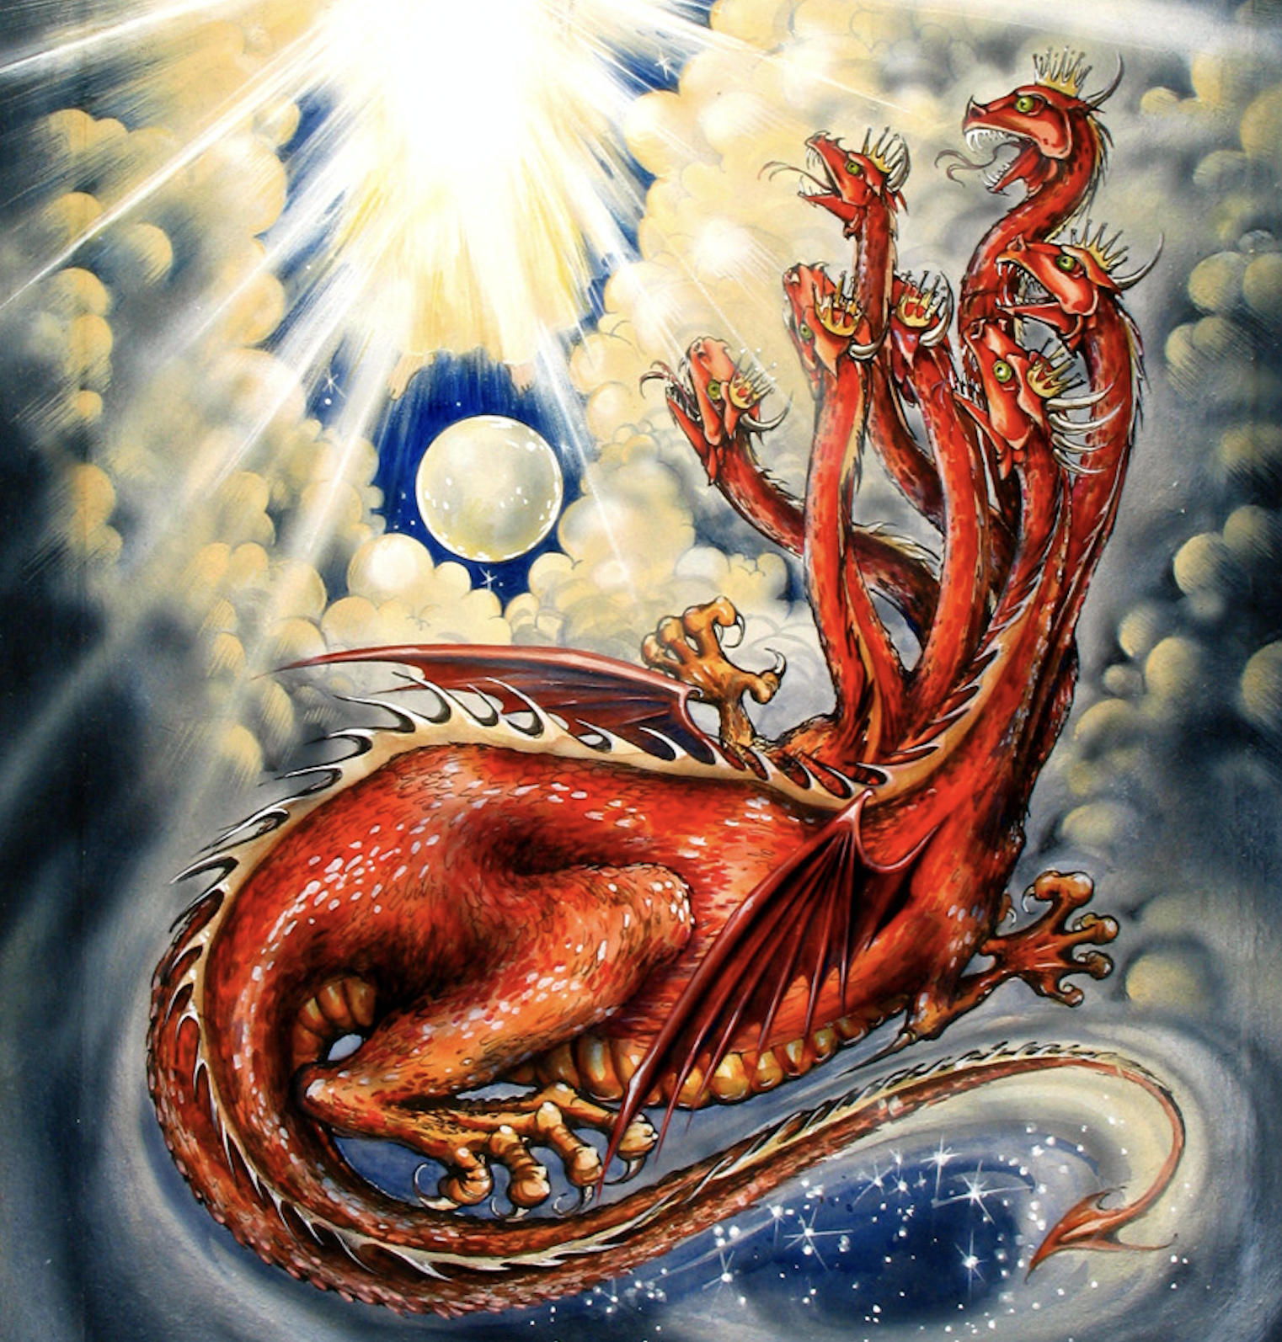
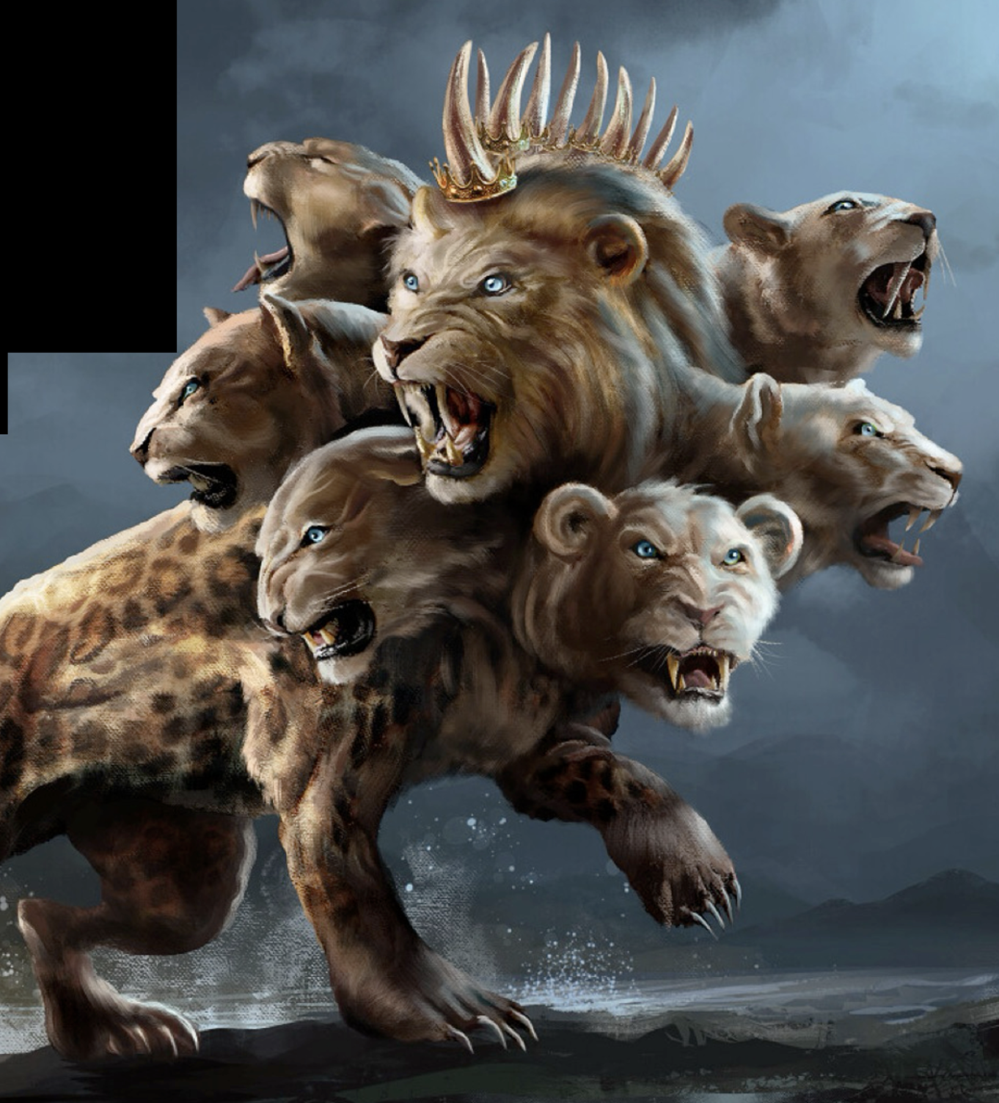
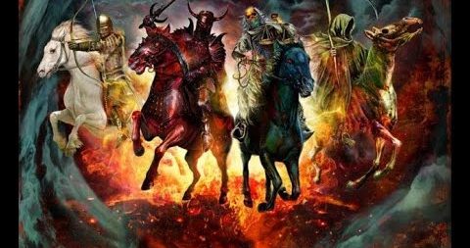
启示Apocalypse希腊词意思是“揭示”启示文学是有关末世的启示。
充满异象，以象征性形式、符号、图像来教导。
Apocalypse is a Greek word that means “to uncover” or “reveal.” Apocalyptic literature sets forth images and teachings related to the end times, often in highly symbolic form, symbols , imagery graphic, even dramatic, visions
1/2

Slide 3
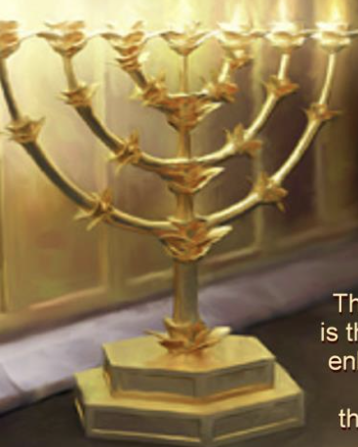
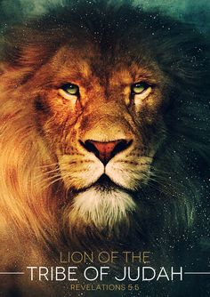
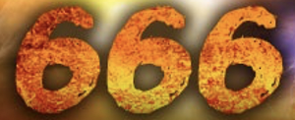
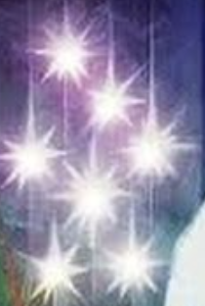
signs 符号、symbols 象征、imagery 图像
启示文学

Slide 4
启示文学
Apocalyptic literature
但以理书
（一部分）
启示录
Part of Book of Daniel
Book of Revelation

Slide 5
启11:7 他们作完见证的时候，那从无底坑里上来的兽必与他们交战，并且得胜，把他们杀了。8 他们的尸首就倒在大城里的街上；这城按著灵意叫所多玛，又叫埃及，就是他们的主钉十字架之处。9 从各民、各族、各方、各国中，有人观看他们的尸首三天半，又不许把尸首放在坟墓里。10 住在地上的人就为他们欢喜快乐，互相馈kuì 送礼物，因这两位先知曾叫住在地上的人受痛苦。
Rev 11:7 And when they have finished their testimony, the beast that rises from the bottomless pit will make war on them and conquer them and kill them,8 and their dead bodies will lie in the street of the great city that symbolically is called Sodom and Egypt, where their Lord was crucified.9 For three and a half days some from the peoples and tribes and languages and nations will gaze at their dead bodies and refuse to let them be placed in a tomb, 10 and those who dwell on the earth will rejoice over them and make merry and exchange presents, because these two prophets had been a torment to those who dwell on the earth.
1/2

Slide 6
11 过了这三天半，有生气从神那里进入他们里面，他们就站起来；看见他们的人甚是害怕。12 两位先知听见有大声音从天上来，对他们说：「上到这里来。」他们就驾著云上了天，他们的仇敌也看见了。13 正在那时候，地大震动，城就倒塌了十分之一，因地震而死的有七千人；其余的都恐惧，归荣耀给天上的神。14 第二样灾祸过去，第三样灾祸快到了。
11 But after the three and a half days a breath of life from God entered them, and they stood up on their feet, and great fear fell on those who saw them. 12 Then they heard a loud voice from heaven saying to them, “Come up here!” And they went up to heaven in a cloud, and their enemies watched them. 13 And at that hour there was a great earthquake, and a tenth of the city fell. Seven thousand people were killed in the earthquake, and the rest were terrified and gave glory to the God of heaven.14 The second woe has passed; behold, the third woe is soon to come.
2/2

Slide 7
重温上文 11:7-10： 兽必与教会交战并且得胜
01
Recap 11:7-10: The beast will wage war against the church and prevail

Slide 8
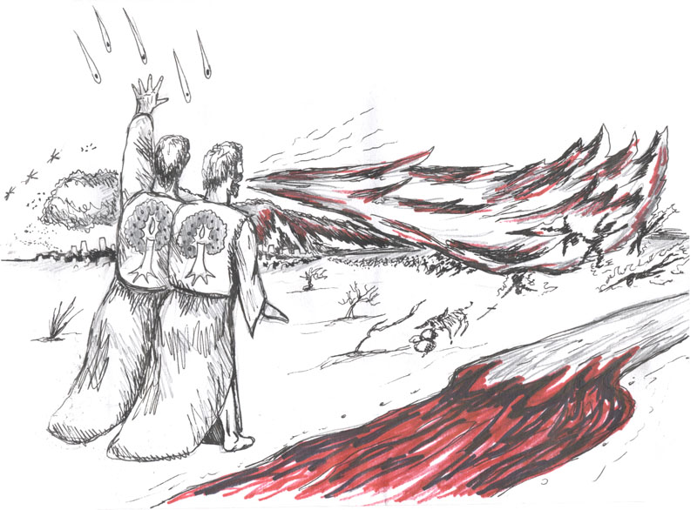
教会为主作见证
Church witness for the Lord

Slide 9
启11:7 他们作完见证的时候，那从无底坑里上来的兽必与他们交战...。
Rev11:7.And when they have finished their testimony, the beast that rises from the bottomless pit will make war on them and conquer them and kill them,

Slide 10
启11:7 . . .兽必与他们交战，并且得胜，把他们杀了。8 他们的尸首就倒在大城里的街上；...
Rev 11:7 … the beast that rises from the bottomless pit will make war on them and conquer them and kill them,8 and their dead bodies will lie in the street of the great city …

Slide 11
教会（信徒）将身体复活
02
The church (believers) will be resurrected.

Slide 12
11 过了这三天半，有生气从神那里进入他们里面，他们就站起来；看见他们的人甚是害怕。
11 But after the three and a half days a breath of life from God entered them, and they stood up on their feet, and great fear fell on those who saw them.

Slide 13
基本解经原则
Basic principle of exegesis
1 清楚的经文要解释不清楚（启示文学）。
Explicit scriptures must be used to interpret unclear ones (apocalyptic literature).
2 启示录的解释必须符合旧约的教导、主耶稣的教导（福音书）、使徒们的教导（新约书信）
The Interpretation of the Book of Revelation must be consistent with the teachings of the Old Testament, the teachings of the Lord Jesus (the Gospels), and the teachings of the apostles (the new testament Epistles).
3 整本圣经是不冲突的。
The whole Bible is non-contradictory.

Slide 14
 | 马太福音 24 章 Matthew Chapter 24
V14 | 福音先传遍天下，末期才来到 Gospel is preached first in all the world, then the end comes
V15 | 那行毁坏可憎出现 the abomination of desolation appears
V16-20 | 基督徒要逃亡 Christians are to flee
V21-22 | 从来都没有这样的大灾难 There has never been such a great tribulation
V23-26 | 假基督必出现 many false christ will appear
V27-28 | 耶稣基督降临时，是众人显而易见之事 When Christ returns, it will be obvious to all
V29 | 耶稣基督降临时天地要震动 When Christ returns, the heavens will be shaken.
V30 | 众人看见耶稣大荣耀驾云降临 The people saw Jesus coming in a cloud with great glory
V31 | 天使吹号从四方招聚选民 angels sounded the trumpet to gather the elect from the four corners

Slide 15
使徒的教导 apostolic teaching
帖后 2:8.那时这不法的人必显露出来。主耶稣要用口中的气灭绝他，用降临的荣光废掉他。
2 Thessalonians 2:8. And then the lawless one will be revealed, whom the Lord Jesus will kill with the breath of his mouth and bring to nothing by the appearance of his coming.

Slide 16
帖撒罗尼迦前书 4:16-17
1 Thessalonians 4:16-17
主再来之日，
是我们复活得荣耀的身体，我们将在云中与主相遇
On the day of the Lord's return,
we will be resurrected with glorified bodies, and we will meet the Lord in the clouds.

Slide 17
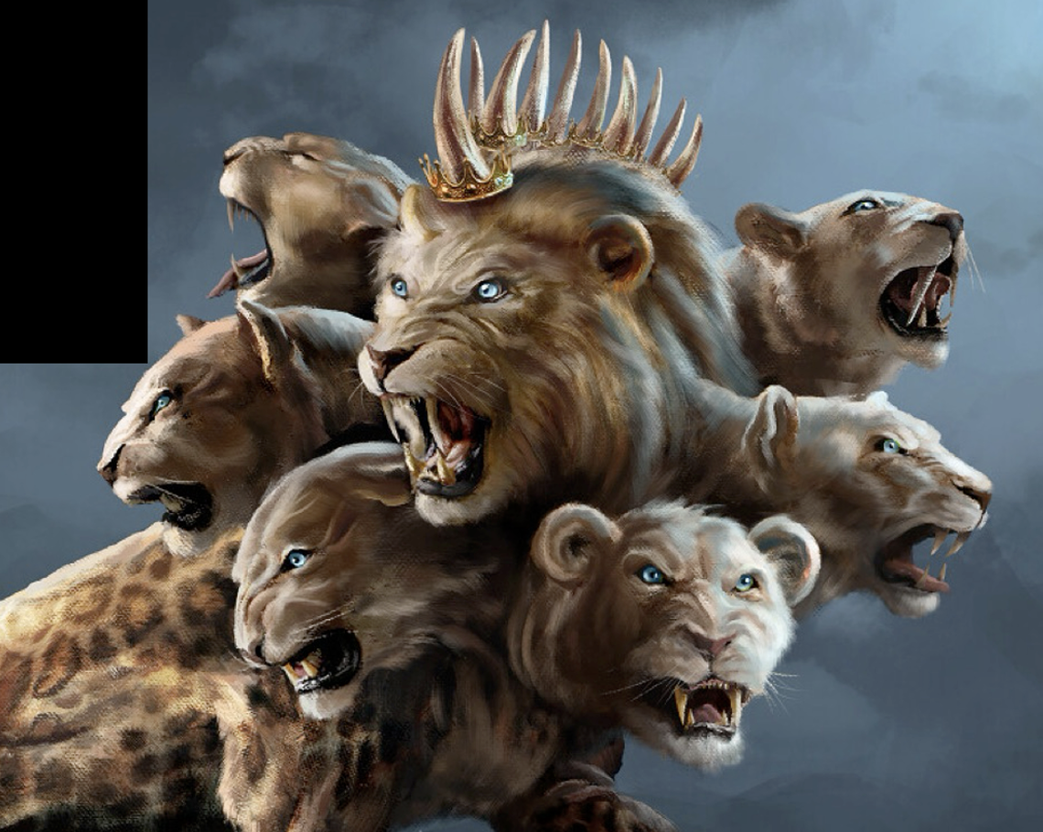
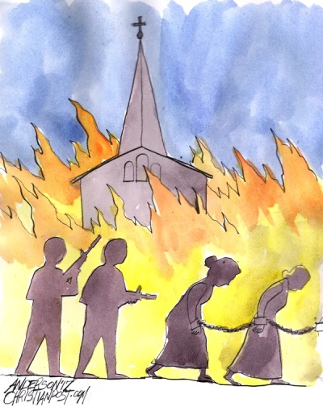
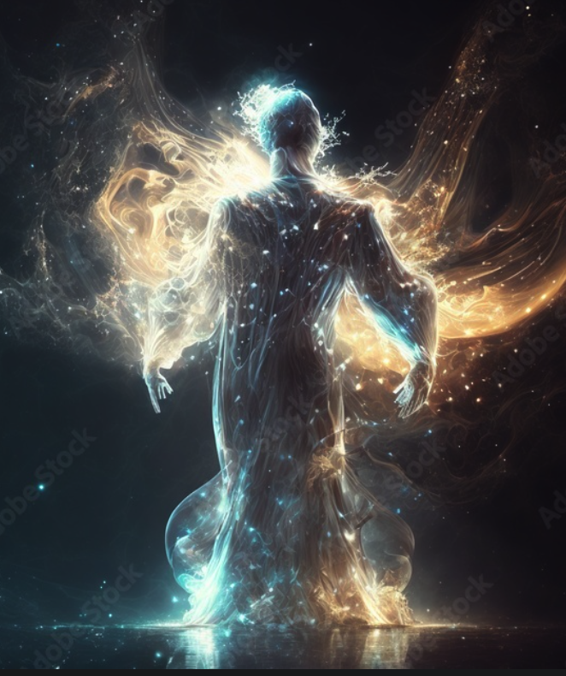
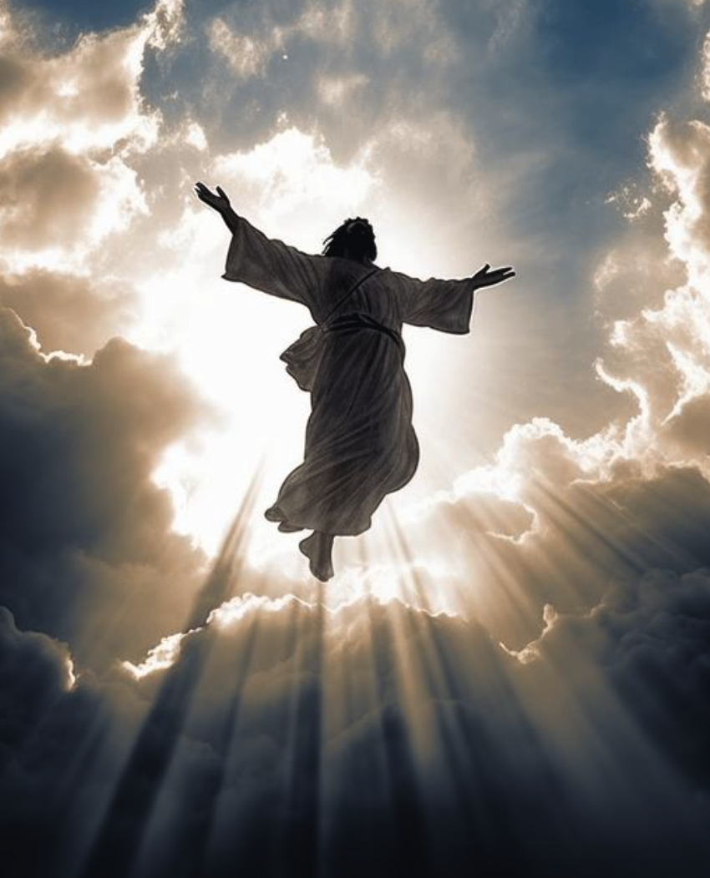
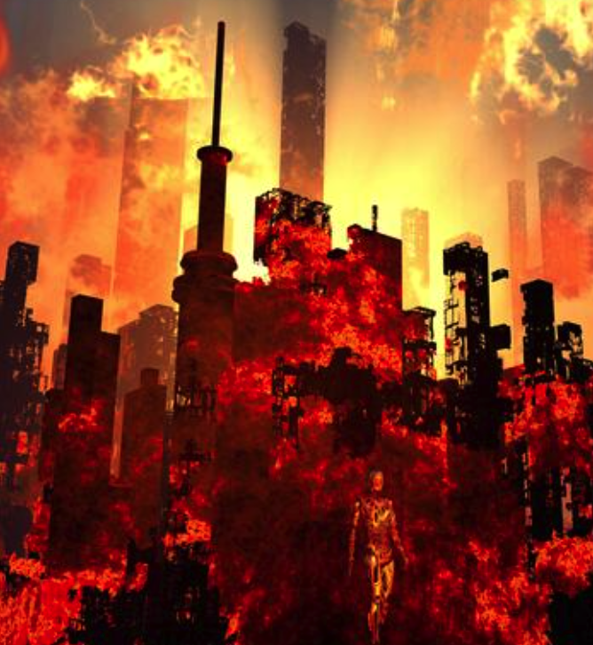
兽
出现
大灾难
主降临
身体复活
我们升天
大审判

Slide 18
我信身体复活
I believe in resurrection （transformation of body)

Slide 19
帖前 4:16.因为主必亲自从天降临，有呼叫的声音和天使长的声音，又有神的号吹响；那在基督里死了的人必先复活。17.以后我们这活着还存留的人必和他们一同被提到云里，在空中与主相遇。这样，我们就要和主永远同在。
1Thess 4:16. For the Lord himself will descend from heaven with a cry of command, with the voice of an archangel, and with the sound of the trumpet of God. And the dead in Christ will rise first.17.Then we who are alive, who are left, will be caught up together with them in the clouds to meet the Lord in the air, and so we will always be with the Lord.

Slide 20
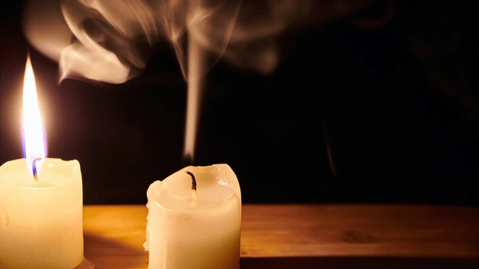
没有灵魂人死如灯灭
A man without a soul and disappears forever

Slide 21
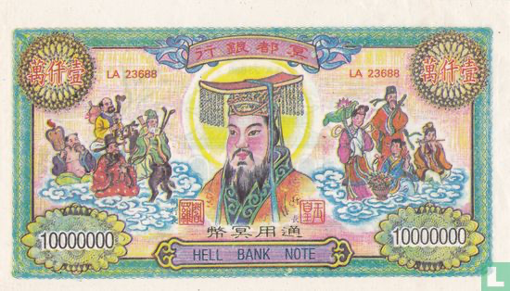

Slide 22
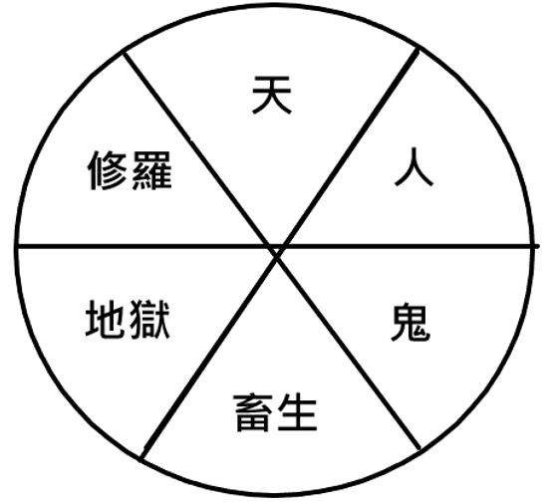
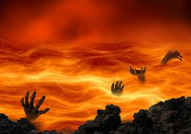
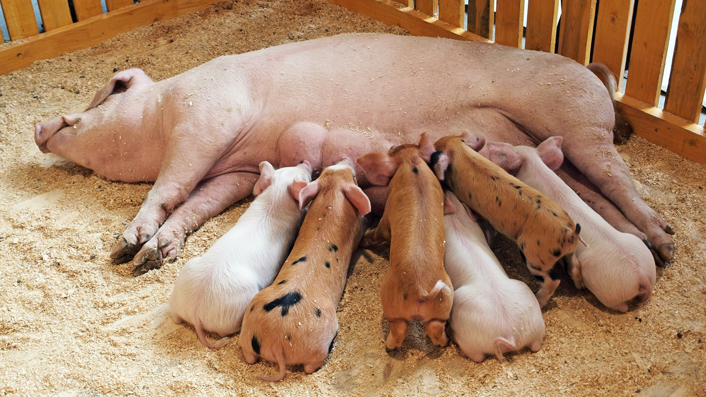
不断受苦
经历生老病死
Never ending of suffering

Slide 23
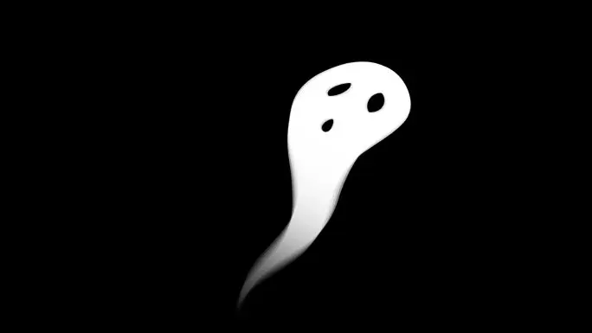
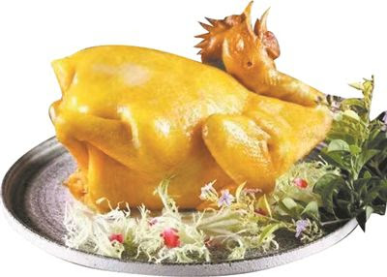
灵魂上天堂却没有身体
The soul without the body goes to heaven

Slide 24
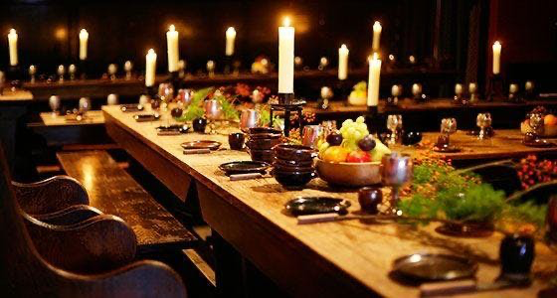
路13:29.
从东从南，从西从北，将有人来，在神的国里吃饭。
Luke 13:29.And people will come from east and west, and from north and south, and recline at table in the kingdom of God..

Slide 25
我们复活后被提到云中与主相会
03
After our resurrection, we were caught up to meet the Lord in the clouds

Slide 26
11 过了这三天半，有生气从神那里进入他们里面，他们就站起来；看见他们的人甚是害怕。12 两位先知听见有大声音从天上来，对他们说：「上到这里来。」他们就驾著云上了天，他们的仇敌也看见了。
11 But after the three and a half days a breath of life from God entered them, and they stood up on their feet, and great fear fell on those who saw them. 12 Then they heard a loud voice from heaven saying to them, “Come up here!” And they went up to heaven in a cloud, and their enemies watched them.

Slide 27
帖前4:16. .. 那在基督里死了的人必先复活。17 以后我们这活着还存留的人必和他们一同被提到云里，在空中与主相遇。这样，我们就要和主永远同在。
1Thess 4:16.. . And the dead in Christ will rise first.17 Then we who are alive, who are left, will be caught up together with them in the clouds to meet the Lord in the air, and so we will always be with the Lord.

Slide 28
林前15:42 死人复活也是这样：所种的是必朽坏的，复活的是不朽坏的；43 所种的是羞辱的，复活的是荣耀的；所种的是软弱的，复活的是强壮的；44 所种的是血气的身体，复活的是灵性的身体。若有血气的身体，也必有灵性的身体。
1 Corin 15: 42. So is it with the resurrection of the dead. What is sown is perishable; what is raised is imperishable. 43.It is sown in dishonor; it is raised in glory. It is sown in weakness; it is raised in power. 44. It is sown a natural body; it is raised a spiritual body. If there is a natural body, there is also a spiritual body.

Slide 29
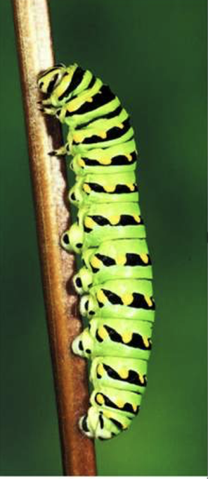

Slide 30
信徒复活升之时， 神刑罚审判全地
04
And when the believers are raised up God will judge the whole earth

Slide 31
13 正在那时候，地大震动，城就倒塌了十分之一，因地震而死的有七千人；其余的都恐惧，归荣耀给天上的神。14 第二样灾祸过去，第三样灾祸快到了。
13 And at that hour there was a great earthquake, and a tenth of the city fell. Seven thousand people were killed in the earthquake, and the rest were terrified and gave glory to the God of heaven.14 The second woe has passed; behold, the third woe is soon to come.

Slide 32
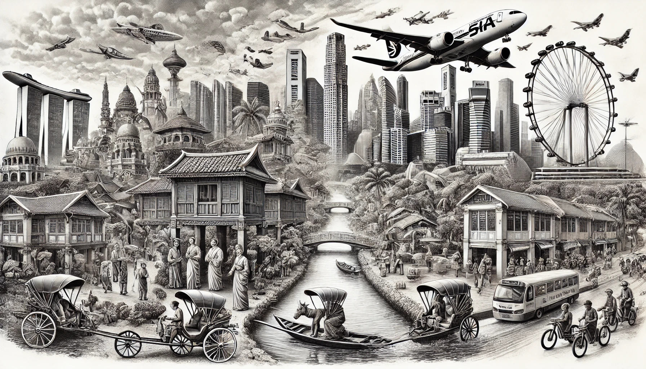
图像过去与现在
Vision of Past and Present

Slide 33
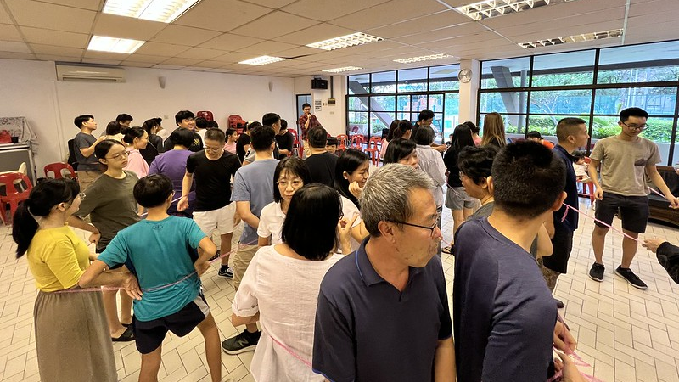
图 1
Vision 1

Slide 34
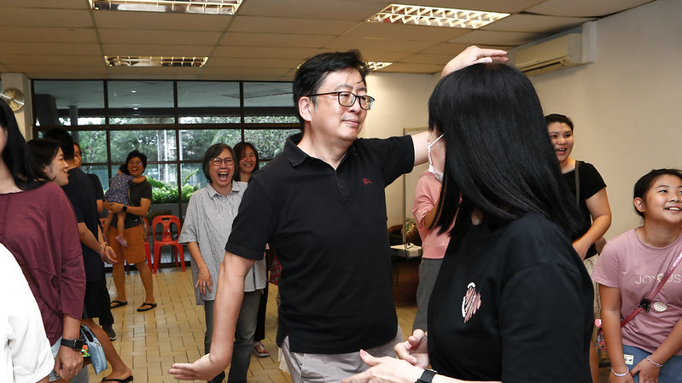
图 2
Vision 2

Slide 35
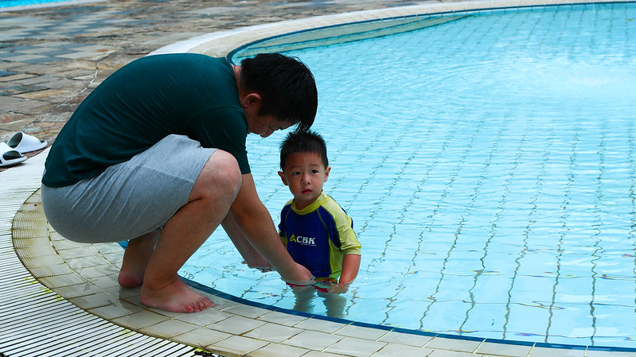
图 3
Vision 3

Slide 36
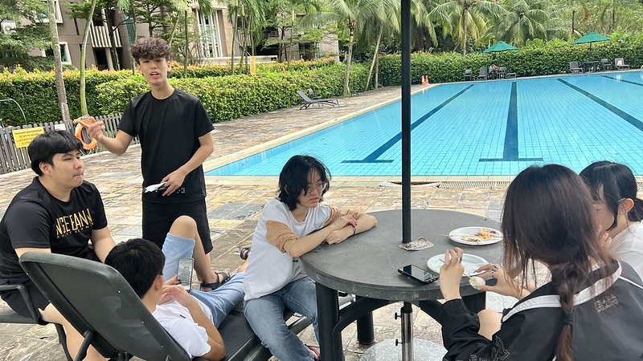
图 4
Vision 4

Slide 37
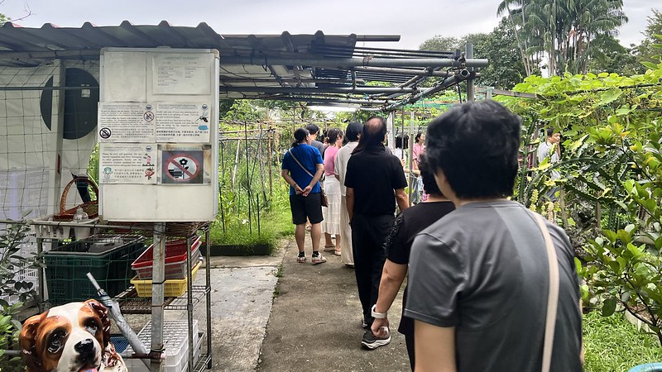
图 5
Vision 5

Slide 38
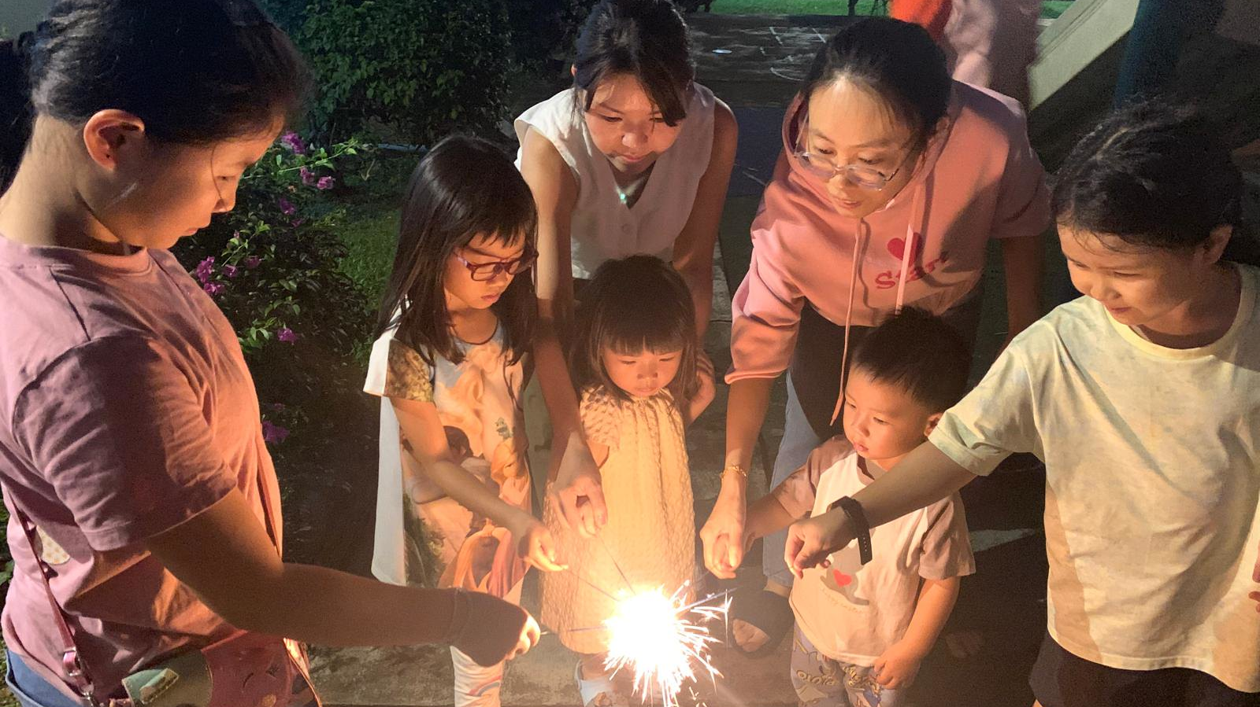
图 6
Vision 6

Slide 39
我信身体复活
I believe in resurrection

Slide 40
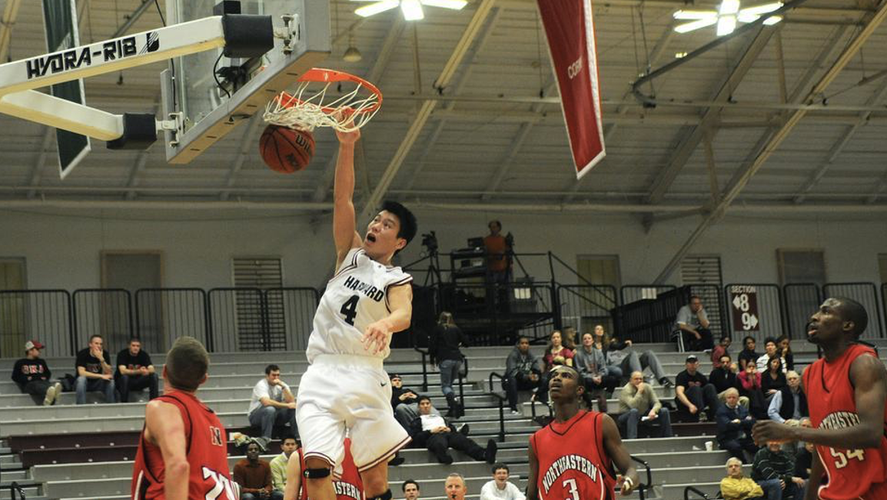

Slide 41
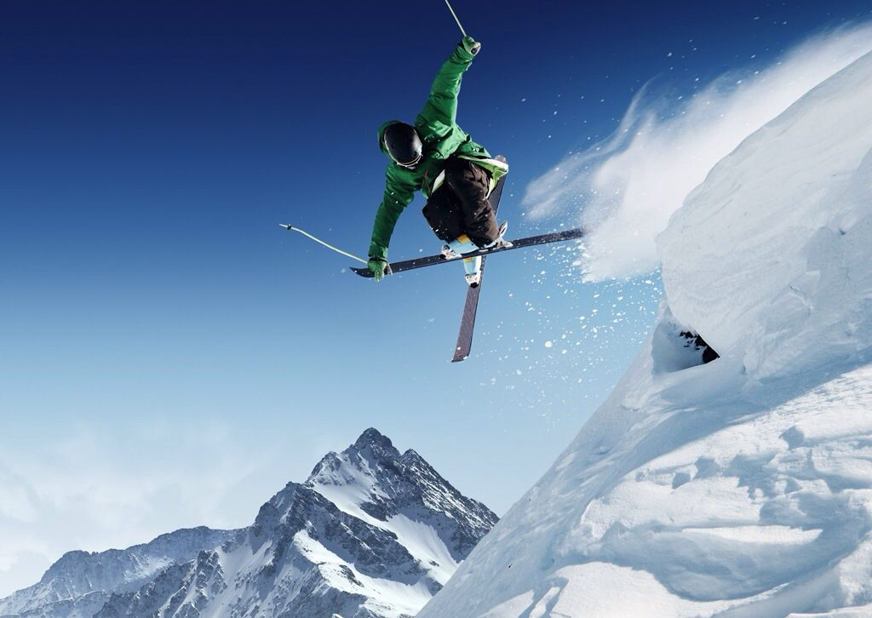

Slide 42
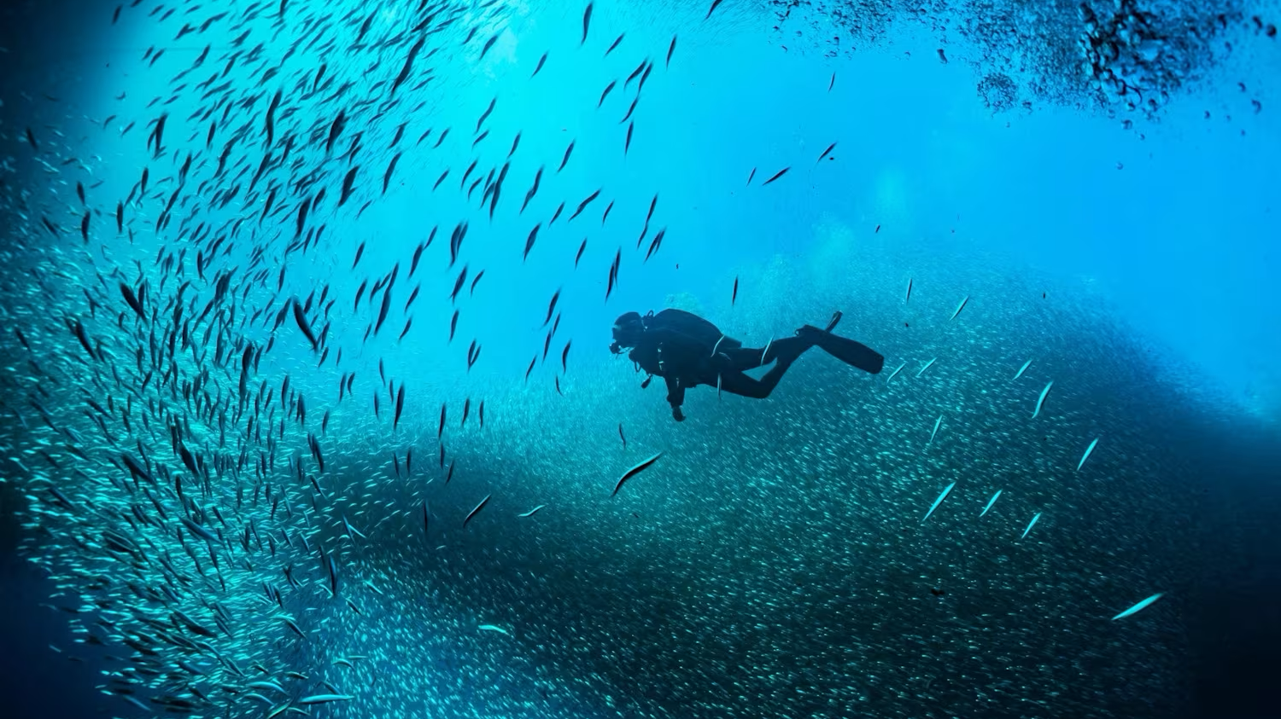

Slide 43
