Slide 1
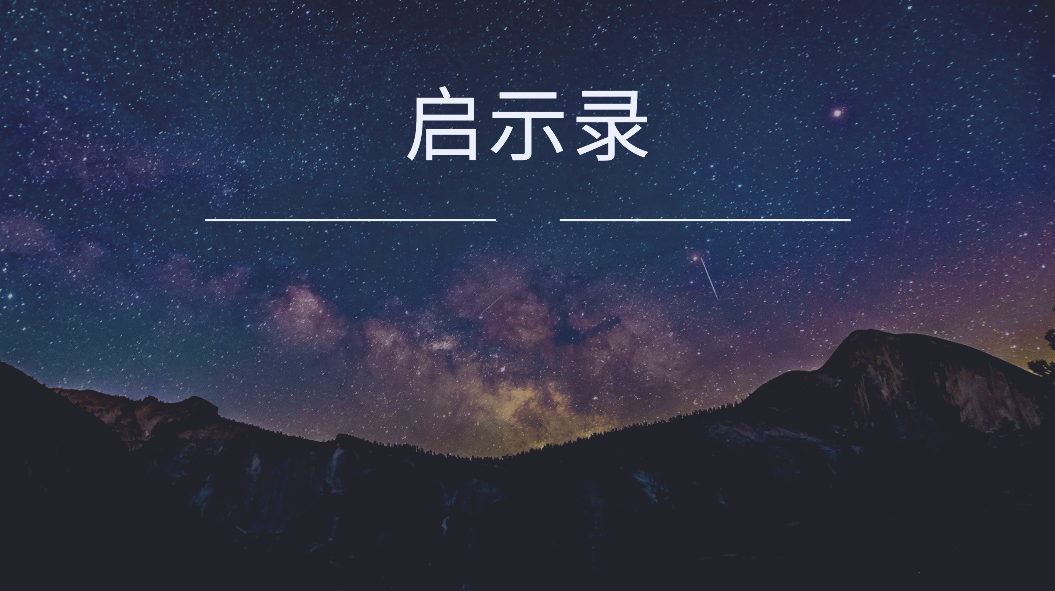
027 第七号
启示录11章15至19
The Seventh Trumpet

Slide 2
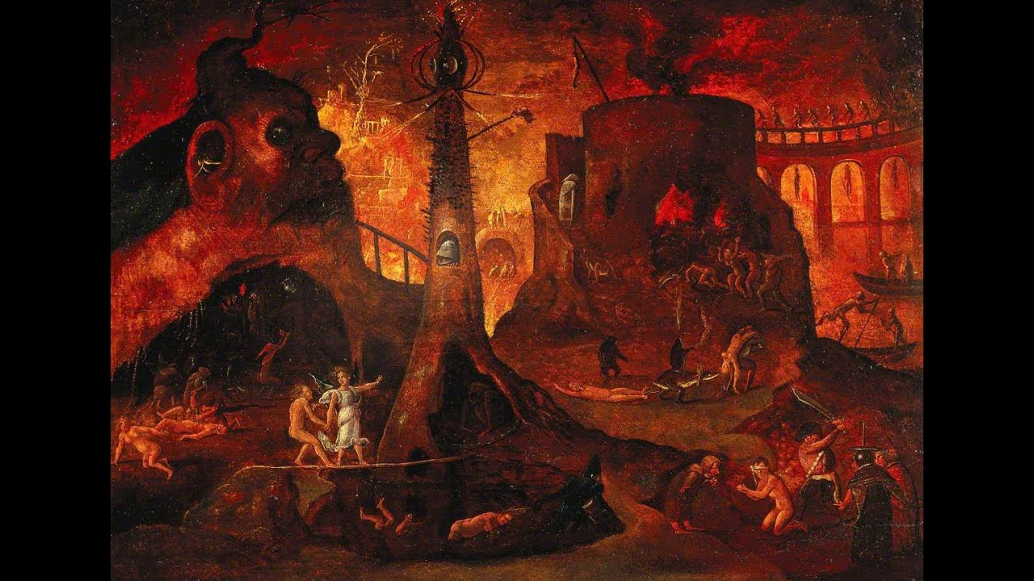
如果神是慈爱的祂为何造了地狱？
If God is loving, why did He create hell?

Slide 3
如果神是公义的祂为何拿掉地狱，不审判刑罚？
If God is just, why would He remove hell and not judge or punish?

Slide 4
启 11:15 第七位天使吹号 ，天上就有大声音说：世上的国成了我主和主基督的国；他要作王，直到永永远远 。16 在神面前，坐在自己位上的二十四位长老，就面伏於地，敬拜神，17 说：昔在、今在的主神全能者啊，我们感谢你！因你执掌大权作王了。
Rev 11:15.Then the seventh angel blew his trumpet, and there were loud voices in heaven, saying, "The kingdom of the world has become the kingdom of our Lord and of his Christ, and he shall reign forever and ever."16.And the twenty-four elders who sit on their thrones before God fell on their faces and worshiped God,17.saying, "We give thanks to you, Lord God Almighty, who is and who was, for you have taken your great power and begun to reign.
1/2

Slide 5
18 外邦发怒，你的忿怒也临到了；审判死人的时候也到了。你的仆人众先知和众圣徒，凡敬畏你名的人，连大带小得赏赐的时候也到了。你败坏那些败坏世界之人的时候也就到了。19 当时，神天上的殿开了，在他殿中现出他的约柜。随後有闪电、声音、雷轰、地震、大雹。
18.The nations raged, but your wrath came, and the time for the dead to be judged, and for rewarding your servants, the prophets and saints, and those who fear your name, both small and great, and for destroying the destroyers of the earth."19.Then Gods temple in heaven was opened, and the ark of his covenant was seen within his temple. There were flashes of lightning, rumblings, peals of thunder, an earthquake, and heavy hail.
2/2

Slide 6
第七号：大审判的其中一个角度
01
The Seventh Trumpet: One Perspective of the Great Judgment

Slide 7
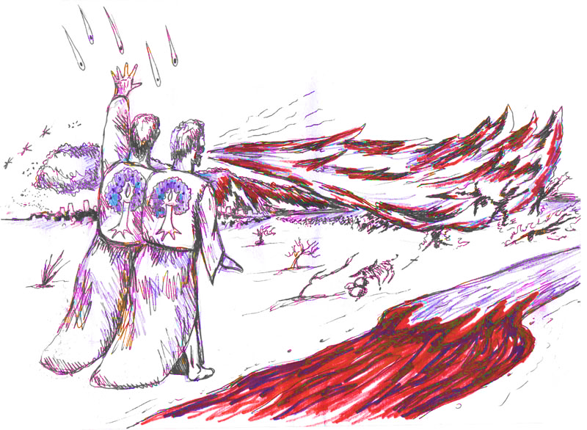
启11:1-14
两位见证人传道
启11:1-14
两位见证人传道
Revelation 11:1-14
Two witness they prophesy
1/3

Slide 8
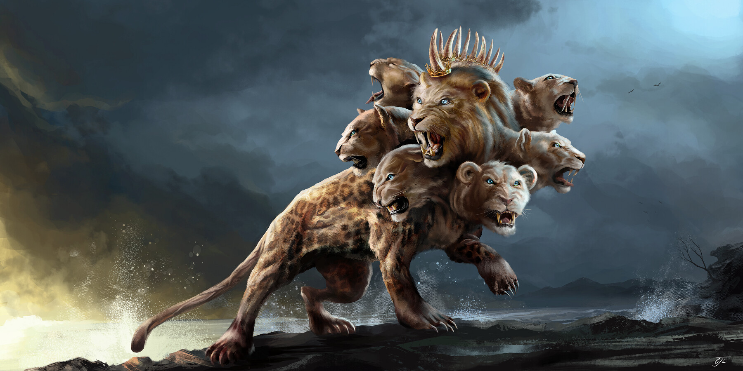
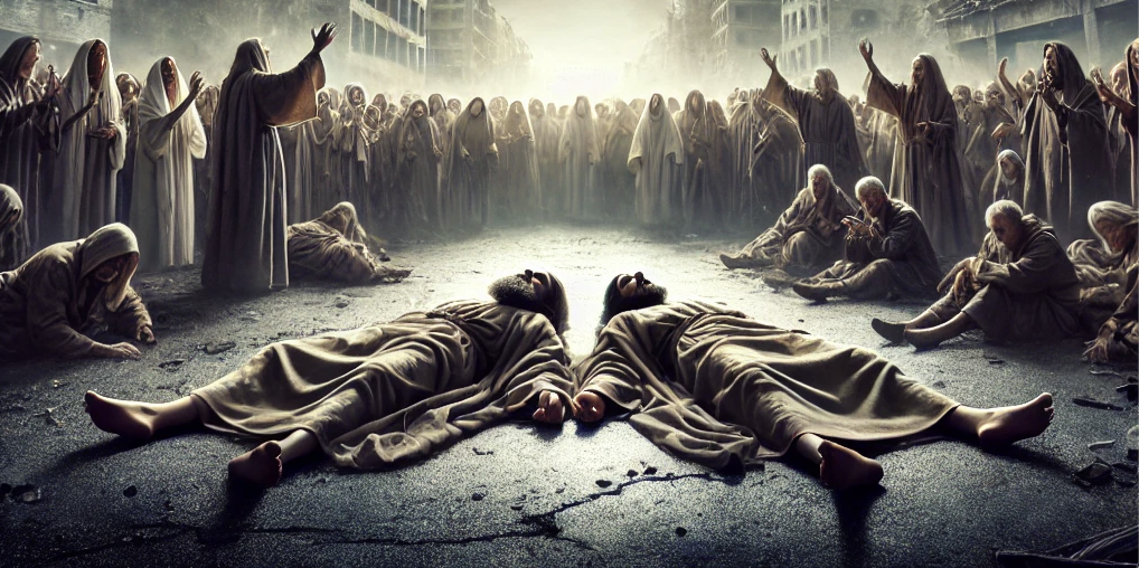
启11:7 他们作完见证的时候，那从无底坑里上来的兽必与他们交战，并且得胜，把他们杀了。
Rev 11:7.And when they have finished their testimony, the beast that rises from the bottomless pit will make war on them and conquer them and kill them,
把他们杀了
2/3

Slide 9
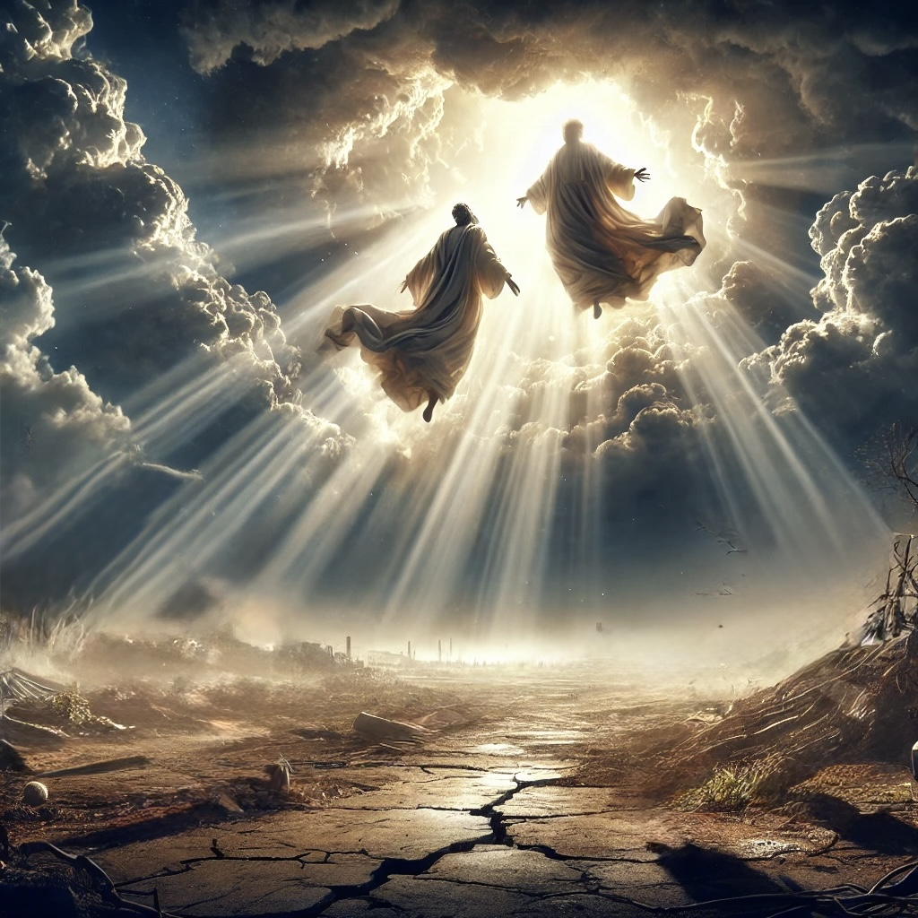
被兽杀害的两位见证人复活升天 (启11:11-12）
The two witnesses who were killed by the beast resurrect and ascend to heaven. (Rev 11:11-12)
3/3

Slide 10
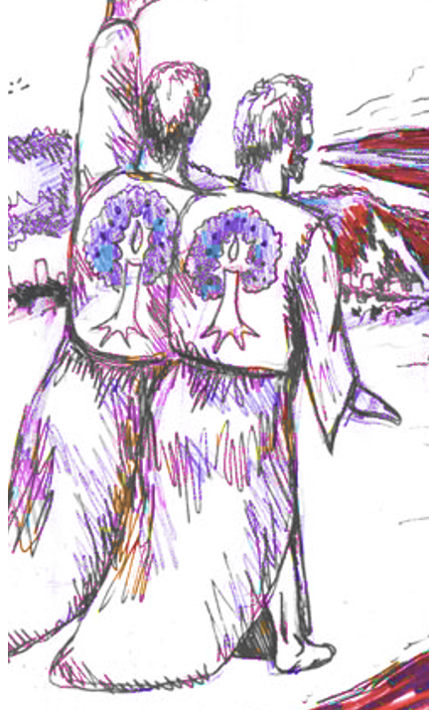
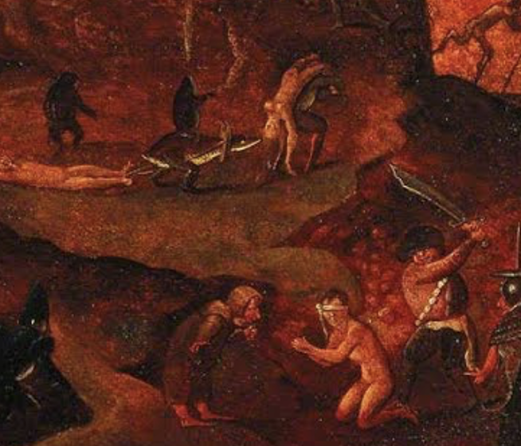
两见证人教会）
兽出现
敌基督）
见证人被杀信徒受难
见证人复活信徒复活
第七号
大审判
Two witness
church）
The Beast
Antichrist
Two Witness killed
Believers in
tribulations
Two Witness ressurect
Believers resurrection
Seventh Trumpet
The Great Judgement

Slide 11
（1）世界的国都成为了神的国
The kingdoms of the world have become the kingdom of God.
（2）主（天父）和主基督要做王直到永远
The Lord (the Father) and the Lord Christ will reign forever and ever.
（3）审判死人的时候到了(V18)。
the time for the dead to be judged.(V18)
（4）败坏世界之人的时候到了(V18)。
destroying the destroyers of the earth.(V18)
大
审
判
启11:15-19
Final
Judgement
Rev 11:15-19

Slide 12
第1环 1st cycle | 第2环 2nd cycle | 第3环 3rd cycle | 第4环 4th cycle | 第5环 5th cycle | 第6环 6th cycle | 第7环 7th cycle
七印 7 Seals 4:1-8:5 | 七号 7 Trumpets 8:6-11:19 | 龙与兽 Dragon and Beast 12:1-14:20 | 七碗 7 Bowls 15:1-16:21 | 巴比伦 Babylon 17:1-19:10 | 白马骑士 White horse 19:11-21 | 白色大宝座 Great white throne 20:1-21:8
1/6

Slide 13
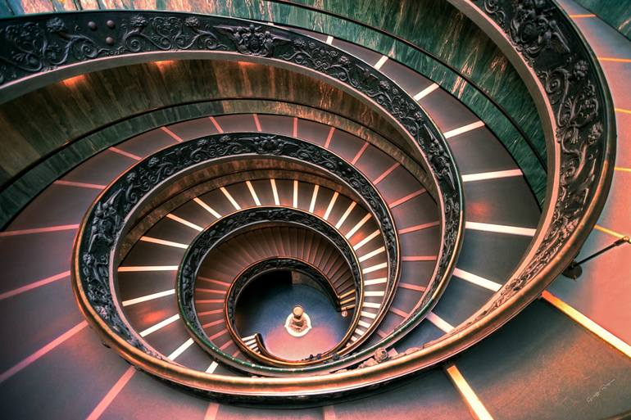
启示录 七环 7 cycle
2/6

Slide 14
第1环 cycle | 第2环 cycle | 第3环 cycle | 第4环 cycle | 第5环 cycle | 第6环 cycle | 第7环 cycle
七印 7 Seals 4:1-8:5 | 七号 7 Trumpets 8:6-11:19 | 龙与兽 Dragon and Beast 12:1-14:20 | 七碗 7 Bowls 15:1-16:21 | 巴比伦 Babylon 17:1-19:10 | 白马骑士 White horse 19:11-21 | 白色大宝座 Great white throne 20:1-21:8
末日审判 Final Judgement 8:5 | 末日审判 Final Judgement 11:15-19 | 末日审判 Final Judgement 14:8-11 | 末日审判 Final Judgement 16:17-21 | 末日审判 Final Judgement 18:9-19:3 | 末日审判 Final Judgement 19:20-21 | 末日审判 Final Judgement 20:7-10
3/6

Slide 15
第1环 cycle | 第2环 cycle | 第3环 cycle | 第4环 cycle | 第5环 cycle | 第6环 cycle | 第7环 cycle
七印 7 Seals 4:1-8:5 | 七号 7 Trumpets 8:6-11:19 | 龙与兽 Dragon and Beast 12:1-14:20 | 七碗 7 Bowls 15:1-16:21 | 巴比伦 Babylon 17:1-19:10 | 白马骑士 White horse 19:11-21 | 白色大宝座 Great white throne 20:1-21:8
末日审判 Final Judgement 8:5 雷轰、响声、闪电和地震 thunder, rumblings, lightning, earthquake. | 末日审判 Final Judgement 11:15-19 闪电、响声、雷轰、地震、大冰雹 lightning, rumblings, thunder, earthquake, heavy hail. | 末日审判 Final Judgement 14:8-11 | 末日审判 Final Judgement 16:17-21 闪电、声音、雷轰、大地震、大雹子 lightning, rumblings, thunder, great earthquake, great hailstones | 末日审判 Final Judgement 18:9-19:3 | 末日审判 Final Judgement 19:20-21 | 末日审判 Final Judgement 20:7-10
4/6

Slide 16
第1环 cycle | 第2环 cycle | 第3环 cycle | 第4环 cycle | 第5环 cycle | 第6环 cycle | 第7环 cycle
七印 7 Seals 4:1-8:5 | 七号 7 Trumpets 8:6-11:19 | 龙与兽 Dragon and Beast 12:1-14:20 | 七碗 7 Bowls 15:1-16:21 | 巴比伦 Babylon 17:1-19:10 | 白马骑士 White horse 19:11-21 | 白色大宝座 Great white throne 20:1-21:8
末日审判 Final Judgement 8:5 雷轰、响声、闪电和地震 thunder, rumblings, lightning, earthquake. | 末日审判 Final Judgement 11:15-19 闪电、响声、雷轰、地震、大冰雹 lightning, rumblings, thunder, earthquake, heavy hail. 审判死人时候到了 time for the dead to be judged | 末日审判 Final Judgement 14:8-11 拜兽和兽像有兽印的人在 火与硫磺受苦 Whoever worships the beast and its image and receives mark of beast tormented with fire and sulfur | 末日审判 Final Judgement 16:17-21 闪电、声音、雷轰、大地震、大雹子 lightning, rumblings, thunder, great earthquake, great hailstones 列国的城倒塌、 海岛与众山不见了 nations cities fell，every island and mountains no more | 末日审判 Final Judgement 18:9-19:3 巴比伦大淫妇 被永远毁灭 Babylon the great prostitute destroyed forever | 末日审判 Final Judgement 19:20-21 兽与假先知 在火湖里 The Beast and False Prophet in lake of fire | 末日审判 Final Judgement 20:7-10 撒但龙、兽和假先知在火湖 Satan Dragon, Beast and False Prophet in lake of fire
5/6

Slide 17
大审判的 7个不同视角
The 7 Different Perspectives of the Great Judgment.
6/6

Slide 18
大审判来临时，父与子要一统天下与天上
02
When the Great Judgment comes,
the Father and the Son will rule in heaven and on earth.

Slide 19
启 11:15 第七位天使吹号 ，天上就有大声音说：世上的国成了我主和主基督的国；他要作王，直到永永远远 。
Rev 11:15.Then the seventh angel blew his trumpet, and there were loud voices in heaven, saying, "The kingdom of the world has become the kingdom of our Lord and of his Christ, and he shall reign forever and ever."

Slide 20
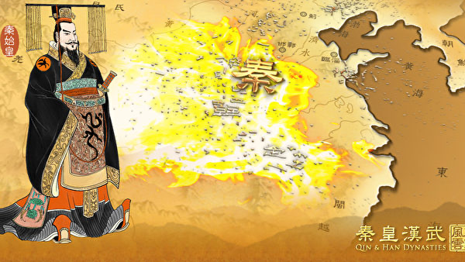
统一天下
秦始皇（BC 259年—210年）

Slide 21
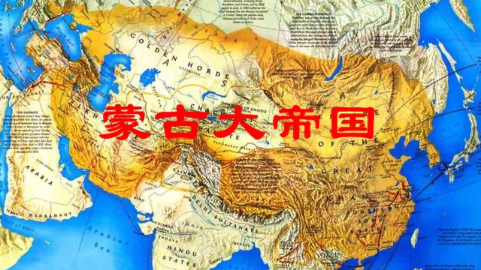
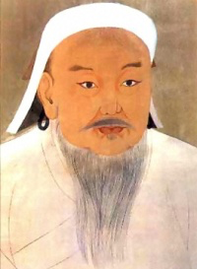
蒙古成吉思汗 1162-1227

Slide 23
16 在神面前，坐在自己位上 的二十四位长老，就面伏於地，敬拜神，17 说：昔在、今在的主神全能者啊，我们感谢你！因你执掌大权作王了。
16.And the twenty-four elders who sit on their thrones before God fell on their faces and worshiped God,17.saying, "We give thanks to you, Lord God Almighty, who is and who was, for you have taken your great power and begun to reign.

Slide 24
审判死人的时候到了
03
The time has come to judge the dead.

Slide 25
18 外邦(列国)发怒，你的忿怒也临到了；审判死人的时候也到了…
18.The nations raged, but your wrath came, and the time for the dead to be judged, …

Slide 26
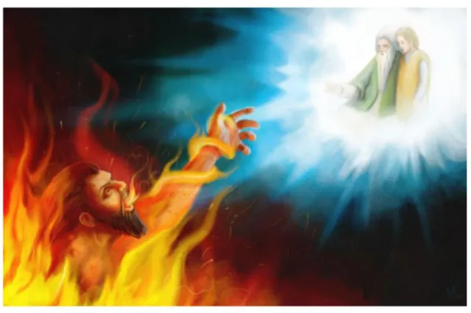
路16:22 ...财主也死了，并且埋葬了23 他在阴间受痛苦，举目远远地望见亚伯拉罕，又望见拉撒路在他怀里，24 就喊着说：『我祖亚伯拉罕哪，可怜我吧！打发拉撒路来，用指头尖蘸点水，凉凉我的舌头；因为我在这火焰里，极其痛苦。』
Luke 16:22 …The rich man also died and was buried,23 and in Hades, being in torment, he lifted up his eyes and saw Abraham far off and Lazarus at his side.24 And he called out, Father Abraham, have mercy on me, and send Lazarus to dip the end of his finger in water and cool my tongue, for I am in anguish in this flame.

Slide 27
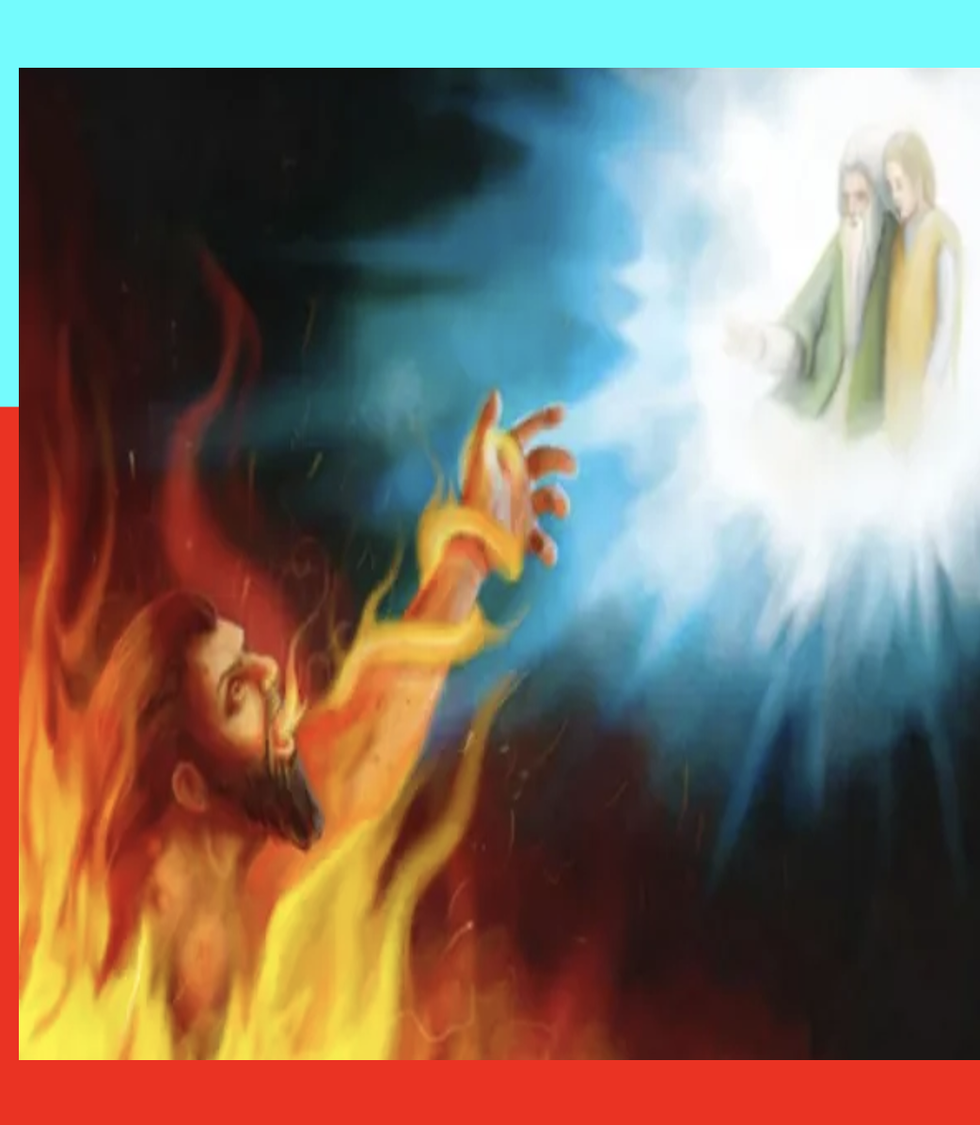
已经在地狱里了， 为什么大审判时， 死人还要再受审判？
Already in hell, why do the dead still need to be judged
at the time of the great judgment?

Slide 28
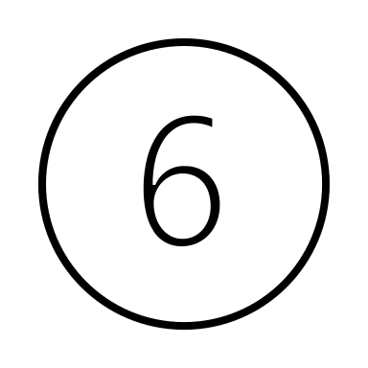
下阴间
（地狱）受苦
等候
基督
再来
死人
复活
约 5:28-29
但 12:2
徒 24:15
大
审判
第二次
死亡
与
不同程度
刑罚
永远
受地狱
之苦
Descend to Hades (Hell), suffer, and wait.
Return
Of
Christ
Resurrection
Of the
Dead
Great
Judgement
Second Death
And
Different degree of punishment
Suffer in hell
In eternity
刑罚有不同程度
Different degree of punishment （太11:21-24、路10:13-14、路12:47-48、来10:29)

Slide 29
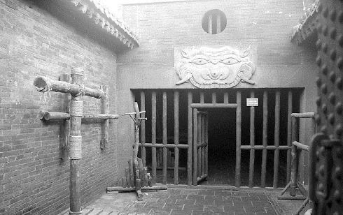
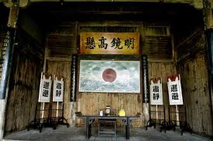
受苦
与等候
Suffer and awaits
大
审判
Final Judgement
永远
受地狱之苦
Suffer in hell in eternity

Slide 30
来 9:27
按着定命，人人都有一死，死后且有审判。
Hebrews 9:27
And just as it is appointed for man to die once, and after that comes judgment,

Slide 31
忠心事主的人要得赏赐
04
Those who faithfully serve the Lord will receive their reward.

Slide 32
18 ...你的仆人众先知和众圣徒，凡敬畏你名的人，连大带小得赏赐的时候也到了。你败坏那些败坏世界之人的时候也就到了。
18… and for rewarding your servants, the prophets and saints, and those who fear your name, both small and great, and for destroying the destroyers of the earth."

Slide 33
太19:28 耶稣说：「我实在告诉你们，你们这跟从我的人，到复兴的时候，人子坐在他荣耀的宝座上，你们也要坐在十二个宝座上，审判以色列十二个支派。29 凡为我的名撇下房屋，或是弟兄、姐妹、父亲、母亲、儿女、田地的，必要得著百倍，并且承受永生。30 然而，有许多在前的，将要在後；在後的，将要在前。」
Mat 19:28 Jesus said to them, “Truly, I say to you, in the new world, when the Son of Man will sit on his glorious throne, you who have followed me will also sit on twelve thrones, judging the twelve tribes of Israel.29 And everyone who has left houses or brothers or sisters or father or mother or children or lands, for my name's sake, will receive a hundredfold and will inherit eternal life.30 But many who are first will be last, and the last first.

Slide 34
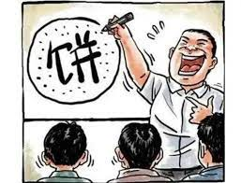

Slide 35
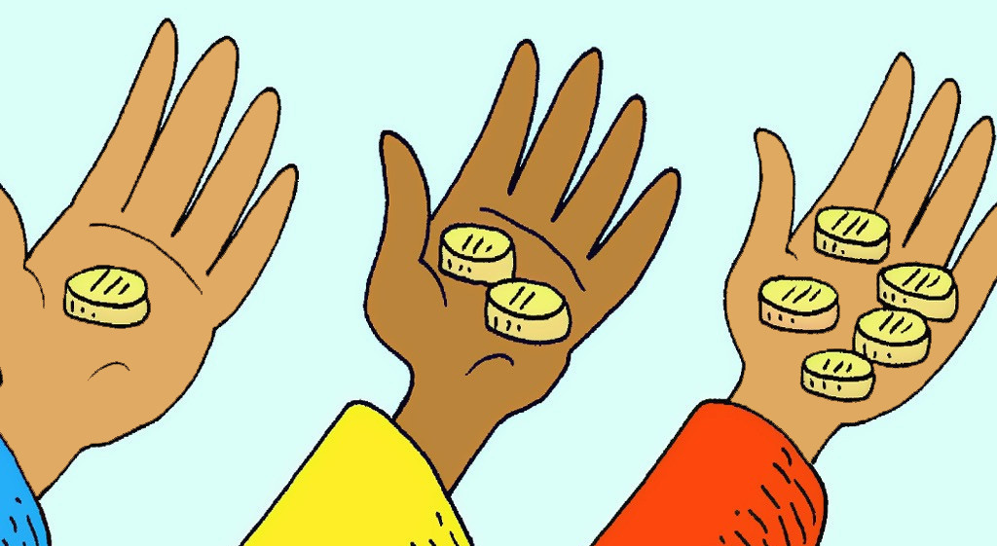
（五千、两千、一千）太 25:14-30
(five talent, two talents, one talent) Mat 25:14-30

Slide 36
19 当时，神天上的殿开了，在他殿中现出他的约柜。随後有闪电、声音、雷轰、地震、大雹。
19.Then Gods temple in heaven was opened, and the ark of his covenant was seen within his temple. There were flashes of lightning, rumblings, peals of thunder, an earthquake, and heavy hail.

Slide 37
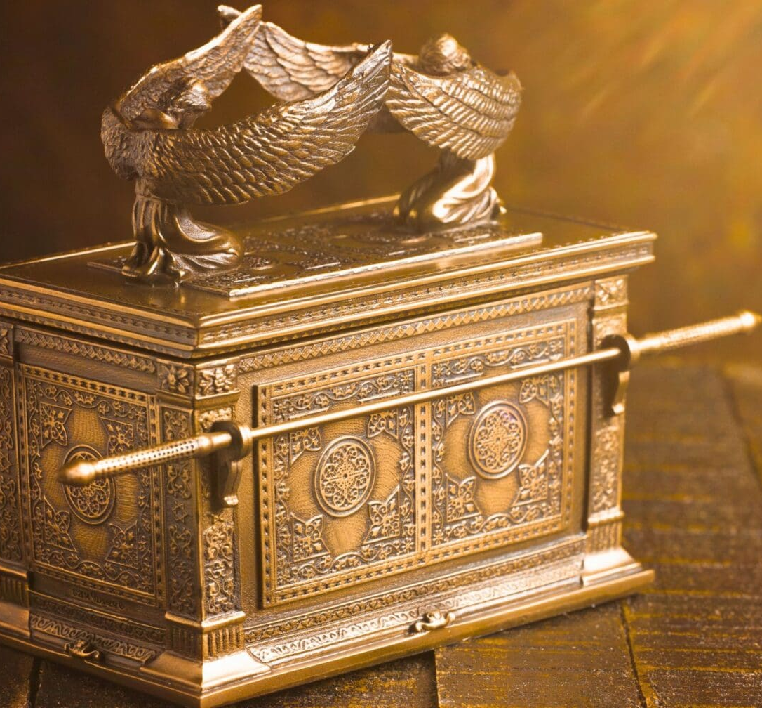
象征神的宝座，神的同在。
(出25:22、民7:89、诗80:1、
诗99:1)
Symbolizes God's throne and His presence.
(Exodus 25:22, Numbers 7:89, Psalm 80:1, 99:1)

Slide 38
大审判来临时，神会审判已经死了的人。
When the great judgment comes, God will judge the dead
大审判来临时，神会按我们一生忠心的服事来赏赐我们。
When the great judgment comes, God will reward us according to our faithful service
throughout our lives.
祈求主帮助我们一生忠心爱主，赢得未来天上的赏赐。
Pray to the Lord to help us remain faithful in loving Him throughout our lives and to
win the heavenly reward in the future.

