Slide 1
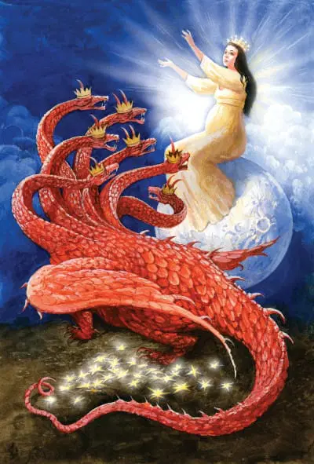
029 七头十角大红龙
启示录12章1至6
The Great Red Dragon with Seven Heads and Ten Horns

Slide 2
Wifi
风 wind
思想 thoughts

Slide 3
启12:1天上现出大异象来：有一个妇人身披日头，脚踏月亮，头戴十二星的冠冕。2 她怀了孕，在生产的艰难中疼痛呼叫。3.天上又现出异象来：有一条大红龙，七头十角；七头上戴着七个冠冕。4.它的尾巴拖拉着天上星辰的三分之一，摔在地上。龙就站在那将要生产的妇人面前，等她生产之后，要吞吃她的孩子。5.妇人生了一个男孩子，是将来要用铁杖辖管万国的；她的孩子被提到神宝座那里去了。6 妇人就逃到旷野，在那里有神给她预备的地方，使她被养活一千二百六十天。
Rev 12:1.And a great sign appeared in heaven: a woman clothed with the sun, with the moon under her feet, and on her head a crown of twelve stars.2.She was pregnant and was crying out in birth pains and the agony of giving birth.3.And another sign appeared in heaven: behold, a great red dragon, with seven heads and ten horns, and on his heads seven diadems.4.His tail swept down a third of the stars of heaven and cast them to the earth. And the dragon stood before the woman who was about to give birth, so that when she bore her child he might devour it.5.She gave birth to a male child, one who is to rule all the nations with a rod of iron, but her child was caught up to God and to his throne,6.and the woman fled into the wilderness, where she has a place prepared by God, in which she is to be nourished for 1,260 days.

Slide 4
生产的妇人
01
A woman giving birth

Slide 5
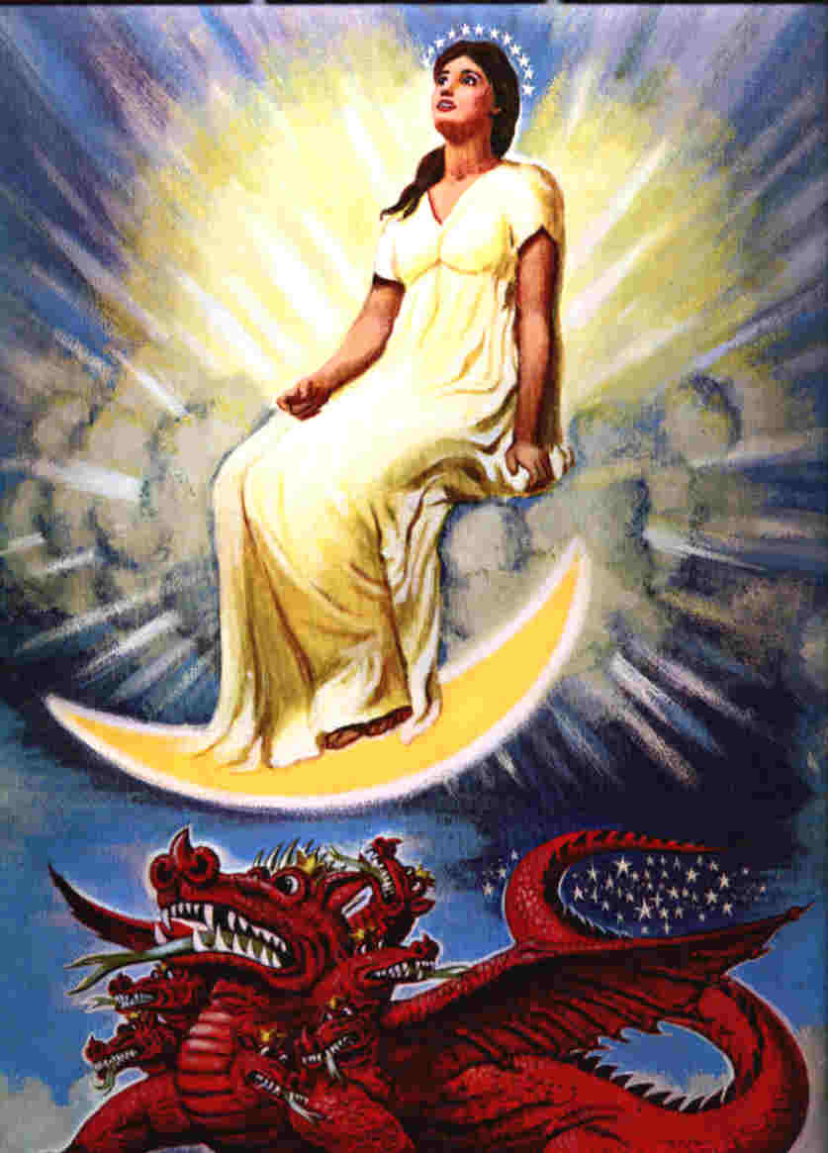
启12:1 天上现出大异象来：有一个妇人身披日头，脚踏 月亮，头戴十二星的冠冕。
Rev 12:1. And a great sign appeared in heaven: a woman clothed with the sun, with the moon under her feet, and on her head a crown of twelve stars.

Slide 6
妇人预表的是旧约与新约教会
The woman symbolizes the Old Testament and New Testament Church.
创37:9 太阳、月亮、星星，象征以色列(旧约的教会)Genesis 37:9 – The sun, moon, and stars symbolize Israel (the Old Testament Church).
妇人受神保护1260天（3.5年）象征新约教会时代。The woman being protected by God for 1,260 days (3.5 years) symbolizes the New Testament Church era.
妇人的子孙就是为耶稣作见证的基督徒 V17 The offspring of the woman refers to Christians who bear witness for Jesus (Rev 12:17).

Slide 7
启 12:2.
她怀了孕，在生产的艰难中疼痛呼叫。
Rev 12:2.
She was pregnant and was crying out in birth pains and the agony of giving birth.

Slide 8
七头十角大红龙
02
The great red dragon with seven heads and ten horns.

Slide 9
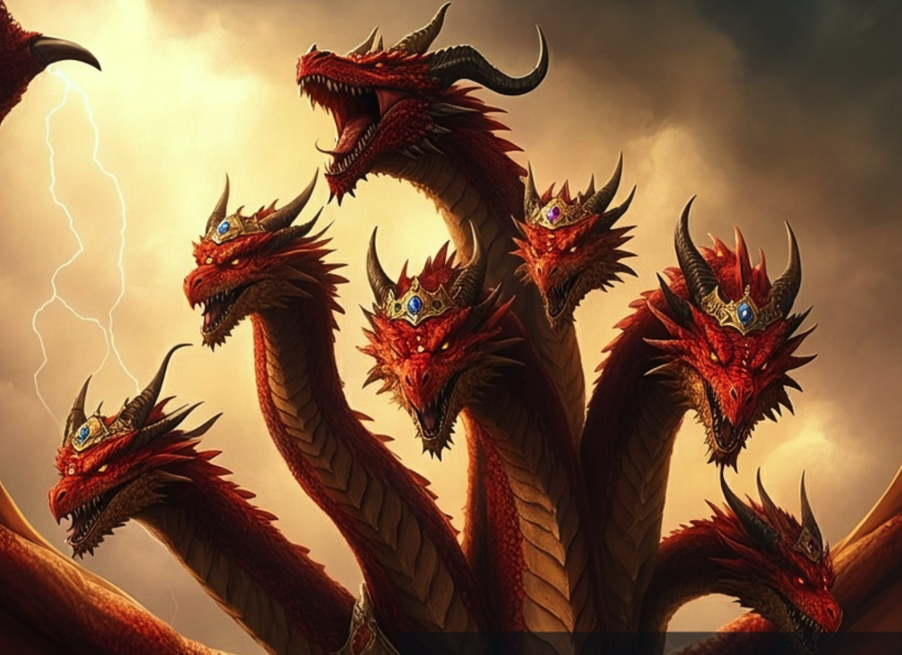
启12：3.
天上又现出异象来：有一条大红龙，七头十角；七头上戴着七个冠冕。
Rev 12:3.
And another sign appeared in heaven: behold, a great red dragon, with seven heads and ten horns, and on his heads seven diadems.

Slide 10
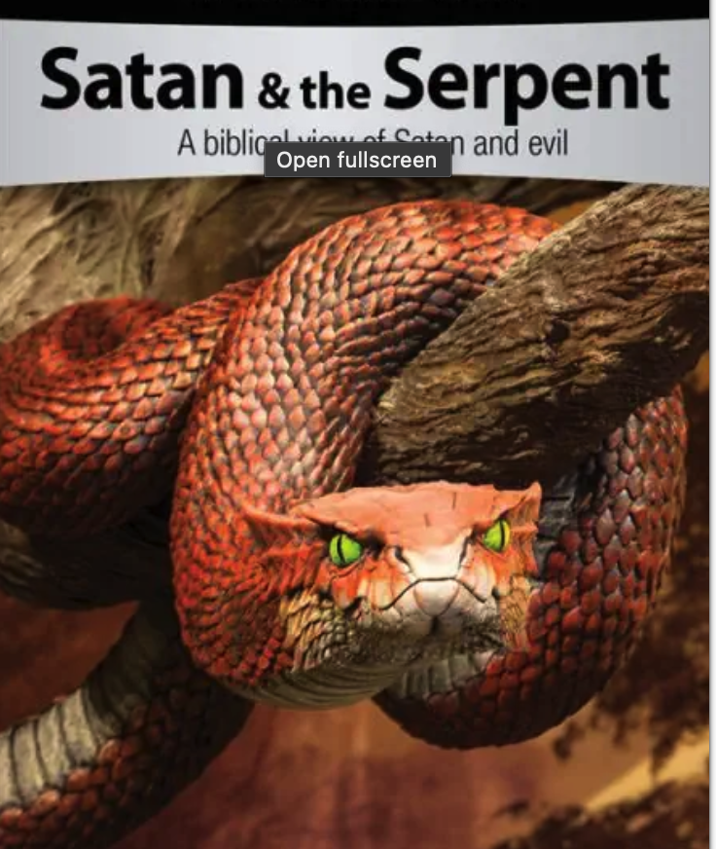
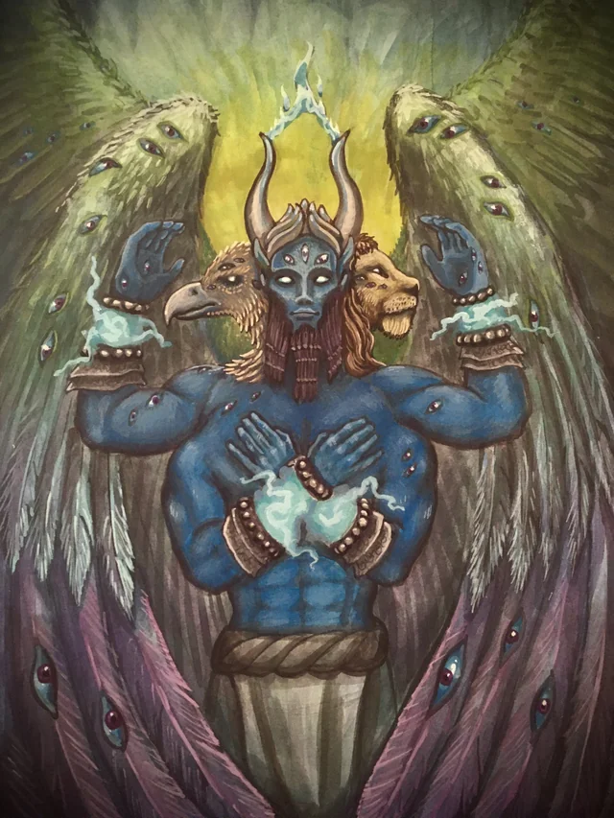
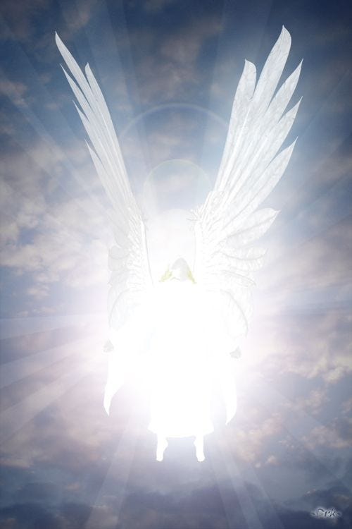
伊甸园的蛇 （创3:1）
Serpent in the Garden of Eden
(Gen 3:1).
基路伯 （结 28:14）
Guardian cheru
(Ezk 28:14).
光明天使
(林后11:14)）
Angel of light
(2Corin11:14).

Slide 11
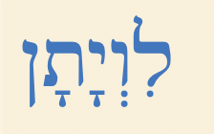
(新译本：以赛亚书 27:1)
到那日，耶和华要施用他锐利、巨大和有力的刀，惩罚鳄鱼 livyâthân (利维坦)，就是那快行的蛇；惩罚鳄鱼，就是那曲行的蛇；并且要杀海中的大龙 tannı̂yn。
Isaiah 27: 1.
In that day the Lord with his hard and great and strong sword will punish Leviathan the fleeing serpent, Leviathan the twisting serpent, and he will slay the dragon that is in the sea.

Slide 12
启12：3.
。。。，七头 十角；
七头上戴着七个冠冕。
Rev 12:3.
。。。, with seven heads and ten horns, and on
his heads seven diadems.

Slide 13
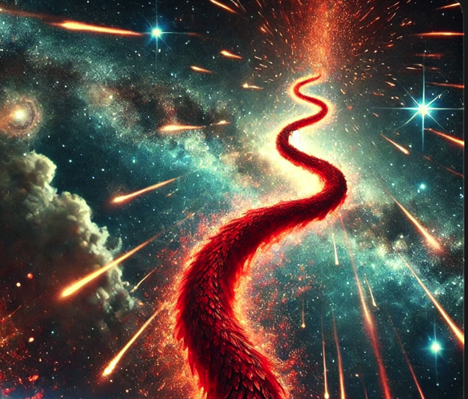
启12:4.它的尾巴拖拉着天上星辰的三分之一，摔在地上。.. .
Rev 12:4 .His tail swept down a third of the stars of heaven and cast them to the earth. …

Slide 14
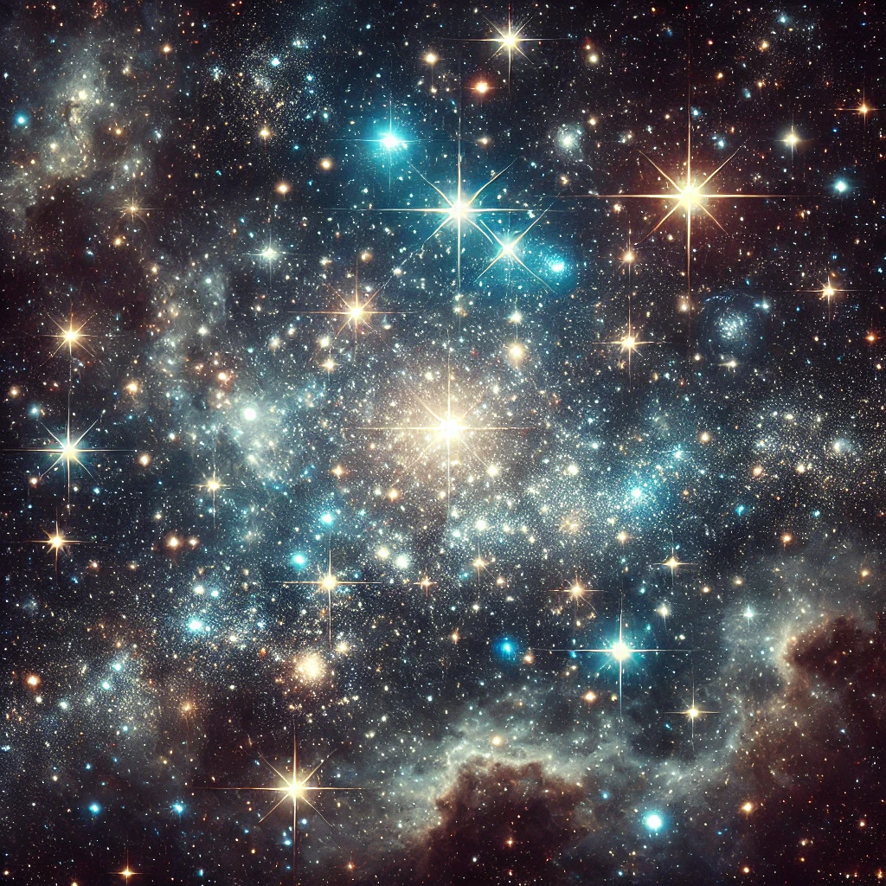
星辰预表：
天使 (伯38:7、申4:19)
神的义人（但12:3）
君王（民24:17）
Stars symbolize:
Angels (Job 38:7; Deut 4:19)
God's righteous ones (Dan 12:3)
Kings (Num 24:17)

Slide 15
A 撒旦蛊惑天上三分之一天使堕落造反神
A. Satan deceived one-third of the heavenly angels into falling.
B 撒旦攻击义人（但8:10、但12:3），包括天上的天使
B. Satan attacks the righteous (Dan 8:10; Dan 12:3), including heavenly angels
C V13教会受撒旦逼迫，所以指攻击代表教会的天使
C. In v.13, the church is persecuted by Satan, so refers to the attack of the angels representing the church.
D 三分之一堕落的天使下到人间
D. Satan caused the fallen one-third of angels to descend to earth.
E 在V7 征战中三分之一堕落天使被逐出天庭。
E. Linked to v.7: This battle led to one-third of the fallen angels to be cast out of heaven.

Slide 16
谁才是你真正的仇敌？

Slide 18
弗6:12 因我们并不是与属血气的争战，乃是与那些执政的、掌权的、管辖这幽暗世界的，以及天空属灵气的恶魔争战。
Ephesians 6
12.For we do not wrestle against flesh and blood, but against the rulers, against the authorities, against the cosmic powers over this present darkness, against the spiritual forces of evil in the heavenly places.

Slide 19
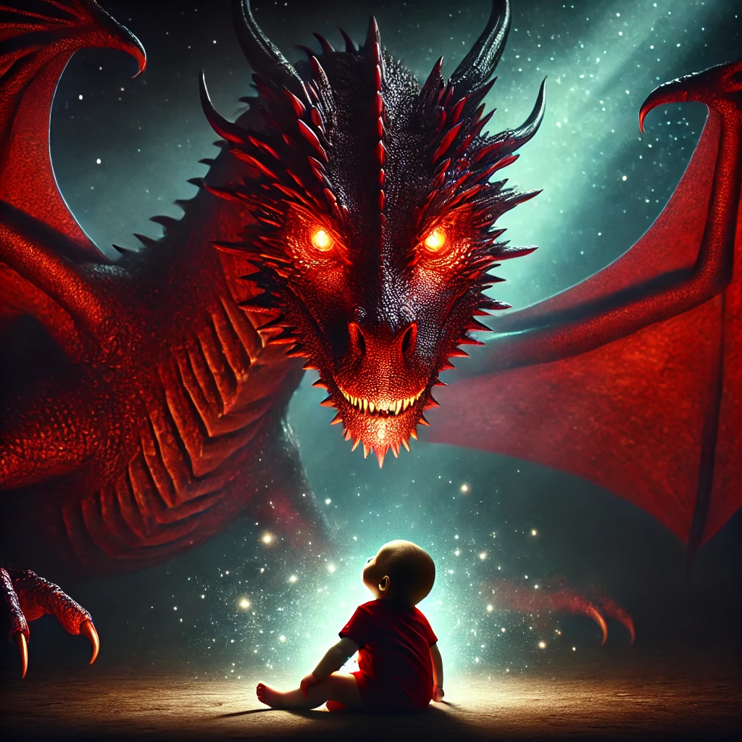
启示录 12：4 。。。
龙就站在那将要生产的妇人面前，等她生产之后，要吞吃她的孩子。
Revelation 12:4
… And the dragon stood before the woman who was about to give birth, so that when she bore her child he might devour it.

Slide 20
生了一个男孩
03
A son is born

Slide 21
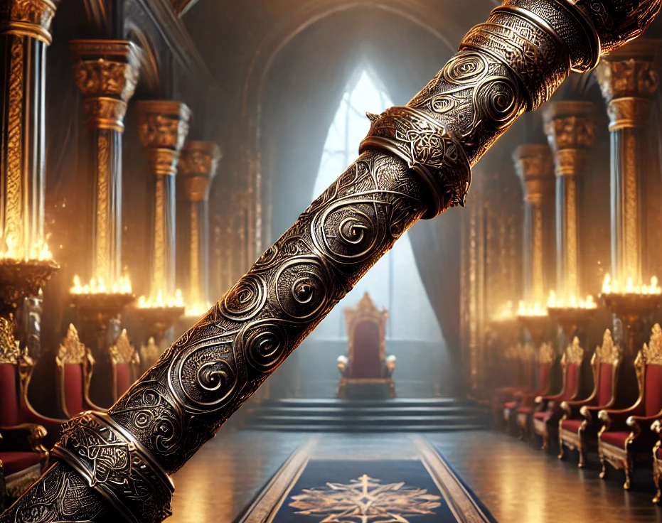
（诗2:7-9*、启2:27）
5 妇人生了一个男孩子，是将来要用铁杖辖管万国的；他的孩子被提到神宝座那里去了。
5.She gave birth to a male child, one who is to rule all the nations with a rod of iron, but her child was caught up to God and to his throne,

Slide 22
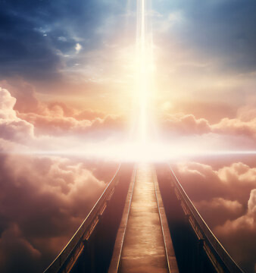
彼前 3:22
耶稣已经进入天堂，
在神的右边；众天使和有权柄的，并有能力的，都服从了他。
1 Peter 3:22.
who has gone into heaven and is at the right hand of God, with angels, authorities, and powers having been subjected to him.

Slide 23
神预备、供应、保护
04
God prepares , provides and protect

Slide 24
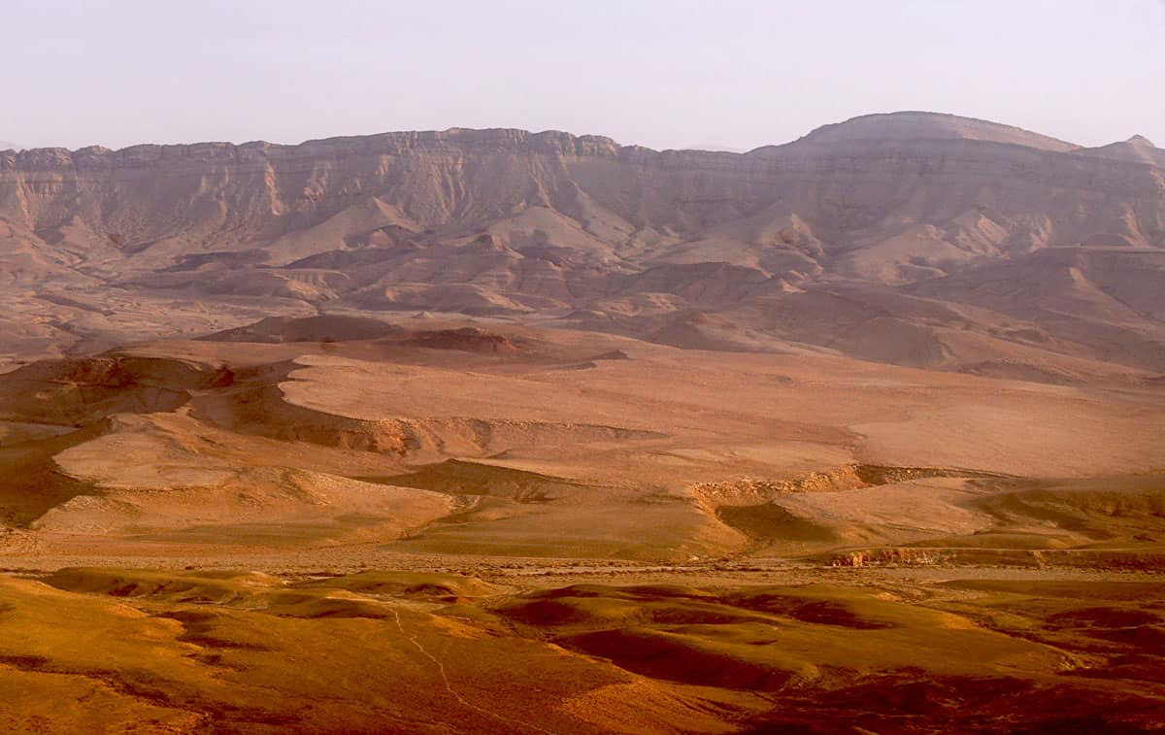
6.
妇人就逃到旷野，在那里有神给她预备的地方，..
6.and the woman fled into the wilderness, where she has a place prepared by God, …

Slide 25
缺乏信心，
害怕就不会行动
Lack of faith, Fear prevents action.

Slide 26
6...
神给她预备的地方，使她被养活 一千二百六十天。
6. .., where she has a place prepared by God, in which she is to be nourished for 1,260 days.

Slide 27
旷野等候进入应许之地
Waiting in the wilderness to enter the promised land.

Slide 28
申 31:6
你们当刚强壮胆，不要害怕，也不要畏惧他们，因为耶和华你的神和你同去。他必不撇下你，也不丢弃你。
Deuteronomy 31:6. Be strong and courageous. Do not fear or be in dread of them, for it is the Lord your God who goes with you. He will not leave you or forsake you.

