Slide 1
03
Baptized, Beloved, and Tested
Mark 1:9-13

Slide 2
Mark 1:9.In those days Jesus came from Nazareth of Galilee and was baptized by John in the Jordan.10.And when he came up out of the water, immediately he saw the heavens being torn open and the Spirit descending on him like a dove. 11.And a voice came from heaven, "You are my beloved Son; with you I am well pleased."12.The Spirit immediately drove him out into the wilderness.13.And he was in the wilderness forty days, being tempted by Satan. And he was with the wild animals, and the angels were ministering to him.

Slide 3
【1】
The Baptism of Christ

Slide 6
【2】
The Affirmation of the Father
and the Anointing of the Spirit

Slide 7
John 1:12 But to all who did receive him, who believed in his name, he gave the right to become children of God,

Slide 8
Ephesians 1:13.In him you also, when you heard the word of truth, the gospel of your salvation, and believed in him, were sealed with the promised Holy Spirit,

Slide 9
Ephesians 3:16. that according to the riches of his glory he may grant you to be strengthened with power through his Spirit in your inner being,

Slide 10
【3】
Jesus Faces Temptation

Slide 11
Hebrews 2:18.
For because he himself has suffered when tempted, he is able to help those who are being tempted.

Slide 12
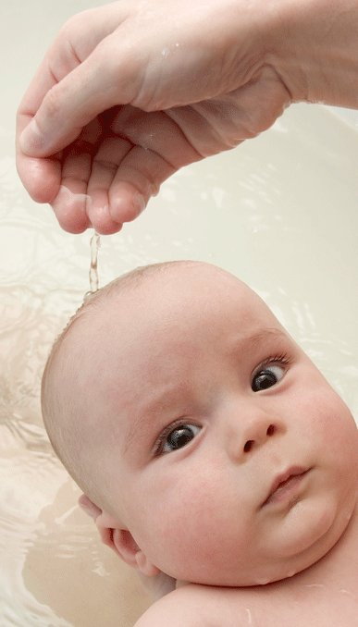
Baptism

Slide 15
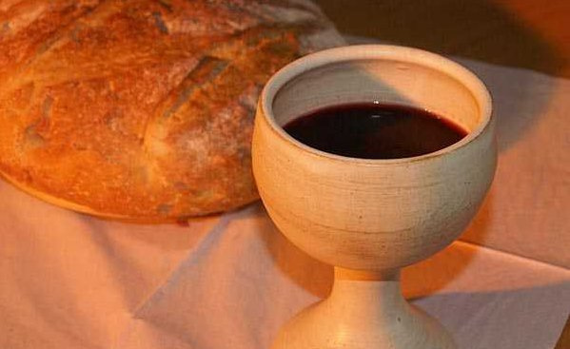
Holy Communion

Slide 16
1 John 4:10. In this is love, not that we have loved God but that he loved us and sent his Son to be the propitiation for our sins.11.Beloved, if God so loved us, we also ought to love one another.

