Slide 1
03 与世俗为友
03 Friendship with the world is enmity with God

Slide 2
雅 4:1.你们中间的争执和打斗是从哪里来的呢？不是从你们肢体中好斗的私欲来的吗？2.你们放纵贪欲，如果得不到，就杀人；你们嫉妒，如果一无所得，就打斗争执。你们得不到，因为你们不求；3.你们求也得不到，因为你们的动机不良，要把所得的耗费在你们的私欲上。4.淫乱的人哪，你们不知道与世俗为友，就是与神为敌吗？所以与世俗为友的，就成了神的仇敌。
James 4:1 .What causes quarrels and what causes fights among you? Is it not this, that your passions are at war within you? 2.You desire and do not have, so you murder. You covet and cannot obtain, so you fight and quarrel. You do not have, because you do not ask.3.You ask and do not receive, because you ask wrongly, to spend it on your passions.4.You adulterous people! Do you not know that friendship with the world is enmity with God? Therefore whoever wishes to be a friend of the world makes himself an enemy of God.
1/2

Slide 3
5.圣经说：“神爱他那安置在我们里面的灵 ，爱到嫉妒的地步”，你们想这话是徒然的吗？6.但神所赐的恩更大；所以圣经上说：“ 神抵挡骄傲的人，赐恩给谦卑的人。”7.你们应当顺服神，抵挡魔鬼，魔鬼就逃避你们。8.你们应当亲近神，神就亲近你们。罪人啊，要洁净你们的手；三心两意的人哪，要清洁你们的心。9.你们要愁苦、悲哀、哭泣，把欢笑变为伤痛，把快乐变为忧愁。
James 4:5.Or do you suppose it is to no purpose that the Scripture says, "He yearns jealously over the spirit that he has made to dwell in us"?6.But he gives more grace. Therefore it says, "God opposes the proud but gives grace to the humble."7.Submit yourselves therefore to God. Resist the devil, and he will flee from you.8.Draw near to God, and he will draw near to you. Cleanse your hands, you sinners, and purify your hearts, you double-minded.9.Be wretched and mourn and weep. Let your laughter be turned to mourning and your joy to gloom..
2/2

Slide 4
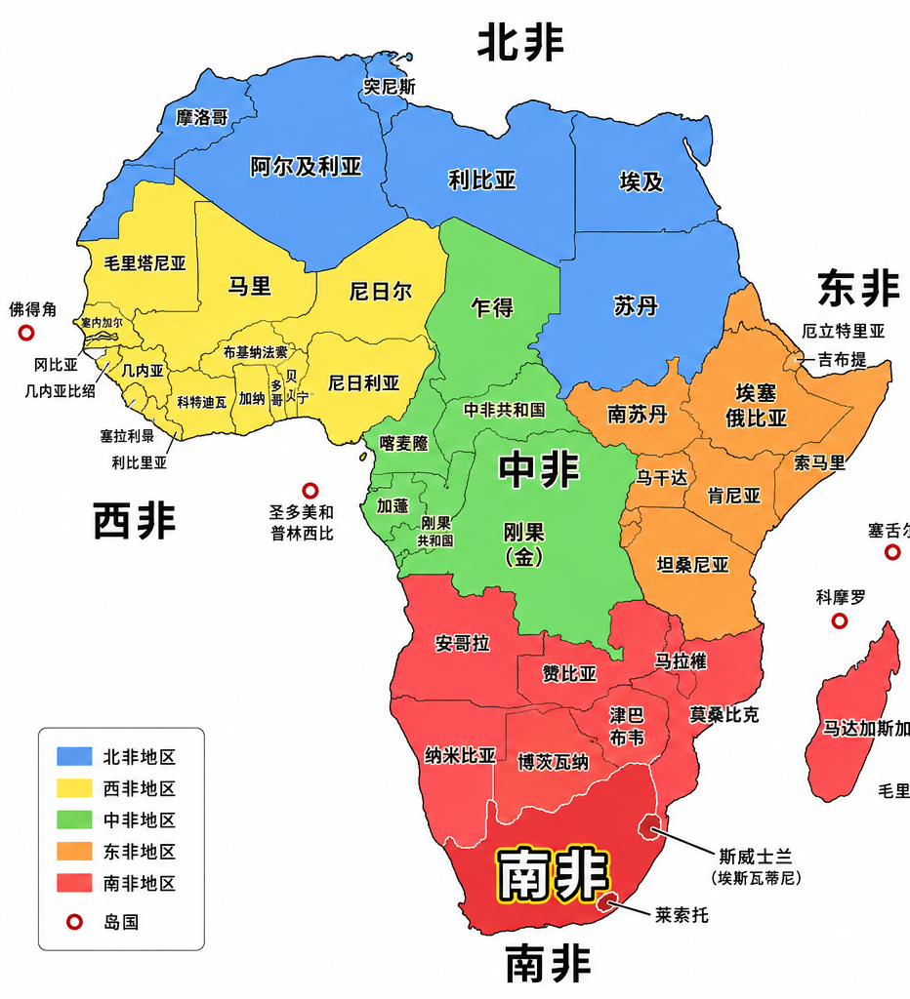
南非south Africa 2022年人口普查显示，约 84.5% 的南非人口认同自己为基督徒。南非是全球暴力犯罪率最高的国家之一，谋杀、持械抢劫、劫车及性暴力问题尤为严重。目前全国平均每天约有60至70宗谋杀案发生，治安问题持续受到广泛关注
South Africa
According to the **2022 Census**, approximately **84.5%** of South Africa's population identifies as Christian.Despite this, South Africa has one of the highest violent crime rates in the world. Murder, armed robbery, carjacking, and sexual violence remain major public safety concerns. On average, **around 60 to 70 murders occur each day** nationwide, and crime continues to be a significant national concern.

Slide 5
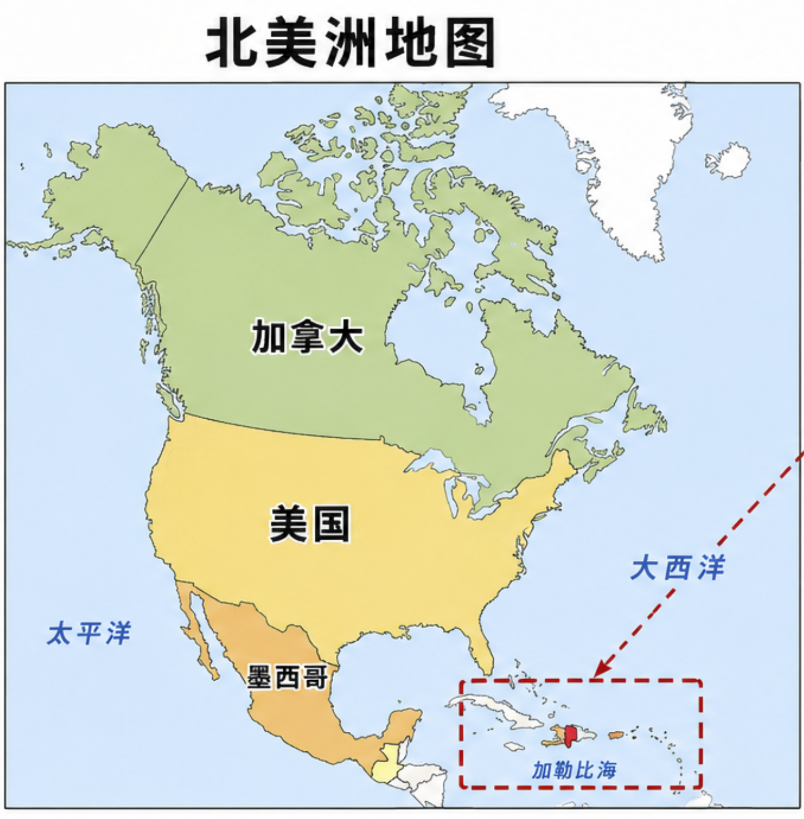
海地（Haiti，北美洲加勒比地区）是一个以基督教为主的国家，约80%的人口自称为基督徒，但许多人同时将基督教信仰与伏都教（Vodou）传统混合实践。近年来，海地因帮派暴力、绑架、高谋杀率、政治不稳及经济困难等问题，整体治安状况较差。
Haiti (in the Caribbean region of North America)** is a predominantly Christian country, with approximately **80% of the population identifying as Christians**. However, many people practise a mixture of Christianity and **Vodou traditions.Haiti has faced serious security problems due to gang violence, kidnappings, a high murder rate, political instability, and economic hardship. As a result, the country’s overall security situation remains poor.

Slide 6
4.淫乱的人哪，你们不知道与世俗为友，就是与神为敌吗？所以与世俗为友的，就成了神的仇敌。
4.You adulterous people! Do you not know that friendship with the world is enmity with God? Therefore whoever wishes to be a friend of the world makes himself an enemy of God.

Slide 7
01
什么是与世俗为友？
What Does It Mean to Be a Friend of the World?

Slide 8
【A】道德观（什么是对与错？）
[A] Morality (What is right and wrong?)
【B】价值观（生命中什么是重要的？）
[B] Values (What is truly important in life?)
【C】世界观 (我们如何理解这世界)
[C] Worldview (How do we understand the world?)

Slide 9
雅 4:1.你们中间的争执和打斗是从哪里来的呢？不是从你们肢体中好斗的私欲来的吗？2.你们放纵贪欲，如果得不到，就杀人；你们嫉妒，如果一无所得，就打斗争执。你们得不到，因为你们不求；3.你们求也得不到，因为你们的动机不良，要把所得的耗费在你们的私欲上。4.淫乱的人哪，你们不知道与世俗为友，就是与神为敌吗？所以与世俗为友的，就成了神的仇敌。
James 4:1 .What causes quarrels and what causes fights among you? Is it not this, that your passions are at war within you? 2.You desire and do not have, so you murder. You covet and cannot obtain, so you fight and quarrel. You do not have, because you do not ask.3.You ask and do not receive, because you ask wrongly, to spend it on your passions.4.You adulterous people! Do you not know that friendship with the world is enmity with God? Therefore whoever wishes to be a friend of the world makes himself an enemy of God.

Slide 10
02
世界观出来问题 (如何理解世界)
A Distorted Worldview (How do we understand the world?)

Slide 11
4.淫乱的人哪，你们不知道与世俗为友，就是与神为敌吗？所以与世俗为友的，就成了神的仇敌。
4.You adulterous people! Do you not know that friendship with the world is enmity with God? Therefore whoever wishes to be a friend of the world makes himself an enemy of God.

Slide 12
4.淫乱的人哪，你们不知道与世俗为友，就是与神为敌吗？所以与世俗为友的，就成了神的仇敌。5.圣经说：“神爱他那安置在我们里面的灵 ，爱到嫉妒的地步”，你们想这话是徒然的吗？6.但神所赐的恩更大；所以圣经上说：“ 神抵挡骄傲的人，赐恩给谦卑的人。”7.你们应当顺服神，抵挡魔鬼，魔鬼就逃避你们。8.你们应当亲近神，神就亲近你们。罪人啊，要洁净你们的手；三心两意的人哪，要清洁你们的心。
James 4:4.You adulterous people! Do you not know that friendship with the world is enmity with God? Therefore whoever wishes to be a friend of the world makes himself an enemy of God. 5.Or do you suppose it is to no purpose that the Scripture says, "He yearns jealously over the spirit that he has made to dwell in us"?6.But he gives more grace. Therefore it says, "God opposes the proud but gives grace to the humble."7.Submit yourselves therefore to God. Resist the devil, and he will flee from you.8.Draw near to God, and he will draw near to you. Cleanse your hands, you sinners, and purify your hearts, you double-minded.

Slide 13
03
基督徒为什么不可与世俗为友？
Why Must Christians Not Pursue Friendship with the World?

Slide 14
5.圣经说：“神爱他那安置在我们里面的灵 ，爱到嫉妒的地步”，你们想这话是徒然的吗？
James 4:5.Or do you suppose it is to no purpose that the Scripture says, "He yearns jealously over the spirit that he has made to dwell in us"?

Slide 15



8.你们应当亲近神，神就亲近你们。
世俗
world
8.Draw near to God, and he will draw near to you.

