Slide 1
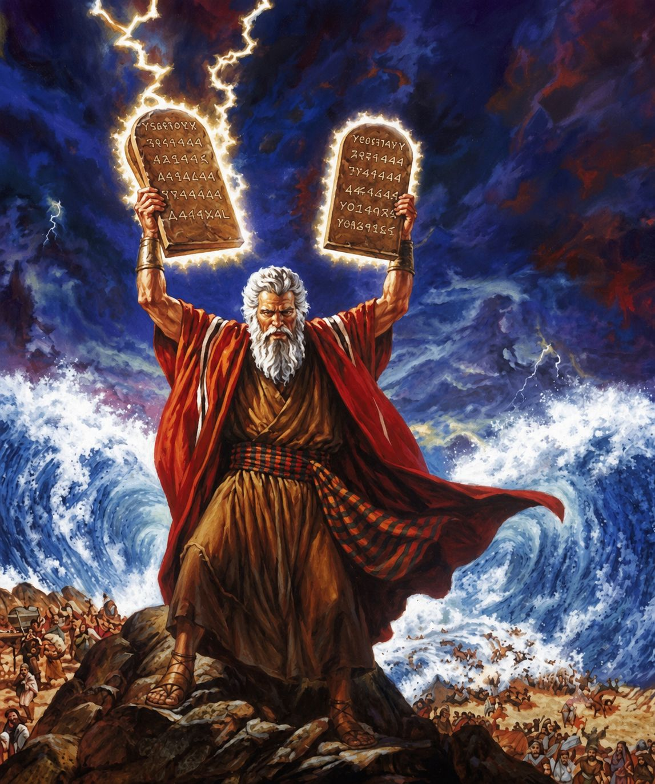
十诫
Ten Commandments
  十诫：关乎人的诫命 （第三讲完）
  出20章1至17
  The Ten Commandments: Commandments Concerning Human Relationships (Part 3)

Slide 2




Slide 3
12 「当孝敬父母，使你的日子在耶和华你神所赐你的地上得以长久。13 「不可杀人。14 「不可奸淫。15 「不可偷盗。16 「不可作假见证陷害人。17 「不可贪恋人的房屋；也不可贪恋人的妻子、仆婢、牛驴，并他一切所有的。」
12 “Honor your father and your mother, that your days may be long in the land that the LORD your God is giving you.13 “You shall not murder.14 “You shall not commit adultery.15 “You shall not steal.16 “You shall not bear false witness against your neighbor.17 “You shall not covet your neighbor's house; you shall not covet your neighbor's wife, or his male servant, or his female servant, or his ox, or his donkey, or anything that is your neighbor's.”

Slide 4
加 5:14
因为全律法都包在「爱人如己」这一句话之内了。
Galatians 5:14.
For the whole law is fulfilled in one word: "You shall love your neighbor as yourself."

Slide 5
01
第五诫：孝敬父母
The Fifth Commandment: Honor Your Father and Mother

Slide 6
弗 6:3.
要孝敬父母，使你得福，在世长寿。这是第一条带应许的诫命。
Ephesians 6:
2."Honor your father and mother" (this is the first commandment with a promise),3."that it may go well with you and that you may live long in the land."

Slide 7
02
第六诫：不可杀人
The Sixth Commandment: You Shall Not Murder

Slide 8
太5:21 你们听见有吩咐古人的话，说：『不可杀人』；又说：『凡杀人的难免受审判。』22 只是我告诉你们：凡向弟兄动怒的，难免受审判；凡骂弟兄是拉加 ῥακά 的，难免公会的审断；凡骂弟兄是魔利mōros 的，难免地狱的火。
Matthew 5:21.
"You have heard that it was said to those of old, 'You shall not murder; and whoever murders will be liable to judgment.' 22.But I say to you that everyone who is angry with his brother will be liable to judgment; whoever insults his brother will be liable to the council; and whoever says, 'You fool!' will be liable to the hell of fire.

Slide 9
约壹3:15 凡恨他弟兄的，就是杀人的；...
1 John 3:15.Everyone who hates his brother is a murderer, ...

Slide 10
03
第七诫：不可奸淫。
The Seventh Commandment: You Shall Not Commit Adultery.

Slide 11
太 5:27你们听见有话说：『不可奸淫。』28 只是我告诉你们，凡看见妇女就动淫念的，这人心里已经与他犯奸淫了。
Mat 5:27 “You have heard that it was said, ‘You shall not commit adultery.’28 But I say to you that everyone who looks at a woman with lustful intent has already committed adultery with her in his heart.

Slide 12
04
第八戒：不可偷盗
The Eighth Commandment: You Shall Not Steal

Slide 13
05
第九诫：不可作假见证陷害人
The Ninth Commandment: You Shall Not Bear False Witness Against Your Neighbor

Slide 14
06
第十诫：不可贪恋人一切所有的
The Tenth Commandment: You Shall Not Covet

Slide 15
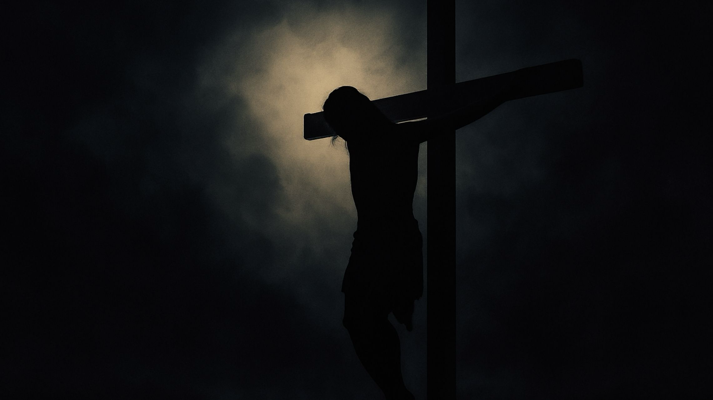
赛 53:6
...耶和华使我们众人的罪孽都归在他身上。
Isa 53:5 But he was pierced for our transgressions; he was crushed for our iniquities; ...

Slide 16
加 5:14
因为全律法都包在「爱人如己」这一句话之内了。
Galatians 5:14.
For the whole law is fulfilled in one word: "You shall love your neighbor as yourself."

Slide 17

