Slide 1
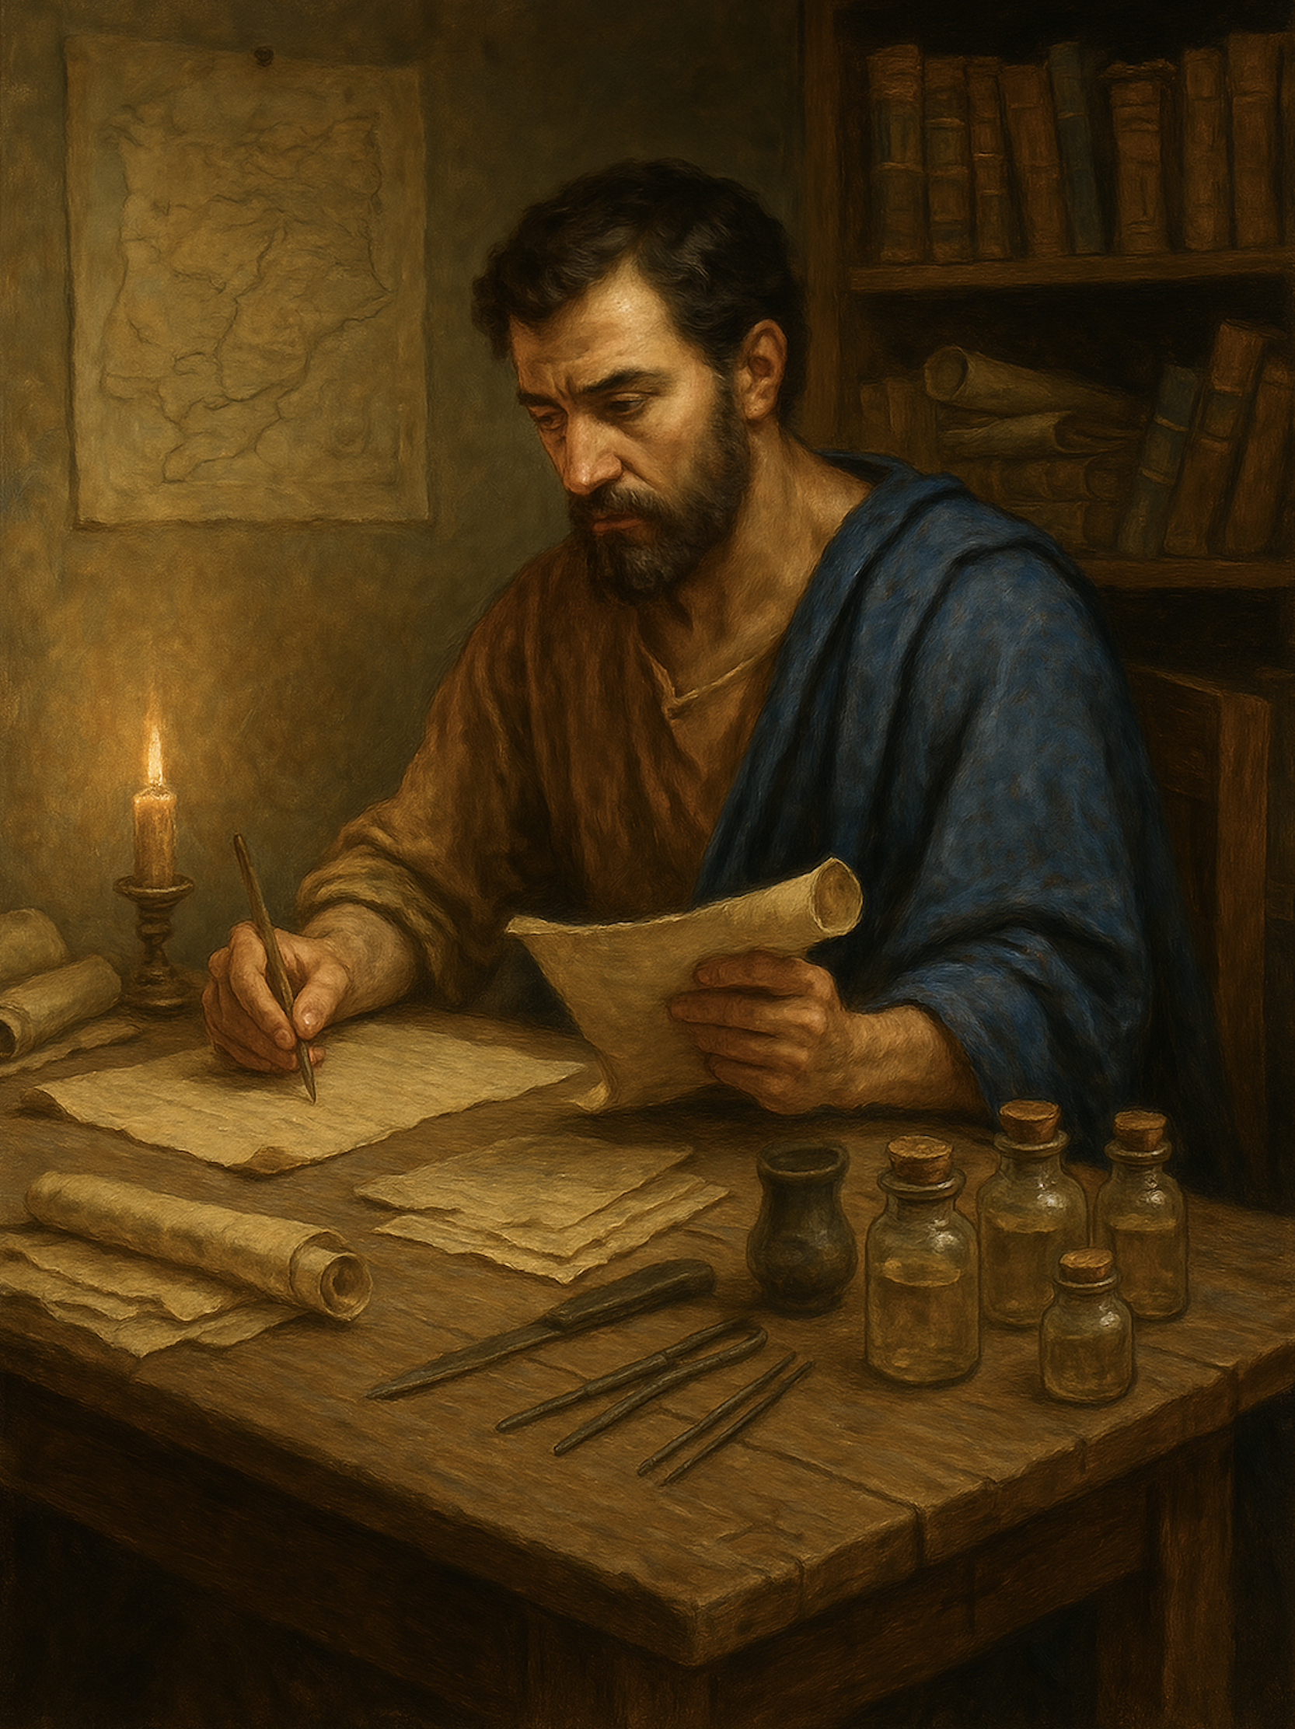
路加福音 Gospel of Luke
03 神使用卑微者，成就祂的应许
路1章39至56
God accomplishes His promises through the lowly

Slide 2
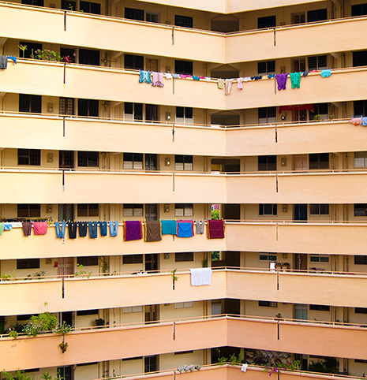

Slide 3
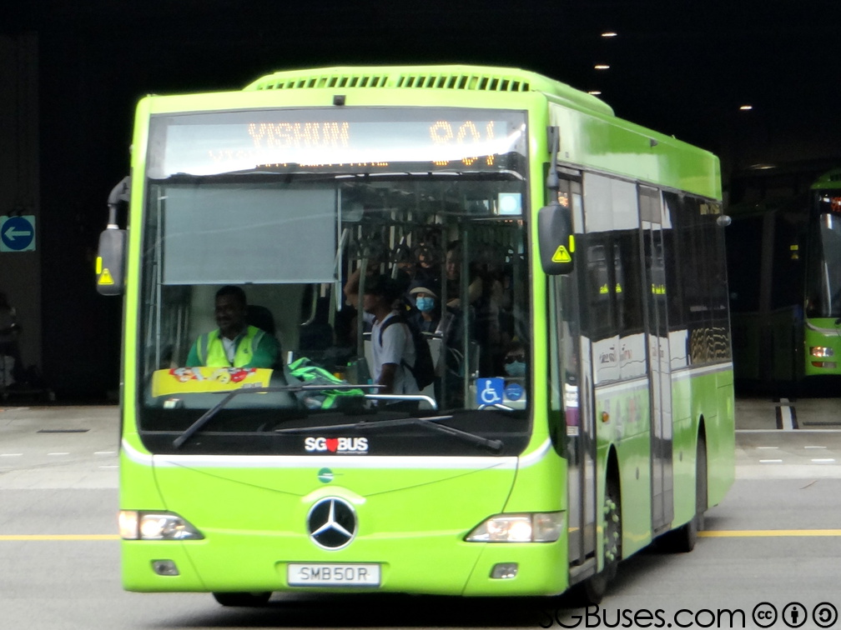
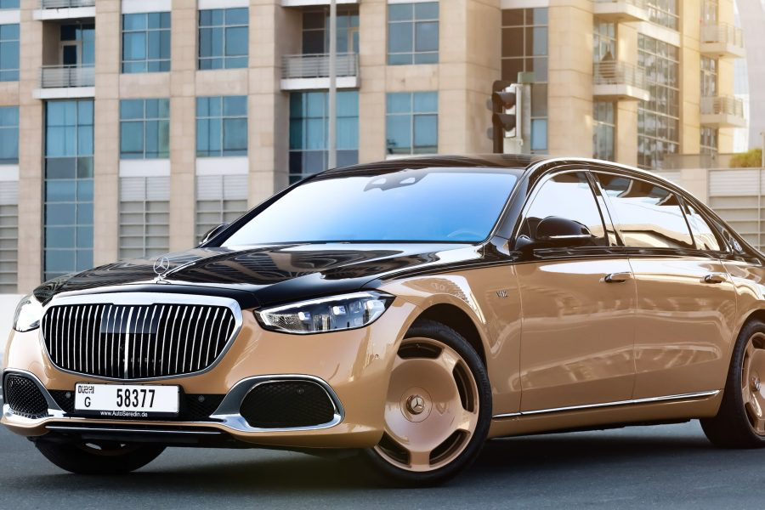
奔驰 Mercedes
奔驰 Mercedes

Slide 4
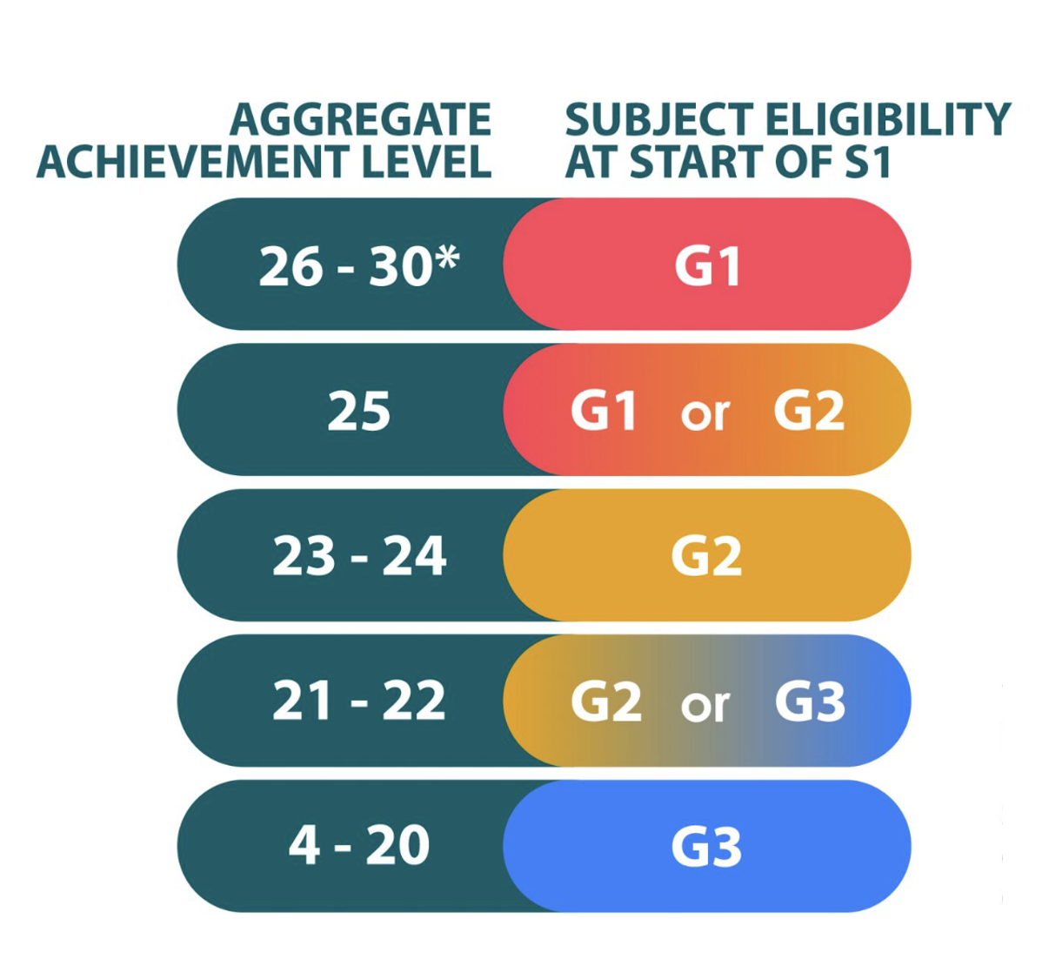
新加坡的小六会考（PSLE）

Slide 5
路1:39.后来，马利亚就起身，急忙向山地去，来到犹大的一座城，40.进了撒迦利亚的家，向以利沙伯问安。41.以利沙伯一听见马利亚的问安，腹中的胎儿就跳动，以利沙伯也被圣灵充满，42.就高声说：“你在女子中是有福的！你腹中的胎儿也是有福的！43.我主的母亲竟然到我这里来。这事怎会临到我呢？44.你看，你问安的声音一进我的耳朵，我腹中的胎儿就欢喜跳跃。45.这相信主传给她的话必要成就的女子是有福的。”
Luke 1:39.In those days Mary arose and went with haste into the hill country, to a town in Judah,40.and she entered the house of Zechariah and greeted Elizabeth.41.And when Elizabeth heard the greeting of Mary, the baby leaped in her womb. And Elizabeth was filled with the Holy Spirit,42.and she exclaimed with a loud cry, "Blessed are you among women, and blessed is the fruit of your womb!43.And why is this granted to me that the mother of my Lord should come to me?44.For behold, when the sound of your greeting came to my ears, the baby in my womb leaped for joy.45.And blessed is she who believed that there would be a fulfilment of what was spoken to her from the Lord."
1/3

Slide 6
46.马利亚说：“我心尊主为大，47.我灵以神我的救主为乐，48.因为他垂顾他婢女的卑微，看哪！今后万代都要称我为有福。49.全能者为我行了大事，他的名为圣；50.他的怜悯世世代代归与敬畏他的人。51.他用膀臂施展大能，驱散心里妄想的狂傲人。52.他使有权能的失位，叫卑微的升高，53.让饥饿的得饱美食，使富足的空手回去。
46.And Mary said, "My soul magnifies the Lord,47.and my spirit rejoices in God my Savior,48.for he has looked on the humble estate of his servant. For behold, from now on all generations will call me blessed;49.for he who is mighty has done great things for me, and holy is his name.50.And his mercy is for those who fear him from generation to generation.51.He has shown strength with his arm; he has scattered the proud in the thoughts of their hearts;52.he has brought down the mighty from their thrones and exalted those of humble estate;53.he has filled the hungry with good things, and the rich he has sent away empty.
2/3

Slide 7
54.他扶助了他的仆人以色列，为要记念他的怜悯，55.正如他向我们列祖所说的，恩待亚伯拉罕和他的后裔，直到永远。”56.马利亚和以利沙伯同住约有三个月，就回家去了。
54.He has helped his servant Israel, in remembrance of his mercy,55.as he spoke to our fathers, to Abraham and to his offspring forever."56.And Mary remained with her about three months and returned to her home.
3/3

Slide 8
01
腹中的胎儿听见就欢喜跳跃
Upon hearing the greeting, the child in the womb leaped with joy

Slide 9
路1:39.后来，马利亚就起身，急忙向山地去，来到犹大的一座城，40.进了撒迦利亚的家，向以利沙伯问安。
Luke 1:39.In those days Mary arose and went with haste into the hill country, to a town in Judah,40.and she entered the house of Zechariah and greeted Elizabeth.

Slide 10
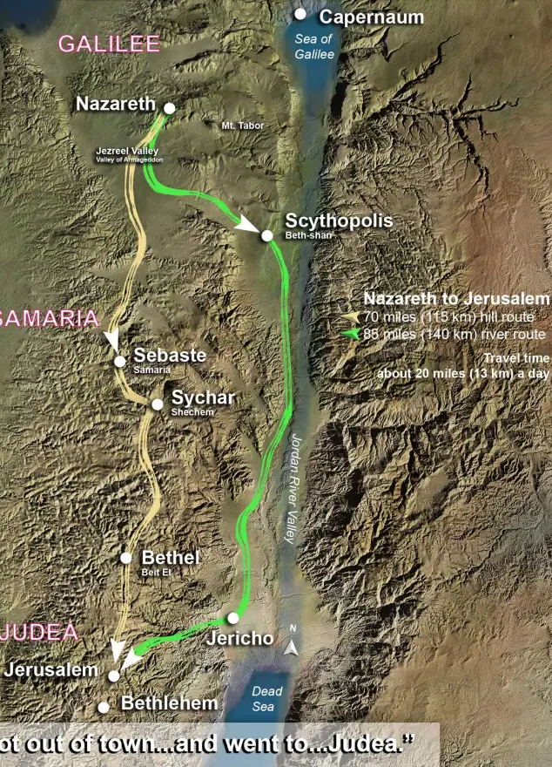
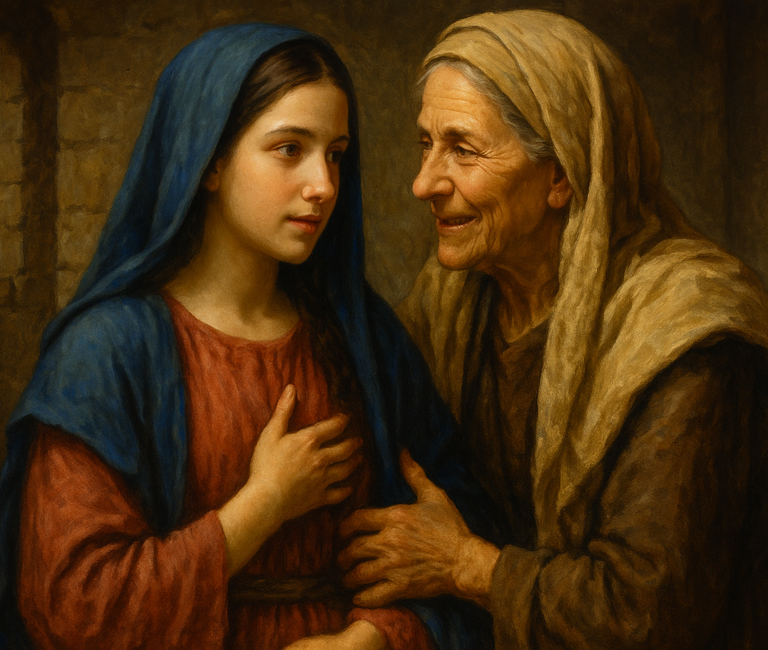
约14岁
拿撒勒
步行大概3天
约100km
约50-60岁
犹大地区

Slide 11
41.以利沙伯一听见马利亚的问安，腹中的胎儿就跳动，以利沙伯也被圣灵充满，。。。44.你看，你问安的声音一进我的耳朵，我腹中的胎儿就欢喜跳跃。
41.And when Elizabeth heard the greeting of Mary, the baby leaped in her womb. And Elizabeth was filled with the Holy Spirit,... 44.For behold, when the sound of your greeting came to my ears, the baby in my womb leaped for joy.

Slide 12
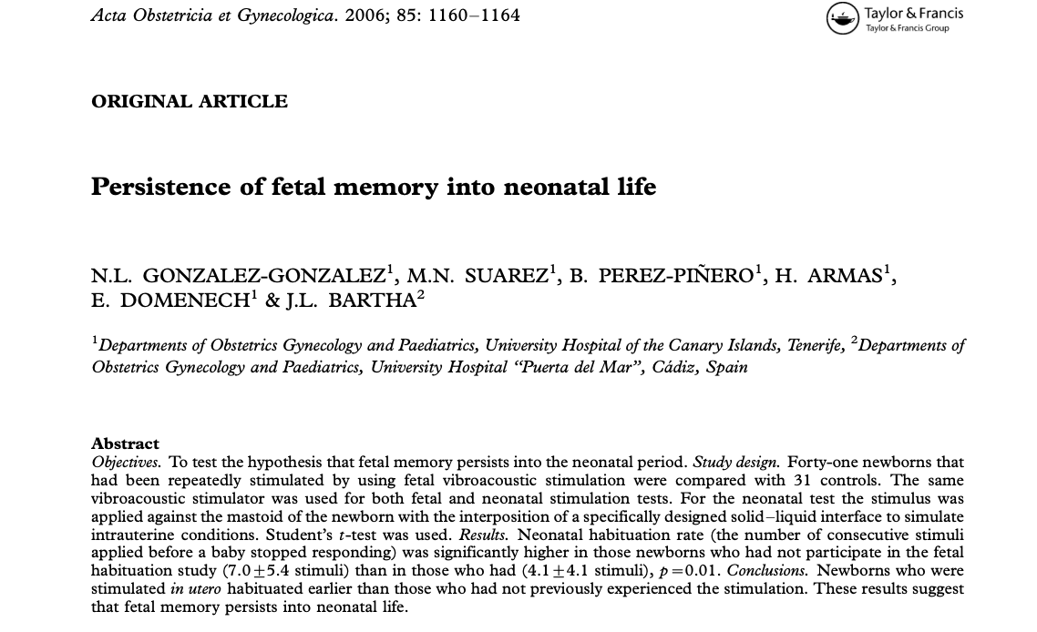
胎儿时期的记忆,延续至新生儿期

Slide 13
02
以利沙伯被圣灵充满而发出预言
Elizabeth, being filled with the Holy Spirit, declared a prophetic message.

Slide 14
41....以利沙伯也被圣灵充满，42.就高声说：“你在女子中是有福的！你腹中的胎儿也是有福的！
41....And Elizabeth was filled with the Holy Spirit, 42.and she exclaimed with a loud cry, "Blessed are you among women, and blessed is the fruit of your womb!

Slide 15
43.我主的母亲竟然到我这里来。这事怎会临到我呢？
43.And why is this granted to me that the mother of my Lord should come to me?

Slide 16
45.
这相信主传给她的话必要成就的女子是有福的。
45.And blessed is she who believed that there would be a fulfilment of what was spoken to her from the Lord."

Slide 17
03
颂赞神顾念卑微之人
Blessed be the God who does not forget the lowly

Slide 18
46.马利亚说：“我心尊主为大，47.我灵以 神我的救主为乐，48.因为他垂顾他婢女的卑微，看哪！今后万代都要称我为有福。49.全能者为我行了大事，他的名为圣；
46.And Mary said, "My soul magnifies the Lord,47.and my spirit rejoices in God my Savior,48.for he has looked on the humble estate of his servant. For behold, from now on all generations will call me blessed;49.for he who is mighty has done great things for me, and holy is his name.

Slide 20
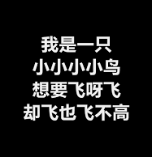
1990年

Slide 21
林前1:26.弟兄们，你们想想，你们这些蒙召的，按人来看有智慧的不多，有权势的不多，出身尊贵的也不多。27.但是神却拣选了世上愚笨的，使那些有智慧的羞愧。他也拣选了世上软弱的，使那些刚强的羞愧。28.他也拣选了世上卑贱的和被人轻视的，以及算不得甚么的，为了要废弃那些自以为是的，29.使所有的人在 神面前都不能自夸。
1 Corinthians 1:26. For consider your calling, brothers: not many of you were wise according to worldly standards, not many were powerful, not many were of noble birth.27.But God chose what is foolish in the world to shame the wise; God chose what is weak in the world to shame the strong;28.God chose what is low and despised in the world, even things that are not, to bring to nothing things that are,29.so that no human being might boast in the presence of God.

Slide 22
49.全能者为我行了大事，他的名为圣；50.他的怜悯世世代代归与敬畏他的人。
49.for he who is mighty has done great things for me, and holy is his name.50.And his mercy is for those who fear him from generation to generation.

Slide 23
雅 4:10.
你们务要在主面前谦卑，他就使你们高升。
James 4:10.
Humble yourselves before the Lord, and he will exalt you.

Slide 24
04
三大势力： 狂傲的、权能的、富足的
The Proud, the Powerful, and the Prosperous: Three Forces That dominates

Slide 25
51.他用膀臂施展大能，驱散心里妄想的狂傲人。52.他使有权能的失位，叫卑微的升高，53.让饥饿的得饱美食，使富足的空手回去。
51.He has shown strength with his arm; he has scattered the proud in the thoughts of their hearts;52.he has brought down the mighty from their thrones and exalted those of humble estate;53.he has filled the hungry with good things, and the rich he has sent away empty.

Slide 26
有权能的
The Mighty
世界的
三大势力
狂傲的
The Proud
财富的
The Rich
The Three Dominant Forces in the World

Slide 27
05
歌颂神记念祂的约
Sing praise to God who remembers His covenant

Slide 28
54.他扶助了他的仆人以色列，为要记念他的怜悯，55.正如他向我们列祖所说的，恩待亚伯拉罕和他的后裔，直到永远。”56.马利亚和以利沙伯同住约有三个月，就回家去了。
54.He has helped his servant Israel, in remembrance of his mercy,55.as he spoke to our fathers, to Abraham and to his offspring forever."56.And Mary remained with her about three months and returned to her home.

Slide 29
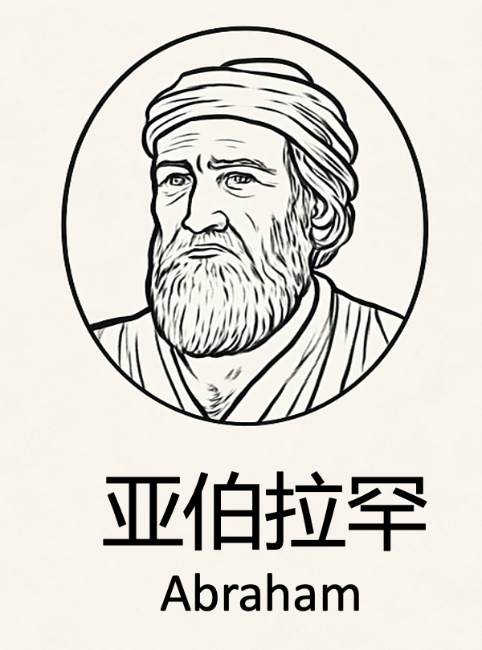
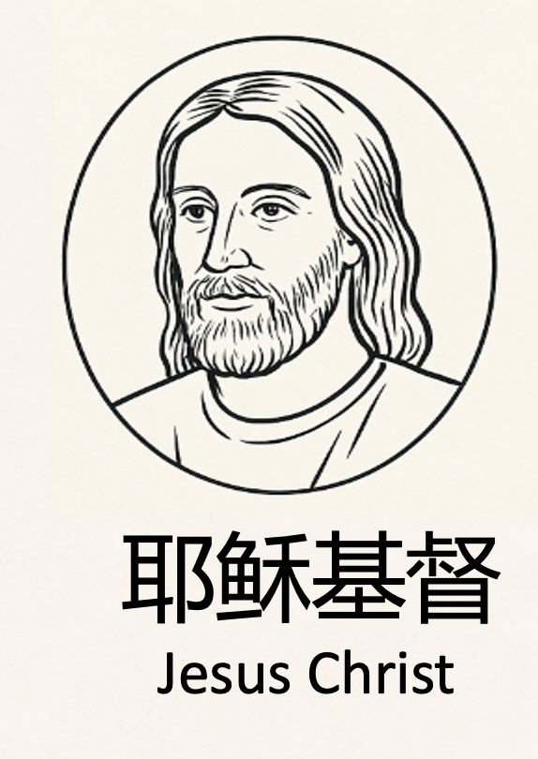
神纪念祂与亚伯拉罕的约
(创12:3、加3:8; 创15:6、罗4:3；创22:18、加3:16、加12:7)
约 2000 年
God remembers His covenant with Abraham (Gen. 12:3; Gal. 3:8; Gen. 15:6; Rom. 4:3;
Gen. 22:18; Gal. 3:16; Gal. 3:7)

Slide 30
55.正如他向我们列祖所说的，恩待亚伯拉罕和他的后裔，直到永远。”
55.as he spoke to our fathers, to Abraham and to his offspring forever."

Slide 31
加 3:7.
所以你们要知道，有信心的人，就是亚伯拉罕的子孙。
Galatians 3:7.
Know then that it is those of faith who are the sons of Abraham.

Slide 32
加3:29.
如果你们属于基督，就是亚伯拉罕的后裔，是按照应许承受产业的了。
Galatians 3:29.
And if you are Christs, then you are Abrahams offspring, heirs according to promise.

Slide 33
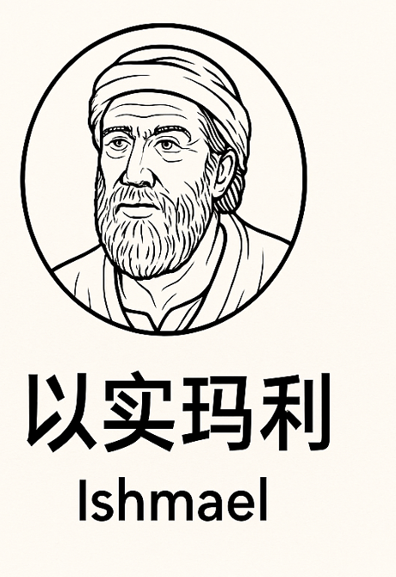
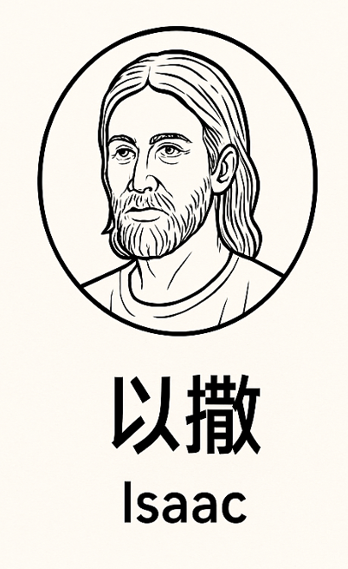
拣选
从来都不是按肉身的！
Election was never according to the flesh!
蒙应许拣选的
(创17:19、罗9:8)
Those who are chosen and called according to the promise

Slide 34
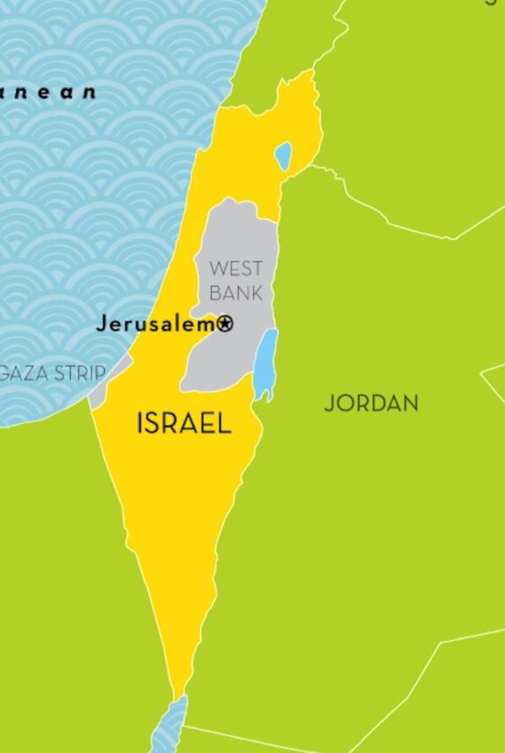
悖逆顽梗
不信主的以色列
信主的教会
（以色列）
蒙应许拣选的
(创17:19、罗9:8)
Those who are chosen and called according to the promise
Rebellious and stubborn,
Israel who does not believe in the Lord
The Church that believes in the Lord (Israel)

Slide 35
加3:29.
如果你们属于基督，就是亚伯拉罕的后裔，是按照应许承受产业的了。
Galatians 3:29.
And if you are Christs, then you are Abrahams offspring, heirs according to promise.

