Slide 1
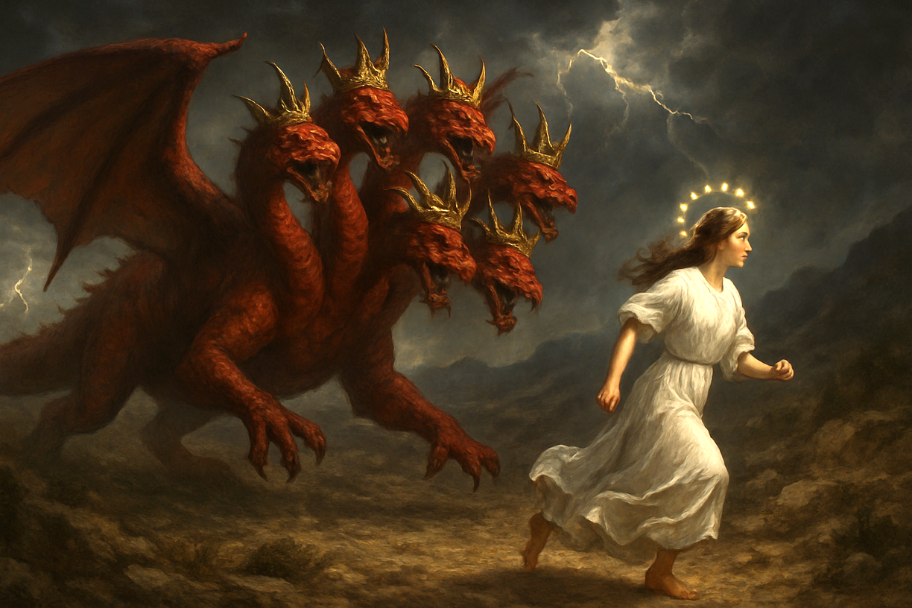

031 大红龙在地上的争战
启示录12章12至17
The Great Red Dragon’s war on earth.

Slide 2
撒旦（魔鬼）
Satan (Devil)
苦难
evil & Suffering
罪恶的世界
Sinful World
有罪的自己
The sinful self
地受了咒诅
Land is cursed

Slide 3
创造者三一神
Creator Triune God
空中掌权者
the power of the air
天使 Angels
被造的世界
Created world
人 Humans
动物植物 Animals and Plants

Slide 4
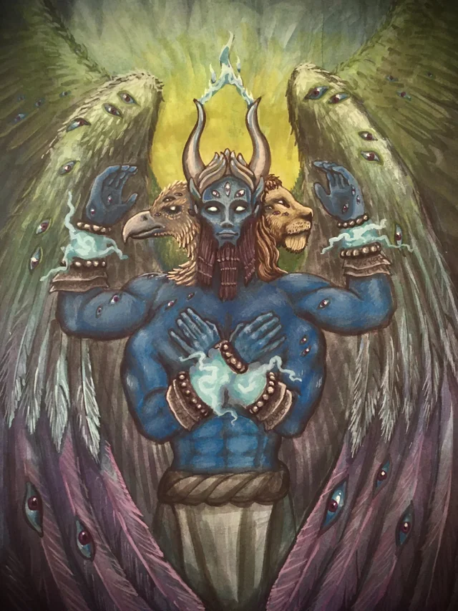
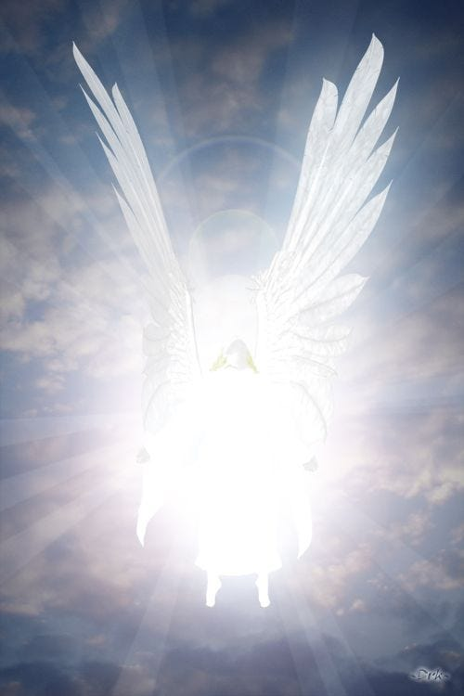
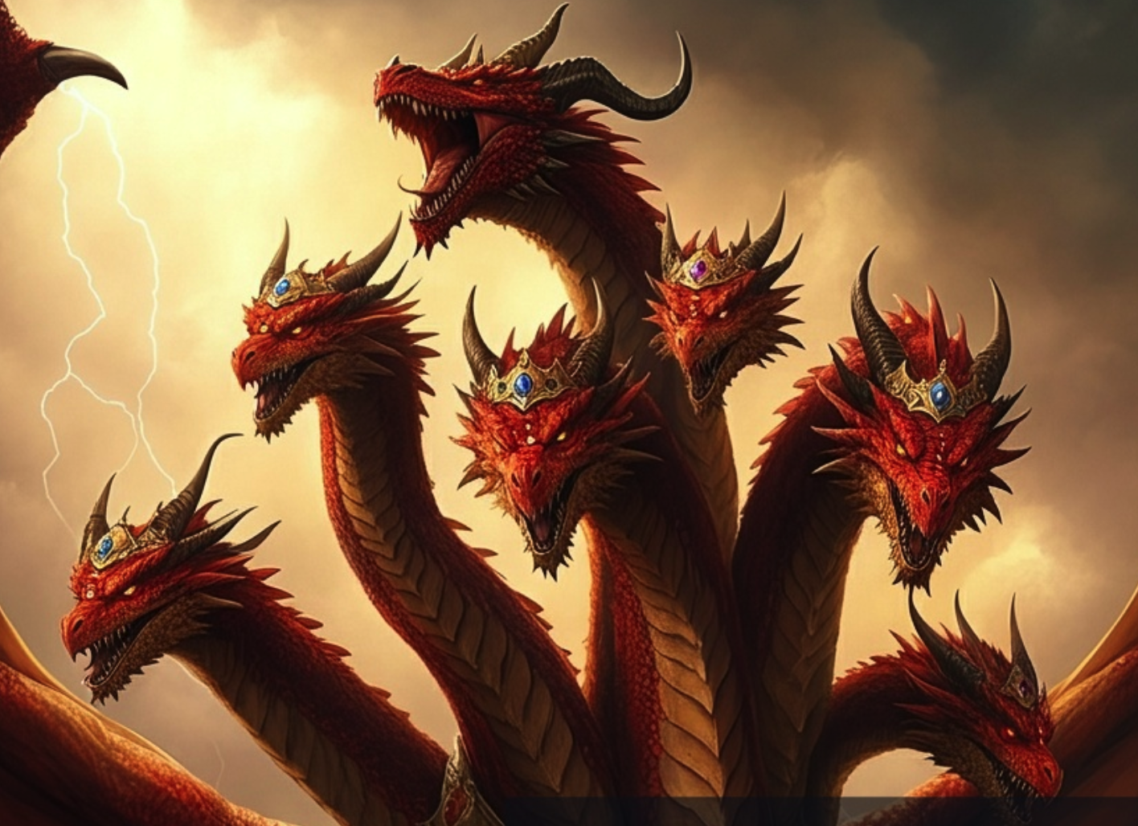
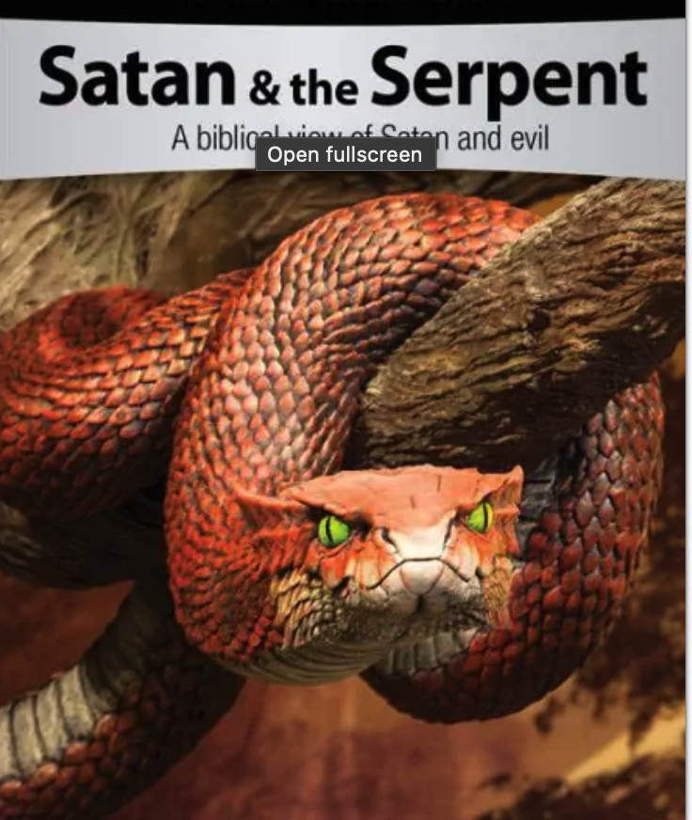
空中掌权者的首领
the prince of the power of the air
七头十角大红龙
（启 12:3
great red dragon with seven heads and ten horns
(Rev 12:3).
伊甸园的蛇
（创3:1）
Serpent in the Garden of Eden
(Gen 3:1).
基路伯
（结 28:14）
Guardian cheru
(Ezk 28:14).
光明天使
(林后11:14)）
Angel of light
(2Corin11:14).

Slide 5
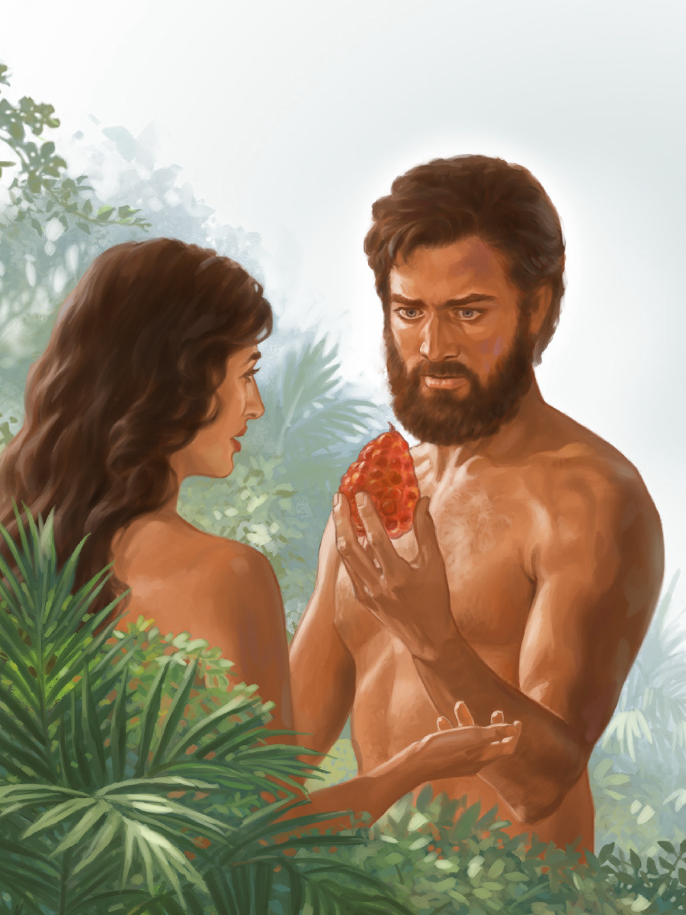
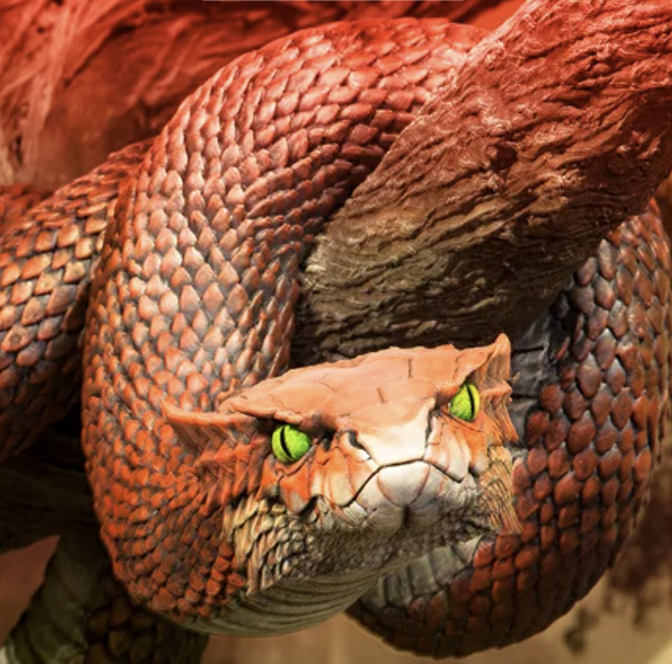
撒旦
欺骗夏娃、
诱惑亚当
Satan deceive eve,
and tempted Adam

Slide 6
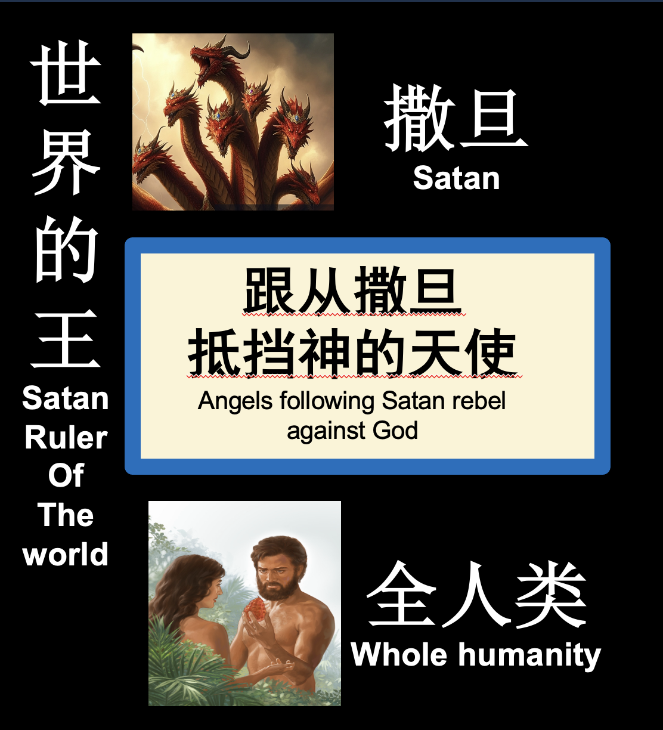

三一神
Creator Triune God
顺服神的天使 Angels in obedience to God
基督救赎的百姓
People Whom Christ has redeemed

Slide 7
重温之前的两讲信息
Revisit the content of the previous two messages

Slide 8

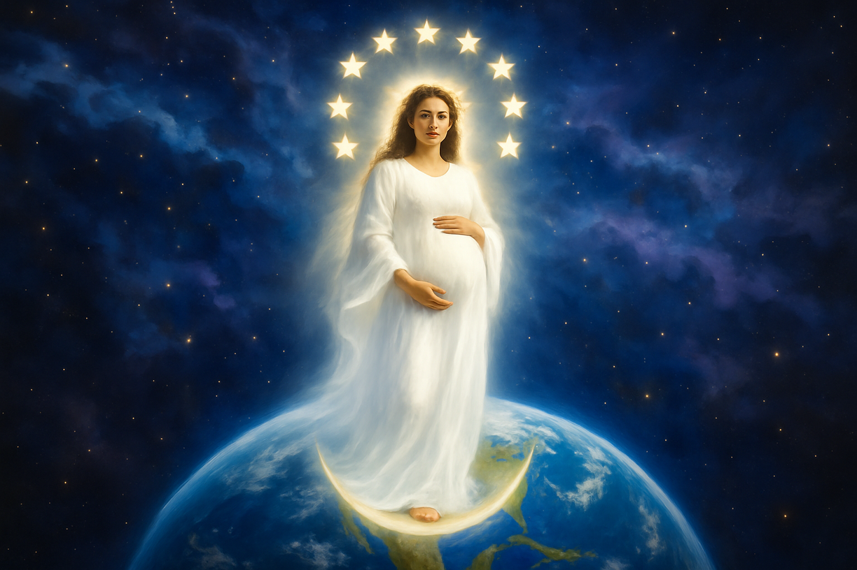
她怀了孕生下了基督。
She was pregnant and gave birth to Christ

Slide 9
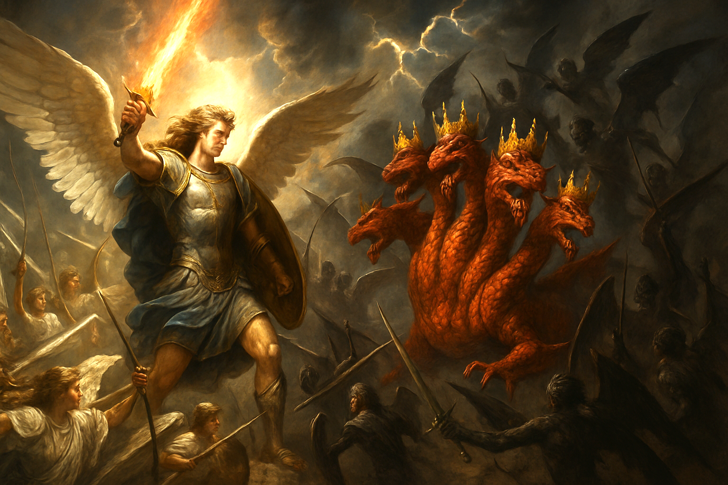
天使长米迦勒与魔鬼征战
The archangel Michael waged war against the devil.

Slide 10
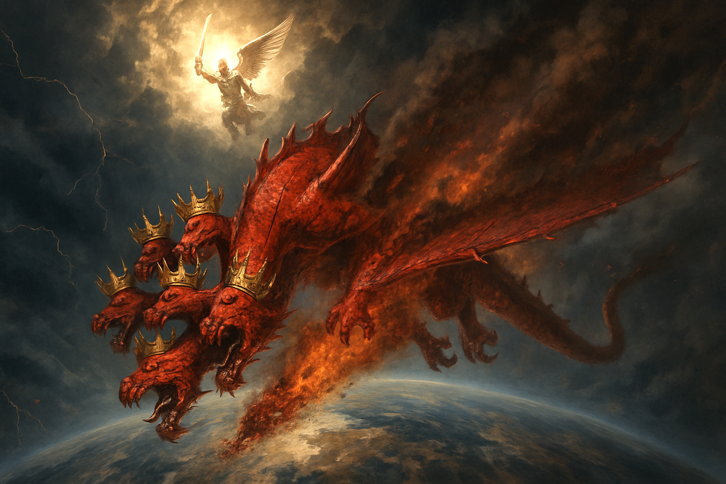
天使长米迦勒把魔鬼赶出天庭
The archangel Michael drove Satan out of heaven.

Slide 11
启12:12.所以，诸天和住在其中的，你们都快乐吧！只是地与海有祸了！因为魔鬼知道自己的时候不多，就气忿忿地下到你们那里去了。」13.龙见自己被摔在地上，就逼迫那生男孩子的妇人。14.于是有大鹰的两个翅膀赐给妇人，叫她能飞到旷野，到自己的地方，躲避那蛇；她在那里被养活一载二载半载。15.蛇就在妇人身后，从口中吐出水来，像河一样，要将妇人冲去。16.地却帮助妇人，开口吞了从龙口吐出来的水。17.龙向妇人发怒，去与她其余的儿女争战，这儿女就是那守神诫命、为耶稣作见证的。18.那时龙就站在海边的沙上。
Rev 12:12.Therefore, rejoice, O heavens and you who dwell in them! But woe to you, O earth and sea, for the devil has come down to you in great wrath, because he knows that his time is short!"13.And when the dragon saw that he had been thrown down to the earth, he pursued the woman who had given birth to the male child.14.But the woman was given the two wings of the great eagle so that she might fly from the serpent into the wilderness, to the place where she is to be nourished for a time, and times, and half a time.15.The serpent poured water like a river out of his mouth after the woman, to sweep her away with a flood.16.But the earth came to the help of the woman, and the earth opened its mouth and swallowed the river that the dragon had poured from his mouth.17.Then the dragon became furious with the woman and went off to make war on the rest of her offspring, on those who keep the commandments of God and hold to the testimony of Jesus. And he stood on the sand of the sea.

Slide 12
魔鬼气忿着急，他尝试消灭妇人（教会）
01
The devil, filled with fury, tried to destroy the woman (the Church).

Slide 13
启12:12.
所以，诸天和住在其中的，你们都快乐吧！只是地与海有祸了！因为魔鬼知道自己的时候不多，就气忿忿地下到你们那里去了。」13.龙见自己被摔在地上，就逼迫那生男孩子的妇人。
Rev 12:12.Therefore, rejoice, O heavens and you who dwell in them! But woe to you, O earth and sea, for the devil has come down to you in great wrath, because he knows that his time is short!"13.And when the dragon saw that he had been thrown down to the earth, he pursued the woman who had given birth to the male child.

Slide 14
13.龙见自己被摔在地上，就逼迫那生男孩子的妇人。
13.And when the dragon saw that he had been thrown down to the earth, he pursued the woman who had given birth to the male child.

Slide 15
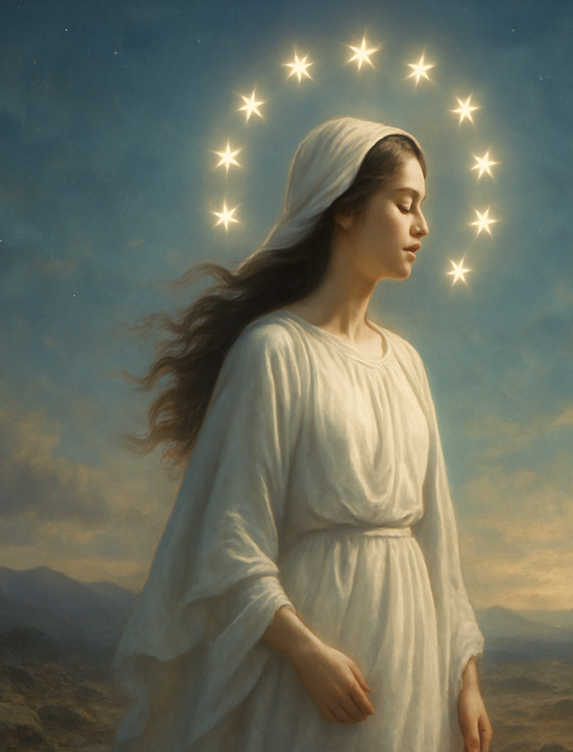
妇人预表：
教会/神子民
（从旧约延续到新约的圣徒群体）
也包括天上的教会
The woman symbolizes:
The Church / God’s people
(A covenant community of saints
from the Old Testament into the New Testament)
It also includes the Church in heaven.

Slide 16
旧约常比喻神的子民，为神的妻子
赛54:5-6、耶2:2、结16:8、何2:19-20
Old Testament often portrays God’s people as His wife
(Isa 54:5–6; Jer 2:2; Ezek 16:8; Hos 2:19–20)

Slide 17
教会在旷野中有神的保护
02
The Church in the wilderness remains under God's protection

Slide 18
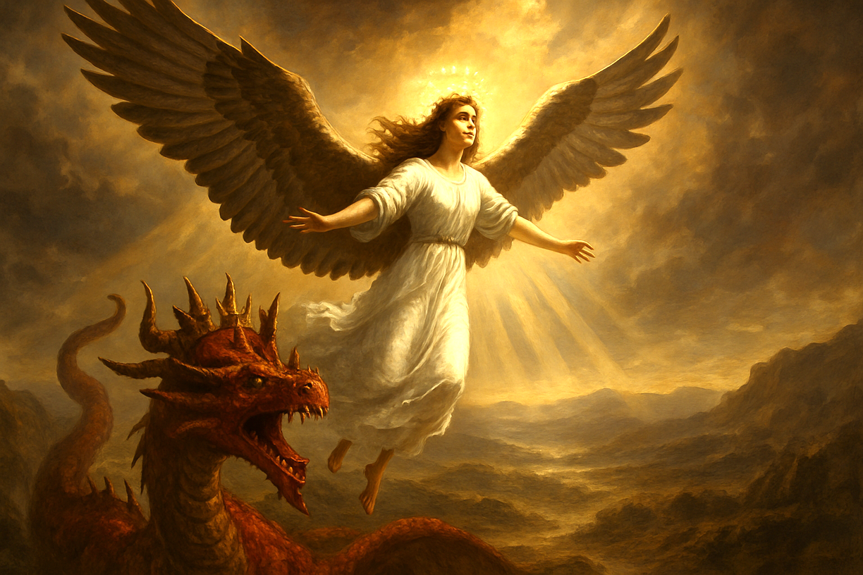
14 于是有大鹰的两个翅膀赐给妇人，叫她能飞到旷野，到自己的地方，躲避那蛇；她在那里被养活一载二载半载。
14.But the woman was given the two wings of the great eagle so that she might fly from the serpent into the wilderness, to the place where she is to be nourished for a time, and times, and half a time.

Slide 19
出19:4
我向埃及人所行的事，你们都看见了，且看见我如鹰将你们背在翅膀上，带来归我。
Exodus 19:4.
You yourselves have seen what I did to the Egyptians, and how I bore you on eagles wings and brought you to myself.

Slide 20
申 32:10.耶和华遇见他在旷野—荒凉野兽吼叫之地，就环绕他，看顾他，保护他，如同保护眼中的瞳人。11.又如鹰搅动巢cháo窝，在雏chú鹰以上两翅chì搧shān展，接取雏鹰，背在两翼之上。
Deuteronomy 32:10. "He found him in a desert land, and in the howling waste of the wilderness; he encircled him, he cared for him, he kept him as the apple of his eye.11.Like an eagle that stirs up its nest, that flutters over its young, spreading out its wings, catching them, bearing them on its pinions,

Slide 21
旧约
神的子民（教会）进入旷野
神如老鹰的翅膀
保护他们
新约
神的子民（教会）进入旷野
神赐教会鹰的翅膀
保护他们
In the Old Testament,
God’s people (the Church) entered the wilderness,
and God protected them like the wings of an eagle.
In the New Testament,
God’s people (the Church) entered the wilderness,
and God protected them and gave the wings of an eagle.

Slide 22
旧约
神的子民（教会）
进入旷野
等候进入
应许之地（迦南地）
新约
神的子民（教会）
进入旷野
等候进入
应许之地（新天新地）
In the Old Testament,
God’s people (the Church)
entered the wilderness,
waiting to enter
the Promised Land (the land of Canaan).
In the New Testament,
God’s people (the Church)
enter the wilderness,
waiting to enter
the Promised Land (the new heaven and new earth).

Slide 23
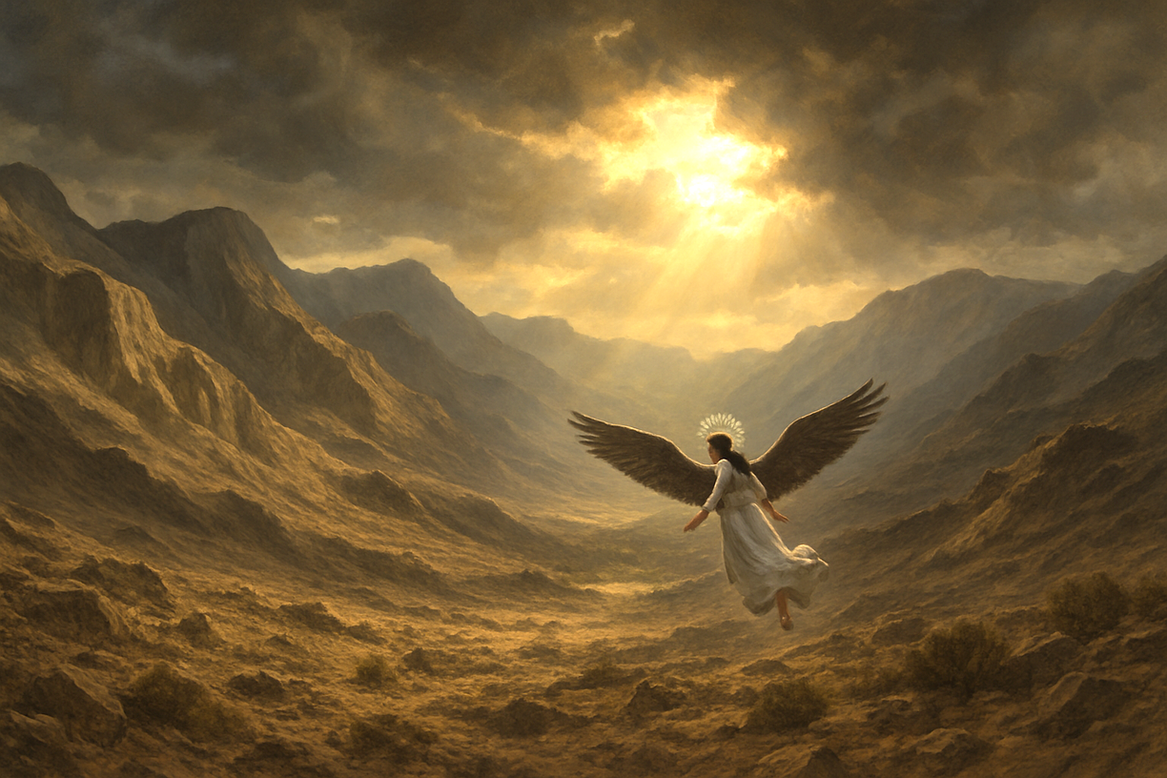
妇人象征着教会，进入了旷野之地。
The woman symbolizes the Church, who has entered the wilderness.

Slide 24
14.。。。躲避那蛇；她在那里被养活一载二载半载。
14...., to the place where she is to be nourished for a time, and times, and half a time.

Slide 25
启12:6 妇人就逃到旷野，在那里有神给他预备的地方，使他被养活一千二百六十天。 。。。。14。。。叫他能飞到旷野，到自己的地方，躲避那蛇；他在那里被养活一载二载半载。
Revelation 12:6.and the woman fled into the wilderness, where she has a place prepared by God, in which she is to be nourished for 1,260 days..........14........she might fly from the serpent into the wilderness, to the place where she is to be nourished for a time, and times, and half a time.

Slide 26
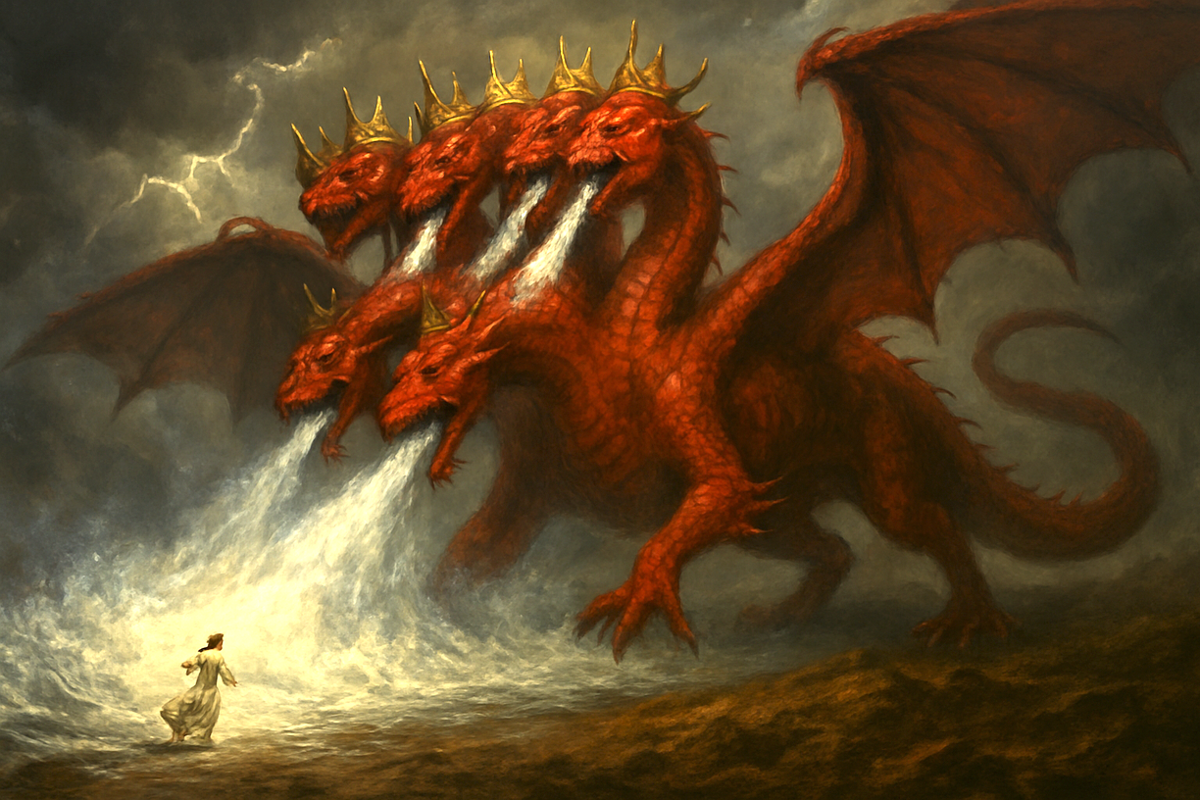
15.蛇就在妇人身后，从口中吐出水来，像河一样，要将妇人冲去。
15.The serpent poured water like a river out of his mouth after the woman, to sweep her away with a flood.

Slide 27
诗 69:1.
神啊，求你救我！因为众水要淹没我。2.我陷在深淤泥中，没有立脚之地；我到了深水中，大水漫过我身。
Psalms 69:1.Save me, O God! For the waters have come up to my neck.2.I sink in deep mire, where there is no foothold; I have come into deep waters, and the flood sweeps over me.

Slide 28
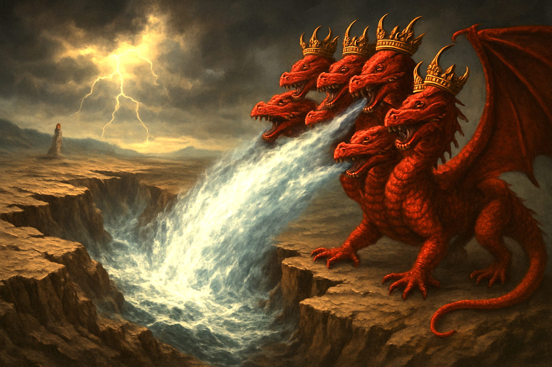
16.地却帮助妇人，开口吞了从龙口吐出来的水。
16.But the earth came to the help of the woman, and the earth opened its mouth and swallowed the river that the dragon had poured from his mouth.

Slide 29
新译本：赛51:9 耶和华的膀臂啊，醒来吧！醒来吧！穿上能力吧！像古时的日子，像上古的世代一样醒来吧！从前砍碎了拉哈伯，刺透了海龙【和合本:大鱼】的，不是你吗？10 使海，就是大渊的水干涸hé，使海的深处变为蒙救赎的人经过之路的，不是你吗？
Isaiah 51:9.Awake, awake, put on strength, O arm of the Lord; awake, as in days of old, the generations of long ago. Was it not you who cut Rahab in pieces, who pierced the dragon?10.Was it not you who dried up the sea, the waters of the great deep, who made the depths of the sea a way for the redeemed to pass over?

Slide 30
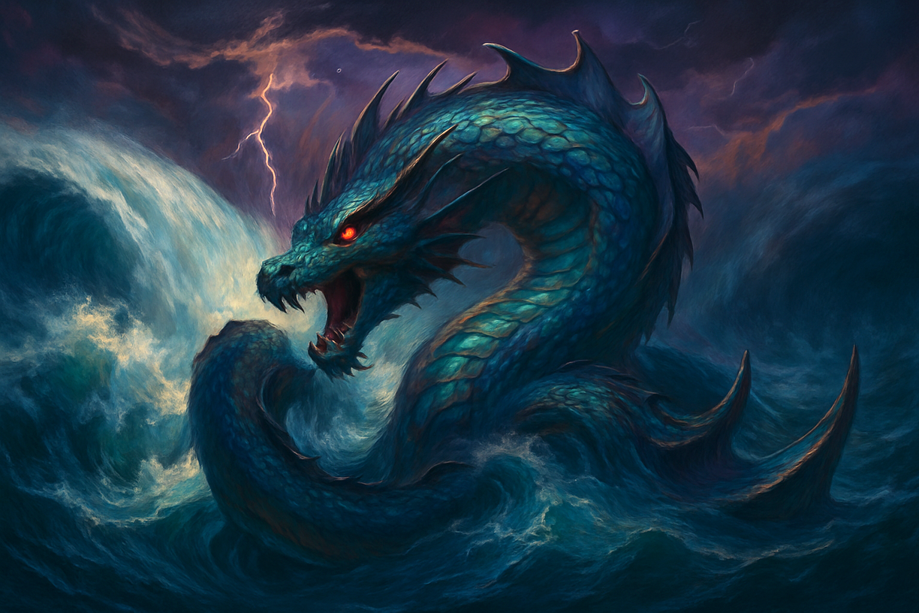
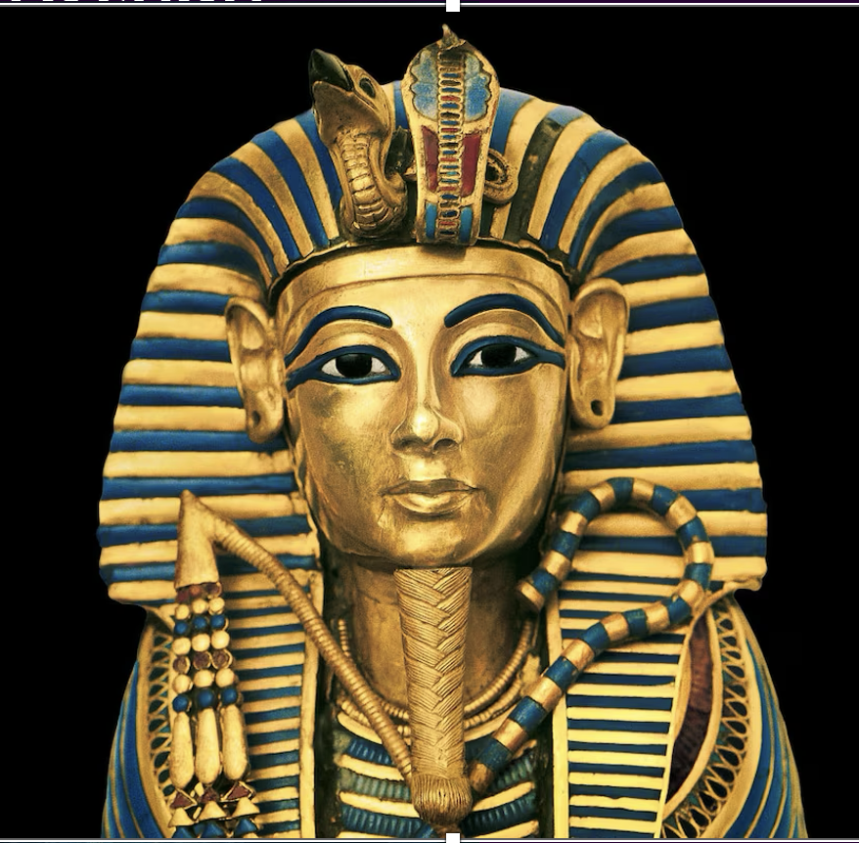
埃及法老被比喻成 The Pharaoh of Egypt is described as
利未亚坦 Leviathan
拉哈伯 Rahab
海龙 dragon
邪恶的海怪 demonic Monsters

Slide 31
龙无法消灭教会，
就去与她的儿女争战
03
The dragon failed to destroy the Church, he turned to wage war against her children.

Slide 32
17.龙向妇人发怒，去与她其余的儿女争战，这儿女就是那守神诫命、为耶稣作见证的。18.那时龙就站在海边的沙上。
17.Then the dragon became furious with the woman and went off to make war on the rest of her offspring, on those who keep the commandments of God and hold to the testimony of Jesus. And he stood on the sand of the sea.

Slide 33
弗6:12
因我们并不是与属血气的争战，乃是与那些执政的、掌权的、管辖这幽暗世界的，以及天空属灵气的恶魔争战。
Ephesians 6:12.
For we do not wrestle against flesh and blood, but against the rulers, against the authorities, against the cosmic powers over this present darkness, against the spiritual forces of evil in the heavenly places.

Slide 34
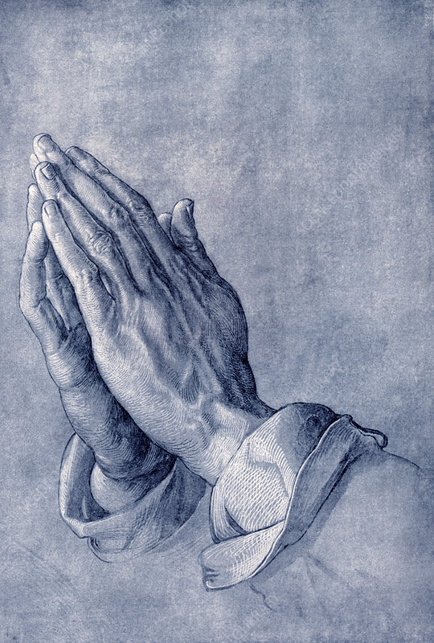
雅各书 4:7.
故此，你们要顺服神。务要抵挡魔鬼，魔鬼就必离开你们逃跑了。
James 4:7.
Submit yourselves therefore to God. Resist the devil, and he will flee from you.

