Slide 1
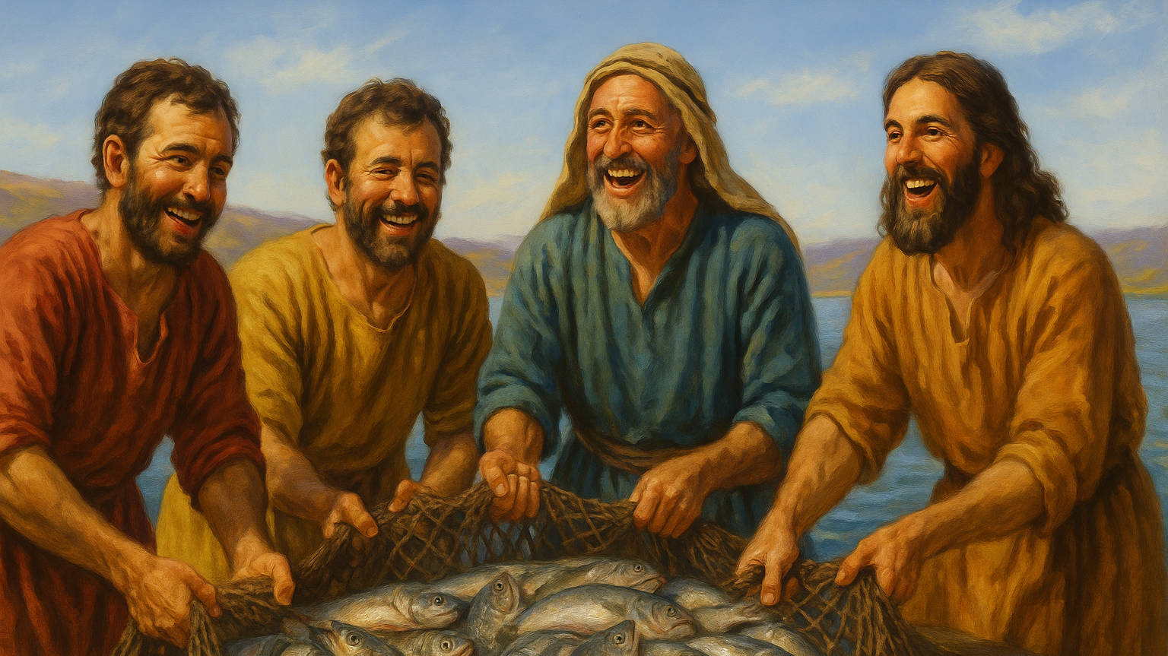
04 God Calls the Lowly to Become Fishers of Men (Mark 1-14-20)

Slide 2
Mark 1:14.Now after John was arrested, Jesus came into Galilee, proclaiming the gospel of God,15.and saying, "The time is fulfilled, and the kingdom of God is at hand; repent and believe in the gospel."16.Passing alongside the Sea of Galilee, he saw Simon and Andrew the brother of Simon casting a net into the sea, for they were fishermen.

Slide 3
Mark 1:17.And Jesus said to them, "Follow me, and I will make you become fishers of men."18.And immediately they left their nets and followed him.19.And going on a little farther, he saw James the son of Zebedee and John his brother, who were in their boat mending the nets.20.And immediately he called them, and they left their father Zebedee in the boat with the hired servants and followed him.

Slide 4
The Forerunner of the Kingdom:
John the Baptist Is Arrested

Slide 5
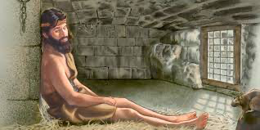
Mark 1:14.Now after John was arrested,

Slide 6
15.and saying, "The time is fulfilled, and the kingdom of God is at hand; repent and believe in the gospel."

Slide 7
B. Christ Explains How to Enter the Kingdom

Slide 8
16.Passing alongside the Sea of Galilee, he saw Simon and Andrew the brother of Simon casting a net into the sea, for they were fishermen.

Slide 9
C. Jesus Recruits uneducated,
lowly men for the Kingdom

Slide 10
Simon Peter and Andrew, James and John

Slide 11
1Co 1: 28
God chose what is low and despised in the world...
1o 1: 28 God chose what is low and despised in the world...

Slide 12
Mark 1:17.And Jesus said to them, "Follow me, and I will make you become fishers of men."

Slide 13
D. The Gift of Transformation
for Those Who Follow Jesus

Slide 15
18.And immediately they left their nets and followed him.19.And going on a little farther, he saw James the son of Zebedee and John his brother, who were in their boat mending the nets.20.And immediately he called them, and they left their father Zebedee in the boat with the hired servants and followed him.

Slide 16
E. Laying Down What Hinders You
and Following Jesus Wholeheartedly

Slide 17
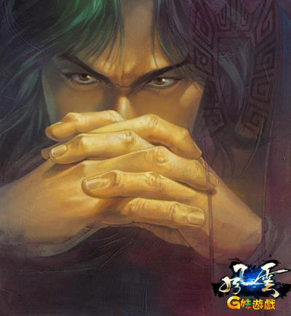

Slide 18
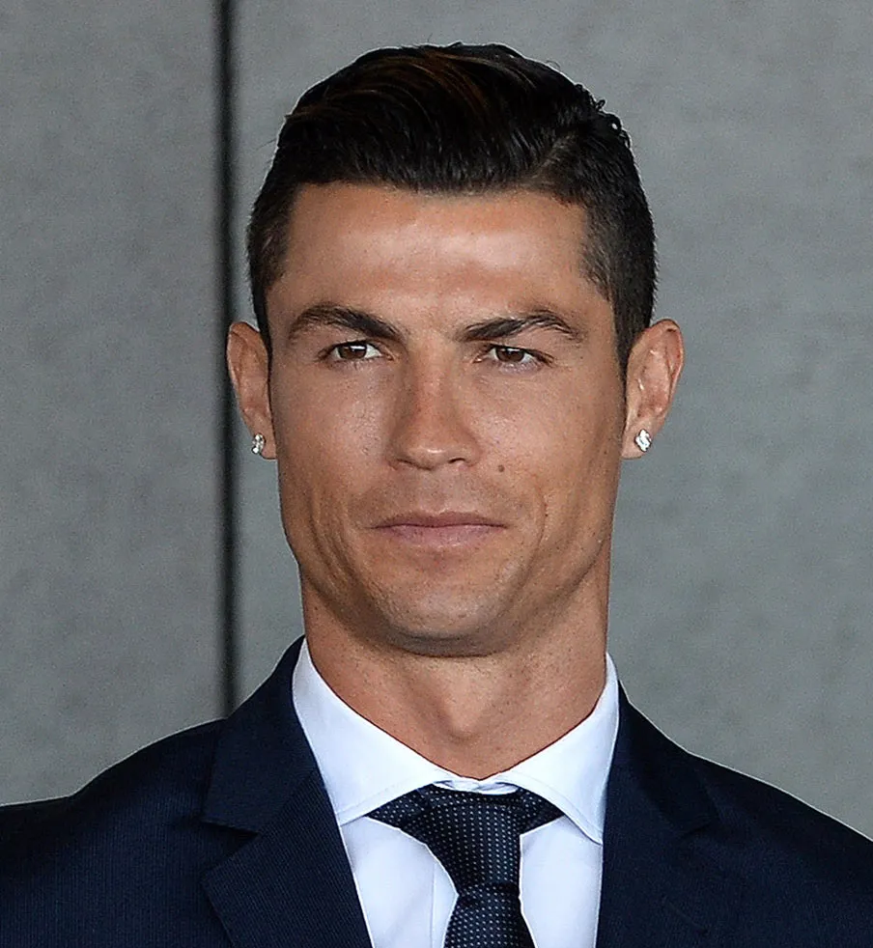
cristiano ronaldo

Slide 19
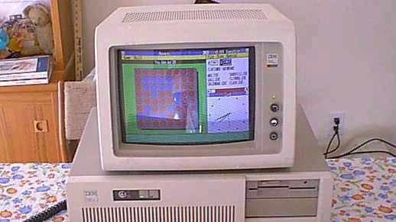

Slide 20
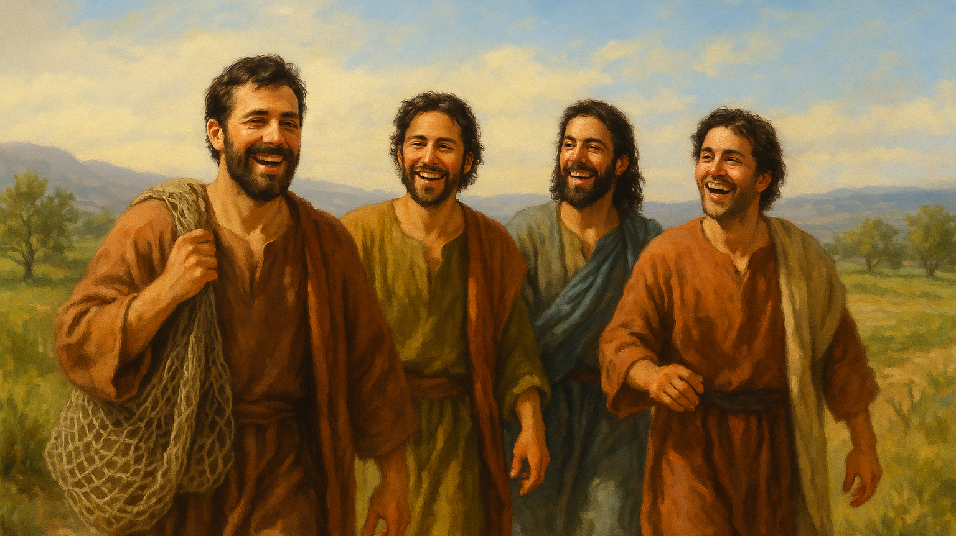
Mark 1:18 ... they left their nets and followed him ...20 ...and they left their father Zebedee in the boat with the hired servants and followed him.

Slide 21
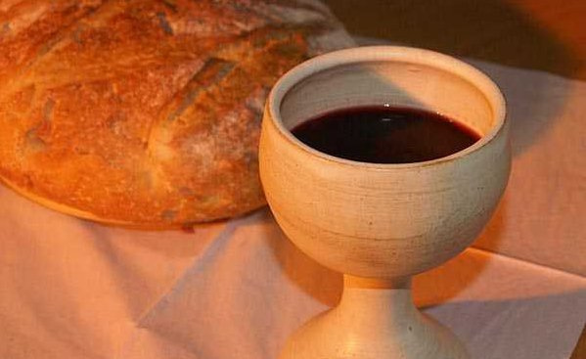
Holy Communion

Slide 22
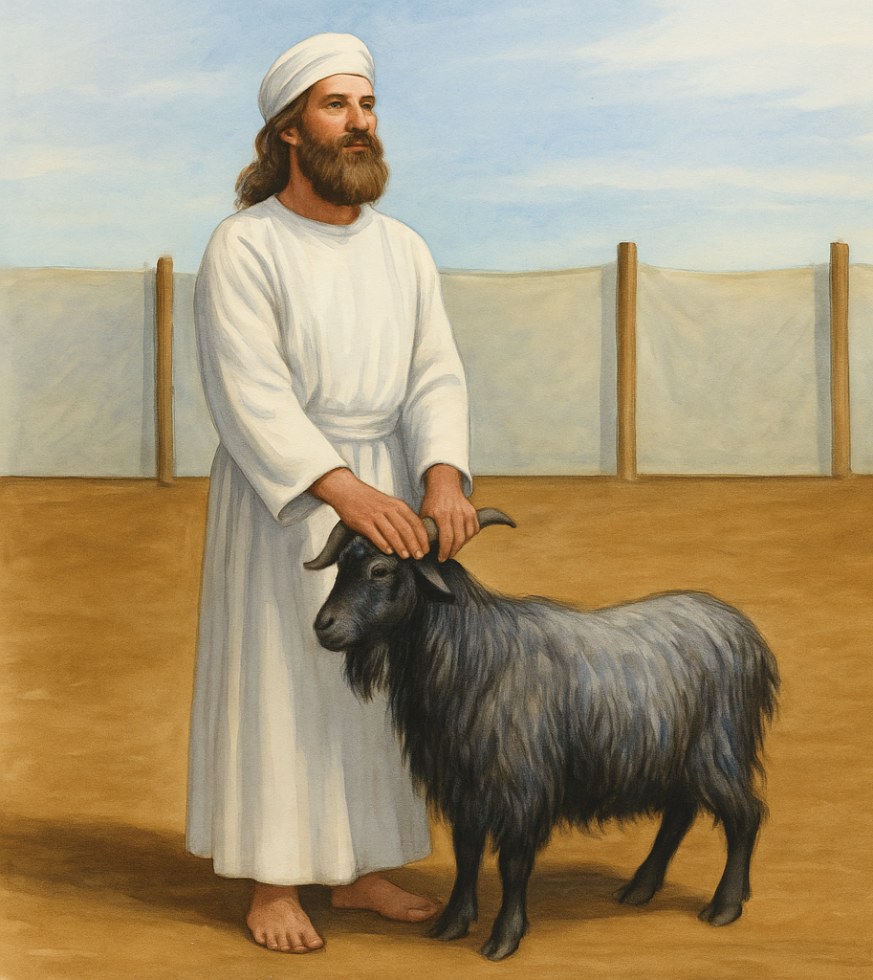
lev 16:15 “Then he shall kill the goat of the sin offering that is for the people … 21 And Aaron shall lay both his hands on the head of the live goat, and confess over it all the iniquities of the people of Israel, and all their transgressions, all their sins. And he shall put them on the head of the goat and send it away into the wilderness by the hand of a man who is in readiness. 22 The goat shall bear all their iniquities

