Slide 1
04 忍耐等候主的再来04 Patiently Waiting for the Lord's Return

Slide 2
雅 5:7 所以，弟兄们，你们应当忍耐，直到主来。看哪，农夫等待着地里宝贵的出产，为它忍耐，直到获得秋霖春雨。8 你们也应当忍耐，坚定自己的心；因为主再来的日子近了。9 弟兄们，不要彼此抱怨，免得你们受审判。看哪，审判的主已经站在门前了。10 弟兄们，你们应当效法奉主的名说话的先知，以他们为受苦忍耐的榜样。
James 5:7.Be patient, therefore, brothers, until the coming of the Lord. See how the farmer waits for the precious fruit of the earth, being patient about it, until it receives the early and the late rains. 8.You also, be patient. Establish your hearts, for the coming of the Lord is at hand.9.Do not grumble against one another, brothers, so that you may not be judged; behold, the Judge is standing at the door.
1/2

Slide 3
11 看哪，那些忍耐的人，我们称他们是有福的；你们听过约伯的忍耐，也看见了主赐给他的结局，知道主是满有怜悯和仁慈的。12 我的弟兄们，最要紧的是不可起誓：不可指着天起誓，也不可指着地起誓，任何的誓都当禁绝。你们的话，是就说是，不是就说不是；免得你们落在审判之下。13 你们中间有人受苦吗？他就应该祷告。有人心情愉快吗？他就应该歌颂。
11.Behold, we consider those blessed who remained steadfast. You have heard of the steadfastness of Job, and you have seen the purpose of the Lord, how the Lord is compassionate and merciful.12.But above all, my brothers, do not swear, either by heaven or by earth or by any other oath, but let your "yes" be yes and your "no" be no, so that you may not fall under condemnation.13.Is anyone among you suffering? Let him pray. Is anyone cheerful? Let him sing praise.
2/2

Slide 4

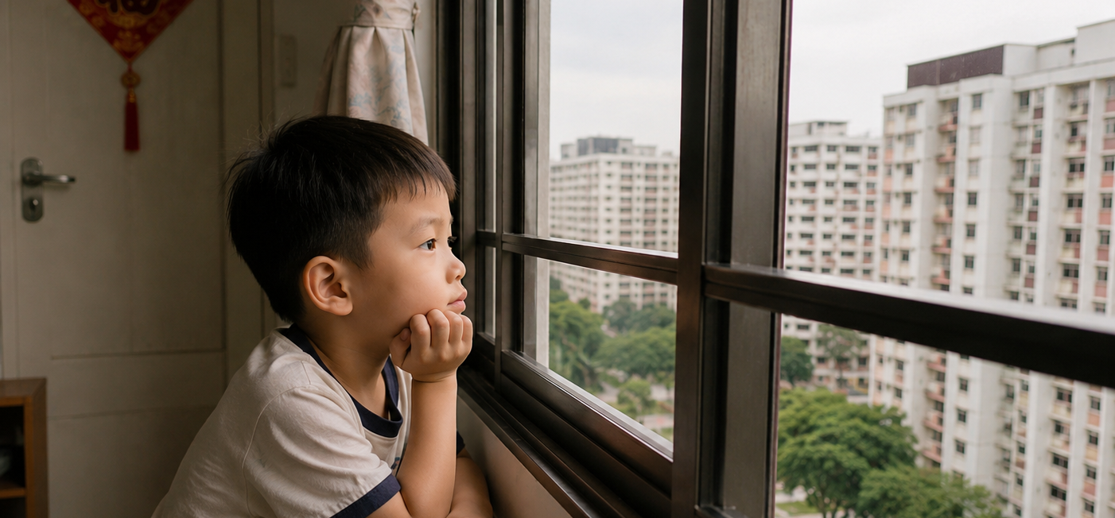

Slide 5
01
受苦时支撑我继续生活的是主必再来
What Does It Mean to Be a Friend of the World?

Slide 6
02
受苦时支撑我继续下去的是
主掌管我最终的结局
What Sustains Me Through Suffering Is the Lord's Sovereign Control Over My Final Destiny.

Slide 7
10 弟兄们，你们应当效法奉主的名说话的先知，以他们为受苦忍耐的榜样。11 看哪，那些忍耐的人，我们称他们是有福的；你们听过约伯的忍耐，也看见了主赐给他的结局，知道主是满有怜悯和仁慈的。
10.As an example of suffering and patience, brothers, take the prophets who spoke in the name of the Lord. 11.Behold, we consider those blessed who remained steadfast. You have heard of the steadfastness of Job, and you have seen the purpose of the Lord, how the Lord is compassionate and merciful.

Slide 8
03
受苦时我提醒自己我效法主的先知
In Times of Suffering, I Remind Myself to Follow the Example of the Lord's Prophets.

Slide 9
13 你们中间有人受苦吗？他就应该祷告。有人心情愉快吗？他就应该歌颂。
13.Is anyone among you suffering? Let him pray. Is anyone cheerful? Let him sing praise.

Slide 10
诗篇39:12 耶和华啊，求你听我的祷告，留心听我的呼求！我流泪，求你不要静默无声！因为我在你面前是客旅，是寄居的，像我列祖一般。13 求你宽容我，使我在去而不返之先可以力量复原。
Psalms 39:12."Hear my prayer, O Lord , and give ear to my cry; hold not your peace at my tears! For I am a sojourner with you, a guest, like all my fathers.13.Look away from me, that I may smile again, before I depart and am no more!"

Slide 11
来5:7 基督在肉体的时候，既大声哀哭，流泪祷告，恳求那能救他免死的主，就因他的虔诚蒙了应允。8 他虽然为儿子，还是因所受的苦难学了顺从。
Hebrews 5:7.In the days of his flesh, Jesus offered up prayers and supplications, with loud cries and tears, to him who was able to save him from death, and he was heard because of his revrence.8.Although he was a son, he learned obedience through what he suffered.

Slide 12
04
受苦时谨慎口舌
Be Careful with My Words in Times of Suffering.

Slide 13
9 弟兄们，不要彼此抱怨，免得你们受审判。看哪，审判的主已经站在门前了。10 弟兄们，你们应当效法奉主的名说话的先知，以他们为受苦忍耐的榜样。
9.Do not grumble against one another, brothers, so that you may not be judged; behold, the Judge is standing at the door.

Slide 14
12 我的弟兄们，最要紧的是不可起誓：不可指着天起誓，也不可指着地起誓，任何的誓都当禁绝。你们的话，是就说是，不是就说不是；免得你们落在审判之下。
12.But above all, my brothers, do not swear, either by heaven or by earth or by any other oath, but let your "yes" be yes and your "no" be no, so that you may not fall under condemnation.13.Is anyone among you suffering? Let him pray. Is anyone cheerful? Let him sing praise.

Slide 15
罗8:1「如今，那些在基督耶稣里的就不定罪了。」
（参考：约3:18、5:24、约壹4:17）
Romans 8:1.There is therefore now no condemnation for those who are in Christ Jesus.
(John 3:18; 5:24; 1 John 4:17.)

Slide 16
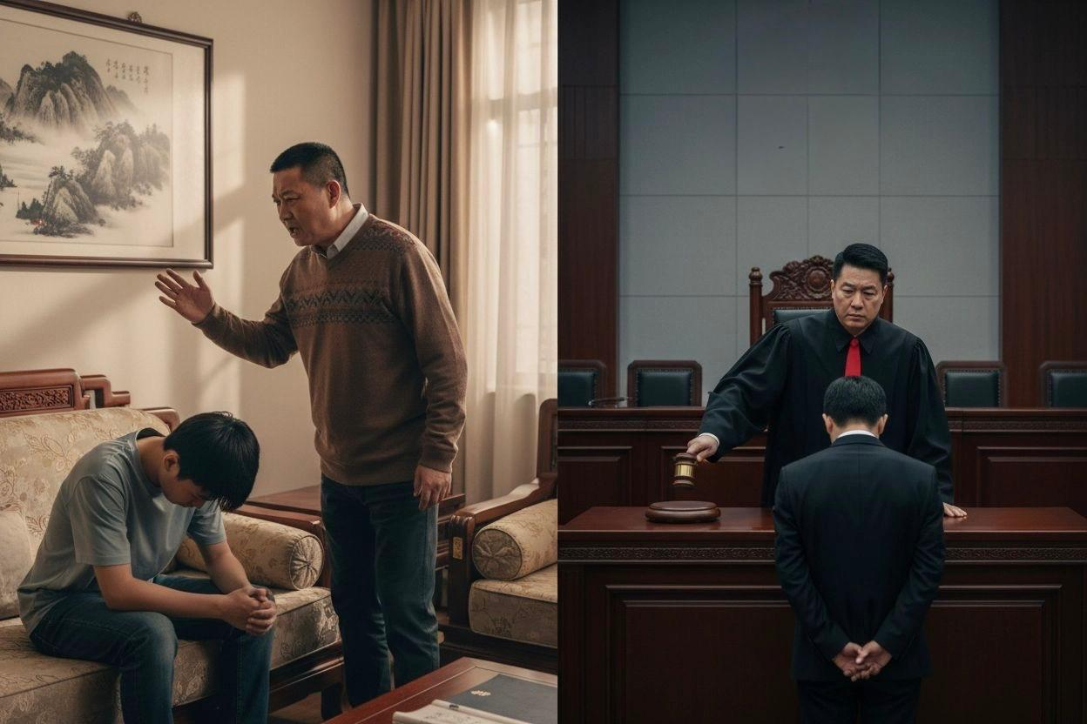
父亲式的审判
（Fatherly judgment）
司法性的定罪
（judicial condemnation ）

