Slide 1
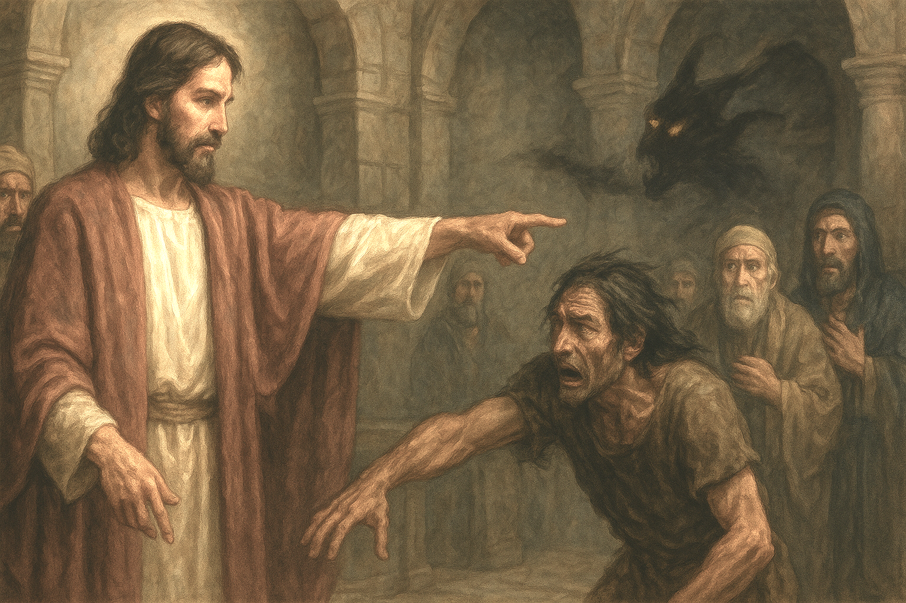
05 The Authority of Christ in His Word and Over the Powers of Darkness (Mark 1:21-28)

Slide 2
Mark 1:21.And they went into Capernaum, and immediately on the Sabbath he entered the synagogue and was teaching.22.And they were astonished at his teaching, for he taught them as one who had authority, and not as the scribes.23.And immediately there was in their synagogue a man with an unclean spirit. And he cried out,24."What have you to do with us, Jesus of Nazareth? Have you come to destroy us? I know who you are—the Holy One of God."

Slide 3
Mark 1:25.But Jesus rebuked him, saying, "Be silent, and come out of him!"26.And the unclean spirit, convulsing him and crying out with a loud voice, came out of him.27.And they were all amazed, so that they questioned among themselves, saying, "What is this? A new teaching with authority! He commands even the unclean spirits, and they obey him."28.And at once his fame spread everywhere throughout all the surrounding region of Galilee.

Slide 4
Jesus Has Authority to Teach Scripture

Slide 5
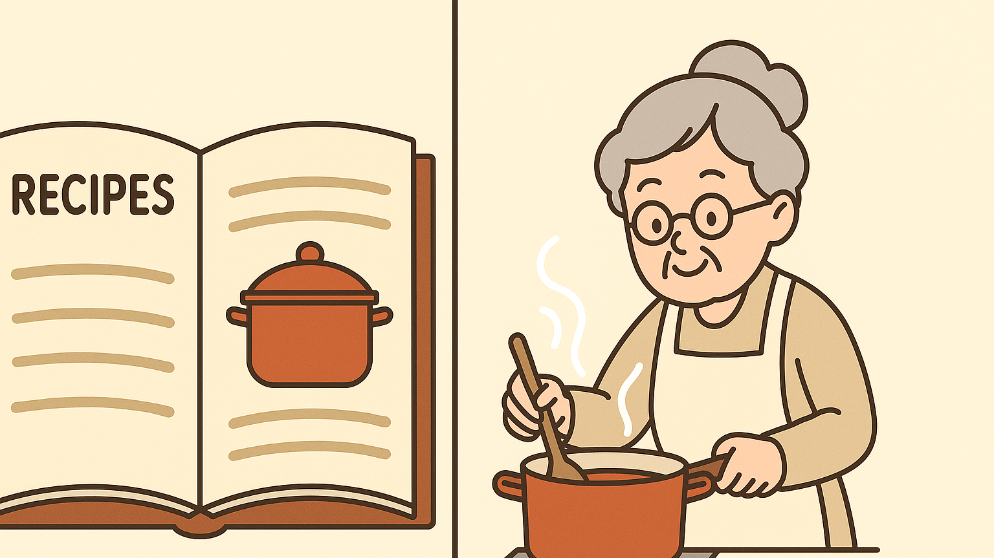

Slide 6
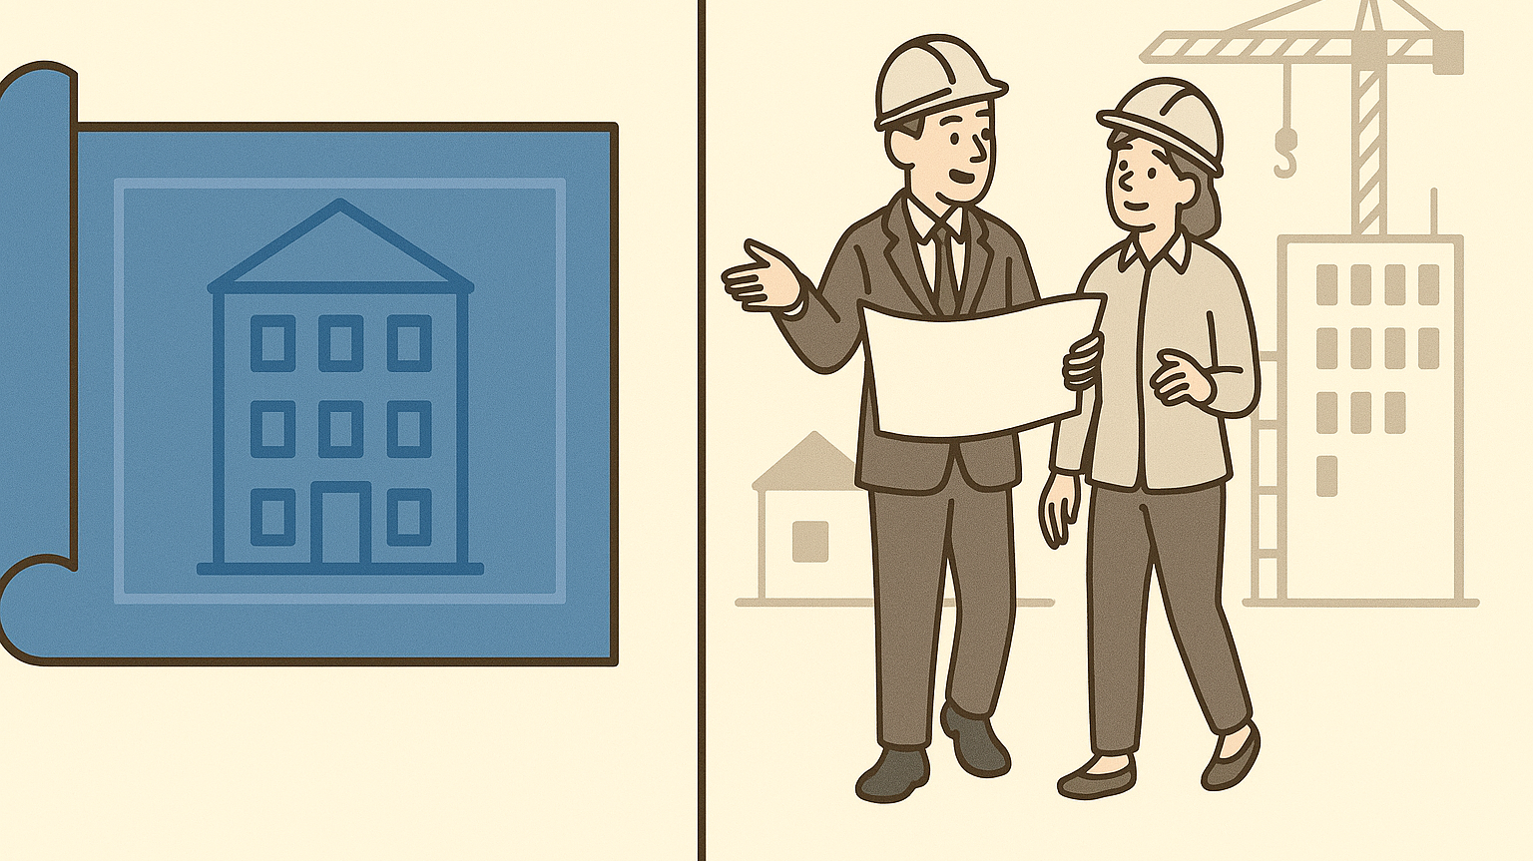

Slide 7
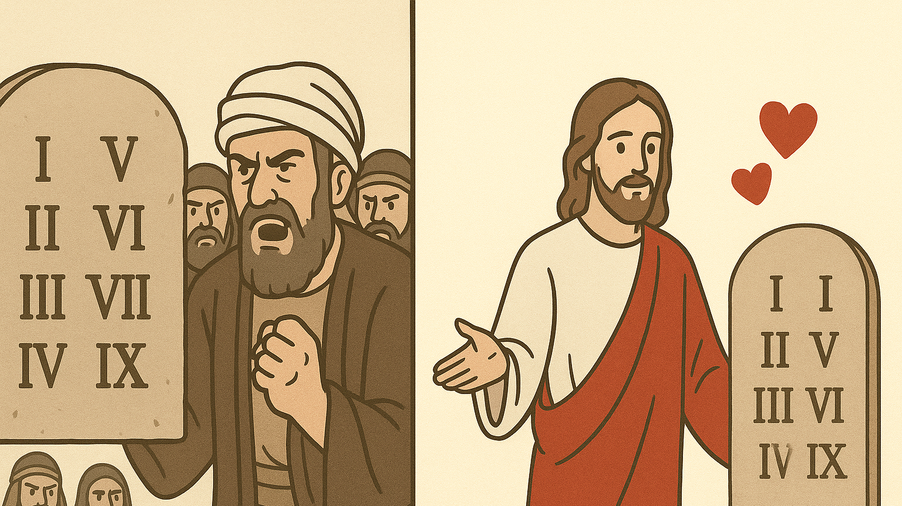

Slide 8
B. Jesus Has Authority Over Unclean Spirits

Slide 9
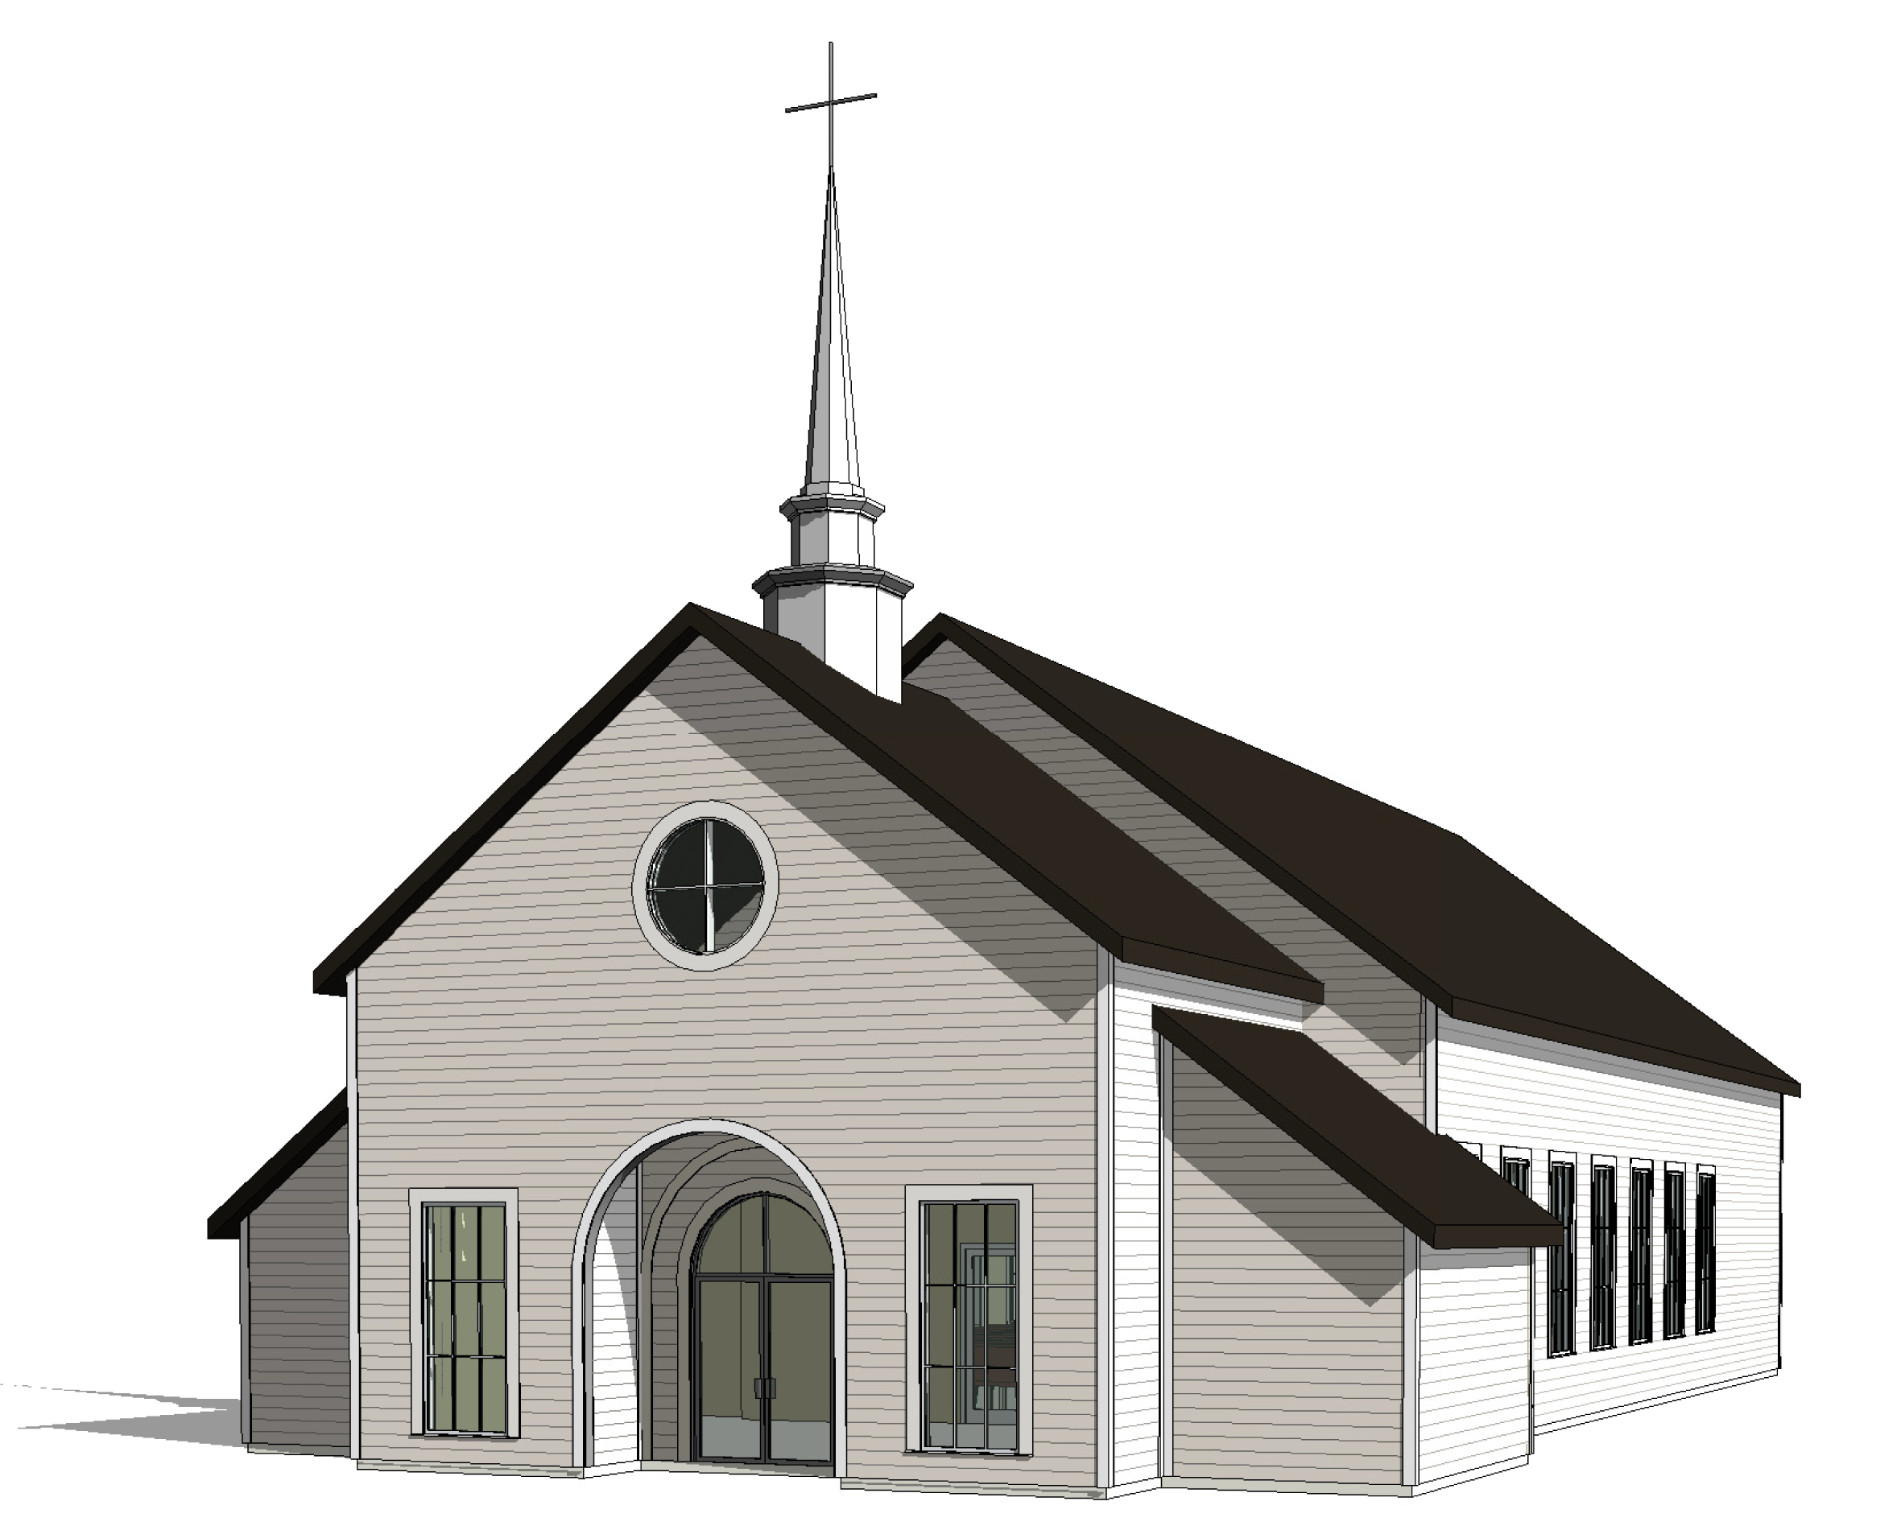

Slide 10
1John 4:4
Little children, you are from God and have overcome them, for he who is in you is greater than he who is in the world.

Slide 11
Signs of clear Demonic possession:
supernatural strength Luk8:29,
supernatural insights Acts16:17,
Self harm Mrk 9:22,
Suppression of personhood (the demon overtakes the will and identity of the individual) Mrk5:9
ALL can be cast out in the name of Jesus Mrk9:38

Slide 12
C. What Does It Mean to Truly Know Jesus?

Slide 13
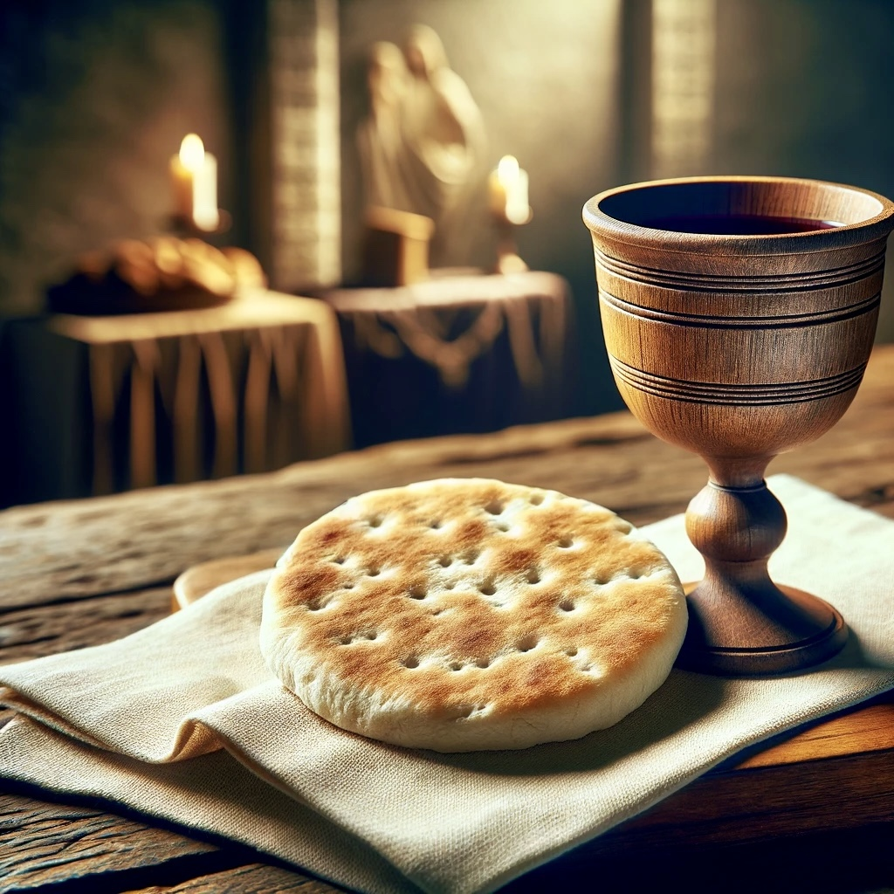
Holy Communion

Slide 14
1 Corinthians 11: 23.For I received from the Lord what I also delivered to you, that the Lord Jesus on the night when he was betrayed took bread,24.and when he had given thanks, he broke it, and said, "This is my body, which is for you. Do this in remembrance of me."25.In the same way also he took the cup, after supper, saying, "This cup is the new covenant in my blood. Do this, as often as you drink it, in remembrance of me."26.For as often as you eat this bread and drink the cup, you proclaim the Lords death until he comes.27.Whoever, therefore, eats the bread or drinks the cup of the Lord in an unworthy manner will be guilty concerning the body and blood of the Lord.28.Let a person examine himself, then, and so eat of the bread and drink of the cup.29.For anyone who eats and drinks without discerning the body eats and drinks judgment on himself.

