Slide 1
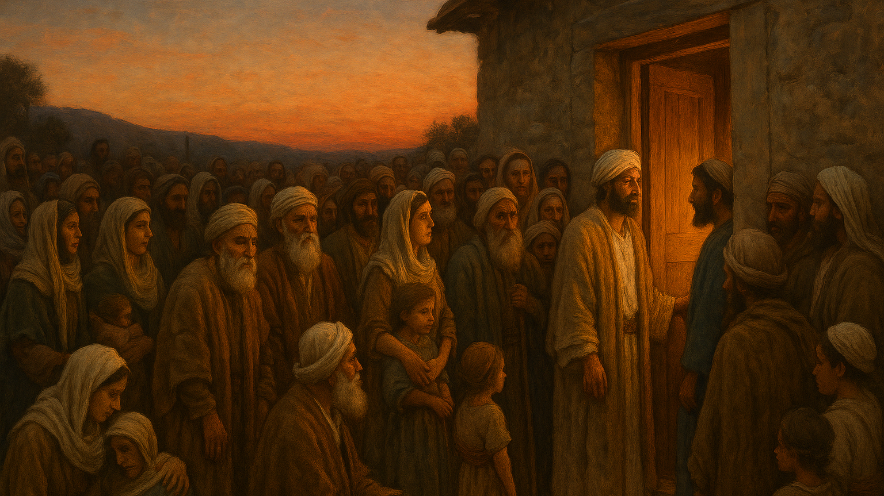
06 Jesus Christ Healing the Broken Proclaiming the Kingdom (Mark 1:29-39)

Slide 2
Mark 1:29.And immediately he left the synagogue and entered the house of Simon and Andrew, with James and John.30.Now Simons mother-in-law lay ill with a fever, and immediately they told him about her.31.And he came and took her by the hand and lifted her up, and the fever left her, and she began to serve them.32.That evening at sundown they brought to him all who were sick or oppressed by demons.33.And the whole city was gathered together at the door.

Slide 3
Mark 1:34.And he healed many who were sick with various diseases, and cast out many demons. And he would not permit the demons to speak, because they knew him.35.And rising very early in the morning, while it was still dark, he departed and went out to a desolate place, and there he prayed.36.And Simon and those who were with him searched for him,37.and they found him and said to him, "Everyone is looking for you."38.And he said to them, "Let us go on to the next towns, that I may preach there also, for that is why I came out."

Slide 4
Mark 1:29.And immediately he left the synagogue and entered the house of Simon and Andrew, with James and John.30.Now Simons mother-in-law lay ill with a fever, and immediately they told him about her.31.And he came and took her by the hand and lifted her up, and the fever left her, and she began to serve them.

Slide 5
32.That evening at sundown they brought to him all who were sick or oppressed by demons.33.And the whole city was gathered together at the door. 34.And he healed many who were sick with various diseases, and cast out many demons. And he would not permit the demons to speak, because they knew him.

Slide 6


Slide 7
34.And he healed many who were sick with various diseases, and cast out many demons. And he would not permit the demons to speak, because they knew him.

Slide 8
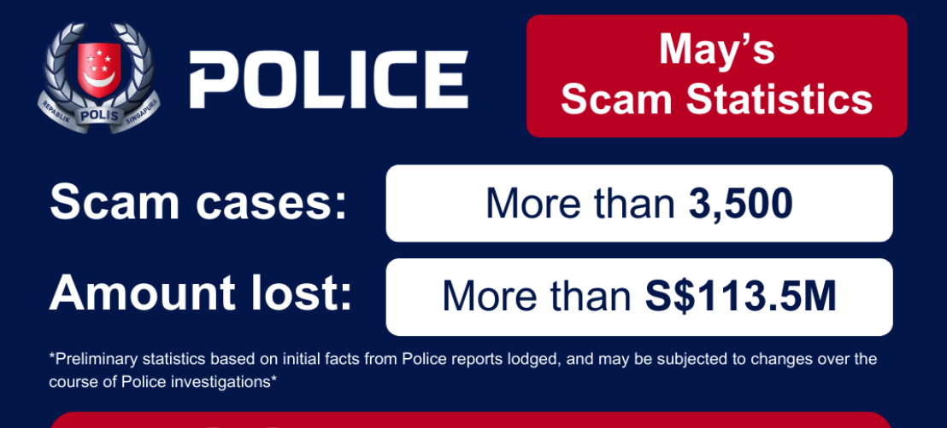
Singapore lost at least S$1.1 billion to scams in 2024 across 51,501 cases

Slide 9
35.And rising very early in the morning, while it was still dark, he departed and went out to a desolate place, and there he prayed.36.And Simon and those who were with him searched for him,37.and they found him and said to him, "Everyone is looking for you."38.And he said to them, "Let us go on to the next towns, that I may preach there also, for that is why I came out."39.And he went throughout all Galilee, preaching in their synagogues and casting out demons.

Slide 10
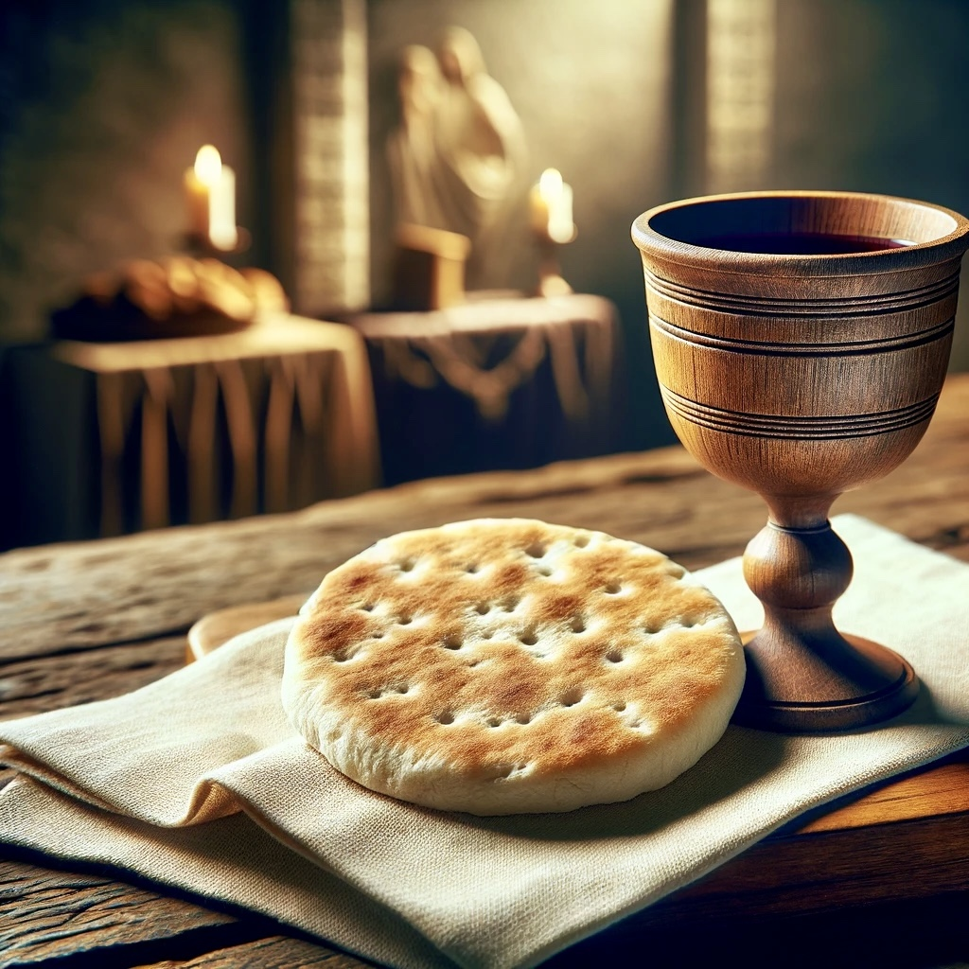
Holy Communion

Slide 11

1 John 4:10. In this is love, not that we have loved God but that he loved us and sent his Son to be the propitiation for our sins.11.Beloved, if God so loved us, we also ought to love one another.

