Slide 1
《大自然为上帝作见证》
Nature’s Case for God

Slide 2
特殊启示
（先知、基督与使徒）
见证
自然启示
宇宙、地球、万物、人
内在启示
知神性、良心的责备、律法公用

Slide 3
自然神学与护教学- 理性的非独立性
上帝在圣经中的启示是所有人类理性思维的“预设前提”，因此当推理reasoning 违背圣经时，它就失去了自身有效性的基础。
上帝创造万物，并维持万有，包括我们的心思意念。这意味着我们之所以能够思考、理解世界，完全是因为祂。当我们以圣经中上帝的启示为起点时，我们的思想才是正确的。但如果有人试图在思考时忽略或违背圣经，就好比一个人把自己坐着的树枝锯断——他们的思维就失去了自身合理性的根基，因为它并没有建立在那位真理与知识的源头上帝之上。
The revelation of God in Scripture is the “presupposition” of all human reasoning, so that when reasoning violates Scripture it loses its own basis for validity.3 But again, it is Scripture itself that tells us to look at the created world to see the imprint of its Creator. Our presupposition urges us to look at the world God has made, and to look at ourselves, his image (Gen 1:27).

Slide 4
自然神学与护教学- 观察世界与我们人自己
但再次强调，正是圣经本身告诉我们要观察受造的世界，以看见造物主的印记。我们的预设前提促使我们观察上帝所创造的世界，也观察我们自己——人是神的形象（创1:27）。
The revelation of God in Scripture is the “presupposition” of all human reasoning, so that when reasoning violates Scripture it loses its own basis for validity.3 But again, it is Scripture itself that tells us to look at the created world to see the imprint of its Creator. Our presupposition urges us to look at the world God has made, and to look at ourselves, his image (Gen 1:27).

Slide 5
自然神学与护教学- 不仅仅是圣经
因此，我对自然神学的辩护是简单的：圣经说，上帝在祂所创造的一切中启示了祂自己，而不仅仅是在圣经中。这一点在《诗篇》第十九篇和《罗马书》第一章中尤为明显。
So my defense of natural theology is a simple one. The Bible says that God is revealed in everything he has created, not only in the Bible. This is especially evident in Psalm 19 and Romans 1

Slide 6
自然神学- 大自然见证神的荣耀
诗篇 19:1.诸天述说神的荣耀；穹苍传扬他的手段。2.这日到那日发出言语；这夜到那夜传出知识。3.无言无语，也无声音可听。4.它的量带通遍天下，它的言语传到地极。神在其间为太阳安设帐幕；5.太阳如同新郎出洞房，又如勇士欢然奔路。6.它从天这边出来，绕到天那边，没有一物被隐藏不得它的热气。
Psalms 19:1.The heavens declare the glory of God, and the sky above proclaims his handiwork.2.Day to day pours out speech, and night to night reveals knowledge.3.There is no speech, nor are there words, whose voice is not heard.4.Their voice goes out through all the earth, and their words to the end of the world. In them he has set a tent for the sun,5.which comes out like a bridegroom leaving his chamber, and, like a strong man, runs its course with joy.6.Its rising is from the end of the heavens, and its circuit to the end of them, and there is nothing hidden from its heat.

Slide 7
自然神学 – 人人都知有神（创造者）
罗1:19.神的事情，人所能知道的，原显明在人心里，因为神已经给他们显明。20.自从造天地以来，神的永能eternal power和神性divine nature是明明可知的，虽是眼不能见，但借着所造之物就可以晓得，叫人无可推诿。
Romans1:19.For what can be known about God is plain to them, because God has shown it to them.20.For his invisible attributes, namely, his eternal power and divine nature, have been clearly perceived, ever since the creation of the world, in the things that have been made. So they are without excuse.

Slide 8
自然神学-自然启示是不足够的
当堕落的人类面对自然启示时，他们“压制”启示，因此救恩的信息必须来自别处。上帝藉着另一种形式的启示——基督福音的传讲——将我们从罪中拯救出来（罗10:14–17）。正是传讲福音瓦解了我们的悖逆，引导我们悔改并相信。 因此，自然启示的运作机制在某种程度上与我们脱离罪的救恩无关。 若要得着得救所需的认识，自然启示是不足够的。
The revelation of God in Scripture is the “presupposition” of all human reasoning, so that when reasoning violates Scripture it loses its own basis for validity.3 But again, it is Scripture itself that tells us to look at the created world to see the imprint of its Creator. Our presupposition urges us to look at the world God has made, and to look at ourselves, his image (Gen 1:27).

Slide 9
自然神学与护教学
自然启示
特殊启示
哪一个更有权威？哪一个在认识世界有创造者更加足够？哪一个更清晰？ 自然启示在什么事上不足？

Slide 10

自然神学与护教学
压制抵挡
压制抵挡
自然启示
知道有神
特殊启示
知道救赎

Slide 11
自然神学与护教学- 人阻挡压制真理
罗马书 1:18.原来，神的忿怒从天上显明在一切不虔不义的人身上，就是那些行不义阻挡真理的人。19.神的事情，人所能知道的，原显明在人心里，因为神已经给他们显明。20.自从造天地以来，神的永能和神性是明明可知的，虽是眼不能见，但借着所造之物就可以晓得，叫人无可推诿。21.因为，他们虽然知道神，却不当作神荣耀他，也不感谢他。他们的思念变为虚妄，无知的心就昏暗了。22.自称为聪明，反成了愚拙，
Romans1:18.For the wrath of God is revealed from heaven against all ungodliness and unrighteousness of men, who by their unrighteousness suppress the truth.19.For what can be known about God is plain to them, because God has shown it to them.20.For his invisible attributes, namely, his eternal power and divine nature, have been clearly perceived, ever since the creation of the world, in the things that have been made. So they are without excuse.21.For although they knew God, they did not honor him as God or give thanks to him, but they became futile in their thinking, and their foolish hearts were darkened.22.Claiming to be wise, they became fools,

Slide 12
自然神学与护教学
保罗在《罗马书》第1章中关于自然启示的论述，是他为“唯有借着基督得救恩典的必要性”所建立的论证基础。在其中，他指出外邦人悖逆他们对上帝的认识。
到了第2章，保罗又说，犹太人也同样如此，因为尽管他们既藉着自然也藉着圣经认识上帝，他们仍然悖逆祂。外邦人和犹太人代表整个人类，因此“没有义人，连一个也没有”（3:10）。
Paul’s discourse on natural revelation in Romans 1 is the foundation of an argument for the necessity of saving grace through Christ. In it, he says that pagans rebel against their knowledge of God. In chapter 2, Paul says that Jews are in the same boat, for though they know God through Scripture as well as nature, they, too, rebel against him. But pagans and Jews constitute the entire human race, so “none is righteous, no, not one” (3:10)

Slide 13
外邦人
犹太人
压制抵挡
压制抵挡
自然启示
知道有神
自然启示
特殊启示

Slide 14
自然神学与护教学
压制抵挡
圣灵的重生使人接受相信福音
使人脱离压制与抵挡神和启示
自然启示
知道有神
特殊启示
福音

Slide 15
在使徒行传14:15–18中，保罗以自然启示为根据,尝试拦阻群众敬拜他和巴拿巴的。
使徒行传 14:15.「诸君，为什么做这事呢？我们也是人，性情和你们一样。我们传福音给你们，是叫你们离弃这些虚妄，归向那创造天、地、海，和其中万物的永生神。16.他在从前的世代，任凭万国各行其道；17.然而为自己未尝不显出证据来，就如常施恩惠，从天降雨，赏赐丰年，叫你们饮食饱足，满心喜乐。」18.二人说了这些话，仅仅地拦住众人不献祭与他们。19.但有些犹太人从安提阿和以哥念来，挑唆众人，就用石头打保罗，以为他是死了，便拖到城外。
Acts 14:15."Men, why are you doing these things? We also are men, of like nature with you, and we bring you good news, that you should turn from these vain things to a living God, who made the heaven and the earth and the sea and all that is in them.16.In past generations he allowed all the nations to walk in their own ways.17.Yet he did not leave himself without witness, for he did good by giving you rains from heaven and fruitful seasons, satisfying your hearts with food and gladness."18.Even with these words they scarcely restrained the people from offering sacrifice to them.

Slide 16
自然神学与护教学
而在《使徒行传》17:22–31中，保罗将自然启示作为他讲道的内容，讲给一群几乎毫无认识上帝所赐书面启示(圣经）的听众。
And in Acts 17:22–31, Paul uses natural revelation as his preaching text to an audience that had little, if any, knowledge of God’s written revelation:

Slide 17
保罗与 伊壁鸠鲁和斯多亚两门的学士 (徒17:18）
伊壁鸠鲁学派（Epicureans） 伊壁鸠鲁学派认为人生的最高善是快乐，不过他们所说的快乐并不是纵欲的享乐，而是追求身体无痛苦（aponia）和灵魂宁静（ataraxia）。他们认为世界是由原子偶然组成的，没有神圣的计划或最终的审判。虽然承认神明存在，但这些神明完全不干涉人间事务，因此人不必惧怕死后刑罚。对他们而言，人生的目标就是活在当下，避免痛苦，寻求内心的安稳。
斯多亚学派（Stoics） 斯多亚学派则与之形成对比，他们认为人生的最高善是德性， 人的任务是顺应自然而活；在斯多亚学派看来，自然就是神圣理性化的宇宙秩序，即 logos，它支配着整个宇宙。” 他们强调自制、坚忍与节制，把情感（pathē）视为非理性的冲动，必须由理性克服。即使痛苦临到，他们认为真正的善只在德性，因此痛苦不能摧毁一个有德性的人。 换句话说，伊壁鸠鲁学派强调避免痛苦以获得宁静，而斯多亚学派则认为痛苦并非真正的恶，即便在痛苦中，人也必须顺服理性，坚持德性。

Slide 18
伊壁鸠鲁和斯多亚两门的学士 徒 17:22.保罗站在亚略·巴古当中，说：「众位雅典人哪，我看你们凡事很敬畏鬼神。23.我游行的时候，观看你们所敬拜的，遇见一座坛，上面写着『未识之神』。你们所不认识而敬拜的，我现在告诉你们。24.创造宇宙和其中万物的神，既是天地的主，就不住人手所造的殿，25.也不用人手服事，好像缺少什么；自己倒将生命、气息、万物，赐给万人。26.他从一本造出万族的人，住在全地上，并且预先定准他们的年限和所住的疆界，27.要叫他们寻求神，或者可以揣摩而得，其实他离我们各人不远；

Slide 19
人有知神性 ： 敬拜各样神明
创造者 与 被造的偶像：不住人手所造的殿，不用人服事，像缺什么
生命源头：将生命、气息、万物，赐给万人
世人起源：从一本造出万族的人 made from one man every nation of mankind
掌管命运：预先定准他们的年限和所住的疆界
人能认识神：可以揣摩而得
神的内在性：其实他离我们各人不远 （神的同在与护理）

Slide 20
徒 17:28.我们生活、动作、存留，都在乎他。就如你们作诗的，有人说：『我们也是他所生的。』29.我们既是神所生的，就不当以为神的神性像人用手艺、心思所雕刻的金、银、石。30.世人蒙昧无知的时候，神并不监察，如今却吩咐各处的人都要悔改。31.因为他已经定了日子，要借着他所设立的人按公义审判天下，并且叫他从死里复活，给万人作可信的凭据。」32.众人听见从死里复活的话，就有讥诮他的；又有人说：「我们再听你讲这个吧！」

Slide 21
神的护理：生活、动作、存留，都在乎他
创造者 ：诗的，有人说：『我们也是他所生的。』
偶像：不当以为神的神性像人用手艺、心思所雕刻的金银、石
人有罪：如今却吩咐各处的人都要悔改
福音（审判）：所设立的人按公义审判天下
福音（十字架） ：叫他从死里复活

Slide 23
徒17:22–31中，保罗以自然启示作为讲道的依据
保罗在这里并没有引用圣经，但他也没有放下以圣经为前提的立场。他呈现了圣经所说的、所有人单凭自然就能知道的事，并由此引出他宣告耶稣是审判者，也是复活的主。他所面对的是不认识圣经、但看见周围世界的人。

Slide 24
徒17:22–31中，保罗以自然启示作为讲道的依据
保罗与他们一同探求世界的奥秘，但他并没有偏离他以圣经为前提的立场。虽然并未直接引用圣经，他却向听众呈现了按圣经对世界的诠释。毕竟，圣经向我们启示真理，不仅关于圣经自身和上帝，也关于整个世界。这就是为什么保罗后来会说，圣经是有益的，“叫属神的人得以完全，预备行各样的善事”（提后3:17）。圣经告诉我们关于一切事物最重要的真理：上帝、世界和自我。

Slide 25
使徒行传 17:30.世人蒙昧无知的时候，神并不监察，如今却吩咐各处的人都要悔改。31.因为他已经定了日子，要借着他所设立的人按公义审判天下，并且叫他从死里复活，给万人作可信的凭据。」
罗马书 1:32.他们虽知道神判定行这样事的人是当死的，然而他们不但自己去行，还喜欢别人去行。
罪恶

Slide 26
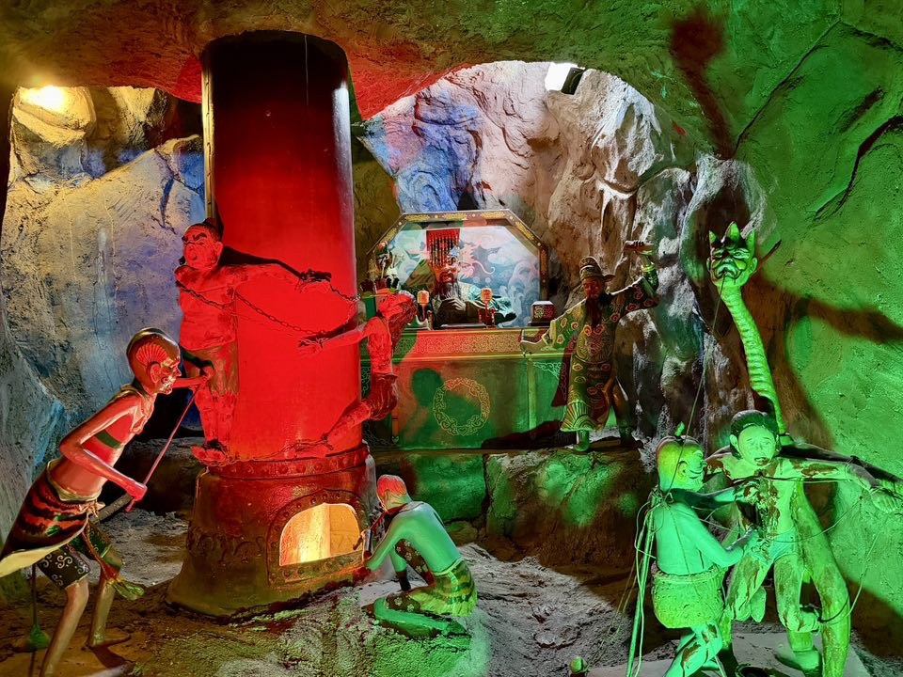
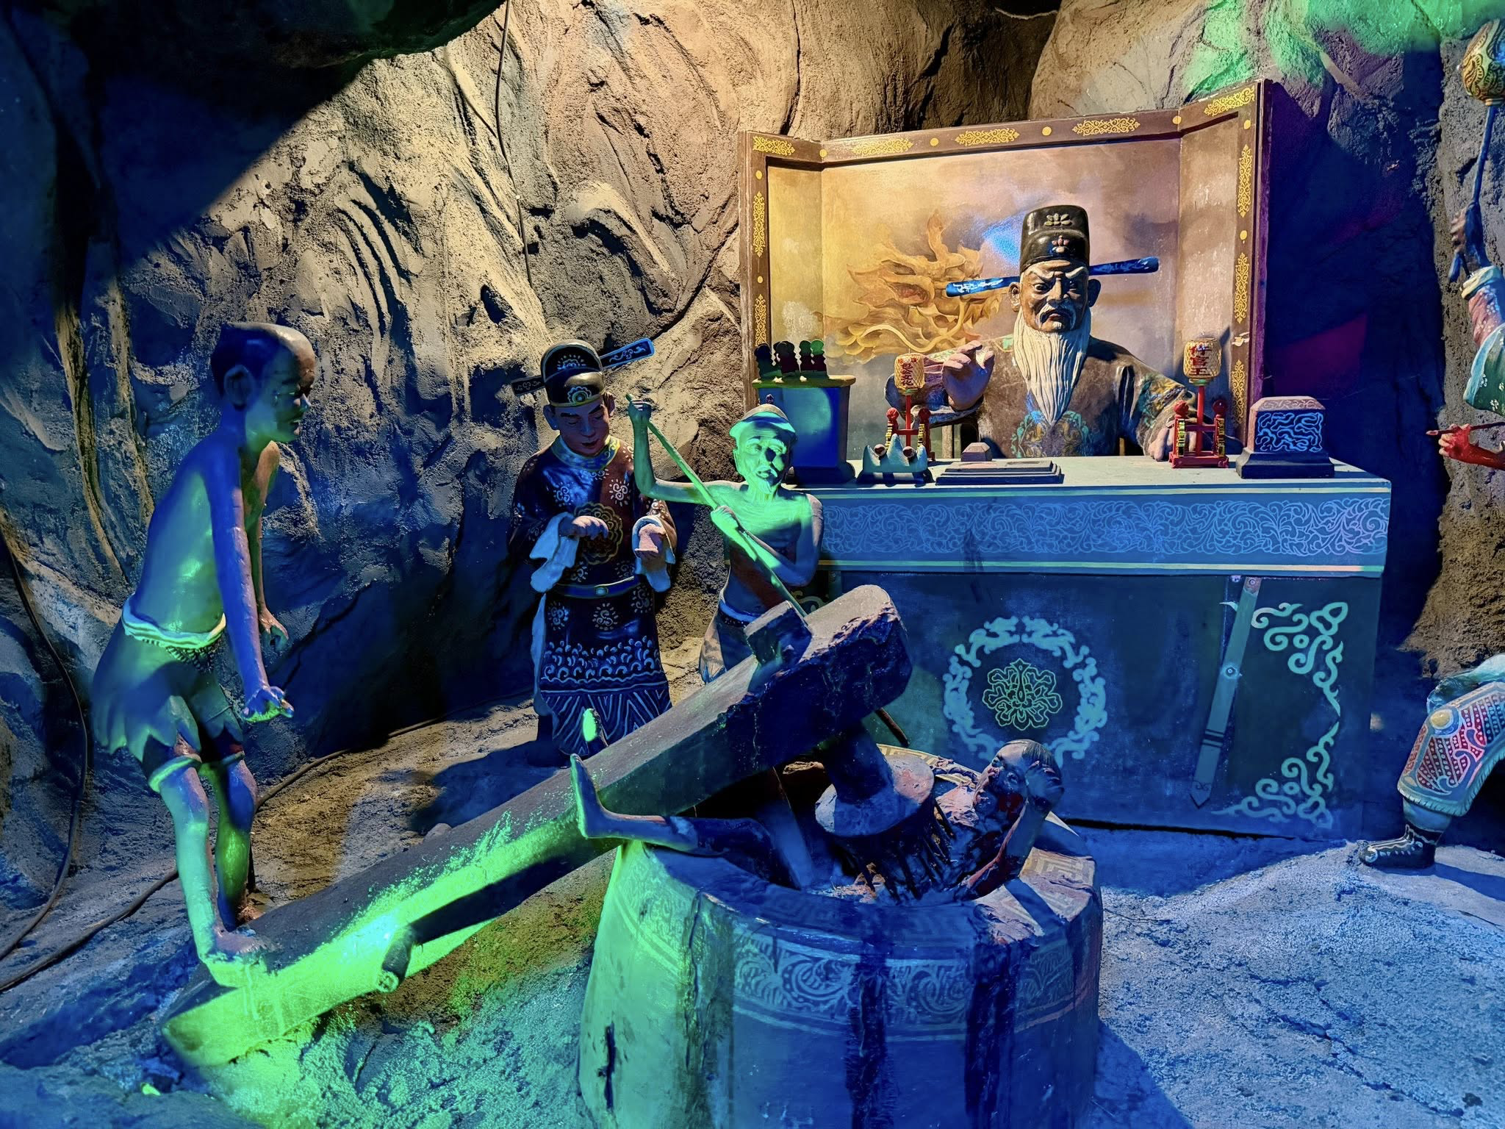
世人知道罪恶与审判！ （华人民间信仰）

Slide 27
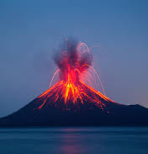
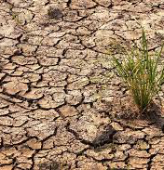
自然灾害中的启示

Slide 28
创世记 3：17. ..，地必为你的缘故受咒诅；你必终身劳苦才能从地里得吃的。
罗马书 1:18.原来，神的忿怒从天上显明在一切不虔不义的人身上，就是那些行不义阻挡真理的人。
启示录 15:1.我又看见在天上有异象，大而且奇，就是七位天使掌管末了的七灾，因为神的大怒在这七灾中发尽了。

Slide 29
自然灾害中的启示
在堕落的人之中，品行相对更好的“好人”会觉得遭遇不公

Slide 30
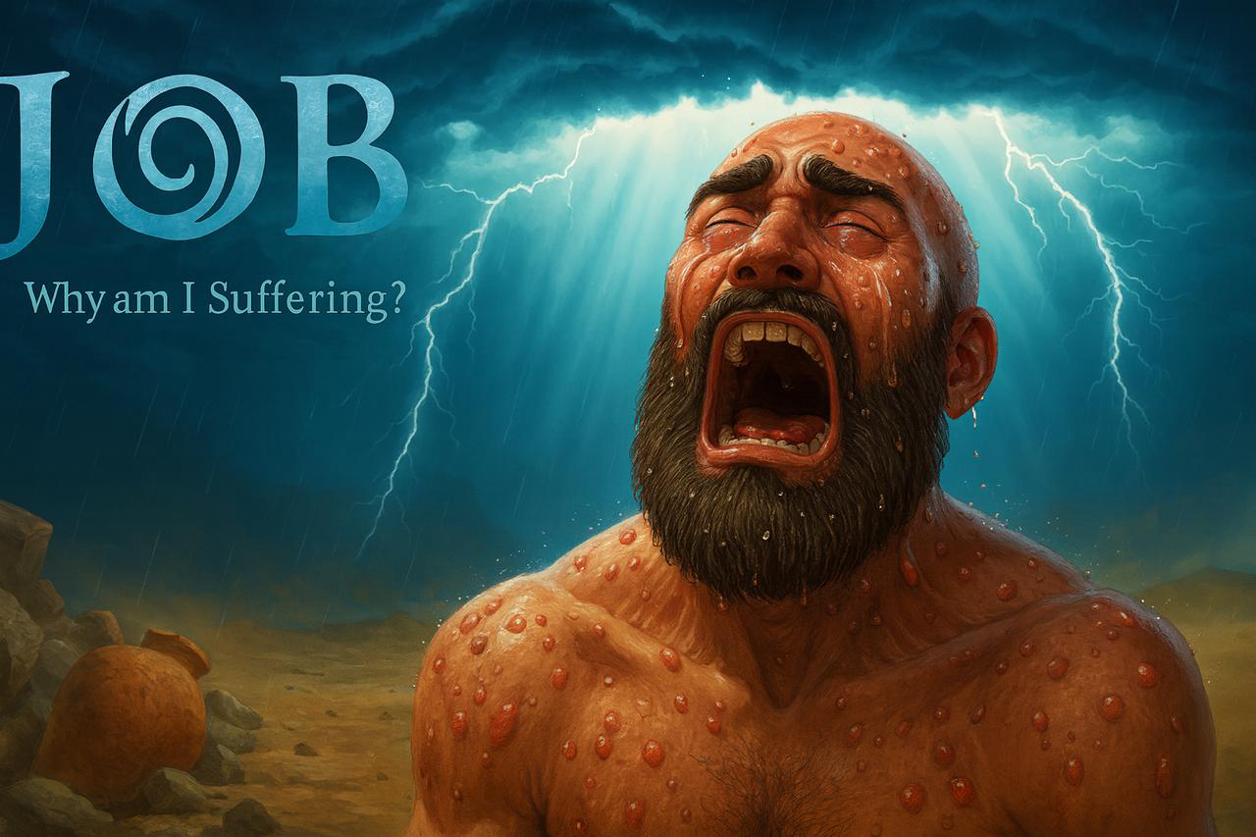
上帝在约伯受苦完毕之后向他显现。为何上帝在向约伯显现的时候，与他谈论的是祂的创造与护理之功（伯38–41章），而不是讨论约伯为何要受苦？

Slide 31
上帝提起祂的创造的时候，是要教导约伯：祂是主，祂是整个创造的作者与主宰。身为创造者，祂拥有创造者的智慧，祂晓得万物的一切，并且知道祂自己在做什么，祂为何要这样做。
当上帝回复约伯的时候，有两处经文提到了海与河中的怪兽。其中一处在《约伯记》40章15至25节，和合本将 Behemoth 译作“河马”；而在《约伯记》41章1至34节，Leviathan 被译作“鳄鱼”。

Slide 32

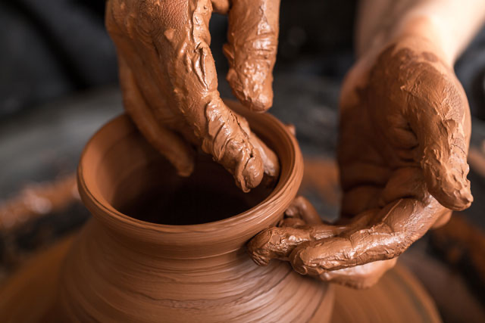
罗马书 9：21.
窑匠难道没有权柄从一团泥里拿一块做成贵重的器皿，又拿一块做成卑贱的器皿吗？
Romans 9:21.Has the potter no right over the clay, to make out of the same lump one vessel for honorable use and another for dishonorable use?

Slide 33
制造者
Maker
窑匠
Potter
制造器皿
权柄塑造并决定 Authority to shape and to decide
作者自己的目的
The author’s own purpose

Slide 34
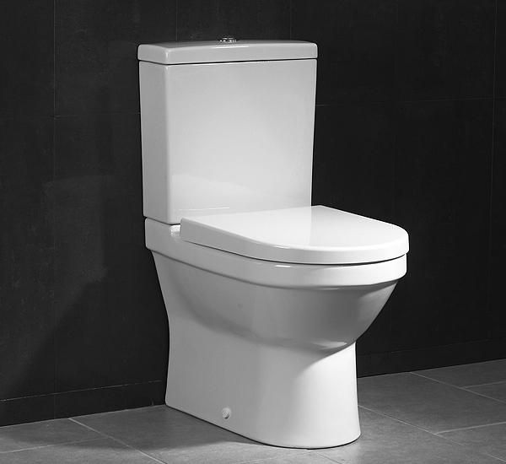
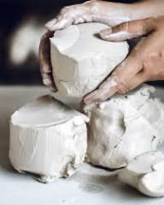
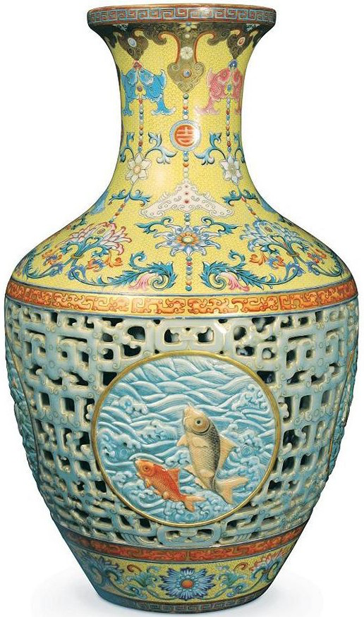
一块做成
卑贱的器皿
and another for dishonorable use
一块做成
贵重的器皿
same lump one vessel for honorable use
同一团泥
same lump of clay

Slide 35
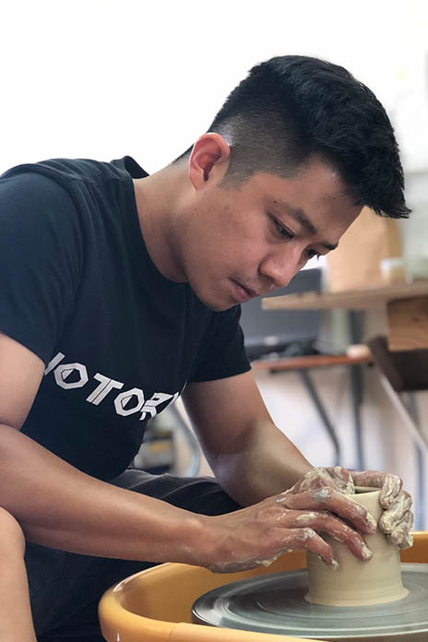
窑匠
窑匠你为何这样塑造我？
“Potter, why did you make me like this?”

Slide 36

杨康
黄蓉
郭靖
金庸作者《射雕英雄传 》

Slide 37
创作者
author
金庸
《射雕英雄传 》
权柄塑造并主宰 Authority to shape and to dictate
作者自己的目的
The author’s own purpose

Slide 38
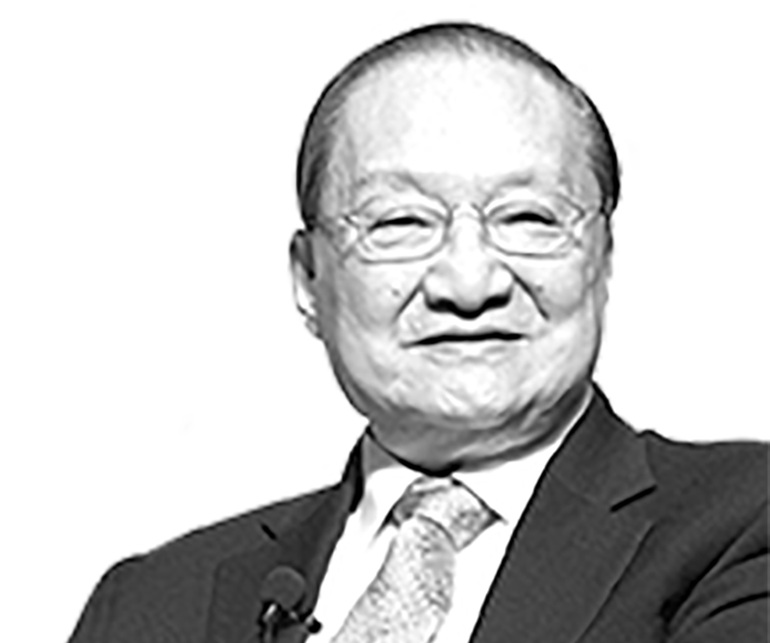
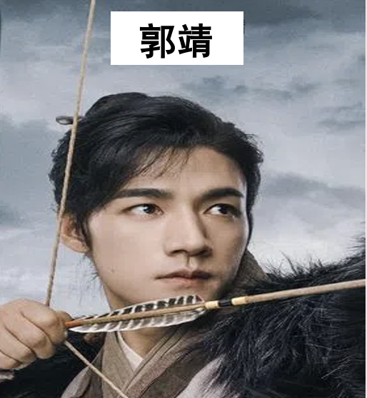
金庸
金庸你为何这样创作我？
“Jin Yong, why did you create me this way?”

Slide 39
创造者 creator
上帝
创造世界
权柄、掌管、主宰 authority, control, and sovereignly reign
神自己的目的
God’s own purpose

Slide 40
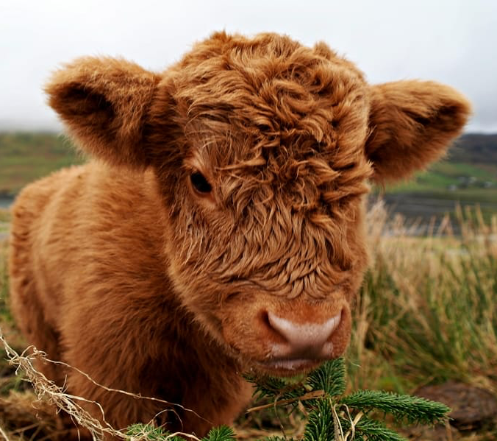

人
Human
1/4

Slide 41
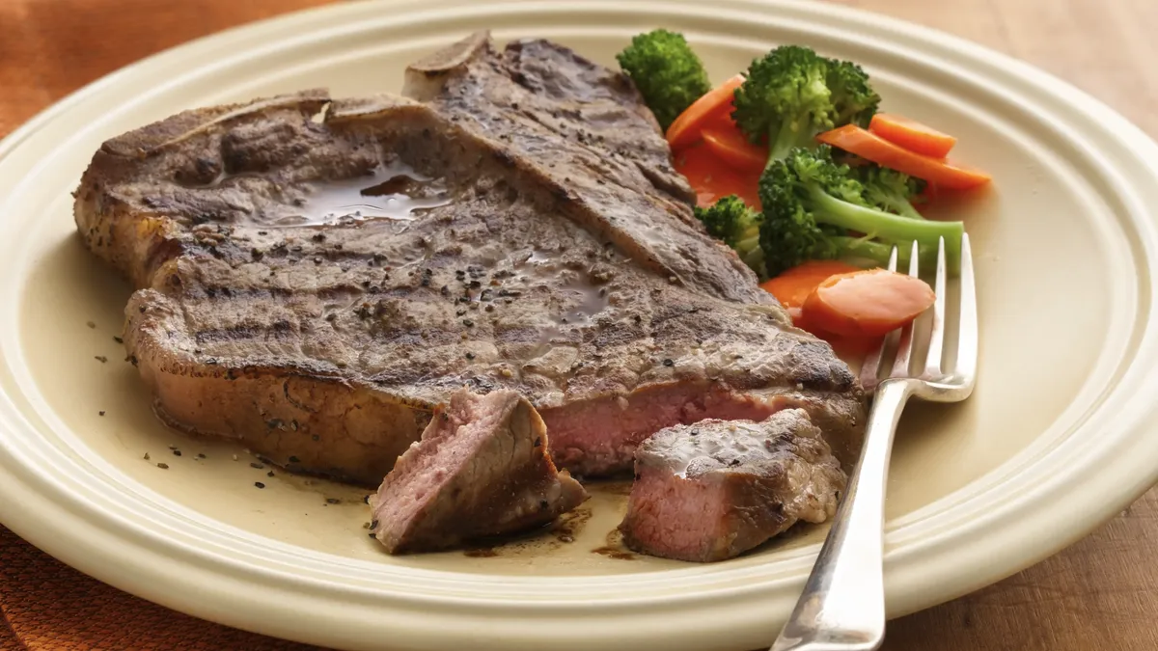
人
Human
2/4

Slide 42
人
Human
谢谢你
不公平
3/4

Slide 43
自然启示与人性
当然，这里的“自然”也包括人类本性 human nature ，因为我们自己就是上帝世界的一部分。上帝照着祂的形象造了我们（创1:27），因此，我们若通过省察自身来认识上帝，也不应感到惊讶。
Of course, “nature” here includes human nature, for we ourselves are part of God’s world. God has made us in his image (Gen 1:27), so it should not surprise us that we should be able to learn of God by scrutinizing ourselves:

Slide 44
上帝的伟大
神的
大能
推论
被造物
（世界”包括人“）
见证
创造者
推论
神的
伟大
推论
神的
恩慈

Slide 45
人本身彰显上帝的伟大
同样地，当我们从宇宙的视角思考自己的成就时，要将我们所做的，与那些为我们而成就的一切完全分开，是非常困难的。我们之所以活着，是因为在我们之上和之下，存在着一个庞大的因果体系 。我们的能力也是如此，因此，我们的成就也是如此。贝多芬之所以能谱写交响曲，是因为他来自一个庞大的家族谱系，也因为他的祖先呼吸着地球的空气，从土地的种子、雨水和阳光中获得饮食。他拥有合适的基因、教育和经验。在他生命的任何时刻，他都可能被一棵倒下的树或一个微小的病毒所毁灭；他的某位祖先也可能在他出生前就被毁灭，从而使贝多芬无法出生于世。这些交响曲的确是他写的，不是别人，也没有人能夺去这些成就。但他的成就依赖于一个远远超越他本身的庞大整体。
Likewise, when we think of our achievements from a cosmic perspective, it is very difficult to isolate what we do from what has been done for us. We are alive because of a vast causal nexus above and below us. The same is true of our abilities, and, therefore, our achievements. Beethoven could write symphonies because he came from a vast family tree, and because all his ancestors breathed the earth’s air and received food and drink from its seeds, rain, and sunshine. He had the right genes, education, and experience. At any moment of his life, he might have been destroyed by a falling tree or a tiny virus. Or one of his ancestors might have been destroyed, preventing Beethoven’s family line from bringing him to life. He wrote the symphonies; nobody else did, and nobody can take those away from him. But his achievements are dependent on something vastly larger than he.

Slide 46
上帝的伟大
世历代以来，大多数人类在某种程度上都承担承认那位伟大者的责任。但这样的承认常常掺杂着骄傲。我们渴望把生命中的福分归功于自己，结果便觉得自己有资格轻视那些没有蒙受同样祝福的同胞。在这一点上，我们对那位伟大者的感恩就落空了——我们并不真正明白祂是何等伟大。
因此，人类敬拜的倾向，是贬低这位伟大者，把祂拉低到与我们同等的层次。保罗那个时代的雅典人就以为，“神性是人用手艺和心思所雕刻，用金、银、石造成的形象”（徒17:29）。于是，敬拜就不再是对那位伟大者的承认，而变成了扭曲—— 一种自我荣耀。
Most human beings through all time have accepted the responsibility of acknowledging the Greatness to some extent. But these acknowledgments have been mixed with pride. We want to take credit for the blessings of life, and as a result, we feel entitled to look down on fellow human beings who have not been so blessed. To that extent, we fail in our appreciation of the Greatness. We don’t understand how truly great it is.So the tendency of human worship is to diminish the Greatness, to bring it down to our level. The Athenians of Paul’s day thought that “the divine being is like gold or silver or stone, an image formed by the art and imagination of man” (Acts 17:29). Thus is worship turned from what it ought to be (an acknowledgment of the Greatness) to a distortion, a self-glorification.

Slide 47
上帝的伟大 – 人类历史的角度
为什么在人类历史中，无论世道多么邪恶，最终邪恶必然倾覆，正义终必得胜？
从圣经中告诉我们神不断在世界中实行审判。
以赛亚书 13:11.我必因邪恶刑罚世界，因罪孽刑罚恶人，使骄傲人的狂妄止息，制伏强暴人的狂傲。

Slide 48
上帝的独一性 ：合一性
自然与历史的进程如此复杂，似乎难以由单一神明完成。似乎确实应该有一位掌管饼干的神、一位掌管咖啡的神，还有一位掌管餐桌家具的神。
但另一方面，必定有那一位，将饼干与咖啡引入贝多芬生命历史中的存在，使他坐在餐桌旁吃下这些食物。多神论无法解决问题，因为它并没有回答这个问题：“是谁能将这些众多的故事整合为一个故事？”我们因万事感谢的那位伟大者，祂当然也是独一者。
然而，这位伟大者怎能同时也是独一者呢？这个世界极其复杂，充满了无数的事物、事件、过程和因果链。在这世界中，存在着一个巨大的关系体系。
So complex is the process of nature and history that it seems too much for one deity to accomplish. Surely, it seems, there must be a god of biscuits, a god of coffee, and a god of dining furniture.On the other hand, there must have been a single being who brought the biscuits and coffee into Beethoven’s life history so that he sat down at the table and consumed the food. Polytheism doesn’t get the job done, since it doesn’t answer the question: “Who is able to turn these many stories into one story?” Who, indeed, brings all the stories of nature together into a consistent, great whole? Surely the Greatness, to whom we owe thanks for everything, is also a Oneness.But how is it possible for the Greatness to also be a Oneness? The world is a place of astonishing complexity, of a vast number of things, events, processes, and causal chains. There is a huge complex of relationships in this world.

Slide 49
上帝的独一性 ：独一性的合理性
多神论中的海神，无法将海洋的状态与沙漠风的运动协调一致。为此，他还得仰赖一位沙漠之神的帮助。正如保罗所说，那位“未识之神”不是一位需要帮助的神。而且，正如我们已经看到的，要将自然与历史的全部复杂性整合为一，唯有独一者才能成就。
A polytheist’s god of the sea cannot integrate the condition of the oceans with the movements of the desert winds. For that he needs the help of a god of the desert. As Paul said, the one unknown God is not a god who ever needs help. And, as we’ve seen, integrating the entire complexity of nature and history can only be done by One

Slide 50
上帝的独一性 与 多元性
但这位独一者不能只是一个抽象的“单一性”，像巴门尼德、亚里士多德、诺斯替派和普罗提诺所设想的那种空洞的单一神明。要完成这一任务，这位独一者必须本身就是一个极其丰富的存在，拥有多样的能力与思想——既思想万有，也思想祂自己。祂必须能够写出一部伟大的故事，将这些现实彼此整合，并与祂自己整合在一起。
此时，基督徒可能会问：自然界是否只显明上帝的独一性，还是也显明一个整合的一与多的实在，就如圣经所启示的三位一体。
But the One cannot be a mere oneness, a conceptual blank, like the singular deities of Parmenides, Aristotle, the Gnostics, and Plotinus. For the One to be able to do this job, the One must be a great complexity of powers and thoughts, thoughts about other things, as well as of himself. He must be able to write a great story, integrating these other realities with one another and with himself. At this point, Christians may ask whether the natural world only reveals the oneness of God, or whether it also reveals an integrated one-and-many, like the biblical Trinity

Slide 51
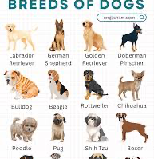

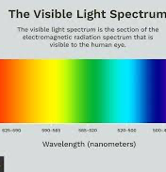
上帝的伟大
为什么世界中有一与众的现象？

Slide 53
上帝的智慧
我们之所以称祂既为“一”，也为“多”，是因为祂在我们自身的经验中创造了统一与复杂的现实。我们惊叹于万物如何彼此契合。
智慧是将深刻知识巧妙运用于实际生活的能力。智慧归属于上帝，它包含世间一切事件、过程与关系。若我们深信那位伟大者已将自然与历史编织成一个统一的故事，那么我们就当为祂在这故事中所彰显的智慧向祂献上感恩，特别是在我们自己生命故事中所彰显的智慧。
The reason why we call him one and many is that he has created a unity and complexity in our own experience. We marvel at how everything fits together
Wisdom is a deep level of knowledge applied with skill to practical life. Ascribed to God, it embraces all the events, processes, and relationships in the world. If we are convinced that the Greatness has woven all of nature and history together into a single story, then we ought to thank him for the wisdom he has displayed in that story, particularly in the stories of our own lives.

Slide 54
上帝的智慧- 大自然（目的导向、设计）
橡树子在特定条件下被设定要成长为橡树。 这个世界有其目标，它是有目的导向的（teleological）。
因此，自然对上帝的见证，不仅在于它的伟大，也不仅在于多中有一的独一性，它更是智慧的彰显：“耶和华啊，你所造的何其多，都是你用智慧造成的；遍地满了你的丰富。”（诗104:24）
An acorn is programmed to become an oak under certain conditions. The world has a goal; it is teleological

Slide 55
上帝的良善（目的导向、设计）
上帝的智慧具有目的性（teleological）——意思是说，因为祂的智慧是有智能的，祂引导自然与历史达成一个特定的目的。
“然而，祂并没有不为自己留下见证；祂施恩，从天降雨，赏赐丰年，叫你们饮食饱足，满心喜乐。”（徒14:17）
God’s wisdom is teleological—meaning that because it is intelligent, it guides nature and history to a particular conclusion
“Yet he did not leave himself without witness, for he did good by giving you rains from heaven and fruitful seasons, satisfying your hearts with food and gladness” (Acts 14:17).

Slide 56
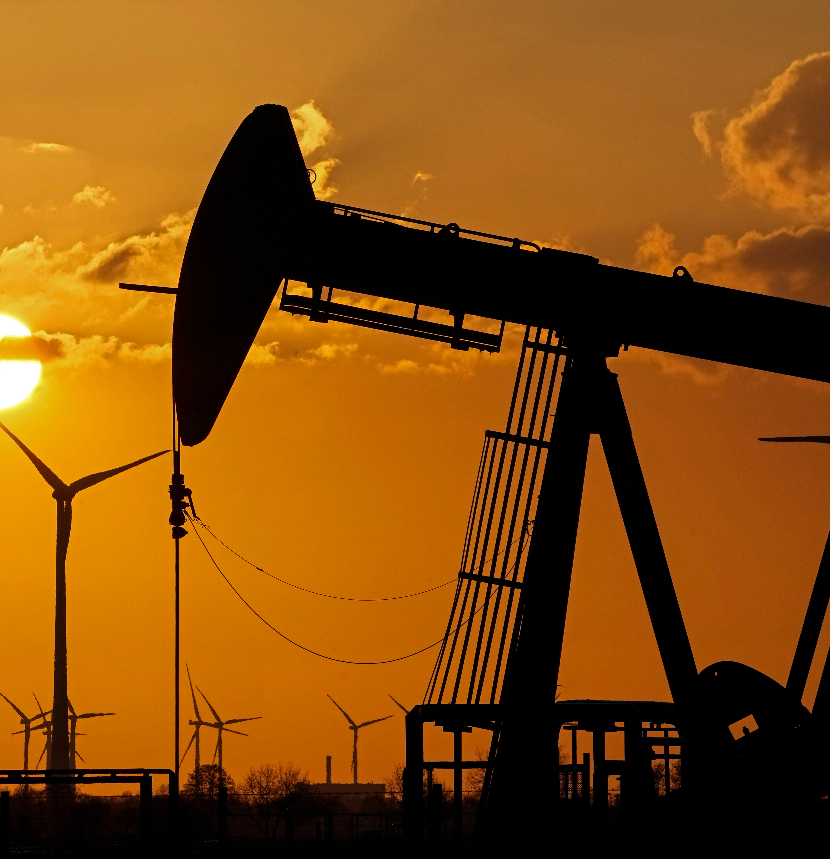
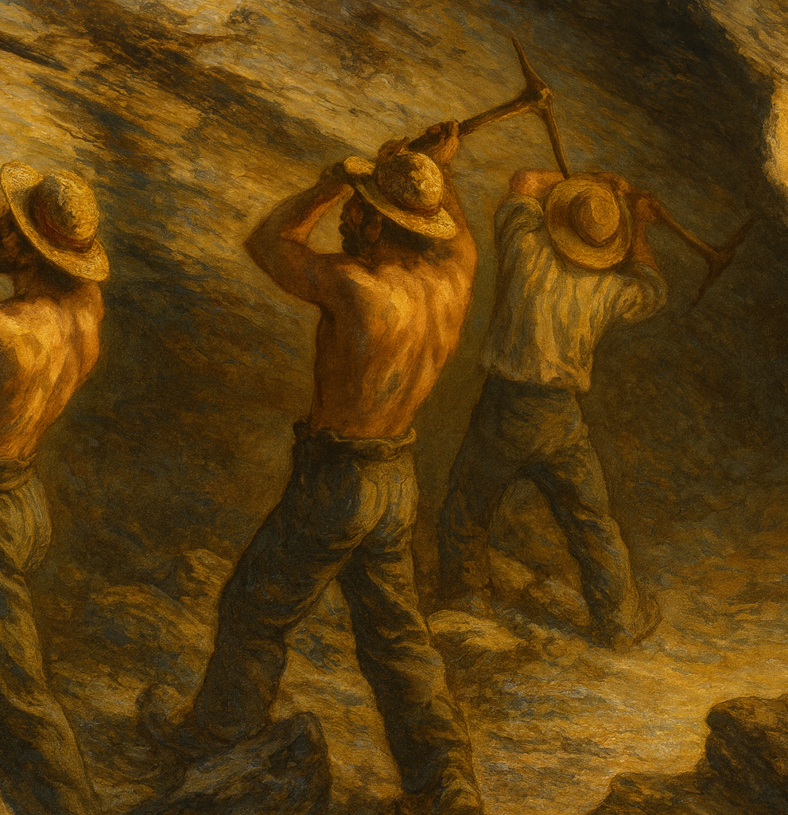
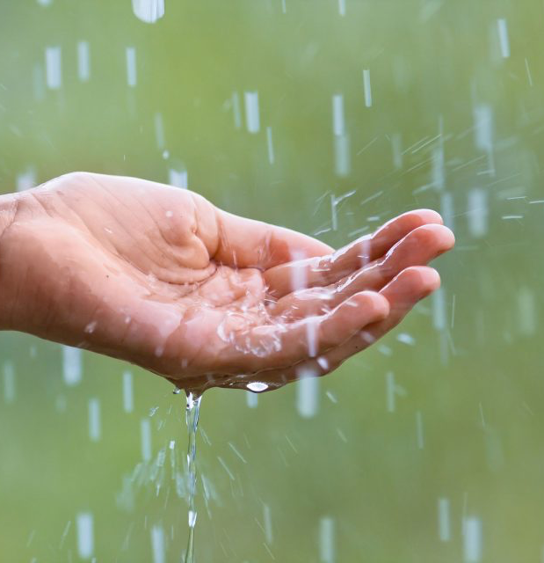
神的供应- 大自然

Slide 57
徒17:22-30
上帝的智慧
God’s wisdom is teleological—meaning that because it is intelligent, it guides nature and history to a particular conclusion
“Yet he did not leave himself without witness, for he did good by giving you rains from heaven and fruitful seasons, satisfying your hearts with food and gladness” (Acts 14:17).

Slide 58
受造界与我们一同叹息 – 期待救赎
但在《罗马书》中，保罗告诉我们，受造界与我们一同叹息，显明上帝的智慧不仅充满理性，也充满救赎的意义。这就意味着，若你对救赎视而不见，你眼中所见的，只是一个盲目进化的世界——正如丁尼生所说：“自然，血牙利爪，残酷无情。”但那藉着基督与上帝和好的人，能重新用《诗篇》104篇与《罗马书》8章的眼光来看受造界，看见上帝奇妙恩赐的倾倒，也看见受造界与我们一同叹息，等候救赎的成全。这就说明，受造界正在见证创造主的良善。
But in Romans, Paul tells us that nature is groaning with us, revealing that God’s wisdom is not only intelligent, but also redemptive.All this means that if you are blind to redemption, you won’t see the wisdom of the created world. You’ll see only a field of blind evolution, what Tennyson called “nature, red in tooth and claw.” But those who are reconciled to God through Christ can see nature again with the vision of Psalm 104 and Romans 8—the outpouring of God’s wonderful gifts, groaning with us for the fulfillment of redemption. And this means it speaks to the goodness of its Creator.

Slide 59
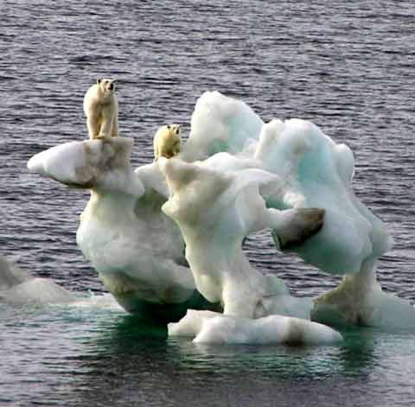

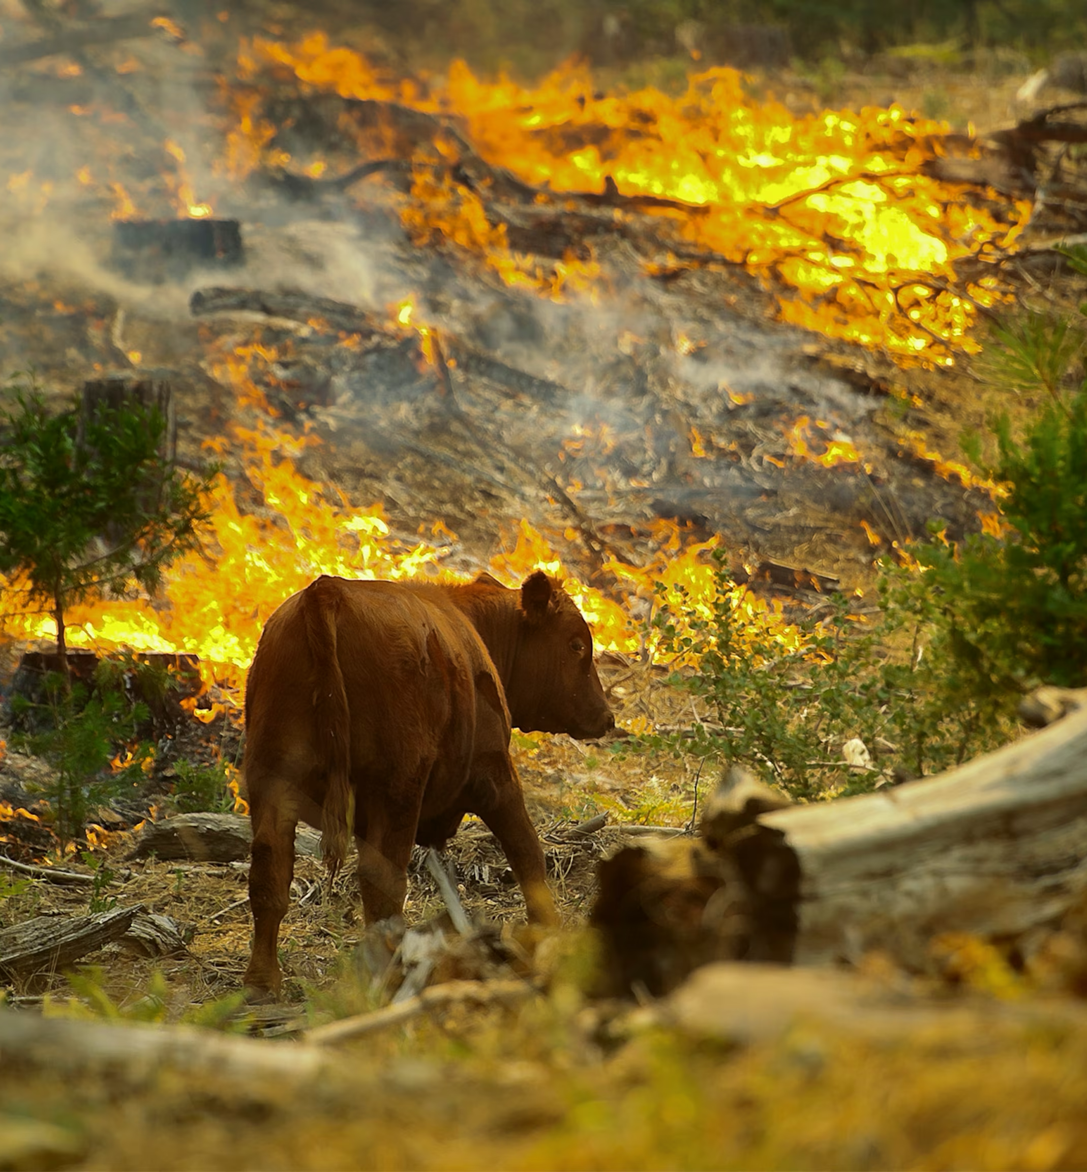
受造界与我们一同叹息 – 期待救赎
疾病与死亡
自然灾害
生态失衡

Slide 60
上帝的良善 – 人拥有道德
哲学家指出，我们无法从非道德性的事实中逻辑地推导出道德判断。有些人试图证明，例如吃人这样的行为是错误的，因为它会给被吃的人带来痛苦。但这种论证无法成立，除非前提首先被证明：使他人受苦本身就是错误的。我们并不是透过科学或哲学论证来学习道德的，而是透过人与人之间的关系来学习。
我们许多人发现，“爱”是生命的律。我们之所以接受他人作为道德权威，是因为我们从他们身上学会了忠诚与爱。我之所以遵循父母的伦理标准，是因为在年幼时我知道他们关心我，并且值得信赖。当然，我的父母并非道德上毫无错误，有时我需要纠正从他们那里学来的某些道德直觉，但我只有在与他人建立新的深层关系之后，才会作出这样的修正。当我开始寻求至高的道德权威时，我无法接受任何低于一位绝对位格者的标准——那就是我称为“上帝”的那一位。
Philosophers have pointed out that we cannot logically derive moral evaluations from non-moral facts. People sometimes try to prove that, say, cannibalism is wrong because it brings pain to those who are eaten. But that argument won’t work unless we first prove the premise that it is wrong to bring pain upon another person. We don’t learn morality through scientific or philosophical arguments. Rather, we learn it through interpersonal relations.Many of us have found that love is the law of life. We accept other people as moral authorities because we learn loyalty and love from them. I follow the ethical standards of my parents because at an early time of life I learned they cared for me and they were trustworthy. Of course, my parents were not ethically infallible. Sometimes I needed to correct the moral intuitions I had learned from them, but only as the result of a new interpersonal relationship. When I sought the highest ethical authority, I could accept nothing less than an absolute person, the person I called God.

Slide 62
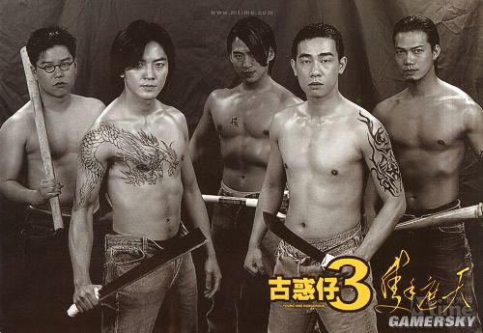
上帝的良善
非位格者怎能产生道德？
为什么世人，所有不同文化都拥有道德？
连邪恶也需要道义？

Slide 63
上帝的同在 – 上帝离我们不远
圣经常说上帝“在高处”掌权（伯16:19；诗18:16）。这是“天上”的同义词，指那高于并超越我们的所在。当耶稣升天时，祂升到空中，直至门徒不再看见祂（徒1:9–11）。但圣经也说，上帝亲近我们，与我们同在，遍在各处（诗139:7–12）。
使徒行传 17:27.要叫他们寻求神，或者可以揣摩而得，其实他离我们各人不远；28.我们生活、动作、存留，都在乎他。就如你们作诗的，有人说：『我们也是他所生的。』
The Bible often says that God reigns “on high” (Job 16:19; Ps 18:16). That is a synonym for heaven, a place above and beyond us. When Jesus ascended to heaven, he rose into the air until he was out of sight (Acts 1:9–11).But Scripture also says that God is near us, with us, in every place(Ps 139:7–12)
he is actually not far from each one of us, for ‘In him we live and move and have our being’; as even some of your own poets have said, ‘For we are indeed his offspring’ ” (Acts 17:27–28).

Slide 64
上帝的同在– 上帝离我们不远，人也拒绝承认
然而，不信的人拒绝承认神的存在，即使神就在镜中显明，即使神在我们自己的思想和身体里有所反映。不信的思想家坚持认为，在这些经文中，是人按照自己的形象创造了“神”，而不是神按照祂的形象创造了人。这种指控确实有几分真实，因为不信的人确实会照着自己的样子制造各样的“神明”。这正是圣经对偶像崇拜的批判，我们在《使徒行传》14章、《使徒行传》17章和《罗马书》1章都看见了这一点。但人所制造的偶像，根本不像那位真实的神。
Yet unbelief refuses to see God, even when God is in the mirror, even when God is reflected in our own minds and bodies. Unbelieving thinkers maintain that in these passages man is making God in his image, rather than the other way around. There is truth in this charge, for nonbelievers do indeed make gods in their image. That is precisely the biblical critique of idolatry that we have seen in Acts 14; Acts 17, and Romans 1. But the idols people make don’t resemble the true God at all.

Slide 65
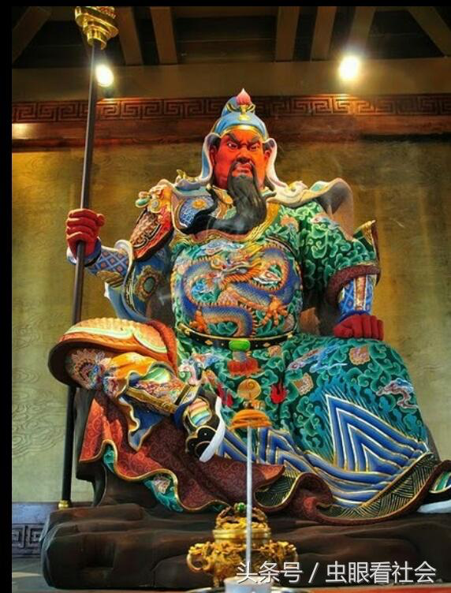
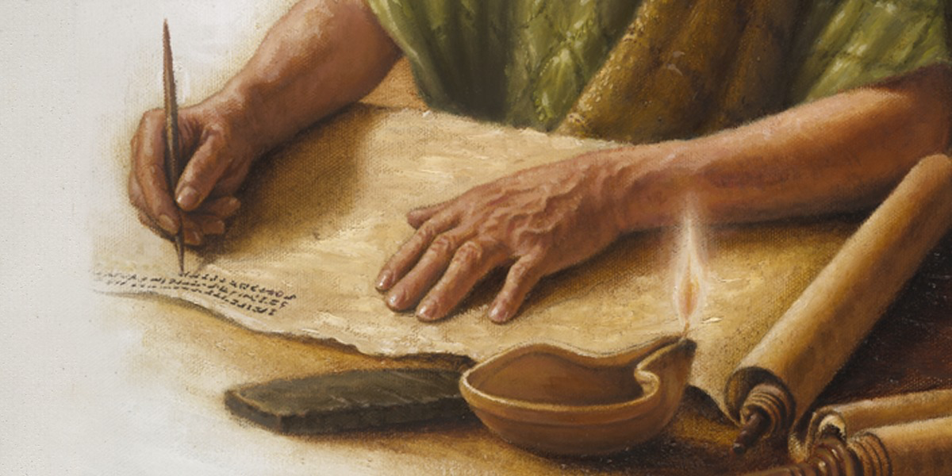
人创造神 – 宗教是人所创造的

Slide 66
上帝的同在– 在基督里才能清楚看见
因此，在基督里，我们不再被罪的扭曲所遮蔽，得以清楚看见那位照着祂形象造我们的上帝。
耶稣将神清楚地启示出来，否则我们凭着天然的眼光，只能“如同对着镜子模糊地看见”祂（林前13:12）。
In Jesus, then, we can see clearly the God who made us in his image, without the distortions of sin. Jesus reveals clearly what we in our natural vision see “in a mirror dimly” (1 Cor 13:12).

Slide 67
人性见证上帝（良心）
因此，我们自身就是创造主所启示的一部分。我们的自我认知应当激励我们敬拜祂，“因我受造奇妙可畏”（诗139:14）。良心正是这启示的一部分。对与错源自于神；祂赐给人良心，使人能够分辨并遵行祂的道德标准。
为了解答这些问题，我将探讨良心的四种状态——四种道德反应。在这些状态中，上帝以不同方式向我们显明祂自己。这四种良心分别是： 被烙过的良心 、控告的良心、觉醒的良心，以及清洁的良心。
So we are ourselves a revelation of our Creator. Our self-knowledge should motivate us to worship him “for we are fearfully and wonderfully made” (Ps 139:14). Conscience is part of that. As God is the author of right and wrong, so he has made the human conscience to read and follow his moral standards.To answer these questions, I shall consider four states of conscience—four kinds of moral reflection. In these, God appears to us in different ways. These are the seared conscience, the accusing conscience, the awakened conscience, and the good conscience.

Slide 68
人性见证上帝（被烙烧的良心）
即使在最败坏的状态下，良心仍然是上帝的启示。哪怕是那些良心被烙烧的人，也“知道 神公义的命令”。若道德没有一个位格性的源头，道德本身就毫无意义。因此，当道德原则触及良心时，那是一场位格性的相遇。良心之所以重要，是因为它是上帝的声音。
这并不是说良心是绝对无误的。正如我们将在后文看到的，良心必须被操练并受教导。被烙烧的良心已经失去了引导行为的能力，必须得着医治。
But even the seared conscience is not totally nonfunctioning. It is still a conscience, after all, not a complete nonentity. A sinner may ignore it regularly, but it is there. Even the person with the seared conscience has not forgotten morality: “Though they know God’s righteous decree that those who practice such things deserve to die, they not only do them but give approval to those who practice them” (Rom 1:32).

Slide 69
人性见证上帝（被烙过的良心）
但即使是被烙过的良心，也并非完全失效。毕竟，它仍是良心，而非全然无有。罪人可能常常忽视它，但它仍然存在。即使是那有着被烙过良心的人，也并未完全忘记道德：“他们虽然知道 神判定行这样事的人是当死的，然而他们不但自己去行，还喜欢别人去行”（罗1:32）。
Conscience, even at its worst, is a revelation of God. Even those with seared consciences “know God’s righteous decree.” Morality is meaningless unless it has a personal source. So when moral principles touch the conscience, it is a personal transaction. Conscience is important because it is the voice of God.That is not to say that the conscience is infallible. As we shall see in later chapters, it must be exercised and informed. A seared conscience has lost its power to direct our behavior, and it needs to be healed.

Slide 70
人性见证上帝（良心）
(新译本）罗马书 2:14.没有律法的外族人，如果按本性行律法上的事，他们虽然没有律法，自己就是自己的律法；15.这就表明律法的作用是刻在他们的心里，有他们的良心一同作证，他们的思想互相较量，或作控告、或作辩护。
The good news is that in the accusing conscience, as in the seared conscience, God speaks: (Rom 2:1–5)

Slide 71
觉醒的良心 THE AWAKENED CONSCIENCE
有时上帝亲自介入。当保罗在腓立比宣讲福音时，主开导了吕底亚的心，使她相信福音（徒16:14）。藉着上帝的主权工作，也就是祂的恩典，人的心才能从不信转变为信靠。
使徒行传 16:14.有一个卖紫色布疋的妇人，名叫吕底亚，是推雅推喇城的人，素来敬拜神。她听见了，主就开导她的心，叫她留心听保罗所讲的话。
sometimes God intervenes. When Paul preached in Philippi, for example, God opened Lydia’s heart to believe the gospel (Acts 16:14). By God’s sovereign action—that is, by grace—people’s hearts are changed from unbelief to faith.

Slide 72
觉醒的良心 THE AWAKENED CONSCIENCE
当上帝的恩典，就是祂在基督里的救恩，临到我们生命的时候，一切就彻底改变。这好比一次全新的创造：
“若有人在基督里，他就是新造的人。旧事已过，一切都变成新的了”（林后5:17）。
When God’s grace, his saving favor in Christ, enters our lives, everything changes. It is like being created all over again: “Therefore, if anyone is in Christ, he is a new creation. The old has passed away; behold, the new has come” (2 Cor 5:17).
Frame, J. M. (2018). Nature’s Case for God: A Brief Biblical Argument (E. Ritzema, J. Edwards, & D. Thevenaz, Eds.; p. 93). Lexham Press.

Slide 73
觉醒的良心 THE AWAKENED CONSCIENCE
希伯来书 9:14.
何况基督借着永远的灵，将自己无瑕无疵献给神，他的血岂不更能洗净你们的心（新译本： 洁净我们的良心 ），除去你们的死行，使你们事奉那永生神吗？
Hebrews 9:14. how much more will the blood of Christ, who through the eternal Spirit offered himself without blemish to God, purify our conscience from dead works to serve the living God.

Slide 74
觉醒的良心 THE AWAKENED CONSCIENCE
这种被洁净的良心，就是我在本章所称的“觉醒的良心”。藉着上帝在基督里的恩典，良心成为我们成圣的工具。它不再被烙伤或玷污，也不再无力指责罪；也不再仅仅是我们自义的工具，用来指责别人、为自己开脱。如今它被唤醒，照着上帝的旨意发挥功用：揭露我们内心的罪，责备它，并引导我们悔改。
当然，这新被唤醒的良心并不完美。即使它引导我们走向成圣，它本身也必须被成圣。它需要被教导和操练。这一过程的一部分，是我们必须学会聆听良心的声音，并顺服它所指示的。另一部分，是良心本身必须变得更加准确和值得信赖。而这正是在我们专注于神的话语、祈求祂的引导，并在属灵争战中积累经验时发生的。
This purified conscience is what I am calling in this chapter the “awakened” conscience. Through God’s grace in Christ, the conscience becomes a means of our sanctification. It is no longer seared or defiled, incapable of challenging sin. Nor is it a mere tool of our self-righteousness, accusing others and excusing ourselves. Now it wakes up in order to perform as God intended: to uncover sin in our own hearts, to rebuke it, and to lead us to repentance.Of course, the newly awakened conscience is not perfect. Even as it leads us to sanctification, it must itself be sanctified. It needs to be taught and trained. Part of this process is that we need to learn to listen to the voice of conscience and to obey what it says. Another part is that conscience itself needs to become more accurate and reliable. That happens as we attend to the word of God, as we pray for guidance, and as we gain experience in fighting the spiritual battle:

