Slide 1
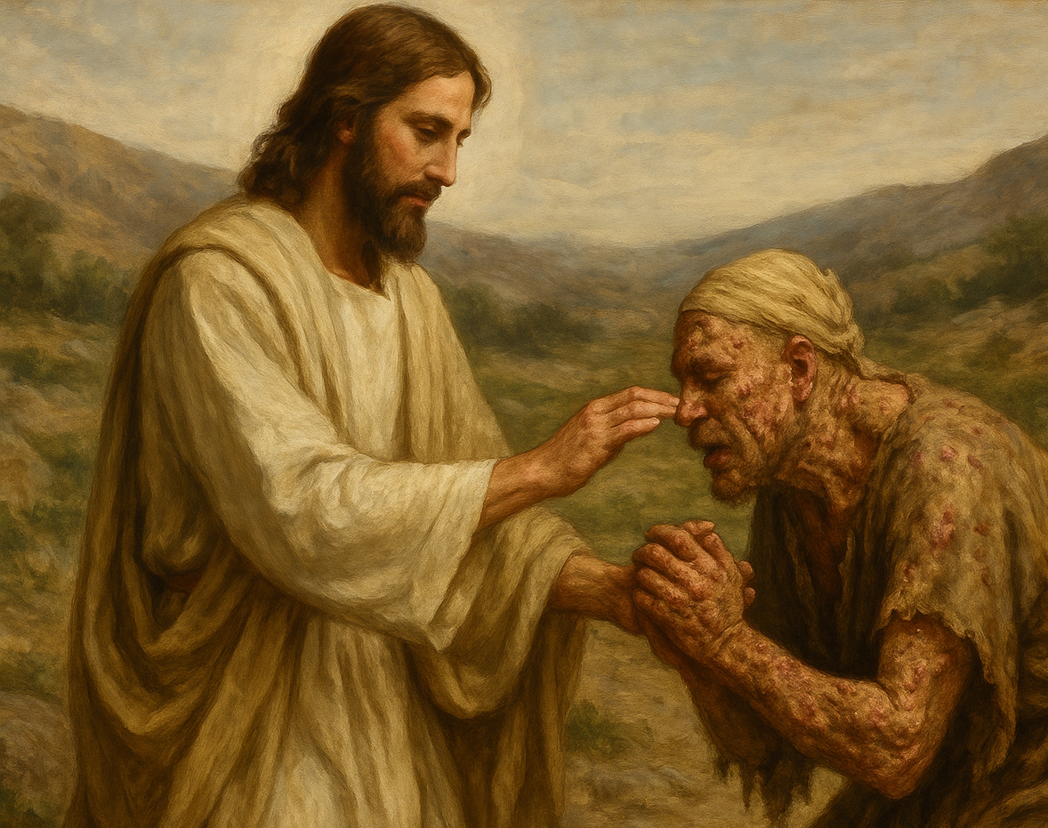
07
Jesus heals a Leper
(Mark 1:40-45)

Slide 2
Mark 1:40. And a leper came to him, imploring him, and kneeling said to him, "If you will, you can make me clean."41.Moved with pity, he stretched out his hand and touched him and said to him, "I will; be clean."42.And immediately the leprosy left him, and he was made clean.43.And Jesus sternly charged him and sent him away at once,44.and said to him, "See that you say nothing to anyone, but go, show yourself to the priest and offer for your cleansing what Moses commanded, for a proof to them."45.But he went out and began to talk freely about it, and to spread the news, so that Jesus could no longer openly enter a town, but was out in desolate places, and people were coming to him from every quarter.

Slide 3
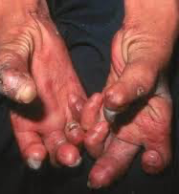
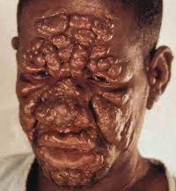

Slide 4
【1】
Sin behaves like leprosy

Slide 5
【1】
A humble and desperate faith

Slide 6
【3】
Jesus was moved with compassion

Slide 7
Matthew 23: 23
... the weightier matters of the law: justice and mercy and faithfulness. .....

Slide 8
Matthew 9:13
Go and learn what this means: ‘I desire mercy, and not sacrifice.’ …

Slide 9
Col 2:16.
Therefore let no one pass judgment on you in questions of food and drink, or with regard to a festival or a new moon or a Sabbath.17.These are a shadow of the things to come, but the substance belongs to Christ.

Slide 10
【4】
Jesus gave clear instructions to the Leper

Slide 11
43.And Jesus sternly charged him and sent him away at once,44.and said to him, "See that you say nothing to anyone, but go, show yourself to the priest and offer for your cleansing what Moses commanded, for a proof to them."45.But he went out and began to talk freely about it, and to spread the news, so that Jesus could no longer openly enter a town, but was out in desolate places, and people were coming to him from every quarter.

Slide 12
Jesus told me, but I didn’t listen.
When I listened, I didn’t understand.
When I understood, I didn’t obey.
When I obeyed, I still got it wrong.
When I was wrong, I didn’t confess.
When I confessed, I didn’t repent.

Slide 13
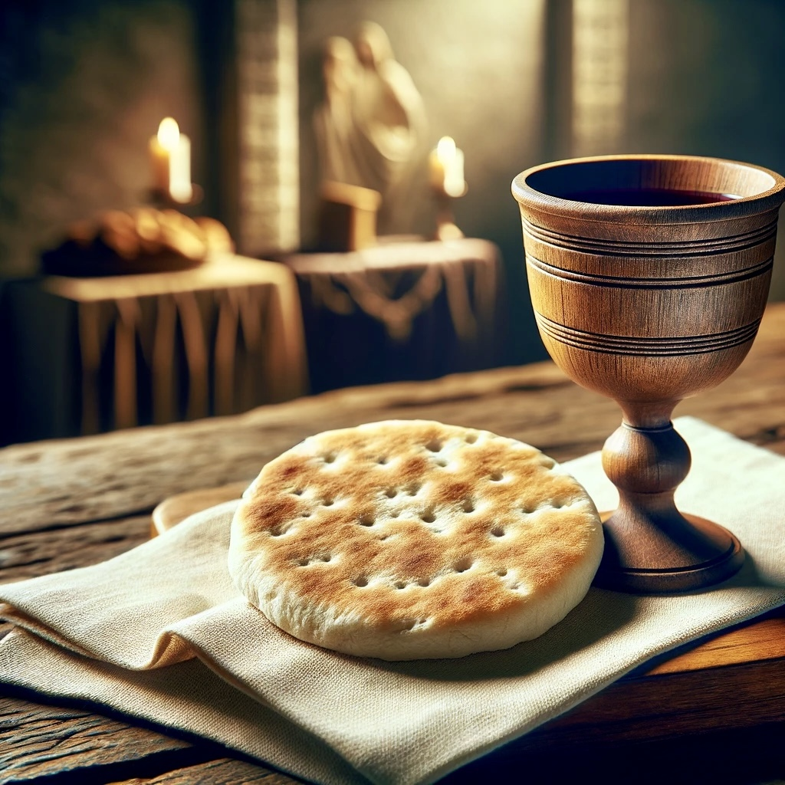
Holy Communion

Slide 14
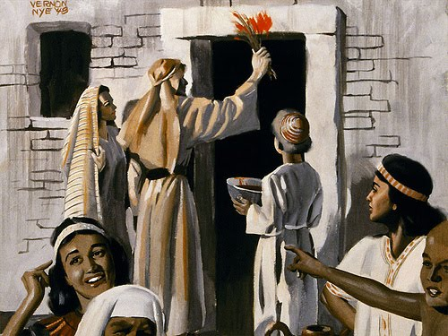
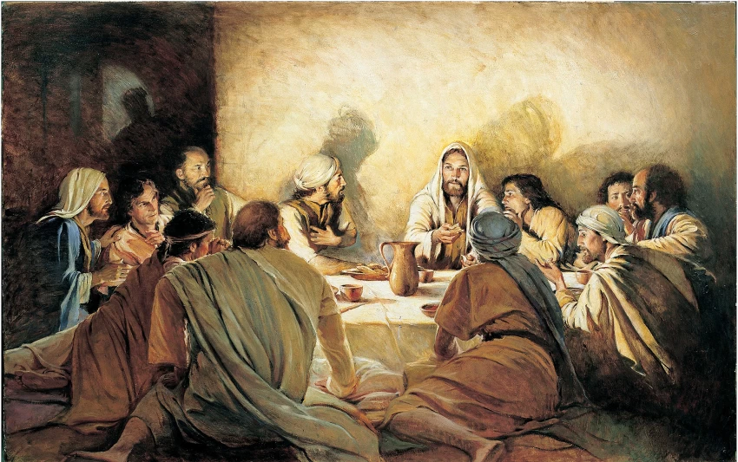
The Holy Communion fulfills the Passover meal.

Slide 15
Exodus 12:21.Then Moses called all the elders of Israel and said to them, "Go and select lambs for yourselves according to your clans, and kill the Passover lamb.22.Take a bunch of hyssop and dip it in the blood that is in the basin, and touch the lintel and the two doorposts with the blood that is in the basin. None of you shall go out of the door of his house until the morning. 23.For the Lord will pass through to strike the Egyptians, and when he sees the blood on the lintel and on the two doorposts, the Lord will pass over the door and will not allow the destroyer to enter your houses to strike you.

Slide 16
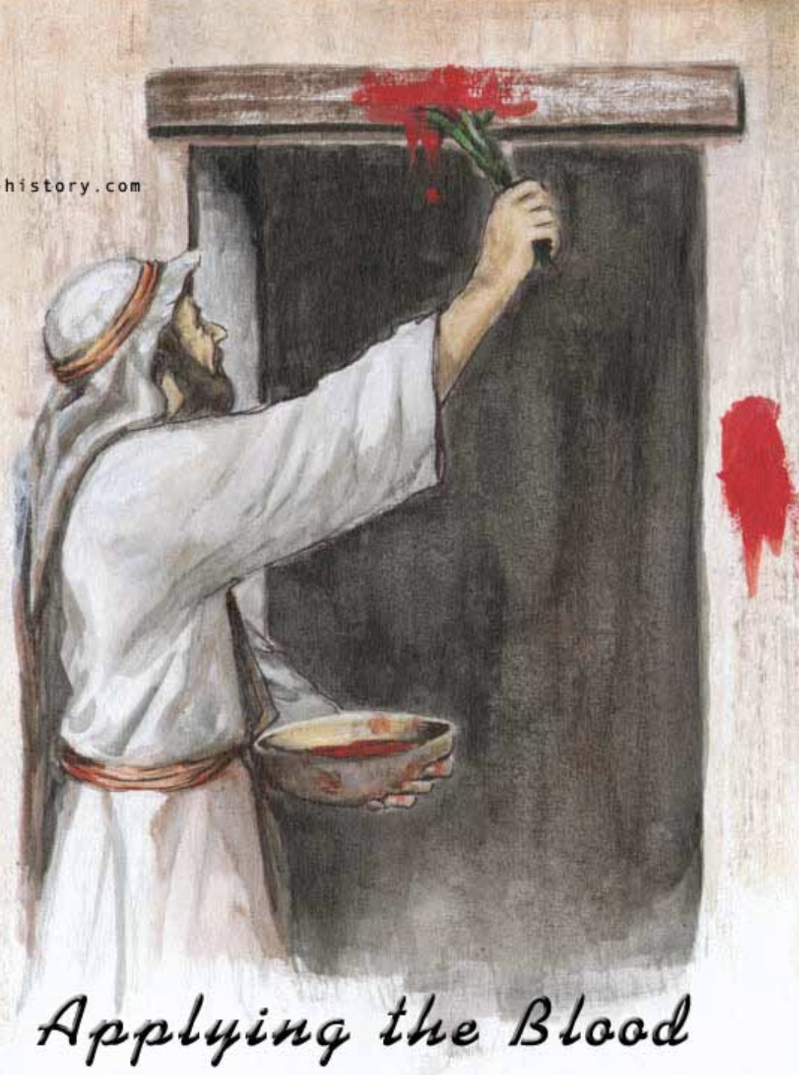
1 Corinthians 5:7 ....
For Christ, our Passover lamb, has been sacrificed.

Slide 17
Because of what Lord Jesus (our Passover lamb) has done for us, God’s judgment has passed over us.

