Slide 1
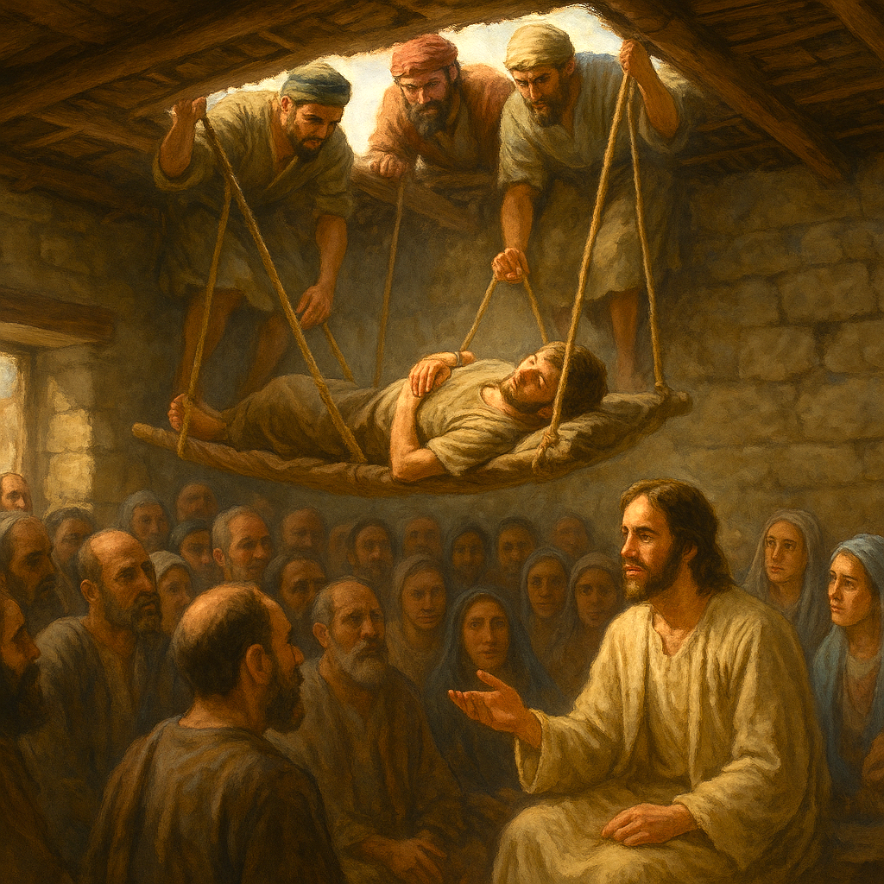
08
Who Can Forgive sins?
Mark 2:1–12

Slide 2
Mark 2:1.And when he returned to Capernaum after some days, it was reported that he was at home.2.And many were gathered together, so that there was no more room, not even at the door. And he was preaching the word to them.3.And they came, bringing to him a paralytic carried by four men.4.And when they could not get near him because of the crowd, they removed the roof above him, and when they had made an opening, they let down the bed on which the paralytic lay.5.And when Jesus saw their faith, he said to the paralytic, "Son, your sins are forgiven."6.Now some of the scribes were sitting there, questioning in their hearts,

Slide 3
Mark 2:7."Why does this man speak like that? He is blaspheming! Who can forgive sins but God alone?"8.And immediately Jesus, perceiving in his spirit that they thus questioned within themselves, said to them, "Why do you question these things in your hearts?9.Which is easier, to say to the paralytic, Your sins are forgiven, or to say, Rise, take up your bed and walk?10.But that you may know that the Son of Man has authority on earth to forgive sins" —he said to the paralytic—11."I say to you, rise, pick up your bed, and go home."12.And he rose and immediately picked up his bed and went out before them all, so that they were all amazed and glorified God, saying, "We never saw anything like this!"

Slide 4
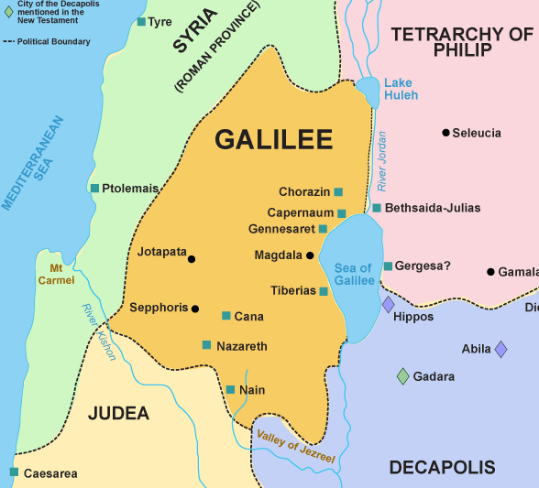
Capernaum is Jesus own city (Mat 9:1) a ministry base for Galilee. Majority in Capernaum do not believe (Mat 11:23)

Slide 5
【1】
The misery of paralysis:
loss of hope, freedom, and imprisonment

Slide 6
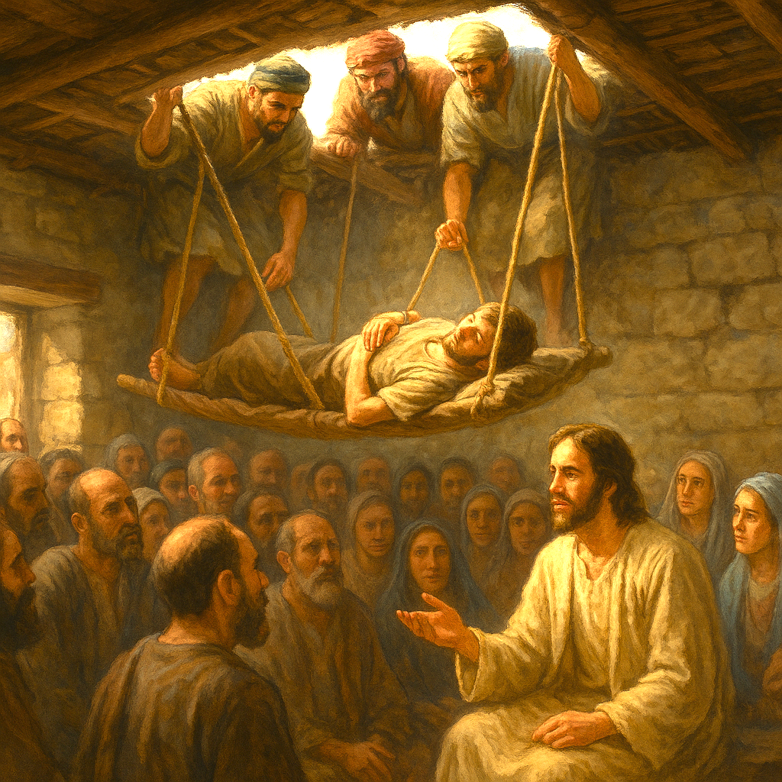

Slide 7
【2】
The faith, friendship,
and compassion of the four men

Slide 8
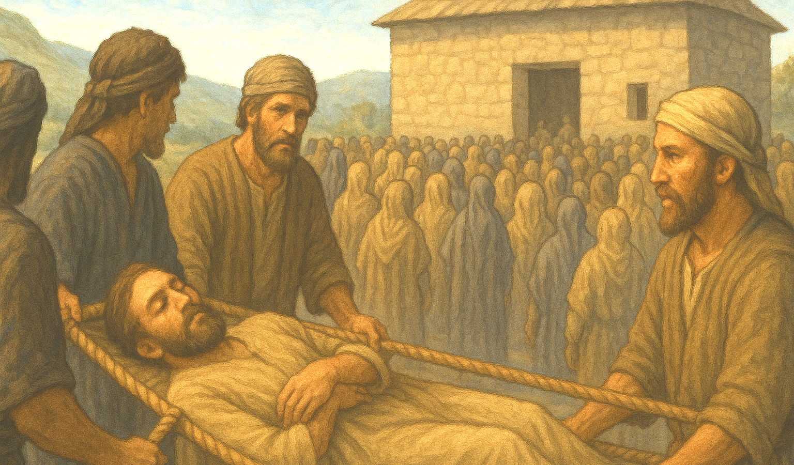

Slide 9
【3】
A matter more important and serious than paralysis

Slide 10
5.And when Jesus saw their faith, he said to the paralytic, "Son, your sins are forgiven."

Slide 11
Acts 10:43. To him all the prophets bear witness that everyone who believes in him receives forgiveness of sins through his name."

Slide 12
5.And when Jesus saw their faith, he said to the paralytic, "Son, your sins are forgiven."

Slide 13
【4】
Who has the authority to forgive sins?

Slide 14
9.Which is easier, to say to the paralytic, Your sins are forgiven, or to say, Rise, take up your bed and walk?

Slide 15
Which is easier?
Your sins are forgiven
Perform miracle heal

Slide 16
10.But that you may know that the Son of Man has authority on earth to forgive sins" —he said to the paralytic—11."I say to you, rise, pick up your bed, and go home."12.And he rose and immediately picked up his bed and went out before them all, so that they were all amazed and glorified God, saying, "We never saw anything like this!"

Slide 17
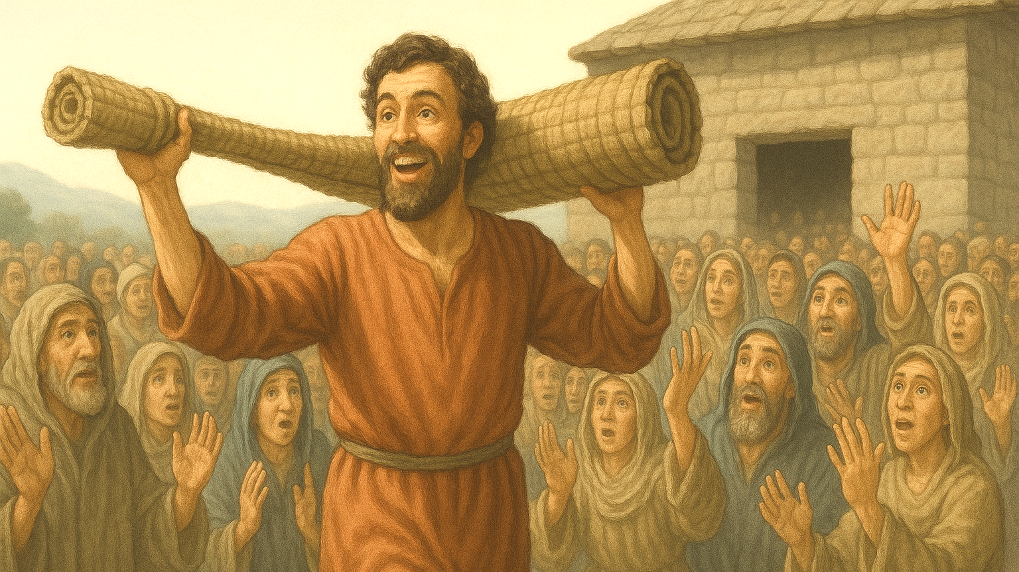
A new life after sins are forgiven and healed

Slide 18

Holy Communion

Slide 19
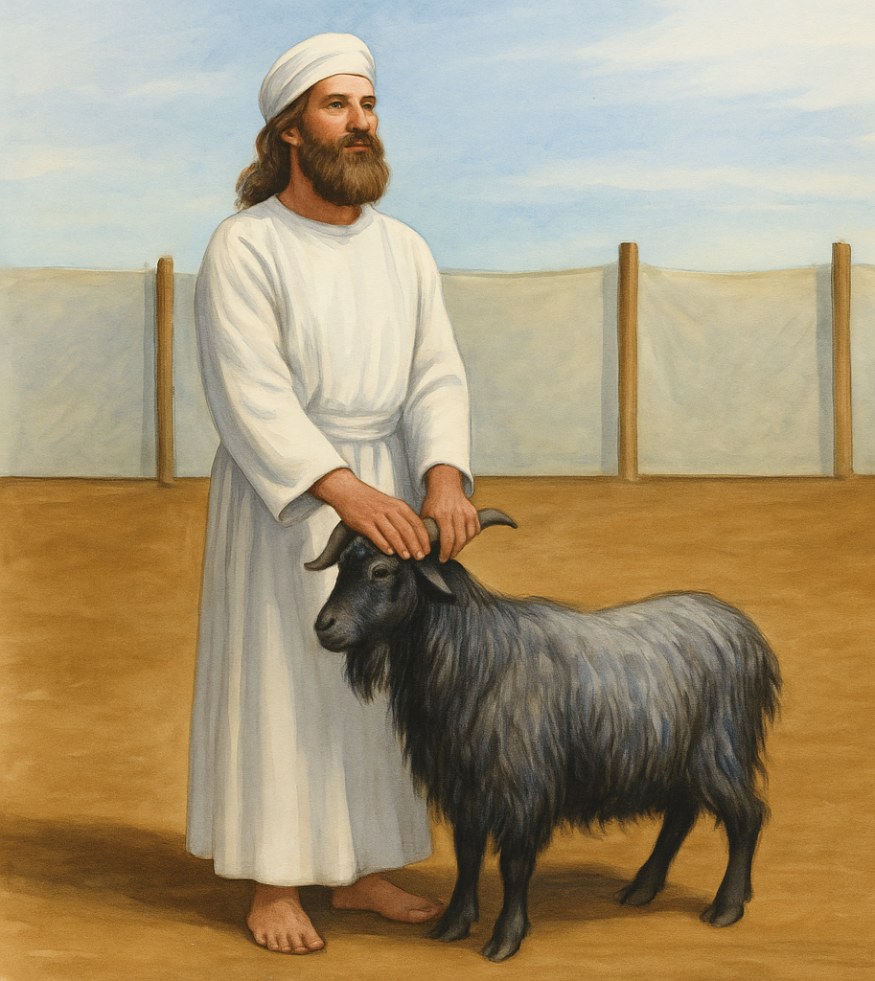
lev 16:15 “Then he shall kill the goat of the sin offering that is for the people … 21 And Aaron shall lay both his hands on the head of the live goat, and confess over it all the iniquities of the people of Israel, and all their transgressions, all their sins. And he shall put them on the head of the goat and send it away into the wilderness by the hand of a man who is in readiness. 22 The goat shall bear all their iniquities

