Slide 1
087 空坟墓
约19章38至20章10
The empty tomb

Slide 2
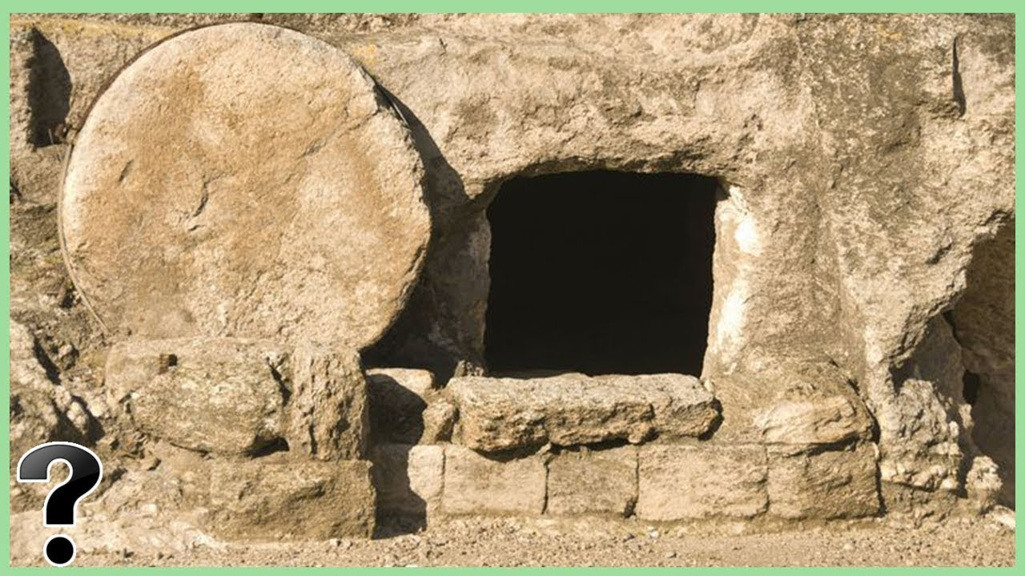

Slide 3
约19:38.这些事以后，有一个亚利马太人约瑟来求彼拉多，要领耶稣的身体；他因为怕犹太人，就暗暗地作耶稣的门徒。彼拉多批准了，他便把耶稣的身体领去。39.从前夜间来见耶稣的尼哥德慕也来了，带着没药和沉香混合的香料，约有三十二公斤。40.他们领取了耶稣的身体，照着犹太人的葬礼的规例，用细麻布和香料把他裹好。
John 19:38.After these things Joseph of Arimathea, who was a disciple of Jesus, but secretly for fear of the Jews, asked Pilate that he might take away the body of Jesus, and Pilate gave him permission. So he came and took away his body.39.Nicodemus also, who earlier had come to Jesus by night, came bringing a mixture of myrrh and aloes, about seventy-five pounds in weight.40.So they took the body of Jesus and bound it in linen cloths with the spices, as is the burial custom of the Jews.
1/4

Slide 4
约19:41.在耶稣钉十字架的地方，有一个园子，园里有一个新的墓穴，是从来没有葬过人的。42因为那天是犹太人的预备日，又因为那墓穴就在附近，他们就把耶稣葬在那里。20:1礼拜日清早，天还没有亮的时候，抹大拉的马利亚来到墓旁，看见石头已经从坟墓移开了。2 她就跑去见西门．彼得，和耶稣所爱的那个门徒，对他们说:“有人把主从坟墓里搬走了，我们不知道他们把他放在哪里。”
John 19:41.Now in the place where he was crucified there was a garden, and in the garden a new tomb in which no one had yet been laid.42.So because of the Jewish day of Preparation, since the tomb was close at hand, they laid Jesus there. 20:1.Now on the first day of the week Mary Magdalene came to the tomb early, while it was still dark, and saw that the stone had been taken away from the tomb.2.So she ran and went to Simon Peter and the other disciple, the one whom Jesus loved, and said to them, "They have taken the Lord out of the tomb, and we do not know where they have laid him."
2/4

Slide 5
3.彼得和那门徒就动身，到坟墓那里去。4.两个人一齐跑，那门徒比彼得跑得快，先到了坟墓，5.屈身向里面观看，看见细麻布还在那里，但他却没有进去。6.西门．彼得随后也到了；他进入坟墓，看见细麻布还放在那里，7.也看见耶稣的裹头巾，没有和细麻布放在一起，而是卷着放在一边。
3.So Peter went out with the other disciple, and they were going toward the tomb.4.Both of them were running together, but the other disciple outran Peter and reached the tomb first.5.And stooping to look in, he saw the linen cloths lying there, but he did not go in.6.Then Simon Peter came, following him, and went into the tomb. He saw the linen cloths lying there,7.and the face cloth, which had been on Jesus head, not lying with the linen cloths but folded up in a place by itself.
3/4

Slide 6
8.那时，先到坟墓的那门徒也进去，他看见，就信了。9.他们还不明白经上所说“他必须从死人中复活”这句话的意思。10.于是两个门徒就回家去了。
8.Then the other disciple, who had reached the tomb first, also went in, and he saw and believed ; 9.for as yet they did not understand the Scripture, that he must rise from the dead.10.Then the disciples went back to their homes.
4/4

Slide 7
01
暗暗作门徒的亚利马太的约瑟
Joseph of Arimathea, who was a secret disciple.

Slide 8
约19:38.这些事以后，有一个亚利马太人约瑟来求彼拉多，要领耶稣的身体；他因为怕犹太人，就暗暗地作耶稣的门徒。彼拉多批准了，他便把耶稣的身体领去。
John 19:38.After these things Joseph of Arimathea, who was a disciple of Jesus, but secretly for fear of the Jews, asked Pilate that he might take away the body of Jesus, and Pilate gave him permission. So he came and took away his body.

Slide 9
太10:32
「凡在人面前认我的，我在我天上的父面前也必认他；33 凡在人面前不认我的，我在我天上的父面前也必不认他。」
Matthew 10:32. So everyone who acknowledges me before men, I also will acknowledge before my Father who is in heaven,33.but whoever denies me before men, I also will deny before my Father who is in heaven.

Slide 10
02
尼哥底母为耶稣预备葬礼
Nicodemus prepared the burial for Jesus

Slide 11
39.从前夜间来见耶稣的尼哥德慕【尼哥底母】也来了，带着没药和沉香混合的香料，约有三十二公斤。40.他们领取了耶稣的身体，照着犹太人的葬礼的规例，用细麻布和香料把他裹好。
39.Nicodemus also, who earlier had come to Jesus by night, came bringing a mixture of myrrh and aloes, about seventy-five pounds in weight.40.So they took the body of Jesus and bound it in linen cloths with the spices, as is the burial custom of the Jews.

Slide 12
03
耶稣葬在新墓穴
Jesus was buried in a new tomb

Slide 13
约19:41.在耶稣钉十字架的地方，有一个园子，园里有一个新的墓穴，是从来没有葬过人的。
John 19:41.Now in the place where he was crucified there was a garden, and in the garden a new tomb in which no one had yet been laid.

Slide 14
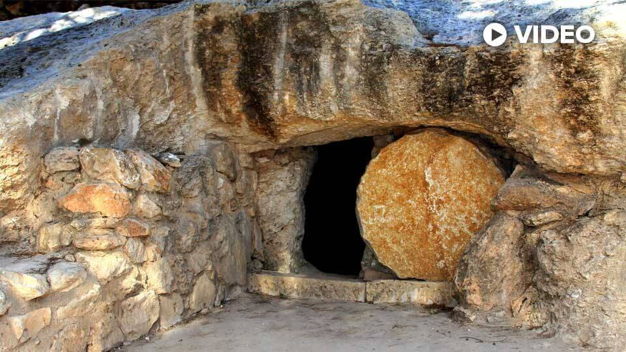
太27:60 安放在自己的新坟墓里，就是他凿在磐石里的。他又把大石头滚到墓门口，就去了。
1/5
1/4

Slide 15
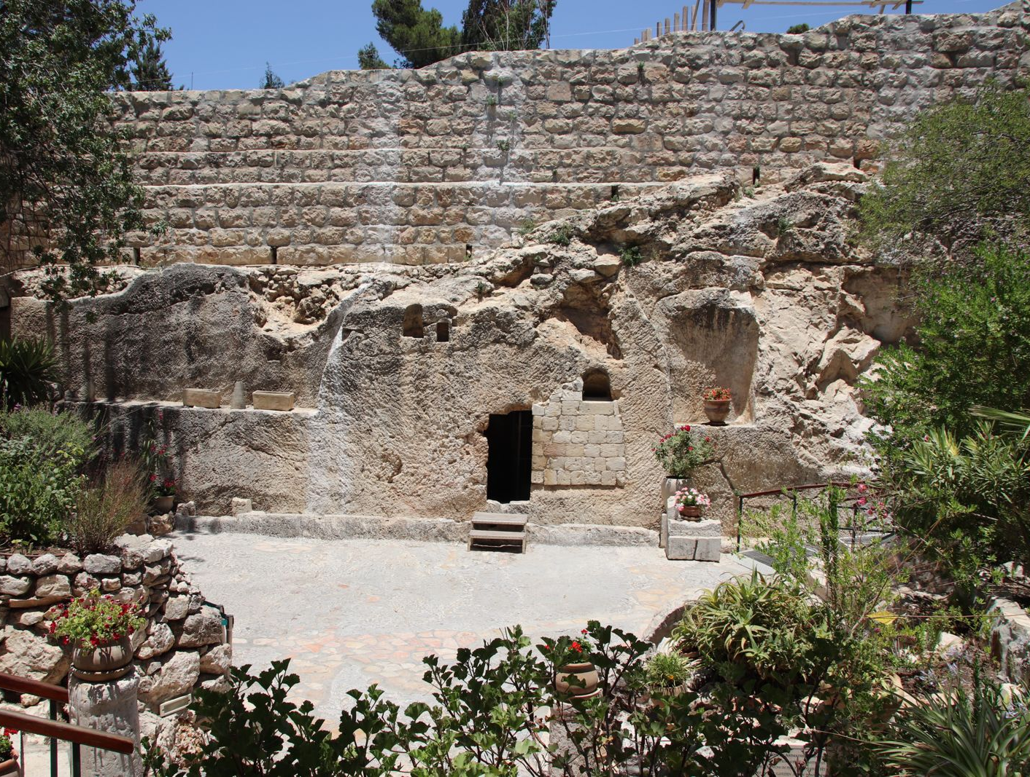
花园墓不太可能是
耶稣的埋葬地点，
追溯至公元前7世纪
The Garden Tomb is unlikely to be the burial site of Jesus, as it dates back to the 7th century BC.
2/5

Slide 16
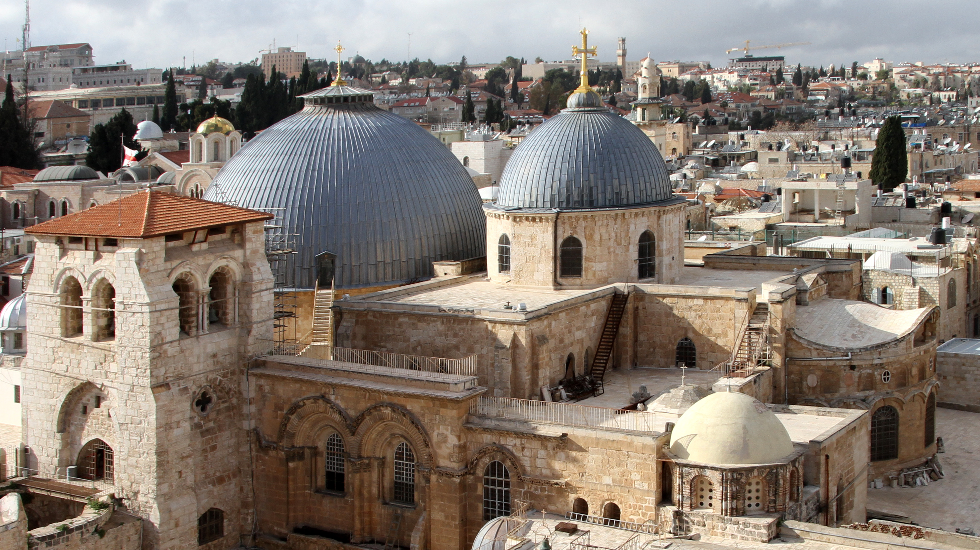
圣墓教堂
Church of the Holy Sepulchre
3/5

Slide 17
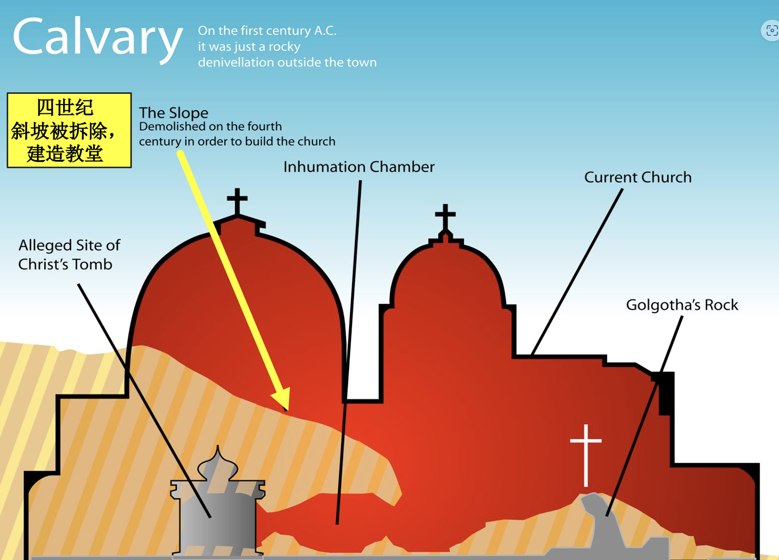
耶路撒冷圣墓教堂
由君士坦丁大帝于4世纪建造
12世纪进行大规模的重建。
4/5

Slide 18
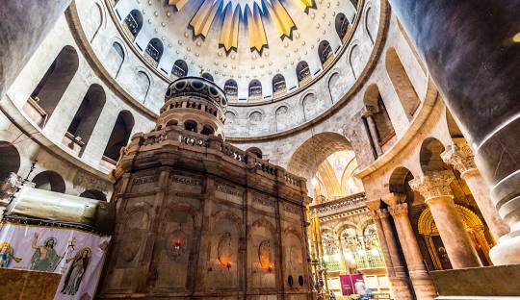
圣墓教堂
Church of the Holy Sepulchre
5/5

Slide 19
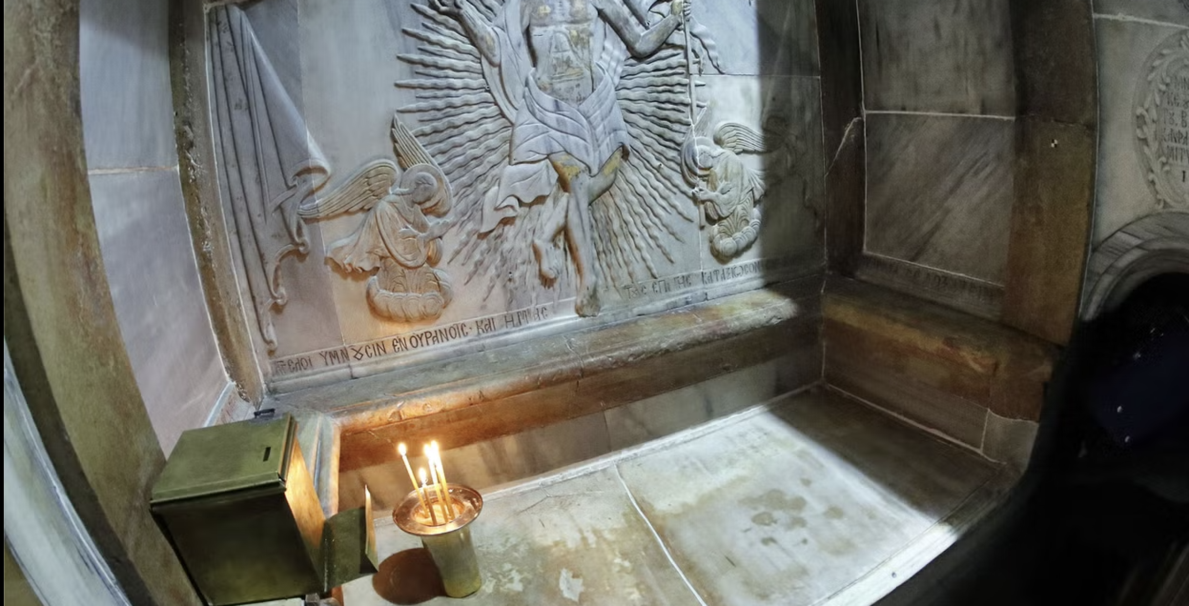
圣墓小堂
Aedicule

Slide 20
04
抹大拉的马利发现坟墓空了
Mary Magdalene discovered the tomb was empty.

Slide 21
20:1 礼拜日清早，天还没有亮的时候，抹大拉的马利亚来到墓旁，看见石头已经从坟墓移开了。2 她就跑去见西门．彼得，和耶稣所爱的那个门徒，对他们说:“有人把主从坟墓里搬走了，我们不知道他们把他放在哪里。”
20:1.Now on the first day of the week Mary Magdalene came to the tomb early, while it was still dark, and saw that the stone had been taken away from the tomb.2.So she ran and went to Simon Peter and the other disciple, the one whom Jesus loved, and said to them, "They have taken the Lord out of the tomb, and we do not know where they have laid him."

Slide 22
05
彼得和约翰看见空坟墓
Peter and John saw the empty tomb

Slide 23
8.那时，先到坟墓的那门徒也进去，他看见，就信了。9.他们还不明白经上所说“他必须从死人中复活”这句话的意思。10.于是两个门徒就回家去了。
8.Then the other disciple, who had reached the tomb first, also went in, and he saw and believed ; 9.for as yet they did not understand the Scripture, that he must rise from the dead.10.Then the disciples went back to their homes.

Slide 24
8.那时，先到坟墓的那门徒也进去，他看见，就信了。9.他们还不明白经上所说“他必须从死人中复活”这句话的意思。10.于是两个门徒就回家去了。
8.Then the other disciple, who had reached the tomb first, also went in, and he saw and believed ; 9.for as yet they did not understand the Scripture, that he must rise from the dead.10.Then the disciples went back to their homes.

Slide 25
他们还不明白经上所说“他必须从死人中复活”
for as yet they did not understand the Scripture, that he must rise from the dead.
（1）信仰是一个旅途
Faith is a journey.
（2）圣经是神的话– 旧约圣经预言基督要复活
The Bible is God's Word – the Old Testament prophesies that Christ will rise again.
（3）约翰提醒教会圣经的重要性。
John reminds the church of the importance of the Bible.

Slide 26
