Slide 1
088 耶稣的显现：消除忧愁、恐惧与疑惑
约20章11至31
The Appearance of Jesus: Dispelling Sorrow, Fear, and Doubt

Slide 2
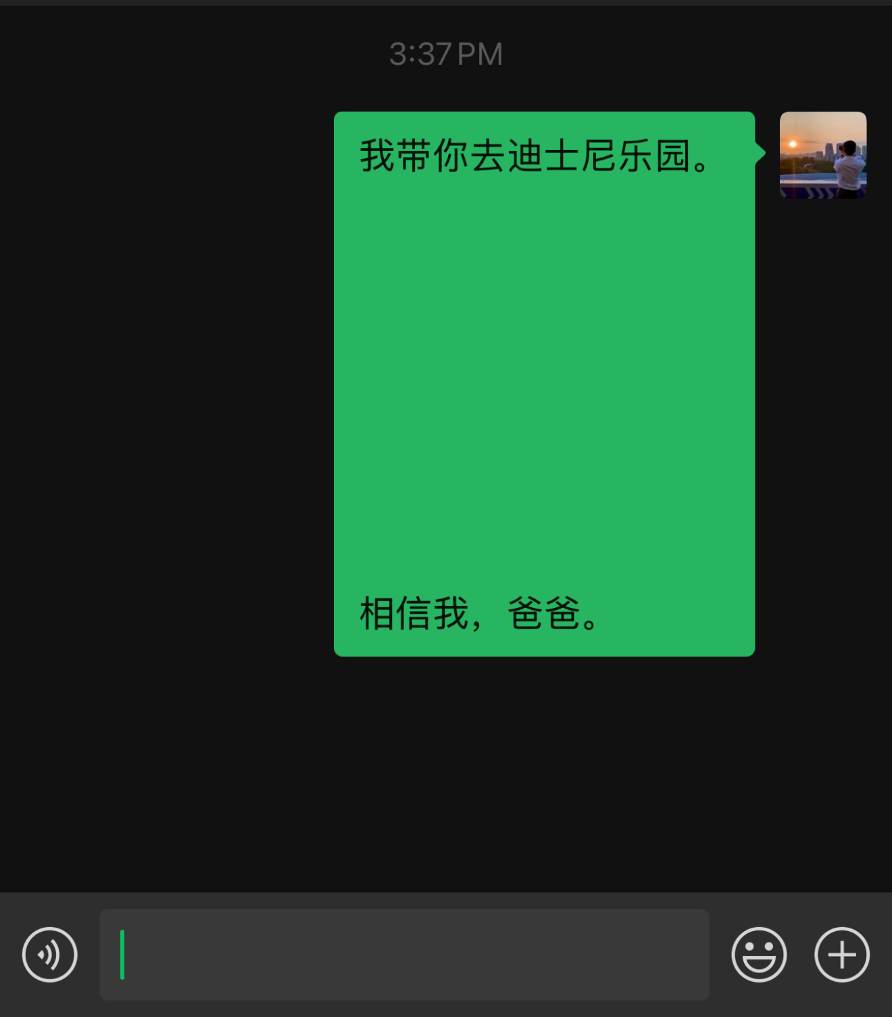
我信爸爸所说：“我带你去迪士尼乐园。”
信息说的
I believe what my dad said:
"I will take you to Disneyland."

Slide 3
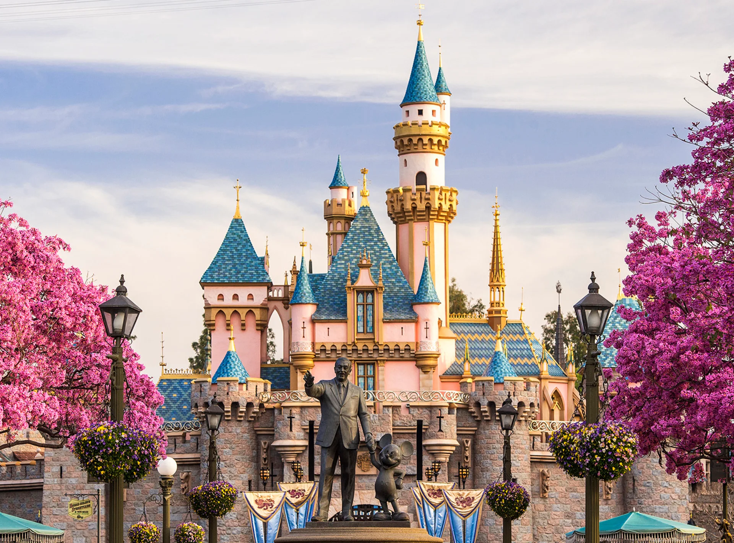
我亲眼看见迪士尼乐园，才相信爸爸说：“我带你去迪士尼乐园。”

Slide 4
爸爸说
你亲眼看见
那一个孩子更有福？
Which child is more blessed?

Slide 5
神说的
你亲眼看见

Slide 6
约 20:11.马利亚站在坟墓外面哭泣。她哭的时候，屈身往里面观看，12.看见两个身穿白衣的天使，坐在安放耶稣身体的地方，一个在头那边，一个在脚那边。13.天使问她：“妇人，你为甚么哭？”她说：“有人把我的主搬走了，我不知道他们把他放在哪里。”14.马利亚说了这话，就转过身来，看见耶稣站在那里，却不知道他就是耶稣。15.耶稣对她说：“妇人，你为甚么哭？你找谁呢？”马利亚以为耶稣是园丁，就对他说：“先生，如果是你把他挪去了，请告诉我你把他放在甚么地方，我好去搬回来。”
John 20：11.But Mary stood weeping outside the tomb, and as she wept she stooped to look into the tomb.12.And she saw two angels in white, sitting where the body of Jesus had lain, one at the head and one at the feet.13.They said to her, "Woman, why are you weeping?" She said to them, "They have taken away my Lord, and I do not know where they have laid him."14.Having said this, she turned around and saw Jesus standing, but she did not know that it was Jesus.15.Jesus said to her, "Woman, why are you weeping? Whom are you seeking?" Supposing him to be the gardener, she said to him, "Sir, if you have carried him away, tell me where you have laid him, and I will take him away."
1/5

Slide 7
16.耶稣对她说：“马利亚！”她转过身来，用希伯来话对他说：“拉波尼！”(就是“老师”的意思。)17.耶稣说：“你不要拉住我，因为我还没有上去见父。你要到我的弟兄们那里去，告诉他们我要上去见我的父，也是你们的父；见我的 神，也是你们的 神。”18.抹大拉的马利亚就去，向门徒报信说：“我已经看见主了！”她又把主对她所说的话告诉他们。
16.Jesus said to her, "Mary." She turned and said to him in Aramaic, "Rabboni!" (which means Teacher).17.Jesus said to her, "Do not cling to me, for I have not yet ascended to the Father; but go to my brothers and say to them, I am ascending to my Father and your Father, to my God and your God."18.Mary Magdalene went and announced to the disciples, "I have seen the Lord"—and that he had said these things to her.
2/5

Slide 8
19.礼拜日黄昏的时候，门徒聚在一起，因为怕犹太人，就把门户都关上。耶稣来了，站在他们中间，说：“愿你们平安。”20.说了这话，就把手和肋旁给他们看。门徒看见主，就欢喜了。21.耶稣又对他们说：“愿你们平安。父怎样差遣了我，我也怎样差遣你们。”22.说了这话，就向他们吹一口气，说：“你们领受圣灵吧！23.你们赦免谁的罪，谁的罪就得赦免；你们不赦免谁的罪，谁的罪就不得赦免。”
19.On the evening of that day, the first day of the week, the doors being locked where the disciples were for fear of the Jews, Jesus came and stood among them and said to them, "Peace be with you."20.When he had said this, he showed them his hands and his side. Then the disciples were glad when they saw the Lord.21.Jesus said to them again, "Peace be with you. As the Father has sent me, even so I am sending you."22.And when he had said this, he breathed on them and said to them, "Receive the Holy Spirit.23.If you forgive the sins of any, they are forgiven them; if you withhold forgiveness from any, it is withheld."
3/5

Slide 9
24.十二个门徒中，有一个称为“双生子”的多马。耶稣来的时候，他没有和门徒在一起。25.其他的门徒对他说：“我们已经见过主了。”多马对他们说：“除非我亲眼看见他手上的钉痕，用我的指头探入那钉痕，又用我的手探入他的肋旁，我决不相信。”26.过了八天，门徒又在屋子里，多马也和他们在一起。门户都关上了。耶稣来了，站在他们中间，说：“愿你们平安。”27.然后对多马说：“把你的指头放在这里，看看我的手吧！伸出你的手来，探探我的肋旁！不要疑惑，只要信！”28.多马对他说：“我的主！我的 神！”
24.Now Thomas, one of the twelve, called the Twin, was not with them when Jesus came.25.So the other disciples told him, "We have seen the Lord." But he said to them, "Unless I see in his hands the mark of the nails, and place my finger into the mark of the nails, and place my hand into his side, I will never believe."26.Eight days later, his disciples were inside again, and Thomas was with them. Although the doors were locked, Jesus came and stood among them and said, "Peace be with you."27.Then he said to Thomas, "Put your finger here, and see my hands; and put out your hand, and place it in my side. Do not disbelieve, but believe."28.Thomas answered him, "My Lord and my God!"
4/5

Slide 10
29.耶稣说：“你因为看见我才信吗？那些没有看见就信的人，是有福的。”30.耶稣在门徒面前还行了许多别的神迹，没有记在这书上。31.但把这些事记下来，是要你们信耶稣是基督，是 神的儿子，并且使你们信了，可以因他的名得生命。
29.Jesus said to him, "Have you believed because you have seen me? Blessed are those who have not seen and yet have believed."30.Now Jesus did many other signs in the presence of the disciples, which are not written in this book;31.but these are written so that you may believe that Jesus is the Christ, the Son of God, and that by believing you may have life in his name.
5/5

Slide 11
01
主消除门徒的忧愁
The Lord dispelled the disciples' sorrow.

Slide 12
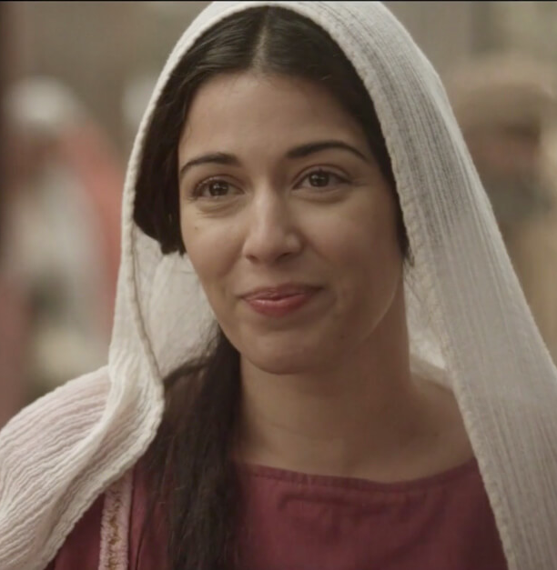
抹大拉的马利亚爱主，
曾有七个鬼从她身上赶出来（路8:2-3）
Mary Magdalene loved the Lord,
seven demons had been cast out from her
(Luke 8:2-3).

Slide 13
约 20:11.马利亚站在坟墓外面哭泣。她哭的时候，屈身往里面观看，12.看见两个身穿白衣的天使，坐在安放耶稣身体的地方，一个在头那边，一个在脚那边。13.天使问她：“妇人，你为甚么哭？”她说：“有人把我的主搬走了，我不知道他们把他放在哪里。”
John 20：11.But Mary stood weeping outside the tomb, and as she wept she stooped to look into the tomb.12.And she saw two angels in white, sitting where the body of Jesus had lain, one at the head and one at the feet.13.They said to her, "Woman, why are you weeping?" She said to them, "They have taken away my Lord, and I do not know where they have laid him."

Slide 14
14.马利亚说了这话，就转过身来，看见耶稣站在那里，却不知道他就是耶稣。15.耶稣对她说：“妇人，你为甚么哭？你找谁呢？”马利亚以为耶稣是园丁，就对他说：“先生，如果是你把他挪去了，请告诉我你把他放在甚么地方，我好去搬回来。”
14.Having said this, she turned around and saw Jesus standing, but she did not know that it was Jesus. 15.Jesus said to her, "Woman, why are you weeping? Whom are you seeking?" Supposing him to be the gardener, she said to him, "Sir, if you have carried him away, tell me where you have laid him, and I will take him away."

Slide 15
17.耶稣说：“你不要拉住我，因为我还没有上去见父。你要到我的弟兄们那里去，告诉他们我要上去见我的父，也是你们的父；见我的 神，也是你们的 神。”18.抹大拉的马利亚就去，向门徒报信说：“我已经看见主了！”她又把主对她所说的话告诉他们。
17.Jesus said to her, "Do not cling to me, for I have not yet ascended to the Father; but go to my brothers and say to them, I am ascending to my Father and your Father, to my God and your God."18.Mary Magdalene went and announced to the disciples, "I have seen the Lord"—and that he had said these things to her.

Slide 16
17.耶稣说：“你不要拉住我，因为我还没有上去见父。你要到我的弟兄们那里去，告诉他们我要上去见我的父
17.Jesus said to her, “Do not cling to me, for I have not yet ascended to the Father; but go to my brothers and say to them, I am ascending to my Father 。。。

Slide 17
17...
告诉他们我要上去见我的父，也是你们的父；见我的神，也是你们的神。”
17.。。 but go to my brothers and say to them, I am ascending to my Father and your Father, to my God and your God."

Slide 18
02
主消除门徒的惧怕
The Lord dispelled the disciples' fear.

Slide 19
19.礼拜日黄昏的时候，门徒聚在一起，因为怕犹太人，就把门户都关上。耶稣来了，站在他们中间，说：“愿你们平安。”20.说了这话，就把手和肋旁给他们看。门徒看见主，就欢喜了。21.耶稣又对他们说：“愿你们平安。父怎样差遣了我，我也怎样差遣你们。”22.说了这话，就向他们吹一口气，说：“你们领受圣灵吧！23.你们赦免谁的罪，谁的罪就得赦免；你们不赦免谁的罪，谁的罪就不得赦免。”
19.On the evening of that day, the first day of the week, the doors being locked where the disciples were for fear of the Jews, Jesus came and stood among them and said to them, "Peace be with you."20.When he had said this, he showed them his hands and his side. Then the disciples were glad when they saw the Lord.21.Jesus said to them again, "Peace be with you. As the Father has sent me, even so I am sending you."22.And when he had said this, he breathed on them and said to them, "Receive the Holy Spirit.23.If you forgive the sins of any, they are forgiven them; if you withhold forgiveness from any, it is withheld."

Slide 20
21.耶稣又对他们说：“愿你们平安。父怎样差遣了我，我也怎样差遣你们。
21.Jesus said to them again, "Peace be with you. As the Father has sent me, even so I am sending you."

Slide 21
22.说了这话，就向他们吹一口气，说：“你们领受圣灵吧！
22.And when he had said this, he breathed on them and said to them, "Receive the Holy Spirit.

Slide 22
23.你们赦免谁的罪，谁的罪就得赦免；你们不赦免谁的罪，谁的罪就不得赦免。”
23.If you forgive the sins of any, they are forgiven them; if you withhold forgiveness from any, it is withheld."

Slide 23
03
主消除门徒的疑惑
The Lord dispelled the disciples' doubt.

Slide 24
24.十二个门徒中，有一个称为“双生子”的多马。耶稣来的时候，他没有和门徒在一起。25.其他的门徒对他说：“我们已经见过主了。”多马对他们说：“除非我亲眼看见他手上的钉痕，用我的指头探入那钉痕，又用我的手探入他的肋旁，我决不相信。”26.过了八天，门徒又在屋子里，多马也和他们在一起。门户都关上了。耶稣来了，站在他们中间，说：“愿你们平安。”27.然后对多马说：“把你的指头放在这里，看看我的手吧！伸出你的手来，探探我的肋旁！不要疑惑，只要信！”28.多马对他说：“我的主！我的 神！”
24.Now Thomas, one of the twelve, called the Twin, was not with them when Jesus came.25.So the other disciples told him, "We have seen the Lord." But he said to them, "Unless I see in his hands the mark of the nails, and place my finger into the mark of the nails, and place my hand into his side, I will never believe."26.Eight days later, his disciples were inside again, and Thomas was with them. Although the doors were locked, Jesus came and stood among them and said, "Peace be with you."27.Then he said to Thomas, "Put your finger here, and see my hands; and put out your hand, and place it in my side. Do not disbelieve, but believe."28.Thomas answered him, "My Lord and my God!"

Slide 25
25...多马对他们说：“除非我亲眼看见他手上的钉痕，用我的指头探入那钉痕，又用我的手探入他的肋旁，我决不相信。”
25.。。But he said to them, "Unless I see in his hands the mark of the nails, and place my finger into the mark of the nails, and place my hand into his side, I will never believe."

Slide 26
27.然后对多马说：“把你的指头放在这里，看看我的手吧！伸出你的手来，探探我的肋旁！不要疑惑，只要信！”28.多马对他说：“我的主！我的 神！”
27.Then he said to Thomas, "Put your finger here, and see my hands; and put out your hand, and place it in my side. Do not disbelieve, but believe."28.Thomas answered him, "My Lord and my God!"

Slide 27
04
没有看见就信的人，是有福的
Blessed are those who believe without seeing

Slide 28
29.耶稣说：“你因为看见我才信吗？那些没有看见就信的人，是有福的。”30.耶稣在门徒面前还行了许多别的神迹，没有记在这书上。31.但把这些事记下来，是要你们信耶稣是基督，是 神的儿子，并且使你们信了，可以因他的名得生命。
29.Jesus said to him, "Have you believed because you have seen me? Blessed are those who have not seen and yet have believed."30.Now Jesus did many other signs in the presence of the disciples, which are not written in this book;31.but these are written so that you may believe that Jesus is the Christ, the Son of God, and that by believing you may have life in his name.

Slide 29
29.耶稣说：“你因为看见我才信吗？那些没有看见就信的人，是有福的。”
29.Jesus said to him, "Have you believed because you have seen me? Blessed are those who have not seen and yet have believed."

Slide 30
30.耶稣在门徒面前还行了许多别的神迹，没有记在这书上。31.但把这些事记下来，是要你们信耶稣是基督，是神的儿子，并且使你们信了，可以因他的名得生命。
30.Now Jesus did many other signs in the presence of the disciples, which are not written in this book;31.but these are written so that you may believe that Jesus is the Christ, the Son of God, and that by believing you may have life in his name.

Slide 31
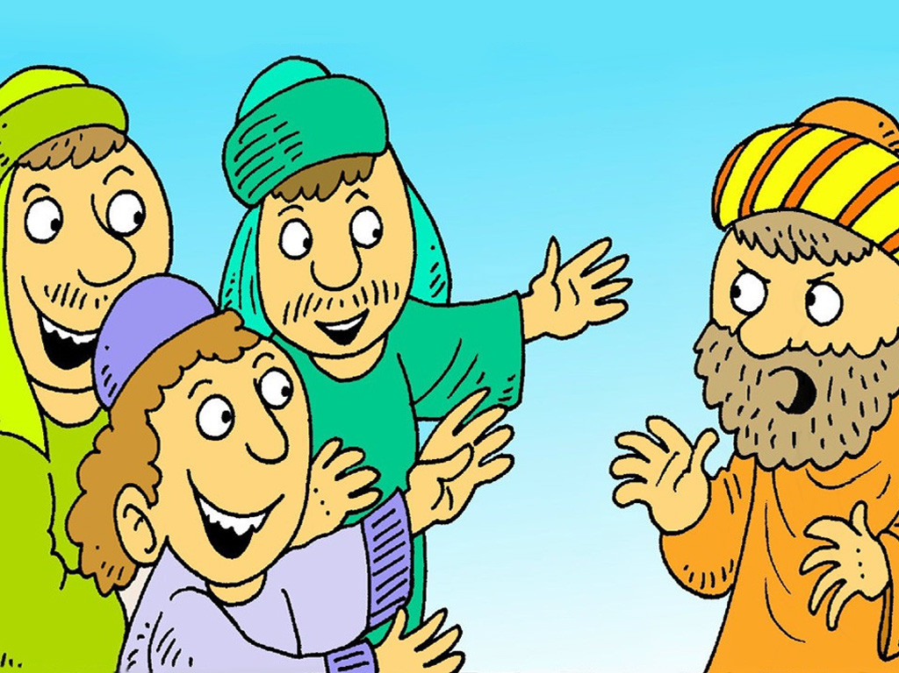
门徒们见证
The disciples' testimony.
门徒们见证
The disciples' testimony.
多马不相信
Thomas do not believe
我们相信
We believed

Slide 32
圣餐
Lord Supper

Slide 33
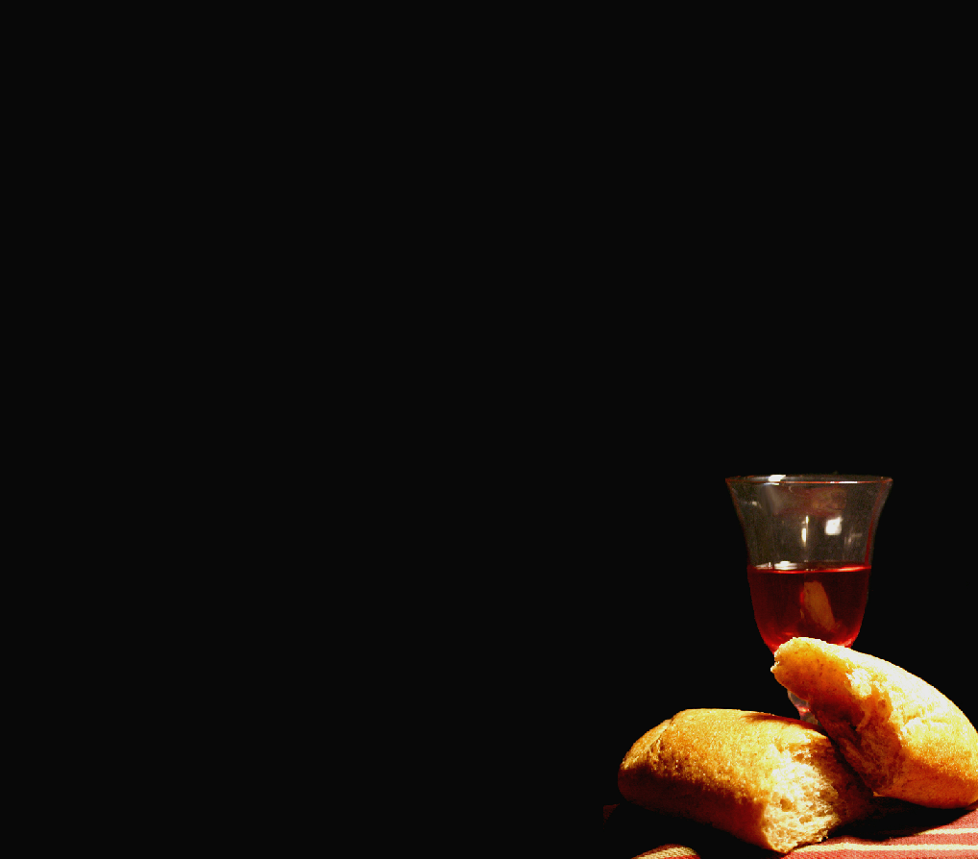
圣餐是什么？
答：圣餐是上帝与我们立约的圣礼。我们按耶稣基督的吩咐，分发并领受饼与酒，来表明祂为我们的罪受死。（路22:20）。
What is the Lord’s Supper
The Lord's Supper is a sacrament of the covenant with our God. wherein, by giving and receiving bread and wine (symbolizing his body and blood) according to the appointment of Jesus Christ , his death is showed forth.

Slide 34
（1）那些以信心与敬畏神的心吃喝这饼与酒（预表基督的身体与血），得上帝属灵的喂养，并在上帝的恩典中长进（太26:26－28；林前11:23－26）
Those who by faith and reverence feed upon the bread and wine (symbolising his body and blood), to their spiritual nourishment and growth in grace.

Slide 35
（2） 圣餐表明信徒在新约中与基督有属灵的联合 。（林前10:16）
The Lord supper point towards our union and communion in Christ.

Slide 36
（3） 圣餐也表明信徒同为一个肢体,是属于耶稣基督的身体。所以我们应当彼此相爱（林前10:17）。
The Lord supper points toward the union of believers as members in the one body of Christ and therefore we ought to love one another.

