Slide 1
089「破碎 ‧ 医治 ‧ 差遣」
约约21章（完）
Brokenness ‧ Healing ‧ Commissioning

Slide 2
约 21:1 这些事以后，耶稣在提比里亚海边再次向门徒显现。他显现的经过是这样的：2当时西门．彼得、称为“双生子”的多马、加利利的迦拿人拿但业、西庇太的两个儿子，和另外两个门徒都聚在一起。3西门．彼得对他们说：“我要打鱼去。”他们说：“我们也跟你一起去。”于是他们出去，上了船，可是那一夜他们并没有打到甚么。
John 21:1 After this Jesus revealed himself again to the disciples by the Sea of Tiberias, and he revealed himself in this way.
2 Simon Peter, Thomas (called the Twin), Nathanael of Cana in Galilee, the sons of Zebedee, and two others of his disciples were together. 3 Simon Peter said to them, "I am going fishing." They said to him, "We will go with you." They went out and got into the boat, but that night they caught nothing.
1/6

Slide 3
4清早的时候，耶稣站在岸边；门徒却不知道他就是耶稣。5耶稣对他们说：“孩子们，打到鱼没有？”他们回答：“没有。”6耶稣说：“把网撒在船的右边，就可以得着。”他们就把网撒下去，可是拉不上来，因为鱼太多。7耶稣所爱的那门徒对彼得说：“是主！”西门．彼得一听见是主，就立刻束上外衣(因为他当时赤着身子)，纵身跳进海里。 8其他的门徒，因为离岸不远(约有一百公尺)，就坐在小船上，把那网鱼拖过来。
4 Just as day was breaking, Jesus stood on the shore; yet the disciples did not know that it was Jesus.5 Jesus said to them, "Children, do you have any fish?" They answered him, "No."6 He said to them, "Cast the net on the right side of the boat, and you will find some." So they cast it, and now they were not able to haul it in, because of the quantity of fish.7 That disciple whom Jesus loved therefore said to Peter, "It is the Lord!" When Simon Peter heard that it was the Lord, he put on his outer garment, for he was stripped for work, and threw himself into the sea. 8The other disciples came in the boat, dragging the net full of fish, for they were not far from the land, but about a hundred yards off.
2/6

Slide 4
9他们上了岸，就看见那里有一堆炭火，上面有鱼有饼。10耶稣对他们说：“把你们刚才打的鱼拿几条来。”11西门．彼得就上船，把网拉到岸上；那网满了大鱼，共有一百五十三条。鱼虽然这么多，网却没有破。12耶稣对他们说：“你们来，吃早饭吧。”门徒中没有一个人敢问他：“你是谁？”因为知道他是主。13耶稣走过来，拿饼递给他们，又照样拿鱼递给他们。14这是耶稣从死人中复活之后，第三次向门徒显现。
3/6

Slide 5
15他们吃了早饭，耶稣问西门．彼得：“约翰的儿子西门，你爱我比这些更深吗？”他回答：“主啊，是的，你知道我爱你。”耶稣说：“你喂养我的小羊。”16耶稣第二次又问他：“约翰的儿子西门，你爱我吗？”他回答：“主啊，是的，你知道我爱你。”耶稣说：“你牧养我的羊。”17耶稣第三次问他：“约翰的儿子西门，你爱我吗？”彼得因为耶稣第三次问他：“你爱我吗？”就忧愁起来，对耶稣说：“主啊，你是无所不知的，你知道我爱你。”耶稣说：“你喂养我的羊。
15When they had finished breakfast, Jesus said to Simon Peter, "Simon, son of John, do you love me more than these?" He said to him, "Yes, Lord; you know that I love you." He said to him, "Feed my lambs."16 He said to him a second time, "Simon, son of John, do you love me?" He said to him, "Yes, Lord; you know that I love you." He said to him, "Tend my sheep."
17He said to him the third time, "Simon, son of John, do you love me?" Peter was grieved because he said to him the third time, "Do you love me?" and he said to him, "Lord, you know everything; you know that I love you." Jesus said to him, "Feed my sheep.
4/6

Slide 6
18我实实在在告诉你，你年轻的时候，自己束上腰带，随意往来；但到了年老的时候，你要伸出手来，别人要把你绑着，带你到你不愿意去的地方。” 19耶稣说这话，是指明彼得将怎样死，来荣耀 神。说了这话，就对彼得说：“你跟从我吧！”20彼得转过身来，看见耶稣所爱的那门徒跟着，就是在晚饭的时候，靠着耶稣的胸膛，问“主啊，出卖你的是谁？”的那个人。21彼得看见他，就问耶稣：“主啊，这个人将来怎么样？”
18Truly, truly, I say to you, when you were young, you used to dress yourself and walk wherever you wanted, but when you are old, you will stretch out your hands, and another will dress you and carry you where you do not want to go."19(This he said to show by what kind of death he was to glorify God.) And after saying this he said to him, "Follow me."Jesus and the Beloved Apostle20Peter turned and saw the disciple whom Jesus loved following them, the one who also had leaned back against him during the supper and had said, "Lord, who is it that is going to betray you?"21When Peter saw him, he said to Jesus, "Lord, what about this man?"
5/6

Slide 7
22耶稣回答他:“如果我要他活到我来的时候，跟你有甚么关系呢？你只管跟从我吧！”23于是这话流传在弟兄中间，说那门徒不会死。其实耶稣并没有对他说他不会死，只是说：“如果我要他活到我来的时候，跟你有甚么关系呢？”24为这些事作证，并且记述这些事的，就是这门徒；我们知道他的见证是真实的。25耶稣所行的，还有许多其他的事；如果都一一写下来，所要写成的书，我想就是这个世界也容不下了。
22Jesus said to him, "If it is my will that he remain until I come, what is that to you? You follow me!"23So the saying spread abroad among the brothers that this disciple was not to die; yet Jesus did not say to him that he was not to die, but, "If it is my will that he remain until I come, what is that to you?"24This is the disciple who is bearing witness about these things, and who has written these things, and we know that his testimony is true.25Now there are also many other things that Jesus did. Were every one of them to be written, I suppose that the world itself could not contain the books that would be written.
6/6

Slide 8
自我倚靠
（信自己超过信神）
Self-reliance
(trusting oneself more than God)
内心骄傲
Pride of the heart
自我高举
（夸耀自己）
Self-exaltation
(boasting in oneself)
自我形象
（爱面子在意人看法）
Self-image consciousness
(concerned with face and others’ opinions)

Slide 9
01
破碎
Brokenness

Slide 10
约 21:1 这些事以后，耶稣在提比里亚海边再次向门徒显现。他显现的经过是这样的：2当时西门．彼得、称为“双生子”的多马、加利利的迦拿人拿但业、西庇太的两个儿子，和另外两个门徒都聚在一起。3西门．彼得对他们说：“我要打鱼去。”他们说：“我们也跟你一起去。”于是他们出去，上了船，可是那一夜他们并没有打到甚么。
John 21:1 After this Jesus revealed himself again to the disciples by the Sea of Tiberias, and he revealed himself in this way.
2 Simon Peter, Thomas (called the Twin), Nathanael of Cana in Galilee, the sons of Zebedee, and two others of his disciples were together. 3 Simon Peter said to them, "I am going fishing." They said to him, "We will go with you." They went out and got into the boat, but that night they caught nothing.

Slide 11
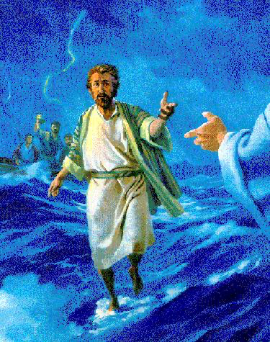
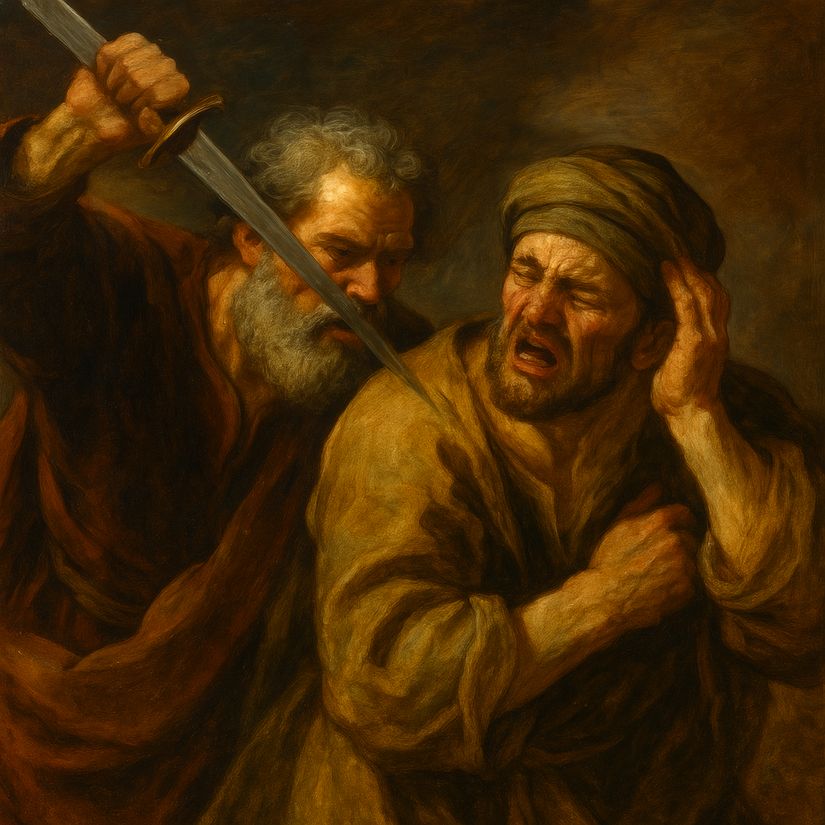
充满勇气自信的彼得
Peter, full of courage and self confidence

Slide 12
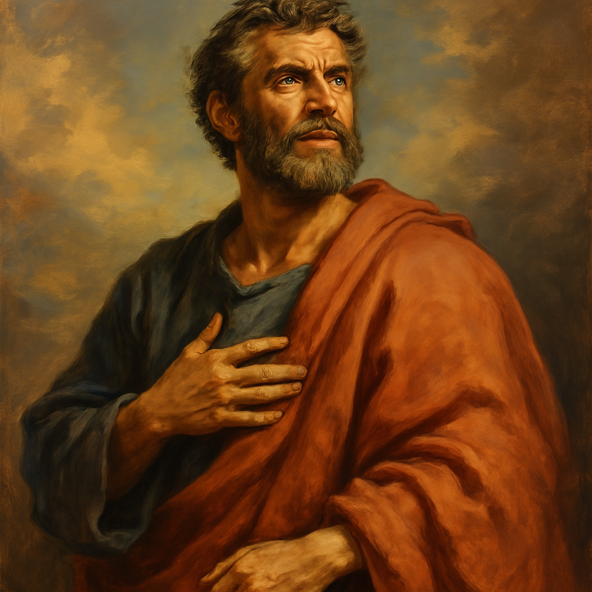
充满自信的彼得
转述:
主说:“你现在不能跟我去”
他回答：我愿意为你舍命 （约13:36-37）
Paraphrased translation:
The Lord said, “You cannot follow me now.”
He replied, “I am ready to lay down my life for you.”
(John 13:36–37)

Slide 13
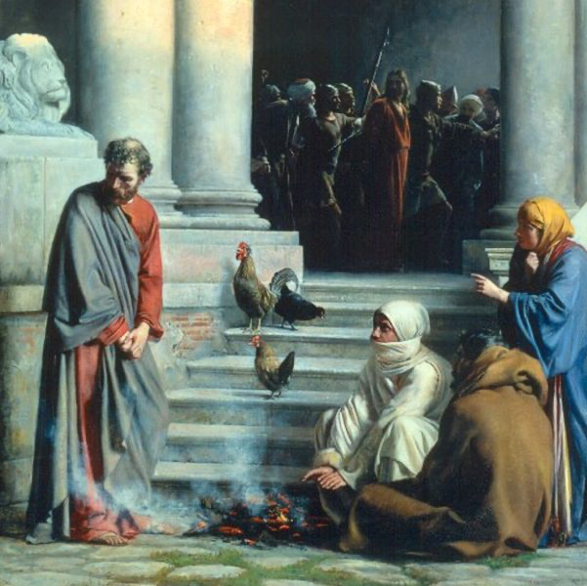
充满自信的彼得跌倒
鸡叫之前，
三次公开行为不认主
Before the rooster crows,
he denied the Lord three times in public actions.

Slide 14
3西门．彼得对他们说：“我要打鱼去。”他们说：“我们也跟你一起去。”
3 Simon Peter said to them, "I am going fishing." They said to him, "We will go with you." They went out and got into the boat, but that night they caught nothing.

Slide 15
02
主来寻他
The Lord came to seek him.

Slide 16
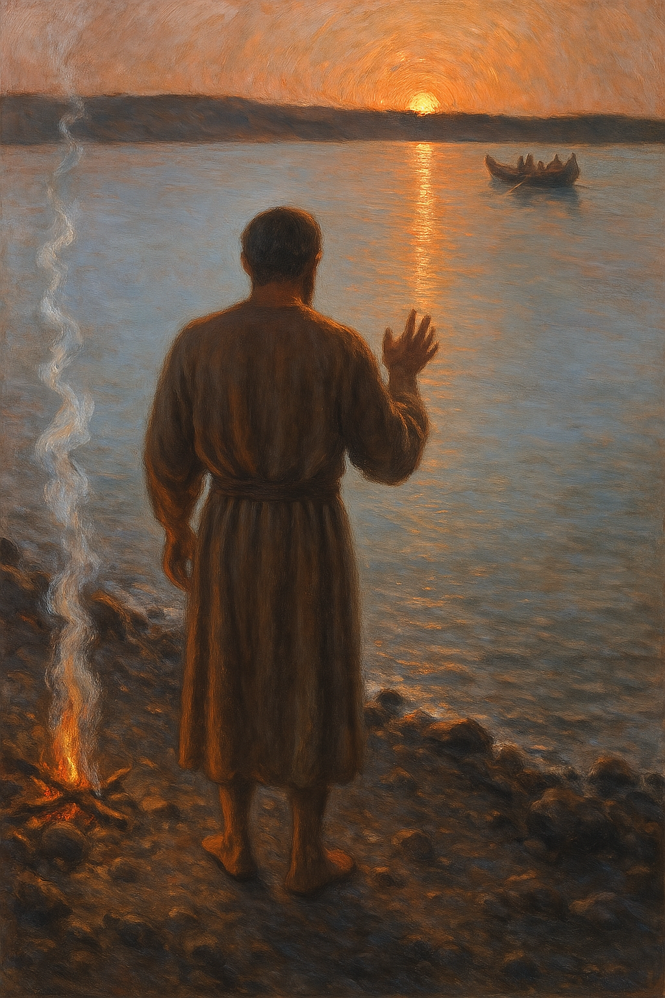

Slide 17
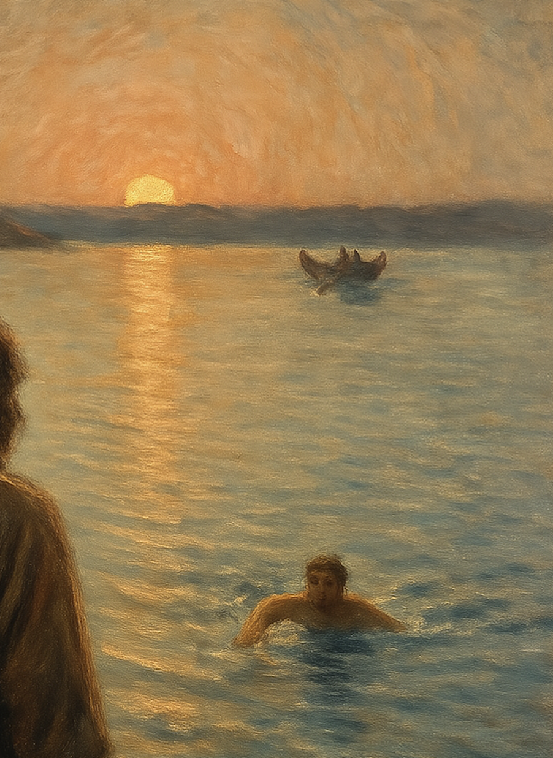

Slide 18
03
主医治与差遣
The Lord heal and commission

Slide 19
15...“约翰的儿子西门，你爱 我比这些更深吗？”他回答:“主啊，是的，你知道我爱 你。”耶稣说：“你喂养我的小羊。”16耶稣第二次又问他：“约翰的儿子西门，你爱 我吗？”他回答：“主啊，是的，你知道我爱 你。”耶稣说：“你牧养我的羊。”17耶稣第三次问他：“约翰的儿子西门，你爱 我吗？”彼得因为耶稣第三次问他:“你爱 我吗？”就忧愁起来，对耶稣说：“主啊，你是无所不知的，你知道我爱 你。”耶稣说：“你喂养我的羊。
15...Jesus said to Simon Peter, "Simon, son of John, do you love me more than these?" He said to him, "Yes, Lord; you know that I love you." He said to him, "Feed my lambs."16 He said to him a second time, "Simon, son of John, do you love me?" He said to him, "Yes, Lord; you know that I love you." He said to him, "Tend my sheep."17He said to him the third time, "Simon, son of John, do you love me?" Peter was grieved because he said to him the third time, "Do you love me?" and he said to him, "Lord, you know everything; you know that I love you." Jesus said to him, "Feed my sheep.

Slide 20
15... 耶稣说：“你喂养我的小羊。”16 ...耶稣说：“你牧养我羊。”17...耶稣说：“你喂养我的羊。
15..."Feed my lambs."16 ..."Tend my sheep."17...Jesus said to him, "Feed my sheep.

Slide 21
17... 就忧愁起来，对耶稣说：“主啊，你是无所不知的，你知道我爱你。”...
17...and he said to him, "Lord, you know everything; you know that I love you.”..

Slide 22
04
认识耶稣是主
Know jesus is lord

Slide 23
18我实实在在告诉你，你年轻的时候，自己束上腰带，随意往来；但到了年老的时候，你要伸出手来，别人要把你绑着，带你到你不愿意去的地方。”19 耶稣说这话，是指明彼得将怎样死，来荣耀 神。说了这话，就对彼得说：“你跟从我吧！”20彼得转过身来，看见耶稣所爱的那门徒跟着，就是在晚饭的时候，靠着耶稣的胸膛，问“主啊，出卖你的是谁？”的那个人。21彼得看见他，就问耶稣：“主啊，这个人将来怎么样？”
18Truly, truly, I say to you, when you were young, you used to dress yourself and walk wherever you wanted, but when you are old, you will stretch out your hands, and another will dress you and carry you where you do not want to go."19(This he said to show by what kind of death he was to glorify God.) And after saying this he said to him, "Follow me."Jesus and the Beloved Apostle20Peter turned and saw the disciple whom Jesus loved following them, the one who also had leaned back against him during the supper and had said, "Lord, who is it that is going to betray you?"21When Peter saw him, he said to Jesus, "Lord, what about this man?"
5/6

Slide 24
22 耶稣回答他:“如果我要他活到我来的时候，跟你有甚么关系呢？你只管跟从我吧！”
22Jesus said to him, "If it is my will that he remain until I come, what is that to you? You follow me!"

Slide 25
执事就职礼
Deacon Installation Service

