Slide 1
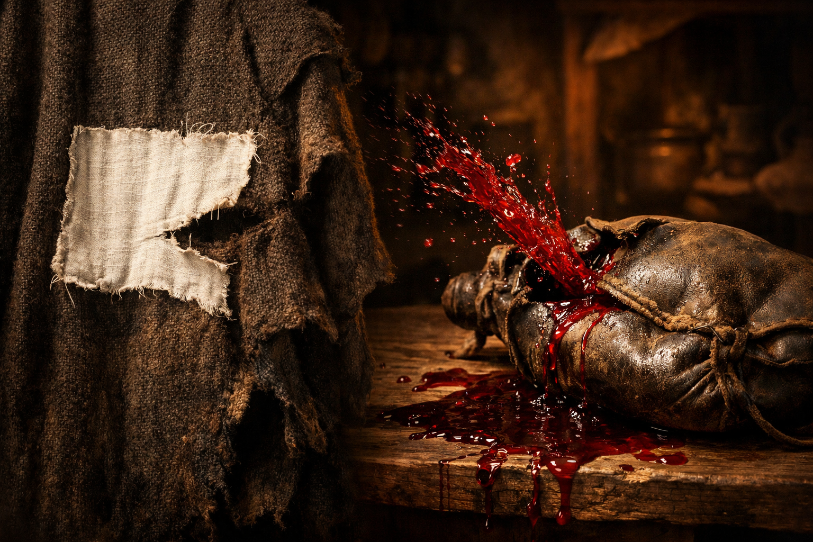
10 The Incompatibility of the New and the Old Mark 2:18-22

Slide 2
Mark 2:18 Now John's disciples and the Pharisees were fasting. And people came and said to him, “Why do John's disciples and the disciples of the Pharisees fast, but your disciples do not fast?”19 And Jesus said to them, “Can the wedding guests fast while the bridegroom is with them? As long as they have the bridegroom with them, they cannot fast.20 The days will come when the bridegroom is taken away from them, and then they will fast in that day.21 No one sews a piece of unshrunk cloth on an old garment. If he does, the patch tears away from it, the new from the old, and a worse tear is made.22 And no one puts new wine into old wineskins. If he does, the wine will burst the skins—and the wine is destroyed, and so are the skins. But new wine is for fresh wineskins.”

Slide 3
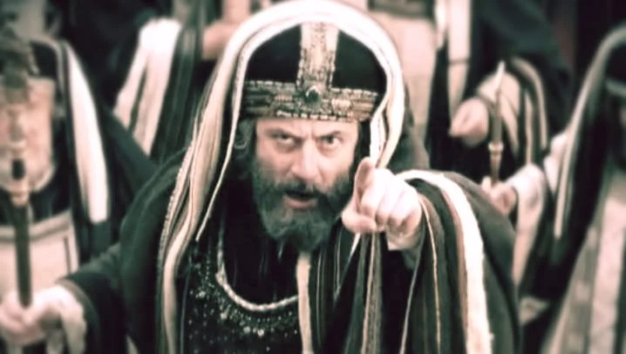
【1】Critical Spiritual Attitudes

Slide 4
【2】First metaphor:
Jesus is the Bridegroom

Slide 5
【3】Second metaphor:
New cloth will tear the old garment.

Slide 6
【4】Third metaphor:
New wine bursts old wineskins. .

Slide 7
5 Reflection

Slide 8
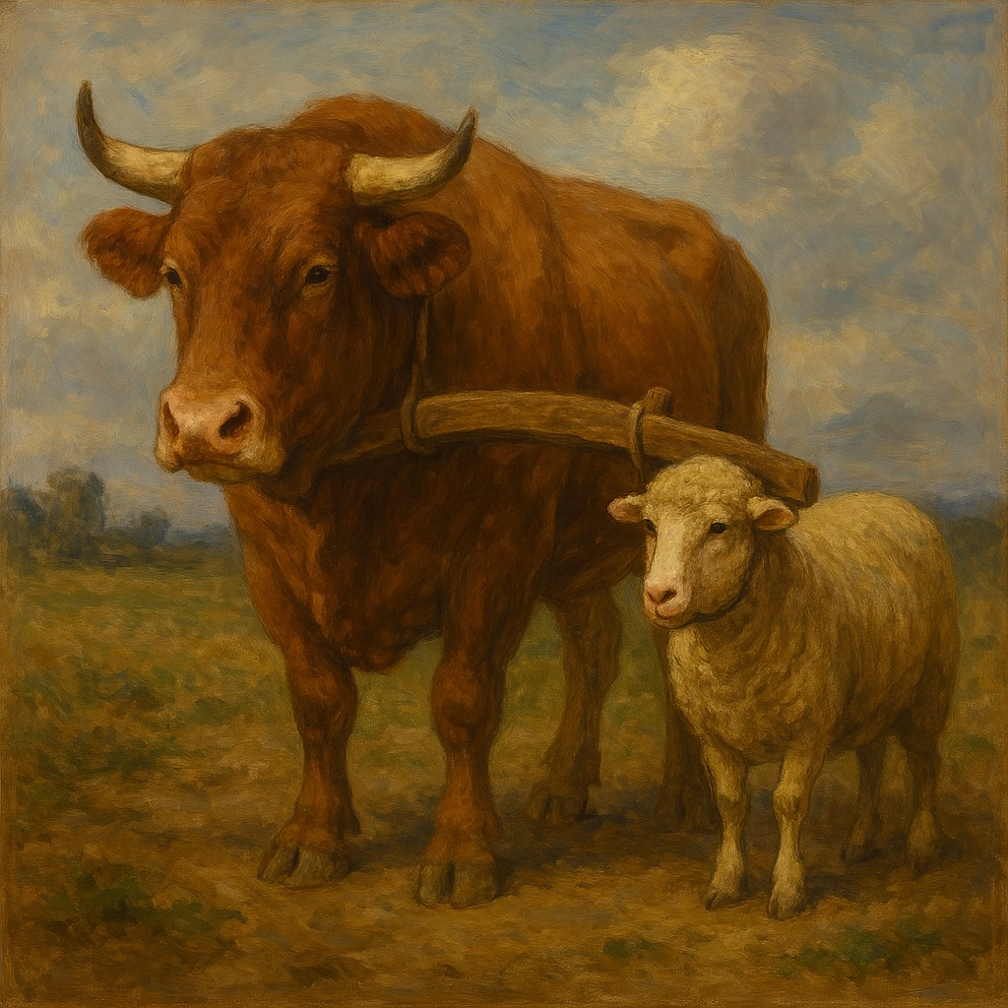

Slide 9
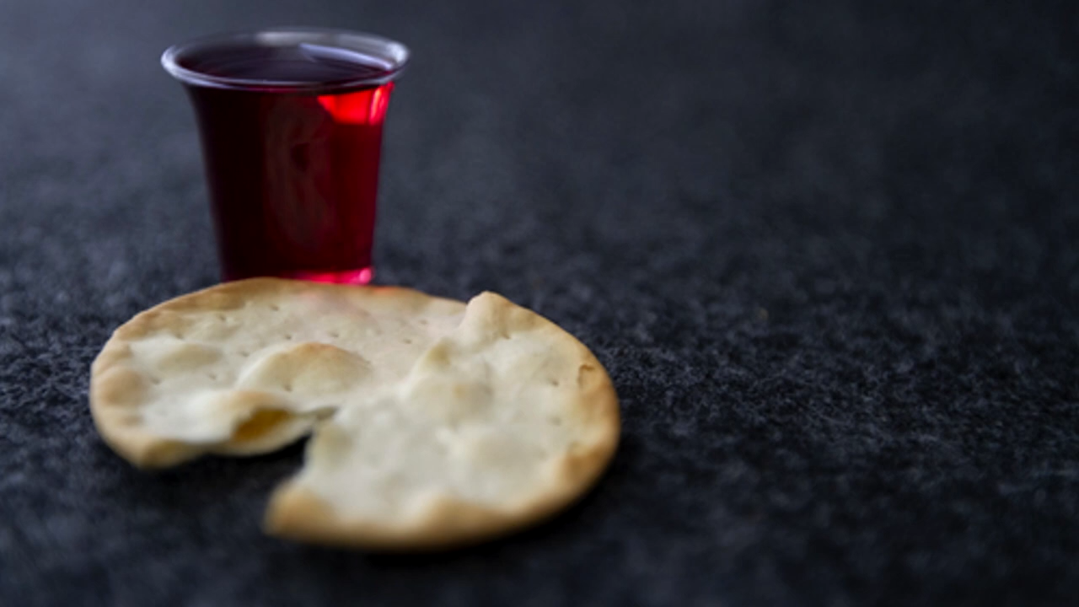
奇异恩典
Holy Communion

Slide 10
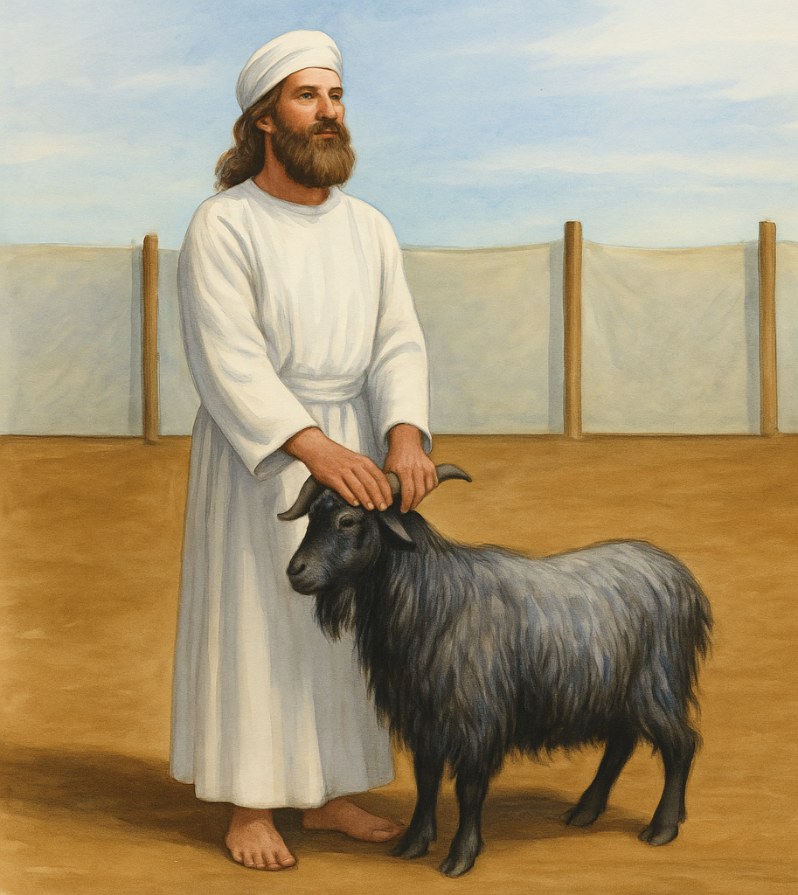
lev 16:15 “Then he shall kill the goat of the sin offering that is for the people … 21 And Aaron shall lay both his hands on the head of the live goat, and confess over it all the iniquities of the people of Israel, and all their transgressions, all their sins. And he shall put them on the head of the goat and send it away into the wilderness by the hand of a man who is in readiness. 22 The goat shall bear all their iniquities

