Slide 1
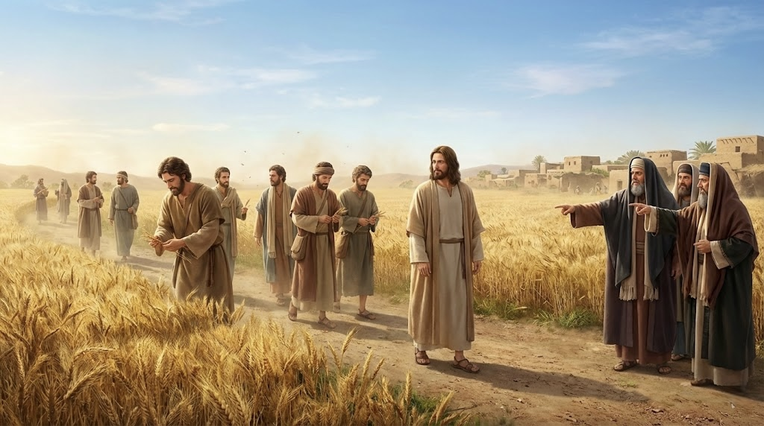
11. The spirit of the Law Mark 2:23–28

Slide 2
Mark 2:23 One Sabbath he was going through the grainfields, and as they made their way, his disciples began to pluck heads of grain. 24 And the Pharisees were saying to him, “Look, why are they doing what is not lawful on the Sabbath? 25 And he said to them, “Have you never read what David did, when he was in need and was hungry, he and those who were with him: 26 how he entered the house of God, in the time of Abiathar the high priest, and ate the bread of the Presence, which it is not lawful for any but the priests to eat, and also gave it to those who were with him?” 27 And he said to them, “The Sabbath was made for man, not man for the Sabbath. 28 So the Son of Man is lord even of the Sabbath.”

Slide 3
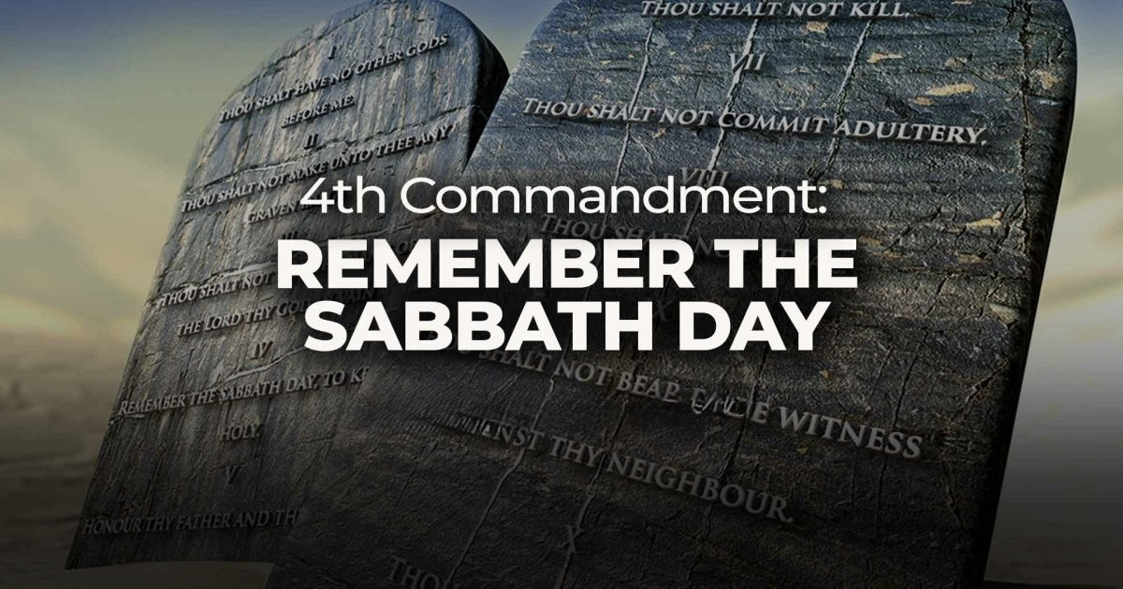
【1】The Background of the Sabbath

Slide 4
【2】The Conflict

Slide 5
【3】
The spirit and principle of Sabbath.

Slide 6
Mat 22:37 And he said to him, “You shall love the Lord your God with all your heart and with all your soul and with all your mind.38 This is the great and first commandment. 39 And a second is like it: You shall love your neighbor as yourself.40 On these two commandments depend all the Law and the Prophets.”

Slide 7
Rom 13:8
Owe no one anything, except to love each other, for the one who loves another has fulfilled the law.

Slide 8
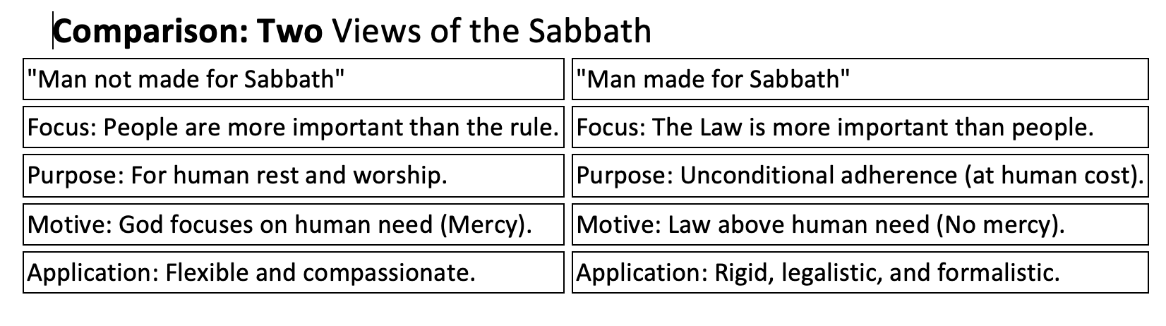

Slide 9
【4】
Application
(The new covenant Context)

Slide 10
Col 2:16–17
"Therefore let no one pass judgment on you in questions of food and drink, or with regard to a festival or a new moon or a Sabbath. These are a shadow of the things to come, but the substance belongs to Christ."

Slide 11
Heb 10:24
And let us consider how to stir up one another to love and good works, 25 not neglecting to meet together, as is the habit of some, but encouraging one another, and all the more as you see the Day drawing near.

Slide 12

奇异恩典
Holy Communion

Slide 13

Joh 6:51 I am the living bread that came down from heaven. If anyone eats of this bread, he will live forever. And the bread that I will give for the life of the world is my flesh.”52 The Jews then disputed among themselves, saying, “How can this man give us his flesh to eat?”53 So Jesus said to them, “Truly, truly, I say to you, unless you eat the flesh of the Son of Man and drink his blood, you have no life in you.54 Whoever feeds on my flesh and drinks my blood has eternal life, and I will raise him up on the last day.55 For my flesh is true food, and my blood is true drink.56 Whoever feeds on my flesh and drinks my blood abides in me, and I in him.57 As the living Father sent me, and I live because of the Father, so whoever feeds on me, he also will live because of me.

