Slide 1
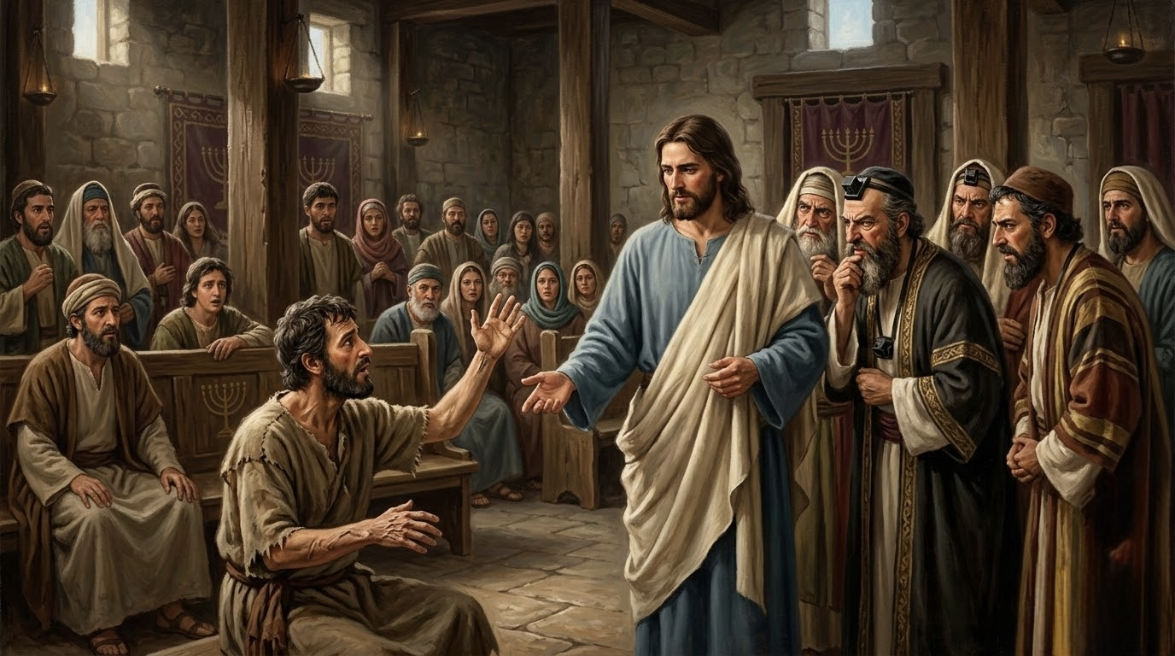
12 When Mercy Confronts Hardened Religion
Mark 3:1–6

Slide 2
Mark 3:1 Again he entered the synagogue, and a man was there with a withered hand.2 And they watched Jesus, to see whether he would heal him on the Sabbath, so that they might accuse him.3 And he said to the man with the withered hand, “Come here.”4 And he said to them, “Is it lawful on the Sabbath to do good or to do harm, to save life or to kill?” But they were silent.5 And he looked around at them with anger, grieved at their hardness of heart, and said to the man, “Stretch out your hand.” He stretched it out, and his hand was restored.6 The Pharisees went out and immediately held counsel with the Herodians against him, how to destroy him.

Slide 3
【1】
The heart of true religion.

Slide 4
Isa 29:13 And the Lord said: “Because this people draw near with their mouth and honor me with their lips, while their hearts are far from me, and their fear of me is a commandment taught by men,

Slide 5
Exo 20:8 “Remember the Sabbath day, to keep it holy.9 Six days you shall labor, and do all your work,10 but the seventh day is a Sabbath to the LORD your God. On it you shall not do any work, you, or your son, or your daughter, your male servant, or your female servant, or your livestock, or the sojourner who is within your gates.

Slide 6
Jas 1:27 Religion that is pure and undefiled before God the Father is this: to visit orphans and widows in their affliction, and to keep oneself unstained from the world.

Slide 7
【2】
A hardened heart that no longer responds to the truth

Slide 8
4 And he said to them, “Is it lawful on the Sabbath to do good or to do harm, to save life or to kill?” But they were silent.

Slide 9
【3】
the cost for carrying out the truth

Slide 10
Rom 14:2
One person believes he may eat anything, while the weak person eats only vegetables.

Slide 11
Rom 14:20 Do not, for the sake of food, destroy the work of God. Everything is indeed clean, but it is wrong for anyone to make another stumble by what he eats. 21 It is good not to eat meat or drink wine or do anything that causes your brother to stumble.

Slide 12
【4】
Restoration beings by
simple obedience

Slide 13
5 And he looked around at them with anger, grieved at their hardness of heart, and said to the man, “Stretch out your hand.” He stretched it out, and his hand was restored.6 The Pharisees went out and immediately held counsel with the Herodians against him, how to destroy him.

Slide 14
• Have we forgotten that true religion is to show mercy and compassion to sinners, the poor, and the lowly?
• Have we been shown recently by God or men some truths to which we may have hardened our hearts?
• Are we facing some core issues and principles that we need to carry out at all cost?

Slide 15
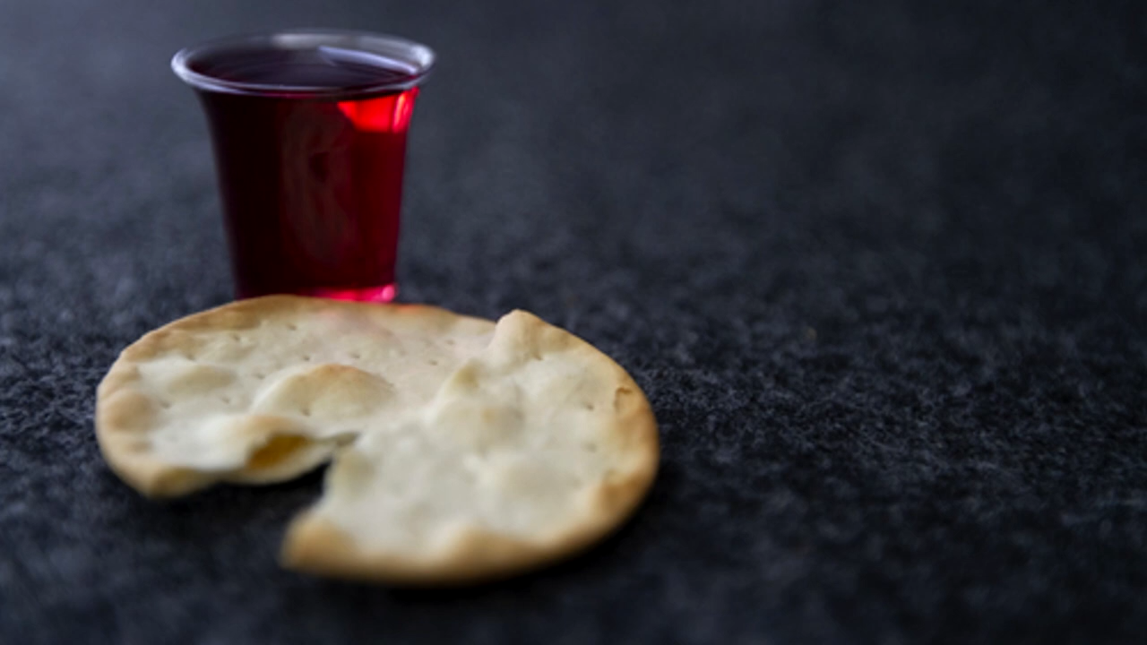
奇异恩典
Holy Communion

Slide 16
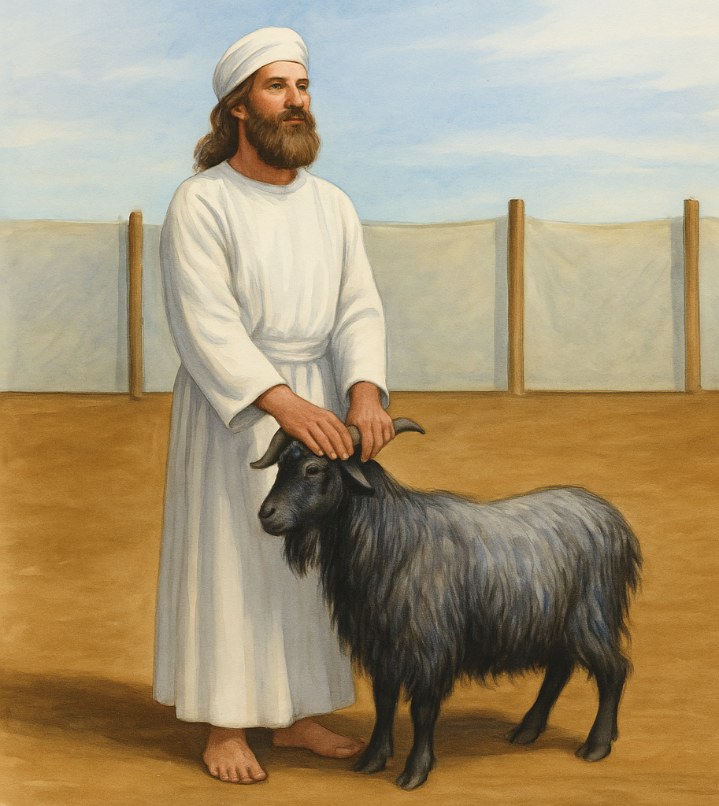
lev 16:15 “Then he shall kill the goat of the sin offering that is for the people … 21 And Aaron shall lay both his hands on the head of the live goat, and confess over it all the iniquities of the people of Israel, and all their transgressions, all their sins. And he shall put them on the head of the goat and send it away into the wilderness by the hand of a man who is in readiness. 22 The goat shall bear all their iniquities

