Slide 1
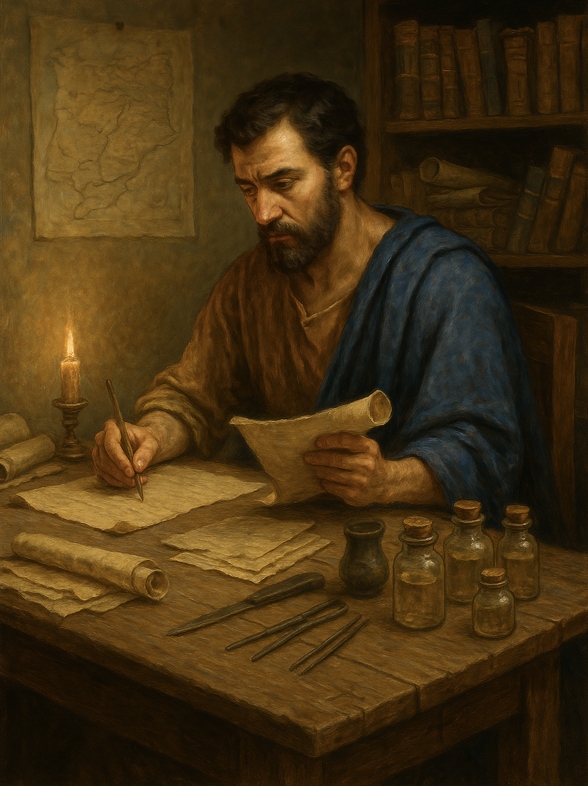
路加福音 Gospel of Luke
012 基督家谱记载的意义与目的
路3章23至37
The Purpose of Christ’s Genealogical Record
.

Slide 2

我们彼此约定一世结为兄弟
We pledged to be brothers for life.

Slide 3
路 3:23 耶稣开始传道，年约三十岁，人以为他是约瑟的儿子，约瑟是希里的儿子，24 依次往上推，是玛塔、利未、麦基、雅拿、约瑟、25 玛他提亚、亚摩斯、拿鸿、以斯利、拿该、26 玛押、玛他提亚、西美、约瑟、约大、27 约哈难、利撒、所罗巴伯、撒拉铁、尼利、28 麦基、亚底、哥桑、以摩当、珥、29 耶书、以利以谢、约令、玛塔、利未、30 西缅、犹大、约瑟、约南、以利亚敬、
Luk 3:23Jesus, when he began his ministry, was about thirty years of age, being the son (as was supposed) of Joseph, the son of Heli, 24 the son of Matthat, the son of Levi, the son of Melchi, the son of Jannai, the son of Joseph,25 the son of Mattathias, the son of Amos, the son of Nahum, the son of Esli, the son of Naggai,26 the son of Maath, the son of Mattathias, the son of Semein, the son of Josech, the son of Joda,27 the son of Joanan, the son of Rhesa, the son of Zerubbabel, the son of Shealtiel, the son of Neri,28 the son of Melchi, the son of Addi, the son of Cosam, the son of Elmadam, the son of Er,29 the son of Joshua, the son of Eliezer, the son of Jorim, the son of Matthat, the son of Levi,

Slide 4
31 米利亚、买拿、马达他、拿单、大卫、32 耶西、俄备得、波阿斯、撒门、拿顺、33 亚米拿达、亚当民、亚兰、希斯仑、法勒斯、犹大、34 雅各、以撒、亚伯拉罕、他拉、拿鹤、35 西鹿、拉吴、法勒、希伯、沙拉、36 该南 、亚法撒、闪、挪亚、拉麦、37 玛土撒拉、以诺、雅列、玛勒列、该南、38 以挪士、塞特、亚当，亚当是上帝的儿子。
31the son of Melea, the son of Menna, the son of Mattatha, the son of Nathan, the son of David,32 the son of Jesse, the son of Obed, the son of Boaz, the son of Sala, the son of Nahshon,33 the son of Amminadab, the son of Admin, the son of Arni, the son of Hezron, the son of Perez, the son of Judah,34 the son of Jacob, the son of Isaac, the son of Abraham, the son of Terah, the son of Nahor,35 the son of Serug, the son of Reu, the son of Peleg, the son of Eber, the son of Shelah,36 the son of Cainan, the son of Arphaxad, the son of Shem, the son of Noah, the son of Lamech,37 the son of Methuselah, the son of Enoch, the son of Jared, the son of Mahalaleel, the son of Cainan,38 the son of Enos, the son of Seth, the son of Adam, the son of God.

Slide 5
01
耶稣基督是神子也是人子
Jesus Christ Is Both the Son of God and the Son of Man

Slide 6
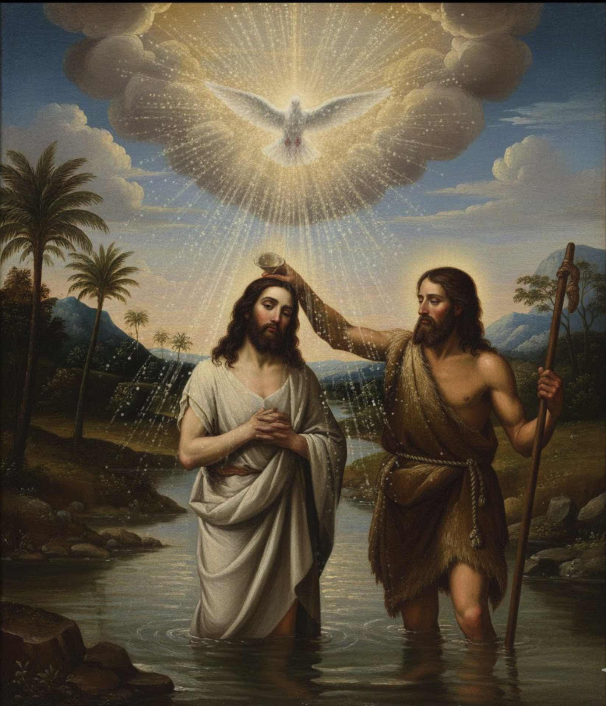
路 3:22.圣灵仿佛鸽子，有形体地降在他身上；有声音从天上来，说：“你是我的爱子，我喜悦你。”
Luke 3:22.and the Holy Spirit descended on him in bodily form, like a dove; and a voice came from heaven, "You are my beloved Son; with you I am well pleased."

Slide 7
路 3:23
耶稣开始传道，年约三十岁，人以为 【依人看来】 他是约瑟的儿子，约瑟是希里的儿子，
Luk 3:23Jesus, when he began his ministry, was about thirty years of age, being the son (as was supposed) of Joseph, the son of Heli,

Slide 8
02
家谱展示神是信实的， 祂是守约的神
The genealogy demonstrates that God is faithful; He is a covenant-keeping God.

Slide 9
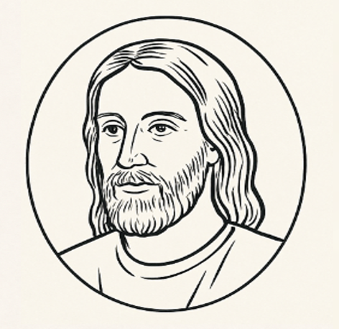
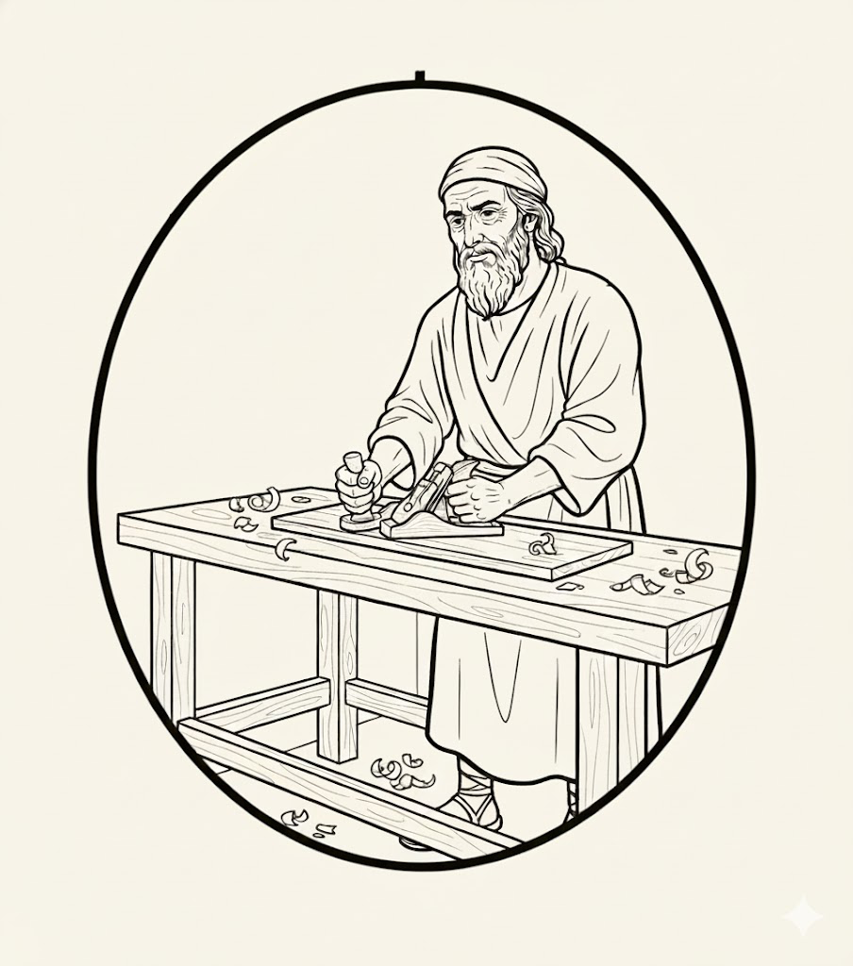
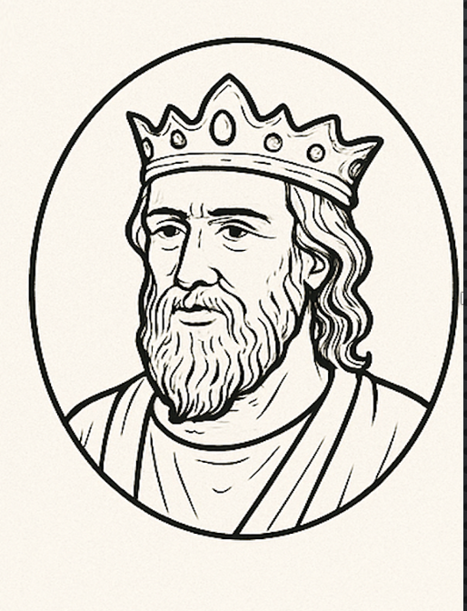
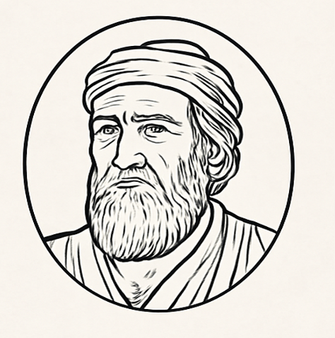
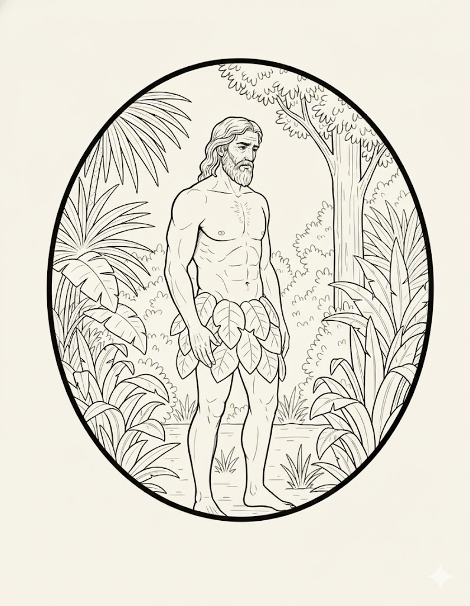
耶稣基督
Jesus Christ
约瑟
Joseph
大卫
David
亚伯拉罕
Abraham
亚当
Adam

Slide 10
创22:18 并且地上万国都必因你的後裔得福，因为你听从了我的话。
Genesis 22:18. and in your offspring shall all the nations of the earth be blessed, because you have obeyed my voice."
亚伯拉罕
Abraham

Slide 11
诗89:29.我要使他的后裔存到永远，使他的王位好象天一样长久。30.如果他的子孙离弃我的律法，不照着我的典章而行；31.如果他们违背我的律例，不遵守我的诫命，32.我就用杖责罚他们的过犯，用鞭责罚他们的罪孽。
大卫
David
Psalms 89:29. I will establish his offspring forever and his throne as the days of the heavens.30.If his children forsake my law and do not walk according to my rules,31.if they violate my statutes and do not keep my commandments, 32.then I will punish their transgression with the rod and their iniquity with stripes,

Slide 12
33.但我必不把我的慈爱从他身上收回，也必不背弃我的信实。34.我必不违背我的约，也不改变我口中所出的话。35.我断然指着自己的圣洁起誓，说:‘我决不向大卫说谎。36.他的后裔必存到永远，他的王位在我面前必像太阳长存,...
大卫
David
Psalms 89:33. but I will not remove from him my steadfast love or be false to my faithfulness. 34.I will not violate my covenant or alter the word that went forth from my lips. 35.Once for all I have sworn by my holiness; I will not lie to David. 36.His offspring shall endure forever, his throne as long as the sun before me.....

Slide 13
诗89:31.如果他们违背我的律例，不遵守我的诫命，32.我就用杖责罚他们的过犯，用鞭责罚他们的罪孽。
大卫
David
Psalms 89:31.if they violate my statutes and do not keep my commandments, 32.then I will punish their transgression with the rod and their iniquity with stripes,

Slide 14
03
圣经家谱中的特殊性与研究限制
Distinctive Features and Limits of Biblical Genealogies.

Slide 15
耶稣基督
Jesus Christ
4-6 BC
约瑟
Joseph
大卫
David
约1000BC
亚伯拉罕
Abraham
约2000BC
亚当
Adam
???

Slide 16
路加福音家谱 Genealogy in the Gospel of Luke |  | 马太福音 Genealogy in the Gospel of Matthew
大卫【君王】 David （King） |  | 大卫【君王】 David （King）
拿单 （历代志上 3:5） Nathan (1 Chronicles 3:5) |  | 所罗门【君王】（历代志上 3:5） Solomon 【King】 (1 Chronicles 3:5)
只有一位君王（大卫） Only one king (David). |  | 【一共14位 君王】家谱 Total 14 Kings Royal Genealogy

Slide 17
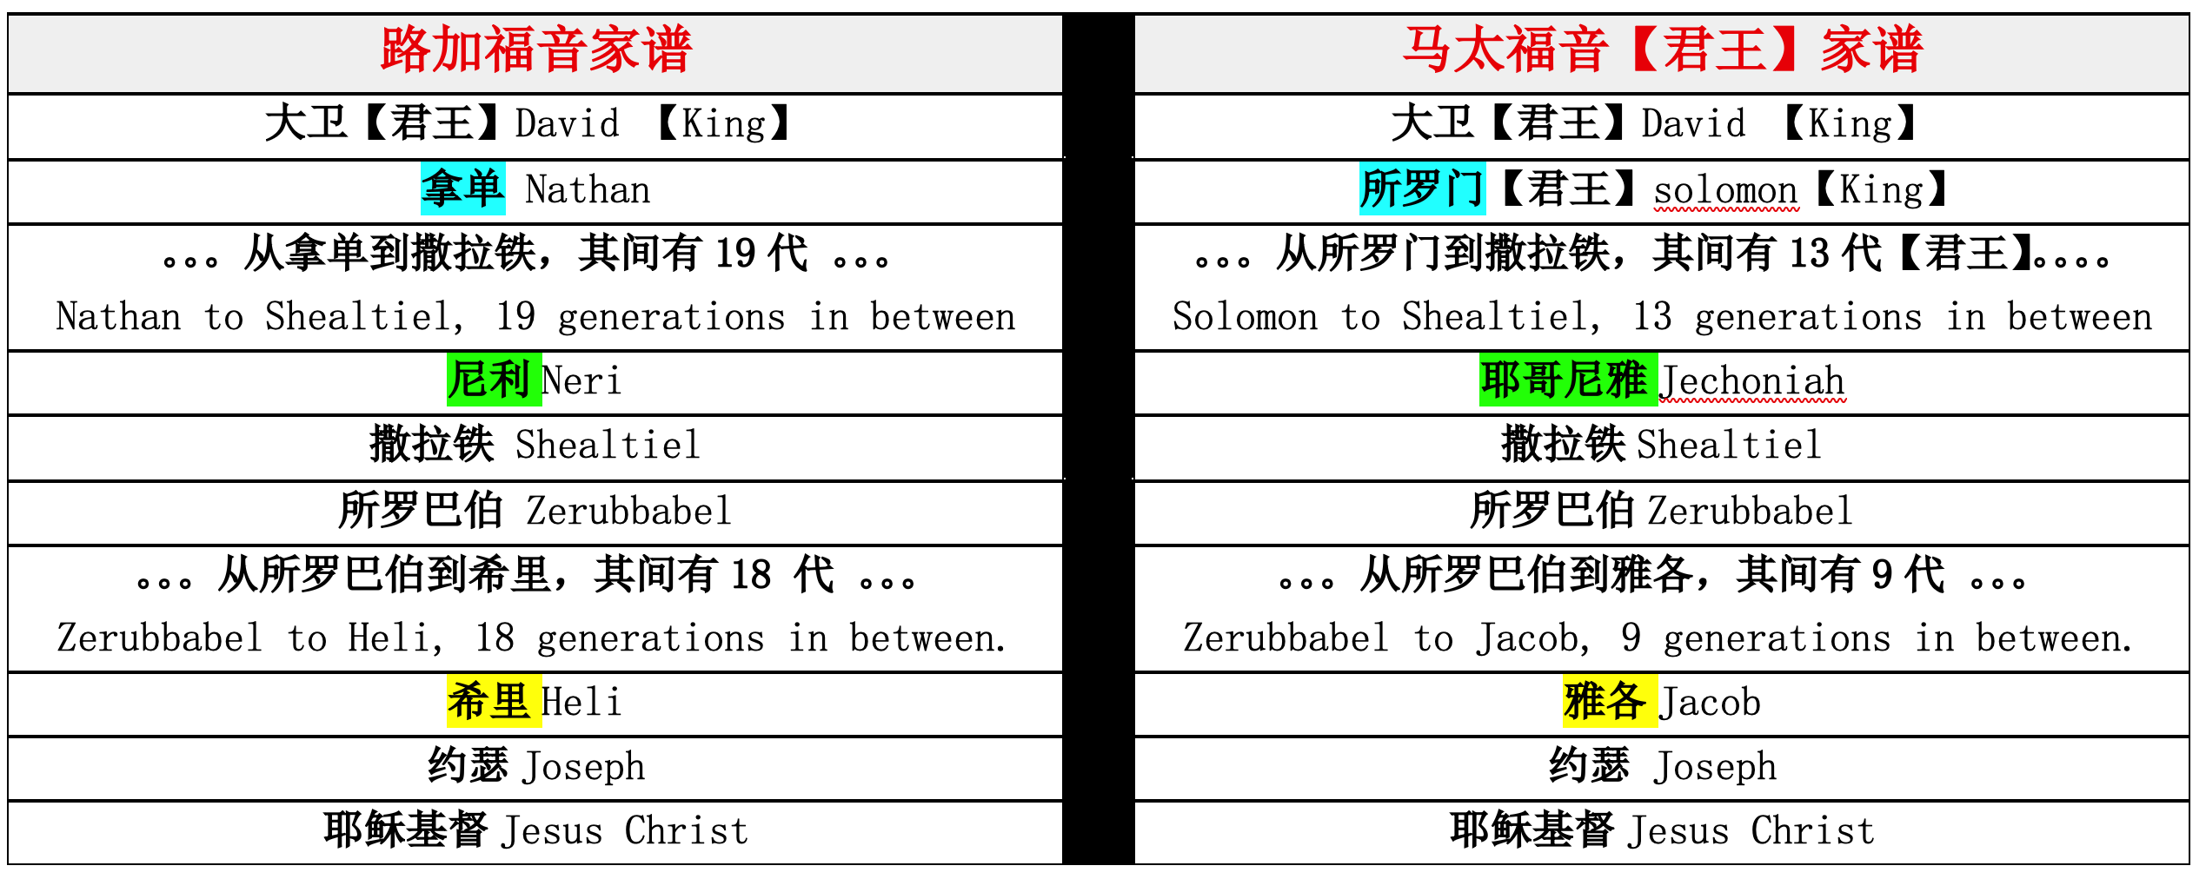

Slide 18
04
耶稣基督是末后的亚当 (罗 5:14; 林前 15:45)
Jesus Christ is the last Adam (Rom 5:14; 1 Cor 15:45).

Slide 19
38 以挪士、塞特、亚当，亚当是上帝的儿子。
38 the son of Enos, the son of Seth, the son of Adam, the son of God.

Slide 20
路3:22 耶稣是神的爱子
Luke 3:22: Jesus is the beloved Son of God
路3:38 亚当是上帝的儿子
Luke 3:38: Adam is the son of God.
路4:1 耶稣旷野受试探得胜
Luke 4:1: Jesus is tempted in the wilderness and is victorious.

Slide 21
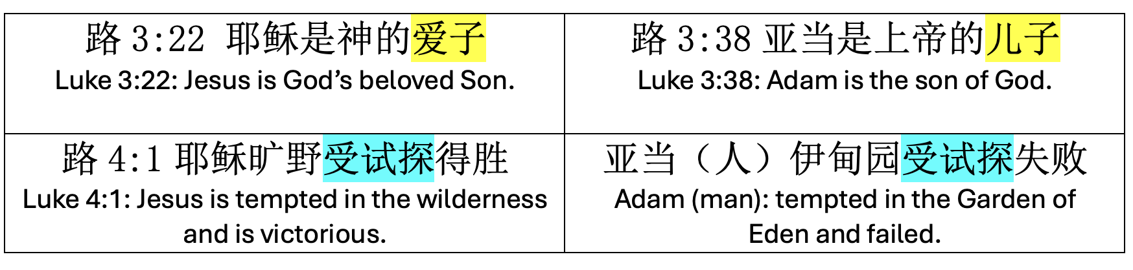

Slide 22

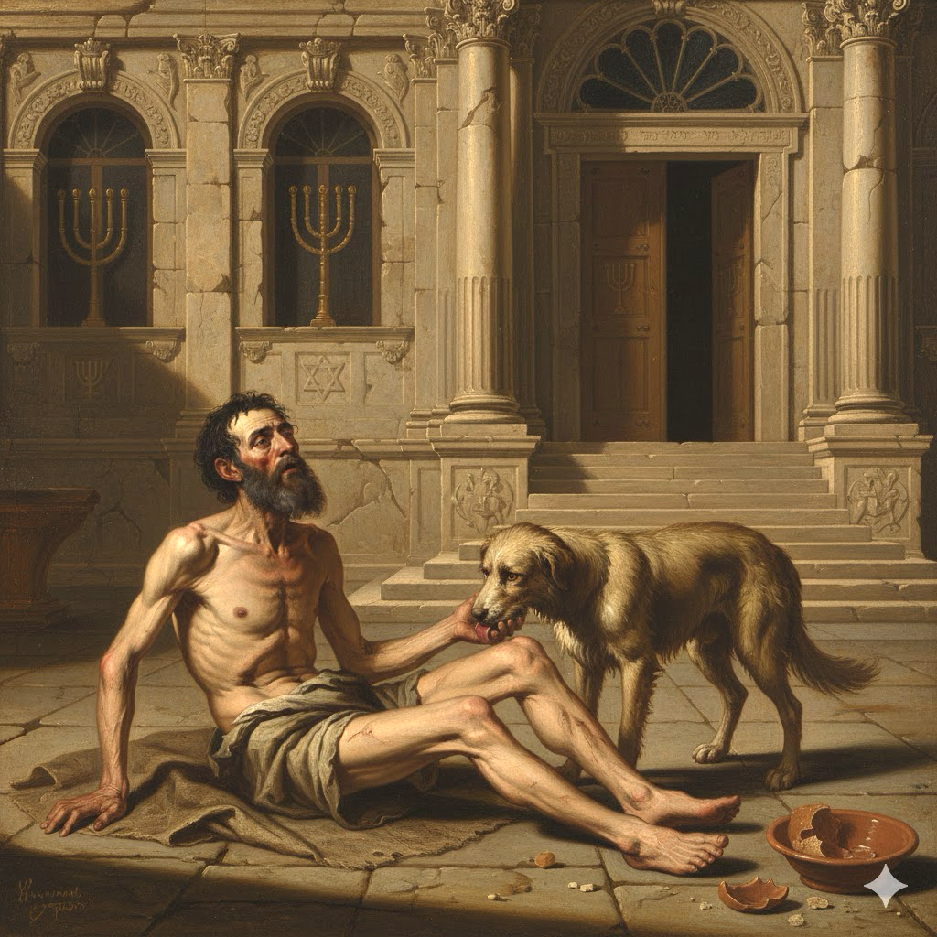
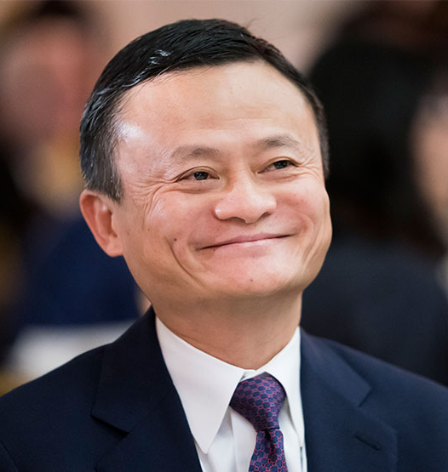
谁是真正的失败？
Who truly failed?

Slide 23

亚当是上帝的儿子
Adam is the son of God.
亚当是猴子的儿子
Adam is the son of Monkey.

Slide 24


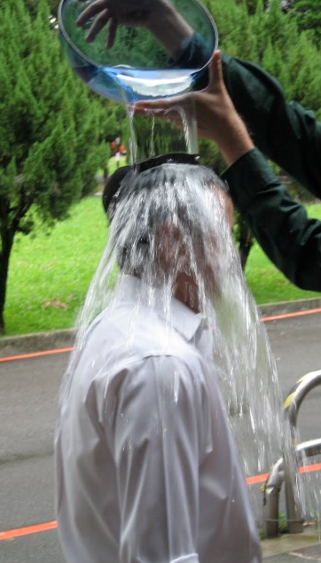
洗礼
与 坚信礼

Slide 25

马太福音 16:24
於是耶稣对门徒说：
若有人要跟从我，就当舍己，背起他的十字架来 跟从我。
Mat 16:24
Then Jesus told his disciples,
“If anyone would come after me, let him deny himself
and take up his cross and follow me.

Slide 26
问：你是否接受耶稣基督是上帝的独生爱子，祂就是上帝？
问：你是否承认自己是罪人，并接受耶稣基督为你的罪钉在十字架上 ？
问：你是否相信耶稣基督赦免你的罪并赐你永生？

Slide 27
问：你是否愿意背起十字架来跟随主耶稣，作主耶稣的门徒？
问：你是否愿意坚守神与你所立的约？一生信主、爱主、顺服主。

