Slide 1
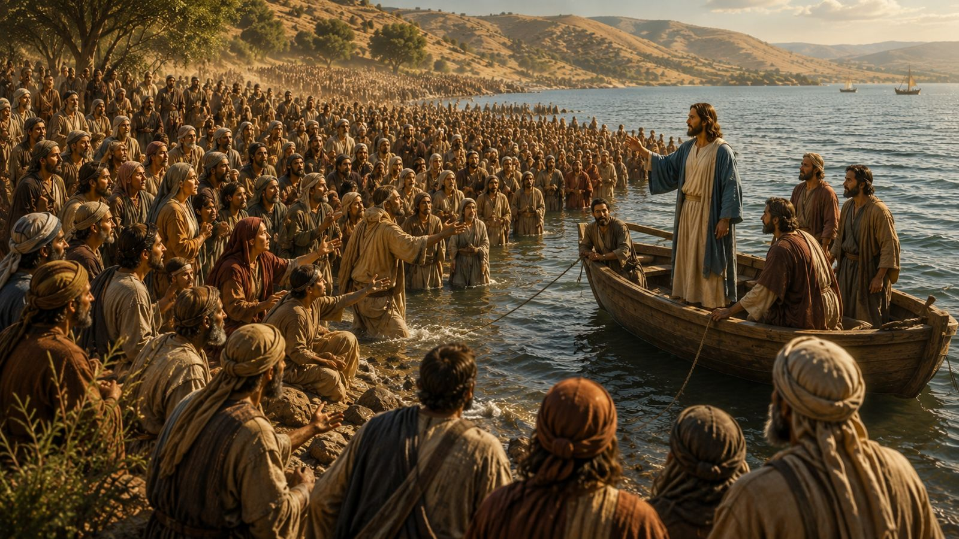
13 Four Ways People Respond to Christ
Mark 3:7–12

Slide 2
Mrk 3:7 Jesus withdrew with his disciples to the sea, and a great crowd followed, from Galilee and Judea8 and Jerusalem and Idumea and from beyond the Jordan and from around Tyre and Sidon. When the great crowd heard all that he was doing, they came to him.9 And he told his disciples to have a boat ready for him because of the crowd, lest they crush him,10 for he had healed many, so that all who had diseases pressed around him to touch him.11 And whenever the unclean spirits saw him, they fell down before him and cried out, “You are the Son of God.”12 And he strictly ordered them not to make him known.

Slide 3
【1】
Jesus show mercy
to those who seek him

Slide 4
James 4:6 ... “God opposes the proud but gives grace to the humble.”

Slide 5
Heb 4:15 For we do not have a high priest who is unable to sympathize with our weaknesses, but one who in every respect has been tempted as we are, yet without sin. 16 Let us then with confidence draw near to the throne of grace, that we may receive mercy and find grace to help in time of need.

Slide 6
【2】
Prepare a Small Boat in our Ministry

Slide 7
9 And he told his disciples to have a boat ready for him because of the crowd, lest they crush him,

Slide 8
Isa 40:30 Even youths shall faint and be weary, and young men shall fall exhausted; 31 but they who wait for the LORD shall renew their strength; they shall mount up with wings like eagles; they shall run and not be weary; they shall walk and not faint.

Slide 9
【3】
Unclean Spirits knew Jesus and obeyed

Slide 10
1 The religious Pharisees did not believe in Jesus.
2 The needy crowds came to Jesus because of their needs, but many eventually left Him (John 6:26–52, 66).
3 The unclean spirits feared (have no love) and obeyed Jesus.
4 The disciples loved Jesus and confessed, "You are the Son of God!" (Mark 1:1).

Slide 11
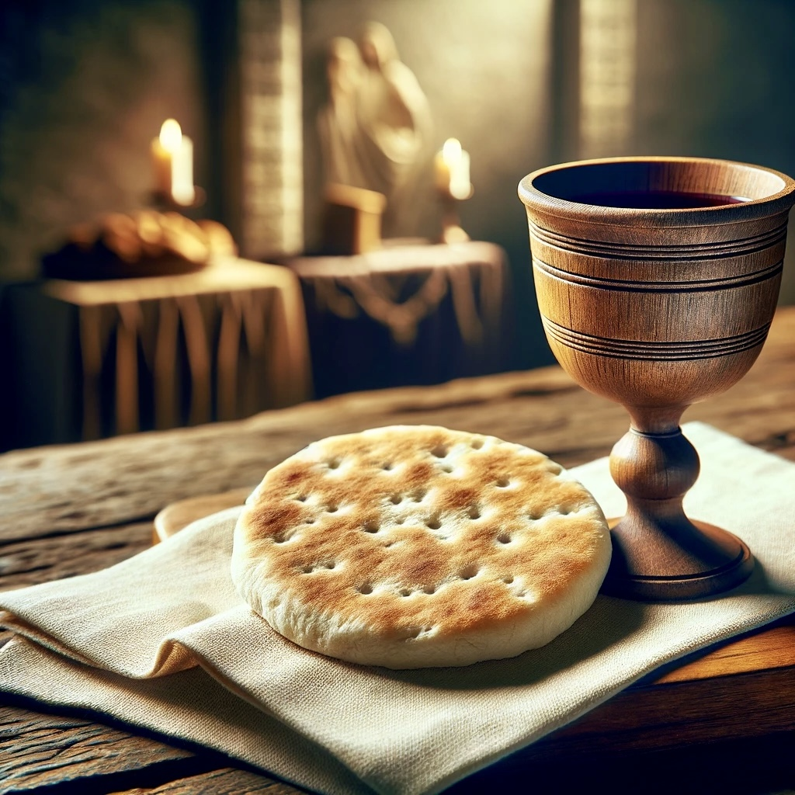
Holy Communion

Slide 12
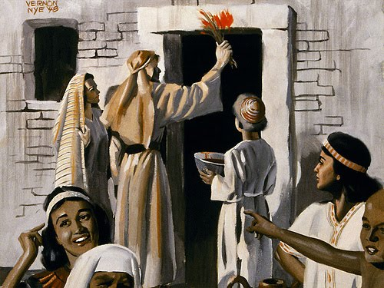
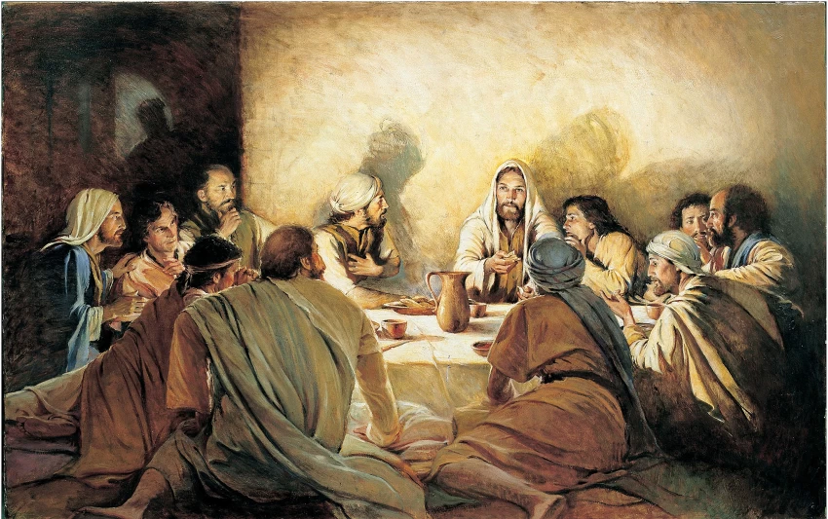
The Holy Communion is the fulfillment of the Passover.

Slide 13
Exodus 12:21.Then Moses called all the elders of Israel and said to them, "Go and select lambs for yourselves according to your clans, and kill the Passover lamb.22.Take a bunch of hyssop and dip it in the blood that is in the basin, and touch the lintel and the two doorposts with the blood that is in the basin. None of you shall go out of the door of his house until the morning. 23.For the Lord will pass through to strike the Egyptians, and when he sees the blood on the lintel and on the two doorposts, the Lord will pass over the door and will not allow the destroyer to enter your houses to strike you.

Slide 14
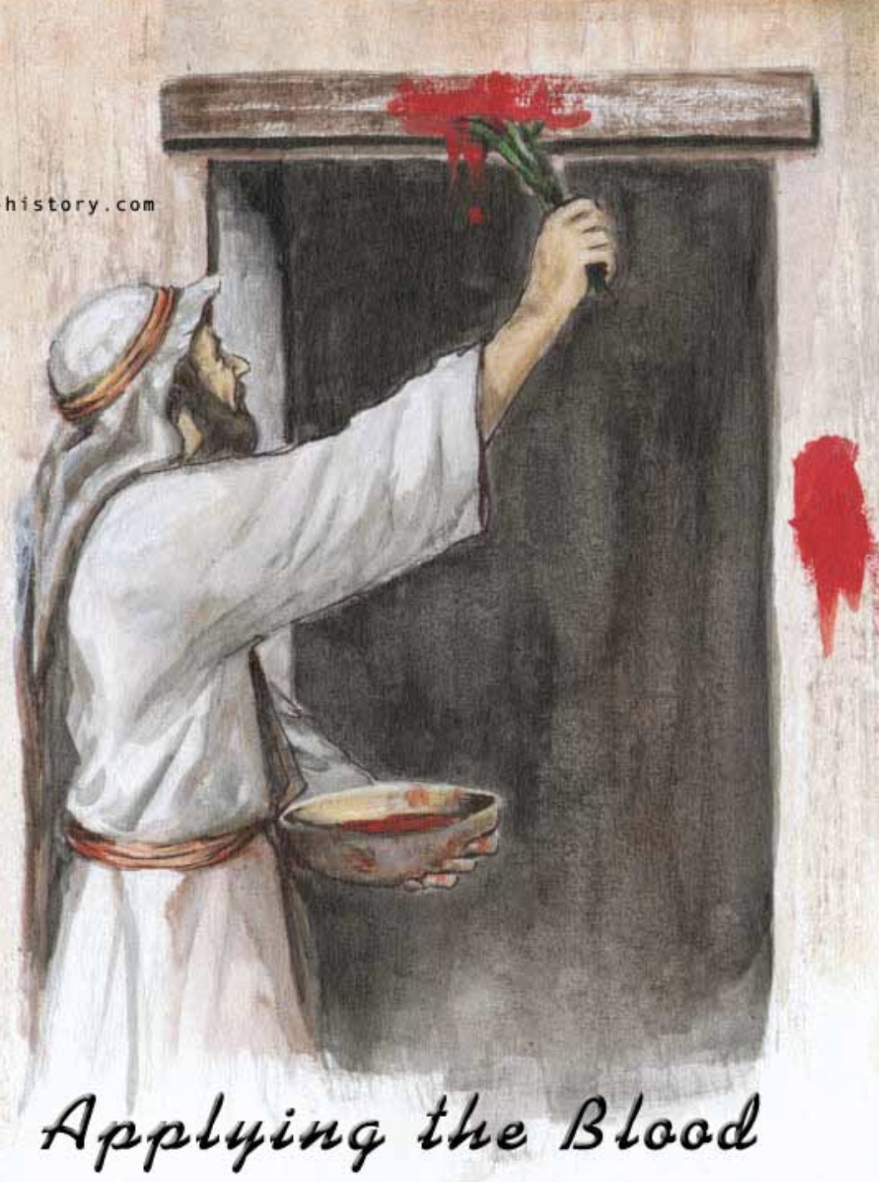
1 Corinthians 5:7 ....
For Christ, our Passover lamb, has been sacrificed.

Slide 15
Because of what Lord Jesus Jesus (our Passover lamb) has done for us, God’s judgment has passed over us.

Slide 16
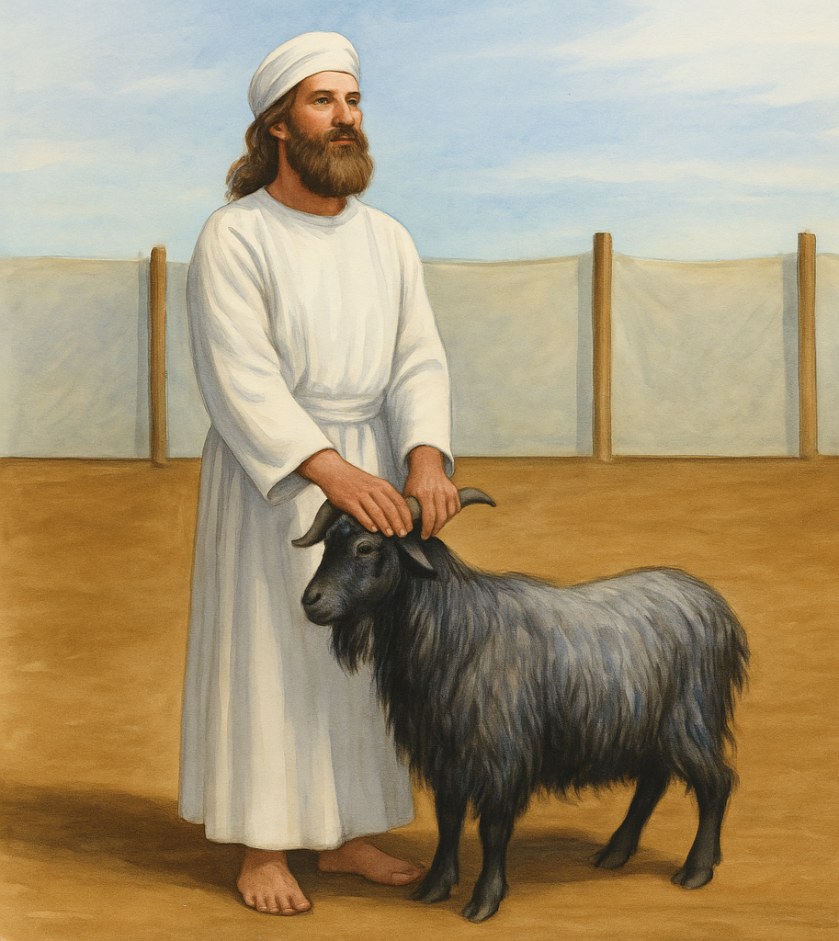
lev 16:15 “Then he shall kill the goat of the sin offering that is for the people … 21 And Aaron shall lay both his hands on the head of the live goat, and confess over it all the iniquities of the people of Israel, and all their transgressions, all their sins. And he shall put them on the head of the goat and send it away into the wilderness by the hand of a man who is in readiness. 22 The goat shall bear all their iniquities

