Slide 1
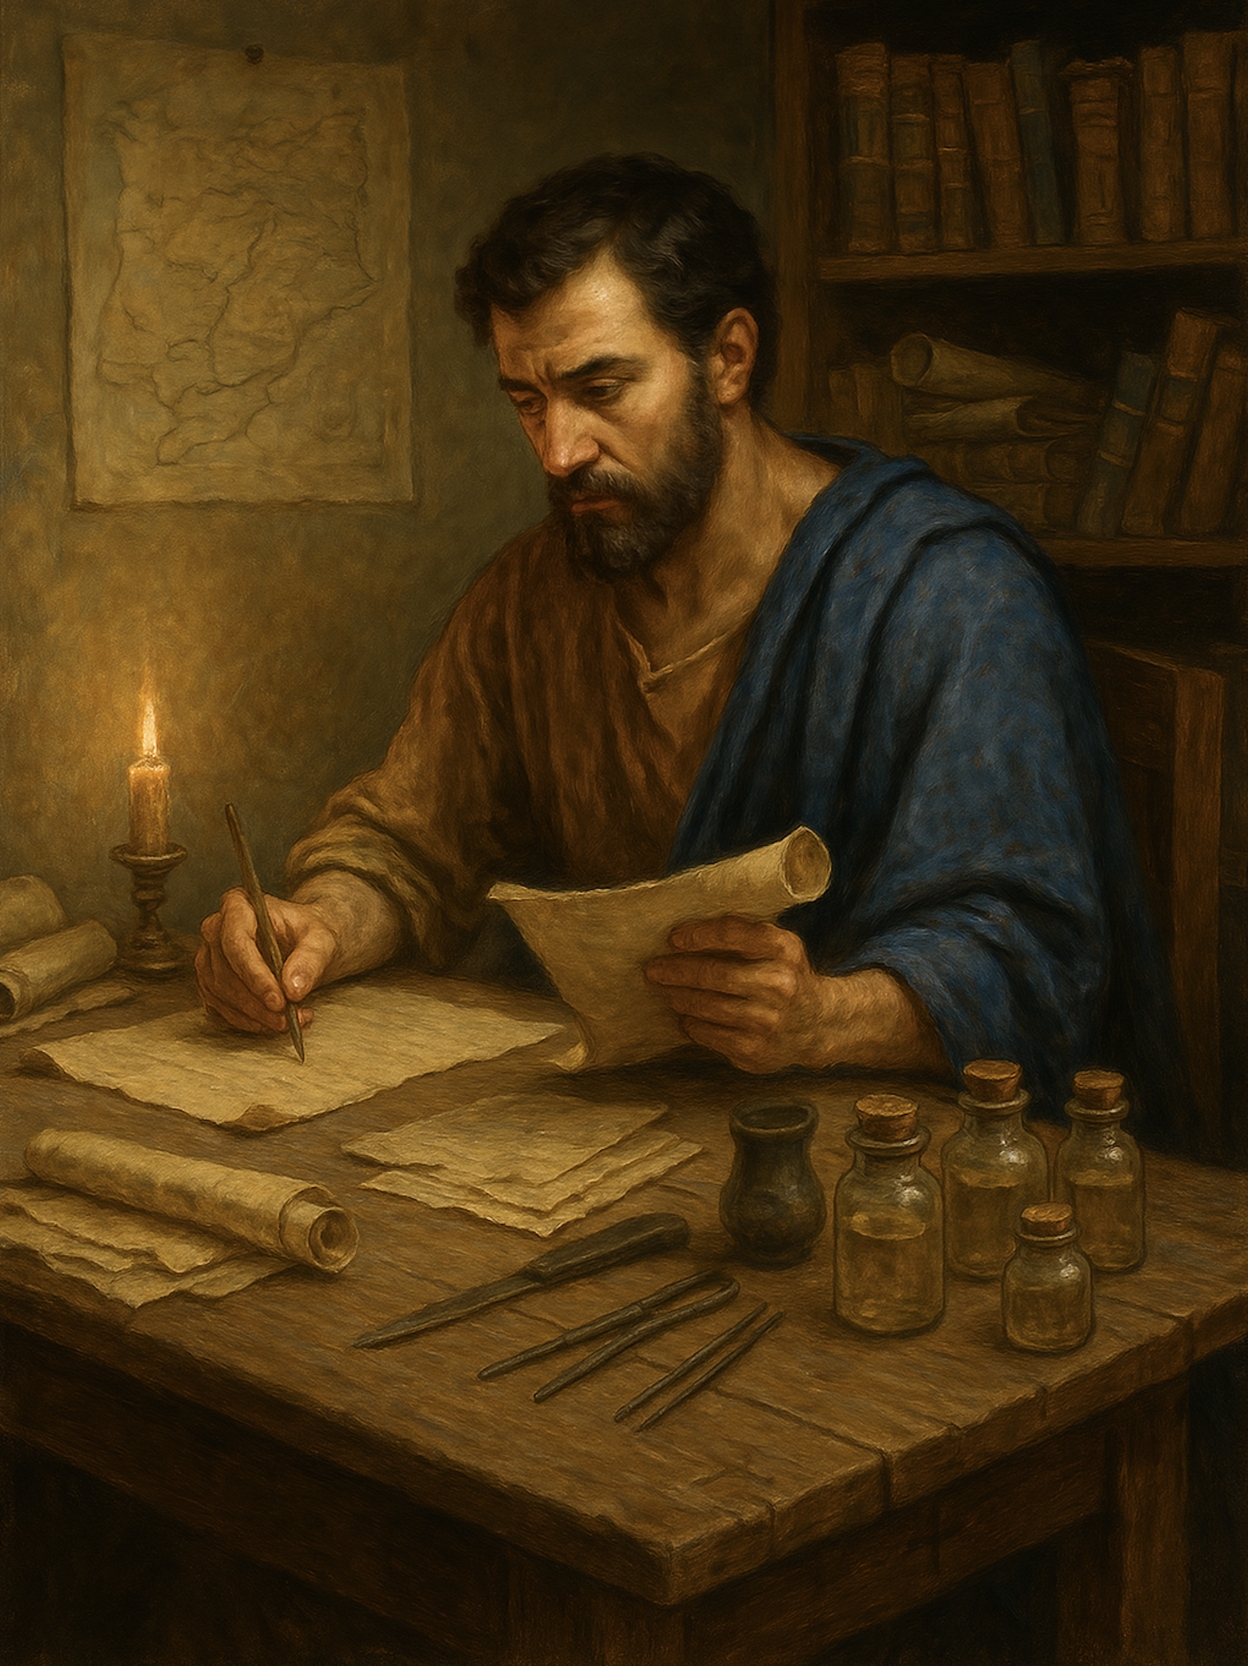
路加福音 Gospel of Luke
13 胜过试探（一）
路加福音 4章1至4
Overcoming Temptation (Part One).

Slide 2

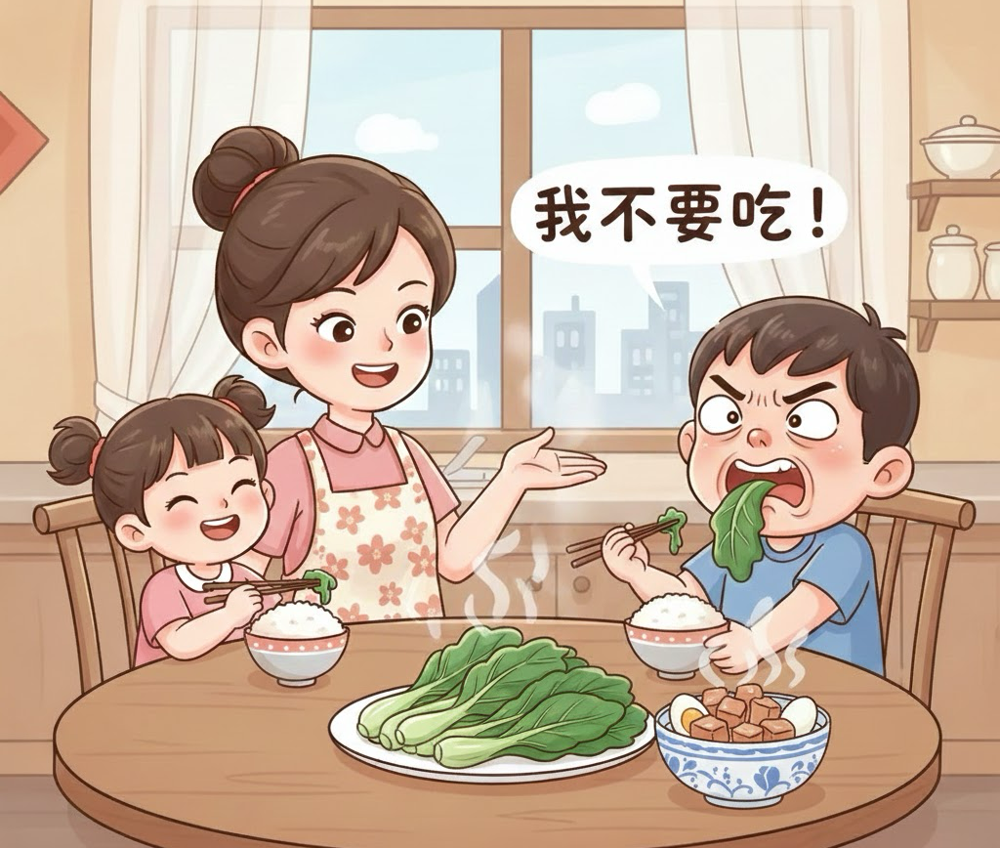

Slide 3
路 4:1.耶稣被圣灵充满，从约旦河回来，圣灵引他到旷野，2.四十天受魔鬼的试探。那些日子他甚么也没有吃，日子满了他就饿了。3.魔鬼对他说：“你若是神的儿子，就吩咐这块石头变成食物吧！”4.耶稣回答：“经上记着：‘人活着不是单靠食物。’”
Luk 4:1 And Jesus, full of the Holy Spirit, returned from the Jordan and was led by the Spirit in the wilderness
2 for forty days, being tempted by the devil. And he ate nothing during those days. And when they were ended, he was hungry.3 The devil said to him, “If you are the Son of God, command this stone to become bread.” 4 And Jesus answered him, “It is written, ‘Man shall not live by bread alone.’”

Slide 4
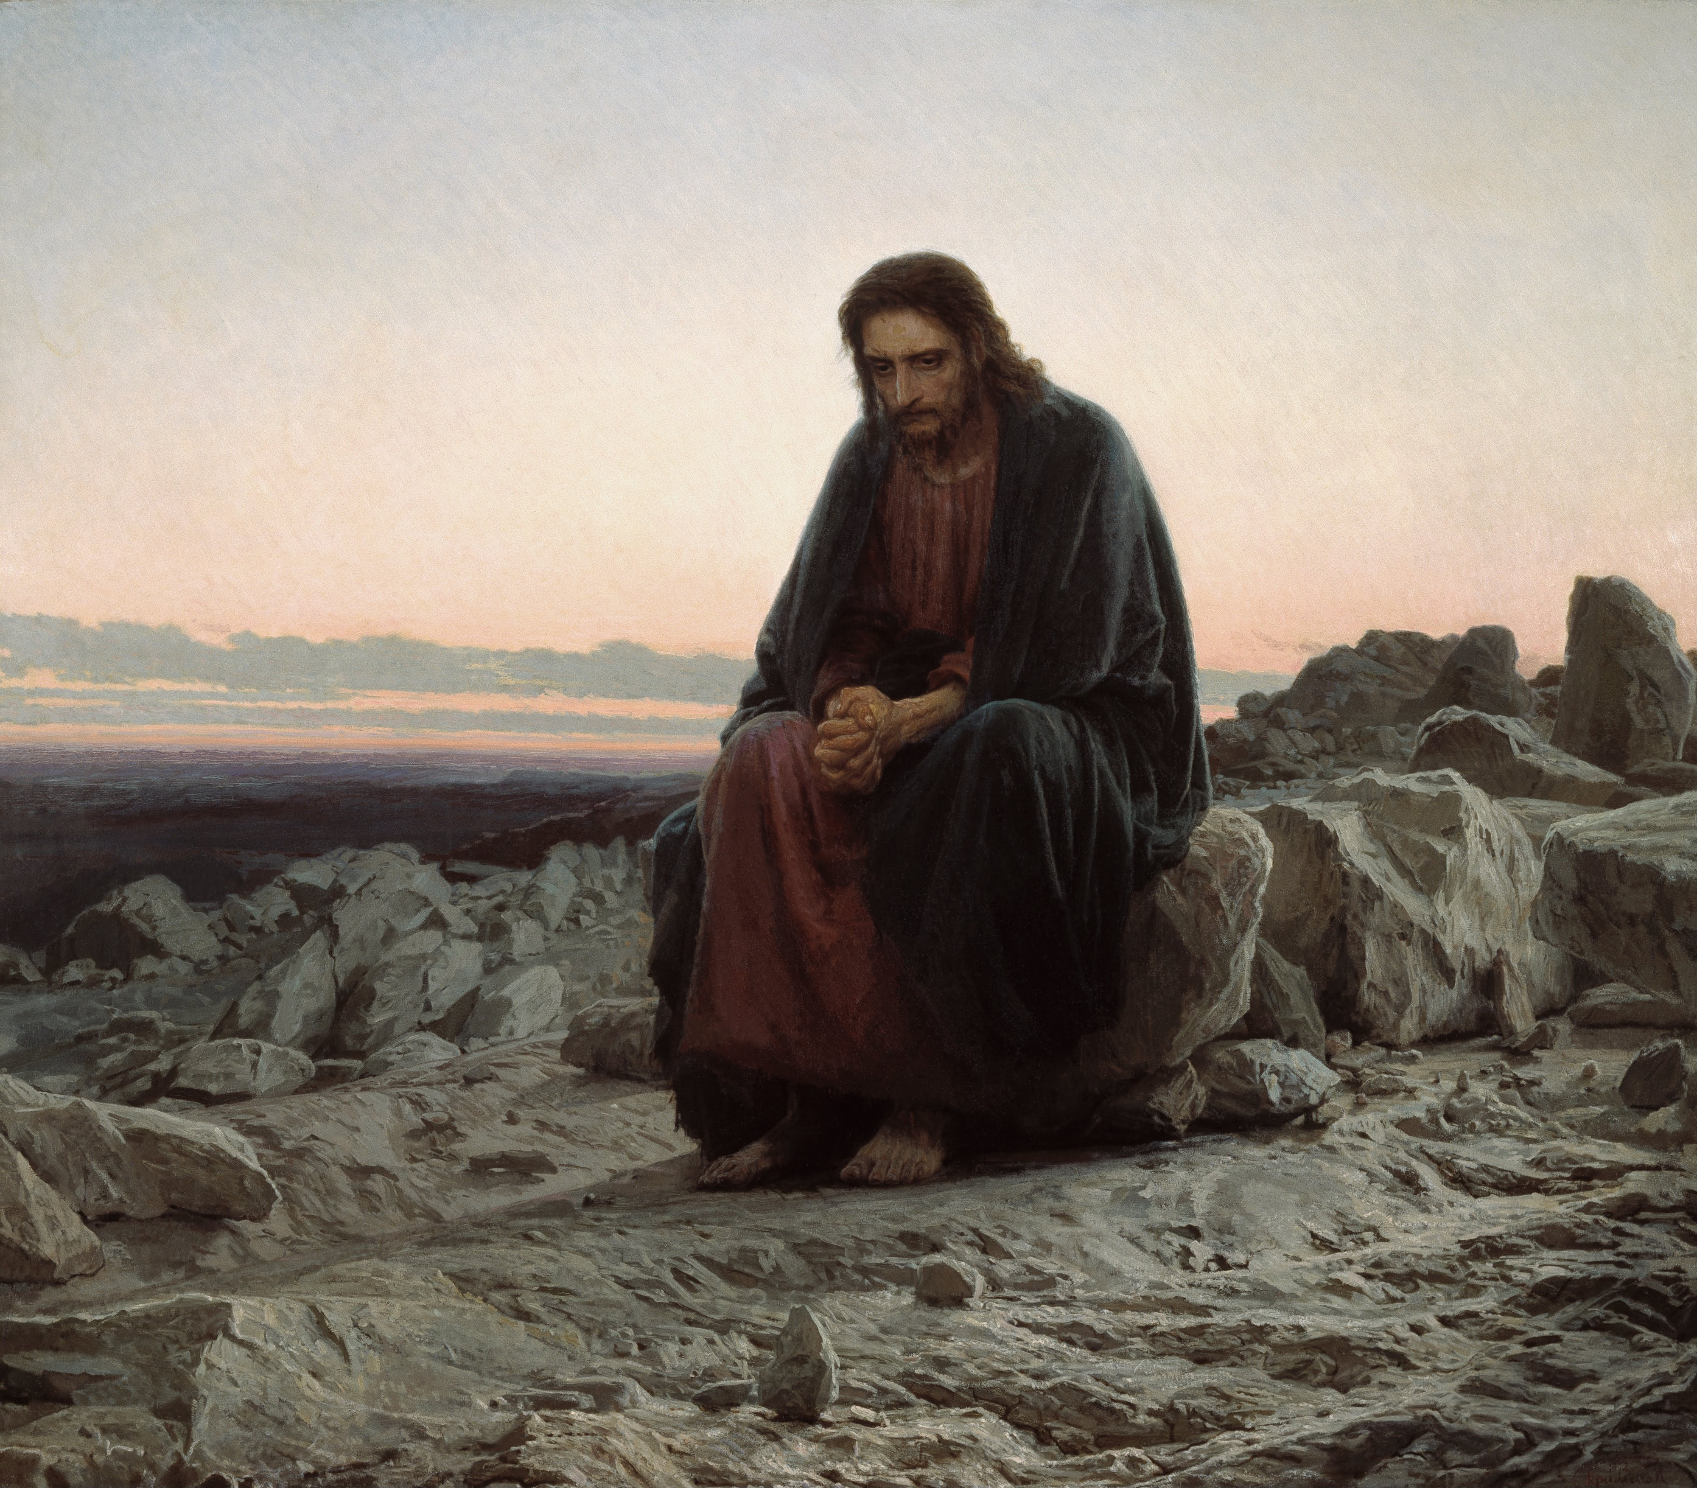
基督在旷野
Christ in the Wilderness - Ivan Kramskoy

Slide 5
01
历史看见人因食物失败
History shows that people have failed because of food.

Slide 6

创世记 2:17. 只是分别善恶树上的果子，你不可吃，因为你吃的日子必定死！」
Genesis 2:17.but of the tree of the knowledge of good and evil you shall not eat, for in the day that you eat of it you shall surely die."

Slide 7
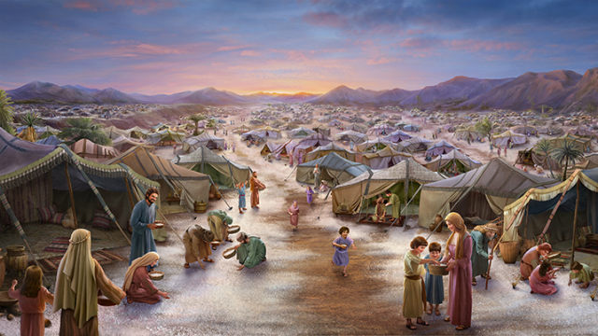
以色列在旷野天天吃吗哪
“The Israelites ate manna every day in the wilderness.”

Slide 8
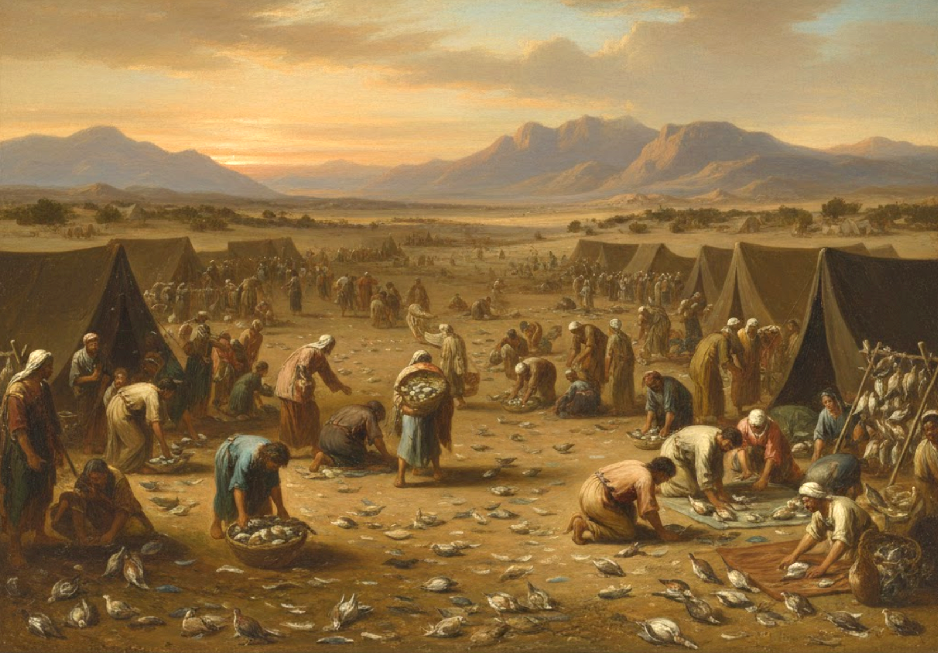
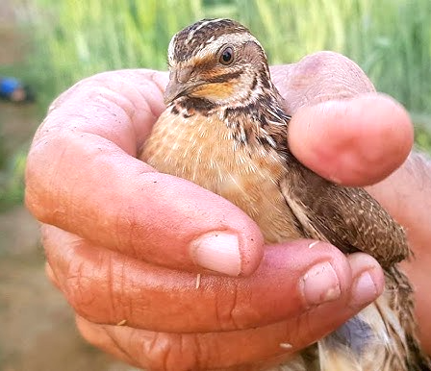
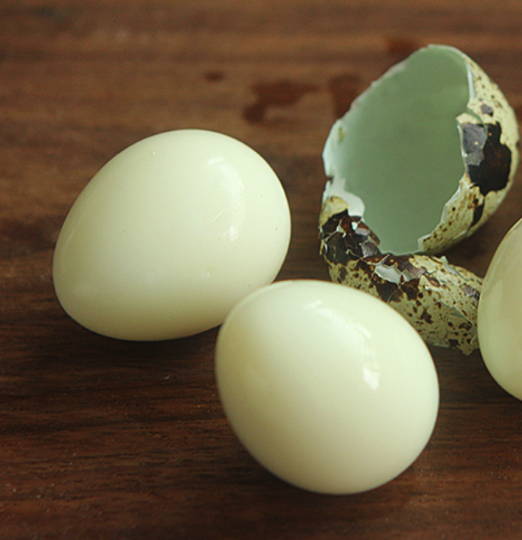
约1.5天，一人抓了最少 约3000只 鹌鹑
In about 1.5 days, each person caught at least about 3,000 quail.

Slide 9
民 11:33 肉在他们牙齿之间,还没有嚼烂,耶和华的怒气就向人民发作,用极重的灾祸击打他们。
Num 11:33 While the meat was yet between their teeth, before it was consumed, the anger of the LORD was kindled against the people, and the LORD struck down the people with a very great plague.
诗篇106:15.神把他们所求的赐给他们，却使灾病临到他们身上。
Psa 106:15 he gave them what they asked, but sent a wasting disease among them.

Slide 10
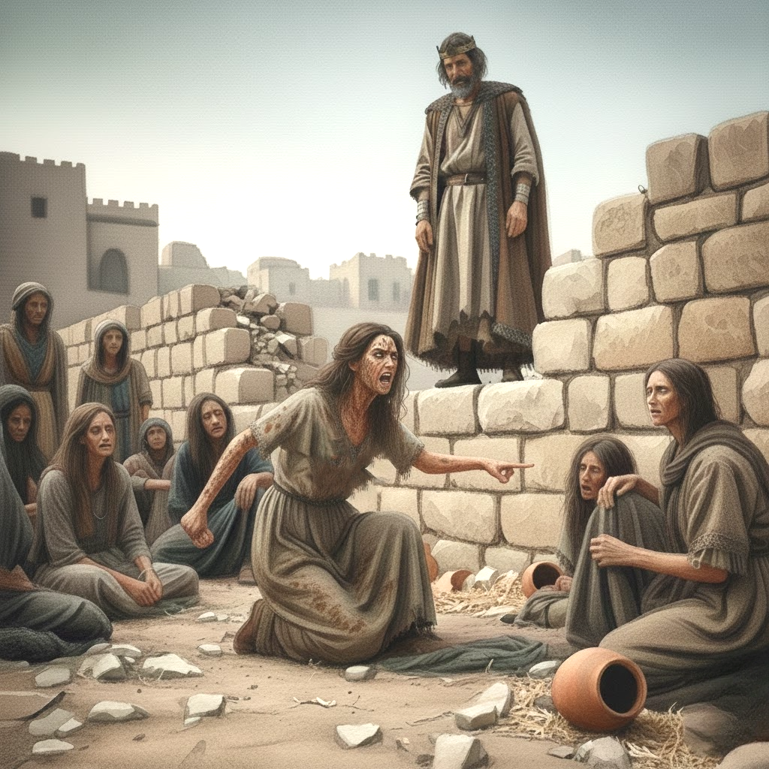
列王纪下 6:29.于是我们把我的儿子煮了，把他吃了。第二日，我对她说：‘把你的儿子交出来，我们好把他吃了。’她却把她的儿子收藏起来。”
2 Kings 6:29. So we boiled my son and ate him. And on the next day I said to her, 'Give your son, that we may eat him.' But she has hidden her son."

Slide 11
02
为什么把石头变成食物是一个试探？
Why is turning stones into food a temptation?

Slide 12
3.魔鬼对他说：“你若是神的儿子，就吩咐这块石头变成食物吧！”
3 The devil said to him, “If you are the Son of God, command this stone to become bread.”

Slide 13
03
我们为什么而活？
What do we live for?

Slide 14
4.耶稣回答：“经上记着：‘人活着不是单靠食物。’”
和合本加【乃是靠神口里所出的一切话。】 太4:4、申命记 8:3
4 And Jesus answered him, “It is written, ‘Man shall not live by bread alone.’”

Slide 15
申8:3 他使你受苦【苦炼你】，任你饥饿，把你和你的列祖不认识的吗哪赐给你吃，使你知道人活着，不是单靠食物，更要靠耶和华口里所出的一切话。
Deu 8:3 And he humbled you and let you hunger and fed you with manna, which you did not know, nor did your fathers know, that he might make you know that man does not live by bread alone, but man lives by every word that comes from the mouth of the LORD.

Slide 16
04
不要忧虑说：吃什麽？喝什麽？穿什麽？
Do not be anxious, saying: What shall we eat? What shall we drink? What shall we wear?

Slide 17
太6:31
所以，不要忧虑说：吃什麽？喝什麽？穿什麽？32 这都是外邦人所求的，你们需用的这一切东西，你们的天父是知道的。33 你们要先求他的国和他的义，这些东西都要加给你们了。
Mat 6:31 Therefore do not be anxious, saying, ‘What shall we eat?’ or ‘What shall we drink?’ or ‘What shall we wear?’32 For the Gentiles seek after all these things, and your heavenly Father knows that you need them all.33 But seek first the kingdom of God and his righteousness, and all these things will be added to you.

