Slide 1
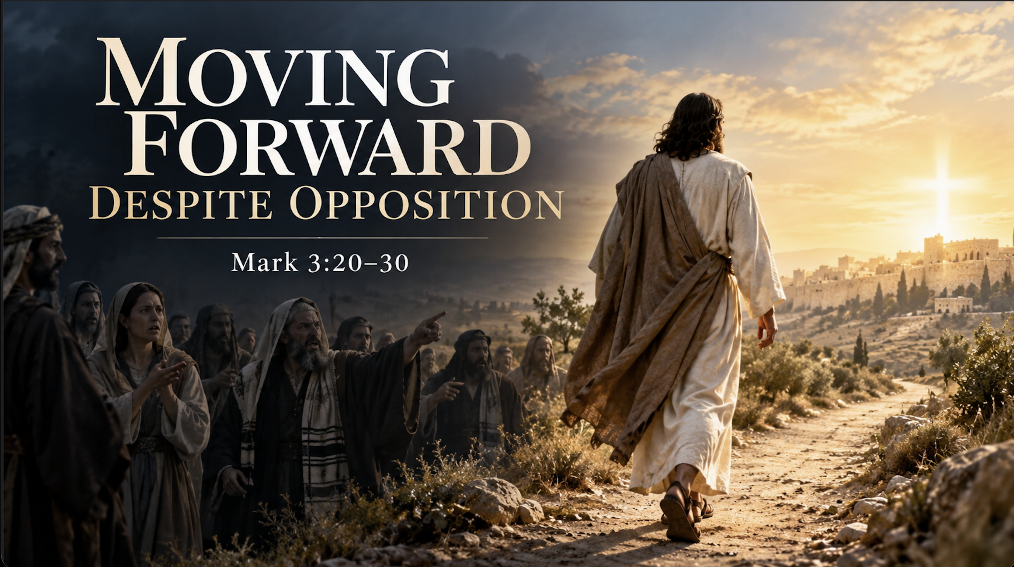

Slide 2
Mrk 3:20 Then he went home, and the crowd gathered again, so that they could not even eat. 21 And when his family heard it, they went out to seize him, for they were saying, “He is out of his mind.” 22 And the scribes who came down from Jerusalem were saying, “He is possessed by Beelzebul,” and “by the prince of demons he casts out the demons.”23 And he called them to him and said to them in parables, “How can Satan cast out Satan?24 If a kingdom is divided against itself, that kingdom cannot stand.25 And if a house is divided against itself, that house will not be able to stand.26 And if Satan has risen up against himself and is divided, he cannot stand, but is coming to an end.

Slide 3
Mrk 3:27 But no one can enter a strong man's house and plunder his goods, unless he first binds the strong man. Then indeed he may plunder his house.28 “Truly, I say to you, all sins will be forgiven the children of man, and whatever blasphemies they utter,29 but whoever blasphemes against the Holy Spirit never has forgiveness, but is guilty of an eternal sin”—30 for they were saying, “He has an unclean spirit.”

Slide 4
【1】
Moving Forward Despite Rejection

Slide 5
【2】
Moving forward in unity

Slide 6
23 And he called them to him and said to them in parables, “How can Satan cast out Satan?24 If a kingdom is divided against itself, that kingdom cannot stand.25 And if a house is divided against itself, that house will not be able to stand.26 And if Satan has risen up against himself and is divided, he cannot stand, but is coming to an end.

Slide 7
【3】
Moving forward relying on the power of Jesus

Slide 8
Mrk 3:27 But no one can enter a strong man's house and plunder his goods, unless he first binds the strong man. Then indeed he may plunder his house.

Slide 9
【4】
Moving forward despite blasphemes
against Jesus

Slide 10
29 but whoever blasphemes against the Holy Spirit never has forgiveness, but is guilty of an eternal sin”—30 for they were saying, “He has an unclean spirit.”

Slide 11
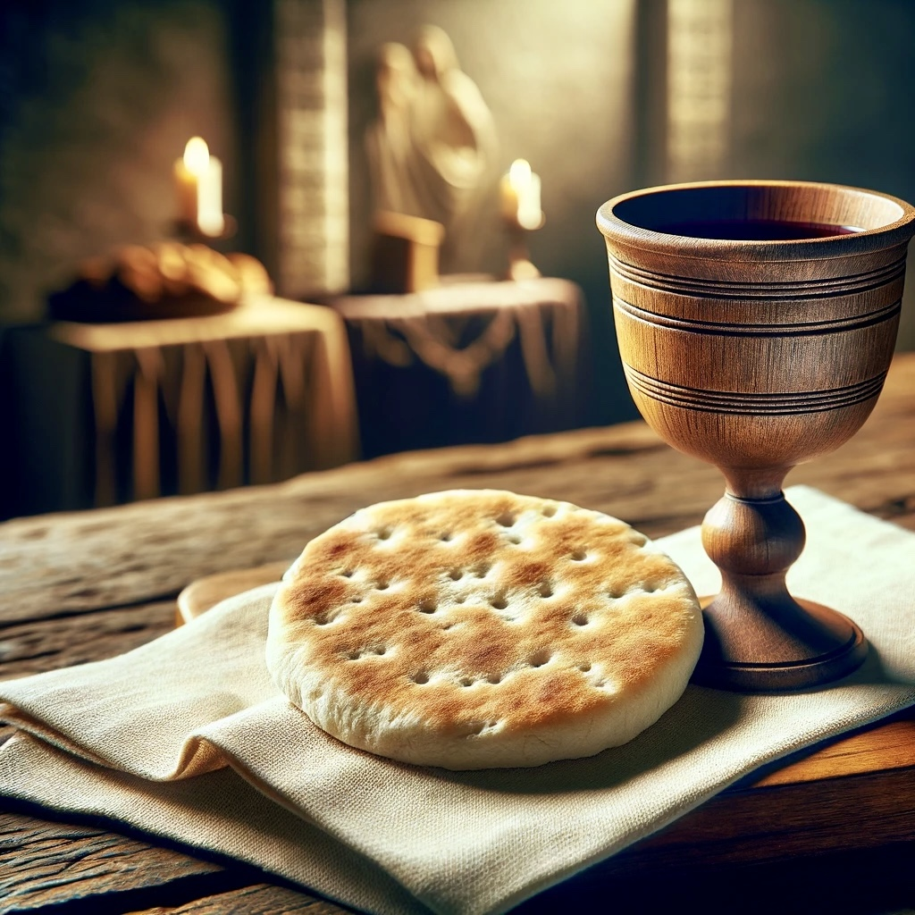
Holy Communion

Slide 12
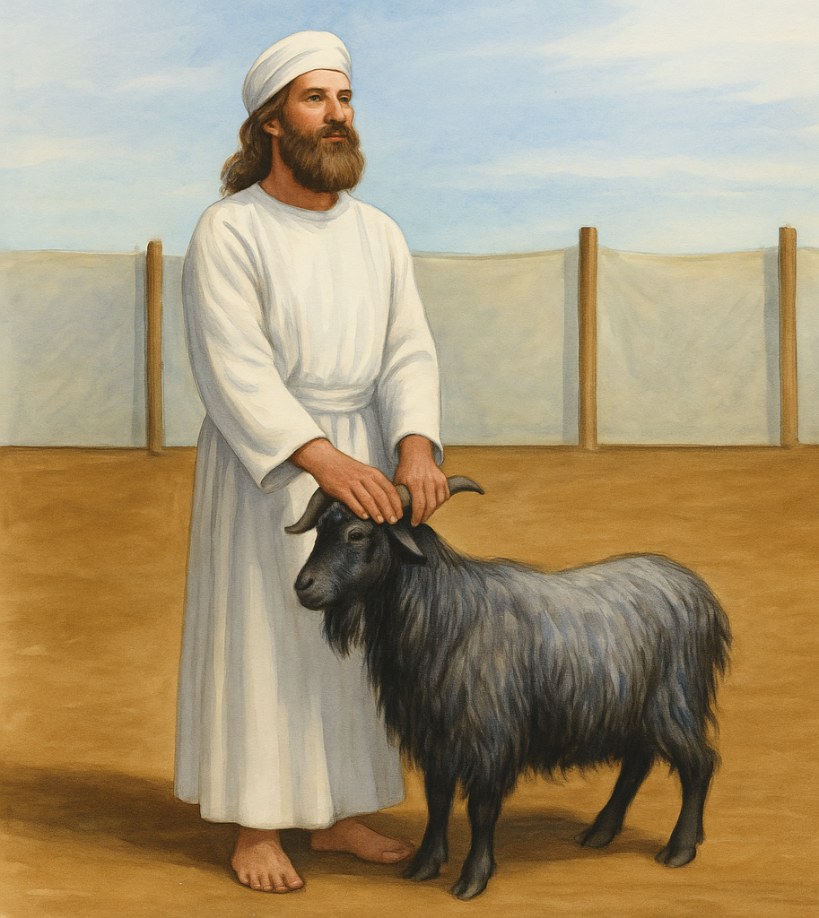
lev 16:15 “Then he shall kill the goat of the sin offering that is for the people … 21 And Aaron shall lay both his hands on the head of the live goat, and confess over it all the iniquities of the people of Israel, and all their transgressions, all their sins. And he shall put them on the head of the goat and send it away into the wilderness by the hand of a man who is in readiness. 22 The goat shall bear all their iniquities

