Slide 1
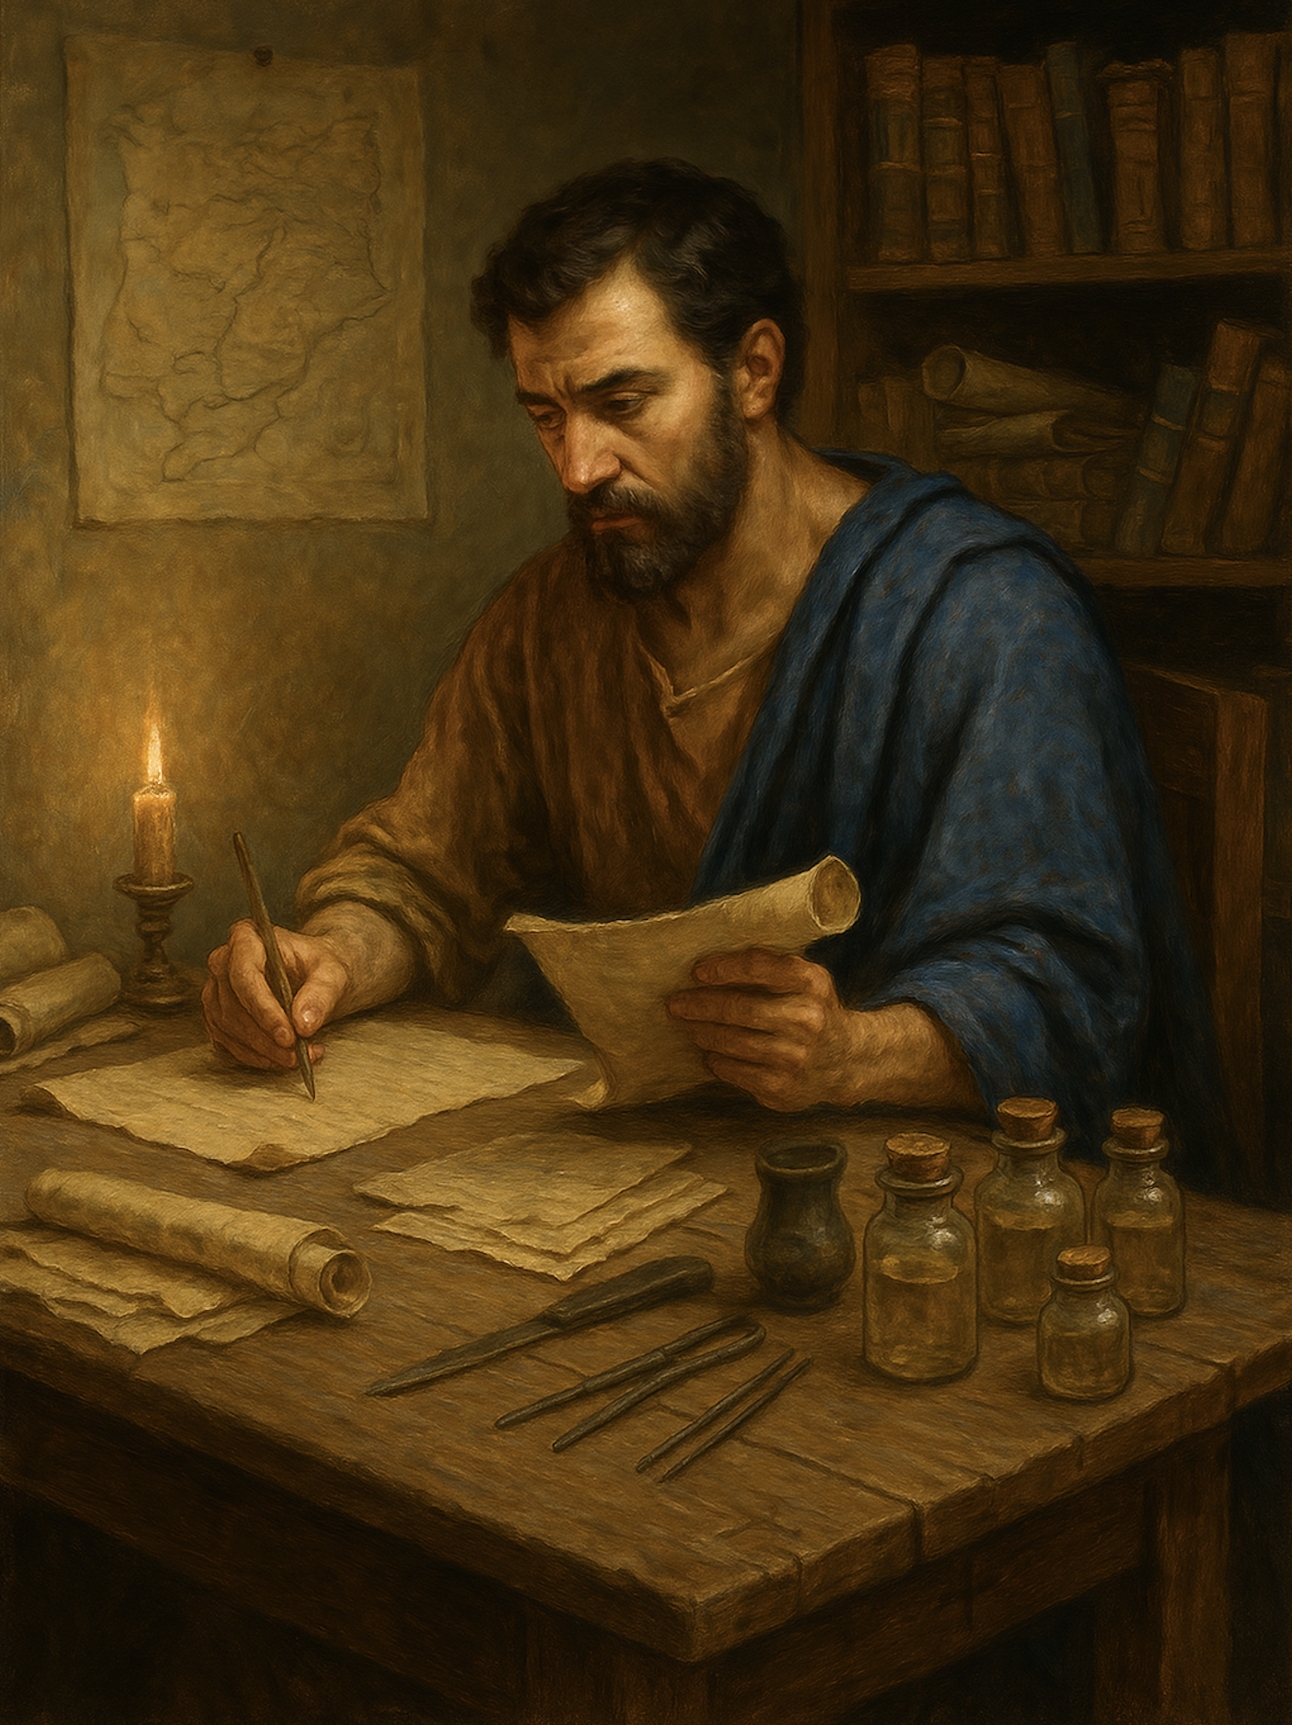
路加福音
Gospel of Luke
  14 胜过试探（二）谁能抵挡权势荣华富贵？
  路加福音 4章5至8
  Overcoming Temptation (II): Who Can Withstand Power, Glory, and Wealth?

Slide 2

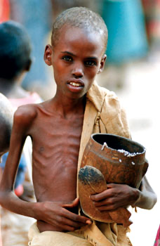
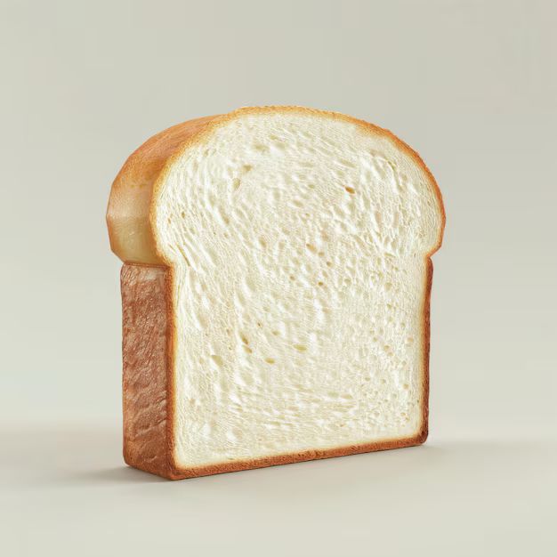

Slide 3




Slide 4
路4:5 魔鬼引他上到高处，霎时间把天下万国指给他看, 6 对他说：“这一切权柄、荣华，我都可以给你；因为这些都交给了我，我愿意给谁就给谁。7 所以，只要你在我面前拜一拜，这一切就全是你的了。”8 耶稣回答：“经上记着：‘当拜主你的上帝，单要事奉他。’”
Luk 4:5.And the devil took him up and showed him all the kingdoms of the world in a moment of time,6.and said to him, "To you I will give all this authority and their glory, for it has been delivered to me, and I give it to whom I will.7.If you, then, will worship me, it will all be yours."8.And Jesus answered him, "It is written, "'You shall worship the Lord your God, and him only shall you serve.'"

Slide 5
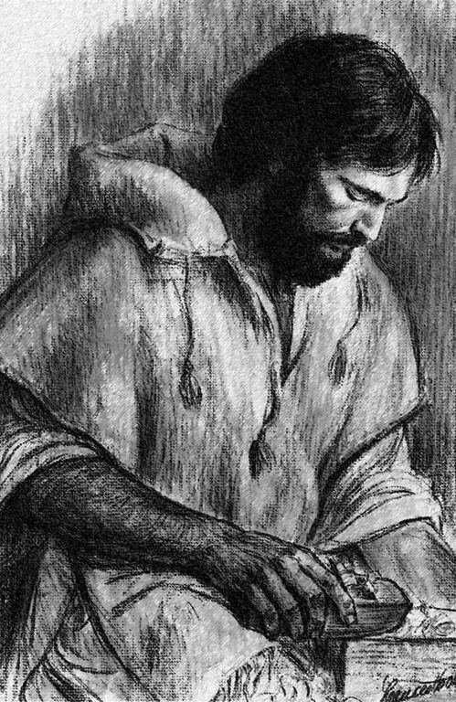
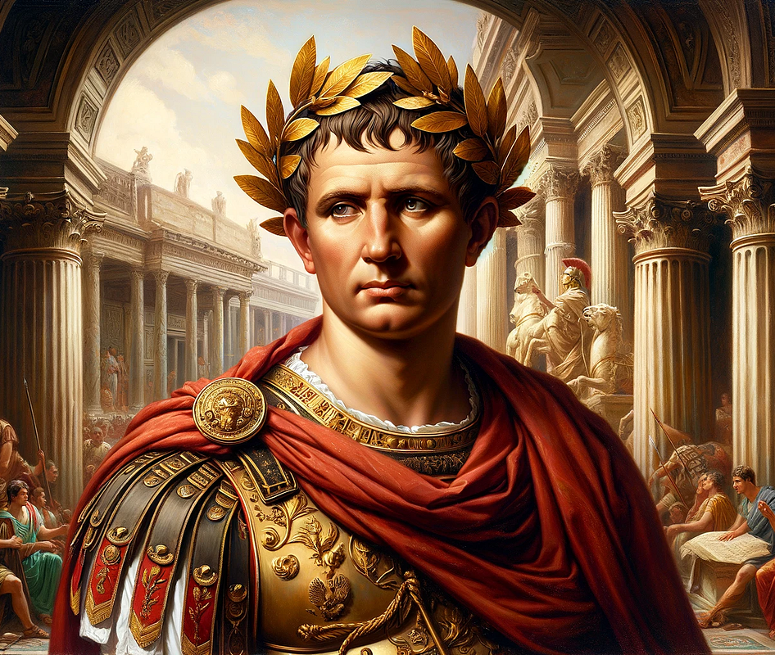
平民 Common people
凯撒（王） Caesar (King)

Slide 6
01
上帝任凭堕落的世界落入魔鬼手中
God gave up the fallen world into the hands of the devil.

Slide 7
路4:5 魔鬼引他上到高处，霎时间把天下万国指给他看, 6 对他说：“这一切权柄、荣华，我都可以给你；因为这些都交给了我【原是交付我的】 ，我愿意给谁就给谁。
Luk 4:5.And the devil took him up and showed him all the kingdoms of the world in a moment of time,6.and said to him, "To you I will give all this authority and their glory, for it has been delivered to me, and I give it to whom I will.

Slide 8
三一神
Triune God
天使 Angels
被造的世界
Created world
人 Humans
动物植物 Animals and Plants

Slide 9
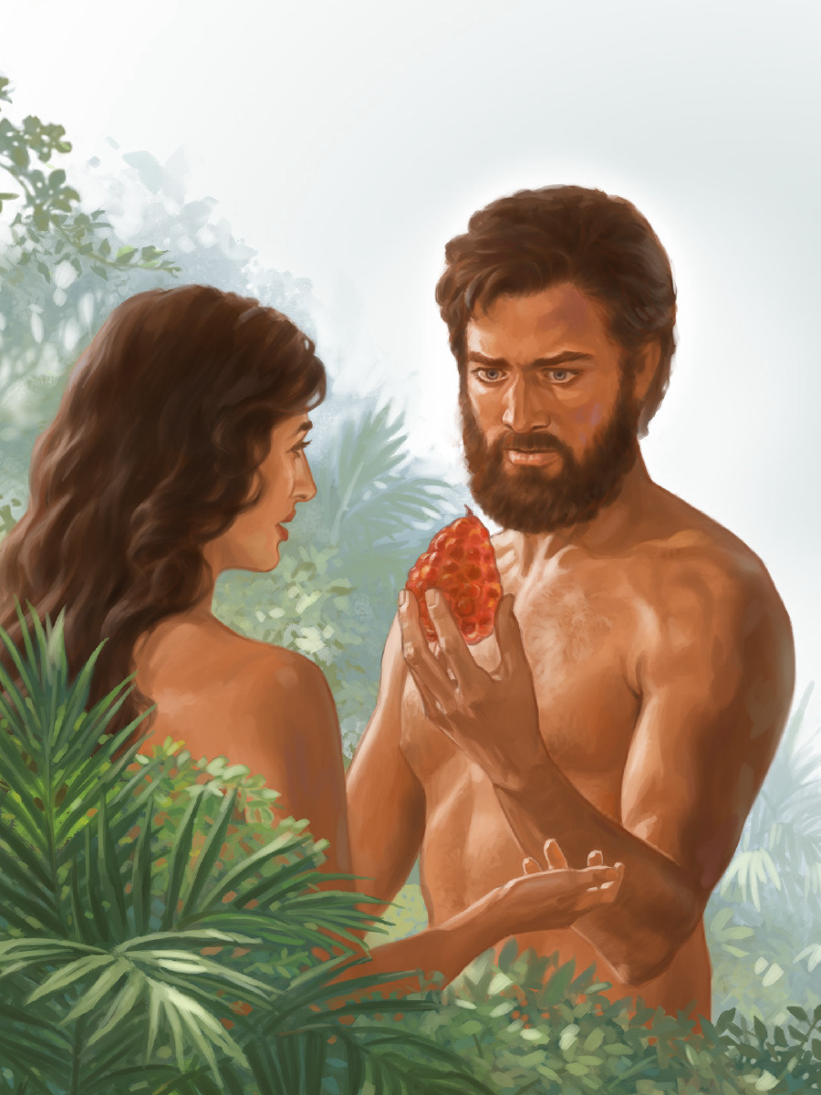
撒旦 Satan
魔鬼成为这世界的王
（约12:31、约14:30、弗2:1 -2 ）
Devil became the ruler of this world (John 12:31; John 14:30；Eph 2:1-2)
魔鬼成了这世界的神
（林后4:4）
Devil became the god of this world
(2 Corinthians 4:4)
人顺从了撒旦
Man obeyed Satan

Slide 10
约壹 5:19
我们知道，我们是属神的，全世界都卧在那恶者手下。
1 John 5:19.
We know that we are from God, and the whole world lies in the power of the evil one.

Slide 11
02
我们能否经得起魔鬼的试探？
Are we able to withstand the devil’s temptation?

Slide 12
7 所以，只要你在我面前拜一拜，这一切就全是你的了。
7.If you, then, will worship me, it will all be yours."

Slide 13
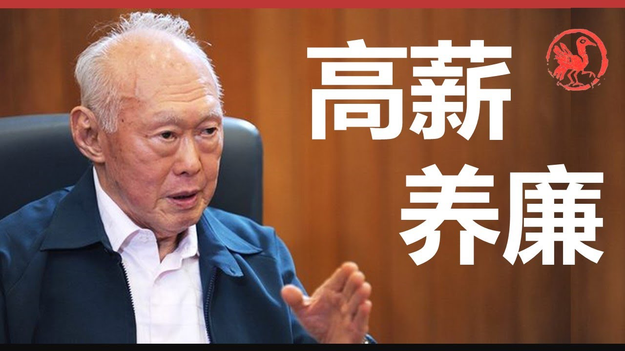

Slide 14



拉维·撒迦利亚
2021 曝光犯奸淫
Exposed adultery

Slide 15
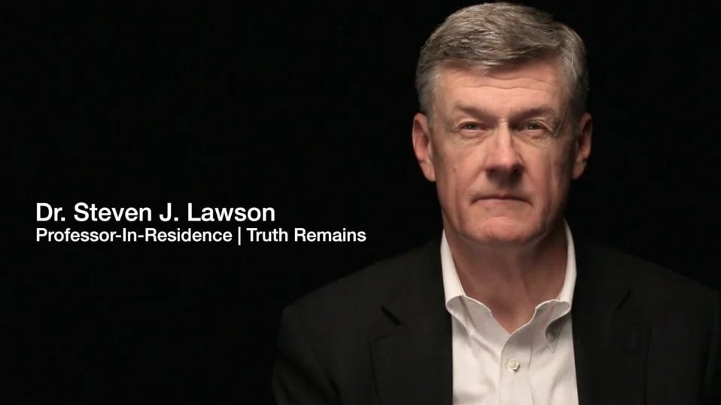
史蒂文·勞森牧師
2024 曝光犯奸淫
Exposed adultery

Slide 16

楊腓力
（Philip Yancey）
2026 曝光犯奸淫
Exposed adultery

Slide 17
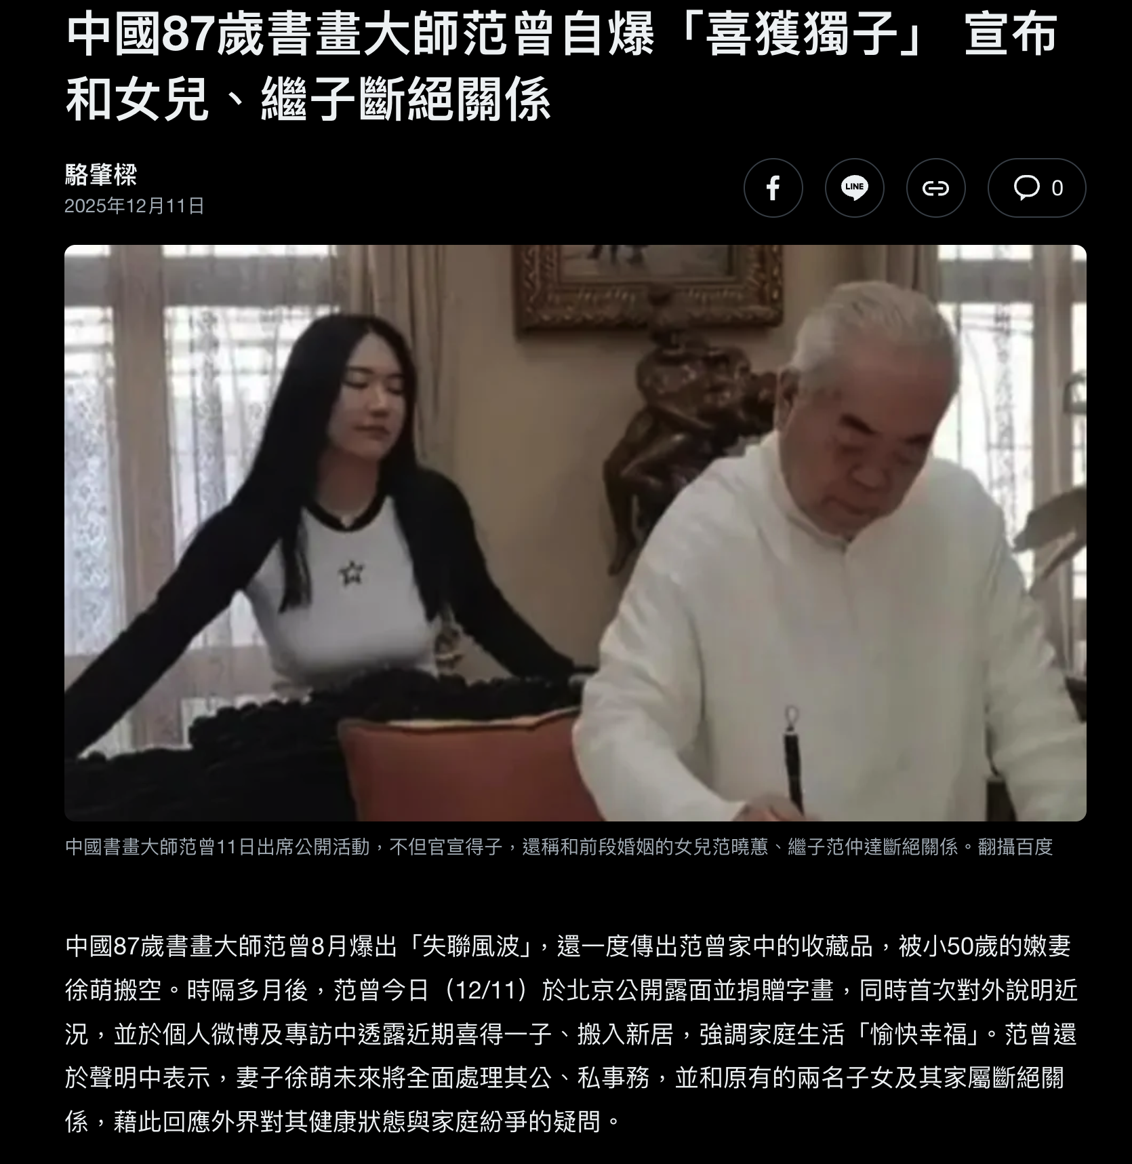

Slide 18
8 耶稣回答：“经上记着：‘当拜主你的上帝，单要事奉他。’”
8.And Jesus answered him, "It is written, "'You shall worship the Lord your God, and him only shall you serve.'"

Slide 19
03
我们如何面对试探？
How should we overcome temptation?

Slide 20
林前15:33
你们不要自欺，滥交朋友是会败坏品德的。
1Co 15:33 Do not be deceived: “Bad company ruins good morals.”

Slide 21
传 4:12
有人能制伏孤身一人，如果有二人就挡得住他。三股合成的绳子，不容易扯断。
Ecc 4:12 And though a man might prevail against one who is alone, two will withstand him—a threefold cord is not quickly broken.

Slide 22
太6:13
不叫我们遇见试探；救我们脱离凶恶（或作：脱离恶者）。
Mat 6:13 And lead us not into temptation, but deliver us from evil.

