Slide 1
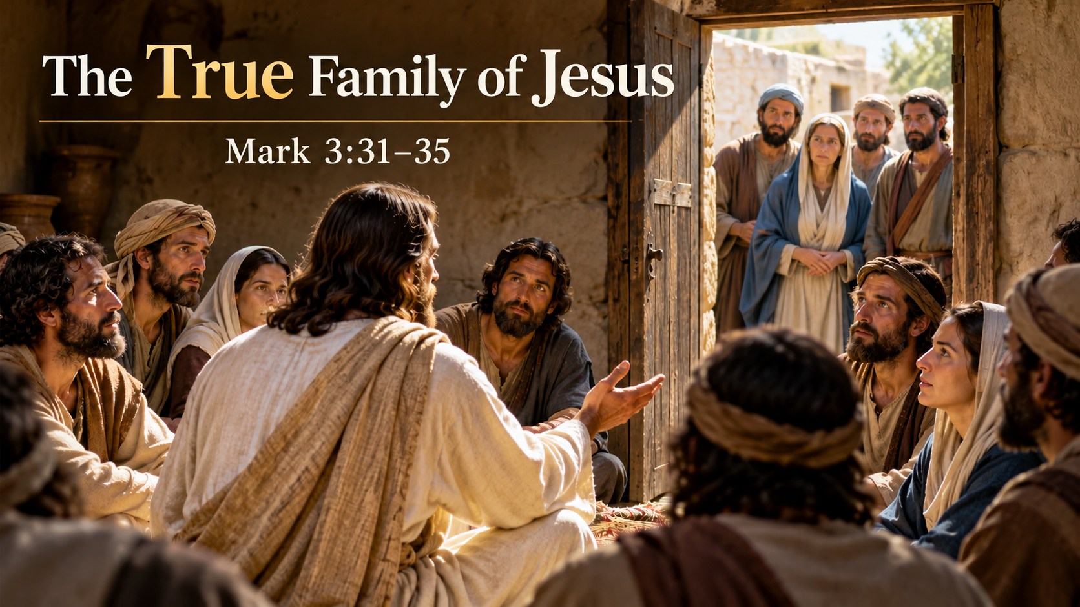

Slide 2
Mrk 3:31 And his mother and his brothers came, and standing outside they sent to him and called him.32 And a crowd was sitting around him, and they said to him, “Your mother and your brothers are outside, seeking you.”33 And he answered them, “Who are my mother and my brothers?”34 And looking about at those who sat around him, he said, “Here are my mother and my brothers! 35 For whoever does the will of God, he is my brother and sister and mother.”

Slide 3
【1】
Disbelief Within Jesus’ Family

Slide 4
【2】
Do Blood Ties Make Us Part of Jesus’ Family?

Slide 5
Mark 1:15
...“The time is fulfilled, and the kingdom of God is at hand; repent and believe in the gospel.”

Slide 6
Jhn 6:40
For this is the will of my Father, that everyone who looks on the Son and believes in him should have eternal life, and I will raise him up on the last day.”

Slide 7
Gal 3:26 for in Christ Jesus you are all sons of God, through faith.27 For as many of you as were baptized into Christ have put on Christ.28 There is neither Jew nor Greek, there is neither slave nor free, there is no male and female, for you are all one in Christ Jesus.29 And if you are Christ's, then you are Abraham's offspring, heirs according to promise.

Slide 8
【3】
Who is the most important person in our lives?

Slide 9
Mat 10:37
Whoever loves father or mother more than me is not worthy of me, and whoever loves son or daughter more than me is not worthy of me.

Slide 10
Luk 14:26 “If anyone comes to me and does not hate his own father and mother and wife and children and brothers and sisters, yes, and even his own life, he cannot be my disciple.

Slide 11
【4】
How Do We Become Members of Jesus’ Family?

Slide 12
Jhn 1:12 But to all who did receive him, who believed in his name, he gave the right to become children of God,13 who were born, not of blood nor of the will of the flesh nor of the will of man, but of God.

Slide 13
【5】
Who Are Our True Family Members?

Slide 14
35 For whoever does the will of God, he is my brother and sister and mother.”

Slide 15
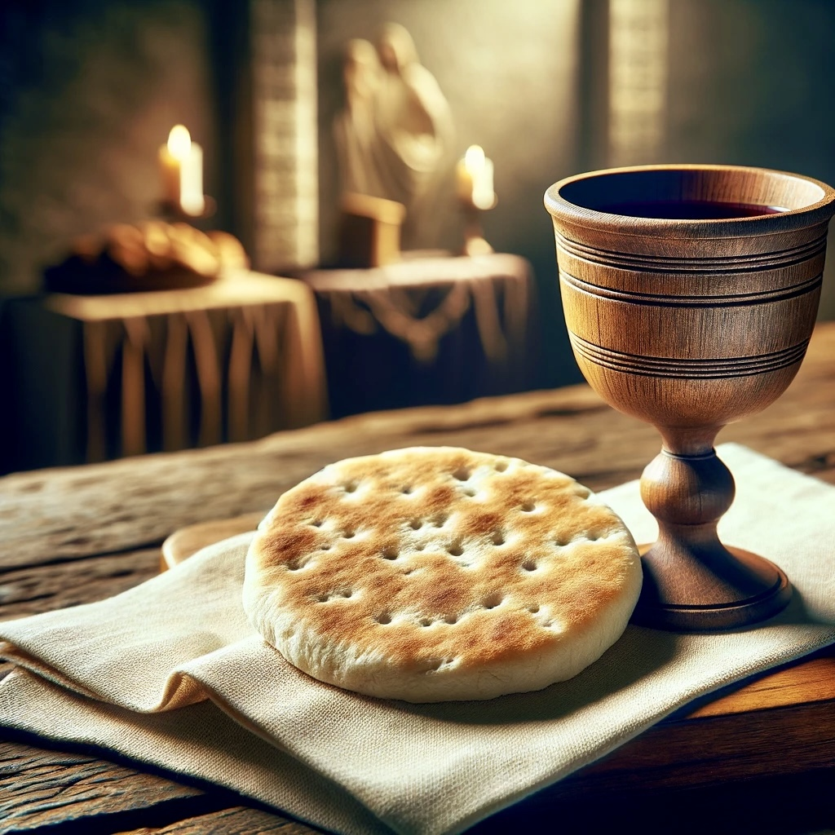
Holy Communion

Slide 16
1Jn 4:10 In this is love, not that we have loved God but that he loved us and sent his Son to be the propitiation for our sins.11 Beloved, if God so loved us, we also ought to love one another.

