Slide 1
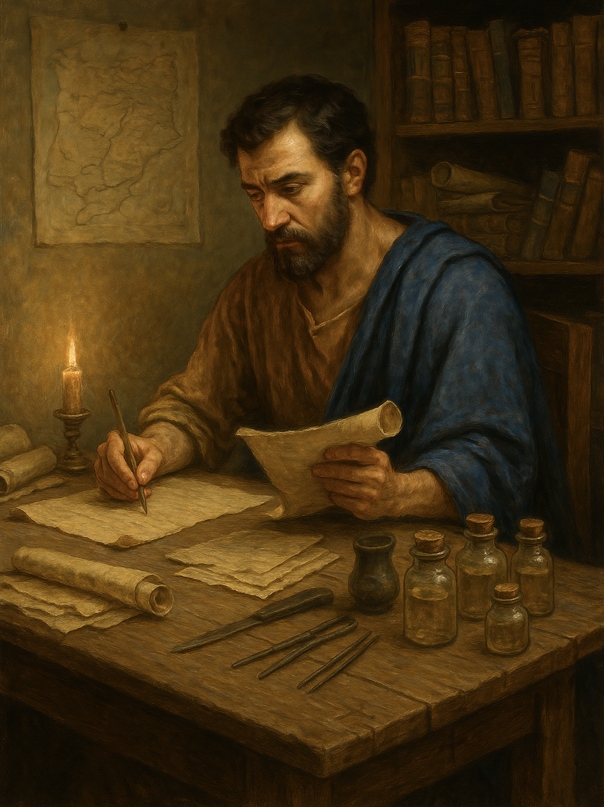
路加福音 Gospel of Luke
15 胜过试探（三）你是神的儿女？
路加福音 4章9至13
Overcoming Temptation (3): Are You the Son of God? (Luke 4:9–13)

Slide 2



Slide 3
路4:9 魔鬼又引他到耶路撒冷，叫他站在殿顶上，对他说: “你若是上帝的儿子，就从这里跳下去吧！10 因为经上记着:‘他为了你，会吩咐自己的使者保护你。’11 又记着：‘用手托住你，免得你的脚碰到石头。’”12 耶稣回答: “经上说：‘不可试探主你的上帝。’”13 魔鬼用尽了各种试探，就暂时离开了耶稣。
Luk 4:9 And he took him to Jerusalem and set him on the pinnacle of the temple and said to him, “If you are the Son of God, throw yourself down from here,10 for it is written, “‘He will command his angels concerning you, to guard you,’11 and “‘On their hands they will bear you up, lest you strike your foot against a stone.’”12 And Jesus answered him, “It is said, ‘You shall not put the Lord your God to the test.’”13 And when the devil had ended every temptation, he departed from him until an opportune time.

Slide 4
01
【1】试探：操控上帝
Temptation: Manipulating God

Slide 5

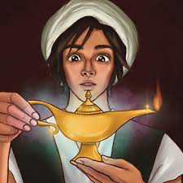

Slide 6
雅 4:15
你们只当说：主若愿意，我们就可以活著，也可以做这事，或做那事。
Jas 4:15 Instead you ought to say, “If the Lord wills, we will live and do this or that.”

Slide 7
02
试探：扭曲圣经（断章取义）
Temptation: Distorting Scripture (Taking Verses Out of Context)

Slide 8
诗篇 91:9 耶和华是我的避难所；你已将至高者当你的居所，10 祸患必不临到你，灾害也不挨近你的帐棚。11 因他要为你吩咐他的使者，在你行的一切道路上保护你。12 他们要用手托著你，免得你的脚碰在石头上。
Psa 91:9 Because you have made the LORD your dwelling place— the Most High, who is my refuge—
10 no evil shall be allowed to befall you, no plague come near your tent.11 For he will command his angels concerning you to guard you in all your ways.12 On their hands they will bear you up, lest you strike your foot against a stone.

Slide 9
诗篇 91:6
也不怕黑夜行的瘟疫，或是午间灭人的毒病。
Psa 91:6 nor the pestilence that stalks in darkness, nor the destruction that wastes at noonday.

Slide 10

腓 4:13 我靠著那加给我力量的，凡事都能做。
Php 4:13 I can do all things through him who strengthens me.

Slide 11





Slide 12
腓4:12 我知道怎样处卑贱，也知道怎样处丰富；或饱足，或饥饿；或有余，或缺乏，随事随在，我都得了秘诀。13 我靠著那加给我力量的，凡事都能做。14 然而，你们和我同受患难原是美事。
Php 4:12 I know how to be brought low, and I know how to abound. In any and every circumstance, I have learned the secret of facing plenty and hunger, abundance and need.13 I can do all things through him who strengthens me.14 Yet it was kind of you to share my trouble.

Slide 13
03
试探：假借信心任性妄为
Temptation: Willful and Reckless Behavior Under the Guise of Faith

Slide 14
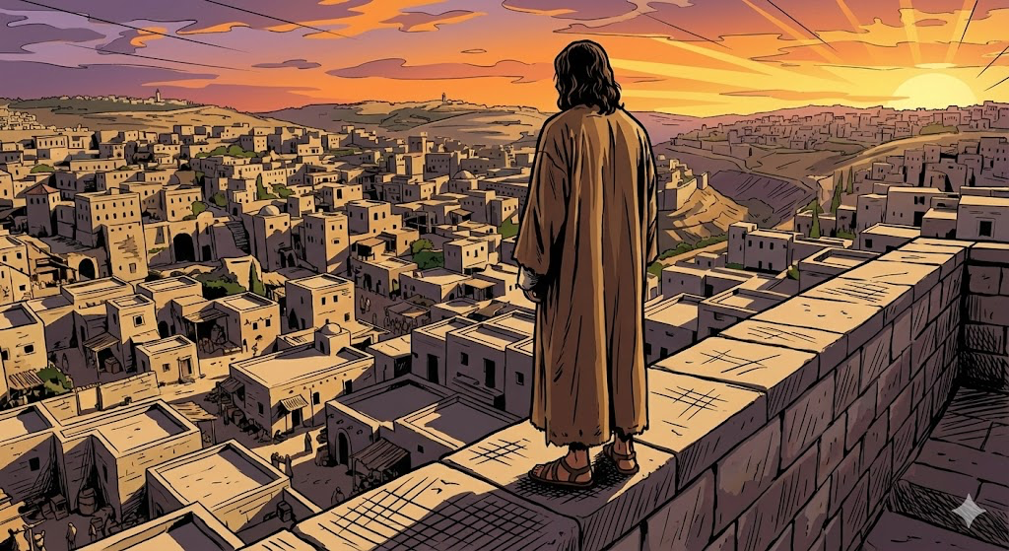

Slide 15
04
试探：贪图荣耀捷径
Temptation: Seeking a Shortcut to Glory

Slide 16


Slide 17
05
试探：陷入自我证明
Temptation: Falling into Self-Justification

Slide 18


Slide 19
约1:12
凡接待他的，就是信他名的人，他就赐他们权柄，作神的儿女。
Jhn 1:12
But to all who did receive him, who believed in his name, he gave the right to become children of God,

Slide 20
路4:12 耶稣回答:“经上说：‘不可试探主你的上帝。’”
Luk 4:12 And Jesus answered him, “It is said, ‘You shall not put the Lord your God to the test.’”
申 6:16
你们不可试探耶和华你们的神，像你们在玛撒那样试探他。
Deu 6:16 “You shall not put the LORD your God to the test, as you tested him at Massah.

Slide 21
路4:13 魔鬼用尽了各种试探，就暂时离开了耶稣。
Luk 4:13 And when the devil had ended every temptation, he departed from him until an opportune time.

Slide 22
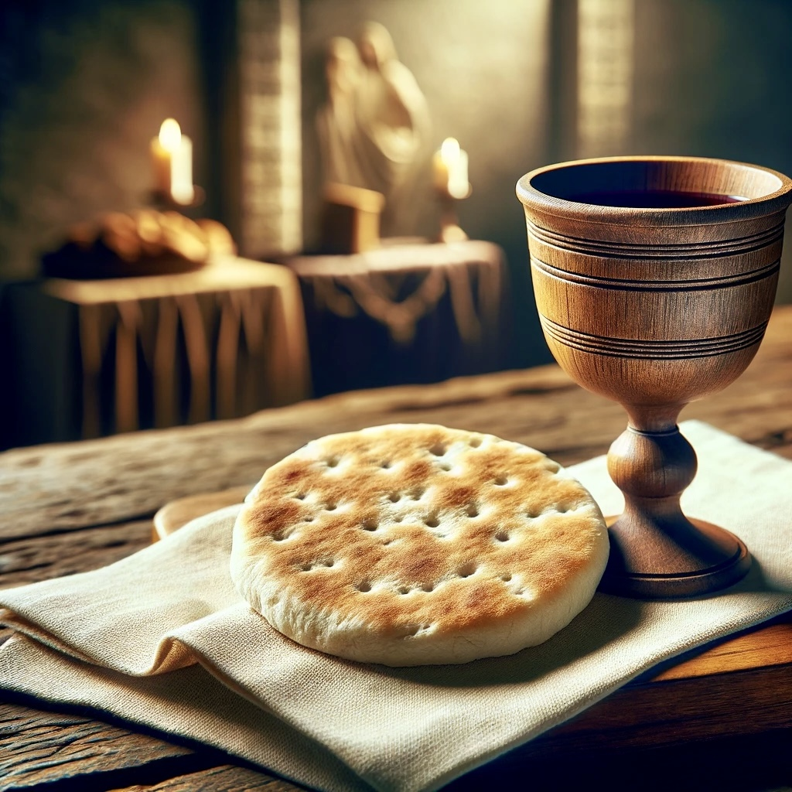
圣餐
Holy Communion

Slide 23
彼前 2:24 他被挂在木头上，亲身担当了我们的罪，使我们既然在罪上死，就得以在义上活。因他受的鞭伤，你们便得了医治。25 你们从前好像迷路的羊，如今却归到你们灵魂的牧人监督了。
1Pe 2:24 He himself bore our sins in his body on the tree, that we might die to sin and live to righteousness. By his wounds you have been healed. 25 For you were straying like sheep, but have now returned to the Shepherd and Overseer of your souls.

