Slide 1
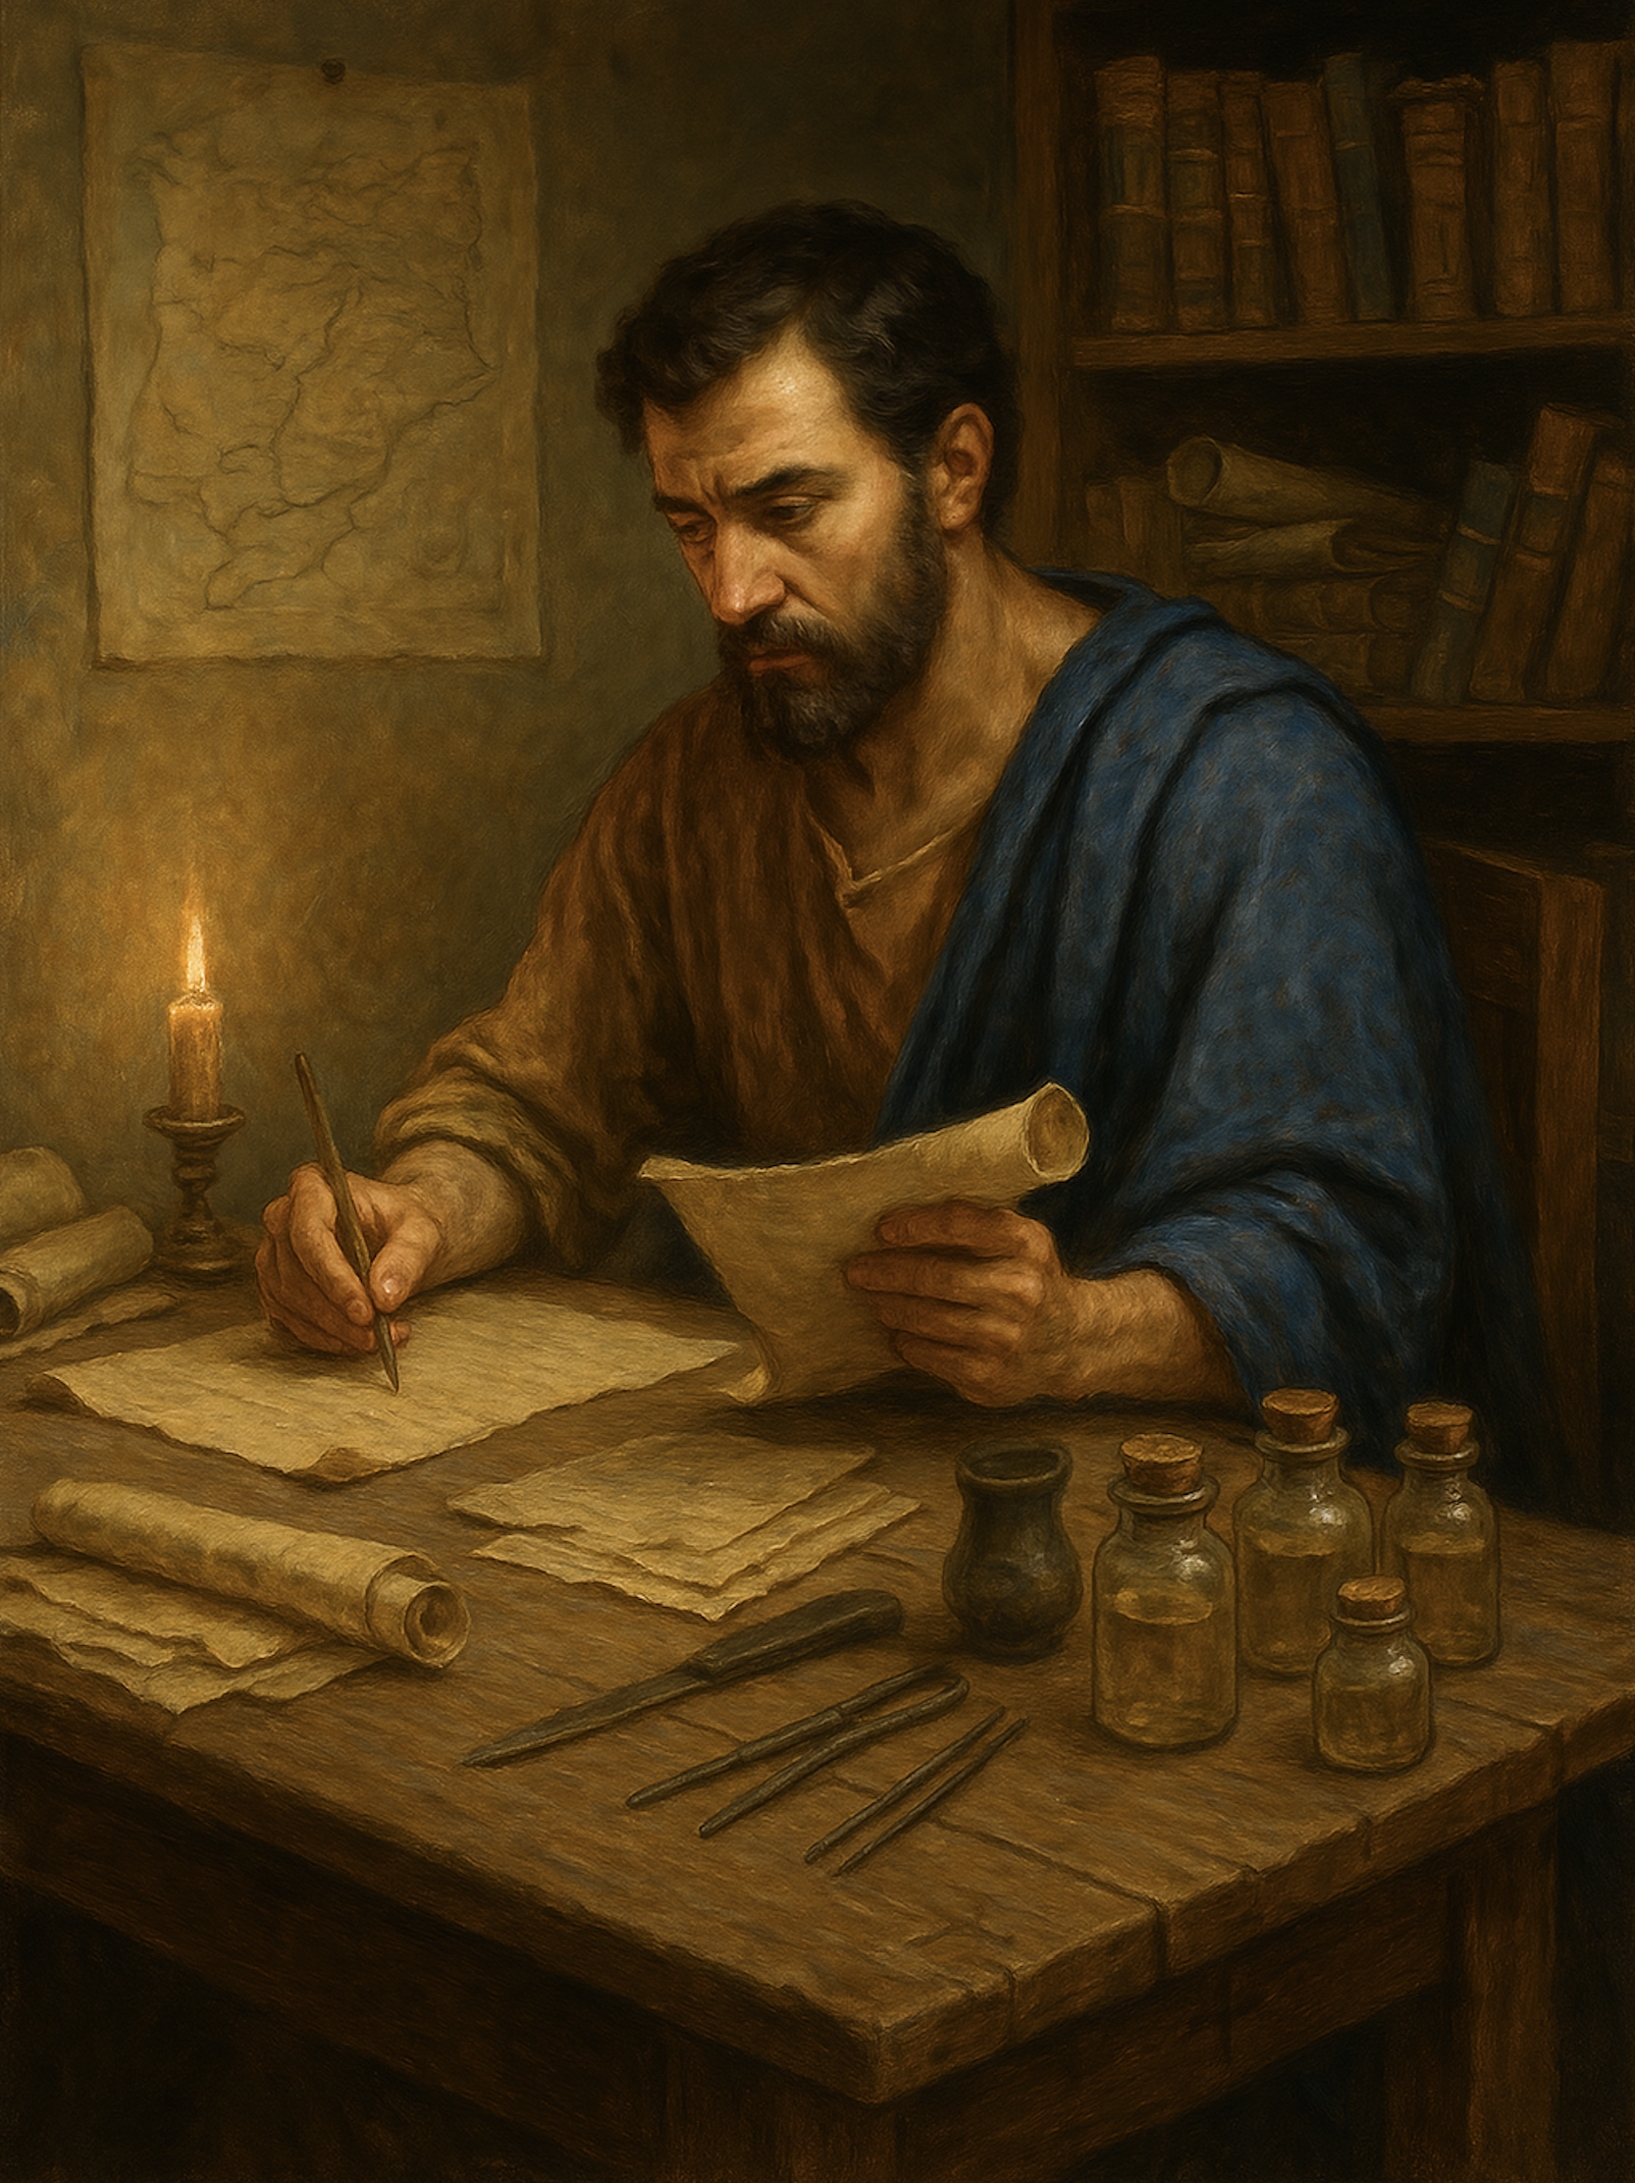
路加福音
Gospel of Luke
  16 圣灵的能力
  路加福音 4章14至15
  OThe Power of the Holy Spirit (Luke 4:14-15)

Slide 2



Slide 3
路4:14 耶稣带着圣灵的能力，回到加利利。他的名声传遍了周围各地。15 他在各会堂里教导人，很受众人的尊崇。
Luk 4:14 And Jesus returned in the power of the Spirit to Galilee, and a report about him went out through all the surrounding country.15 And he taught in their synagogues, being glorified by all.

Slide 4
圣灵的运行: Holy Spirit at work
撒迦利亚 (Zechariah) (1:67),
施洗约翰 (John the Baptist) (1:15),
以利沙伯 (Elizabeth) (1:41),
马利亚 (Mary) (1:35),
西面 (Simeon) (2:25),
耶稣基督 (Jesus Christ) 受孕 conception (1:35),受洗 baptism (3:22), 受试探 temptation (4:1),公开事工 public ministry (4:18).

Slide 5
01
【1】圣灵是谁？
Who is the Holy Spirit ?

Slide 6
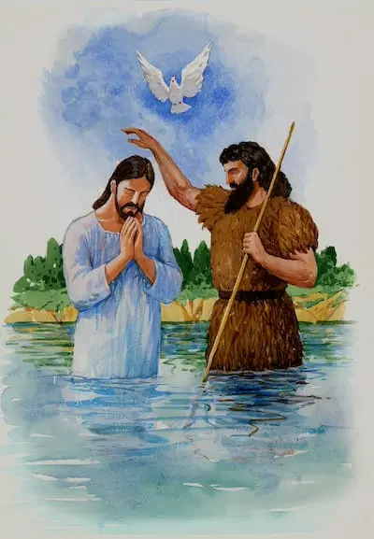
路 3:21 ...耶稣也受了洗。正祷告的时候，天就开了，22 圣灵降临在他身上，形状彷佛鸽子；又有声音从天上来，说：「你是我的爱子，我喜悦你。」
Luk 3:21 ..., and when Jesus also had been baptized and was praying, the heavens were opened,22 and the Holy Spirit descended on him in bodily form, like a dove; and a voice came from heaven, “You are my beloved Son; with you I am well pleased.”

Slide 7
02
圣灵的一部分工作
Part of the work of the Holy Spirit

Slide 8
圣灵的一部分工作 : Part of the work of the Holy Spirit
（A）圣灵的重生: The regeneration of the Holy Spirit:
得着新生命（约 3:5-8；多 3:5）使人愿意悔改相信
To receive new life (John 3:5–8; Titus 3:5), causing a person to be willing to repent and believe.

Slide 9
圣灵的一部分工作 : Part of the work of the Holy Spirit
（B）圣灵的内住：The indwelling of the Holy Spirit
加 4:6 你们既为儿子，神就差他儿子的灵进入我们的心，呼叫：「阿爸！父！」Gal 4:6 And because you are sons, God has sent the Spirit of his Son into our hearts, crying, “Abba! Father!”

Slide 10
圣灵的一部分工作 : Part of the work of the Holy Spirit
（C）圣灵的充满： The filling of the Holy Spirit:
生命中掌权的程度（弗 5:18）掌管信徒的思想、情感与意志。
The degree of reigning in life (Ephesians 5:18), governing the believer’s thoughts, affections, and will.

Slide 11
圣灵的一部分工作 : Part of the work of the Holy Spirit
（D）圣灵的能力： The power of the Holy Spirit:
（1）生命改变的能力 The power of life transformation,
（2）事奉传福音的能力 the power for service and evangelism,
（3）神迹异能见证主。 miracles and mighty works bearing witness to the Lord.

Slide 12
03
圣灵的能力
The power of the Holy Spirit

Slide 13
圣灵的能力 : The power of the Holy Spirit
（A）圣灵赐生命的改变（罗 8:13）
(A) The Holy Spirit Grants Transformation of Life
罗马书 8:13...如果靠着圣灵治死身体的恶行，你们就必活着。14.因为蒙 神的灵引导的，都是神的儿子。
Rom 8:13 ...but if by the Spirit you put to death the deeds of the body, you will live.14 For all who are led by the Spirit of God are sons of God.

Slide 14
圣灵的能力 : The power of the Holy Spirit
（B）圣灵赐带领教会的能力 (士3:10 、士6:34 )
(B) The Holy Spirit empowers to Lead the Church
士6:34 耶和华的灵降在基甸身上，他就吹角；亚比以谢族都聚集跟随他。...
Jdg 6:34 But the Spirit of the LORD clothed Gideon, and he sounded the trumpet, and the Abiezrites were called out to follow him.

Slide 15
圣灵的能力 : The power of the Holy Spirit
（C）讲道与教导的能力（罗15:18、林前 2:4-5）
The power of preaching and teaching
林前 2:4.我说的话、讲的道，都不是用智慧的话去说服人，而是用圣灵和能力来证明，5.使你们的信不是凭着人的智慧，而是凭着神的能力。
1Co 2:4 and my speech and my message were not in plausible words of wisdom, but in demonstration of the Spirit and of power,

Slide 16
圣灵的能力 : The power of the Holy Spirit
(D)传福音的能力（徒1:8）
The power for evangelism (Acts 1:8).
徒 1:8.可是圣灵降临在你们身上，你们就必领受能力，并且要在耶路撒冷、犹太全地、撒玛利亚，直到地极，作我的见证人。”
Act 1:8 But you will receive power when the Holy Spirit has come upon you, and you will be my witnesses in Jerusalem and in all Judea and Samaria, and to the end of the earth.”

Slide 17
圣灵的能力 : The power of the Holy Spirit
(E)（恩赐/能力）医治、神迹与异能 （路4:18、徒10:38、徒14:3、罗15:18-19）(Gifts/abilities) healing, miracles, and mighty works (Luke 4:18; Acts 10:38; Acts 14:3; Romans 15:18–19).
林前 12:9 还有一人蒙这位圣灵赐他医病的恩赐，10 又叫一人能行异能...11 这一切都是这位圣灵所运行、随己意分给各人的。
1Co 12:9 ... to another gifts of healing by the one Spirit, 10 to another the working of miracles, ....

Slide 18
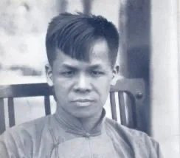
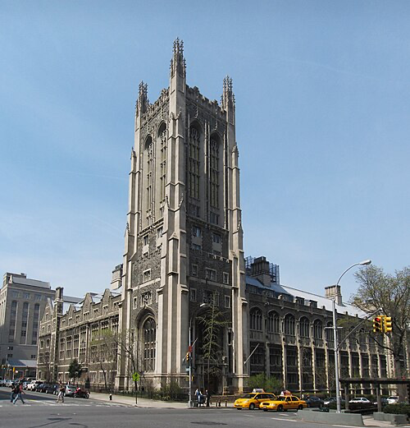
协和神学院自由派
Union Theological Seminary (New York)
宋尚节博士 1901-1944
(Dr John Sung, 1901–1944)

Slide 19
04
如何得圣灵的能力?
How to receive the power of the Holy Spirit?

Slide 20
王下 2:9 过去之後，以利亚对以利沙说：「我未曾被接去离开你，你要我为你做什麽，只管求我。」以利沙说：「愿感动你的灵加倍地感动我。」10 以利亚说：「你所求的难得。虽然如此，我被接去离开你的时候，你若看见我，就必得著；不然，必得不著了。」
2Ki 2:9 When they had crossed, Elijah said to Elisha, “Ask what I shall do for you, before I am taken from you.” And Elisha said, “Please let there be a double portion of your spirit on me.”10 And he said, “You have asked a hard thing; yet, if you see me as I am being taken from you, it shall be so for you, but if you do not see me, it shall not be so.”
.

Slide 21

撒迦利亚书 4：6....
‘不是倚靠权势，不是倚靠能力，而是倚靠我的灵。’这是万军之耶和华说的。
Zec 4:6 ... : Not by might, nor by power, but by my Spirit, says the LORD of hosts.

Slide 22
祈求主的灵充满永约教会，祈求主加添永约教会能力，为主作工。
Pray that the Lord’s Spirit would fill Reformed Covenant Church, and pray that the Lord would add more power to Reformed Covenant Church to serve the Lord.

Slide 23
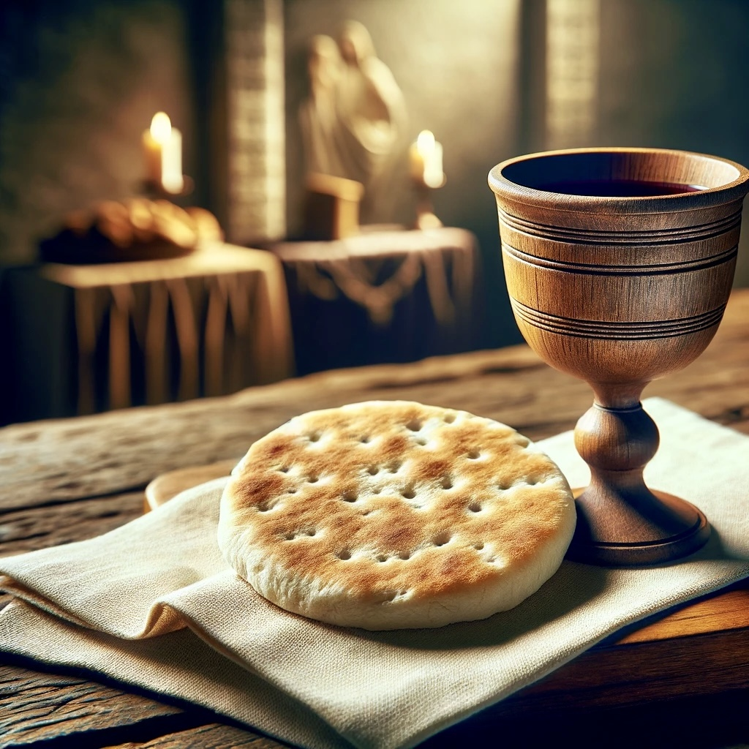
圣餐
Holy Communion

Slide 24

出 24:8 摩西就取了血来，洒在人民的身上，说：“看哪，这是立约的血，这约是耶和华按着这一切话与你们立的。”9 随后，摩西、亚伦、拿答、亚比户和以色列长老中的七十人都上了山。10 他们看见了以色列的上帝；在上帝的脚下有好像蓝宝石一样晶莹的铺路，好像天色一般明亮。11 他不伸手攻击以色列人中的显贵；他们看见上帝，并且又吃又喝。
Exo24:8 And Moses took the blood and threw it on the people and said, “Behold the blood of the covenant that the LORD has made with you in accordance with all these words.”9 Then Moses and Aaron, Nadab, and Abihu, and seventy of the elders of Israel went up,10 and they saw the God of Israel. There was under his feet as it were a pavement of sapphire stone, like the very heaven for clearness.11 And he did not lay his hand on the chief men of the people of Israel; they beheld God, and ate and drank.

Slide 25
太 26:26 他们吃的时候，耶稣拿起饼来，祝谢了就擘开，递给门徒，说：“你们拿去吃吧，这是我的身体。”27 耶稣又拿起杯来，祝谢了就递给他们，说：“你们都喝吧，28 这是我的血，是为立约的，为许多人流出来，使罪得赦。
Mat 26:26 Now as they were eating, Jesus took bread, and after blessing it broke it and gave it to the disciples, and said, “Take, eat; this is my body.” 27 And he took a cup, and when he had given thanks he gave it to them, saying, “Drink of it, all of you, 28 for this is my blood of the covenant, which is poured out for many for the forgiveness of sins.

