Slide 1
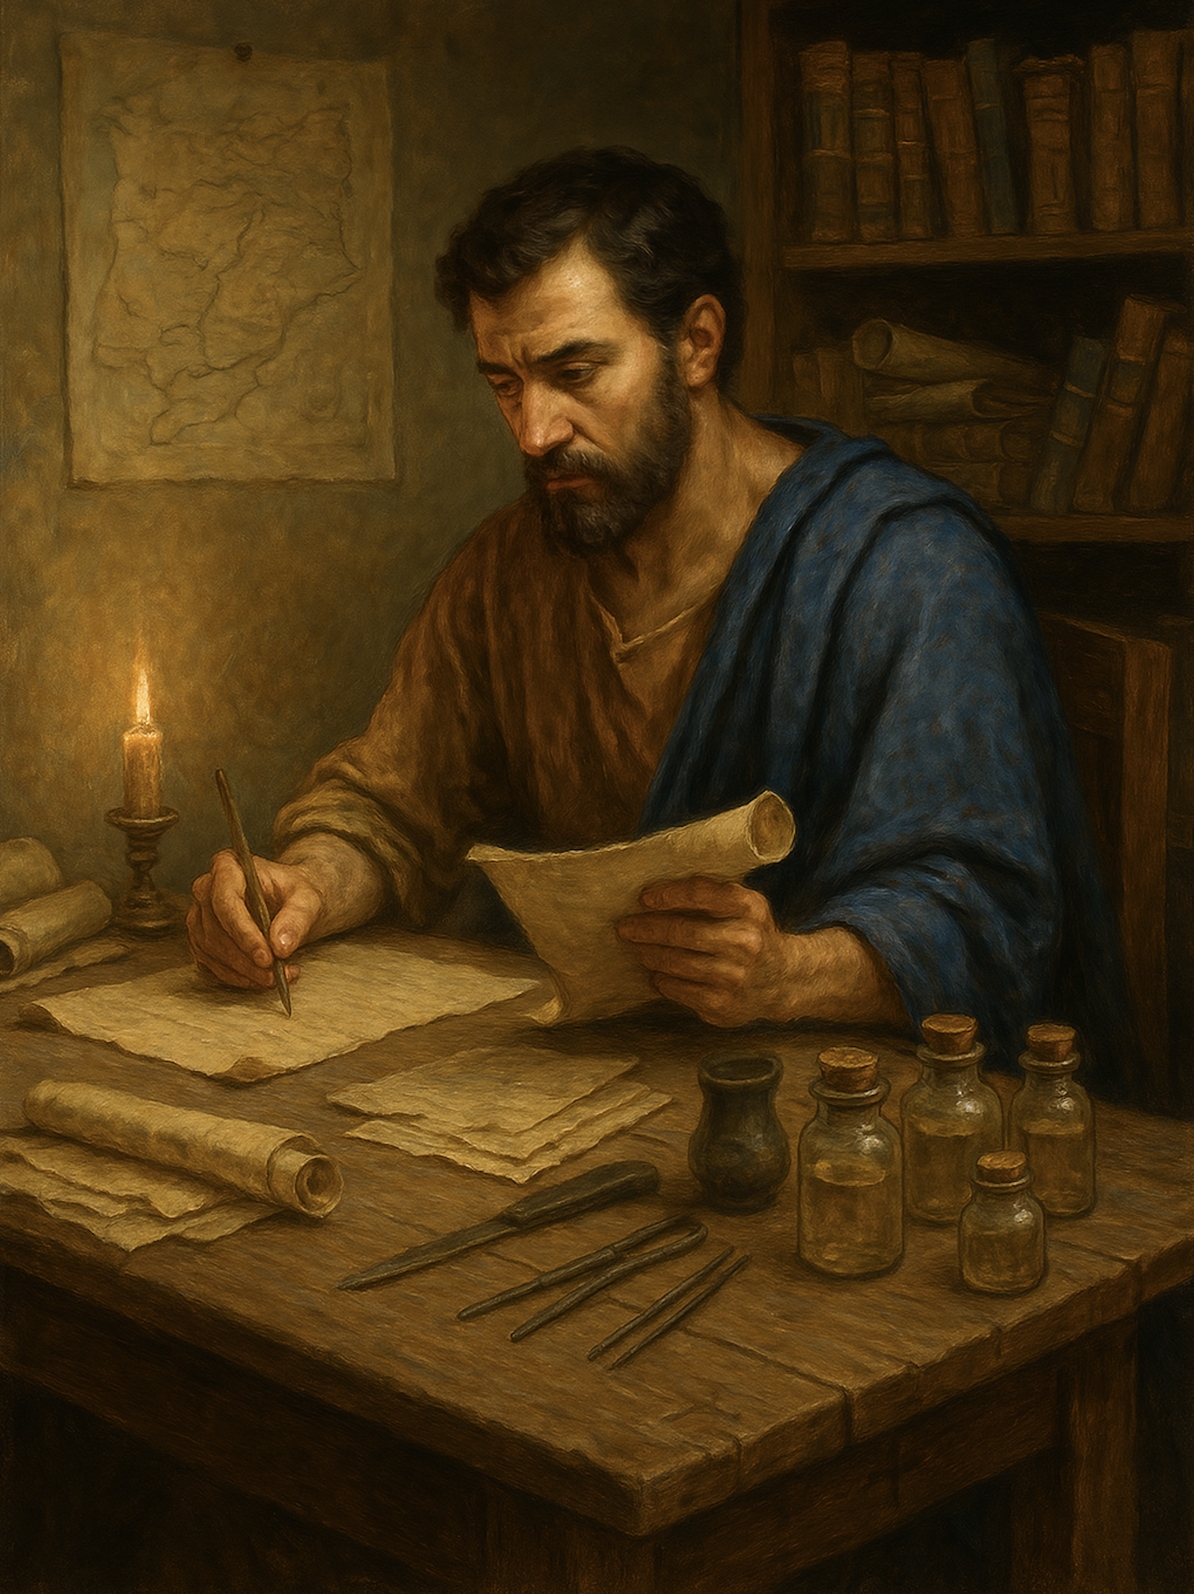
路加福音 Gospel of Luke
17 真相
路加福音 路4章14至30
The Truth (Luke 4:14-30)

Slide 2

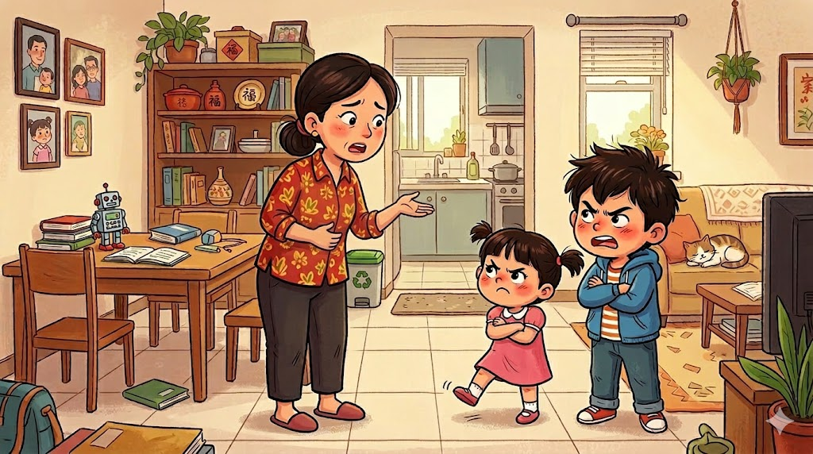

Slide 3
路加福音 4:14.耶稣带着圣灵的能力，回到加利利。他的名声传遍了周围各地。15.他在各会堂里教导人，很受众人的尊崇。16.耶稣来到拿撒勒自己长大的地方，照着习惯在安息日进入会堂，站起来要读经。
Luke 4:14.And Jesus returned in the power of the Spirit to Galilee, and a report about him went out through all the surrounding country. 15.And he taught in their synagogues, being glorified by all.16.And he came to Nazareth, where he had been brought up. And as was his custom, he went to the synagogue on the Sabbath day, and he stood up to read.
1/5

Slide 4
17.有人把以赛亚先知的书递给他，他展开书卷找到一处，上面写着：18.“主的灵在我身上，因为他膏我去传福音给贫穷的人，差遣我去宣告被掳的得释放，瞎眼的得看见，受压制的得自由，19.又宣告主悦纳人的禧年。”20.他把书卷卷好，交还侍役，就坐下。会堂里众人都注视他。
4:17.And the scroll of the prophet Isaiah was given to him. He unrolled the scroll and found the place where it was written,18."The Spirit of the Lord is upon me, because he has anointed me to proclaim good news to the poor. He has sent me to proclaim liberty to the captives and recovering of sight to the blind, to set at liberty those who are oppressed,19.to proclaim the year of the Lord's favor."20.And he rolled up the scroll and gave it back to the attendant and sat down. And the eyes of all in the synagogue were fixed on him.
2/5

Slide 5
21.他就对他们说：“这段经文今天应验在你们中间了。” 22.众人称赞他，希奇他口中所出的恩言，并且说：“这不是约瑟的儿子吗？”23.他说：“你们必向我说这俗语：‘医生，治好你自己吧！’也必说：‘我们听见你在迦百农所行的一切事，也该在你本乡这里行啊！’”24.他又说：“我实在告诉你们，没有先知在他本乡是受欢迎的。
Luke 4:21.And he began to say to them, "Today this Scripture has been fulfilled in your hearing."22.And all spoke well of him and marveled at the gracious words that were coming from his mouth. And they said, "Is not this Joseph's son?"23.And he said to them, "Doubtless you will quote to me this proverb, '"Physician, heal yourself." What we have heard you did at Capernaum, do here in your hometown as well.'"24.And he said, "Truly, I say to you, no prophet is acceptable in his hometown.
3/5

Slide 6
25.我对你们说实话，当以利亚的时候，三年六个月不下雨，遍地大起饥荒，那时以色列中有许多寡妇，26.以利亚没有奉差遣往他们中间任何一个那里去，只到西顿 撒勒法的一个寡妇那里。27.以利沙先知的时候，以色列中有许多患痲风的人，其中除了叙利亚的乃缦，没有一个得洁净的。
Luk 4:25.But in truth, I tell you, there were many widows in Israel in the days of Elijah, when the heavens were shut up three years and six months, and a great famine came over all the land,26.and Elijah was sent to none of them but only to Zarephath, in the land of Sidon, to a woman who was a widow.27.And there were many lepers in Israel in the time of the prophet Elisha, and none of them was cleansed, but only Naaman the Syrian."
4/5

Slide 7
28.会堂里的众人听见这话，都怒气填胸，29.起来赶他出城(这城原来建在山上)，他们拉他到山崖，要把他推下去。30.耶稣却从他们中间走过，就离去了。
Luke 4:28.When they heard these things, all in the synagogue were filled with wrath.29.And they rose up and drove him out of the town and brought him to the brow of the hill on which their town was built, so that they could throw him down the cliff.30.But passing through their midst, he went away.
5/5

Slide 8
01
以赛亚书（约主前700年前)的预言
The prophecy of the Book of Isaiah (around 700 BC).

Slide 9
18.“主的灵在我身上，因为他膏我去传福音给贫穷的人，差遣我去宣告被掳的得释放，瞎眼的得看见，受压制的得自由，19.又宣告主悦纳人的禧年。”20.他把书卷卷好，交还侍役，就坐下。会堂里众人都注视他。 21.他就对他们说：“这段经文今天应验在你们中间了。”
18."The Spirit of the Lord is upon me, because he has anointed me to proclaim good news to the poor. He has sent me to proclaim liberty to the captives and recovering of sight to the blind, to set at liberty those who are oppressed,19.to proclaim the year of the Lord's favor."20.And he rolled up the scroll and gave it back to the attendant and sat down. And the eyes of all in the synagogue were fixed on him. 21.And he began to say to them, "Today this Scripture has been fulfilled in your hearing."

Slide 10
赛61:1 主耶和华的灵在我身上；因为耶和华用膏膏我，叫我传好信息给谦卑的人，差遣我医好伤心的人，报告被掳的得释放，被囚的出监牢；2 报告耶和华的恩年，2 报告耶和华的恩年，和我们神报仇的日子；安慰一切悲哀的人，
Isa 61:1 The Spirit of the Lord GOD is upon me, because the LORD has anointed me to bring good news to the poor; he has sent me to bind up the brokenhearted, to proclaim liberty to the captives, and the opening of the prison to those who are bound;2 to proclaim the year of the LORD's favor, and the day of vengeance of our God; to comfort all who mourn;

Slide 11
02
不信的心，称赞主是不被悦纳
Praise offered from a heart of unbelief is not pleasing to the Lord.

Slide 12
22.众人称赞他，希奇他口中所出的恩言，并且说：“这不是约瑟的儿子吗？”
22.And all spoke well of him and marveled at the gracious words that were coming from his mouth. And they said, "Is not this Joseph's son?"

Slide 13
可6:3 这不是那木匠吗？不是马利亚的儿子，雅各、约西、犹大、西门的哥哥吗？他的妹妹们不也在我们这里吗？”他们就厌弃耶稣。
Mark 6:3.Is not this the carpenter, the son of Mary and brother of James and Joses and Judas and Simon? And are not his sisters here with us?" And they took offense at him.

Slide 14
23.他说：“你们必向我说这俗语：‘医生，治好你自己吧！’也必说：‘我们听见你在迦百农所行的一切事，也该在你本乡这里行啊！’”24.他又说：“我实在告诉你们，没有先知在他本乡是受欢迎的。
23.And he said to them, "Doubtless you will quote to me this proverb, '"Physician, heal yourself." What we have heard you did at Capernaum, do here in your hometown as well.'"24.And he said, "Truly, I say to you, no prophet is acceptable in his hometown.

Slide 15
人的沟通学：Principles of communication:
和女人沟通，要注意感受，而不是道理。
With women: focus on feelings, not reasoning.
和男人沟通，讲理与证明，而不是感受。
With men: reason and evidence, not feelings.
和孩子沟通，要注意鼓励，而不是说教。
With children: emphasize encouragement, not lectures.
和老人沟通，要注意尊重，而不是对错。
With the elderly: show respect, not over right or wrong

Slide 16
我们可以效法主耶稣对拿撒勒的讲话方式吗？
Can we imitate the way the Lord Jesus spoke to the people of Nazareth?

Slide 17
我先证明自己来使人相信，不是合情合理吗？
为何主不给他们行神迹？？
Is it not reasonable to prove oneself first so that people may believe?
Why did the Lord not perform miracles for them?

Slide 18
可8:11 法利赛人出来盘问耶稣，求他从天上显个神迹给他们看，想要试探他。12 耶稣心里深深的叹息，说：「这世代为什麽求神迹呢？我实在告诉你们，没有神迹给这世代看。」13 他就离开他们...
Mrk 8:11 The Pharisees came and began to argue with him, seeking from him a sign from heaven to test him.12 And he sighed deeply in his spirit and said, “Why does this generation seek a sign? Truly, I say to you, no sign will be given to this generation.”13 And he left them, got into the boat again, and went to the other side.

Slide 19
约 10:25 耶稣回答说：我已经告诉你们，你们不信。我奉我父之名所行的事可以为我作见证；26 只是你们不信，因为你们不是我的羊。
Jhn 10:25 Jesus answered them, “I told you, and you do not believe. The works that I do in my Father's name bear witness about me,26 but you do not believe because you are not among my sheep.

Slide 20
约 12:37
他虽然在他们面前行了许多神迹，他们还是不信他。
Jhn 12:37 Though he had done so many signs before them, they still did not believe in him,

Slide 21
03
先知是不受本乡欢迎
A prophet is not welcomed in his hometown.

Slide 22
24.他又说:“我实在告诉你们，没有先知在他本乡是受欢迎的。 25.我对你们说实话，当以利亚的时候，三年六个月不下雨，遍地大起饥荒，那时以色列中有许多寡妇，26.以利亚没有奉差遣往他们中间任何一个那里去，只到西顿 撒勒法的一个寡妇那里。27.以利沙先知的时候，以色列中有许多患痲风的人，其中除了叙利亚的乃缦，没有一个得洁净的。
24 And he said, “Truly, I say to you, no prophet is acceptable in his hometown. 25.But in truth, I tell you, there were many widows in Israel in the days of Elijah, when the heavens were shut up three years and six months, and a great famine came over all the land,26.and Elijah was sent to none of them but only to Zarephath, in the land of Sidon, to a woman who was a widow.27.And there were many lepers in Israel in the time of the prophet Elisha, and none of them was cleansed, but only Naaman the Syrian."

Slide 23
04
真相的代价
The cost of the truth.

Slide 24
28.会堂里的众人听见这话，都怒气填胸，29.起来赶他出城(这城原来建在山上)，他们拉他到山崖，要把他推下去。30.耶稣却从他们中间走过，就离去了。
Luke 4:28.When they heard these things, all in the synagogue were filled with wrath.29.And they rose up and drove him out of the town and brought him to the brow of the hill on which their town was built, so that they could throw him down the cliff.30.But passing through their midst, he went away.

Slide 25
你是贫穷？你是瞎眼的？你是被罪掳去？
Are you poor? Are you blind? Are you taken captive by sin?

