Slide 1
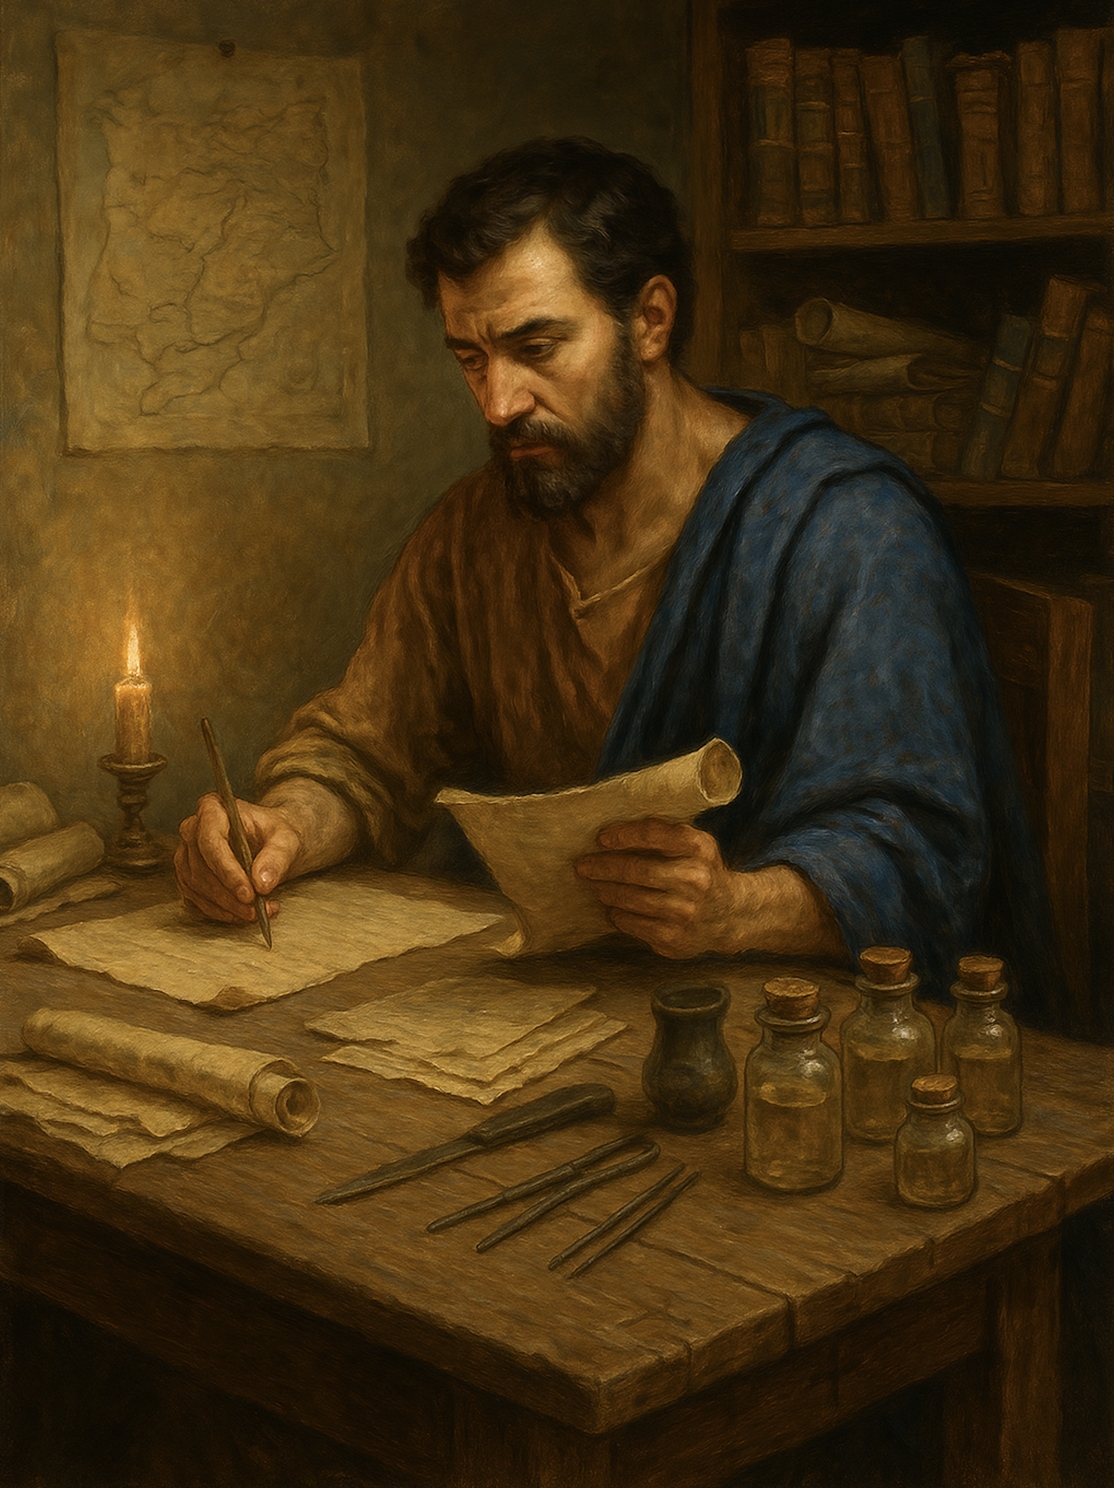
路加福音 Gospel of Luke
18 传神的国福音
路加福音 路4章31至44
Preach the Good news of the Kingdom of God (Luke 4:31-44)

Slide 2

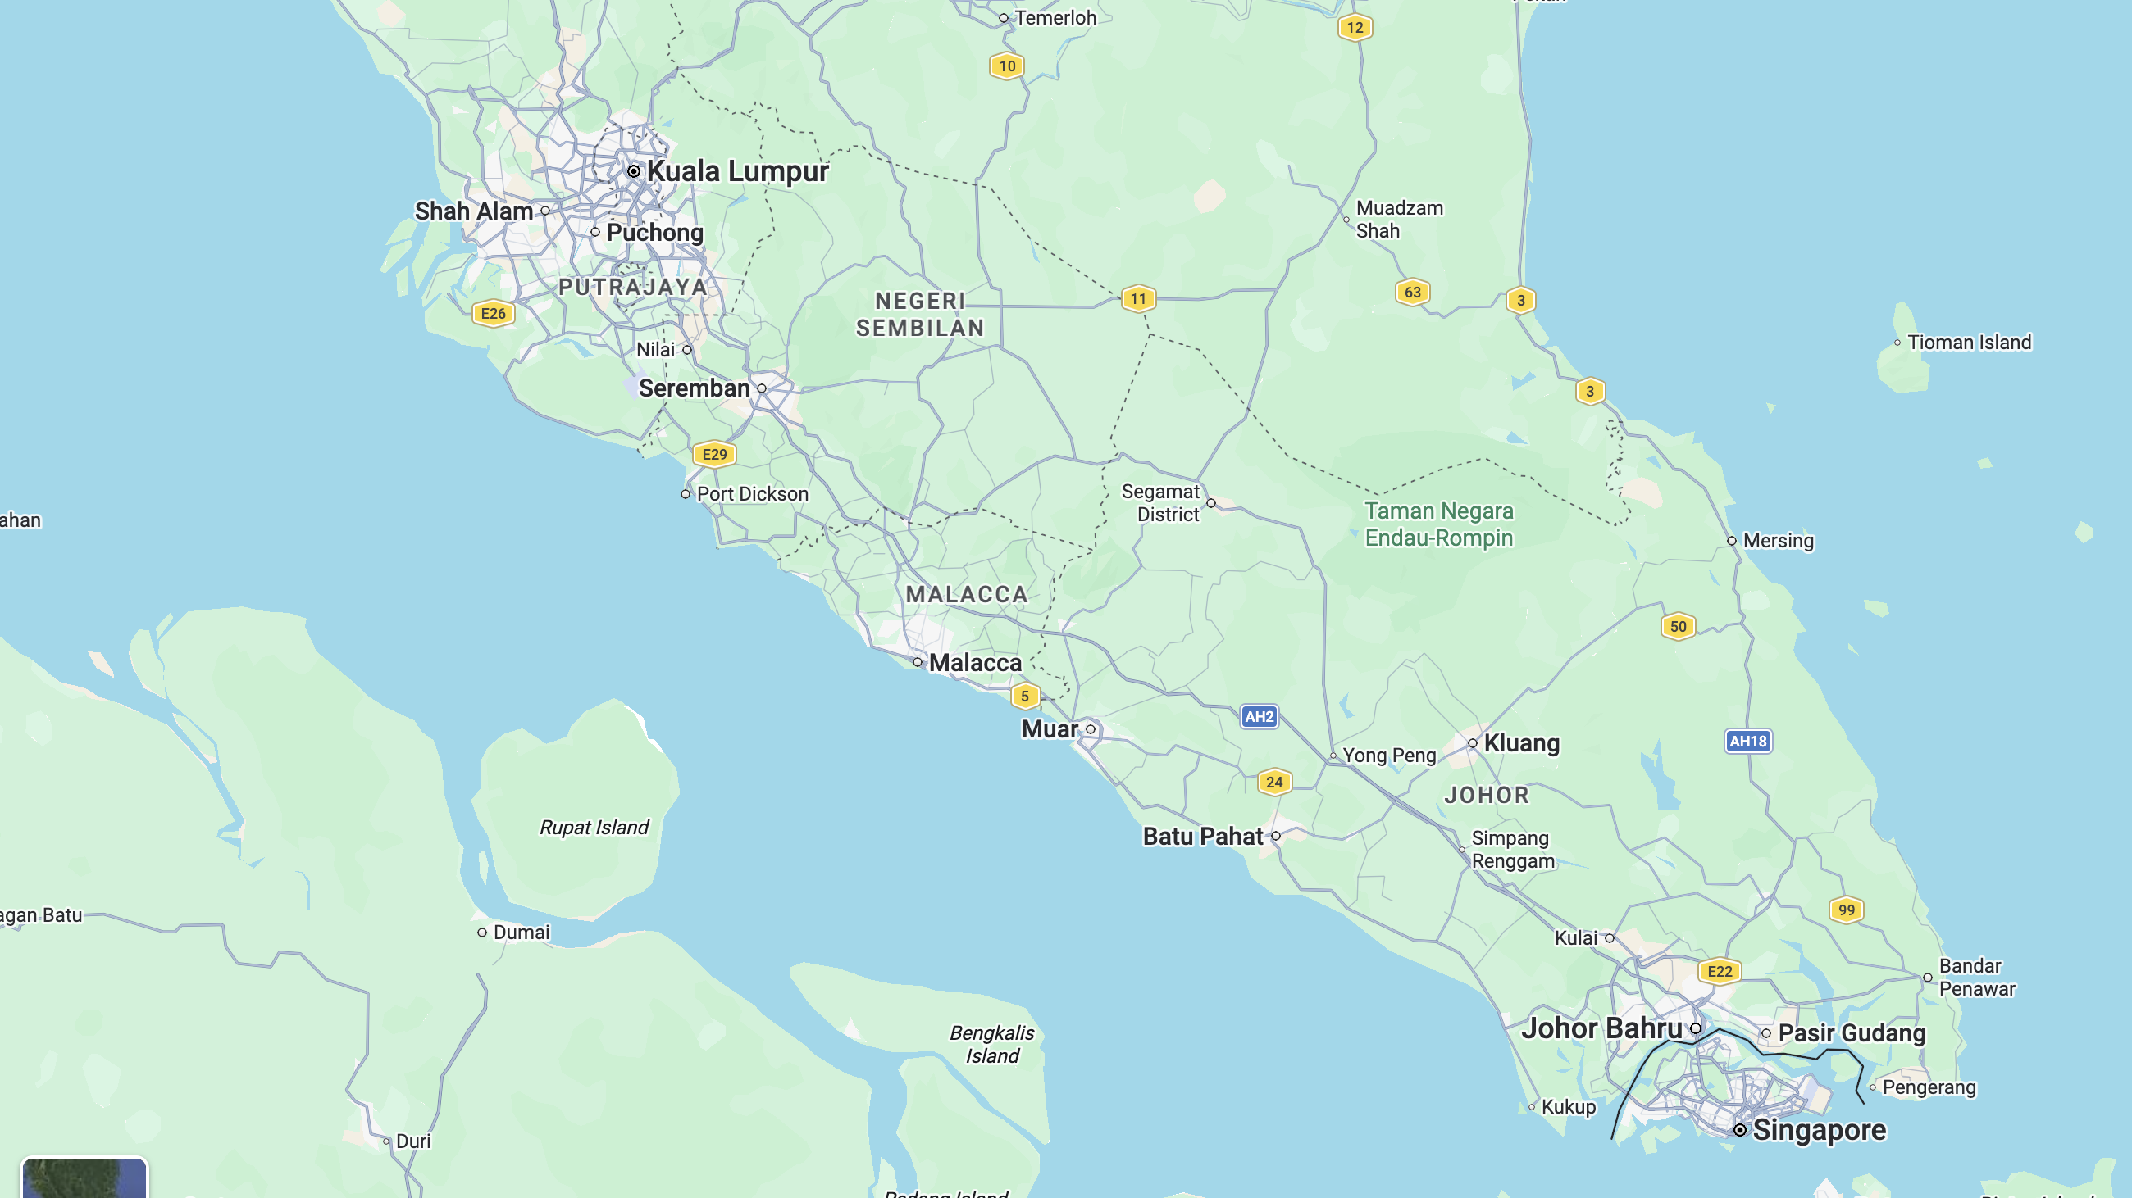
1/3

Slide 3
神的国在哪里？
Where is the kingdom of God?
2/3

Slide 4
路 17:21. 人也不得说：『看哪，在这里！看哪，在那里！』因为神的国就在你们心里。」
Luke 17:21.
nor will they say, 'Look, here it is!' or 'There!' for behold, the kingdom of God is in the midst of you."
3/3

Slide 5
路加福音 4:31.耶稣下到加利利的迦百农城，在安息日教导人。32.他们对他的教训都很惊奇，因为他的话带着权柄。33.会堂里有一个被污鬼附着的人，大声喊叫：34.“哎！拿撒勒人耶稣，我们跟你有甚么关系呢？你来毁灭我们吗？我知道你是谁，你是神的圣者。” 35.耶稣斥责他说：“住口！从他身上出来！”鬼把那人摔倒在众人中间，就从他身上出来了，没有伤害他。
Luke 4:31.And he went down to Capernaum, a city of Galilee. And he was teaching them on the Sabbath, 32.and they were astonished at his teaching, for his word possessed authority.33.And in the synagogue there was a man who had the spirit of an unclean demon, and he cried out with a loud voice,34."Ha! What have you to do with us, Jesus of Nazareth? Have you come to destroy us? I know who you are—the Holy One of God."35.But Jesus rebuked him, saying, "Be silent and come out of him!" And when the demon had thrown him down in their midst, he came out of him, having done him no harm.
1/3

Slide 6
36.众人都惊骇，彼此谈论说：“这是怎么回事？他用权柄能力吩咐污灵，污灵竟出来了。”37.耶稣的名声，传遍了周围各地。38.他起身离开会堂，进入西门的家。西门的岳母正在发高热，他们为她求耶稣。39.耶稣站在她旁边，斥责那热病，热就退了；她立刻起身服事他们。40.日落的时候，不论害甚么病的人，都被带到耶稣那里；他一一为他们按手，医好他们。
36.And they were all amazed and said to one another, "What is this word? For with authority and power he commands the unclean spirits, and they come out!"37.And reports about him went out into every place in the surrounding region.38.And he arose and left the synagogue and entered Simon's house. Now Simon's mother-in-law was ill with a high fever, and they appealed to him on her behalf. 39.And he stood over her and rebuked the fever, and it left her, and immediately she rose and began to serve them.40.Now when the sun was setting, all those who had any who were sick with various diseases brought them to him, and he laid his hands on every one of them and healed them.
2/3

Slide 7
41.又有鬼从好些人身上出来，喊着说：“你是神的儿子。”耶稣斥责他们，不许他们说话，因为他们知道他是基督。42.天一亮，耶稣出来，到旷野地方去。众人寻找他，一直找到他那里， 要留住他，不要他离开他们。43.他却说：“我也必须到别的城去传神国的福音，因为我是为了这缘故奉差遣的。”44.于是他往犹太的各会堂去传道。
41.And demons also came out of many, crying, "You are the Son of God!" But he rebuked them and would not allow them to speak, because they knew that he was the Christ.42.And when it was day, he departed and went into a desolate place. And the people sought him and came to him, and would have kept him from leaving them, 43.but he said to them, "I must preach the good news of the kingdom of God to the other towns as well; for I was sent for this purpose."44.And he was preaching in the synagogues of Judea.
3/3

Slide 8
01
迦百农城的背景
Historical background of Capernaum

Slide 9
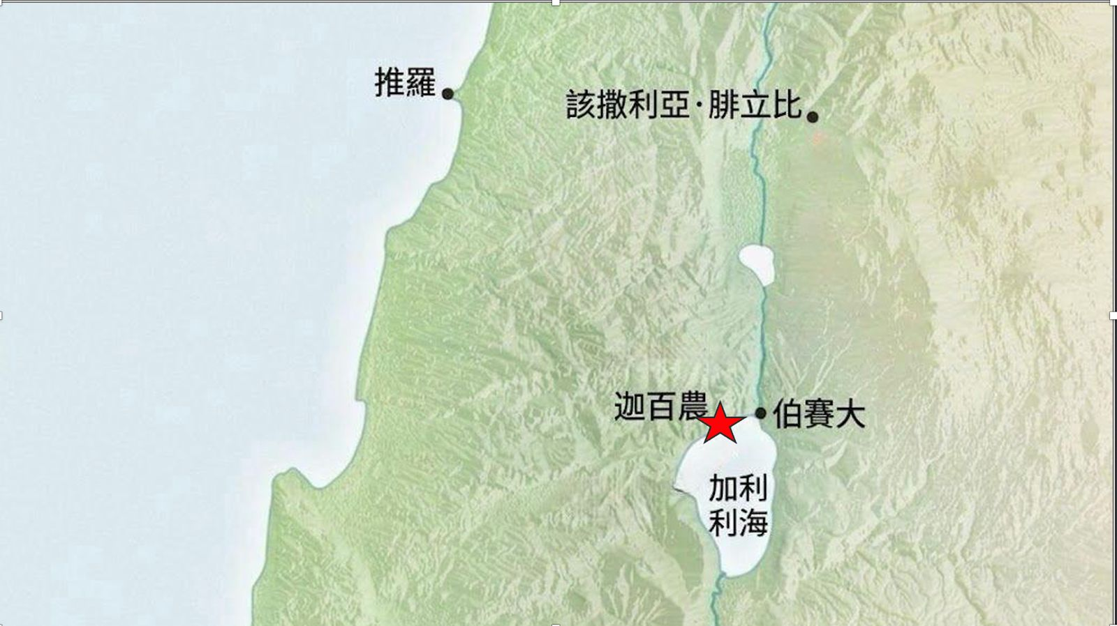
迦百农城
Capernaum
自己的城 太9:1
His own city (Mat 9:1)
彼得的家 路4:38
Peter’s house (Luk 4:38)

Slide 10
02
主耶稣的权柄
The authority of the Lord Jesus.

Slide 11
32.他们对他的教训都很惊奇，因为他的话带着权柄。
32.and they were astonished at his teaching, for his word possessed authority.

Slide 12

35. 耶稣斥责他说：“住口！从他身上出来！”
鬼 把那人摔倒在众人中间，就从他身上出来了，没有伤害他。
35.But Jesus rebuked him, saying, "Be silent and come out of him!" And when the demon had thrown him down in their midst, he came out of him, having done him no harm.

Slide 13
39.耶稣站在她旁边，斥责那热病，热就退了；她立刻起身服事他们。
39.And he stood over her and rebuked the fever, and it left her, and immediately she rose and began to serve them.

Slide 14
雅 5:14
你们中间有病了的呢，他就该请教会的长老来；他们可以奉主的名用油抹他，为他祷告。
James 5:14.
Is anyone among you sick? Let him call for the elders of the church, and let them pray over him, anointing him with oil in the name of the Lord.

Slide 15
03
魔鬼的信心
The faith of demons

Slide 16
34“哎！拿撒勒人耶稣，我们跟你有甚么关系呢？你来毁灭我们吗？我知道你是谁，你是神的圣者。”
.....41.....“你是神的儿子。”耶稣斥责他们，不许他们说话，因为他们知道他是基督。
34."Ha! What have you to do with us, Jesus of Nazareth? Have you come to destroy us? I know who you are—the Holy One of God.”.... 41......, "You are the Son of God!" But he rebuked them and would not allow them to speak, because they knew that he was the Christ.

Slide 17
雅 2:19
你信神只有一位，你信的不错；鬼魔也信，却是战惊。
James 2:19
You believe that God is one; you do well. Even the demons believe—and shudder!

Slide 18
你顺服主吗？
Do you submit to the Lord?
信心
Faith
你信靠主吗？
Do you trust the Lord?
你爱主吗？
Do you love the Lord?

Slide 19
来源不对
The source is wrong.
Why forbid the demons?
为何
禁止魔鬼
时机不对
Wrong timing and place
内心误导
The hearts are mislead

Slide 20
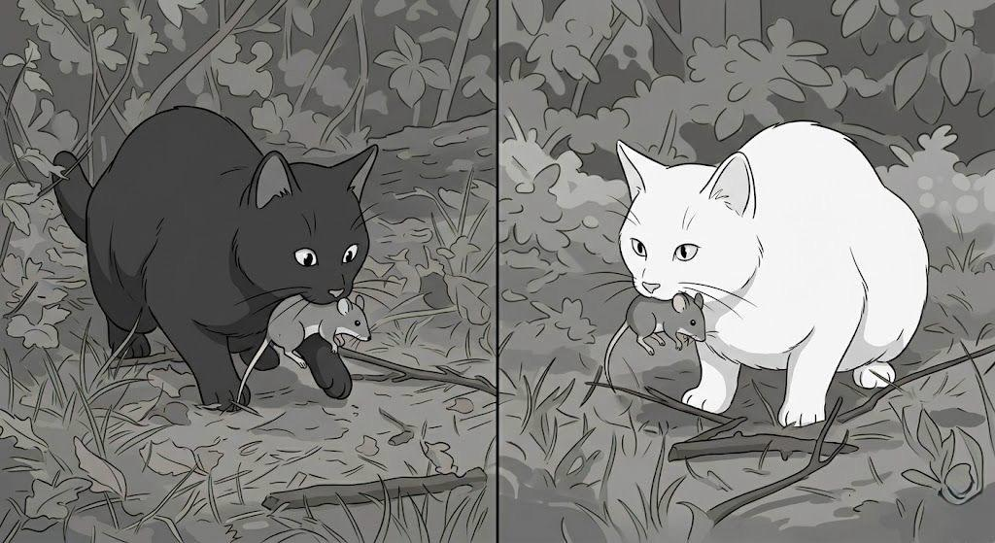
不管黑猫白猫，能捉老鼠的就是好猫
It doesn’t matter whether the cat is black or white; if it catches mice, it’s a good cat

Slide 21
原则，诫命
Principles and Commandments.
决定
Decisions
处境后果
Consequences
动机
Your motives

Slide 22
04
传神国福音的使命
The mission to proclaim the gospel of the kingdom of God

Slide 23
43.他却说：“我也必须到别的城去传神国的福音，因为我是为了这缘故奉差遣的。”44.于是他往犹太的各会堂去传道。
43.but he said to them, "I must preach the good news of the kingdom of God to the other towns as well; for I was sent for this purpose."44.And he was preaching in the synagogues of Judea.

Slide 24
王
King
国
Kingdom
国土
Land
子民
People

Slide 25
来 2:8
叫万物都服在他的脚下。既叫万物都服他，就没有剩下一样不服他的。只是如今我们还不见万物都服他。
Hebrews 2:8.
putting everything in subjection under his feet." Now in putting everything in subjection to him, he left nothing outside his control. At present, we do not yet see everything in subjection to him.

Slide 26
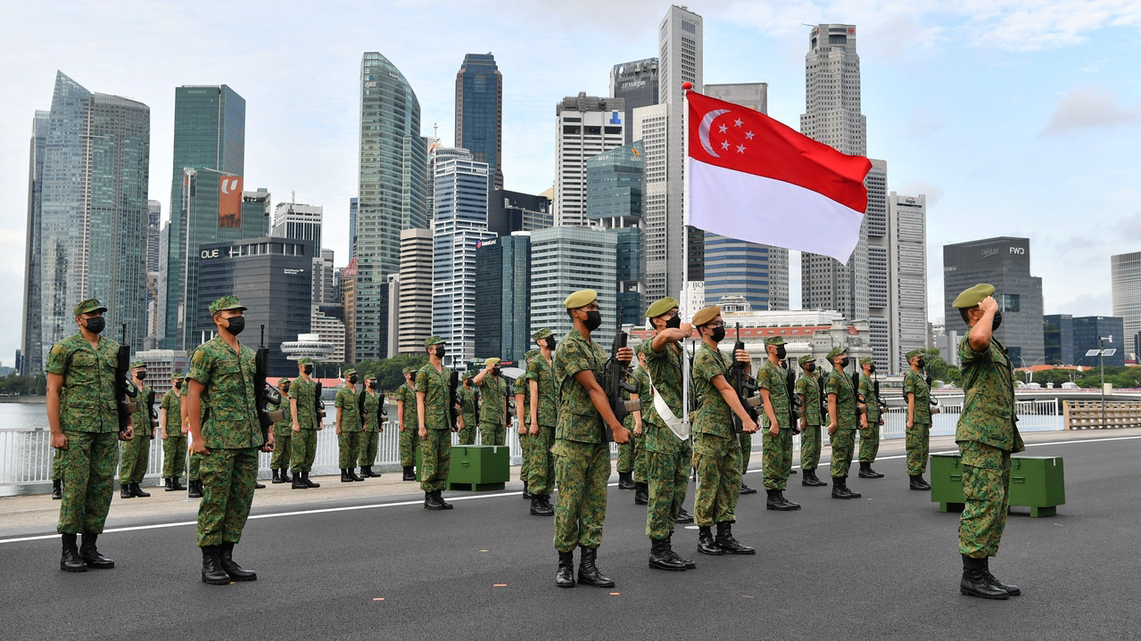

Slide 27
