Slide 1
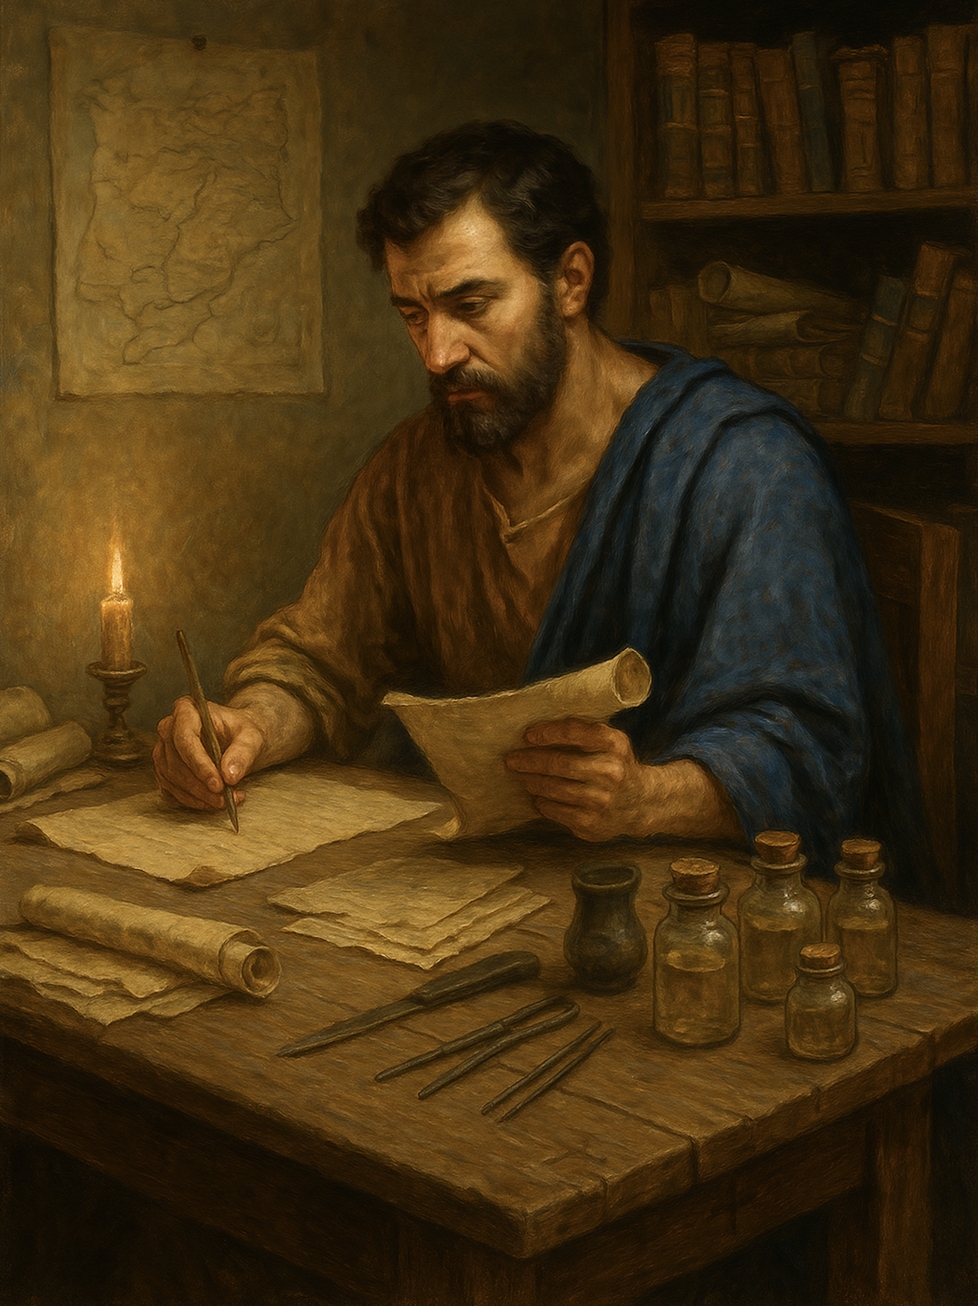
路加福音
Gospel of Luke
  19 不要怕！从今以后，你要作得人的渔夫了
  路加福音 5章1至11
  Do not be afraid; from now on you will catch people.(Luke 5:1-11)

Slide 2

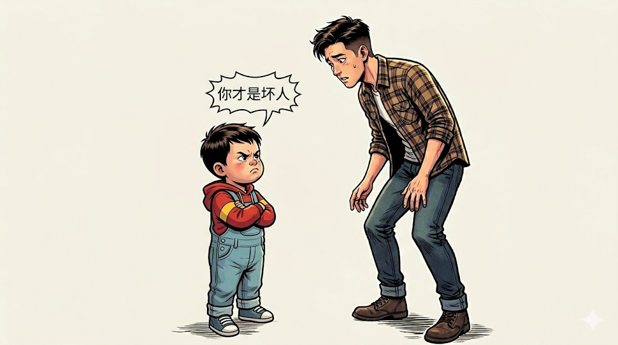

Slide 3
路加福音 5:1.耶稣站在革尼撒勒湖边，众人拥挤他，要听 神的道。2.他看见两只船停在湖边，渔夫离开船洗网去了。3.他上了西门的那一只船，请他撑开，离岸不远，就坐下，从船上教导众人。4.讲完了，就对西门说：“把船开到水深的地方，下网打鱼！”5.西门说：“主啊，我们整夜劳苦，毫无所得，不过，我愿照你的话下网。”6.他们下了网，就圈住很多鱼，网几乎裂开，
Luke 5:1.On one occasion, while the crowd was pressing in on him to hear the word of God, he was standing by the lake of Gennesaret, 2.and he saw two boats by the lake, but the fishermen had gone out of them and were washing their nets.3.Getting into one of the boats, which was Simon's, he asked him to put out a little from the land. And he sat down and taught the people from the boat.4.And when he had finished speaking, he said to Simon, "Put out into the deep and let down your nets for a catch."5.And Simon answered, "Master, we toiled all night and took nothing! But at your word I will let down the nets."6.And when they had done this, they enclosed a large number of fish, and their nets were breaking.
1/2

Slide 4
7.就招呼另外那只船上的同伴来帮助，他们就来把两只船装满，甚至船要下沉。8.西门．彼得看见这种情景，就俯伏在耶稣膝前，说：“主啊，离开我，因为我是个罪人。”9.他和跟他在一起的人，因这网所打的鱼，都十分惊骇。10.西门的伙伴，西庇太的儿子雅各、约翰也是这样。耶稣对西门说：“不要怕！从今以后，你要作得人的渔夫了。”11.他们把两只船拢了岸，撇下一切，跟从了耶稣。
7.They signaled to their partners in the other boat to come and help them. And they came and filled both the boats, so that they began to sink.8.But when Simon Peter saw it, he fell down at Jesus' knees, saying, "Depart from me, for I am a sinful man, O Lord."9.For he and all who were with him were astonished at the catch of fish that they had taken,10.and so also were James and John, sons of Zebedee, who were partners with Simon. And Jesus said to Simon, "Do not be afraid; from now on you will be catching men."11.And when they had brought their boats to land, they left everything and followed him.
2/2

Slide 5
01
众人拥挤要听神的道
The crowd was pressing in to hear the word of God.

Slide 6
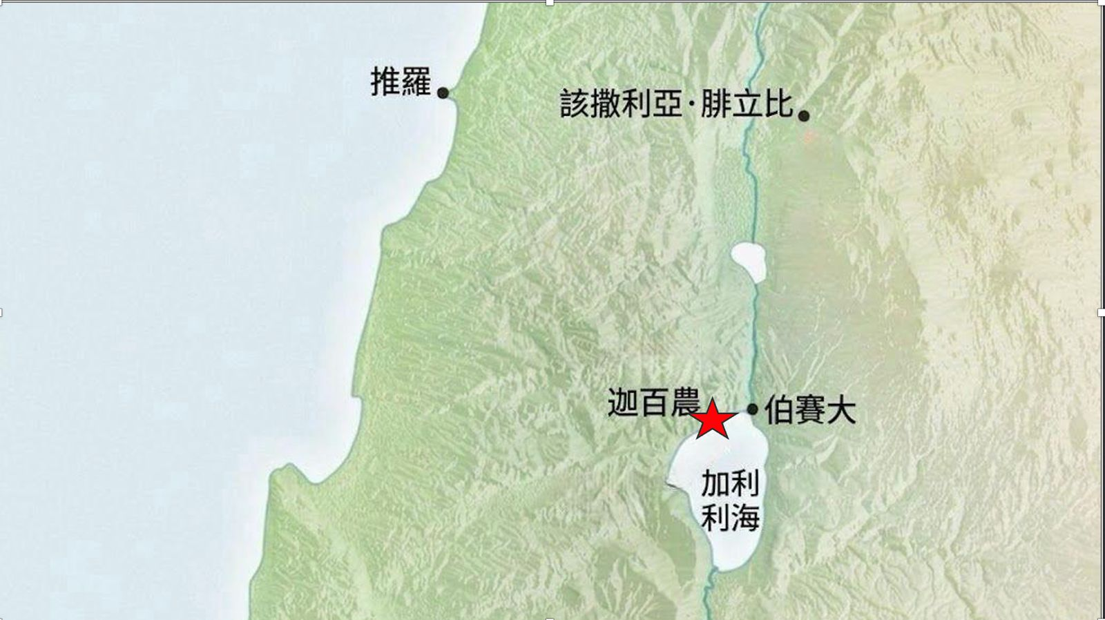
迦百农城
Capernaum
自己的城 太9:1
His own city (Mat 9:1)
彼得的家 路4:38
Peter’s house (Luk 4:38)

Slide 7
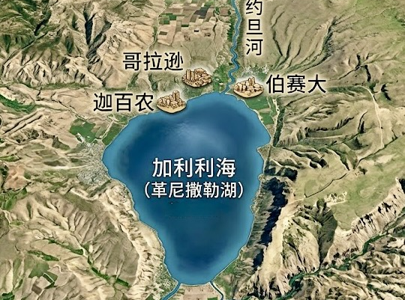

Slide 8
路加福音 5:1.
耶稣站在革尼撒勒湖边，众人拥挤他，要听神的道。
Luke 5:1.On one occasion, while the crowd was pressing in on him to hear the word of God, he was standing by the lake of Gennesaret,

Slide 9
太 11:20.那时，耶稣开始责备那些他曾在那里行过许多神迹的城，因为它们不肯悔改：21.“哥拉逊啊，你有祸了！伯赛大啊，你有祸了！在你们那里行过的神迹，如果行在推罗和西顿，它们早已披麻蒙灰悔改了。22.但我告诉你们，在审判的日子，推罗和西顿所受的，比你们还轻呢。23.迦百农啊！你会被高举到天上吗？你必降到阴间。在你那里行过的神迹，如果行在所多玛，那城还会存留到今天。24.但我告诉你们，在审判的日子，所多玛那地方所受的，比你还轻呢。”
Matthew 11:20.Then he began to denounce the cities where most of his mighty works had been done, because they did not repent. 21."Woe to you, Chorazin! Woe to you, Bethsaida! For if the mighty works done in you had been done in Tyre and Sidon, they would have repented long ago in sackcloth and ashes.22.But I tell you, it will be more bearable on the day of judgment for Tyre and Sidon than for you.23.And you, Capernaum, will you be exalted to heaven? You will be brought down to Hades. For if the mighty works done in you had been done in Sodom, it would have remained until this day.24.But I tell you that it will be more tolerable on the day of judgment for the land of Sodom than for you."

Slide 10
信靠主道
（还是不信？） Trust in the Lord’s word (or not believe?)
信道
Faith in God’s word
遵守主道
（拒绝遵守？）
Obey the Lord’s word
(or refuse to obey?)
渴慕主道
（还是厌烦？） Long for the Lord’s word (or be weary of it?)

Slide 11
02
彼得信与顺服主的话
Peter believed and obeyed the Lord’s word.

Slide 12
4.讲完了，就对西门说：“把船开到水深的地方，下网打鱼！”5.西门说：“主【夫子】啊，我们整夜劳苦，毫无所得，不过，我愿照你的话下网。”6.他们下了网，就圈住很多鱼，网几乎裂开，
4.And when he had finished speaking, he said to Simon, "Put out into the deep and let down your nets for a catch."5.And Simon answered, "Master, we toiled all night and took nothing! But at your word I will let down the nets."6.And when they had done this, they enclosed a large number of fish, and their nets were breaking.

Slide 13
03
认识主、认识自己
Know the Lord; know yourself.

Slide 14

8. 西门．彼得看见这种情景，就俯伏在耶稣膝前，说：“主 啊，离开我，因为我是个罪人。”
8.But when Simon Peter saw it, he fell down at Jesus' knees, saying, "Depart from me, for I am a sinful man, O Lord."

Slide 15
04
做门徒，是为主作得人的渔夫
To be a disciple is to become a fisher of people for the Lord.

Slide 16
10.西门的伙伴，西庇太的儿子雅各、约翰也是这样。耶稣对西门说：“不要怕！从今以后，你要作得人的渔夫了。”11.他们把两只船拢了岸，撇下一切，跟从了耶稣。
10.and so also were James and John, sons of Zebedee, who were partners with Simon. And Jesus said to Simon, "Do not be afraid; from now on you will be catching men."11.And when they had brought their boats to land, they left everything and followed him.

Slide 17
林前1:28
神也拣选了世上卑贱的，被人厌恶的，以及那无有的，...。
1 Corinthians 1：28.
God chose what is low and despised in the world, even things that are not, to bring to nothing things that are,

Slide 18
太 28:19
所以，你们要去，使万民作我的门徒，奉父、子、圣灵的名给他们施洗。20 凡我所吩咐你们的，都教训他们遵守，我就常与你们同在，直到世界的末了。
Matthew 28:19. Go therefore and make disciples of all nations, baptizing them in the name of the Father and of the Son and of the Holy Spirit,
20.teaching them to observe all that I have commanded you. And behold, I am with you always, to the end of the age."

Slide 19
10....
耶稣对西门说：
“不要怕！从今以后，你要作得人的渔夫了。
10....And Jesus said to Simon, "Do not be afraid; from now on you will be catching men."

