Slide 1
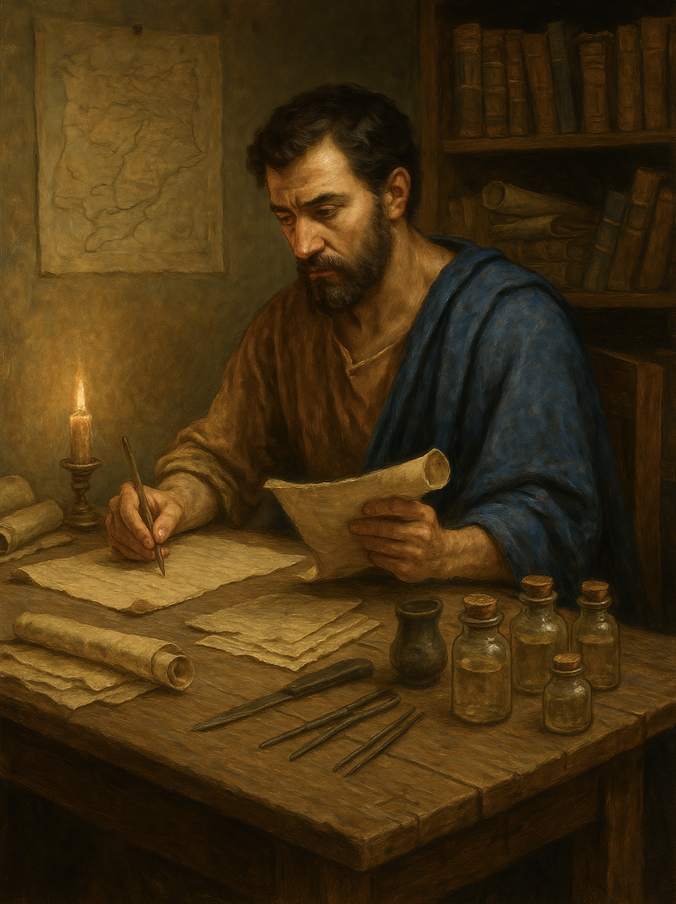
路加福音
Gospel of Luke
  20 主啊！如果你肯，必能使我洁净
  路5章12至16
  "Lord, if you will, you can make me clean.".(Luke 5:12-16)

Slide 2
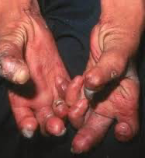
如果你得大麻风
If you had leprosy,
你盼望什么？
what would you hope for?
你希望人怜悯你吗？
Would you hope others would show mercy to you?
如果别人有大麻风，你愿意怜悯他吗？
If someone else had leprosy, would you be willing to show mercy to him?

Slide 3
路 5:12.有一次，耶稣在一个城里，突然有一个满身痲风 的人看见他，就把脸伏在地上，求他说：“主啊！如果你肯，必能使我洁净。”13.耶稣伸手摸他，说：“我肯，你洁净了吧！”痲风立刻离开了他。14.耶稣嘱咐他不可告诉任何人，“你只要去给祭司检查，并且照着摩西所规定的，为你得洁净献祭，好向大家作证。”15.但他的名声却越发传扬出去，成群的人来聚集，要听道，并且要使他们的疾病痊愈。16耶稣却退到旷野去祷告。
Luke 5:12.While he was in one of the cities, there came a man full of leprosy. And when he saw Jesus, he fell on his face and begged him, "Lord, if you will, you can make me clean." 13.And Jesus stretched out his hand and touched him, saying, "I will; be clean." And immediately the leprosy left him.14.And he charged him to tell no one, but "go and show yourself to the priest, and make an offering for your cleansing, as Moses commanded, for a proof to them."15.But now even more the report about him went abroad, and great crowds gathered to hear him and to be healed of their infirmities.16.But he would withdraw to desolate places and pray.

Slide 4
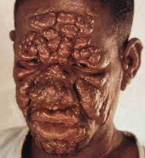
大麻风 Hansen's disease

Slide 5
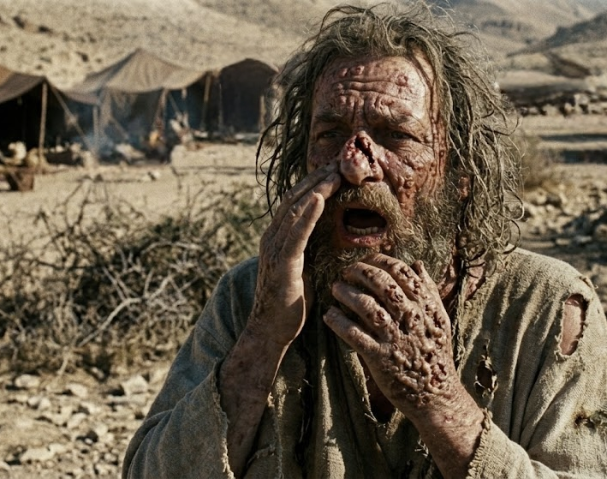
利13:45
身上患有痲风病的人，要撕裂自己的衣服，披头散发，遮盖上唇喊叫：‘不洁净！不洁净！’46.在他患病的日子里，他是不洁净的；他既然不洁净，就要独居，住在营外。
Leviticus 13:45."The leprous person who has the disease shall wear torn clothes and let the hair of his head hang loose, and he shall cover his upper lip and cry out, 'Unclean, unclean.’ 46.He shall remain unclean as long as he has the disease. He is unclean. He shall live alone. His dwelling shall be outside the camp.

Slide 6
01
罪有如大麻风
Sin Is Like Leprosy.

Slide 7
民5:1
耶和华晓谕摩西说：2「你吩咐以色列人，使一切长大麻疯的，患漏症的，并因死尸不洁净的，都出营外去。3 无论男女都要使他们出到营外，免得污秽他们的营；这营是我所住的。
Numbers 5:1. The Lord spoke to Moses, saying, 2."Command the people of Israel that they put out of the camp everyone who is leprous or has a discharge and everyone who is unclean through contact with the dead.3.You shall put out both male and female, putting them outside the camp, that they may not defile their camp, in the midst of which I dwell."

Slide 8
约壹1:9.
我们若承认自己的罪,神是信实的、公义的,必定赦免我们的罪,洁净我们脱离一切不义。
1 John 1:9. If we confess our sins, he is faithful and just to forgive us our sins and to cleanse us from all unrighteousness.

Slide 9
02
勇敢来到主前
Come Boldly Before the Lord

Slide 10
路 5:12.。。。 突然有一个满身痲风 的人看见他，就把脸伏在地上，求他说：“主啊！如果你肯，必能使我洁净。”
Luke 5:12.。。。 there came a man full of leprosy. And when he saw Jesus, he fell on his face and begged him, "Lord, if you will, you can make me clean."

Slide 11
诗34:8
你们要尝尝主恩的滋味，便知道他是美善；投靠他的人有福了！
Psalms 34:8.
Oh, taste and see that the Lord is good! Blessed is the man who takes refuge in him!

Slide 12
03
主的吩咐
the Lord’s Command.

Slide 13
14.耶稣嘱咐他不可告诉任何人，“你只要去给祭司检查，并且照着摩西所规定的，为你得洁净献祭，好向大家作证。”
14.And he charged him to tell no one, but "go and show yourself to the priest, and make an offering for your cleansing, as Moses commanded, for a proof to them."

Slide 14
可 1:45.那人出去，倒说许多的话，把这件事传扬开了，叫耶稣以后不得再明明地进城，只好在外边旷野地方。人从各处都就了他来。
Mark 1:45. But he went out and began to talk freely about it, and to spread the news, so that Jesus could no longer openly enter a town, but was out in desolate places, and people were coming to him from every quarter.

Slide 15
路 5:15.但他的名声却越发传扬出去，成群的人来聚集，要听道，并且要使他们的疾病痊愈。16 耶稣却退到旷野去祷告。
15.But now even more the report about him went abroad, and great crowds gathered to hear him and to be healed of their infirmities.16.But he would withdraw to desolate places and pray.

Slide 16
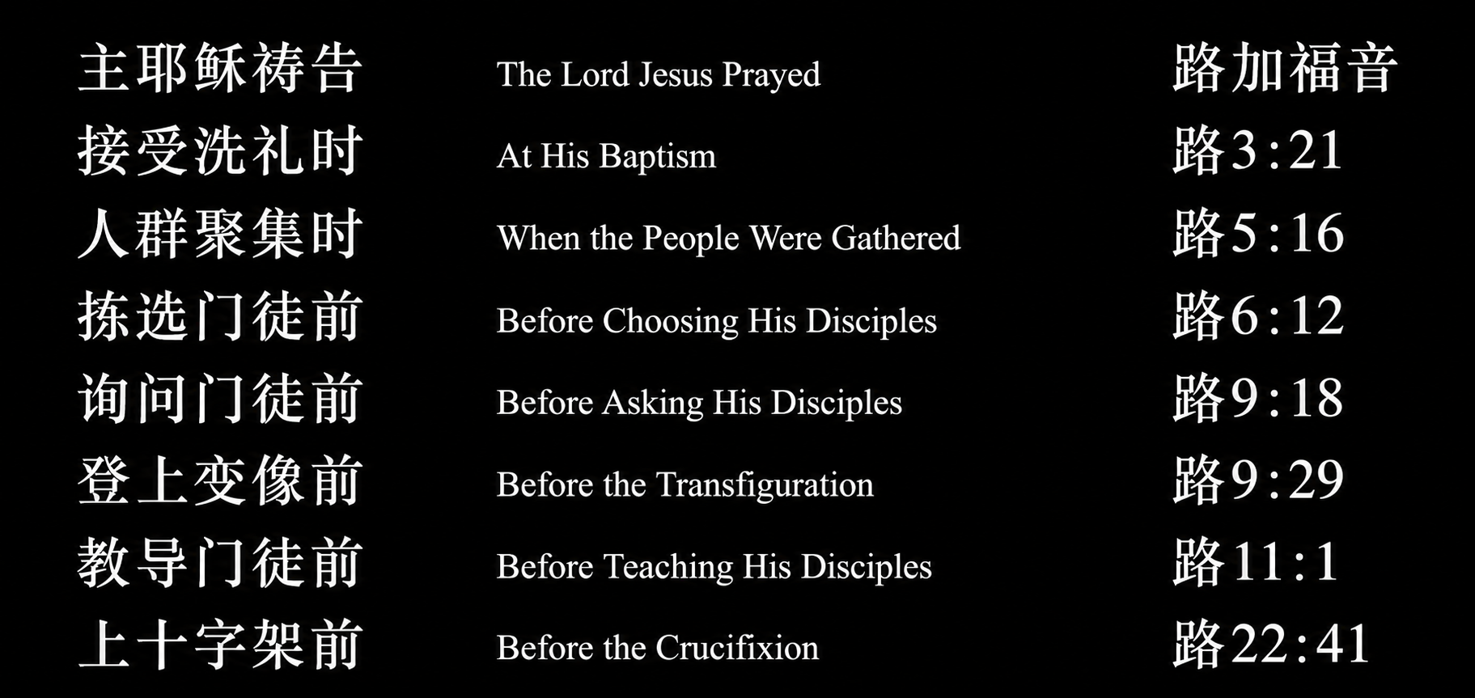

Slide 17
来 4:15 因我们的大祭司并非不能体恤我们的软弱。他也曾凡事受过试探，与我们一样，只是他没有犯罪。16 所以，我们只管坦然无惧的来到施恩的宝座前，为要得怜恤，蒙恩惠，作随时的帮助。
Hebrews 4
15. For we do not have a high priest who is unable to sympathize with our weaknesses, but one who in every respect has been tempted as we are, yet without sin.16.Let us then with confidence draw near to the throne of grace, that we may receive mercy and find grace to help in time of need.

