Slide 1
你若不是从水和圣灵生的，就不能进上帝的国 Zeal for your house will consume me
017信心与神迹
约翰福音 4章 43-54
Faith and Miracles

Slide 2
代下20:9『倘有祸患临到我们，或刀兵灾殃，或瘟疫饥荒，我们在急难的时候，站在这殿前向你呼求，你必垂听而拯救，因为你的名在这殿里。』

Slide 3
从来没有
见过神迹
never see miracles before
见过神迹
seen miracles before
信心
Faith

Slide 4
4:39...那城里就有许多撒玛利亚人信了耶稣。
Joh 4:39 Many Samaritans from that town believed in him …

Slide 5
约4:43 两天之后，耶稣离开那里，往加利利去。44 耶稣自己说过：“先知在本乡是不受尊敬的。”45 耶稣到了加利利的时候，加利利人都欢迎他，因为他们曾经上耶路撒冷去过节，见过他所行的一切。
Joh 4:43 After the two days he departed for Galilee.44 (For Jesus himself had testified that a prophet has no honor in his own hometown.) 45 So when he came to Galilee, the Galileans welcomed him, having seen all that he had done in Jerusalem at the feast. For they too had gone to the feast.
1/4

Slide 6
46 耶稣又到了加利利的迦拿，就是他变水为酒的地方。有一个大臣，他的儿子在迦百农患病。47 他听见耶稣从犹太到了加利利，就来见他，求他下去医治他的儿子，因为他的儿子快要死了。48 耶稣对他说：“你们若看不见神迹奇事，总是不肯信。”
Joh 4:46 So he came again to Cana in Galilee, where he had made the water wine. And at Capernaum there was an official whose son was ill.:47 When this man heard that Jesus had come from Judea to Galilee, he went to him and asked him to come down and heal his son, for he was at the point of death. 48 So Jesus said to him, “Unless you see signs and wonders you will not believe.”
2/4

Slide 7
49 大臣说：“先生，求你趁我的孩子还没有死就下去吧！”50 耶稣告诉他：“回去吧，你的儿子好了。”那人信耶稣对他说的话，就回去了。51 正下去的时候，他的仆人迎着他走来，说他的孩子好了。
Joh 4:49 The official said to him, “Sir, come down before my child dies.”50 Jesus said to him, “Go; your son will live.” The man believed the word that Jesus spoke to him and went on his way. 51 As he was going down, his servants met him and told him that his son was recovering.
3/4

Slide 8
52 他就向仆人查问孩子是什么时候好转的。他们告诉他：“昨天下午一点钟，热就退了。”53 这父亲就知道，那正是耶稣告诉他“你的儿子好了”的时候，他自己和全家就信了。54 这是耶稣从犹太回到加利利以后所行的第二件神迹。
52 So he asked them the hour when he began to get better, and they said to him, “Yesterday at the seventh hour the fever left him.”53 The father knew that was the hour when Jesus had said to him, “Your son will live.” And he himself believed, and all his household.54 This was now the second sign that Jesus did when he had come from Judea to Galilee.
4/4

Slide 9
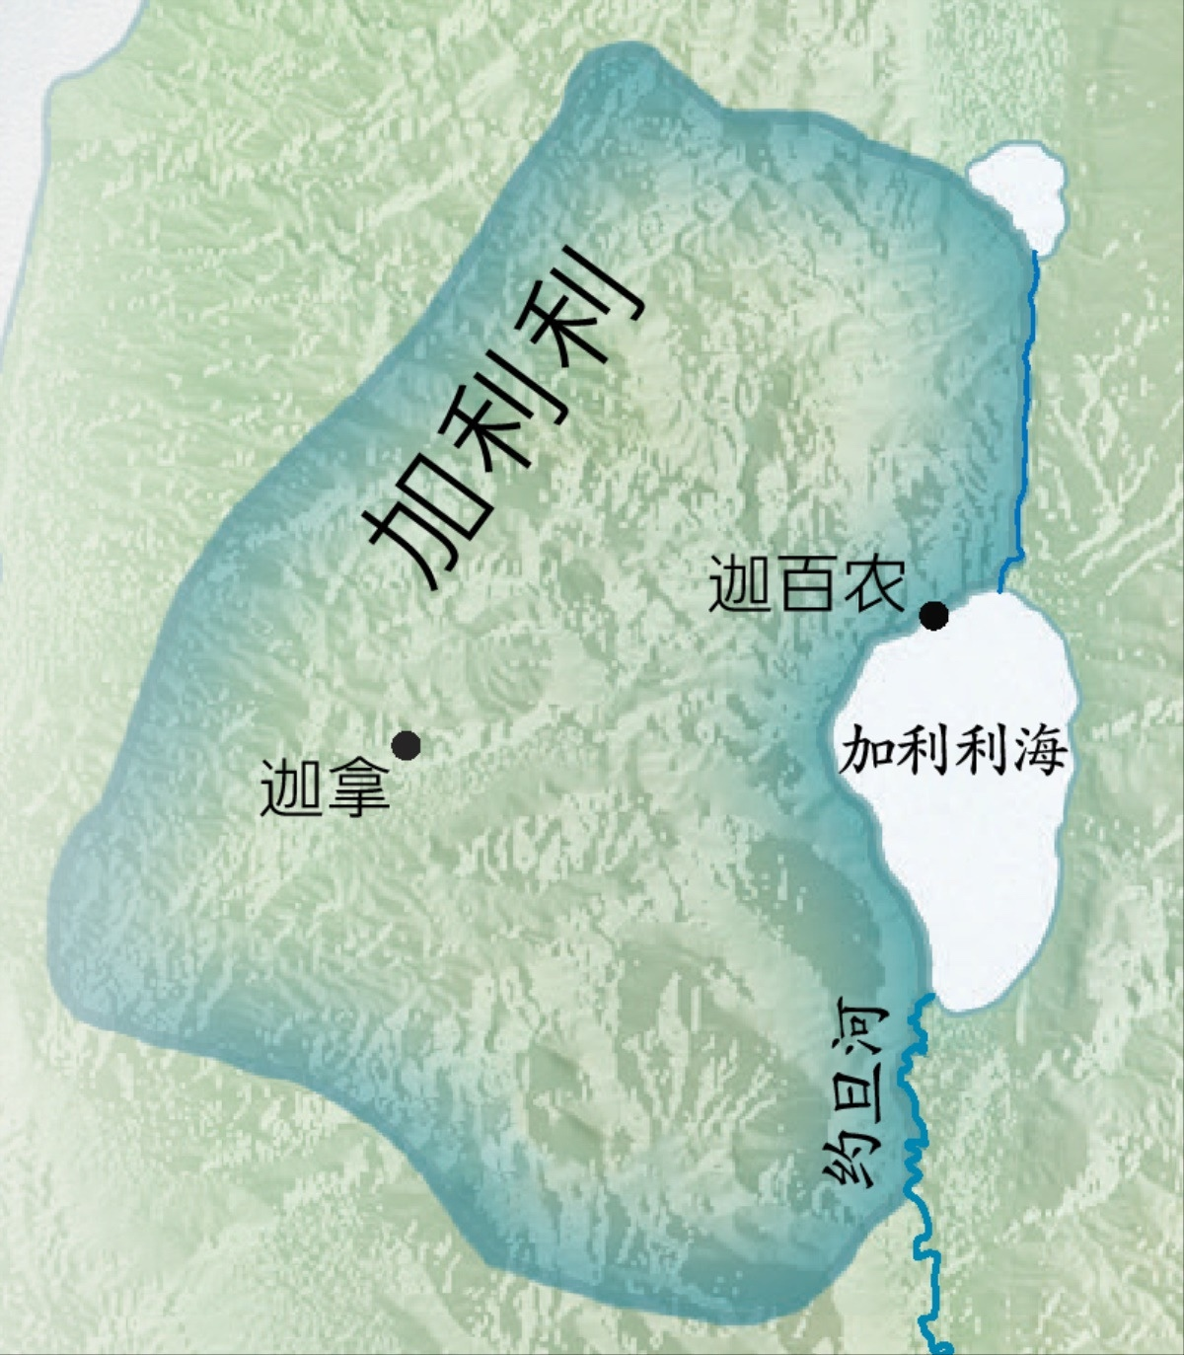

Slide 10
（I）
有些人可能因经历神迹而暂时接待耶稣
Some people may temporarily receive Jesus because they experience miracles

Slide 11
约4:43 两天之后，耶稣离开那里，往加利利去。44 耶稣自己说过：“先知在本乡是不受尊敬的。”45 耶稣到了加利利的时候，加利利人都欢迎他，因为他们曾经上耶路撒冷去过节，见过他所行的一切。
Joh 4:43 After the two days he departed for Galilee.44 (For Jesus himself had testified that a prophet has no honor in his own hometown.) 45 So when he came to Galilee, the Galileans welcomed him, having seen all that he had done in Jerusalem at the feast. For they too had gone to the feast.
1/4

Slide 12
约4:43 两天之后，耶稣离开那里，往加利利去。44 耶稣自己说过：“先知在本乡是不受尊敬的。”45 耶稣到了加利利的时候，加利利人都欢迎他，因为他们曾经上耶路撒冷去过节，见过他所行的一切。
45 So when he came to Galilee, the Galileans welcomed him, having seen all that he had done in Jerusalem at the feast. For they too had gone to the feast.

Slide 13
（2:23）
耶稣在
耶路撒冷
行神迹
（4:45）
加利利人
欢迎接待
耶稣
（6:66）
在加利利
许多门徒
离开耶稣
2:22
Jesus performed signs in Jerusalem
4:45
Galileans welcome
Jesus
4:45
In Galilee
Many disciples
depart from Jesus

Slide 14
约4:43 两天之后，耶稣离开那里，往加利利去。44 耶稣自己说过：“先知在本乡是不受尊敬的。”45 耶稣到了加利利的时候，加利利人都欢迎他，因为他们曾经上耶路撒冷去过节，见过他所行的一切。
44 (For Jesus himself had testified that a prophet has no honor in his own hometown.)

Slide 15
约2:23
...许多人看见他所行的神迹,就信了他的名。24 耶稣却不信任他们,因为他知道所有的人,
Joh 2:23 Now when he was in Jerusalem at the Passover Feast, many believed in his name when they saw the signs that he was doing.24 But Jesus on his part did not entrust himself to them, because he knew all people

Slide 16
（II）
耶稣责备犹太人，若不见神迹
总是不肯信
But Jesus rebuked the Jews, and unless they see signs and wonders, they would not believe

Slide 17
46 耶稣又到了加利利的迦拿，就是他变水为酒的地方。有一个大臣，他的儿子在迦百农患病。47 他听见耶稣从犹太到了加利利，就来见他，求他下去医治他的儿子，因为他的儿子快要死了。48 耶稣对他说：“你们若看不见神迹奇事，总是不肯信。”
Joh 4:46 So he came again to Cana in Galilee, where he had made the water wine. And at Capernaum there was an official whose son was ill.:47 When this man heard that Jesus had come from Judea to Galilee, he went to him and asked him to come down and heal his son, for he was at the point of death. 48 So Jesus said to him, “Unless you see signs and wonders you will not believe.”
2/4

Slide 18
约28公里

Slide 19
46 耶稣又到了加利利的迦拿，就是他变水为酒的地方。有一个大臣，他的儿子在迦百农患病。47 他听见耶稣从犹太到了加利利，就来见他，求他下去医治他的儿子，因为他的儿子快要死了。48 耶稣对他说：“你们若看不见神迹奇事，总是不肯信。”
48 So Jesus said to him, “Unless you see signs and wonders you will not believe.”

Slide 20
见到神迹的人就一定信耶稣？
Anyone who sees miracles will believe in Jesus?

Slide 21
太11:23
迦百农啊！你会被高举到天上吗？你必降到阴间。在你那里行过的神迹，如果行在所多玛，那城还会存留到今天。24 但我告诉你们，在审判的日子，所多玛那地方所受的，比你还轻呢。
Mat 11:23 And you, Capernaum, will you be exalted to heaven? You will be brought down to Hades. For if the mighty works done in you had been done in Sodom, it would have remained until this day.24 But I tell you that it will be more tolerable on the day of judgment for the land of Sodom than for you.”

Slide 22
为什么有一些人看见神迹后不信？
Why do some people see miracles and do not believe?
为什么有一些人看见神迹后会相信？
Why do some people believe after seeing miracles ?
为什么一些从来没有看见神迹却相信？
Why do some people believe even if they never see miracles?

Slide 23
46 耶稣又到了加利利的迦拿，就是他变水为酒的地方。有一个大臣，他的儿子在迦百农患病。47 他听见耶稣从犹太到了加利利，就来见他，求他下去医治他的儿子，因为他的儿子快要死了。48 耶稣对他说：“你们若看不见神迹奇事，总是不肯信。”
48 So Jesus said to him, “Unless you see signs and wonders you will not believe.”

Slide 24
（III）
看大臣信心的旅程
See the official journey of faith

Slide 25
49 大臣说:“先生,求你趁我的孩子还没有死就下去吧！”50 耶稣告诉他:“回去吧,你的儿子好了。”那人信耶稣对他说的话,就回去了。51 正下去的时候,他的仆人迎着他走来,说他的孩子好了。52 他就向仆人查问孩子是什么时候好转的。他们告诉他:“昨天下午一点钟,热就退了。”53 这父亲就知道,那正是耶稣告诉他“你的儿子好了”的时候他自己和全家就信了。54 这是耶稣从犹太回到加利利以后所行的第二件神迹。

Slide 26
49 大臣说:“先生,求你趁我的孩子还没有死就下去吧！”50 耶稣告诉他:“回去吧,你的儿子好了【活了】。 。”那人信耶稣对他说的话,就回去了。51 正下去的时候,他的仆人迎着他走来,说他的孩子好了。52 他就向仆人查问孩子是什么时候好转的。他们告诉他:“昨天下午一点钟,热就退了。”53 这父亲就知道,那正是耶稣告诉他“你的儿子好了”的时候他自己和全家就信了。54 这是耶稣从犹太回到加利利以后所行的第二件神迹。
Joh 4:50 Jesus said to him, “Go; your son will live.” The man believed the word that Jesus spoke to him and went on his way.

Slide 27
49 大臣说:“先生,求你趁我的孩子还没有死就下去吧！”50 耶稣告诉他:“回去吧,你的儿子好了。”那人信耶稣对他说的话,就回去了。51 正下去的时候,他的仆人迎着他走来,说他的孩子好了。52 他就向仆人查问孩子是什么时候好转的。他们告诉他:“昨天下午一点钟,热就退了。”53 这父亲就知道,那正是耶稣告诉他“你的儿子好了”的时候他自己和全家就信了。54 这是耶稣从犹太回到加利利以后所行的第二件神迹。
Joh 4:53 The father knew that was the hour when Jesus had said to him, “Your son will live.” And he himself believed, and all his household.

Slide 28
若有一些人像这大臣一样无法全心信靠主，求主祢怜恤帮助他们。
If there are people like this official who cannot trust the Lord with all their heart, please be merciful and help them.

