Slide 1
从信徒到执事： 神生命塑造的奇妙之工
提前3:8-13
From Believer to Deacon: The Marvelous Work of God in Shaping Lives

Slide 2
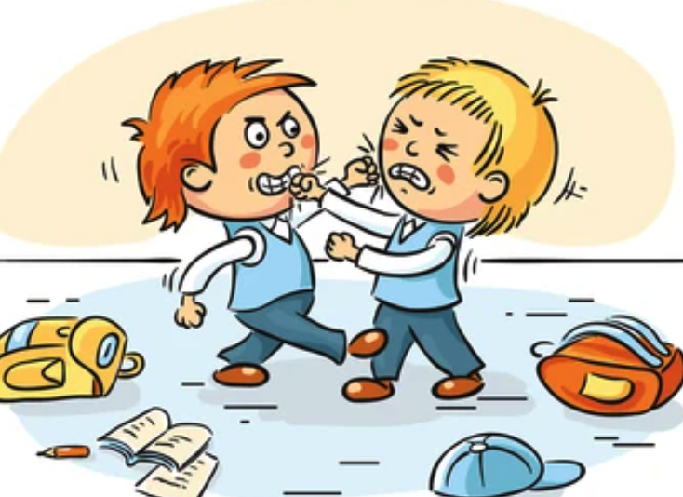
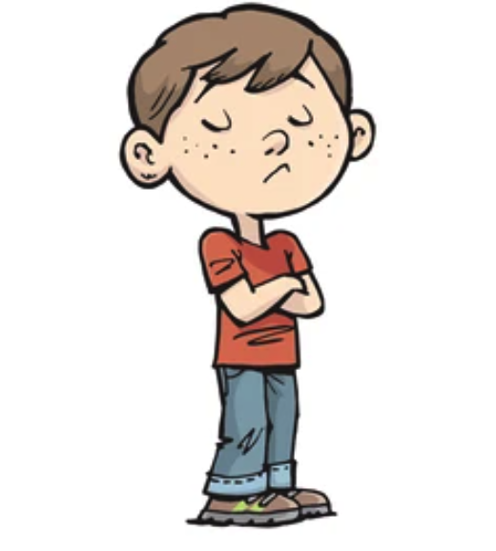
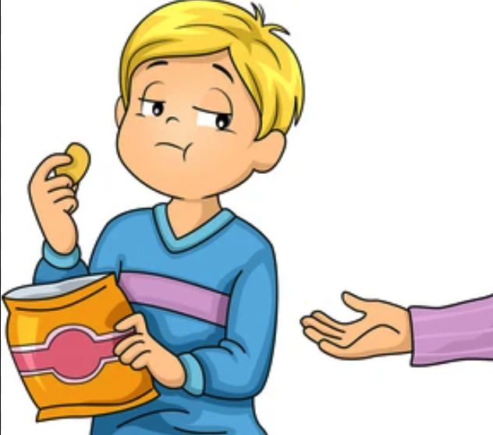

Slide 3
提前3:8 作执事的，也是如此：必须端庄，不一口两舌，不好喝酒，不贪不义之财；9 要存清洁的良心，固守真道的奥秘。10 这等人也要先受试验，若没有可责之处，然後叫他们作执事。11 女执事（原文作女人）也是如此：必须端庄，不说谗言，有节制，凡事忠心。12 执事只要作一个妇人的丈夫，好好管理儿女和自己的家。13 因为善作执事的，自己就得到美好的地步，并且在基督耶稣里的真道上大有胆量。
1Ti 3:8 Deacons likewise must be dignified, not double-tongued, not addicted to much wine, not greedy for dishonest gain.9 They must hold the mystery of the faith with a clear conscience.10 And let them also be tested first; then let them serve as deacons if they prove themselves blameless.11 Their wives likewise must be dignified, not slanderers, but sober-minded, faithful in all things.12 Let deacons each be the husband of one wife, managing their children and their own households well.13 For those who serve well as deacons gain a good standing for themselves and also great confidence in the faith that is in Christ Jesus.

Slide 4
执事负责什么？
【1】
What Are the Responsibilities of a Deacon?

Slide 5
耶稣基督
（透过圣经与圣灵）
Jesus Christ thru His Spirit and His word
牧师/长老
Ministers and Elders
监督
Overseer
长执会
执事 Deacons

Slide 6
执事的责任
协助牧师带领事工 Assist the Overseer to lead the ministries
财务与预算 to plan and manage finances
怜悯弟兄姐妹 to show mercy and care to bros & Sis

Slide 7
神能塑造改变我们的生命
【2】
God Can Shape and Transform Our Lives

Slide 8
VS
金钱、地位
恩赐、才干
Money and Status,
Spiritual Gifts and Talents
生命与榜样
Life and Example

Slide 9
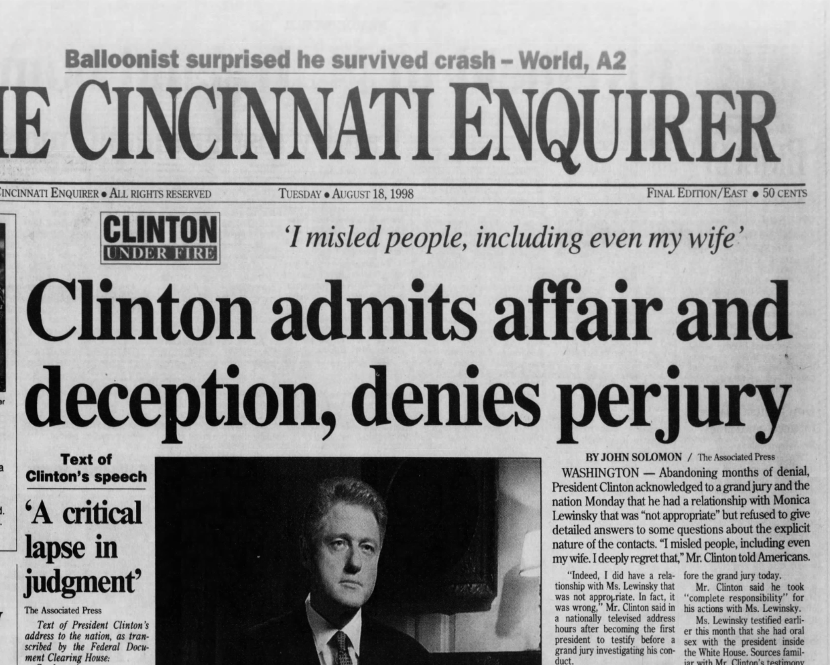
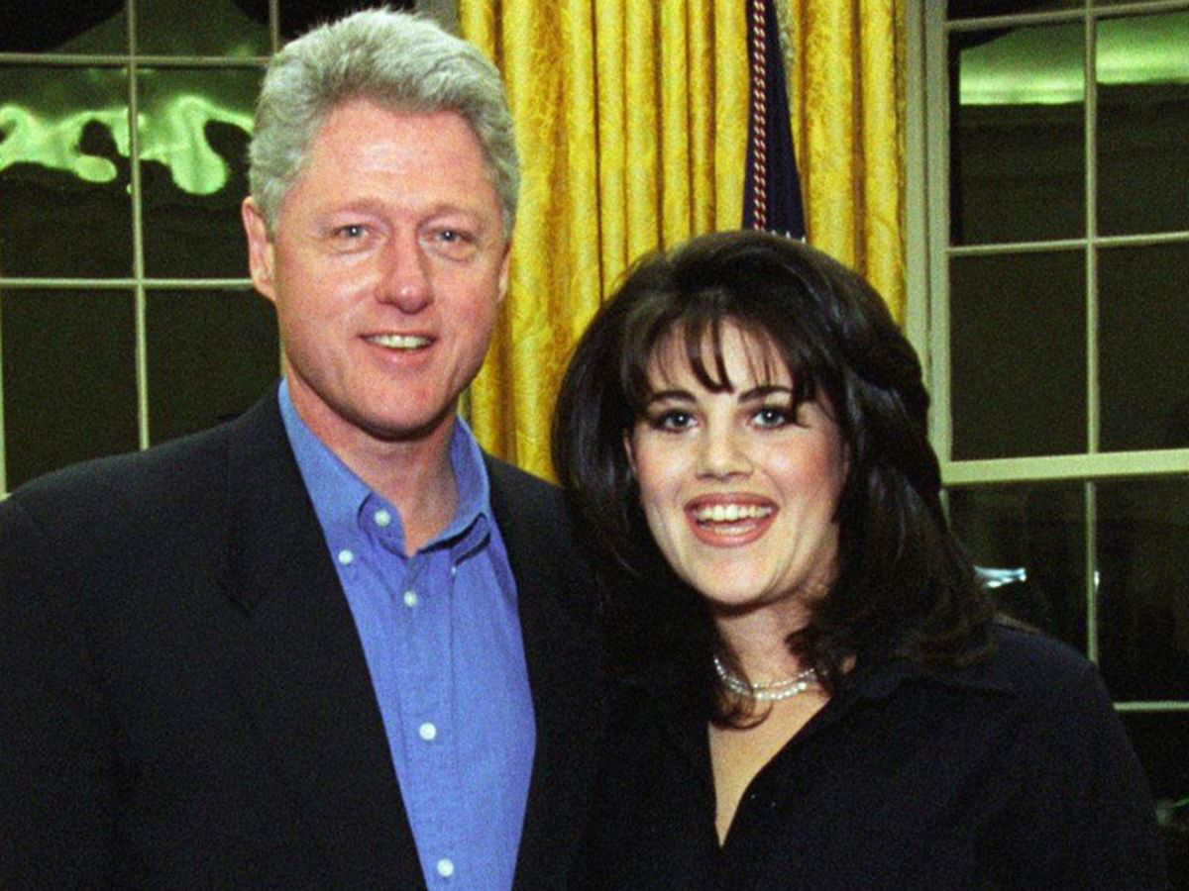
才干、地位、金钱
Talents, Status, and Money

Slide 10
能力才干、地位、金钱
Talents, Status, and Money

Slide 11
生命的榜样
【3】
Example of Life

Slide 12
提前3:8
作执事的，也是如此：必须端庄，不一口两舌，不好喝酒，不贪不义之财；
1Ti 3:8 Deacons likewise must be dignified, not double-tongued, not addicted to much wine, not greedy for dishonest gain.

Slide 13
提前3:8
作执事的，也是如此：必须端庄，不一口两舌，不好喝酒，不贪不义之财；
1Ti 3:8 Deacons likewise must be dignified, not double-tongued, not addicted to much wine, not greedy for dishonest gain.

Slide 14
提前3:8
作执事的，也是如此：必须端庄，不一口两舌，
不好喝酒，不贪不义之财；
1Ti 3:8 Deacons likewise must be dignified, not double-tongued, not addicted to much wine, not greedy for dishonest gain.

Slide 15
提前3:8
作执事的，也是如此：必须端庄，不一口两舌，不好喝酒，不贪不义之财；
1Ti 3:8 Deacons likewise must be dignified, not double-tongued, not addicted to much wine, not greedy for dishonest gain.

Slide 16
9 要存清洁的良心，固守真道的奥秘。
9 They must hold the mystery of the faith with a clear conscience.

Slide 17
9 要存清洁的良心，固守真道的奥秘。
9 They must hold the mystery of the faith with a clear conscience.

Slide 18
10 这等人也要先受试验，若没有可责之处，然後叫他们作执事。
10 And let them also be tested first; then let them serve as deacons if they prove themselves blameless.

Slide 19
11 女执事（原文作女人） 也是如此：必须端庄，不说谗言，有节制，凡事忠心。
ESV 11 Their wives likewise must be dignified, not slanderers, but sober-minded, faithful in all things.
(ASV) Women

Slide 20
罗马书 16:1
我对你们举荐我们的姊妹非比；她是坚革哩教会中的女执事. 。

Slide 21
11 女执事（原文作女人）也是如此：必须端庄，不说谗言，有节制，凡事忠心。
ESV 11 Their wives likewise must be dignified, not slanderers, but sober-minded, faithful in all things.
(ASV) Women

Slide 22
执事须好好管理自己的家
【4】
Deacons must be able to manage their own household

Slide 23
12 执事只要作一个妇人的丈夫，好好管理儿女和自己的家。
12 Let deacons each be the husband of one wife, managing their children and their own households well.

Slide 24
12 执事只要作一个妇人的丈夫，好好管理儿女和自己的家。
12 Let deacons each be the husband of one wife, managing their children and their own households well.

Slide 25
得到美好的地步
【5】
gain a good standing for themselves

Slide 26
13 因为善作执事的，自己就得到美好的地步，并且在基督耶稣里的真道上大有胆量。
13 For those who serve well as deacons gain a good standing for themselves and also great confidence in the faith that is in Christ Jesus.

Slide 27
约翰福音 12:26.
若有人服事我，就当跟从我；我在哪里，服事我的人也要在那里；若有人服事我，我父必尊重他。」
John 12:26.If anyone serves me, he must follow me; and where I am, there will my servant be also. If anyone serves me, the Father will honor him.

Slide 28
13 因为善作执事的，自己就得到美好的地步，并且在基督耶稣里的真道上大有胆量。
13 For those who serve well as deacons gain a good standing for themselves and also great confidence in the faith that is in Christ Jesus.

