Slide 2
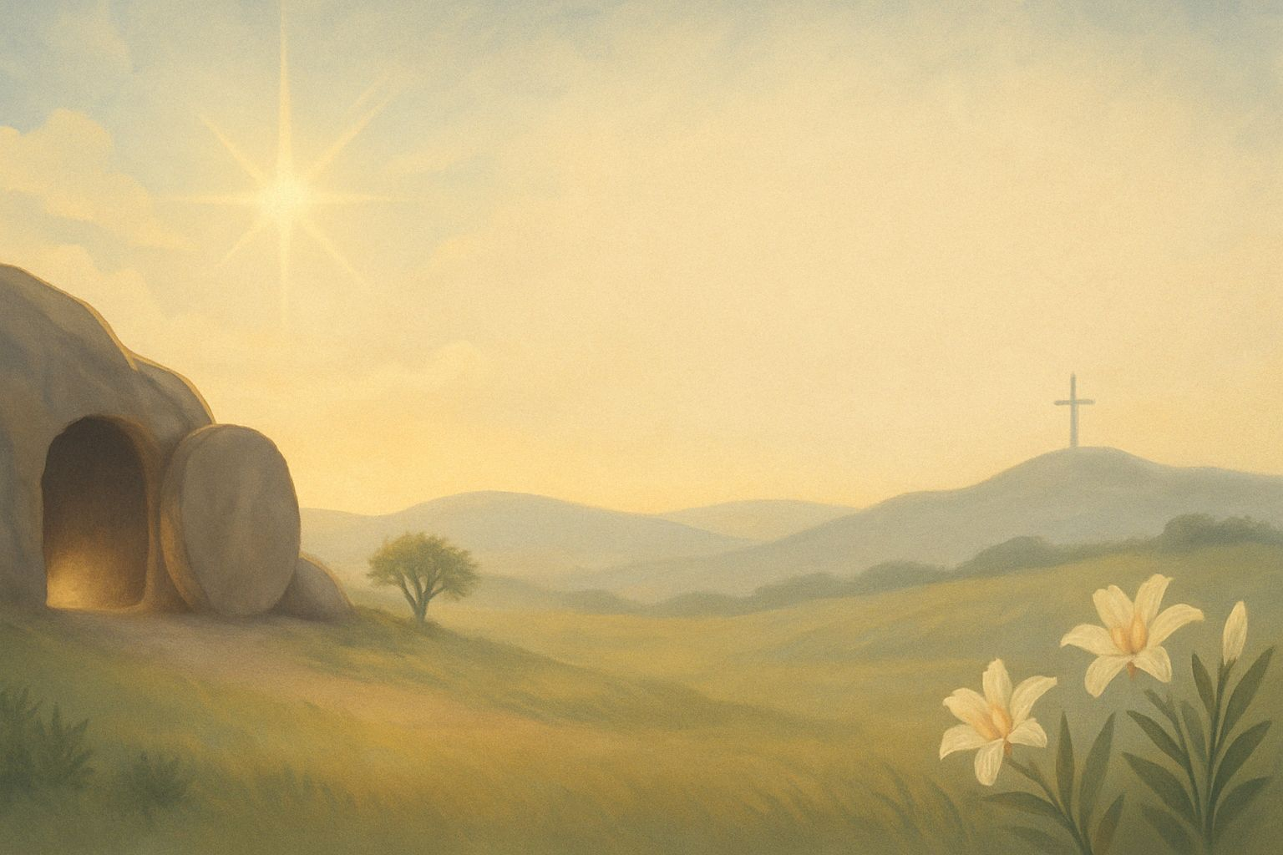
主耶稣在哪里？ Where is Jesus?

Slide 3
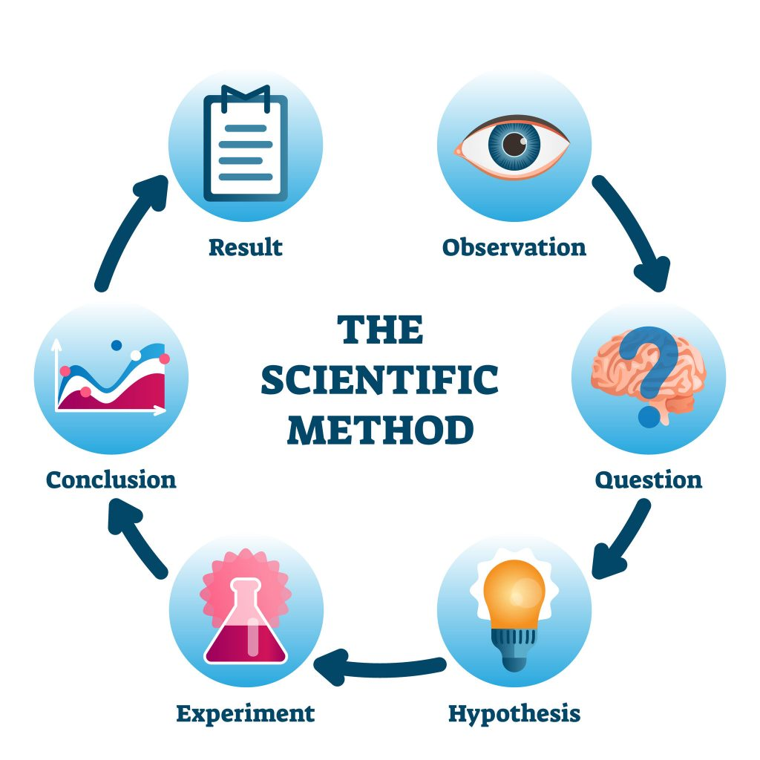
结果
观察
结论
提问
科学方法
实验
假设

Slide 4
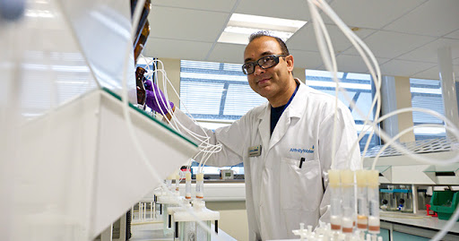
三大基础：
可观察、可重复、可衡量
Foundations : Observation, Repetition, Measurement
可观察的现象
Observable
可重复实验
Repeatable
可衡量实验
Measurable/Testable

Slide 5
科学无法证明:Science cannot prove:
物质以外的层面 beyond material world
2. 人的理 Human reason
3. 人的情感 Human emotion
4. 道德 Morality
5. 过去的历史 Past historical events
6. 上帝 God

Slide 6
复活的合理性
01
The Reasonableness of the Resurrection

Slide 7
《道德经》
第四十章「。。。天下万物生于有，有生于无。」
简易：世界上的一切东西，都是从已经存在的东西变化出来的；
但最一开始，那些存在的东西，是从‘无’中产生出来的。
All things in the world originate from what already exists; yet in the beginning, even what exists came forth from “Non-being/ Nothingness.”

Slide 8
「无」
“Non-being/ Nothingness.”
「无」“Non-being/Nothingness”
是没有智慧 has no wisdom
是没有情感 has no emotion
是没有能力 has no power
是没有道德 has no morality
「无」若是能生「有」，那「无」就不是「无」。If “Non-being” can give rise to “Being,” then it is no longer truly “Non-being.”

Slide 9
「无」
“Non-being/ Nothingness.”
「存有」
Existence

Slide 10
在以色列的旧约历史中，已有3次复活的证明。
02
Three resurrections are recorded in Israel’s Old Testament history.

Slide 11
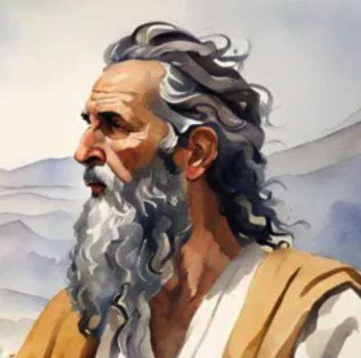
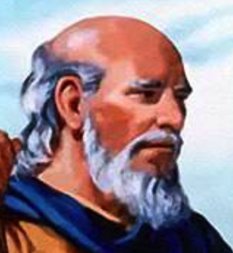
2025年
约2000年
以利亚
约主前
870年
以利沙
约主前
850年
3/3

Slide 12
列王纪上 17:21 以利亚三次伏在孩子的身上，求告耶和华说：「耶和华—我的神啊，求你使这孩子的灵魂仍入他的身体！」22耶和华应允以利亚的话，孩子的灵魂仍入他的身体，他就活了。
And he cried to the Lord , "O Lord my God, have you brought calamity even upon the widow with whom I sojourn, by killing her son?” Then he stretched himself upon the child three times and cried to the Lord , "O Lord my God, let this childs life come into him again."(1 Kings 17:20-21 ESV)

Slide 13
耶稣三次使人复活。 (路7:11-17、8:40-56、约11:1-44)
03
Jesus raised three people from the dead (Lk 7:11–17; 8:40–56; Jn 11:1–44).

Slide 14
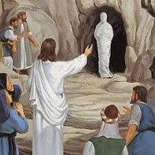
约11:38 耶稣又心里悲叹，来到坟墓前；那坟墓是个洞，有一块石头挡着。39 耶稣说：「你们把石头挪开。」那死人的姊姊马大对他说：「主啊，他现在必是臭了，因为他死了已经四天了。」
Then Jesus, deeply moved again, came to the tomb. It was a cave, and a stone lay against it.Jesus said, "Take away the stone." Martha, the sister of the dead man, said to him, "Lord, by this time there will be an odor, for he has been dead four days."(John 11:38-39 ESV)

Slide 15
路1:3 这些事我既从起头都详细考察了，就定意要按著次序写给你，4 使你知道所学之道都是确实的。
it seemed good to me also, having followed all things closely for some time past, to write an orderly account for you, most excellent Theophilus, that you may have certainty concerning the things you have been taught.(Luke 1:3-4 ESV)

Slide 16
犹太人无法出示耶稣 的身体作为反驳
04
The Jews could not produce Jesus’ body to refute the resurrection.

Slide 17
太27:64 因此，请吩咐人将坟墓把守妥当，直到第三日，恐怕他的门徒来，把他偷了去，就告诉百姓说：『他从死里复活了。』这样，那後来的迷惑比先前的更利害了！」65 彼拉多说：「你们有看守的兵，去吧！尽你们所能的把守妥当。」66 他们就带著看守的兵同去，封了石头，将坟墓把守妥当。
Therefore order the tomb to be made secure until the third day, lest his disciples go and steal him away and tell the people, He has risen from the dead, and the last fraud will be worse than the first.” Pilate said to them, "You have a guard of soldiers. Go, make it as secure as you can.” So they went and made the tomb secure by sealing the stone and setting a guard.(Matthew 27:64-66 ESV)

Slide 18
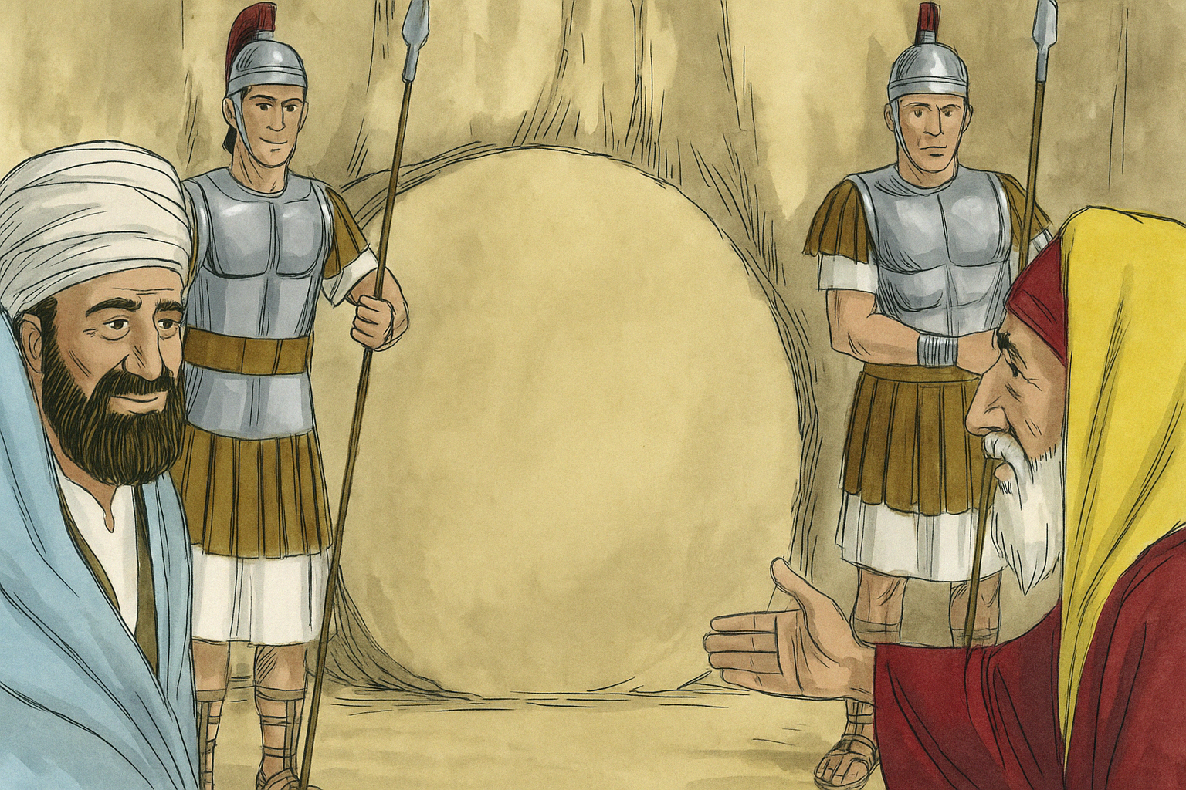

Slide 19
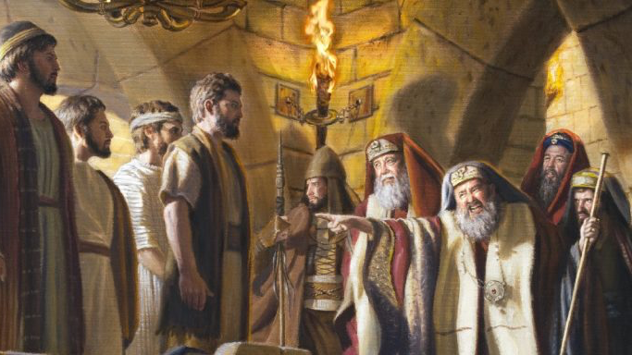
徒 5:25-33 Acts 5:25-33

Slide 20
500多人亲眼看见
05
500 eye witness

Slide 21
林前 15:4 而且埋葬了；又照圣经所说，第三天复活了，5 并且显给矶法看，然後显给十二使徒看；6 後来一时显给五百多弟兄看，其中一大半到如今还在，却也有已经睡了的。7 以後显给雅各看，再显给众使徒看，8 末了也显给我看...
that he was buried, that he was raised on the third day in accordance with the Scriptures, and that he appeared to Cephas, then to the twelve. Then he appeared to more than five hundred brothers at one time, most of whom are still alive, though some have fallen asleep. Then he appeared to James, then to all the apostles. Last of all, as to one untimely born, he appeared also to me.(1 Corinthians 15:4-8 ESV)

Slide 22
保罗反对福音者的转变
06
The conversion of Paul, the one who opposed the gospel

Slide 23
徒26:13 王啊，我在路上，晌午的时候，看见从天发光，比日头还亮，四面照著我并与我同行的人。14 我们都仆倒在地，我就听见有声音用希伯来话向我说：『扫罗！扫罗！为什麽逼迫我？你用脚踢刺是难的！』15 我说：『主啊，你是谁？』主说：『我就是你所逼迫的耶稣。16 你起来站著，我特意向你显现，要派你作执事，作见证，将你所看见的事和我将要指示你的事证明出来。...
At midday, O king, I saw on the way a light from heaven, brighter than the sun, that shone around me and those who journeyed with me.And when we had all fallen to the ground, I heard a voice saying to me in the Hebrew language, Saul, Saul, why are you persecuting me? It is hard for you to kick against the goads.And I said, Who are you, Lord? And the Lord said, I am Jesus whom you are persecuting.But rise and stand upon your feet, for I have appeared to you for this purpose, to appoint you as a servant and witness to the things in which you have seen me and to those in which I will appear to you,(Acts 26:13-16 ESV)

Slide 24
用性命来担保
07
To vouch at the cost of one’s life

Slide 26
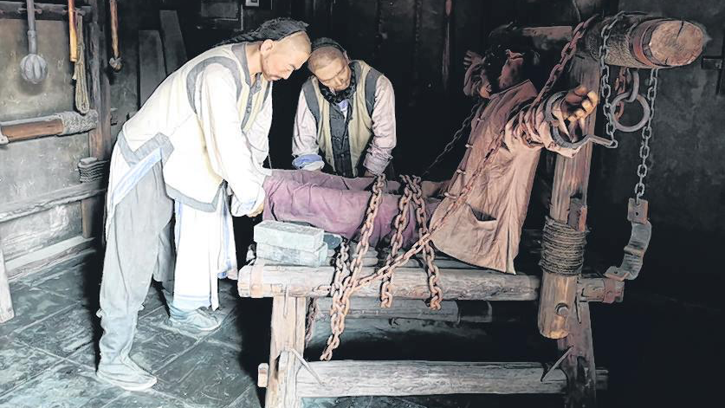

Slide 29
经历复活的大能
08
experience the power of the resurrection

Slide 30
我事奉永活救主
我事奉永活救主，祂今在世活着。 我知道祂确活着；无论人如何说； 但我亲见祂慈手，我闻祂安慰声， 每次当我需求祂，总在我旁。
救主 耶稣 今天仍然活着， 祂与我谈，祂伴我走，同行生命窄路。 我要传扬 主救恩到万邦， 我要高举主的圣名，因主耶稣救我。

Slide 31
