Slide 1
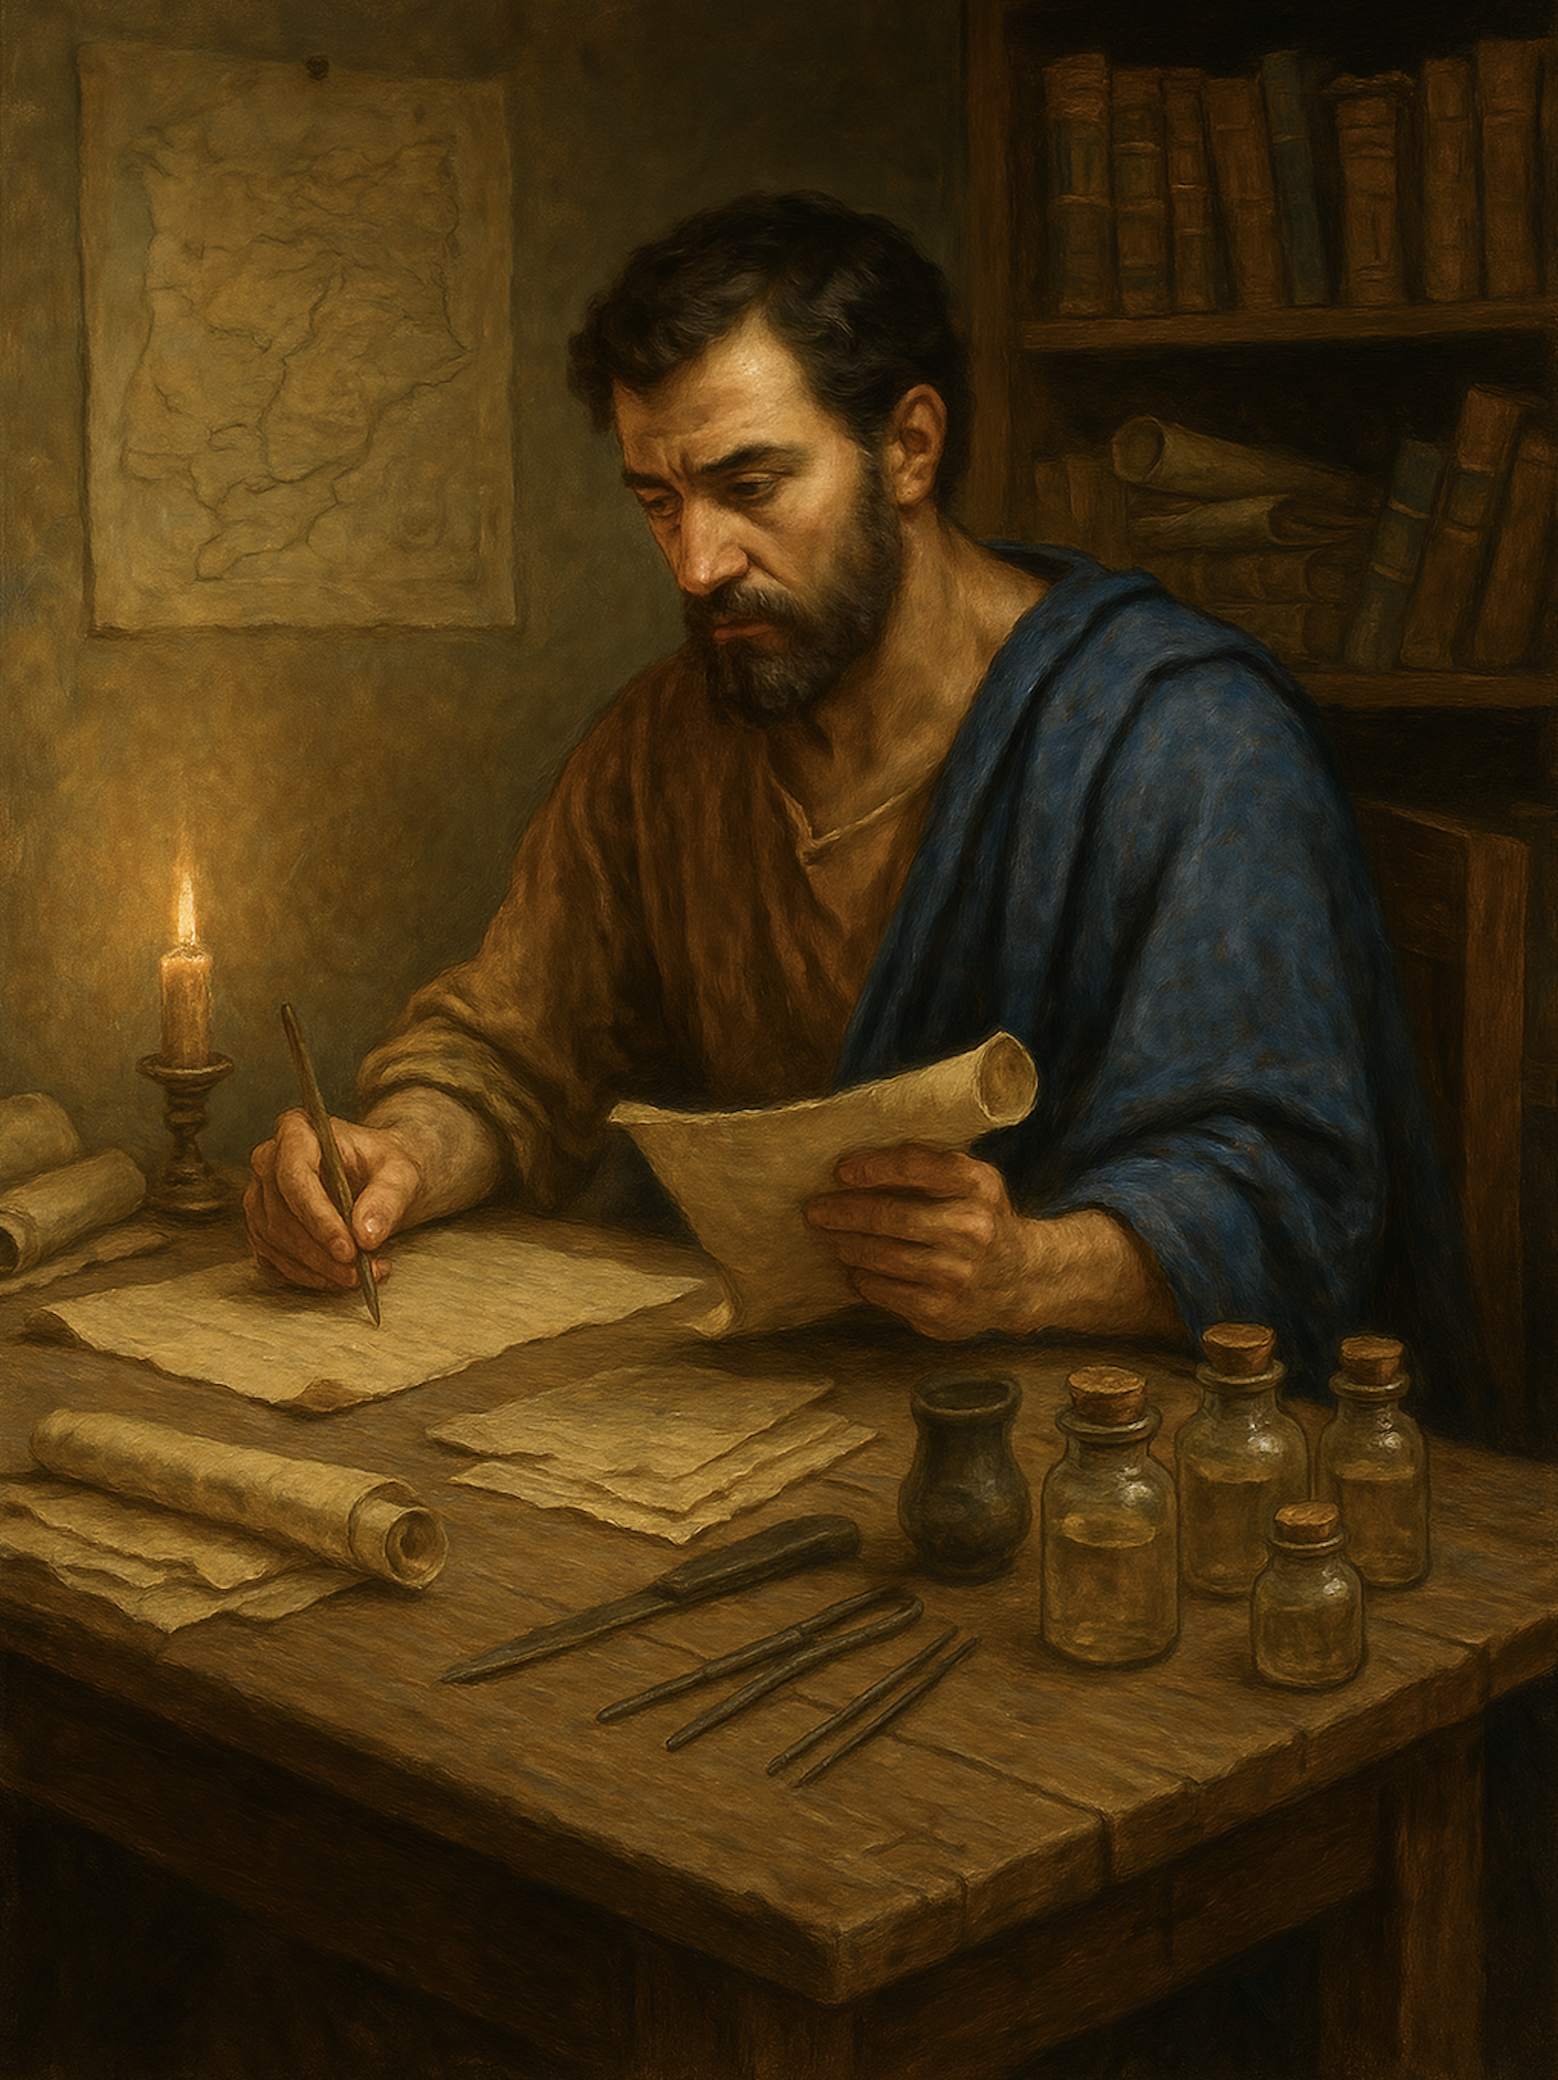
路加福音
Gospel of Luke
  21 赦罪的权柄
  路 5章17至26
  The Authority to Forgive Sins — Luke 5:17–26

Slide 2




Slide 3
路 5:17.有一天，耶稣正在教导人，法利赛人和律法教师也坐在那里，他们是从加利利和犹太各乡村，并耶路撒冷来的；主的能力与他同在，叫他能医病。18.有人用床抬着一个瘫子，想送进去，放在耶稣跟前。19.因为人多，没有办法进去，就上了房顶，从瓦间把瘫子和床往当中缒下去，正在耶稣跟前。20.他看见他们的信心，就说：“朋友，你的罪赦了。”
Luke 5:117.On one of those days, as he was teaching, Pharisees and teachers of the law were sitting there, who had come from every village of Galilee and Judea and from Jerusalem. And the power of the Lord was with him to heal. 18.And behold, some men were bringing on a bed a man who was paralyzed, and they were seeking to bring him in and lay him before Jesus,19.but finding no way to bring him in, because of the crowd, they went up on the roof and let him down with his bed through the tiles into the midst before Jesus.20.And when he saw their faith, he said, "Man, your sins are forgiven you."
1/2

Slide 4
21.经学家和法利赛人就议论起来，说：“这人是谁，竟然说僭jiàn妄的话？除神一位以外，谁能赦罪呢？”22.耶稣知道他们的议论，就对他们说：“你们心里为甚么议论呢？23.说：‘你的罪赦了’，或说：‘起来行走’，哪一样容易呢？24.然而为了要你们知道，人子在地上有赦罪的权柄，我吩咐你，起来，拿起你的床，回家去吧。”25.那人立刻当众起来，拿着他躺过的床，颂赞神，回家去了。26.众人都惊奇，颂赞神，并且十分惧怕，说：“我们今天看见了不平常的事。”
21.And the scribes and the Pharisees began to question, saying, "Who is this who speaks blasphemies? Who can forgive sins but God alone?"22.When Jesus perceived their thoughts, he answered them, "Why do you question in your hearts? 23.Which is easier, to say, 'Your sins are forgiven you,' or to say, 'Rise and walk'?24.But that you may know that the Son of Man has authority on earth to forgive sins" —he said to the man who was paralyzed— "I say to you, rise, pick up your bed and go home."25.And immediately he rose up before them and picked up what he had been lying on and went home, glorifying God.26.And amazement seized them all, and they glorified God and were filled with awe, saying, "We have seen extraordinary things today."
2/2

Slide 5
01
不顾代价的信心
Faith That Spares No Cost.

Slide 6
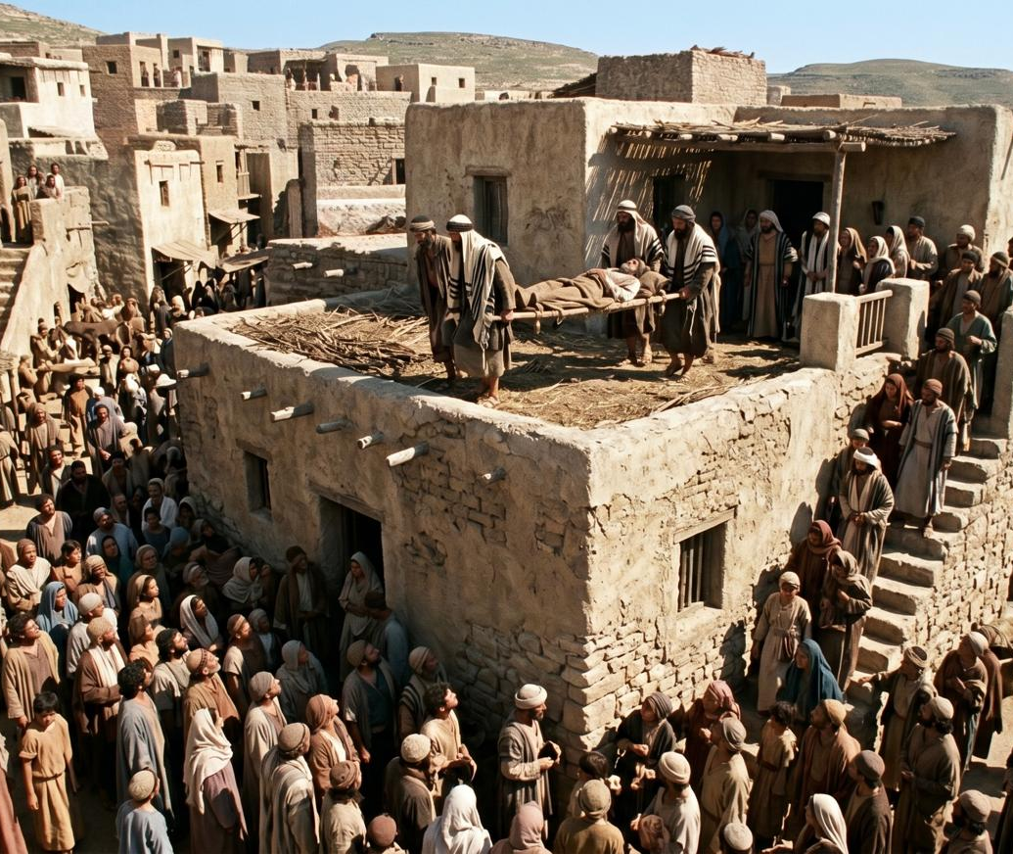
路 5:19.因为人多，没有办法进去，就上了房顶，从瓦间把瘫子和床往当中缒下去，正在耶稣跟前。 20.他看见他们的信心。。。
(可2:4 拆了房顶)
Luke 5:19.but finding no way to bring him in, because of the crowd, they went up on the roof and let him down with his bed through the tiles into the midst before Jesus. 20.And when he saw their faith, 。。。
(Mark 2:4 — They Removed the Roof)

Slide 7
02
信主耶稣，罪得赦免
Believe in the Lord Jesus, and Your Sins Will Be Forgiven

Slide 8
20.他看见他们的信心，就说:“朋友，你的罪(复数）赦了。”
20.And when he saw their faith, he said, "Man, your sins are forgiven you."

Slide 9
徒10:43.
所有先知都为他作见证：所有信他的，都必借着他的名，罪得赦免。
Acts 10:43. To him all the prophets bear witness that everyone who believes in him receives forgiveness of sins through his name."

Slide 10
03
人子在地上有赦免的权柄
The Son of Man Has Authority on Earth to Forgive Sins

Slide 11
21.经学家和法利赛人就议论起来，说：“这人是谁，竟然说僭jiàn妄的话？除神一位以外，谁能赦罪呢？”22.耶稣知道他们的议论，就对他们说：“你们心里为甚么议论呢？23.说：‘你的罪赦了’，或说：‘起来行走’，哪一样容易呢？24.然而为了要你们知道，人子在地上有赦罪的权柄，我吩咐你，起来，拿起你的床，回家去吧。”25.那人立刻当众起来，拿着他躺过的床，颂赞神，回家去了。26.众人都惊奇，颂赞神，并且十分惧怕，说：“我们今天看见了不平常的事。”
21.And the scribes and the Pharisees began to question, saying, "Who is this who speaks blasphemies? Who can forgive sins but God alone?"22.When Jesus perceived their thoughts, he answered them, "Why do you question in your hearts? 23.Which is easier, to say, 'Your sins are forgiven you,' or to say, 'Rise and walk'?24.But that you may know that the Son of Man has authority on earth to forgive sins" —he said to the man who was paralyzed— "I say to you, rise, pick up your bed and go home."25.And immediately he rose up before them and picked up what he had been lying on and went home, glorifying God.26.And amazement seized them all, and they glorified God and were filled with awe, saying, "We have seen extraordinary things today."

Slide 12
哪一句更容易说？
Which statement is easier to say?
你的罪赦了
你起来行走
Your sins are forgiven
Rise and walk.

Slide 13
哪一件更容易做？
Which statement is easier to say?
你的罪赦了
你起来行走
Your sins are forgiven
Rise and walk.

Slide 14
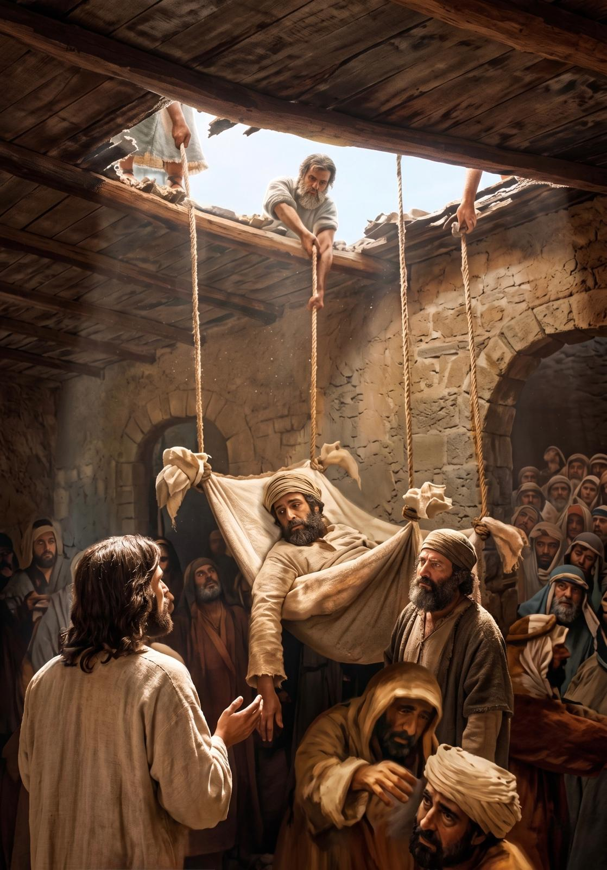
求主赐你：
信心相信、
朋友帮助你、
重新站起来。
May the Lord grant you faith to believe, friends to help you, and strength to rise again.

