Slide 1
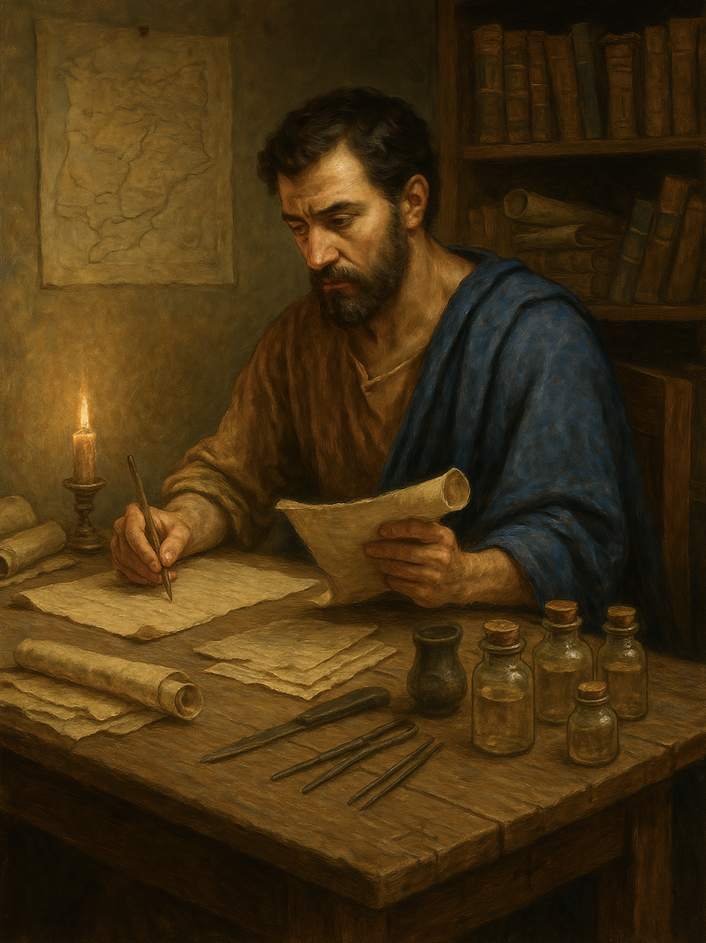
路加福音
Gospel of Luke
  22 耶稣召罪人悔改
  路5章27至31
  Jesus Calls Sinners to Repentance — Luke 5:27–31

Slide 2



你如何看待自己？ How you see yourself ?

Slide 3
路5:27事后，耶稣出去，看见一个税吏，名叫利未，坐在税关那里，就对他说：“来跟从我！”28他就撇下一切 ，起来跟从了耶稣。29利未在自己家里，为他大摆筵席 ，有许多税吏和别的人一起吃饭 。30法利赛人和经学家埋怨他的门徒，说：“你们为甚么跟税吏和罪人 一起吃喝呢？”31耶稣回答：“健康的人不需要医生，有病的人才需要。32我来不是要召义人，而是要召罪人悔改 。”
Luke 5:27.After this he went out and saw a tax collector named Levi, sitting at the tax booth. And he said to him, "Follow me." 28.And leaving everything, he rose and followed him.29.And Levi made him a great feast in his house, and there was a large company of tax collectors and others reclining at table with them.30.And the Pharisees and their scribes grumbled at his disciples, saying, "Why do you eat and drink with tax collectors and sinners?"31.And Jesus answered them, "Those who are well have no need of a physician, but those who are sick.32.I have not come to call the righteous but sinners to repentance."

Slide 4
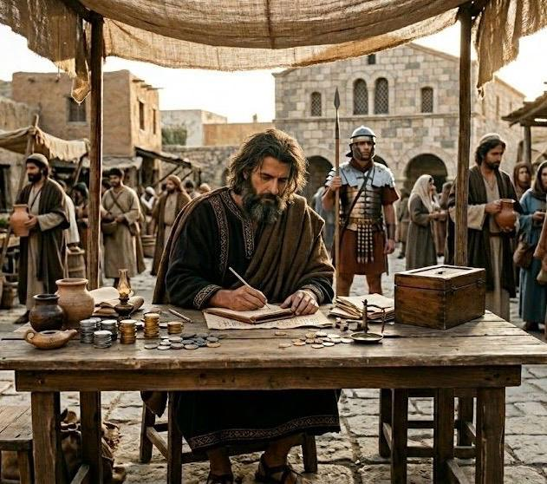
利未，又名马太（太9:9）
是一名税吏。
十二使徒之一，马太福音的作者
Levi, also known as Matthew, (Matthew 9:9)
was a tax collector.
One of the Twelve Apostles and the Author of the Gospel of Matthew.

Slide 5
01
耶稣召罪人
Jesus Calls Sinners.

Slide 6
路5:27事后，耶稣出去，看见一个税吏，名叫利未，坐在税关那里，就对他说：“来跟从我！”28他就撇下一切 ，起来跟从了耶稣。
Luke 5:27.After this he went out and saw a tax collector named Levi, sitting at the tax booth. And he said to him, "Follow me." 28.And leaving everything, he rose and followed him.

Slide 7
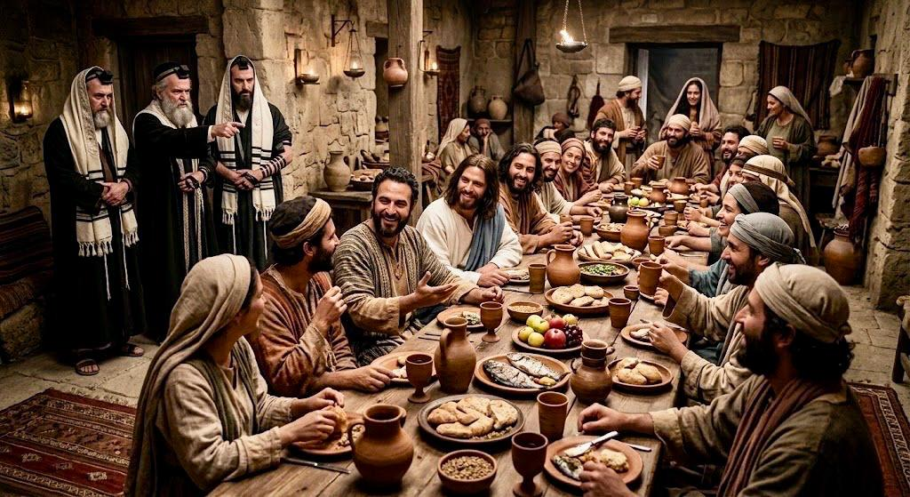
29利未在自己家里，为他大摆筵席，有许多税吏和别的人一起吃饭。
29.And Levi made him a great feast in his house, and there was a large company of tax collectors and others reclining at table with them.

Slide 8
02
两种不同的圣洁
Two Different Kinds of Holiness

Slide 9
法利赛人的圣洁：(太23:27-28、路18:9-12)
The Holiness of the Pharisees: (Matthew 23:27–28; Luke 18:9–12)

Slide 10
法利赛人的圣洁：(太23:27-28、路18:9-12)
The Holiness of the Pharisees: (Matthew 23:27–28; Luke 18:9–12)
路 18:11 法利赛人站著，自言自语的祷告说：『神啊，我感谢你，我不像别人勒索、不义、奸淫，也不像这个税吏。12 我一个礼拜禁食两次，凡我所得的都捐上十分之一。』
Luke 18:11.The Pharisee, standing by himself, prayed thus: 'God, I thank you that I am not like other men, extortioners, unjust, adulterers, or even like this tax collector. 12. I fast twice a week; I give tithes of all that I get.'

Slide 11
法利赛人的圣洁：(太23:27-28、路18:9-12)
The Holiness of the Pharisees: (Matthew 23:27–28; Luke 18:9–12)
（1）属灵的骄傲、自义
Spiritual Pride and Self-Righteousness
（2）论断人
Judging Others

Slide 12
30法利赛人和经学家埋怨他的门徒，说：“你们为甚么跟税吏和罪人 一起吃喝呢？”
30.And the Pharisees and their scribes grumbled at his disciples, saying, "Why do you eat and drink with tax collectors and sinners?"

Slide 13
法利赛人的圣洁：(太23:27-28、路18:9-12)
The Holiness of the Pharisees: (Matthew 23:27–28; Luke 18:9–12)
（1）属灵的骄傲、自义
Spiritual Pride and Self-Righteousness
（2）论断人
Judging Others
（3）无怜悯之心
Lack of Compassion and Mercy

Slide 14
雅4:6
...所以经上说：神阻挡骄傲的人，赐恩给谦卑的人。
James 4:6....it says, "God opposes the proud but gives grace to the humble."

Slide 15
税吏马太的圣洁
The Holiness of the Matthew the tax collector
（1）属灵的谦卑
Spiritual Humility
（2）不论断人
Not Judging Others
（3）有怜悯之心
Shows Compassion and Mercy

Slide 16
03
有病的人才有需要
Those Who Are Sick Are the Ones in Need

Slide 17
31 耶稣回答：“健康的人不需要医生，有病的人才需要。32 我来不是要召义人，而是要召罪人悔改 。”
31.And Jesus answered them, "Those who are well have no need of a physician, but those who are sick.32.I have not come to call the righteous but sinners to repentance."

Slide 18
诗篇 34:8.
你们要尝尝主恩的滋味，便知道他是美善；投靠他的人有福了！。
Psalms 34:8.
Oh, taste and see that the Lord is good! Blessed is the man who takes refuge in him!

