Slide 1
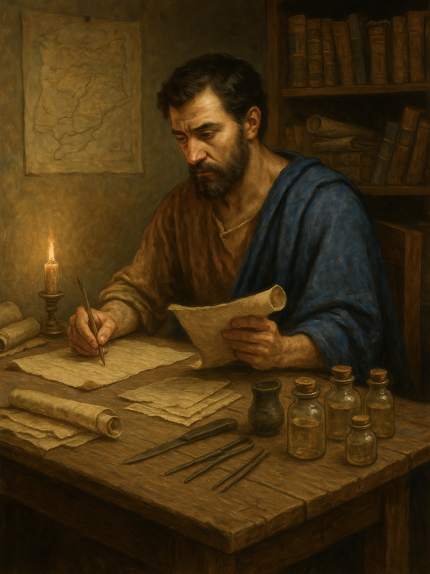
路加福音
Gospel of Luke
  23 不要让旧传统与思维拦阻你
  路5章33至39
  Do not let old traditions and ways of thinking hinder you Luke 5:33–39

Slide 2
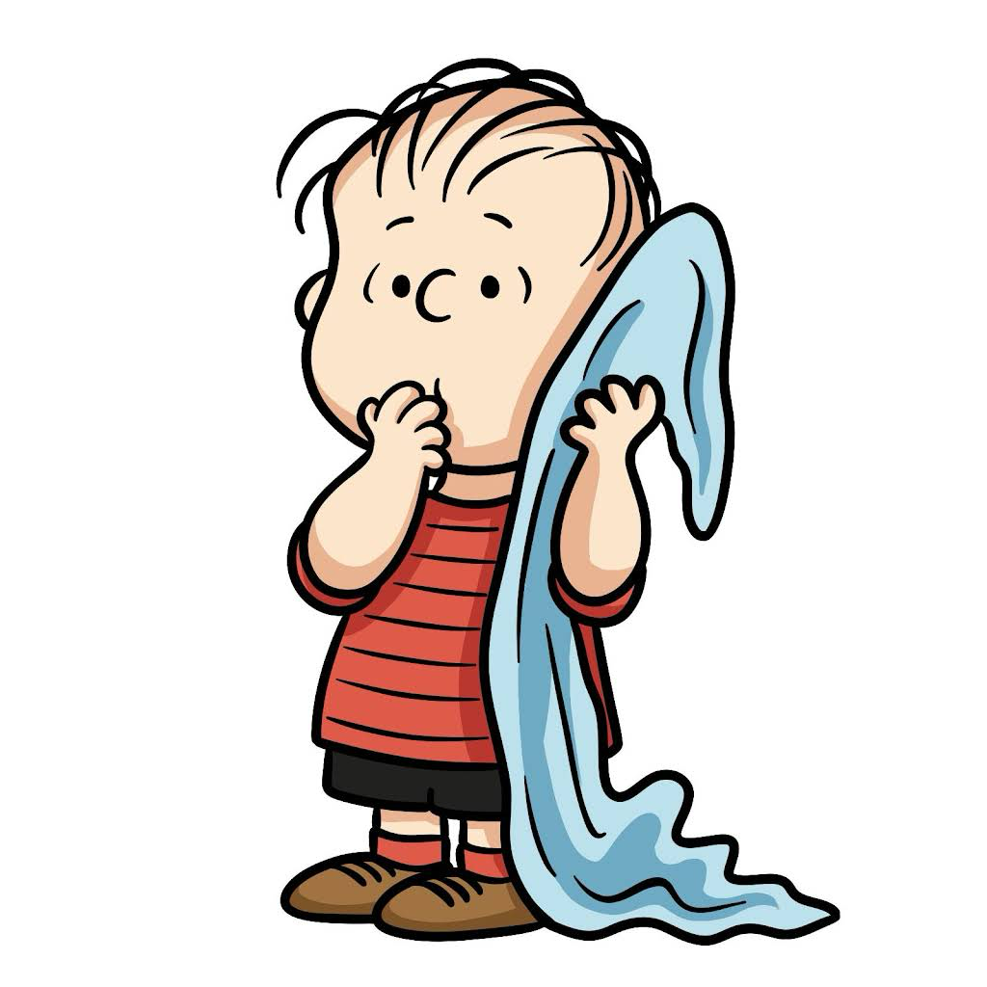
莱纳斯（Linus），著名漫画《花生漫画》（Peanuts）。

Slide 3
路5:33.他们说：“约翰的门徒常常禁食、祈祷，法利赛人的门徒也是这样，而你的门徒却又吃又喝。”34.耶稣说：“新郎跟宾客在一起的时候，你们怎么可以叫宾客禁食呢？35.但日子到了，新郎要被取去，离开他们，那一天他们就要禁食了。”36.他又对他们设个比喻说：“没有人会从新衣服撕下一块布，补在旧衣服上，如果这样，不但新衣服撕破了，而且新撕下的布，也和旧的不调和。37.也没有人会把新酒装在旧皮袋里；如果这样，新酒就会把皮袋胀破，不但酒漏掉，皮袋也损坏了；38.人总是把新酒装在新皮袋里。39.喝惯陈酒的人，就不想喝新酒，他总说陈的好。”
Luke 5:33.And they said to him, "The disciples of John fast often and offer prayers, and so do the disciples of the Pharisees, but yours eat and drink." 34.And Jesus said to them, "Can you make wedding guests fast while the bridegroom is with them?35.The days will come when the bridegroom is taken away from them, and then they will fast in those days."36.He also told them a parable: "No one tears a piece from a new garment and puts it on an old garment. If he does, he will tear the new, and the piece from the new will not match the old.37.And no one puts new wine into old wineskins. If he does, the new wine will burst the skins and it will be spilled, and the skins will be destroyed.38.But new wine must be put into fresh wineskins.39.And no one after drinking old wine desires new, for he says, 'The old is good.'"

Slide 4
背景
Context.

Slide 5
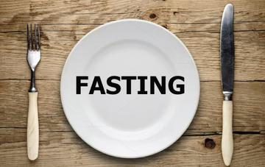
禁食是为了专心寻求神、谦卑自己，暂时停止进食
Fasting is for the purpose of seeking God with undivided devotion and humbling oneself by temporarily abstaining from food

Slide 6
禁食 Fasting
（1）哀痛 Mourning
（2）认罪悔改 Confession and repentance
（3）危难时 In times of crisis
（4）神面前谦卑自己 Humbling oneself before God
（5）寻求主、亲近主 Seek the Lord and drawing near to Him

Slide 7
路5:33.
他们说：“约翰的门徒常常禁食、祈祷，法利赛人的门徒也是这样，而你的门徒却又吃又喝。”
Luke 5:33.And they said to him, "The disciples of John fast often and offer prayers, and so do the disciples of the Pharisees, but yours eat and drink."

Slide 8
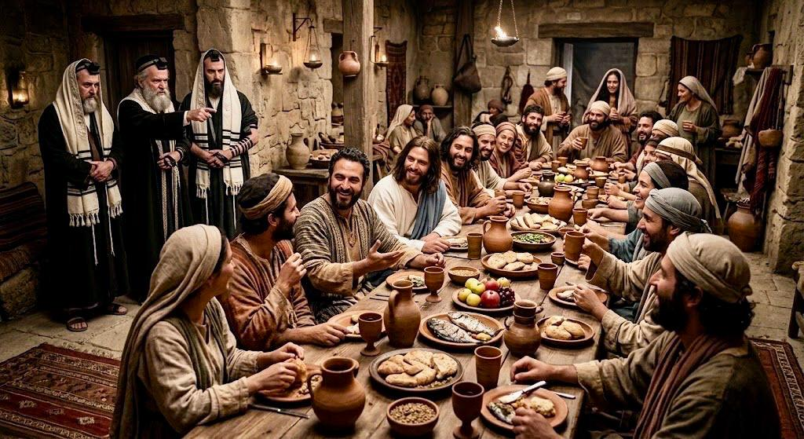
29利未在自己家里，为他大摆筵席，有许多税吏和别的人一起吃饭。
29.And Levi made him a great feast in his house, and there was a large company of tax collectors and others reclining at table with them.

Slide 9
01
从耶稣的回复认识祂是谁
Recognize Who Jesus Is Through His Response

Slide 10
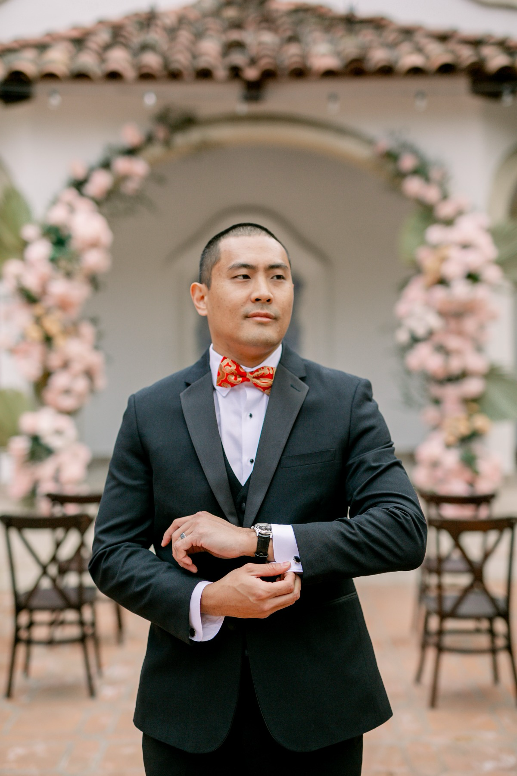
34.耶稣说：“新郎跟宾客在一起的时候，你们怎么可以叫宾客禁食呢？35.但日子到了，新郎要被取去，离开他们，那一天他们就要禁食了。”
34.And Jesus said to them, "Can you make wedding guests fast while the bridegroom is with them?

Slide 11
上帝爱百姓，经常比喻自己是丈夫
God loves His people and often portrays Himself as their husband.
赛54:5 因为造你的，就是你的丈夫；万军之耶和华是他的名；救赎你的，就是以色列的圣者；他被称为全地的上帝。
Isaiah 54:5. For your Maker is your husband, the Lord of hosts is his name; and the Holy One of Israel is your Redeemer, the God of the whole earth he is called.

Slide 12
35.但日子到了，新郎要被取去，离开他们，那一天他们就要禁食了。
35.The days will come when the bridegroom is taken away from them, and then they will fast in those days."

Slide 13
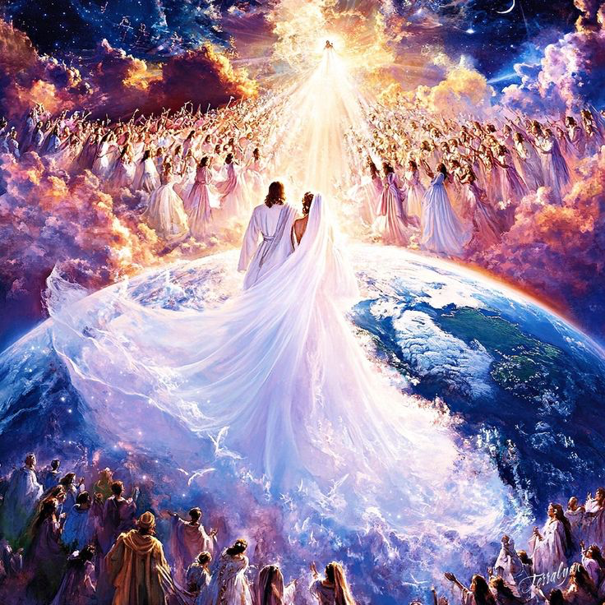
启 19:7 我们要欢喜快乐，把荣耀归给他！因为羊羔的婚期到了；他的新娘也自己预备好了。
Revelation 19:7.Let us rejoice and exult and give him the glory, for the marriage of the Lamb has come, and his Bride has made herself ready;

Slide 14
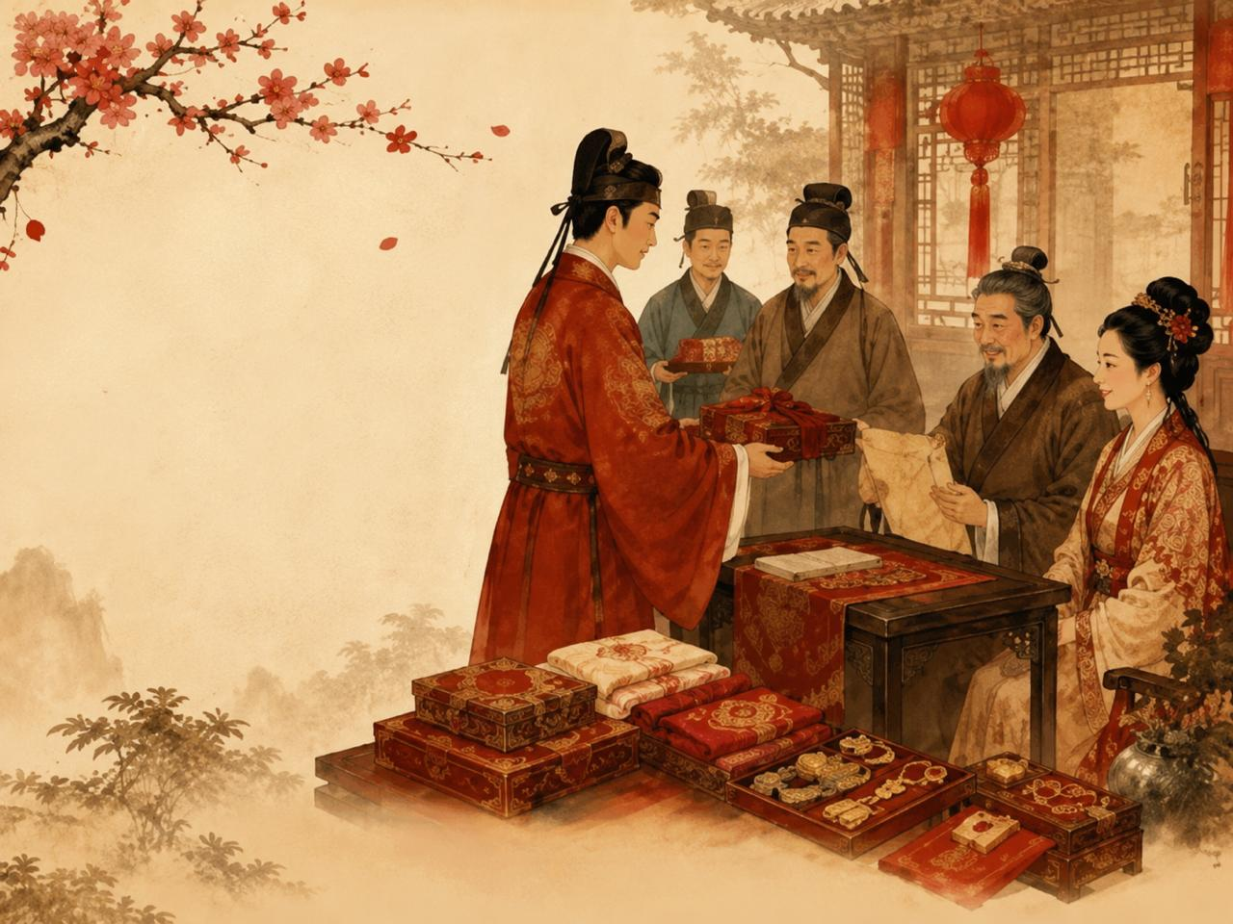
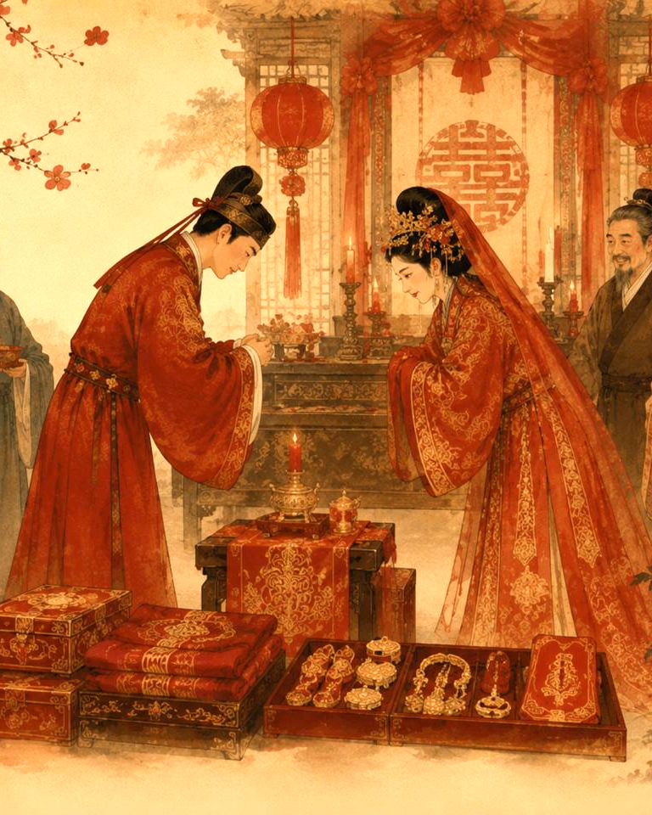
订婚 Betrothal（Erusin）
婚宴 Wedding（Nissuin）

Slide 15
02
新与旧原不相配
The new and the old are inherently incompatible.

Slide 16
36.他又对他们设个比喻说：“没有人会从新衣服撕下一块布，补在旧衣服上，如果这样，不但新衣服撕破了，而且新撕下的布，也和旧的不调和。37.也没有人会把新酒装在旧皮袋里；如果这样，新酒就会把皮袋胀破，不但酒漏掉，皮袋也损坏了；38.人总是把新酒装在新皮袋里。
36.He also told them a parable: "No one tears a piece from a new garment and puts it on an old garment. If he does, he will tear the new, and the piece from the new will not match the old.37.And no one puts new wine into old wineskins. If he does, the new wine will burst the skins and it will be spilled, and the skins will be destroyed.38.But new wine must be put into fresh wineskins.

Slide 17
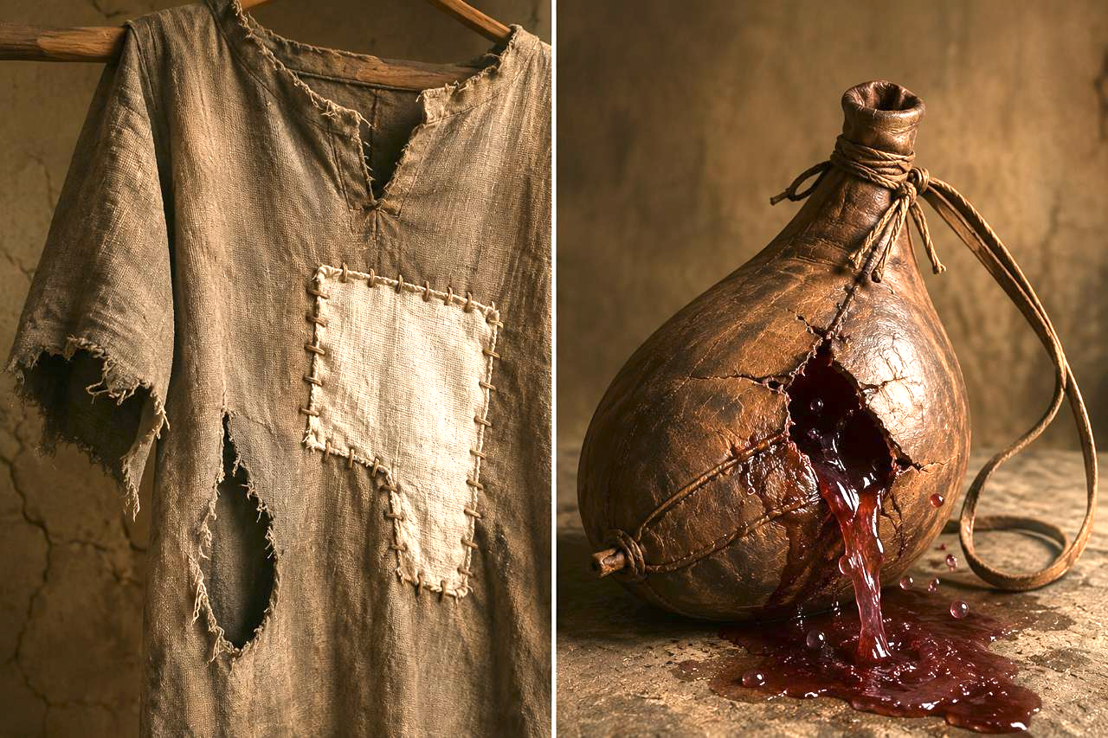
新酒装在旧皮袋里
new wine into old wineskins
新衣服补旧衣服
new garment and puts it on an old garment
破掉
破掉

Slide 18
新与旧放在一起
Combining the new with the old.
1 新与旧的不调和
the new will not match the old
2 旧的会因新的破掉
The old is torn by the new.
3 没有人会这样做
No wise man will do so

Slide 19
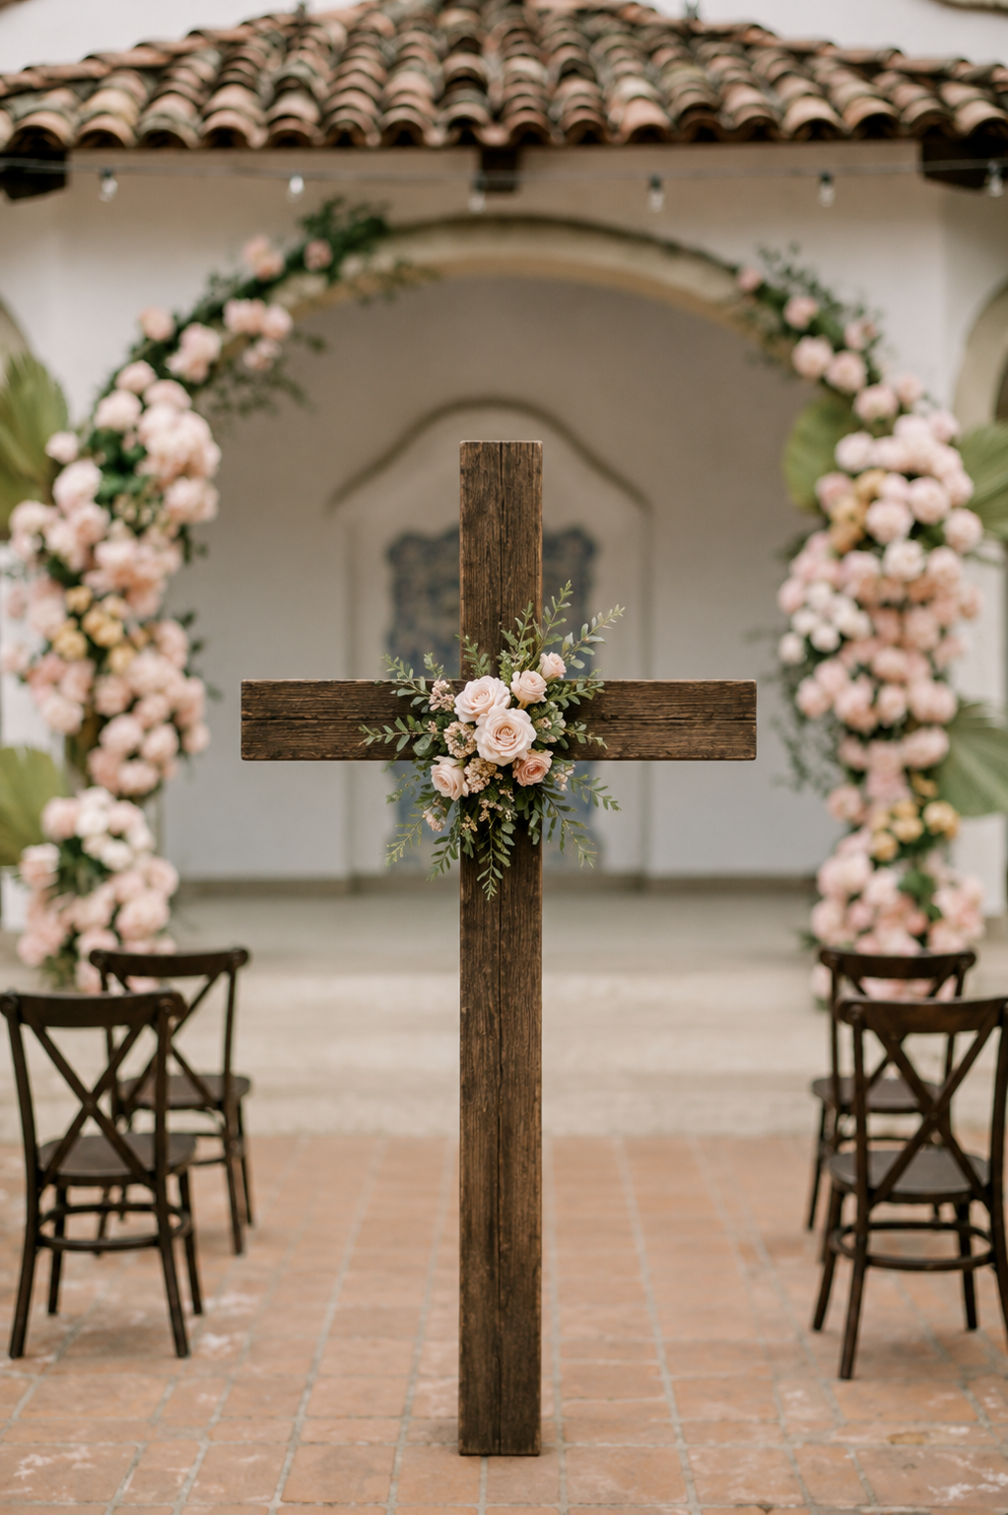
新郎来了！
The Bridegroom Has Come!
旧约
Old Covenant
新约
New Covenant
上帝来了！
God has come!

Slide 20
道德律
Moral Law
旧约的律法与诫命
The Old Testament Law and Commandments
民事律
Civil Law
礼仪律
Ceremonial Law

Slide 21
旧约的律法与诫命
The Old Testament Law and Commandments
民事律
Civil Law

Slide 22
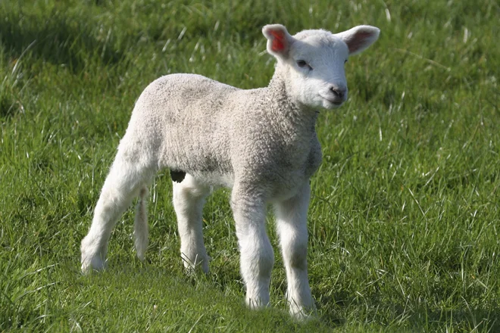
旧约的律法与诫命
The Old Testament Law and Commandments
民事律
Civil Law

Slide 23
旧约的律法与诫命
The Old Testament Law and Commandments
礼仪律
Ceremonial Law

Slide 24
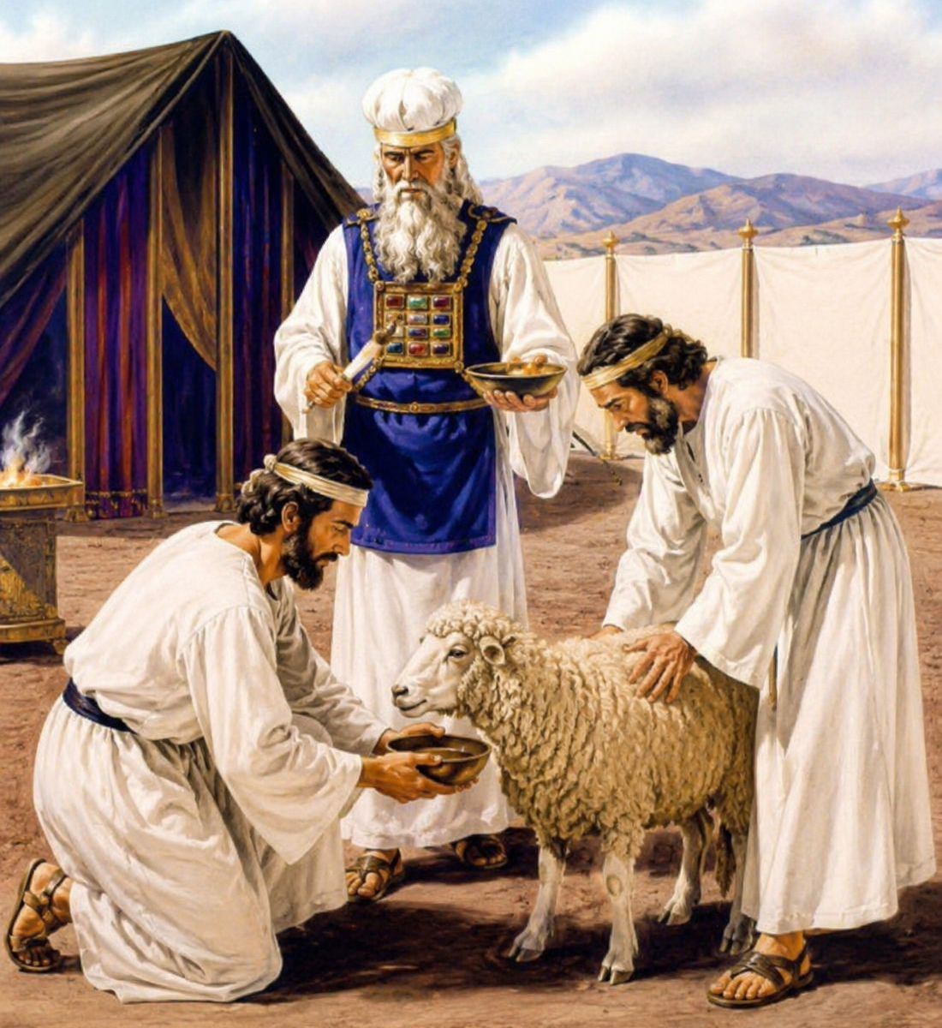
祭司献祭
Priest offer sacrifice
旧约的律法与诫命
The Old Testament Law and Commandments
礼仪律
Ceremonial Law

Slide 25
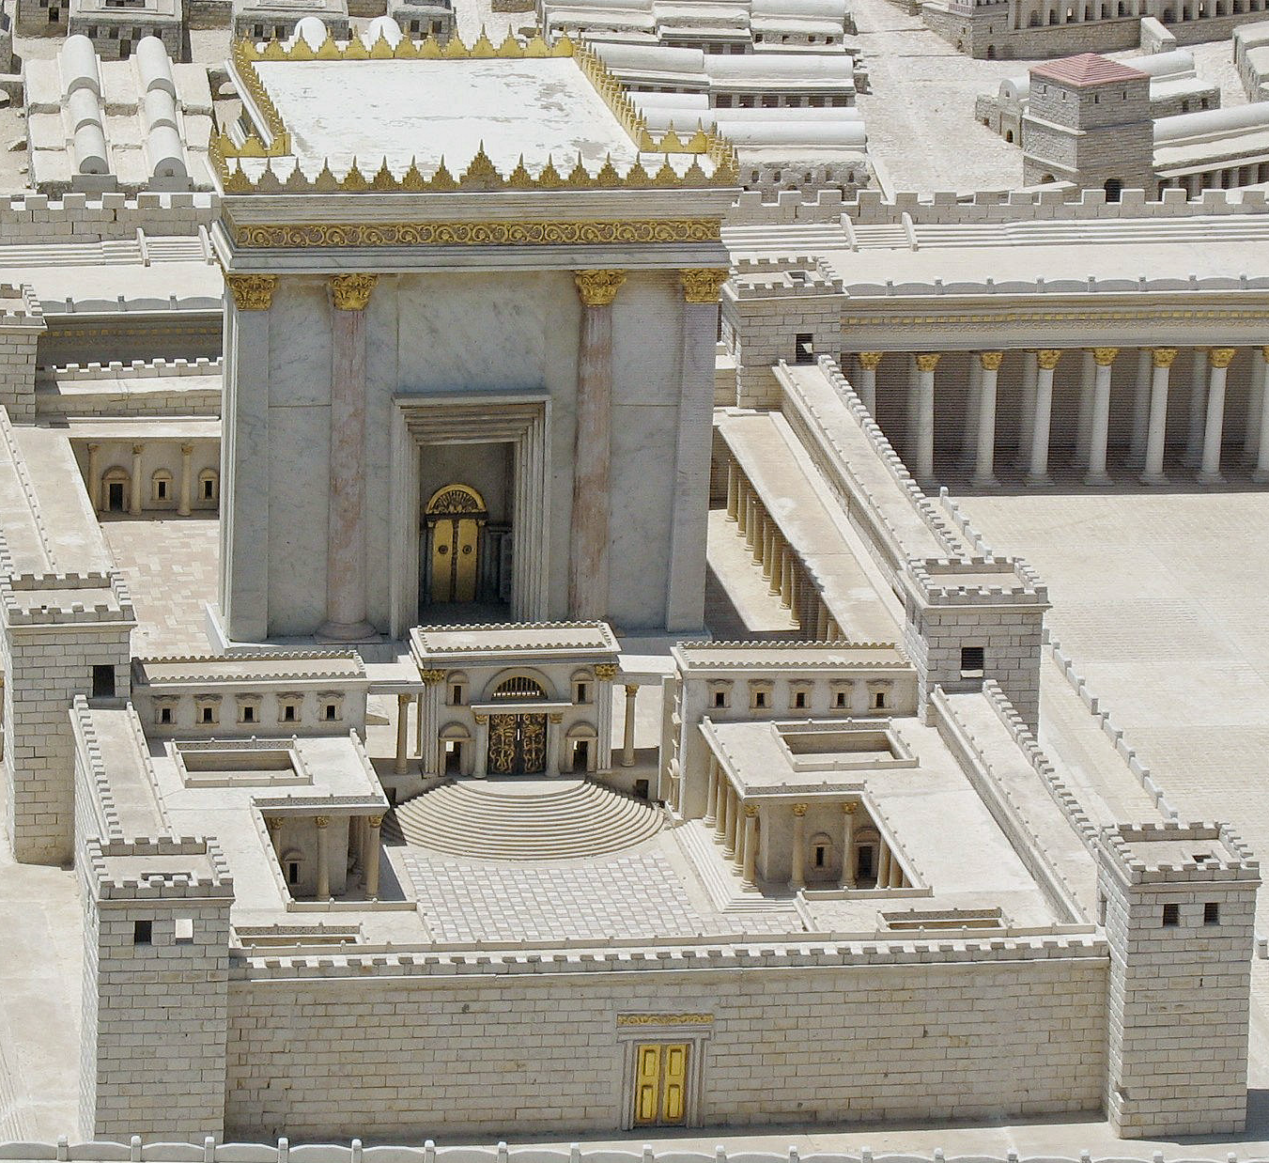
耶路撒冷圣殿
Jerusalem Temple
旧约的律法与诫命
The Old Testament Law and Commandments
礼仪律
Ceremonial Law

Slide 26
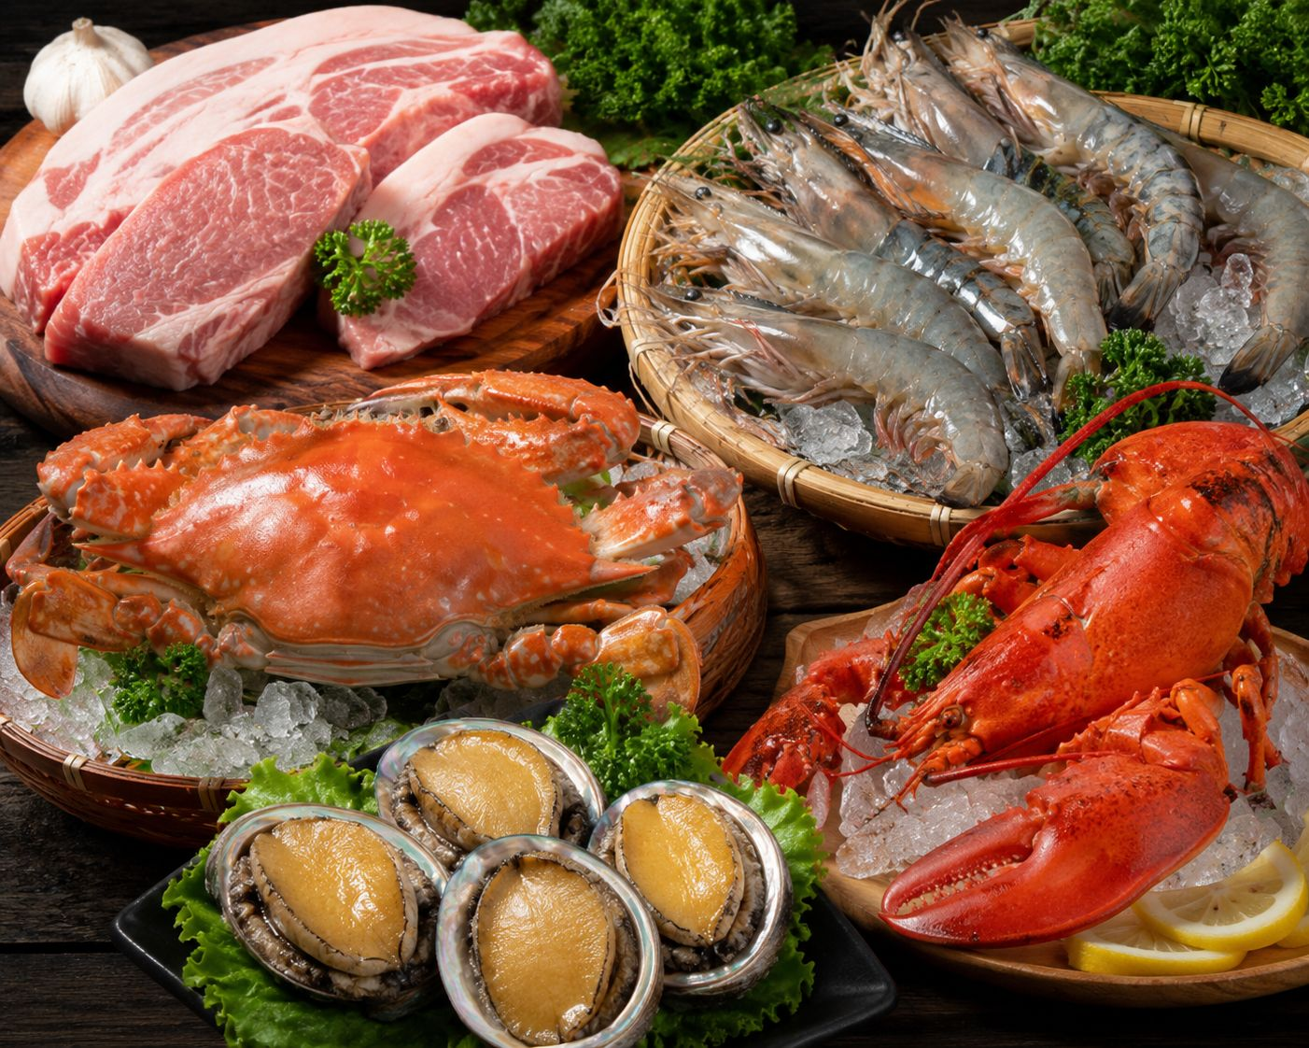
猪肉、虾、螃蟹、龙虾、鲍鱼Pork • Shrimp • Crab • Lobster • Abalone
旧约的律法与诫命
The Old Testament Law and Commandments
礼仪律
Ceremonial Law

Slide 27
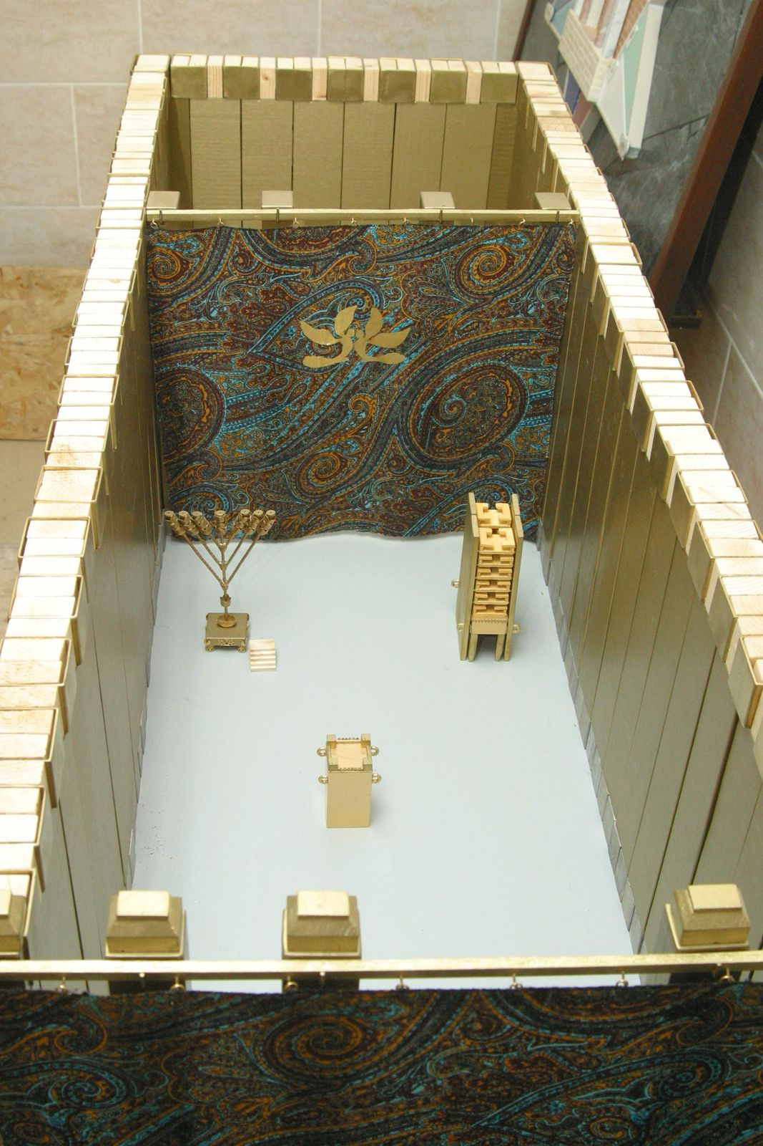
普通人不能进至圣所
Commoners cannot enter the Holy Place
旧约的律法与诫命
The Old Testament Law and Commandments
礼仪律
Ceremonial Law

Slide 28
道德、精神、原则是延续的，而礼仪律和民事律则改变了。
The moral, spiritual, and principial aspects are continuous, whereas the ceremonial and civil laws have changed.
道德律
Moral Law
旧约的律法与诫命
The Old Testament Law and Commandments
民事律
Civil Law
礼仪律
Ceremonial Law

Slide 29
39.喝惯陈酒的人，就不想喝新酒，他总说陈的好。
39.And no one after drinking old wine desires new, for he says, 'The old is good.'"

Slide 30
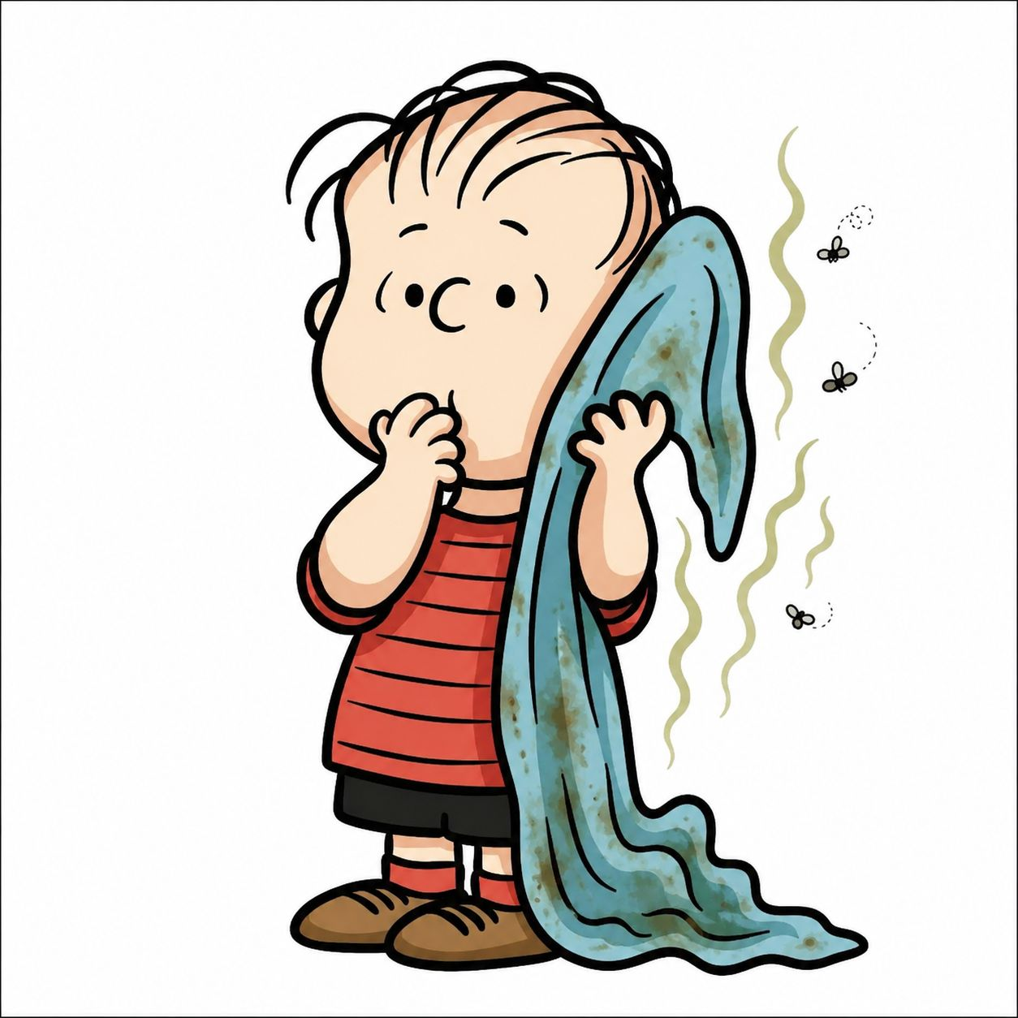

Slide 31
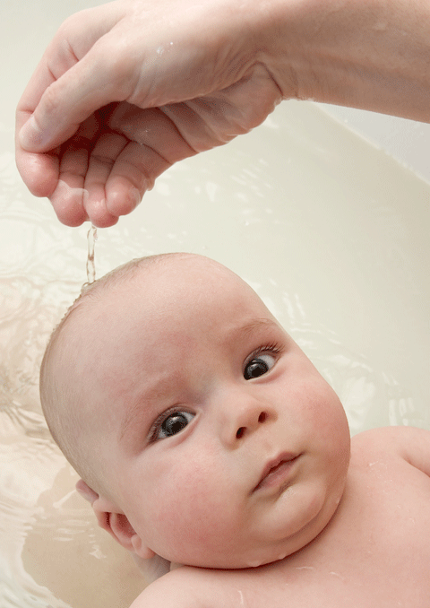
婴孩洗礼

Slide 32
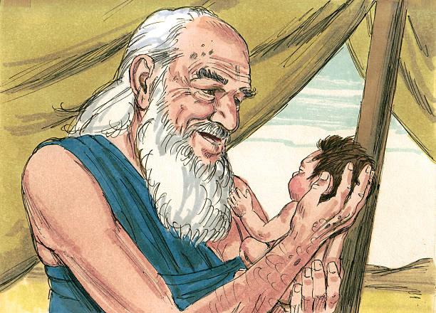
约中的记号
亚伯拉罕
为以撒行割礼
新约中的记号
我们
为孩子洗礼

Slide 33
旧与新的印记与记号，都同样指向孩子未来要因信主而被称义。
罗4:11 他领受了割礼为记号，作他受割礼之前因信称义的印证…

Slide 34
亚伯拉罕
为以撒行割礼
我们
为孩子洗礼
印记与记号不保证孩子长大后一定信主

Slide 35
父母亲的责任
教导孩子谨守上帝的约
创17:9 上帝又对亚伯拉罕说:“你和你世世代代的后裔都要谨守我的约。
不断的把孩子带到主前
路18:16 耶稣却叫他们过来，说:“让小孩子到我这里来，不要禁止他们，因为上帝的国正属于这样的人。
（路18:15-16; 太19:13-15；可10:13-16）

Slide 36
父母亲的责任
申 4:9 …总要把这些事传给你的子子孙孙，
弗 6:4 你们作父亲的，不要激怒儿女，却要照着主的教训和劝戒，养育他们。
问：你们是否愿意照上帝的吩咐教导儿女敬畏主？

Slide 37
劝勉
对父母的劝诫：
在上帝普遍的护理（providence）中，我们晓得多数不敬畏主的父母，因不按主的吩咐牧养儿女。儿女长大后，大多数成为背约弃主者。
对教会的劝诫：
教会有责任牧养、教导、关心孩子来认识主耶稣。

Slide 38
孩子：
上帝把我生在信徒家中！
我是基督徒！
我是上帝约中的子民！
我是教会的一份子！
你们（父母与教会）要教导我，使我长大后守约信主！

Slide 39
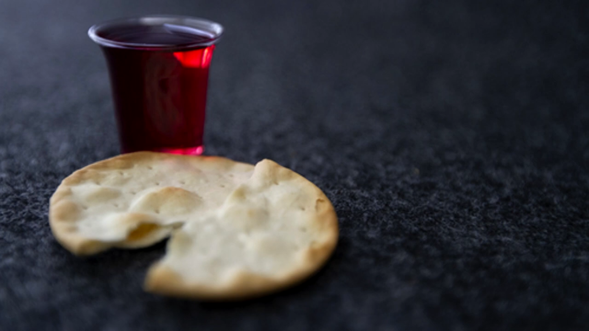
奇异恩典
圣餐

Slide 40
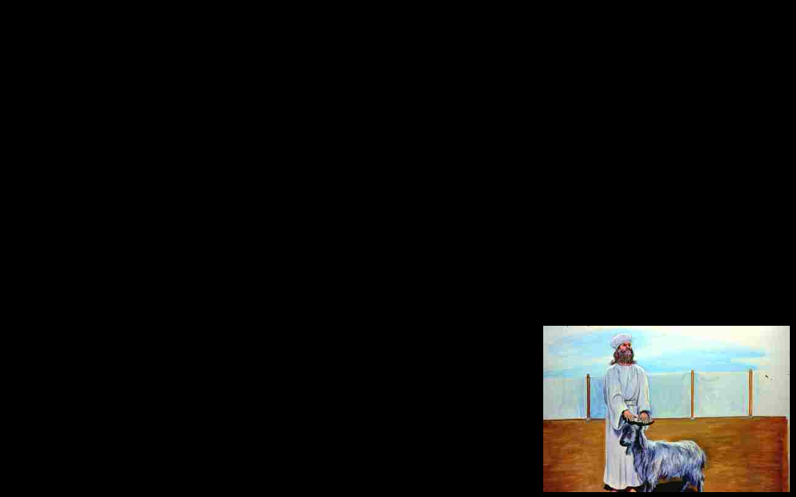
利16:21 亚伦两手按在那只活山羊头上，承认以色列人的一切罪孽和他们的过犯，就是他们一切罪孽。把它们都归在那山羊的头上；然后经由已预定的人，把羊送到旷野里去。22 那只山羊就担当他们的一切罪孽，...
lev 16:15 “Then he shall kill the goat of the sin offering that is for the people … 21 And Aaron shall lay both his hands on the head of the live goat, and confess over it all the iniquities of the people of Israel, and all their transgressions, all their sins. And he shall put them on the head of the goat and send it away into the wilderness by the hand of a man who is in readiness. 22The goat shall bear all their iniquities

