Slide 1
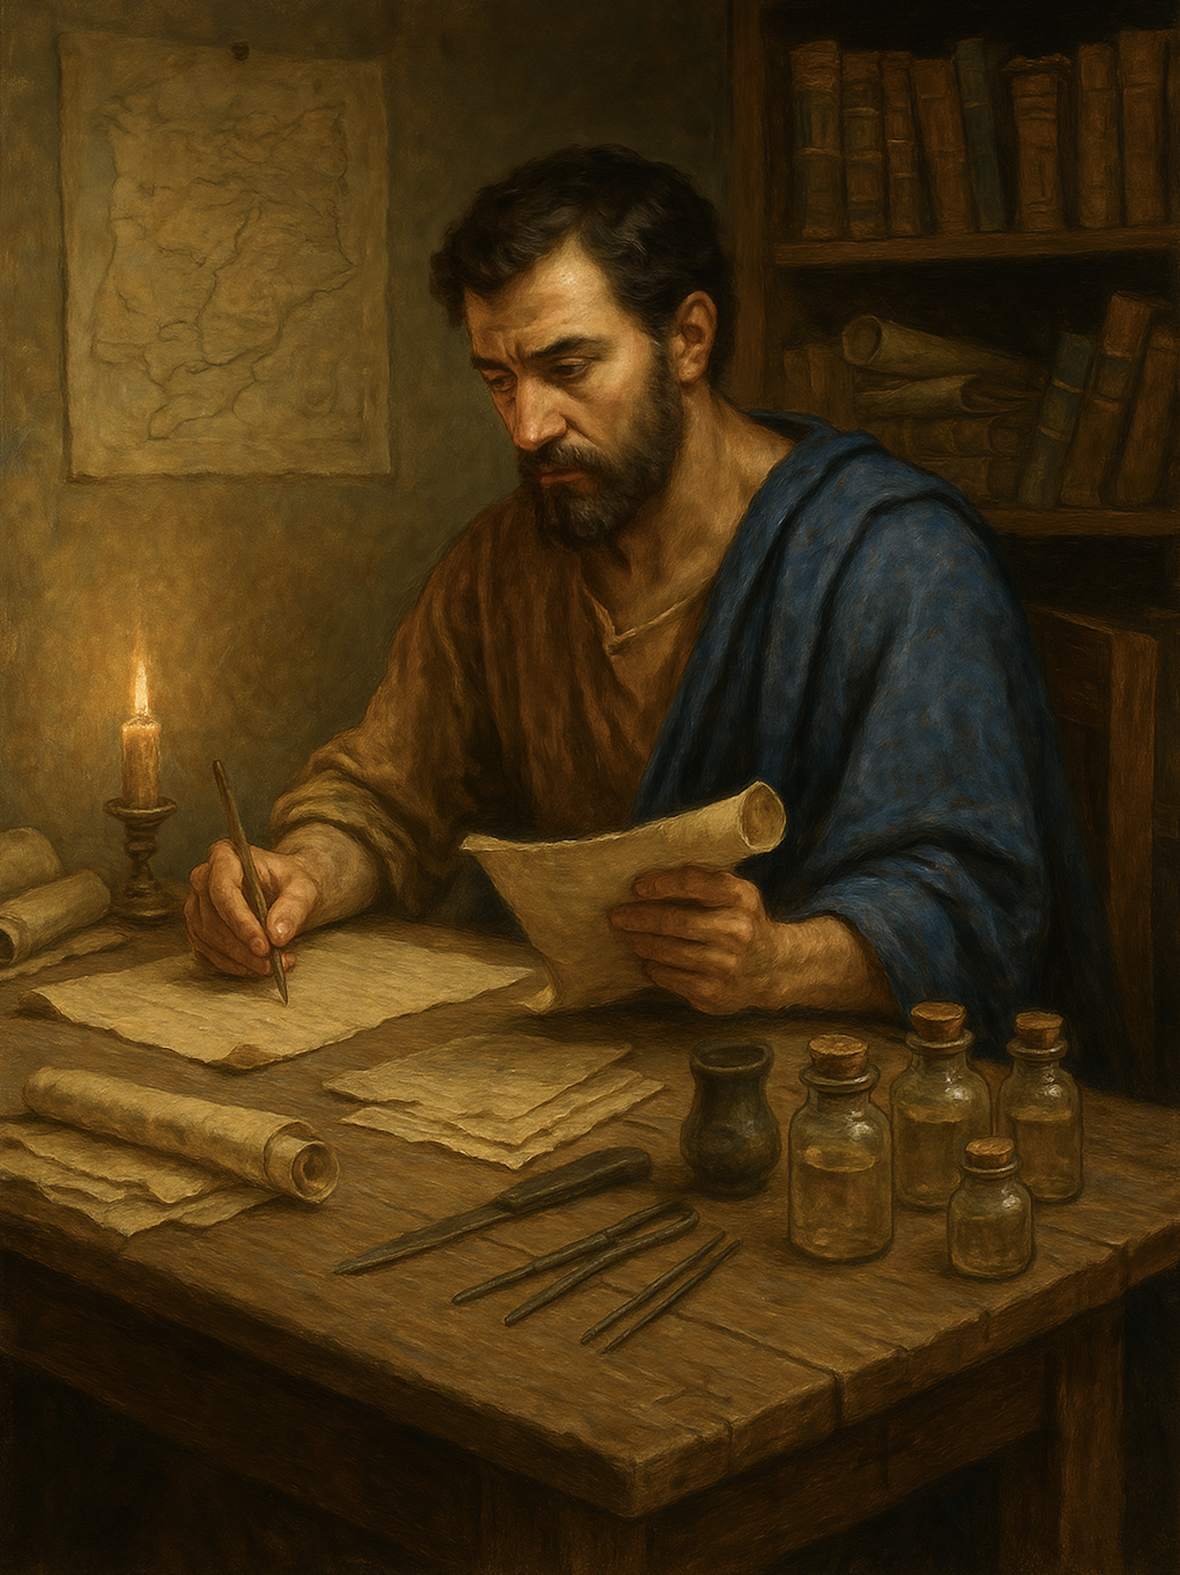
路加福音
Gospel of Luke
  24 误解与误用律法，反而伤害人
  路6章1至5、太12章1至8
  Misunderstanding and Misusing the Law, Causing Harm to People
  Luke 6:1–5; Matthew 12:1–8

Slide 2
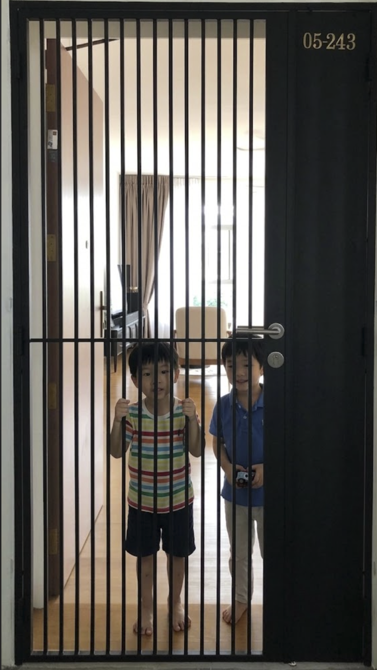
父母严厉地命令：“无论谁来了，不管是什么人，你们都不可以开门！！！”
The parents sternly commanded, “No matter who comes, regardless of who they are, you must not open the door!!!”

Slide 3
路 6:1 有一个安息日，耶稣从麦田经过，他的门徒摘了麦穗，用手搓着吃。2 有几个法利赛人说：“你们为什么作安息日不可作的事呢？”3 耶稣回答：“大卫和跟他在一起的人，在饥饿的时候所作的，你们没有念过吗？4 他不是进了上帝的殿，吃了陈设饼，也给跟他在一起的人吃吗？这饼除了祭司以外，别的人是不可以吃的。”5 他又对他们说：“人子是安息日的主。”
Luk 6:1 On a Sabbath, while he was going through the grainfields, his disciples plucked and ate some heads of grain, rubbing them in their hands.2 But some of the Pharisees said, “Why are you doing what is not lawful to do on the Sabbath?”3 And Jesus answered them, “Have you not read what David did when he was hungry, he and those who were with him:4 how he entered the house of God and took and ate the bread of the Presence, which is not lawful for any but the priests to eat, and also gave it to those with him?”5 And he said to them, “The Son of Man is lord of the Sabbath.”

Slide 4
01
指控门徒违背神的诫命
Accusing the Disciples of Breaking God’s Commandments

Slide 5
路 6:1 有一个安息日，耶稣从麦田经过，他的门徒摘了麦穗，用手搓着吃。2 有几个法利赛人说：“你们为什么作安息日不可作的事呢？”
Luk 6:1 On a Sabbath, while he was going through the grainfields, his disciples plucked and ate some heads of grain, rubbing them in their hands.2 But some of the Pharisees said, “Why are you doing what is not lawful to do on the Sabbath?”

Slide 6
出 35:2
六日要作工,第七日乃为圣日,当向耶和华守为安息圣日;凡这日之内作工的，必把他治死。
Exo 35:2 Six days work shall be done, but on the seventh day you shall have a Sabbath of solemn rest, holy to the LORD. Whoever does any work on it shall be put to death.

Slide 7
02
主引用旧约个案来反驳
The Lord cited an Old Testament case to refute them.

Slide 8
3 耶稣回答：“大卫和跟他在一起的人，在饥饿的时候所作的，你们没有念过吗？4 他不是进了上帝的殿，吃了陈设饼，也给跟他在一起的人吃吗？这饼除了祭司以外，别的人是不可以吃的。”
3 And Jesus answered them, “Have you not read what David did when he was hungry, he and those who were with him:4 how he entered the house of God and took and ate the bread of the Presence, which is not lawful for any but the priests to eat, and also gave it to those with him?”

Slide 9
规范 Normative
（唯独祭司可以吃）
(only priests could eat)
内在（动机）
Existential (motives)
（大卫为活命、大祭司怜悯大卫）
(David to survive; the high priest showed him mercy)
处境 situational
（没有别的饼）
(no other bread)

Slide 10
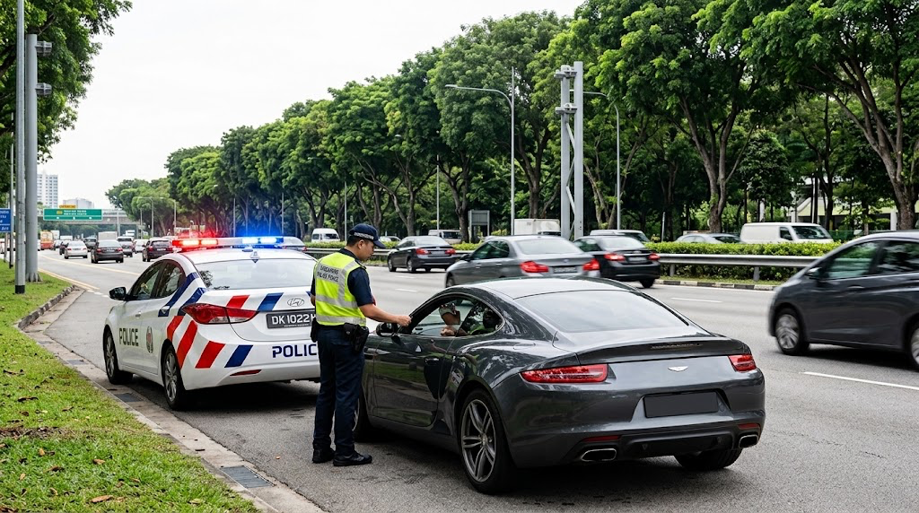

Slide 11
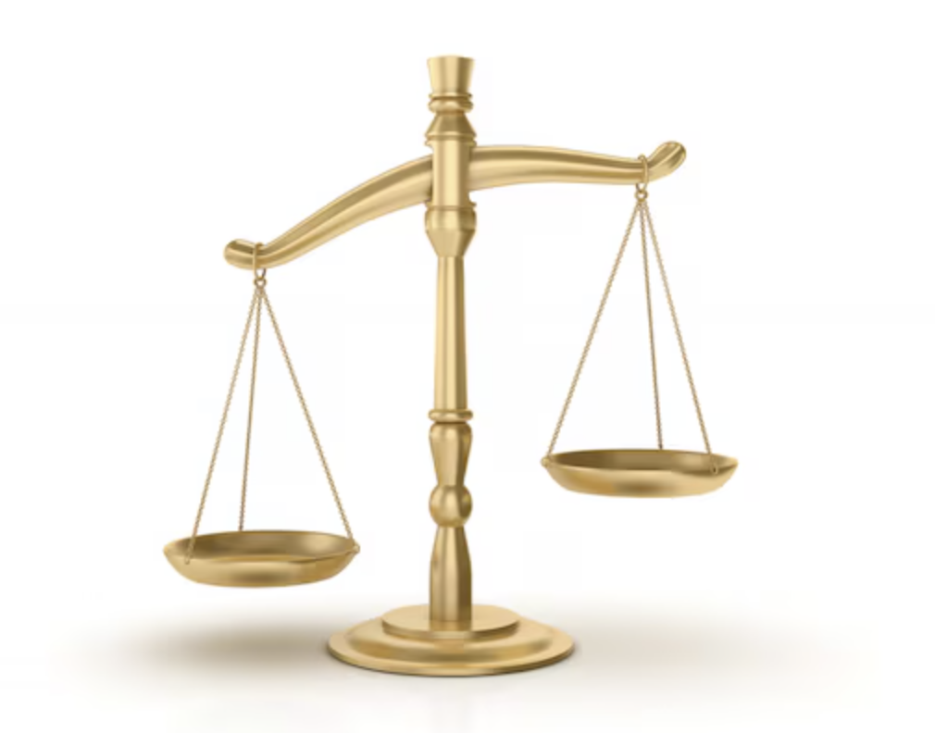
律法 有轻,有重 （太23:23）
The law has weightier and lesser matters (Matt. 23:23).

Slide 12
03
看马太福音记载
主引用第二个案例来反驳
See Matthew’s account: the Lord cites a second case to refute them.

Slide 13
太 12:4 他不是进了上帝的殿，吃了他和跟他在一起的人不可以吃，只有祭司才可以吃的陈设饼吗？5 律法书上记着：安息日，祭司在殿里供职，触犯了安息日，也不算有罪；你们也没有念过吗？
Mat 12:4 how he entered the house of God and ate the bread of the Presence, which it was not lawful for him to eat nor for those who were with him, but only for the priests?5 Or have you not read in the Law how on the Sabbath the priests in the temple profane the Sabbath and are guiltless?

Slide 14
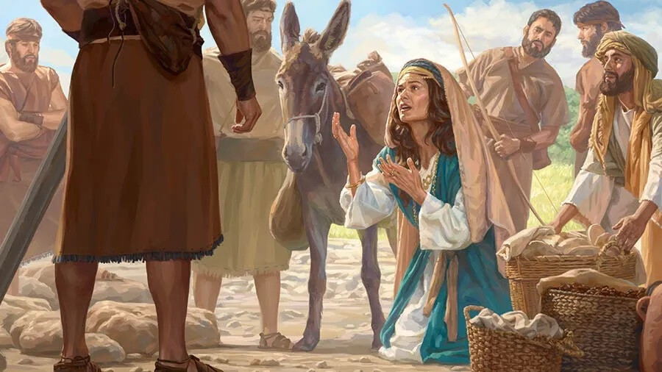
拿八拒绝帮助大卫,但妻子亚比该违背丈夫，暗中带着食物去见大卫，阻止了一场流血事件。大卫因此称颂上帝，也称赞亚比该的智慧。（撒上 25:18-33）
Nabal refused to help David, but Abigail defied her husband and secretly brought food to David, preventing bloodshed. David therefore praised God and commended Abigail’s wisdom. (
1 Sam. 25:18–33)

Slide 15
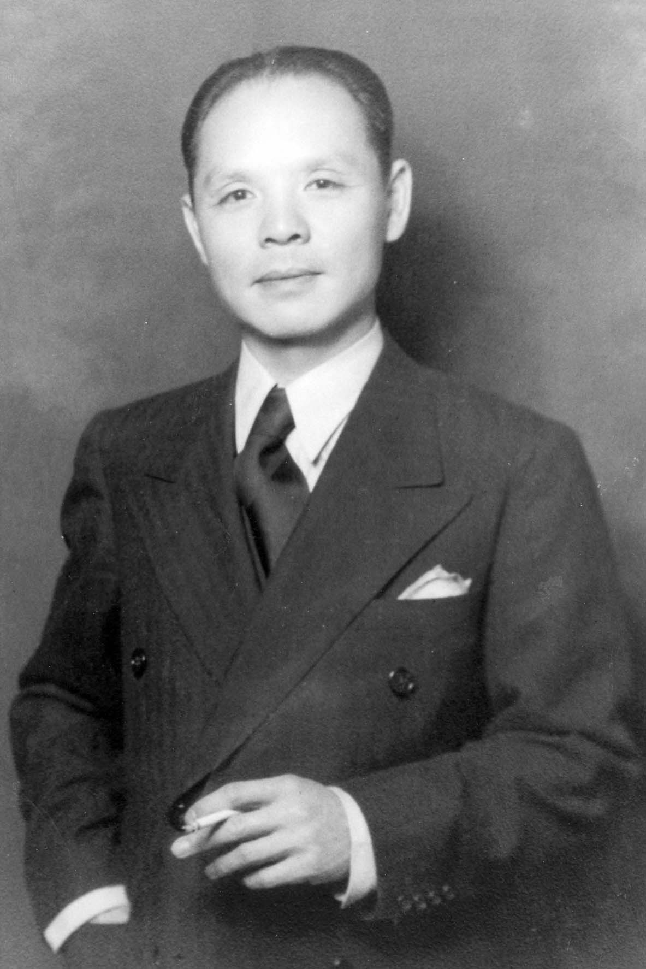
1938年奥地利被纳粹德国吞并后，犹太人必须取得外国签证才能逃离。中国驻维也纳总领事何凤山（基督徒华人信义会 Lutheran）拒绝服从上司（中国驻德国大使）停止向犹太人发放签证的命令，冒险偷偷大量签发“前往上海”的签证，帮助约4,000名犹太人逃离纳粹迫害。
After Nazi Germany annexed Austria in 1938, Chinese Consul-General Ho Feng-Shan, a Lutheran Christian, defied orders to stop issuing visas to Jews and secretly issued Shanghai visas, helping about 4,000 Jews escape Nazi persecution.

Slide 16
04
神更喜悦怜悯，胜过祭祀
God desires mercy rather than sacrifice.

Slide 17
太12:6 我告诉你们，这里有一位是比圣殿更大的。7 如果你们明白‘我喜爱怜悯，不喜爱祭祀’这句话的意思，就不会把无罪的定罪了。8 因为人子是安息日的主。
Mat 12:6 I tell you, something greater than the temple is here.7 And if you had known what this means, ‘I desire mercy, and not sacrifice,’ you would not have condemned the guiltless.8 For the Son of Man is lord of the Sabbath.”

Slide 18
太12:8 因为人子是安息日的主。
8 For the Son of Man is lord of the Sabbath.”

Slide 19

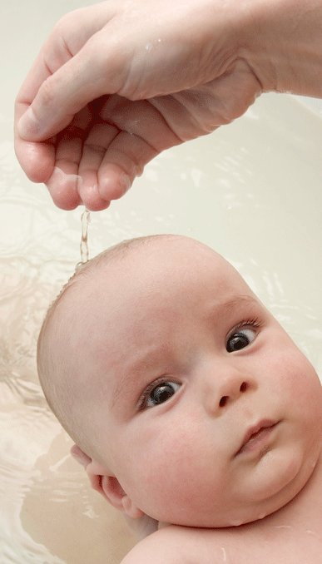
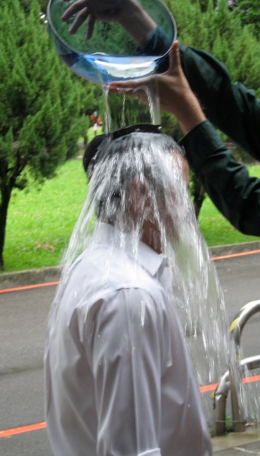
洗礼

Slide 20

马太福音 16:24
於是耶稣对门徒说：
若有人要跟从我，就当舍己，背起他的十字架来跟从我。
Mat 16:24
Then Jesus told his disciples,
“If anyone would come after me, let him deny himself
and take up his cross and follow me.

Slide 21
问：你是否接受耶稣基督是上帝的独生爱子，祂就是上帝？
问：你是否承认自己是罪人，并接受耶稣基督为你的罪钉在十字架上 ？
问：你是否相信耶稣基督赦免你的罪并赐你永生？

Slide 22
问：你是否愿意背起十字架来跟随主耶稣，作主耶稣的门徒？
问：你是否愿意坚守神与你所立的约？一生信主、爱主、顺服主。

