Slide 1
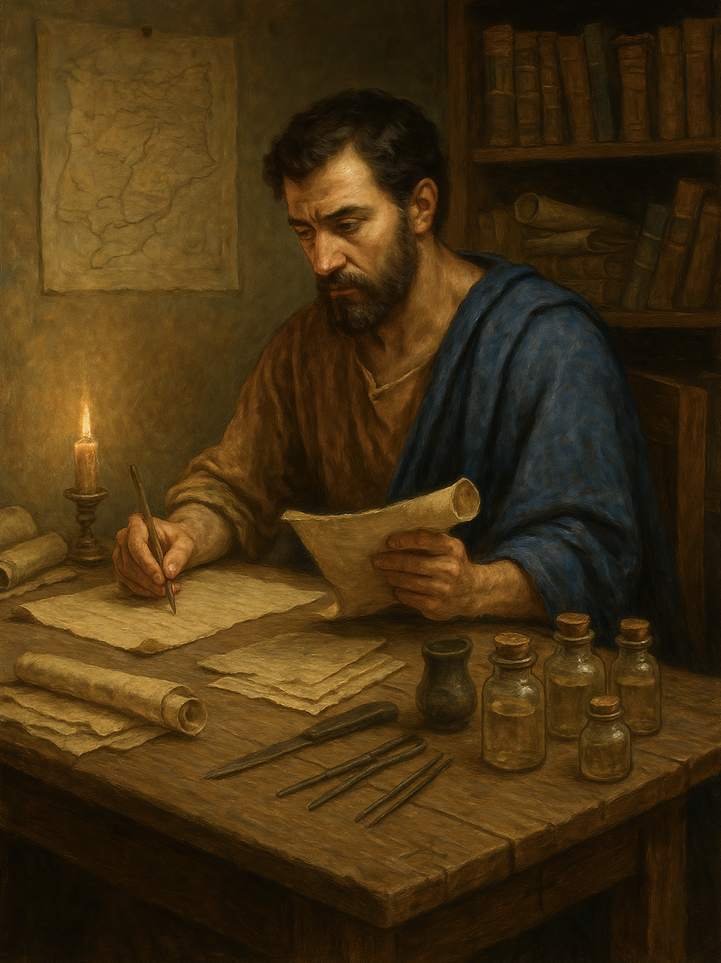
路加福音
Gospel of Luke
  25 我们要避开的属灵光景
  路6章6至11
  The Spiritual Condition We Must Avoid
  Luke 6:6–11

Slide 2

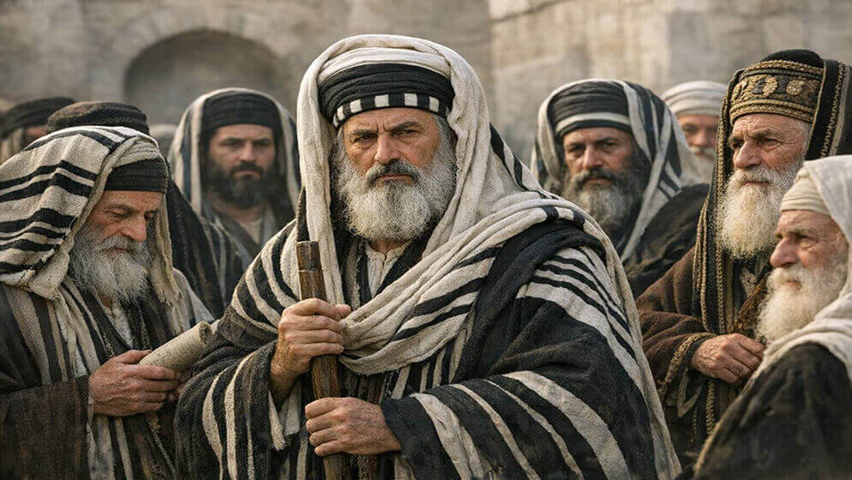

Slide 3
路6:6 另一个安息日，耶稣进入会堂教导人，在那里有一个人，右手枯干，7.经学家和法利赛人要看他会不会在安息日治病，好找把柄控告他。8.耶稣知道他们的意念，就对那一只手枯干了的人说：“起来，站在当中！”那人就起来站着。9.耶稣对他们说：“我问你们：在安息日哪一样是可以作的呢：作好事还是坏事？救命还是害命？”10.他环视周围所有的人，就对那人说：“伸出你的手来！”他把手一伸，手就复原了。11.他们却大怒，彼此商议怎样对付耶稣。
Luke 6:6 .On another Sabbath, he entered the synagogue and was teaching, and a man was there whose right hand was withered. 7.And the scribes and the Pharisees watched him, to see whether he would heal on the Sabbath, so that they might find a reason to accuse him.8.But he knew their thoughts, and he said to the man with the withered hand, "Come and stand here." And he rose and stood there.9.And Jesus said to them, "I ask you, is it lawful on the Sabbath to do good or to do harm, to save life or to destroy it?"10.And after looking around at them all he said to him, "Stretch out your hand." And he did so, and his hand was restored. 11.But they were filled with fury and discussed with one another what they might do to Jesus.

Slide 4
背景
Context

Slide 5
01
不受教
Unteachable

Slide 6
路6:6 另一个安息日，耶稣进入会堂教导人，在那里有一个人，右手枯干，7.经学家和法利赛人要看他会不会在安息日治病，好找把柄控告他。
Luke 6:6. On another Sabbath, he entered the synagogue and was teaching, and a man was there whose right hand was withered. 7.And the scribes and the Pharisees watched him, to see whether he would heal on the Sabbath, so that they might find a reason to accuse him.

Slide 7
02
没有爱人怜悯之心
Lacking a Heart of Love and Compassion

Slide 8
8.耶稣知道他们的意念，就对那一只手枯干了的人说：“起来，站在当中！”那人就起来站着。
8.But he knew their thoughts, and he said to the man with the withered hand, "Come and stand here." And he rose and stood there.

Slide 9
【彼得后书 1:5】.正因这缘故，你们要分外地殷勤。有了信心，又要加上德行；有了德行，又要加上知识；6.有了知识，又要加上节制；有了节制，又要加上忍耐；有了忍耐，又要加上虔敬；7.有了虔敬，又要加上爱弟兄的心；有了爱弟兄的心，又要加上爱众人的心。
2 Peter 1:5.For this very reason, make every effort to supplement your faith with virtue, and virtue with knowledge,6.and knowledge with self-control, and self-control with steadfastness, and steadfastness with godliness,7.and godliness with brotherly affection, and brotherly affection with love.

Slide 10
03
不愿承认错误
Unwilling to Admit One’s Mistakes

Slide 11
9.耶稣对他们说：“我问你们：在安息日哪一样是可以作的呢：作好事还是坏事？救命还是害命？”10.他环视周围所有的人，就对那人说：“伸出你的手来！”他把手一伸，手就复原了。
9.And Jesus said to them, "I ask you, is it lawful on the Sabbath to do good or to do harm, to save life or to destroy it?"10.And after looking around at them all he said to him, "Stretch out your hand." And he did so, and his hand was restored.

Slide 12
04
心里刚硬
Hardness of Heart

Slide 13
11.他们却大怒，彼此商议怎样对付耶稣。
11.But they were filled with fury and discussed with one another what they might do to Jesus.

