Slide 1

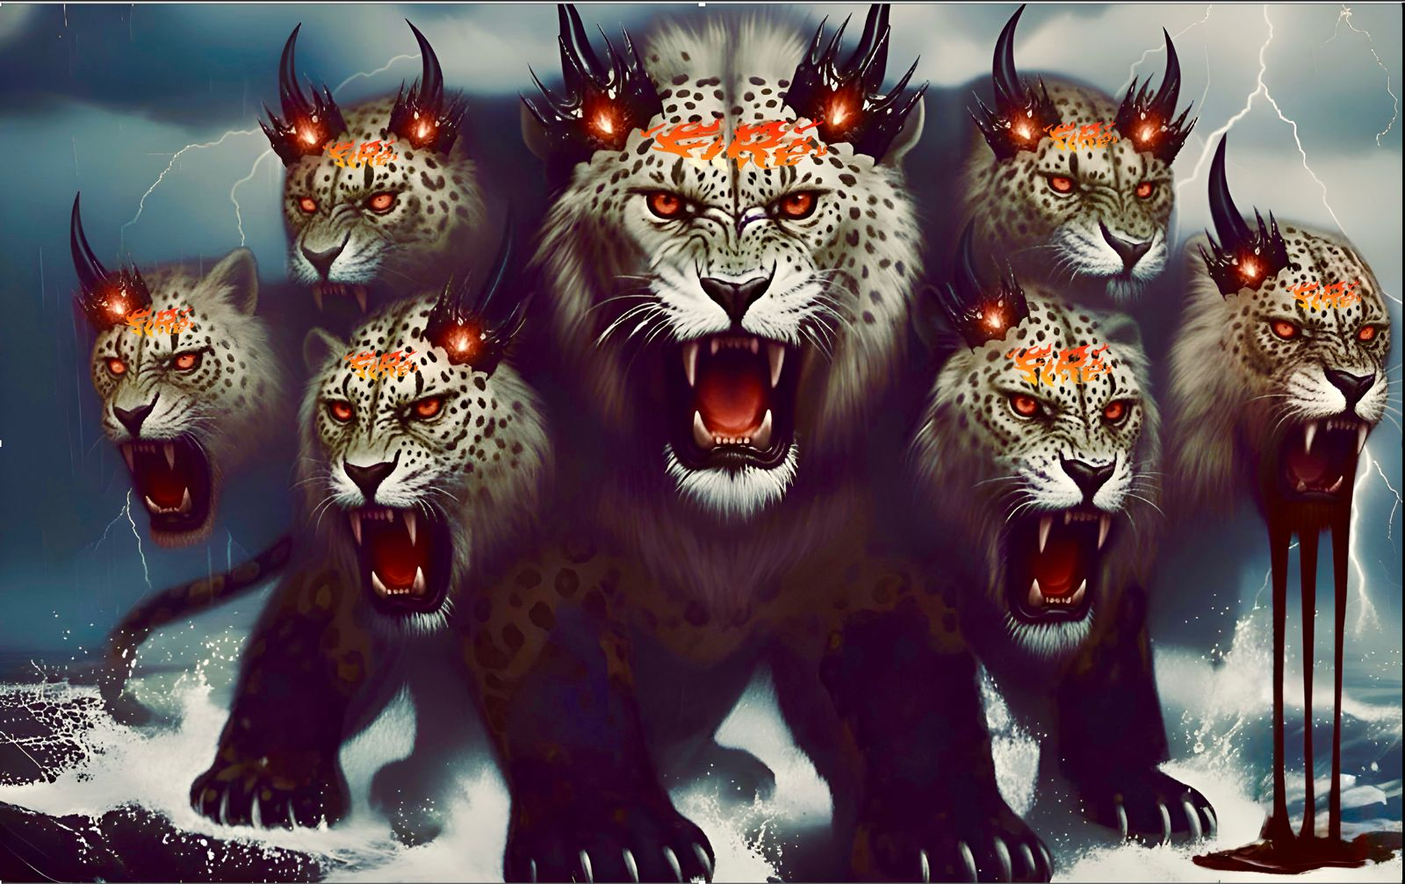
32 兽从海中上来（上）
启示录13章1至4
The Beast Rising Out of the Sea (Part 1)

Slide 2
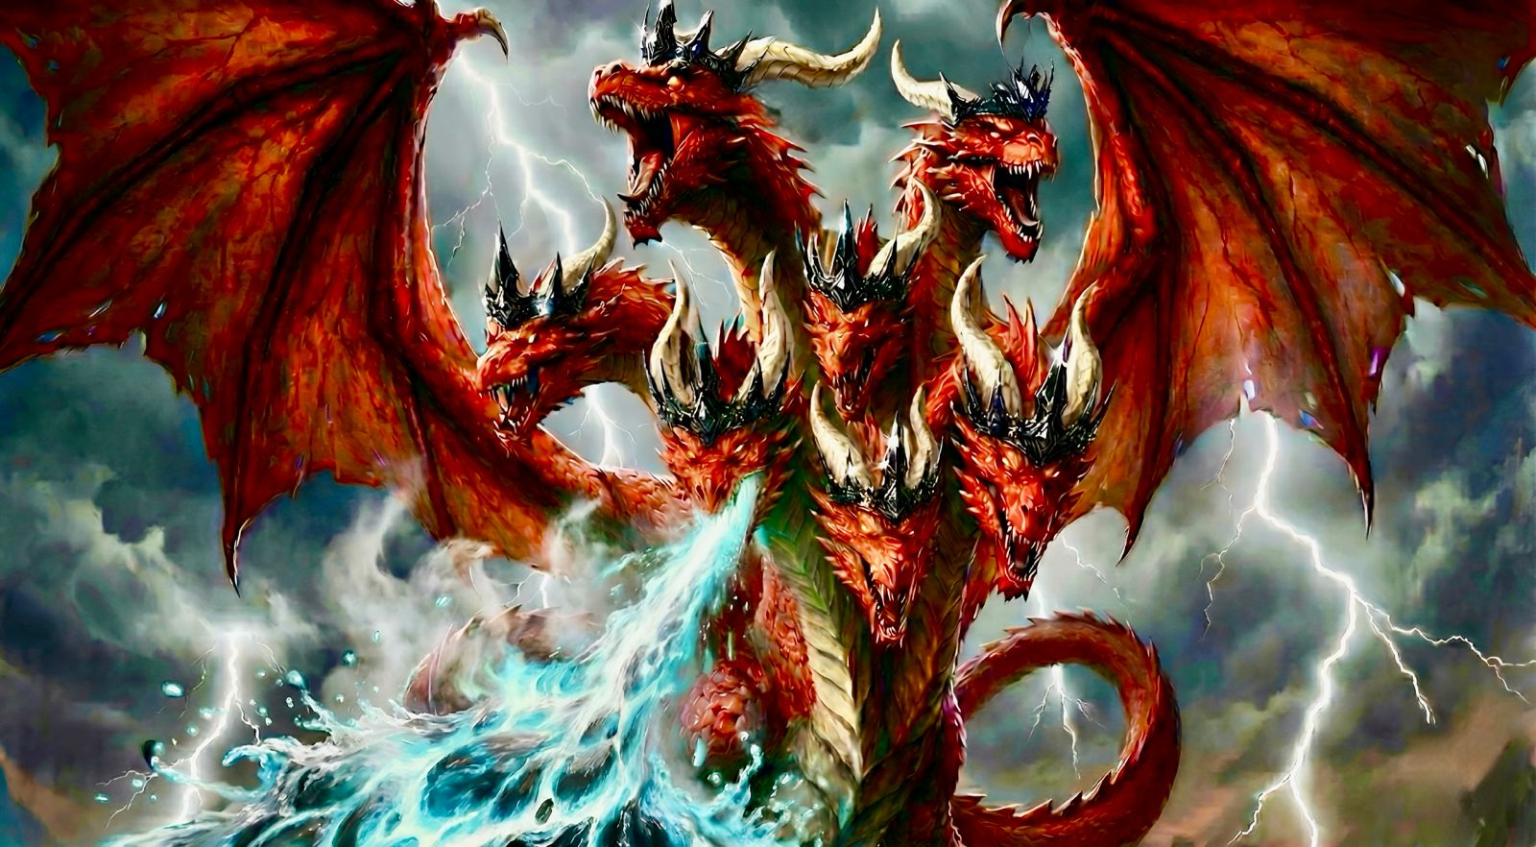

Slide 3
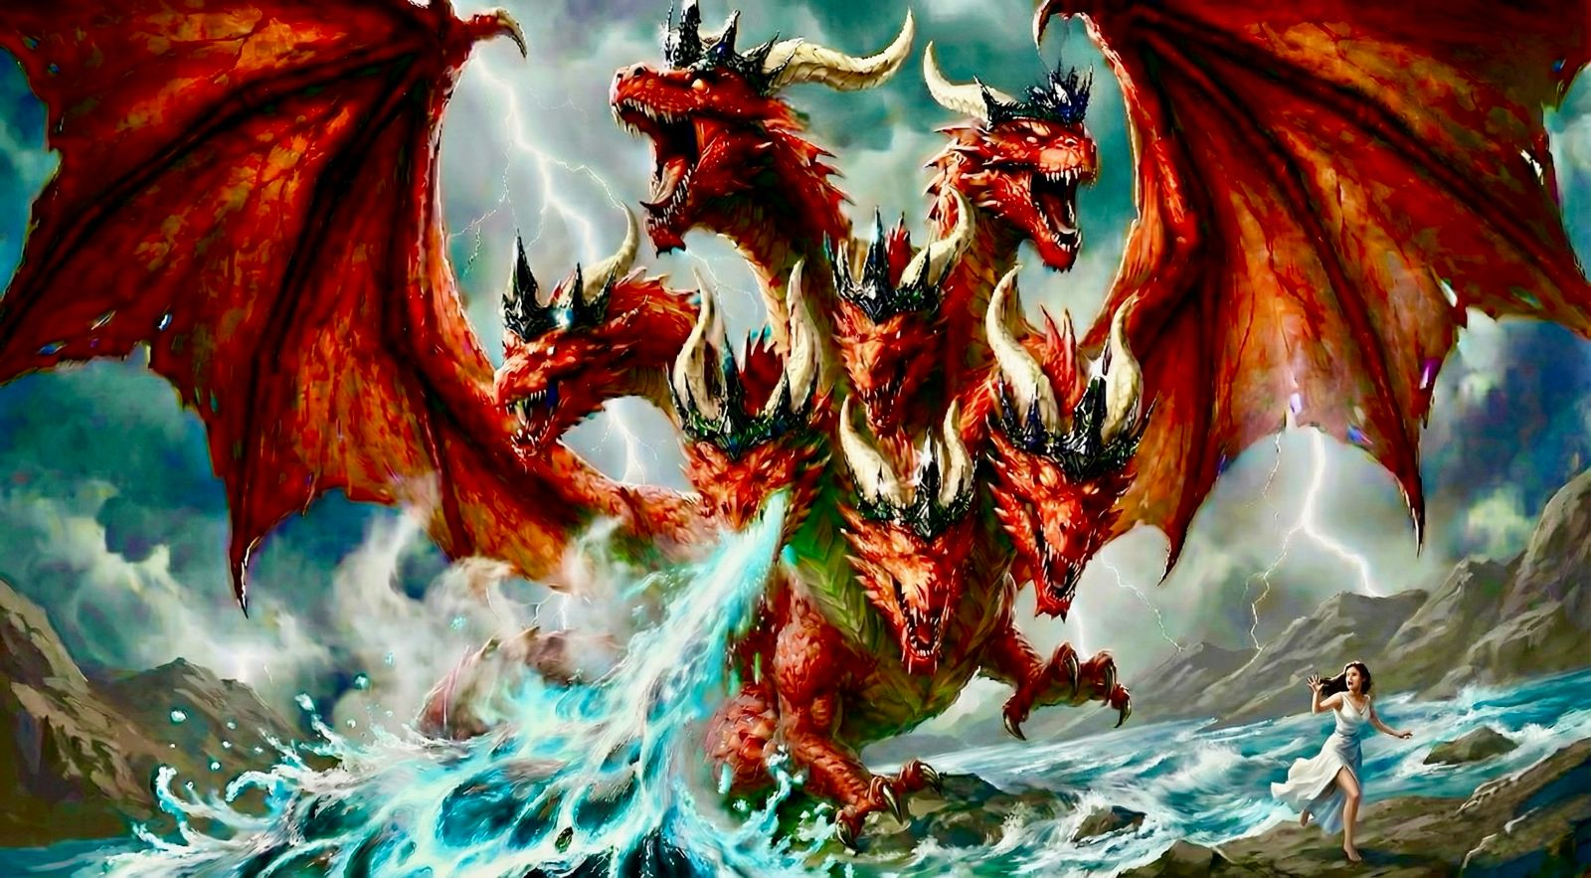
红龙忿怒，就转向攻击妇人(教会）其余的儿女（信徒）
The enraged red dragon turned to attack the Woman (the church) offspring（Believers).

Slide 4
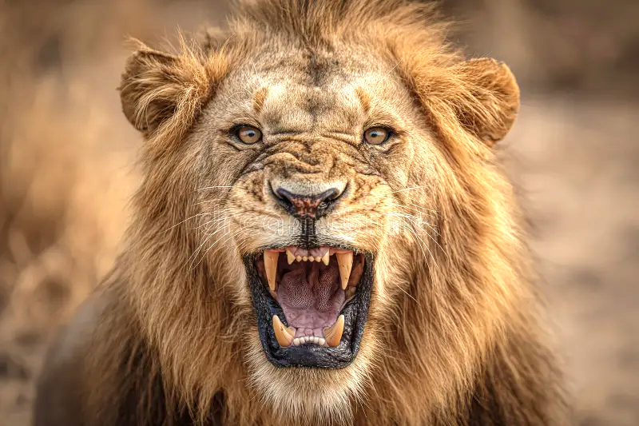
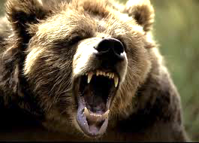
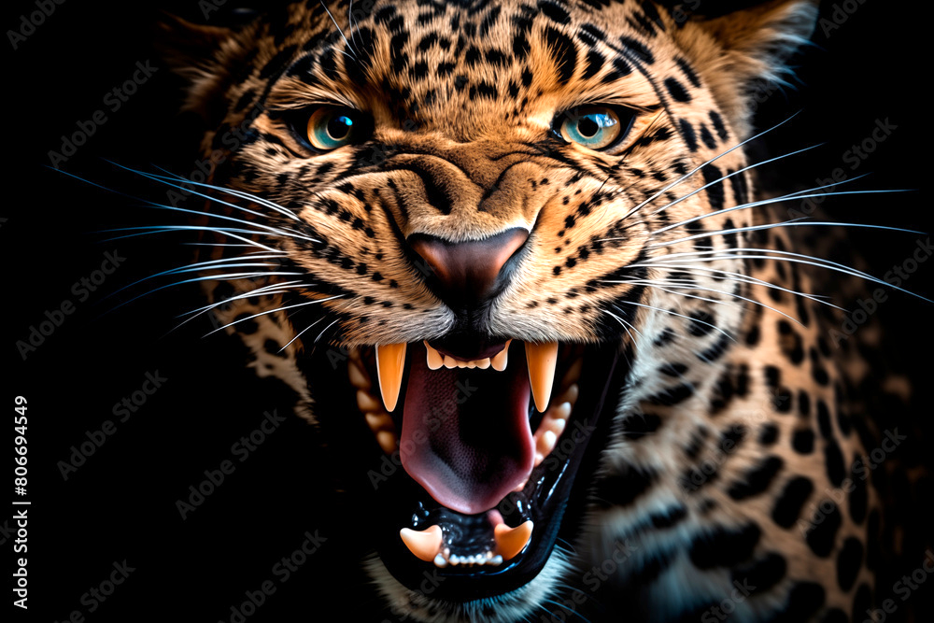

Slide 5
启13:1我又看见一个兽 从海中上来，有十角七头，在十角上戴著十个冠冕，七头上有亵渎的名号。2 我所看见的兽，形状 像豹，脚像熊的脚，口像狮子的口。那龙将自己的能力、座位、和大权柄都给了他。3 我看见兽的七头中，有一个似乎受了死伤，那死伤却医好了。全地的人都希奇跟从那兽，4 又拜那龙，因为他将自己的权柄给了兽，也拜兽，说：「谁能比这兽，谁能与他交战呢？」
Rev 13:1 And I saw a beast rising out of the sea, with ten horns and seven heads, with ten diadems on its horns and blasphemous names on its heads.2 And the beast that I saw was like a leopard; its feet were like a bear's, and its mouth was like a lion's mouth. And to it the dragon gave his power and his throne and great authority.3 One of its heads seemed to have a mortal wound, but its mortal wound was healed, and the whole earth marveled as they followed the beast.4 And they worshiped the dragon, for he had given his authority to the beast, and they worshiped the beast, saying, “Who is like the beast, and who can fight against it?”

Slide 7
旧约:抵挡神的国度与君王比喻为海兽
01
Old Testament: Kingdoms and rulers who oppose God are symbolized as sea beasts.

Slide 8
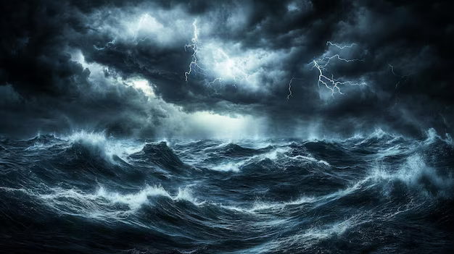
旧约海象征地上邪恶权势 哈3:8-15 、诗74:13、89-9:10、赛27:1、伯26:12
兽在无底坑（海底） 启11:7
OT: The sea symbolizes earthly evil powers/authorities. (Hab 3:8-15, Ps 74:13, 89:9-10, Isa 27:1, Job 26:12)The Beast is in the bottomless pit (under the sea). (Rev 11:7)

Slide 9
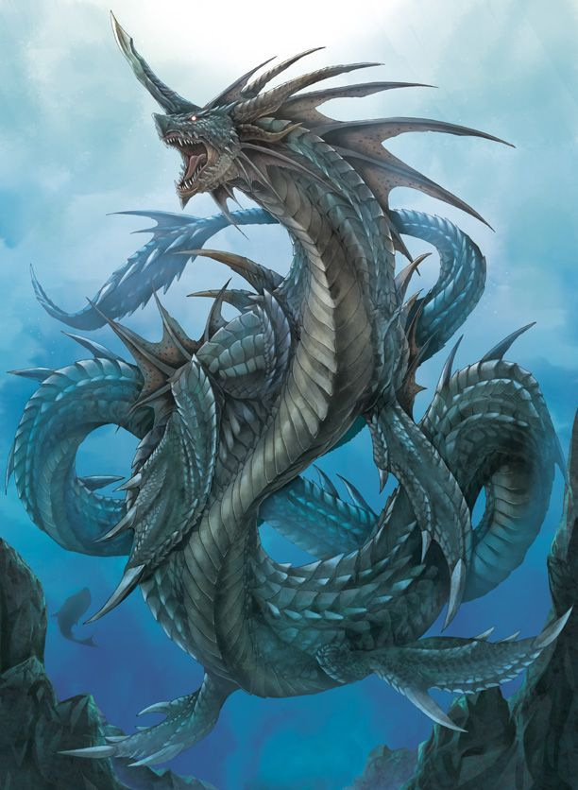
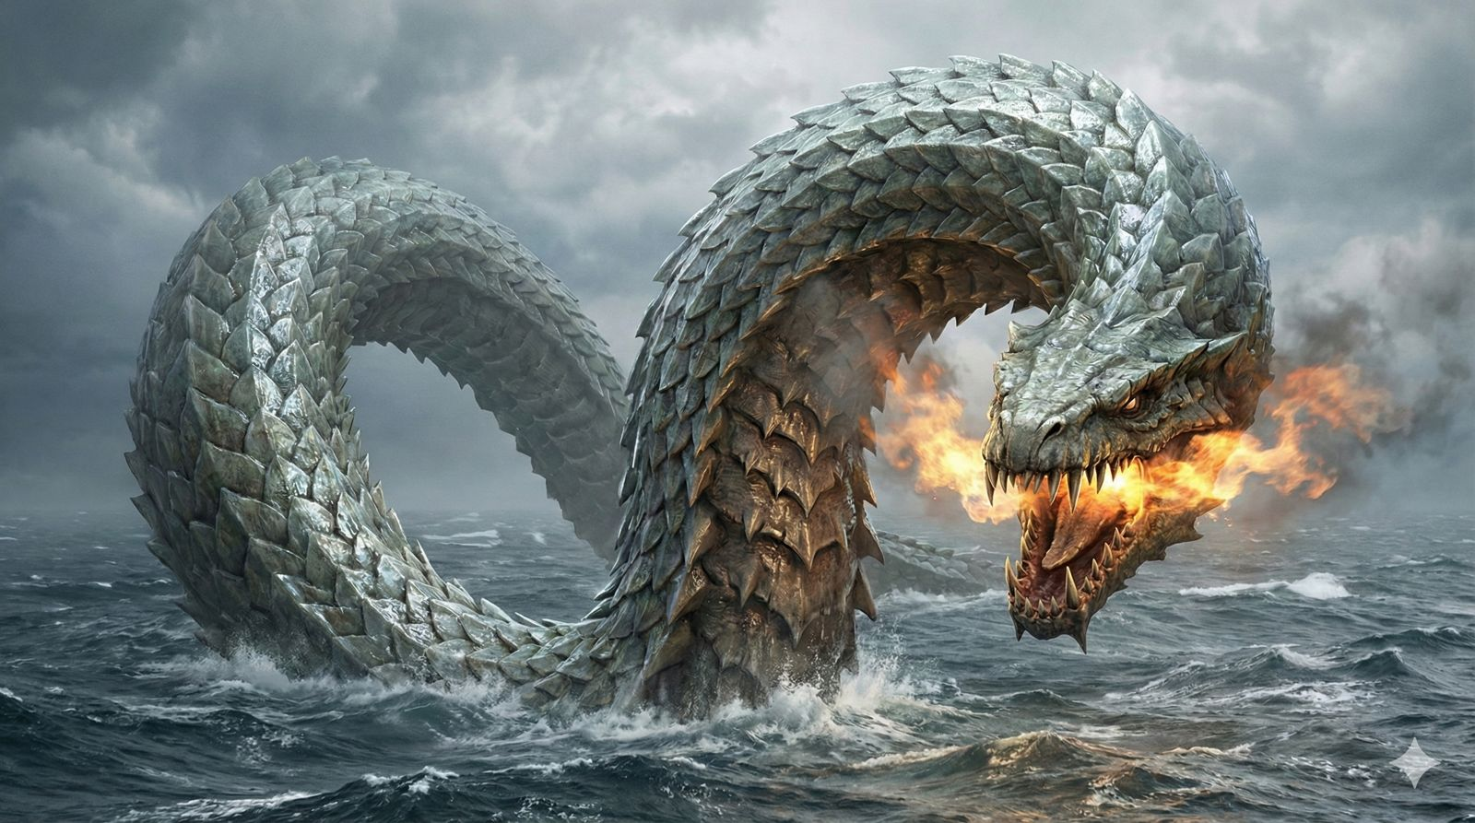
tannı̂yn
伯7:12、诗74:13、赛27:1、赛51:9、耶51:34、结29:3
大鱼、(新译本 海怪）、龙
Dragon、 monster
רַהַב rahab
拉哈伯 (伯9:13、伯26:12、
诗89:10、赛30:7、赛51:9
rahab

Slide 10
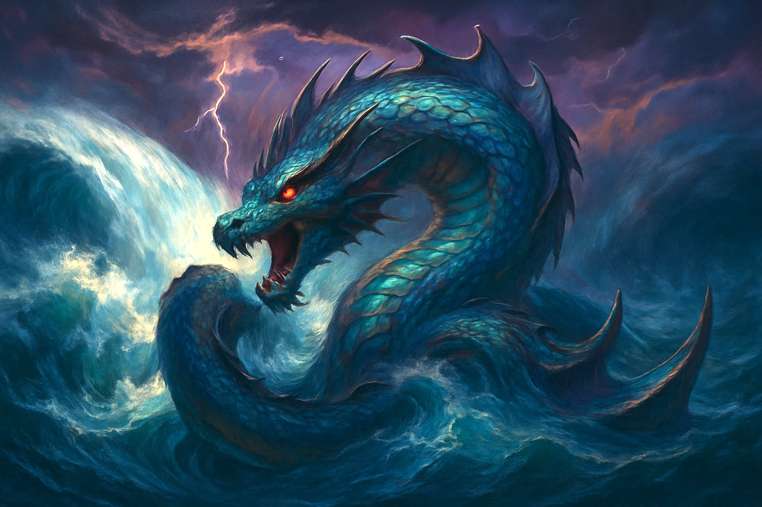
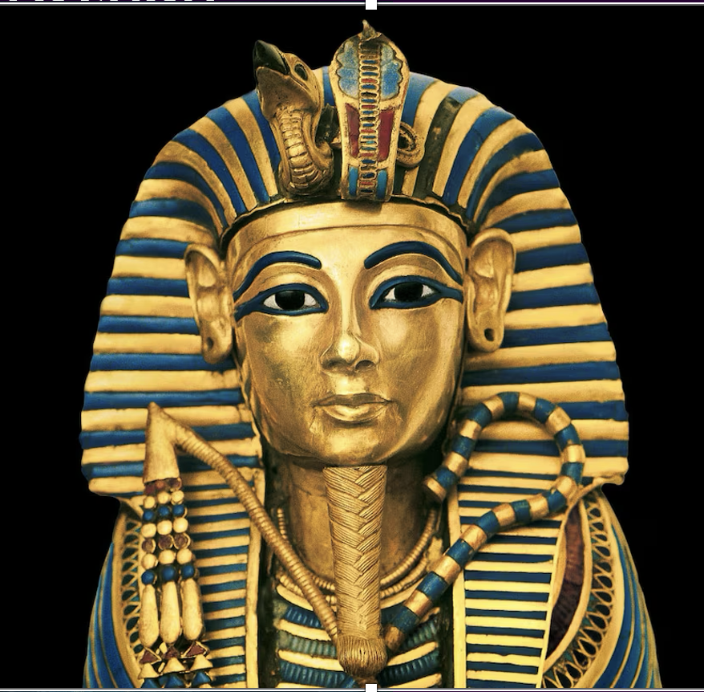
用来比喻
Used to symbolize
利未亚坦 Leviathan
拉哈伯 Rahab
海龙 dragon
邪恶的海怪 demonic Monsters
敌对神的埃及法老
The Pharaoh of Egypt who opposes God

Slide 11
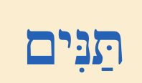
结29:2
人子啊，你要向埃及王法老预言攻击他和埃及全地，3 说主耶和华如此说：埃及王法老啊，我与你这卧在自己河中的大鱼 tannı̂yn （新译本：大海怪 great dragon/ ASV great monster） 为敌。.....
Ezk 29:2 “Son of man, set your face against Pharaoh king of Egypt, and prophesy against him and against all Egypt;3 speak, and say, Thus says the Lord GOD: “Behold, I am against you, Pharaoh king of Egypt, the great dragon that lies in the midst of his streams,....

Slide 12
赛30:7 埃及的帮助是徒然无益的；所以我称他为「坐而不动的拉哈伯 Rahab」。
Isa 30:7 Egypt's help is worthless and empty; therefore I have called her “Rahab who sits still.
赛51:9 耶和华的膀臂啊，兴起！兴起！以能力为衣穿上，像古时的年日、上古的世代兴起一样。从前砍碎 拉哈伯 Rahab、刺透 大鱼 tannı̂yn（新译本：海龙dragon）的，不是你吗？10 使海与深渊的水乾涸、使海的深处变为赎民经过之路的，不是你吗？
Isa 51:9 Awake, awake, put on strength, O arm of the LORD; awake, as in days of old, the generations of long ago. Was it not you who cut Rahab in pieces, who pierced the dragon? 10 Was it not you who dried up the sea, the waters of the great deep, who made the depths of the sea a way for the redeemed to pass over?

Slide 13
רַהַב
拉哈伯 rahab
比喻
Symbolizes
敌对上帝
的君王、国家、国度。
Kings, nations, and kingdoms opposing God.
海兽 Beast from the Sea
tannı̂yn
大鱼、龙
新译本:海怪、
Dragon、 monster

Slide 14
但以理书中出现的四只海兽
02
The four sea beasts that appear in the Book of Daniel.

Slide 15
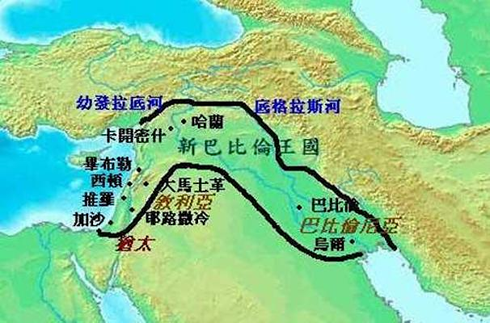
新巴比伦帝国
Neo-Babylonian Empire
626 B.C. to 539 B.C.

Slide 16
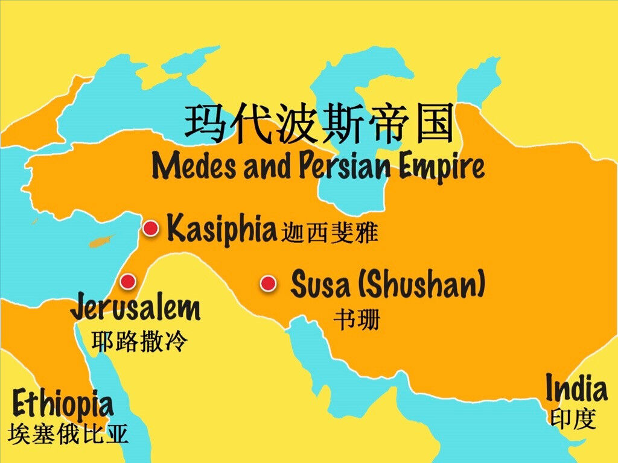
波斯玛代帝国
Medo-Persia
539 B.C. to 331 B.C..

Slide 17
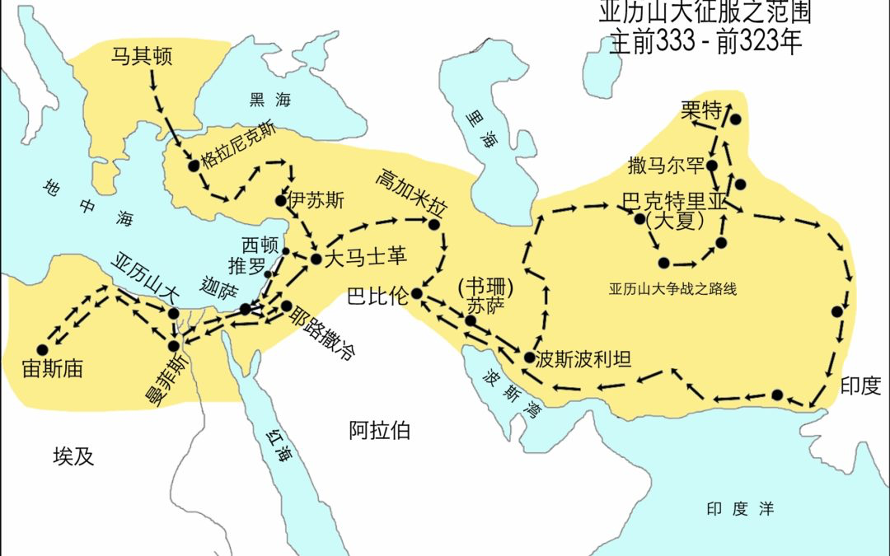
马其顿帝国
Macedonian Empire.
336 B.C. to 323 B.C..

Slide 18
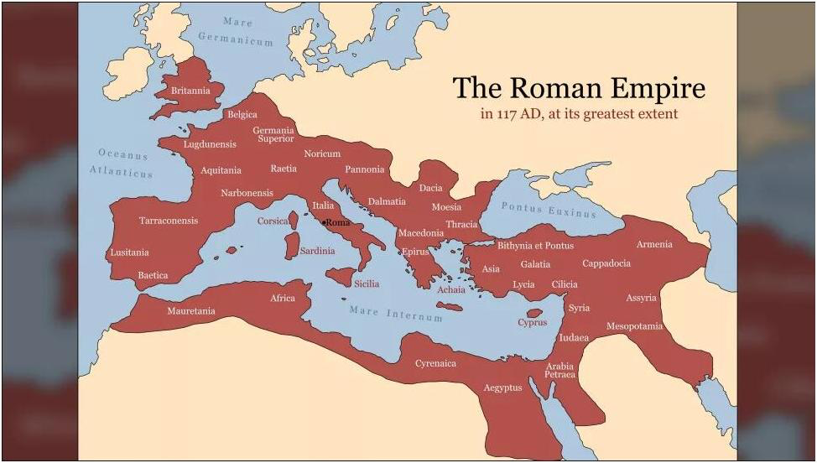
罗马帝国
Roman Empire.
27 B.C. to A.D. 395

Slide 19
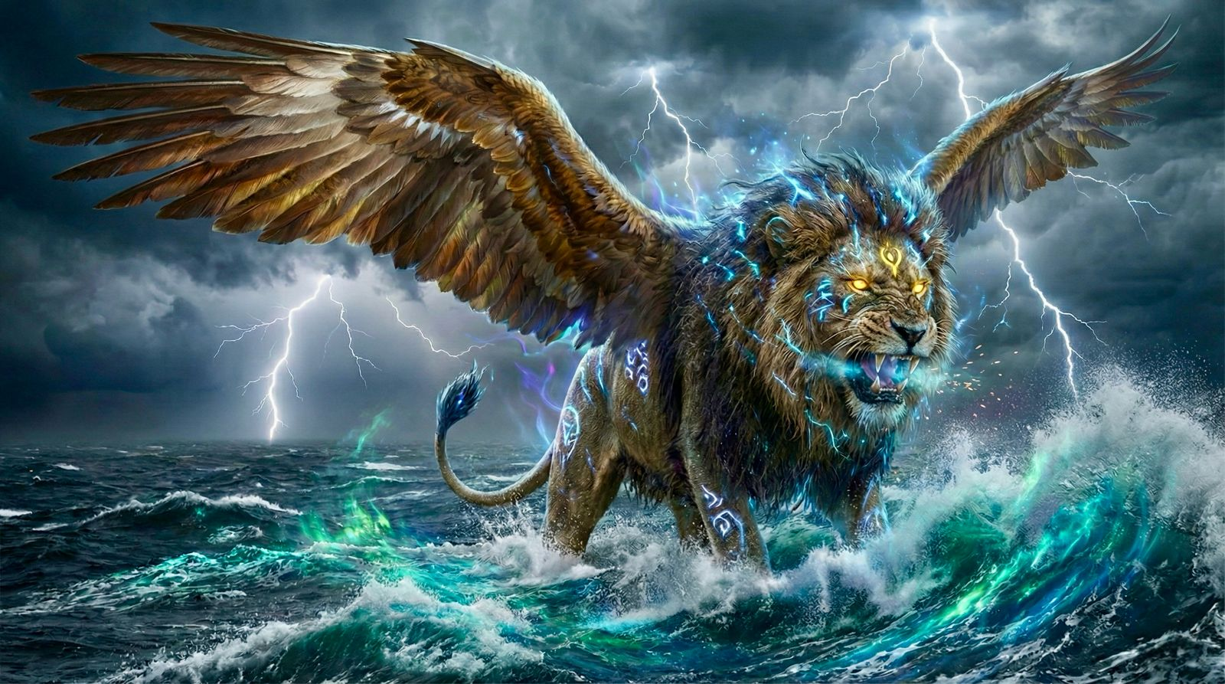
兽一：像【狮子】有鹰的翅膀 （但7:4）
象征 新巴比伦帝国
Beast One: Like a [Lion] with eagle’s wings (Dan 7:4).
Symbolizes the Neo-Babylonian Empire (Neo Babylon).

Slide 20
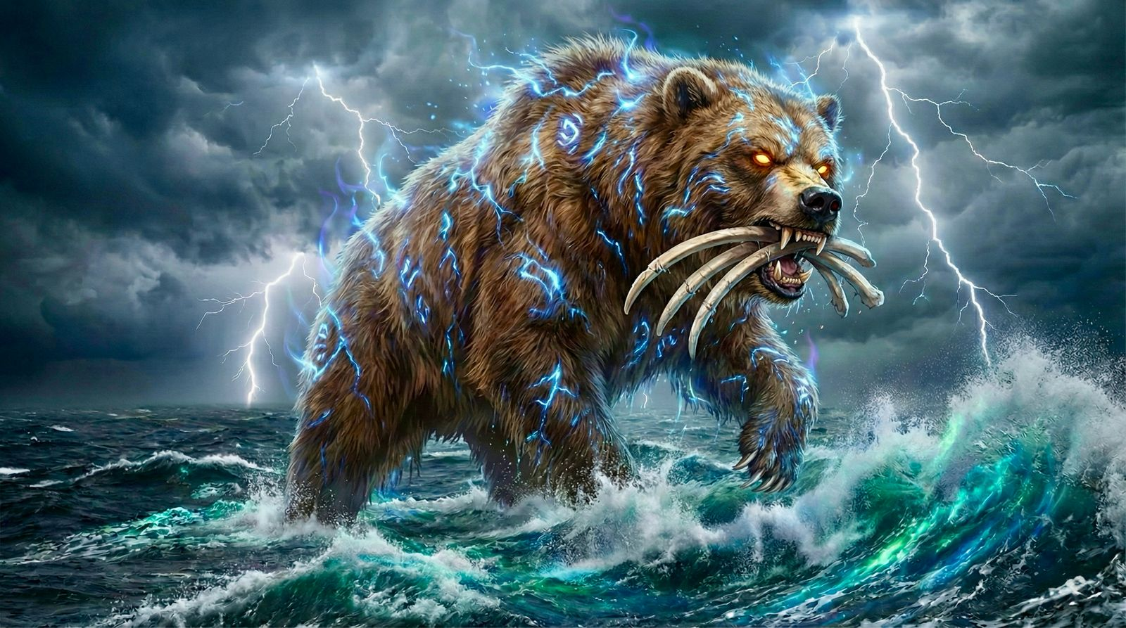
兽二：像【熊】口齿内衔著三根肋骨（但7:5）象征 波斯玛代帝国
Beast Two: Like a [Bear] with three ribs in its mouth (Dan 7:5).
Symbolizes the Medo-Persian Empire.

Slide 21
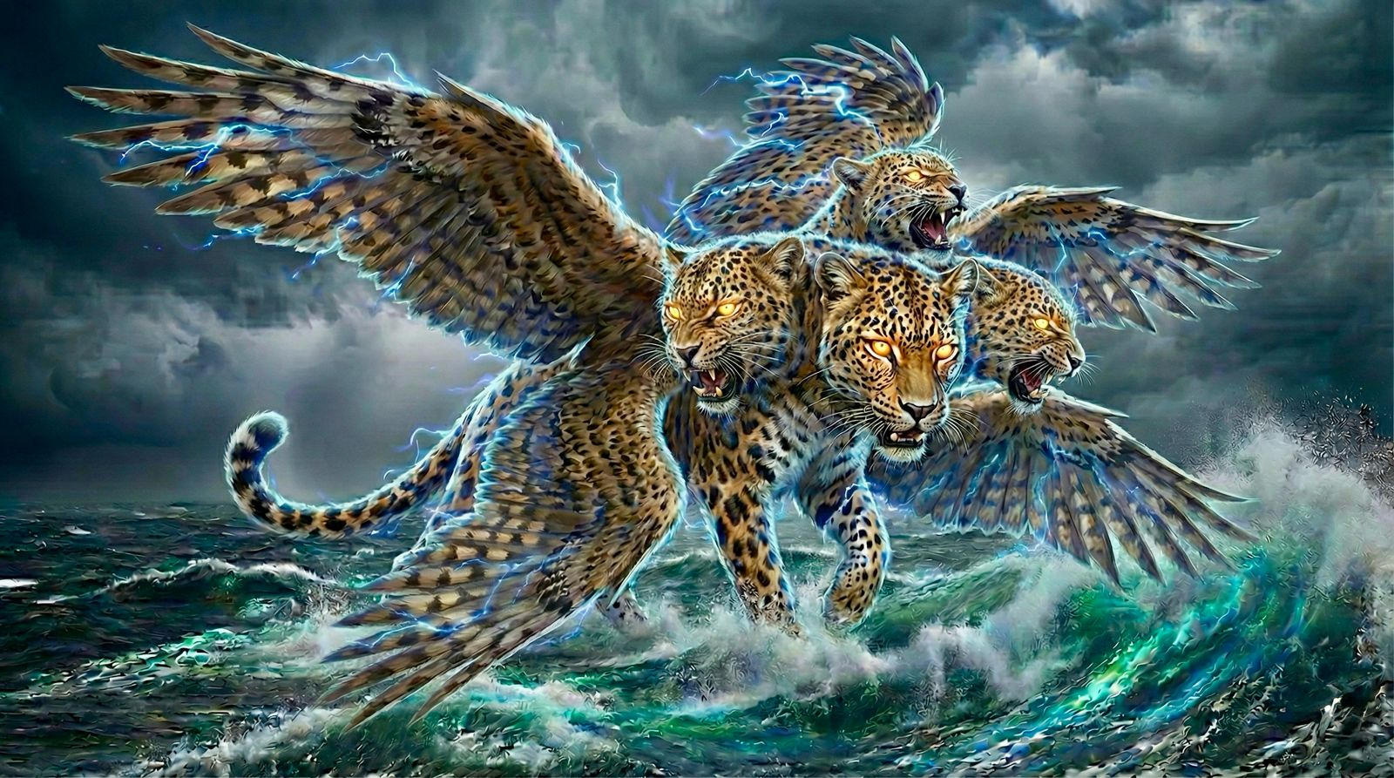
兽三：像【豹】四头背上有四个翅膀（但7:6）象征 马其顿帝国
Beast Three: Like a [Leopard] with four wings and four heads (Dan 7:6). Symbolizes the Macedonian Empire..

Slide 22
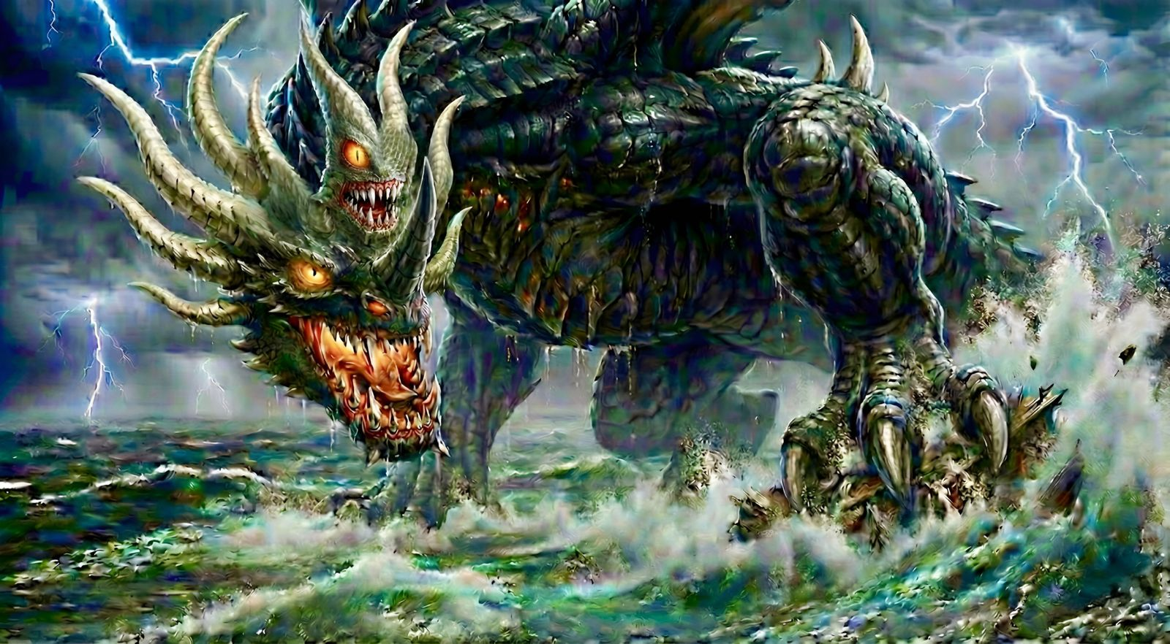
兽四：【甚是可怕】头有十角（但7:7）
象征 罗马帝国
Beast Four: [Exceedingly terrifying] with ten horns (Dan 7:7). Symbolizes the Roman Empire..

Slide 23
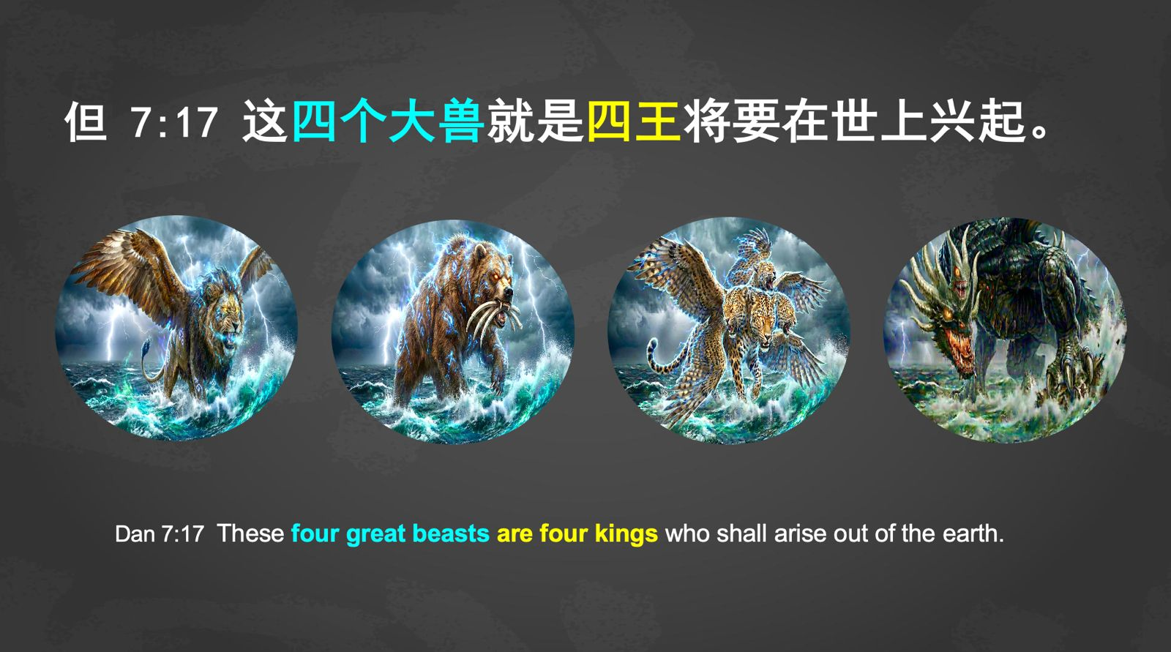

Slide 24
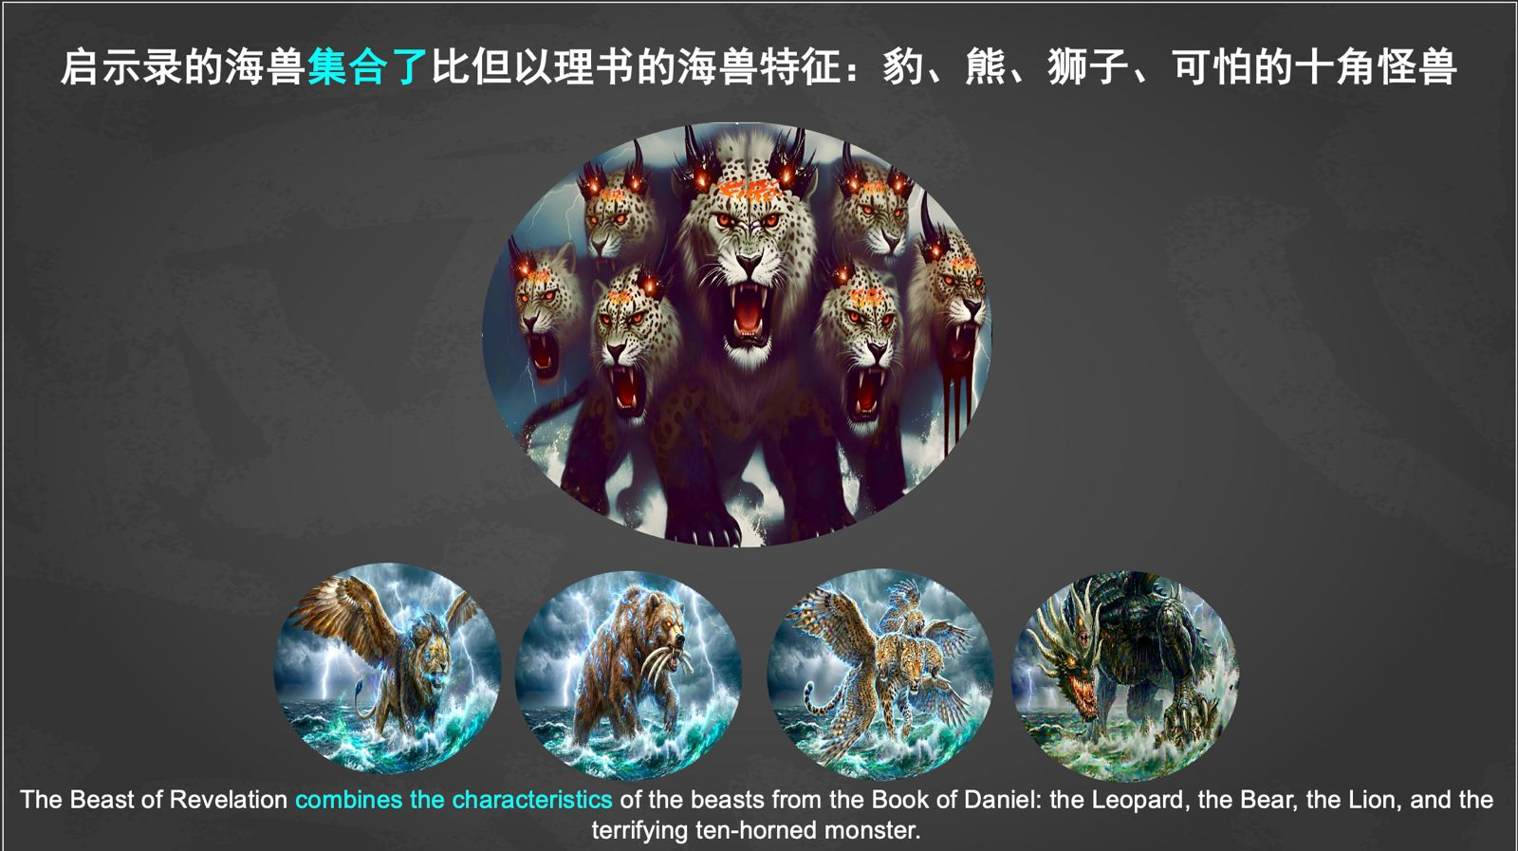

Slide 25
兽是敌基督，象征所有任何敌对逼迫上帝子民的国度与君王
The Beast is the Antichrist It symbolizes all kingdoms and rulers that opposes and persecutes God's people.
它也预表最终要来的敌基督的世界国度与君王。
It also typifies the final Antichrist kingdom (world) and ruler.

Slide 26
启示录中海兽的特征
03
The characteristics of the Beast in Revelation.

Slide 27
启13:1
我又看见一个兽 从海中上来，有十角 七头，在十角上戴著十个冠冕，七头上有亵渎的名号。
Rev 13:1 And I saw a beast rising out of the sea, with ten horns and seven heads, with ten diadems on its horns and blasphemous names on its heads.

Slide 28
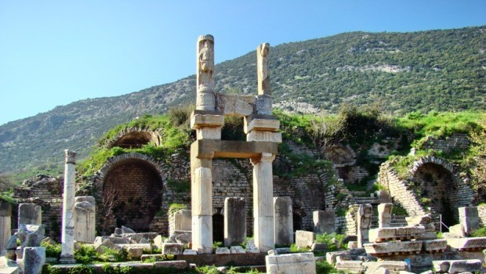
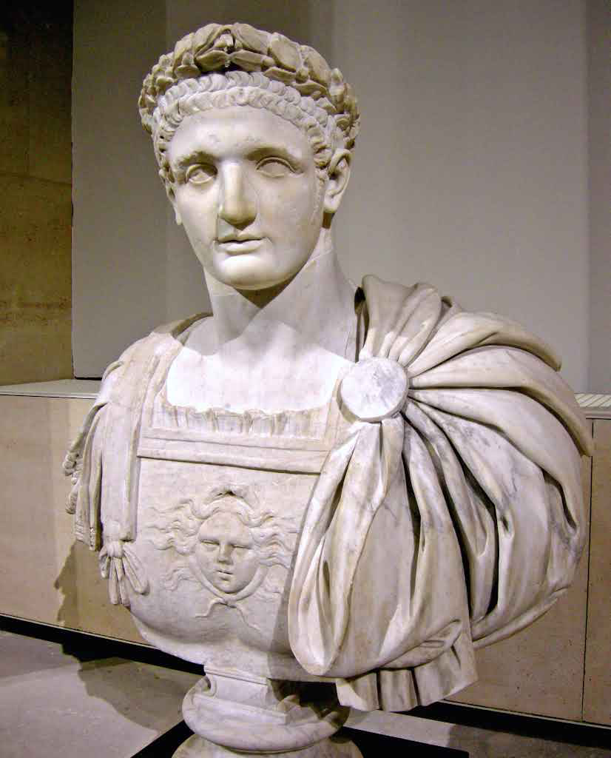
罗马皇帝图密善
(Emperor Domitian)
图密善神庙 - 土耳其，以弗所
Temple of Domitian - Ephesus Turkey

Slide 29
启13:2
....那龙将自己的能力、座位、和大权柄都给了他。
Rev 13:2 .... And to it the dragon gave his power and his throne and great authority.

Slide 30
全地的人都会拜那兽
04
All the world will worship the Beast.

Slide 31
3 我看见兽的七头中，有一个似乎受了死伤，那死伤却医好了。全地的人都希奇跟从那兽，
3 One of its heads seemed to have a mortal wound, but its mortal wound was healed, and the whole earth marveled as they followed the beast.

Slide 32
3 。。。全地的人都希奇跟从那兽，4 又拜那龙，因为他将自己的权柄给了兽，也拜兽，说：「谁能比这兽，谁能与他交战呢？」
3 。。。and the whole earth marveled as they followed the beast.4 And they worshiped the dragon, for he had given his authority to the beast, and they worshiped the beast, saying, “Who is like the beast, and who can fight against it?”

Slide 33
帖后2:4
他是抵挡主，高抬自己，超过一切称为神的和一切受人敬拜的，甚至坐在神的殿里，自称是神。
2Th 2:4 who opposes and exalts himself against every so-called god or object of worship, so that he takes his seat in the temple of God, proclaiming himself to be God.

