Slide 1

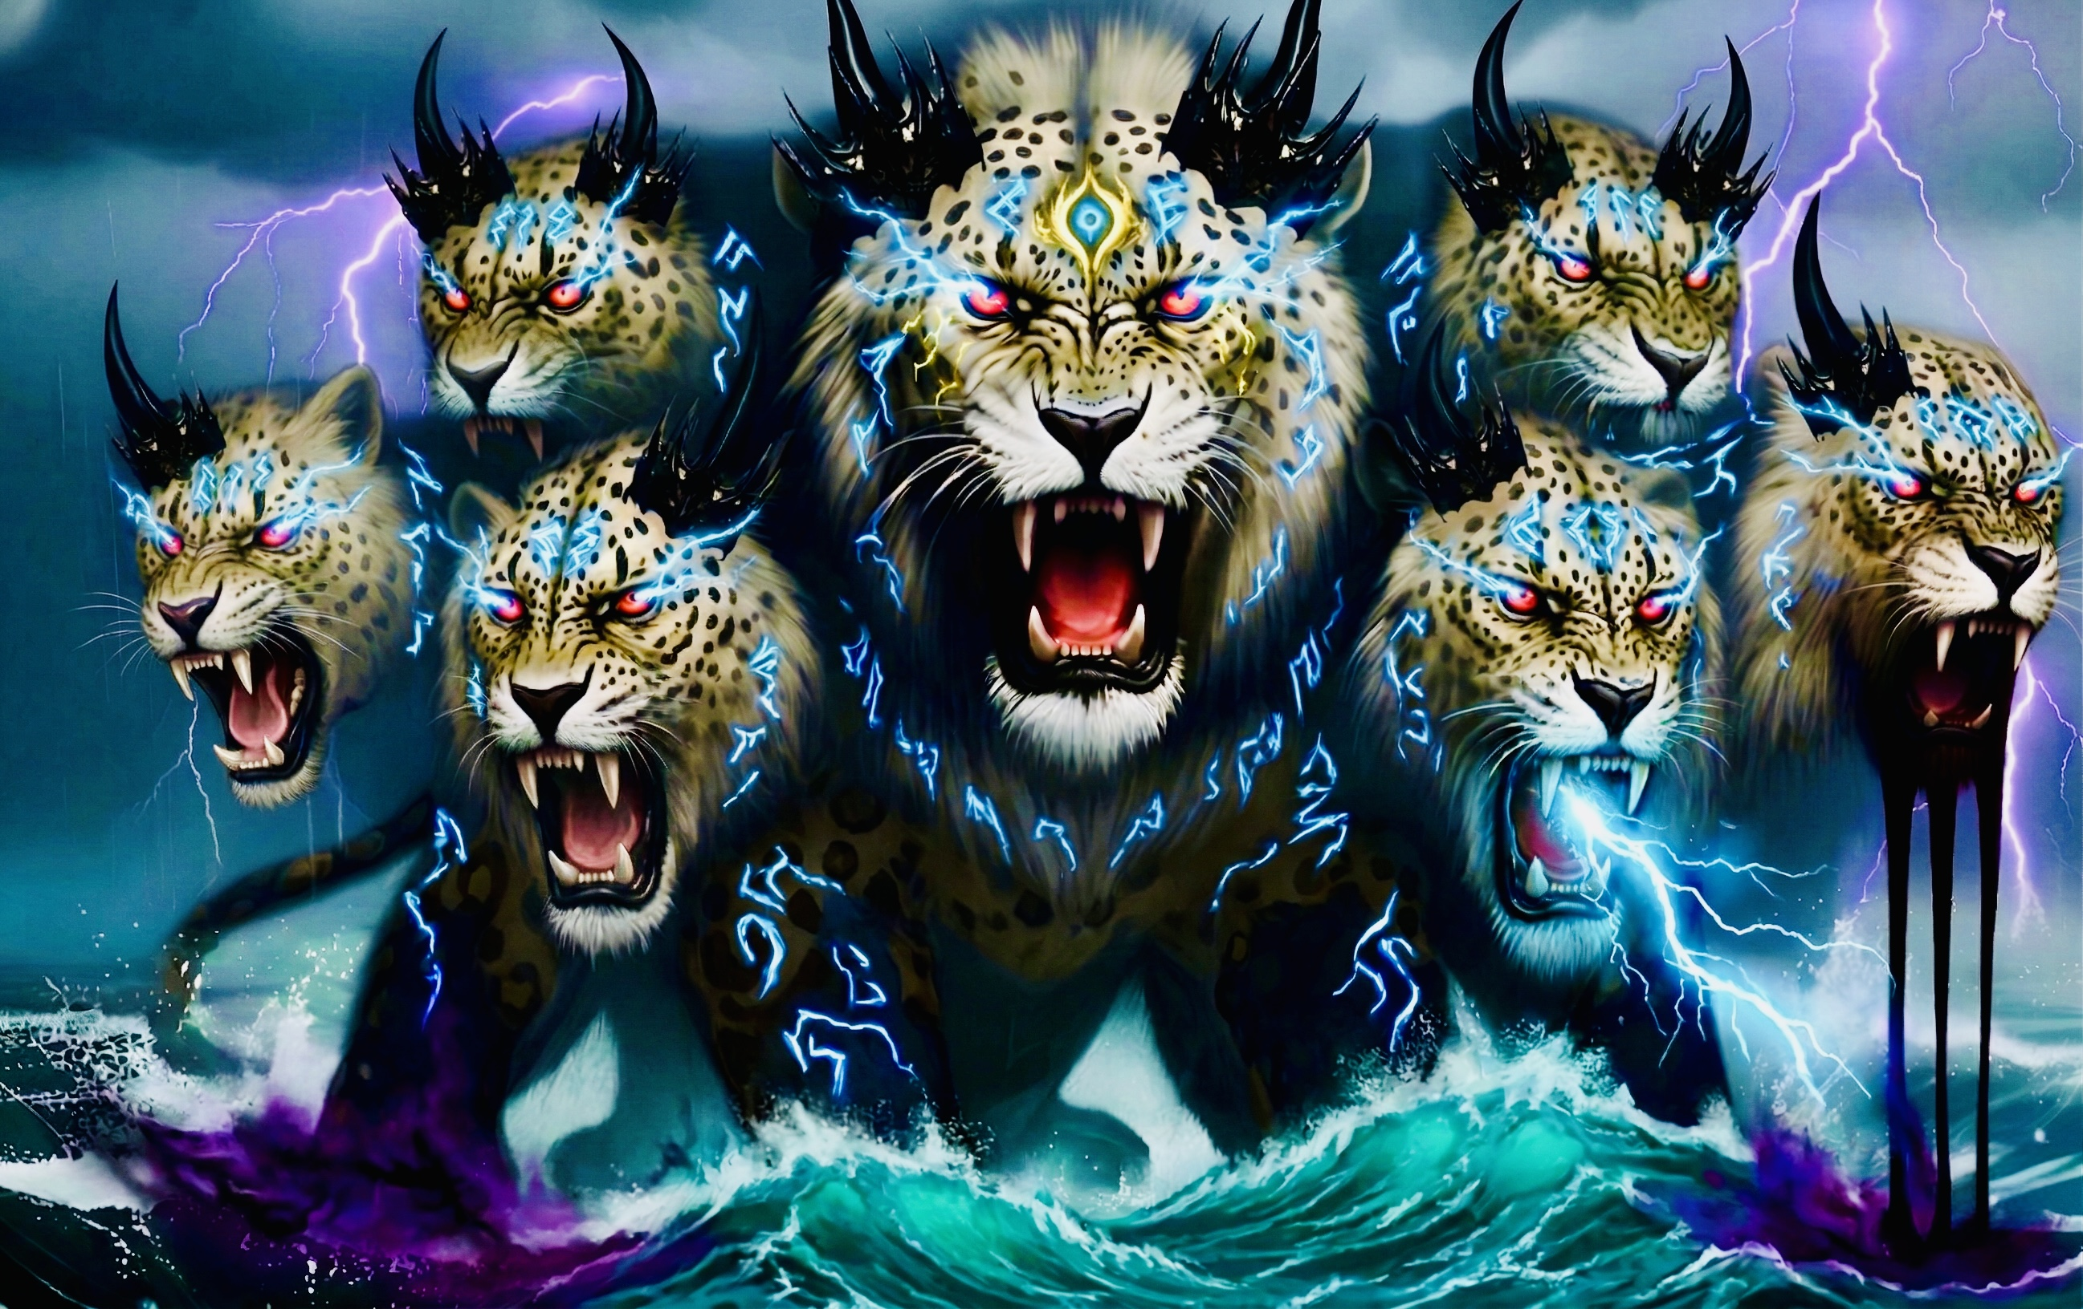
33 兽从海中上来（下）
启示录13章5至10
The Beast Rising Out of the Sea (Part 2)

Slide 2
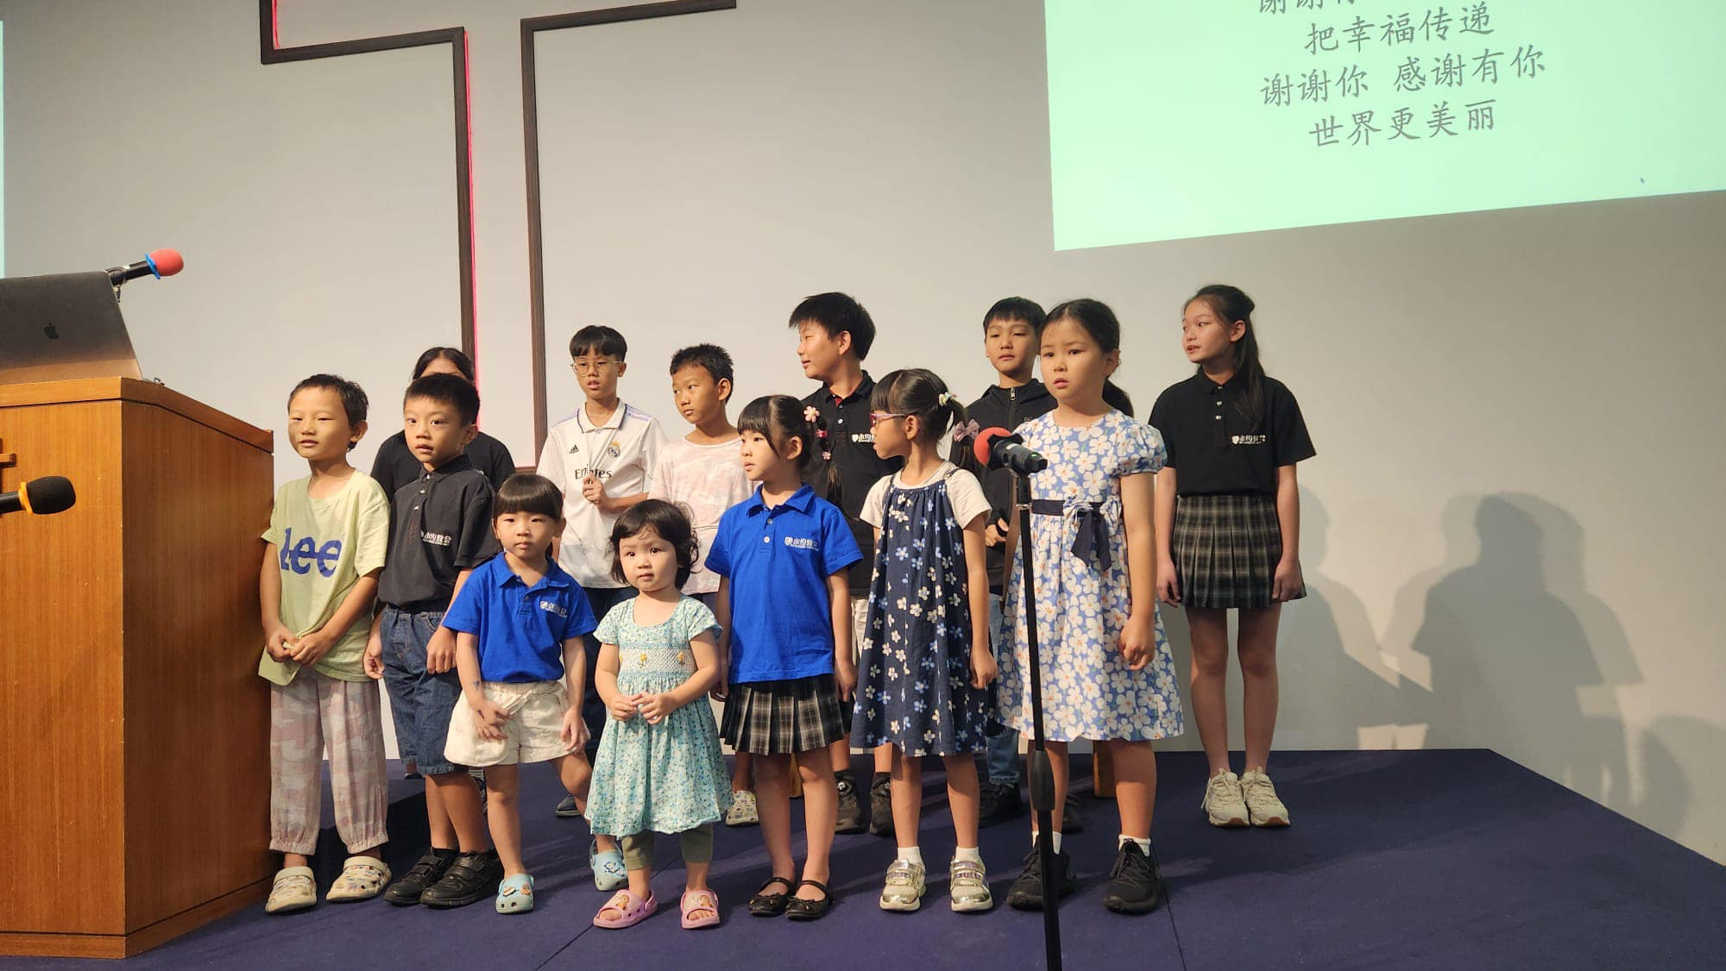

Slide 3
启13:1我又看见一个兽 从海中上来，有十角七头，在十角上戴著十个冠冕，七头上有亵渎的名号。2 我所看见的兽，形状 像豹，脚像熊的脚，口像狮子的口。那龙将自己的能力、座位、和大权柄都给了他。3 我看见兽的七头中，有一个似乎受了死伤，那死伤却医好了。全地的人都希奇跟从那兽，4 又拜那龙，因为他将自己的权柄给了兽，也拜兽，说：「谁能比这兽，谁能与他交战呢？」
Rev 13:1 And I saw a beast rising out of the sea, with ten horns and seven heads, with ten diadems on its horns and blasphemous names on its heads.2 And the beast that I saw was like a leopard; its feet were like a bear's, and its mouth was like a lion's mouth. And to it the dragon gave his power and his throne and great authority.3 One of its heads seemed to have a mortal wound, but its mortal wound was healed, and the whole earth marveled as they followed the beast.4 And they worshiped the dragon, for he had given his authority to the beast, and they worshiped the beast, saying, “Who is like the beast, and who can fight against it?”

Slide 4
5.又赐给它说夸大亵渎话的口，又有权柄赐给它，可以任意而行四十二个月。6.兽就开口向神说亵渎的话，亵渎神的名并他的帐幕，以及那些住在天上的。7.又任凭它与圣徒争战，并且得胜；也把权柄赐给它，制伏各族、各民、各方、各国。8.凡住在地上、名字从创世以来没有记在被杀之羔羊生命册上的人，都要拜它。9.凡有耳的，就应当听！10.掳掠人的，必被掳掠；用刀杀人的，必被刀杀。圣徒的忍耐和信心就是在此。
5.And the beast was given a mouth uttering haughty and blasphemous words, and it was allowed to exercise authority for forty-two months.6.It opened its mouth to utter blasphemies against God, blaspheming his name and his dwelling, that is, those who dwell in heaven.7.Also it was allowed to make war on the saints and to conquer them. And authority was given it over every tribe and people and language and nation,8.and all who dwell on earth will worship it, everyone whose name has not been written before the foundation of the world in the book of life of the Lamb who was slain.9.If anyone has an ear, let him hear:10.If anyone is to be taken captive, to captivity he goes; if anyone is to be slain with the sword, with the sword must he be slain. Here is a call for the endurance and faith of the saints.

Slide 5

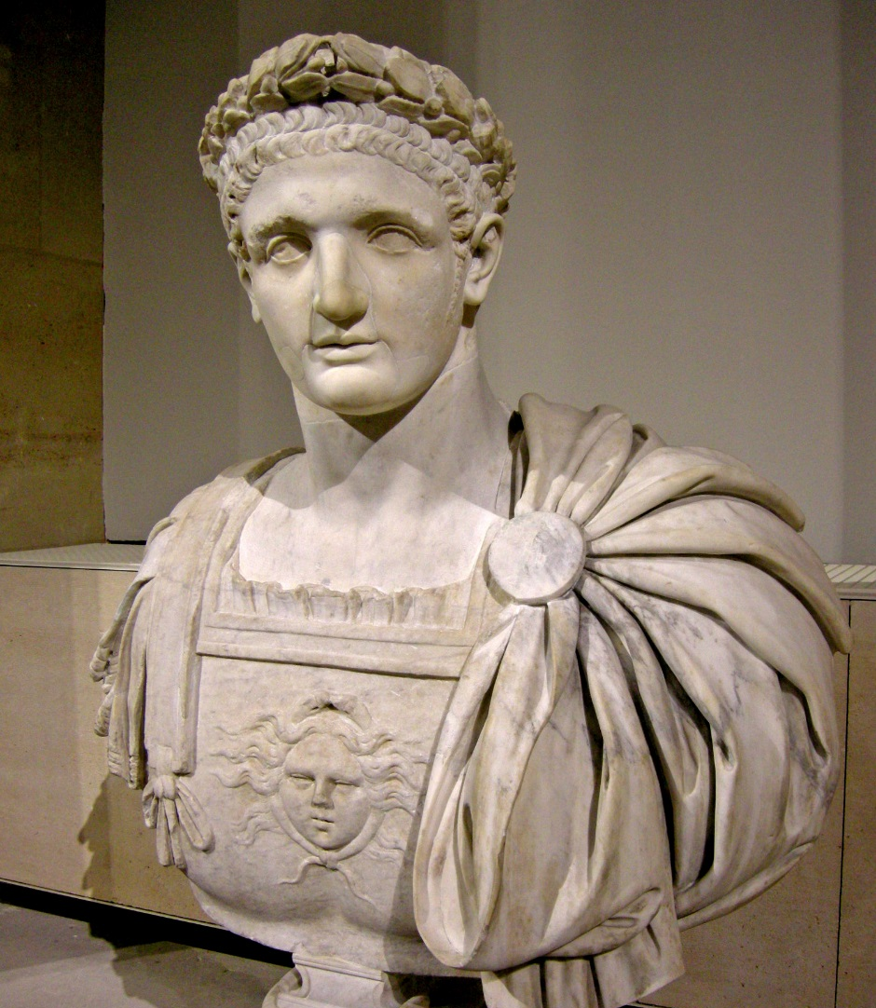
图密善(81-96AD 在位）逼迫杀害基督徒
Titus Flavius Caesar Domitianus
was Roman emperor from 81 to 96. heavily persecuted Christians

Slide 6
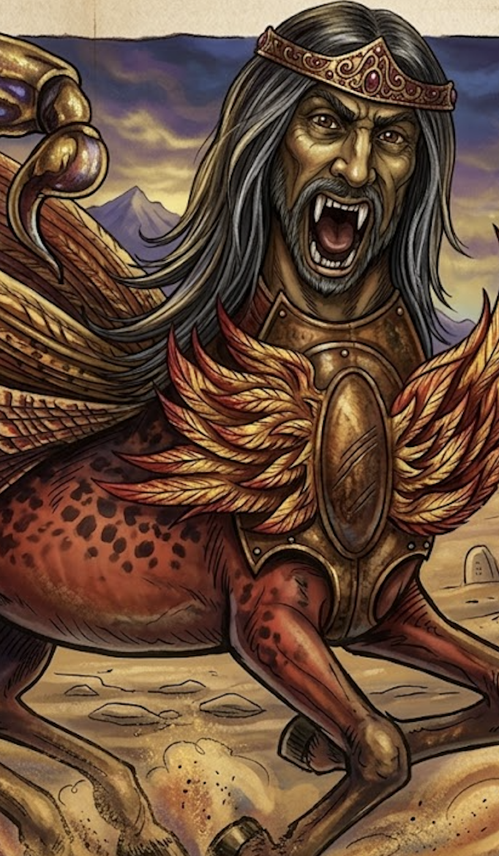
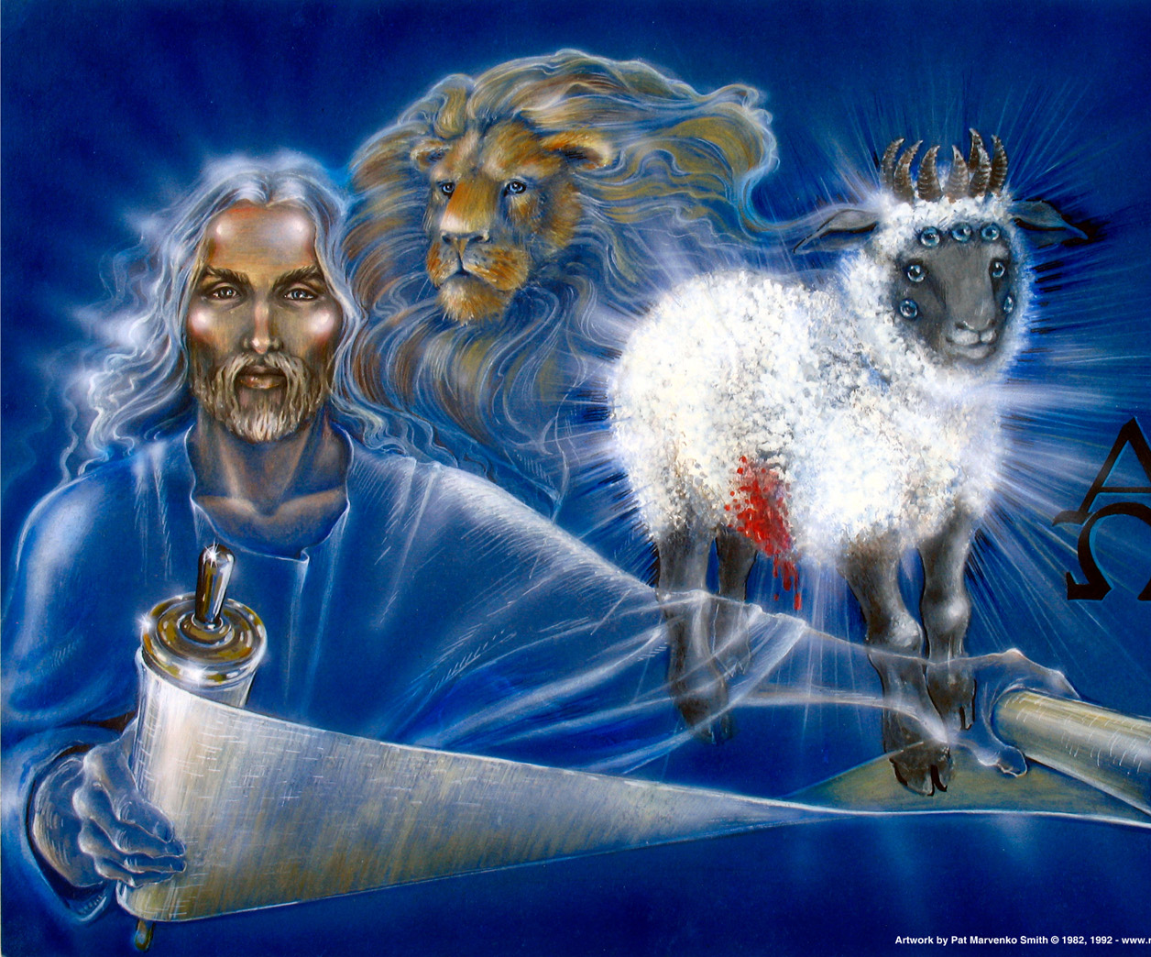
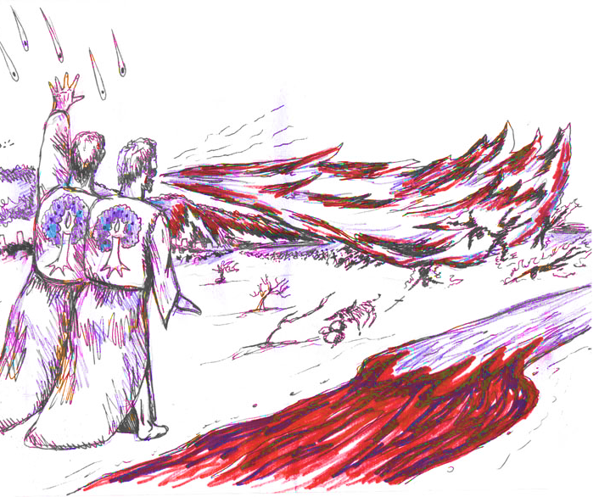
启示文学: Apocalyptic Literature 意象imagery 象征 symbolism

Slide 8
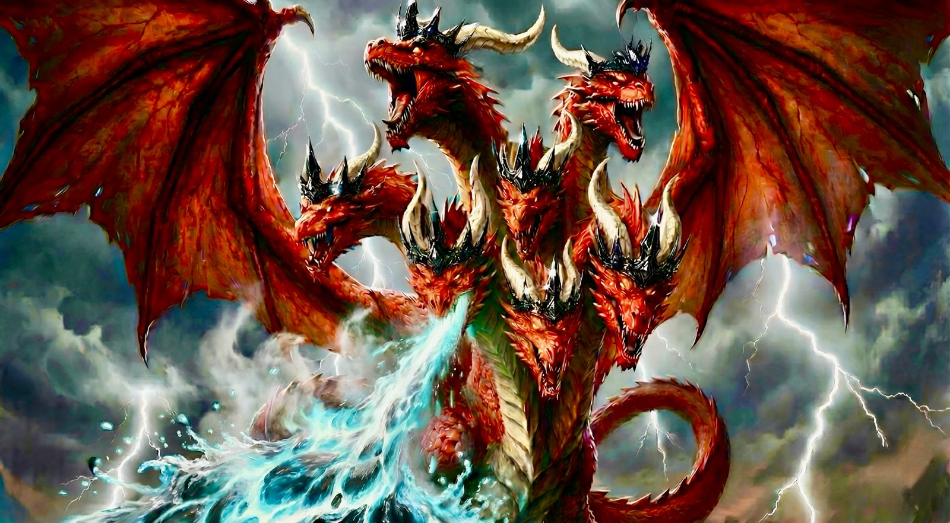
启 12:3 ...有一条大红龙，七头十角；七头上戴著七个冠冕。
Rev 12:3 ...behold, a great red dragon, with seven heads and ten horns, and on his heads seven diadems.

Slide 9
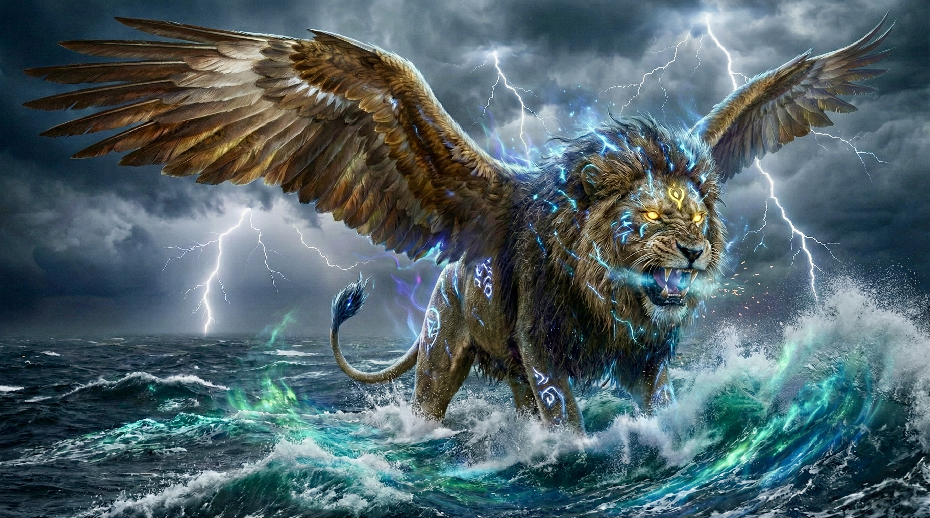
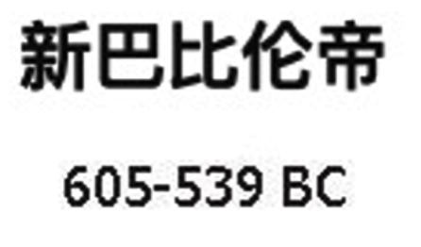
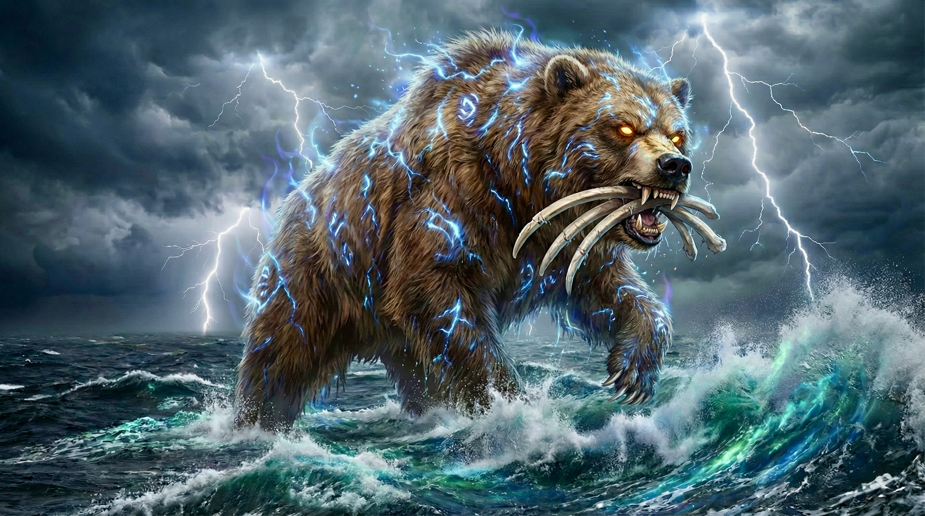

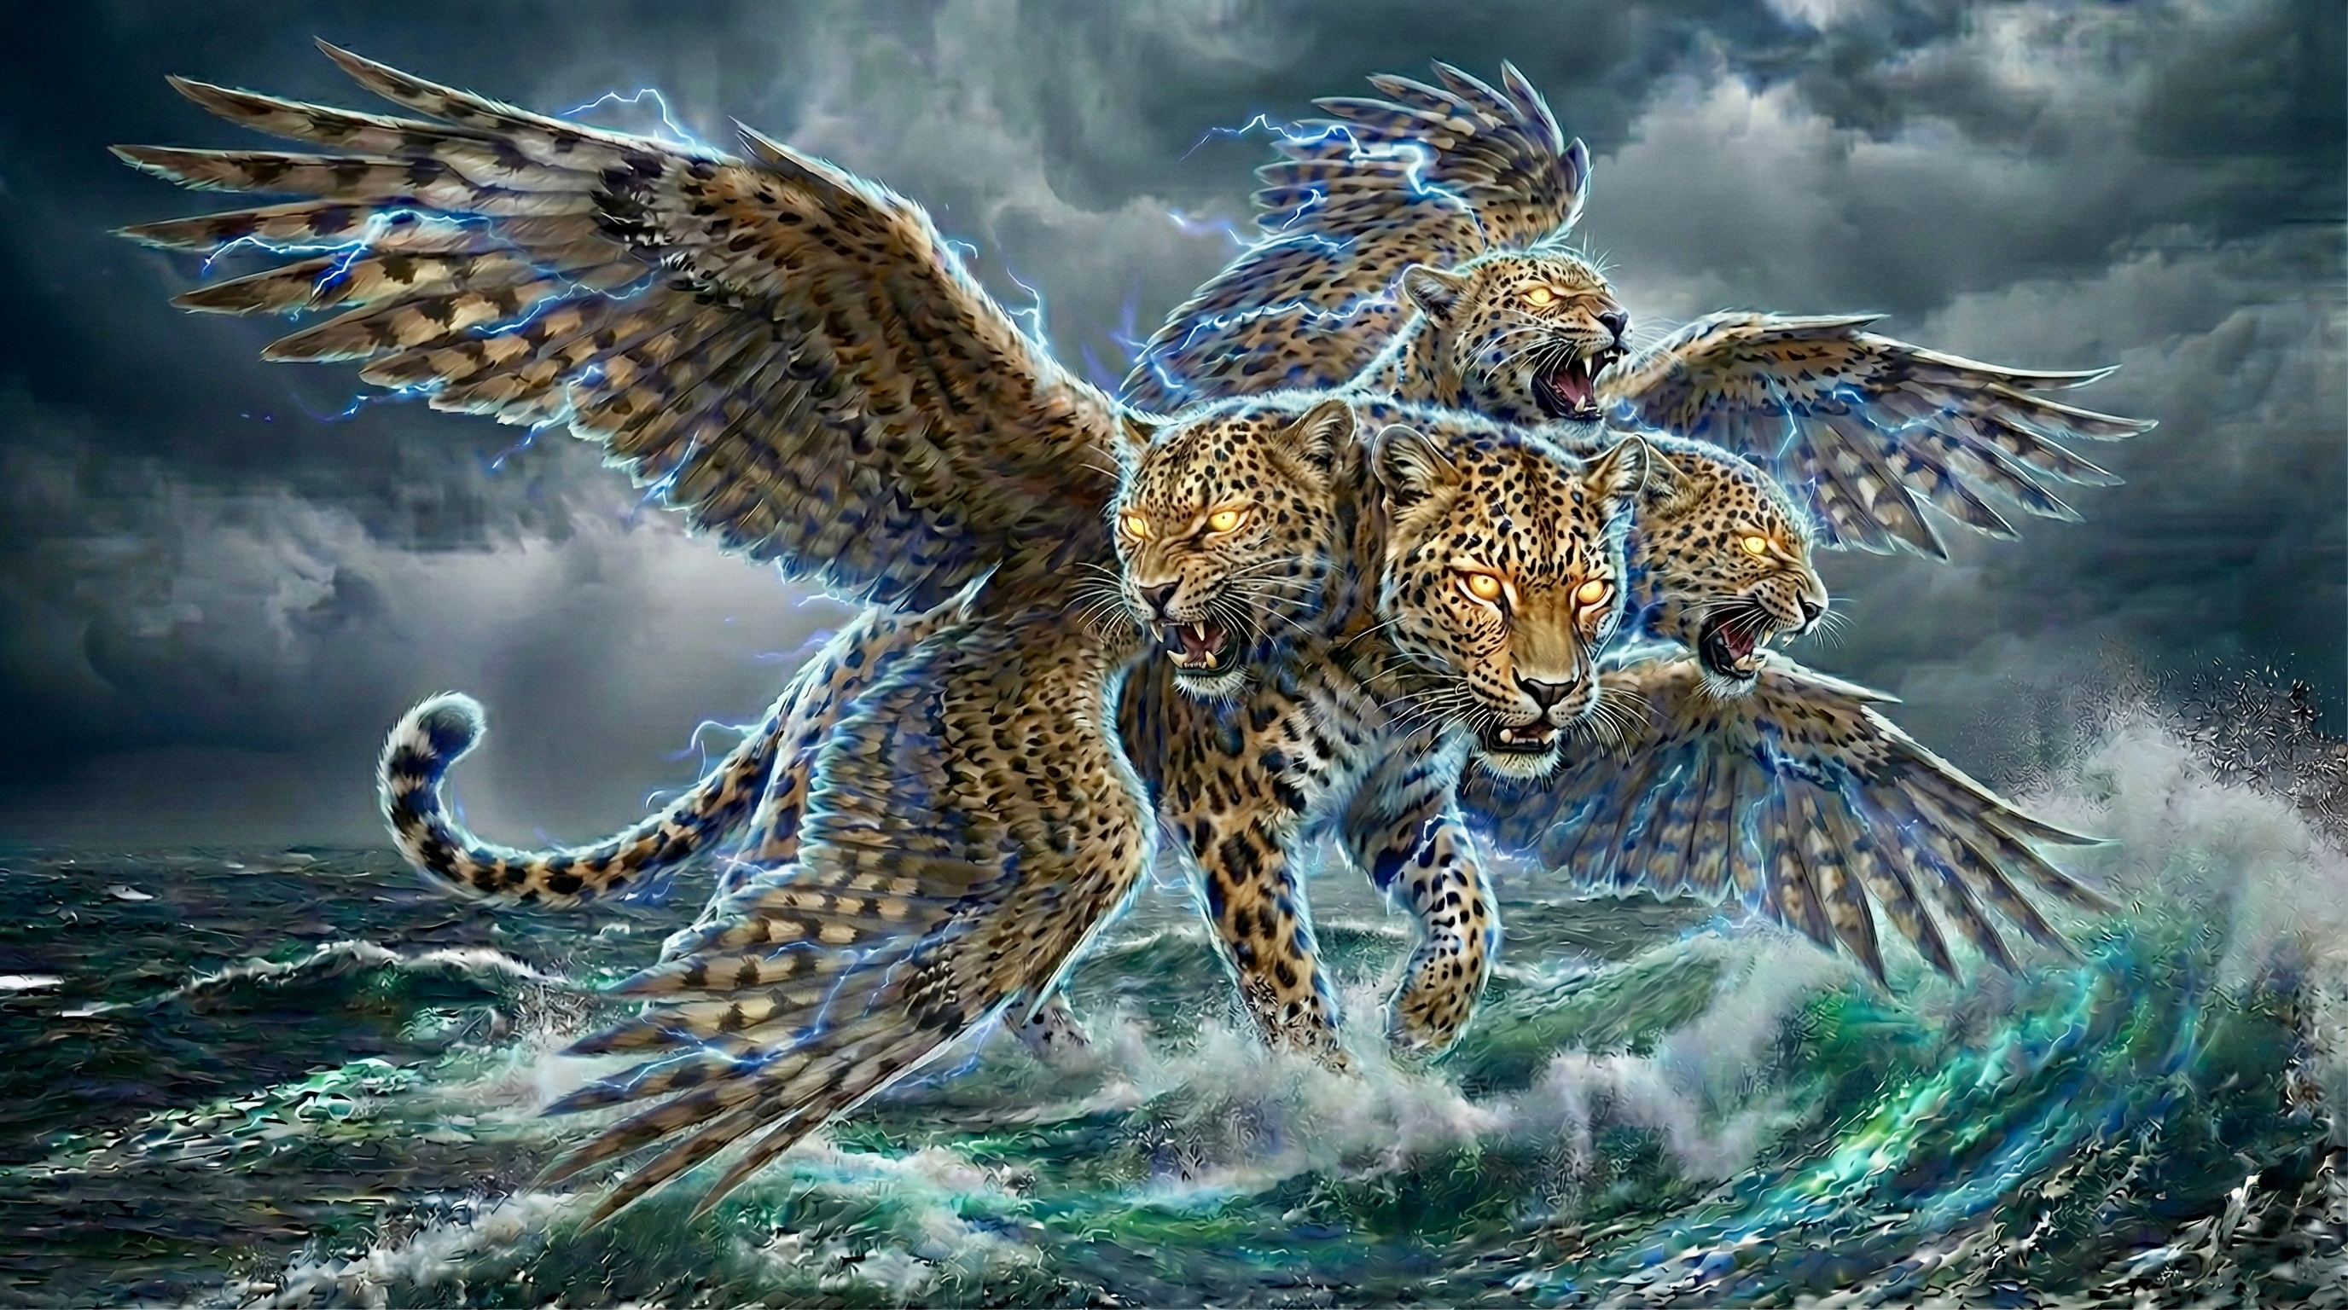
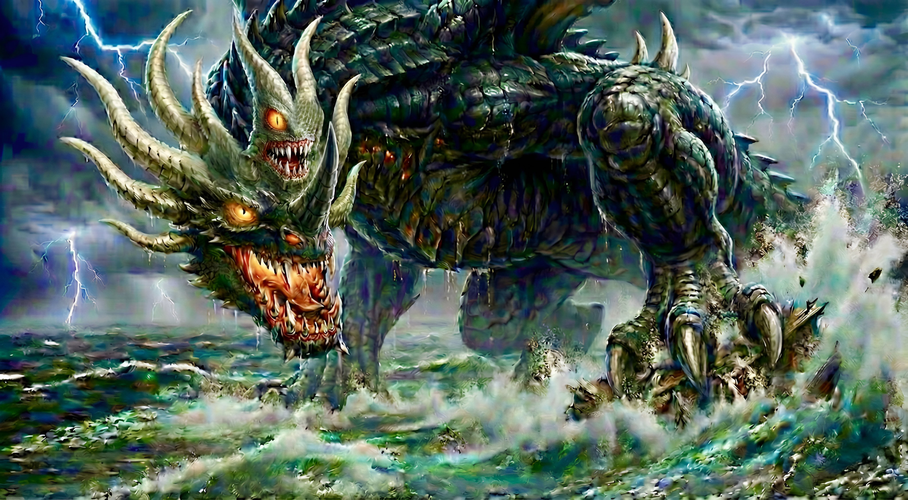
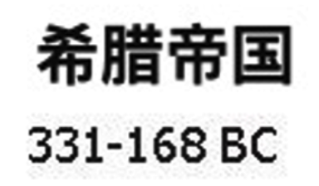
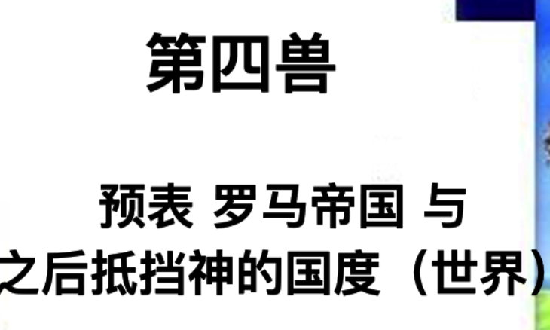
但 7:3 有四个大兽从海中上来，形状各有不同。
Dan 7:3 And four great beasts came up out of the sea, different from one another.

Slide 10
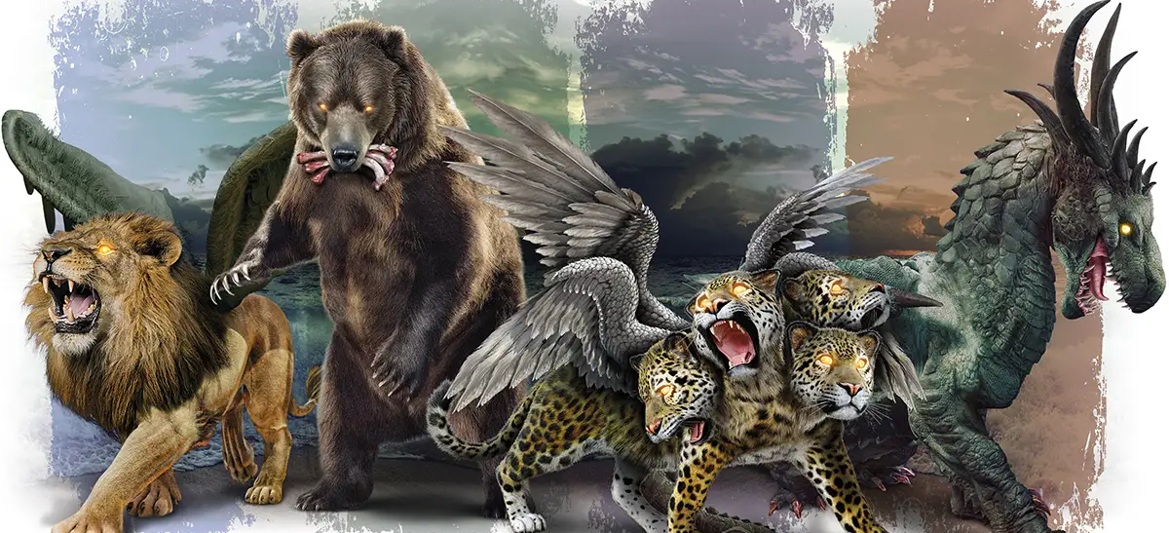
但 7:17 这四个大兽就是四王将要在世上兴起。
Dan 7:17 ‘These four great beasts are four kings who shall arise out of the earth.

Slide 11
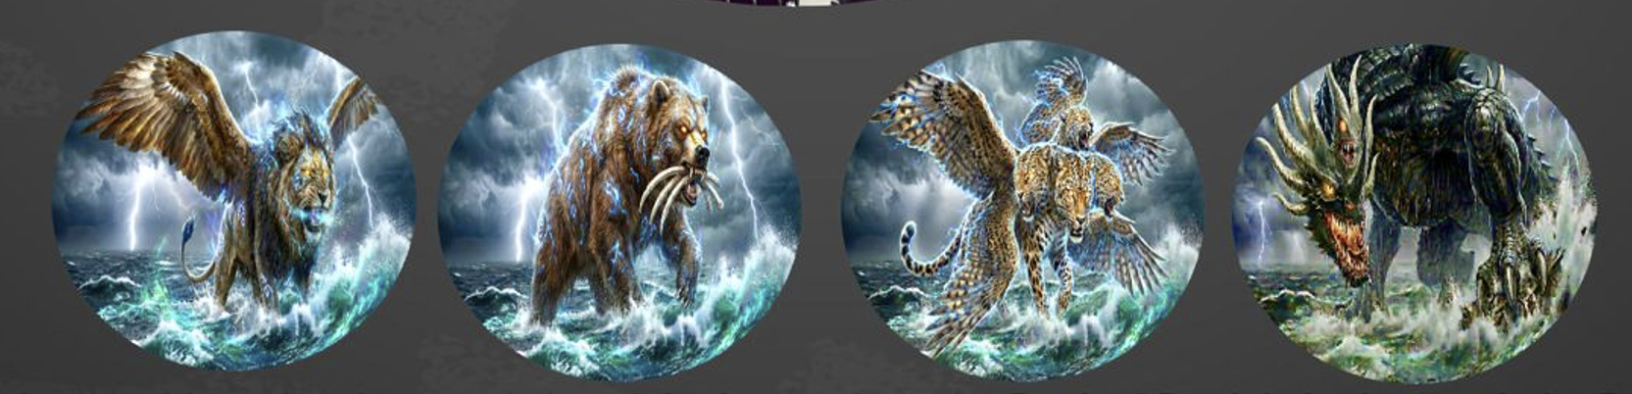
启示录的海兽集合但以理书的海兽特征：狮子、熊、豹、十角怪兽、
但多出了7头、十冠冕
The sea beast in Revelation combines the features of the sea beasts in the book of Daniel: the lion,the bear, the leopard, and the ten-horned beast,but additionally has seven heads and ten crowns.

Slide 12
兽是敌基督，象征所有任何敌对逼迫上帝子民的国度与君王
The Beast is the Antichrist It symbolizes all kingdoms and rulers that opposes and persecutes God's people.
它也预表最终要来的敌基督的世界国度与君王。
It also typifies the final Antichrist kingdom (world) and ruler.

Slide 13
龙使人敬拜兽，赐兽权柄与能力
01
The dragon causes people to worship the beast and gives the beast authority and power.

Slide 14
2 。。。那龙将自己的能力、座位、和大权柄都给了他。。。。4 又拜那龙，因为他将自己的权柄给了兽，也拜兽，说：「谁能比这兽，谁能与他交战呢？」
2 。。。. And to it the dragon gave his power and his throne and great authority.。。。4 And they worshiped the dragon, for he had given his authority to the beast, and they worshiped the beast, saying, “Who is like the beast, and who can fight against it?”

Slide 15
1 领导被神化 成敬拜对象
Leadership is deified and becomes an object of worship
2 国家领导是唯一“拯救者”
National leaders are portrayed as only “savior”
3 对领袖绝对忠心
Absolute loyalty to the leader
4 控制影响社会与文化的思想与媒体
Control and influence over societal and cultural thought and the media

Slide 16
5 运动与组织的手势、符号、口号、
use of gestures, symbols, and slogans in movements and organizations
6 社会中无人可以批评领袖与国家
No one in society is allowed to criticize the leader
7 逼迫基督徒
the nation Persecution of Christians

Slide 17
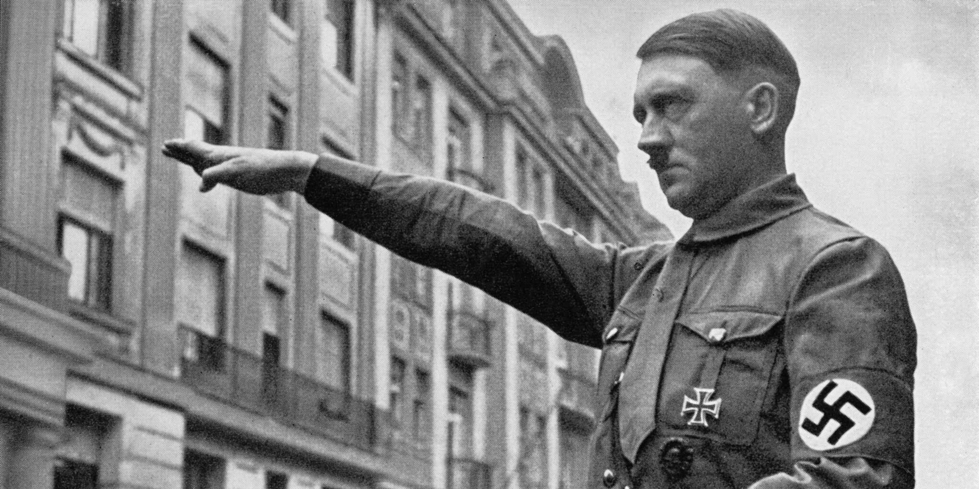
Adolf Hitler（希特勒）领导下的纳粹Nazi德国（1933–1945）
1领导被神化 成敬拜对象
Leadership is deified and becomes an object of worship
2国家领导是唯一“拯救者”
National leaders are portrayed as “saviors”
3对领袖绝对忠心
Absolute loyalty to the leader
4控制影响社会与文化的思想与媒体
Control and influence over societal and cultural thought and the media

Slide 18
Adolf Hitler（希特勒）领导下的纳粹Nazi德国（1933–1945）
5运动与组织的手势、符号、口号、
use of gestures, symbols, and slogans in movements and organizations
6社会中无人可以批评领袖与国家
No one in society is allowed to criticize the leader
7逼迫基督徒
the nation Persecution of Christians

Slide 19
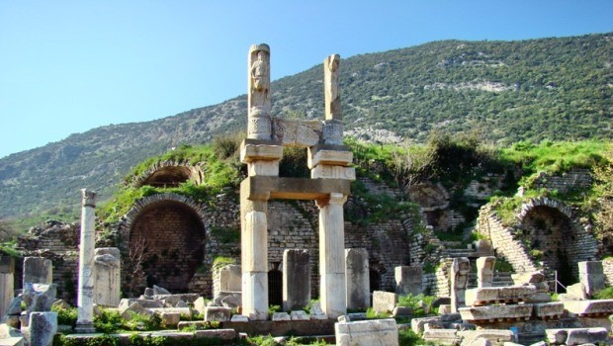
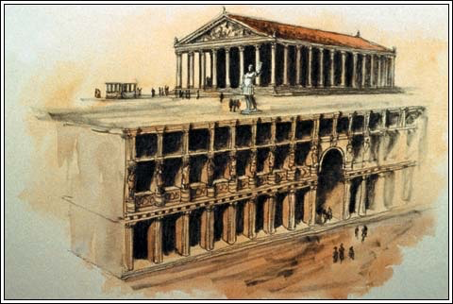
敬拜图密善的庙殿，在土耳其（以弗所）
Domitian temple at Ephesus
图密善(81-96 在位）
自称为神与主，并要求被敬拜
Titus Flavius Caesar Domitianus demands to be worshiped as God and Lord.

Slide 20
启11:7.他们作完见证的时候，那从无底坑里上来的兽必与他们交战，并且得胜，把他们杀了。
Revelation 11:7.And when they have finished their testimony, the beast that rises from the bottomless pit will make war on them and conquer them and kill them,

Slide 21
终极的兽出现时，除了神所拣选的人，世人都会跟从并敬拜他
02
When the ultimate beast appears, all people will follow and worship him except those chosen by God.
.

Slide 22
3 。。。全地的人都希奇跟从那兽，4 又拜那龙，因为他将自己的权柄给了兽，也拜兽，。。。 8.凡住在地上、名字从创世以来没有记在被杀之羔羊生命册上的人，都要拜它。
3 。。。and the whole earth marveled as they followed the beast.4 And they worshiped the dragon, for he had given his authority to the beast, and they worshiped the beast, 。。。 8.and all who dwell on earth will worship it, everyone whose name has not been written before the foundation of the world in the book of life of the Lamb who was slain.

Slide 23

8.凡住在地上、名字从创世以来没有记在被杀之羔羊生命册上的人，都要拜它。
8.and all who dwell on earth will worship it, everyone whose name has not been written before the foundation of the world in the book of life of the Lamb who was slain.

Slide 24
弗1:4.就如神从创立世界以前，在基督里拣选了我们，使我们在他面前成为圣洁，无有瑕疵；
Eph 1:4 even as he chose us in him before the foundation of the world, that we should be holy and blameless before him. In love

Slide 25
海兽说亵渎神的话
03
The sea beast speaks blasphemous words against God.

Slide 26
5.又赐给它说夸大亵渎话的口，又有权柄赐给它，可以任意而行四十二个月。6.兽就开口向神说亵渎的话，亵渎神的名并他的帐幕，以及那些住在天上的。
5.And the beast was given a mouth uttering haughty and blasphemous words, and it was allowed to exercise authority for forty-two months.6.It opened its mouth to utter blasphemies against God, blaspheming his name and his dwelling, that is, those who dwell in heaven.

Slide 27
但以理书中的第四海兽
角有眼睛，口说夸大的话
但7:7-8、但7:19-21、25
(兽的角象征王 但7:24)
The fourth sea beast in the book of Daniel
Its horn has eyes and a mouth that speaks great things
Daniel 7:7–8; Daniel 7:19–21; 25
(The horns of the beast symbolize kings, Daniel 7:24)

Slide 28

帖后 2:2....，说主的日子现在到了，不要轻易动心，也不要惊慌。3.人不拘用什么法子，你们总不要被他诱惑；因为那日子以前，必有离道反教的事，并有那大罪人，就是沉沦之子，显露出来。4.他是抵挡主，高抬自己，超过一切称为神的和一切受人敬拜的，甚至坐在神的殿里，自称是神。
2 Thessalonians 2:2.... to the effect that the day of the Lord has come.3.Let no one deceive you in any way. For that day will not come, unless the rebellion comes first, and the man of lawlessness is revealed, the son of destruction, 4.who opposes and exalts himself against every so-called god or object of worship, so that he takes his seat in the temple of God, proclaiming himself to be God.

Slide 29
（1）全世界的人都会跟从并敬拜兽
People throughout the whole world will follow and worship the beast
（2）兽会说夸大亵渎话，自称为神。
(2) The beast will speak arrogant and blasphemous words and will claim to be God

Slide 30
兽逼迫教会四十二个月
04
The beast persecutes the church for forty-two months.

Slide 31
三年半 | 书卷 | 象征整个新约教会时代
42个月 | 启11:2 | 【逼迫】外邦人践踏圣城（教会）。
1260天 | 启11:3 | 【逼迫】神保护两个见证人（教会）, 传道1260天。
42个月 | 启13:5 | 【逼迫】 海兽任意逼迫教会。（但7:25）
1260天 | 启12:6 | 【逼迫】神保护受逼迫的妇人（教会）被养活1260天 妇人生下基督V5也生下为耶稣作见证的儿女“基督徒”V17
一载二载半载 | 启12:14 | 【逼迫】神保护妇人（教会）躲避龙的逼迫
一载二载半载 | 但7:25 但12:7 | 【逼迫】但以理书第四海兽折磨圣民

Slide 32
蒙神所拣选的人必坚忍到
05
Those chosen by God will persevere to the end.

Slide 33
7.又任凭它与圣徒争战，并且得胜；也把权柄赐给它，制伏各族、各民、各方、各国。8.凡住在地上、名字从创世以来没有记在被杀之羔羊生命册上的人，都要拜它。9.凡有耳的，就应当听！10.掳掠人的，必被掳掠；用刀杀人的，必被刀杀。圣徒的忍耐和信心就是在此。
7.Also it was allowed to make war on the saints and to conquer them. And authority was given it over every tribe and people and language and nation,8.and all who dwell on earth will worship it, everyone whose name has not been written before the foundation of the world in the book of life of the Lamb who was slain.9.If anyone has an ear, let him hear:10.If anyone is to be taken captive, to captivity he goes; if anyone is to be slain with the sword, with the sword must he be slain. Here is a call for the endurance and faith of the saints.

Slide 34
9.凡有耳的，就应当听！10.掳掠人的，必被掳掠；用刀杀人的，必被刀杀。圣徒的忍耐和信心就是在此。
9.If anyone has an ear, let him hear: 10.If anyone is to be taken captive, to captivity he goes; if anyone is to be slain with the sword, with the sword must he be slain. Here is a call for the endurance and faith of the saints.

Slide 35
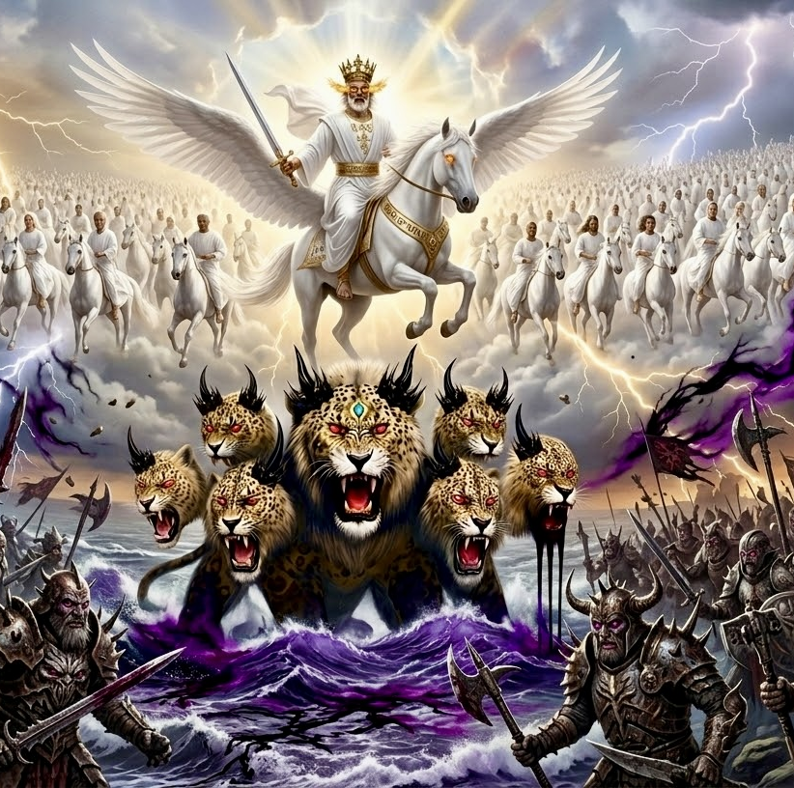
启19:19
我看见那兽和 地上的君王，并他们的众军都聚集，要与骑白马的并他的军兵争战。
Rev 19:19 And I saw the beast and the kings of the earth with their armies gathered to make war against him who was sitting on the horse and against his army.

Slide 36
1）世人都会跟从并敬拜兽
People in the world will follow and worship the beast
2）兽会说夸大亵渎话，自称为神。
(2) The beast will speak arrogant and blasphemous words and will claim to be God
3）迫害基督徒
(3) Persecution of Christians

Slide 37
可 13:13.并且你们要为我的名被众人恨恶。惟有忍耐到底的，必然得救。
Mrk 13:13 And you will be hated by all for my name's sake. But the one who endures to the end will be saved.

