Slide 1

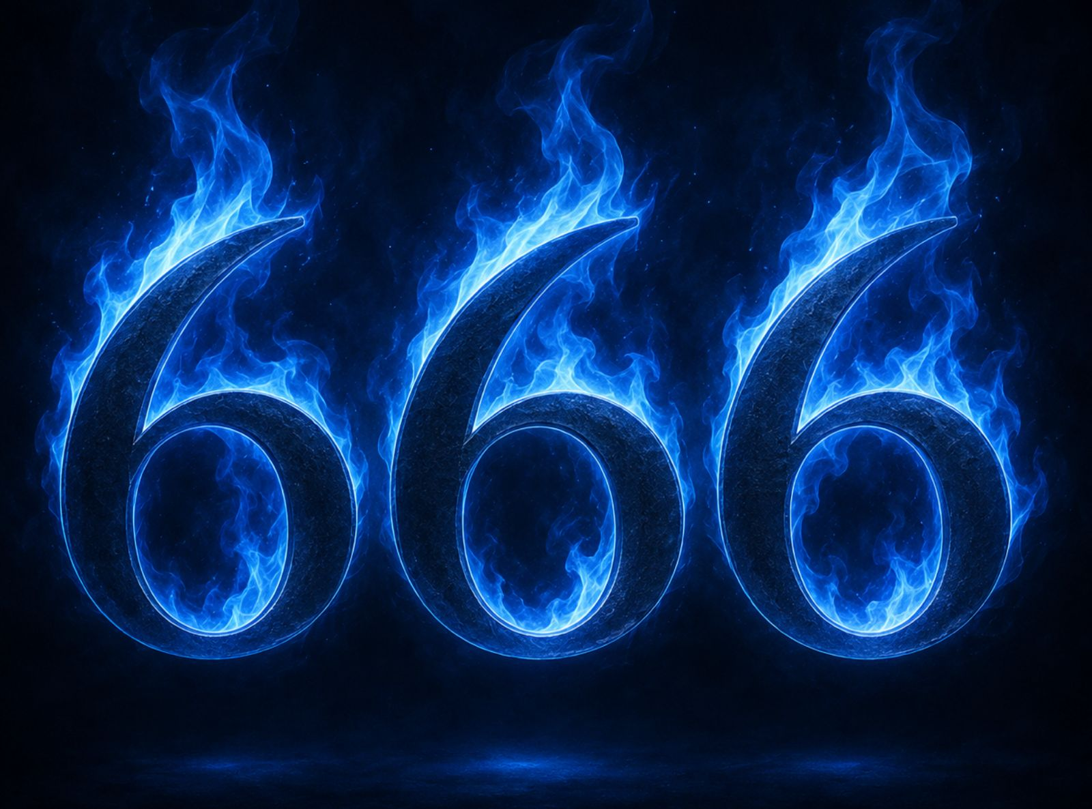
《 6 6 6 》
启示录13章11至18（下）
666 .(Part 2)

Slide 2
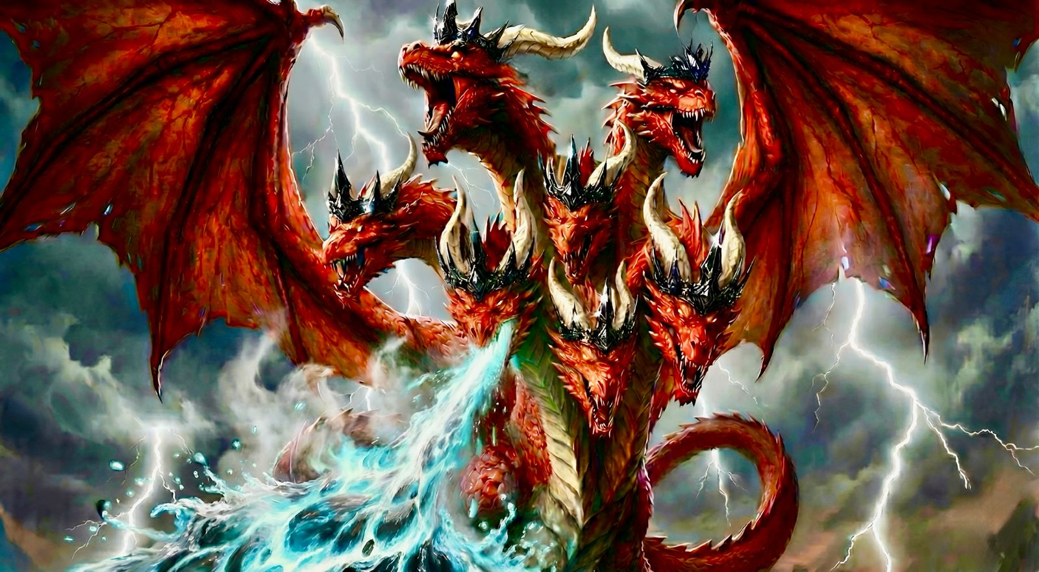
启 12:3 ...有一条大红龙，七头十角；七头上戴著七个冠冕。
Rev 12:3 ...behold, a great red dragon, with seven heads and ten horns, and on his heads seven diadems.

Slide 3
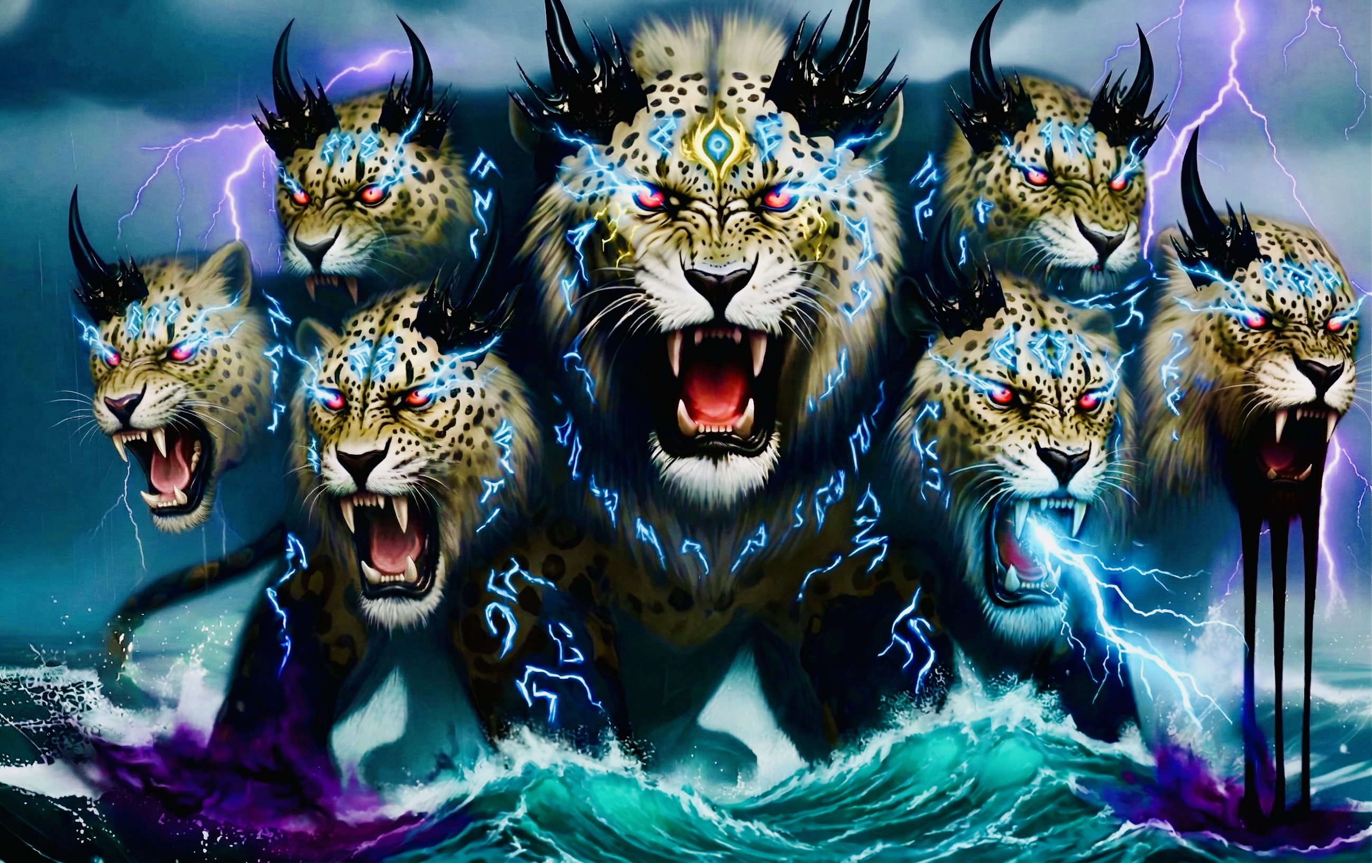
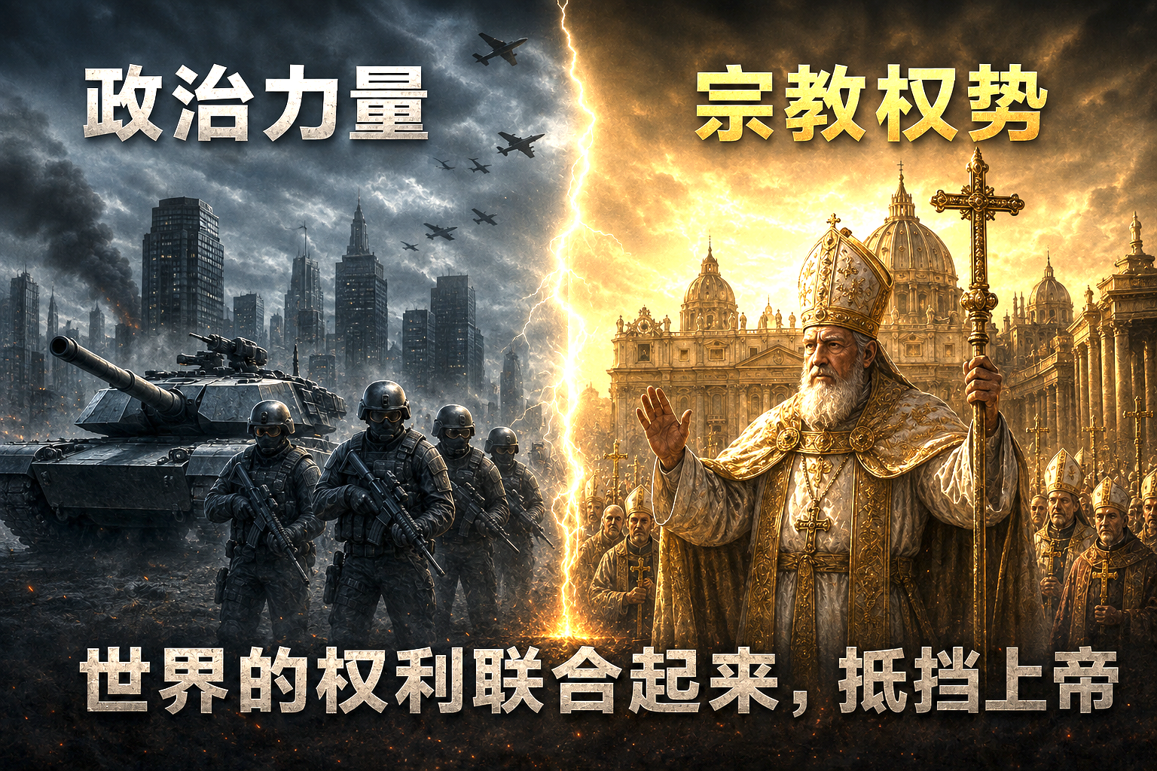

逼迫伤害基督徒的（君王、帝国、政治、国度）
Those who persecute and harm Christians (kings, empires, political powers, kingdoms)

Slide 4

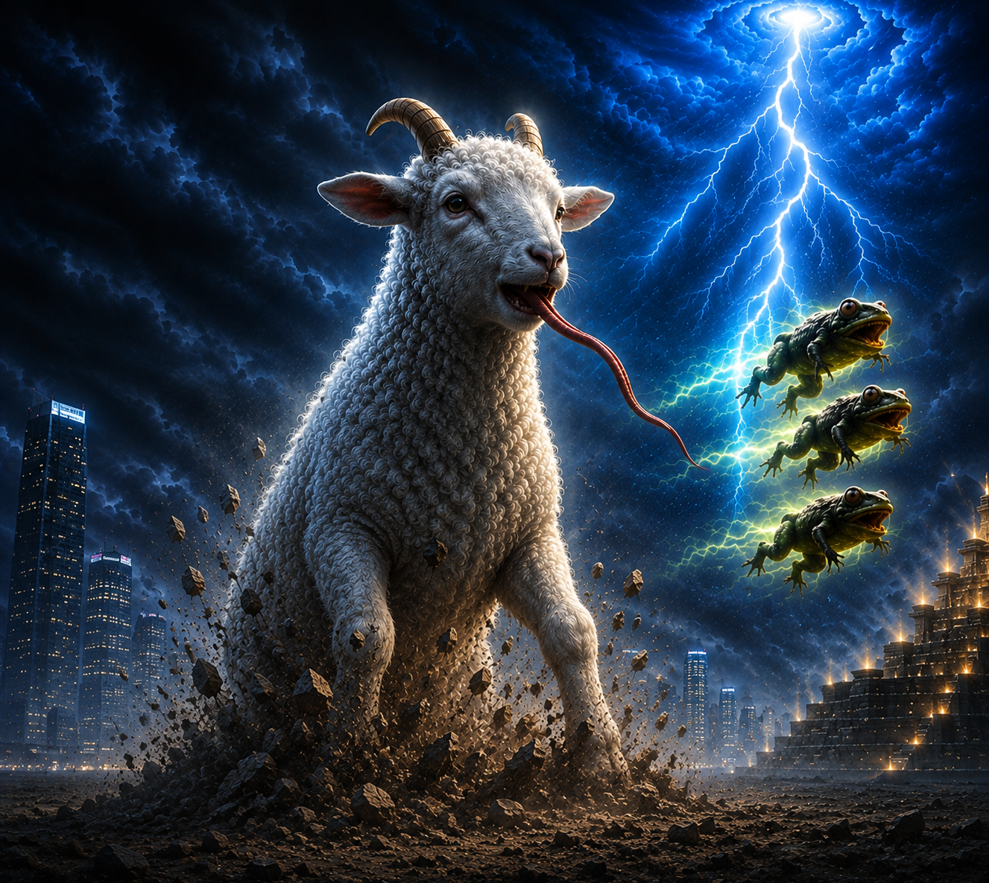
说话好像龙
假先知
it spoke like a dragon.
False prophet

Slide 5
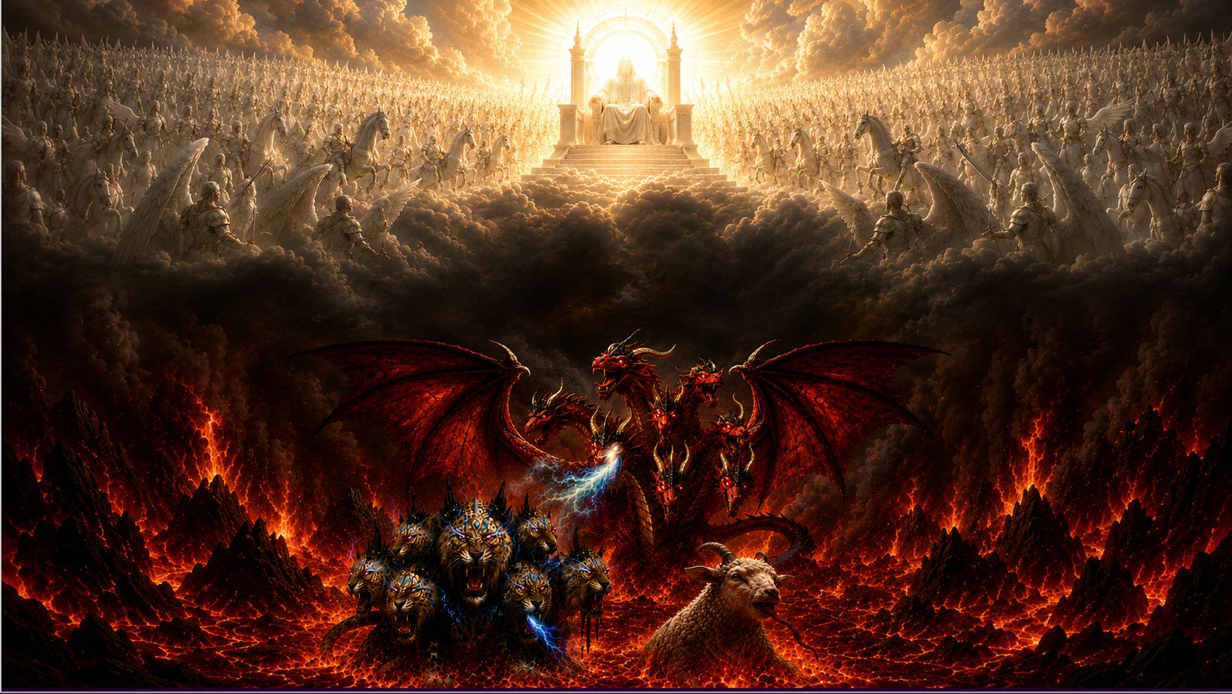
基督得胜

Slide 6
启13:11 我又看见另有一个兽从地中上来有两角如同羊羔，说话好像龙。12 他在头一个兽面前，施行头一个兽所有的权柄，并且叫地和住在地上的人拜那死伤医好的头一个兽。13 又行大奇事，甚至在人面前，叫火从天降在地上。14 他因赐给他权柄在兽面前能行奇事，就迷惑住在地上的人，说：「要给那受刀伤还活著的兽作个像。」启 13:11 我又看见另有一个兽从地中上来有两角如同羊羔，说话好像龙。12 他在头一个兽面前，施行头一个兽所有的权柄，且叫地和住在地上的人拜那死伤医好的头一个兽。13 又行大奇事，甚至在人面前，叫火从天降在地上。14 他因赐给他权柄在兽面前能行奇事，就迷惑住在地上的人，说：「要给那受刀伤还活著的兽作个像。」
Rev 13:11 Then I saw another beast rising out of the earth. It had two horns like a lamb and it spoke like a dragon.12 It exercises all the authority of the first beast in its presence, and makes the earth and its inhabitants worship the first beast, whose mortal wound was healed.13 It performs great signs, even making fire come down from heaven to earth in front of people,14 and by the signs that it is allowed to work in the presence of the beast it deceives those who dwell on earth, telling them to make an image for the beast that was wounded by the sword and yet lived.

Slide 7
15.又有权柄赐给它，叫兽像有生气，并且能说话，又叫所有不拜兽像的人都被杀害。16.它又叫众人，无论大小贫富，自主的、为奴的，都在右手上或是在额上受一个印记。17.除了那受印记、有了兽名或有兽名数目的，都不得作买卖。18.在这里有智慧。凡有聪明的，可以算计兽的数目，因为这是人的数目，它的数目是六百六十六。我又看见另有一个兽从地中上来有两角如同羊羔，说话好像龙。12 他在头一个兽面前，施行头一个兽所有的权柄，且叫地和住在地上的人拜那死伤医好的头一个兽。13 又行大奇事，甚至在人面前，叫火从天降在地上。14 他因赐给他权柄在兽面前能行奇事，就迷惑住在地上的人，说：「要给那受刀伤还活著的兽作个像。」
15.And it was allowed to give breath to the image of the beast, so that the image of the beast might even speak and might cause those who would not worship the image of the beast to be slain.16.Also it causes all, both small and great, both rich and poor, both free and slave, to be marked on the right hand or the forehead,17.so that no one can buy or sell unless he has the mark, that is, the name of the beast or the number of its name.18.This calls for wisdom: let the one who has understanding calculate the number of the beast, for it is the number of a man, and his number is 666.

Slide 8
地兽（假先知）迷惑世人去拜兽像
01
The beast from the earth (the false prophet) deceives
the world into worshiping the image of the beast.
.

Slide 9
14 他因赐给他权柄在兽面前能行奇事，就迷惑住在地上的人，说:「要给那受刀伤还活著的兽作个像。」启 13:11 我又看见另有一个兽从地中上来有两角如同羊羔，说话好像龙。12 他在头一个兽面前，施行头一个兽所有的权柄，且叫地和住在地上的人拜那死伤医好的头一个兽。13 又行大奇事，甚至在人面前，叫火从天降在地上。14 他因赐给他权柄在兽面前能行奇事，就迷惑住在地上的人，说：「要给那受刀伤还活著的兽作个像。」
14 and by the signs that it is allowed to work in the presence of the beast it deceives those who dwell on earth, telling them to make an image for the beast that was wounded by the sword and yet lived.

Slide 10
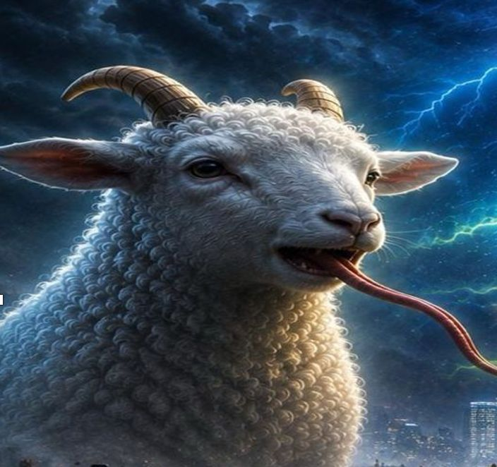
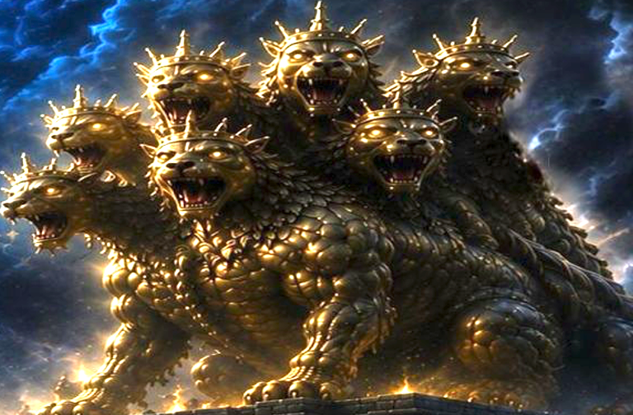
龙（撒旦）赐权柄给地兽
The dragon (Satan) gives authority to the beast from the earth.
地兽叫海兽的像有生气并且能说话
The Land beast allowed to give breath to the image of the Sea beast, so that the image might even speak
兽的像
The image of the Sea Beast
海兽
the Sea Beast

Slide 11
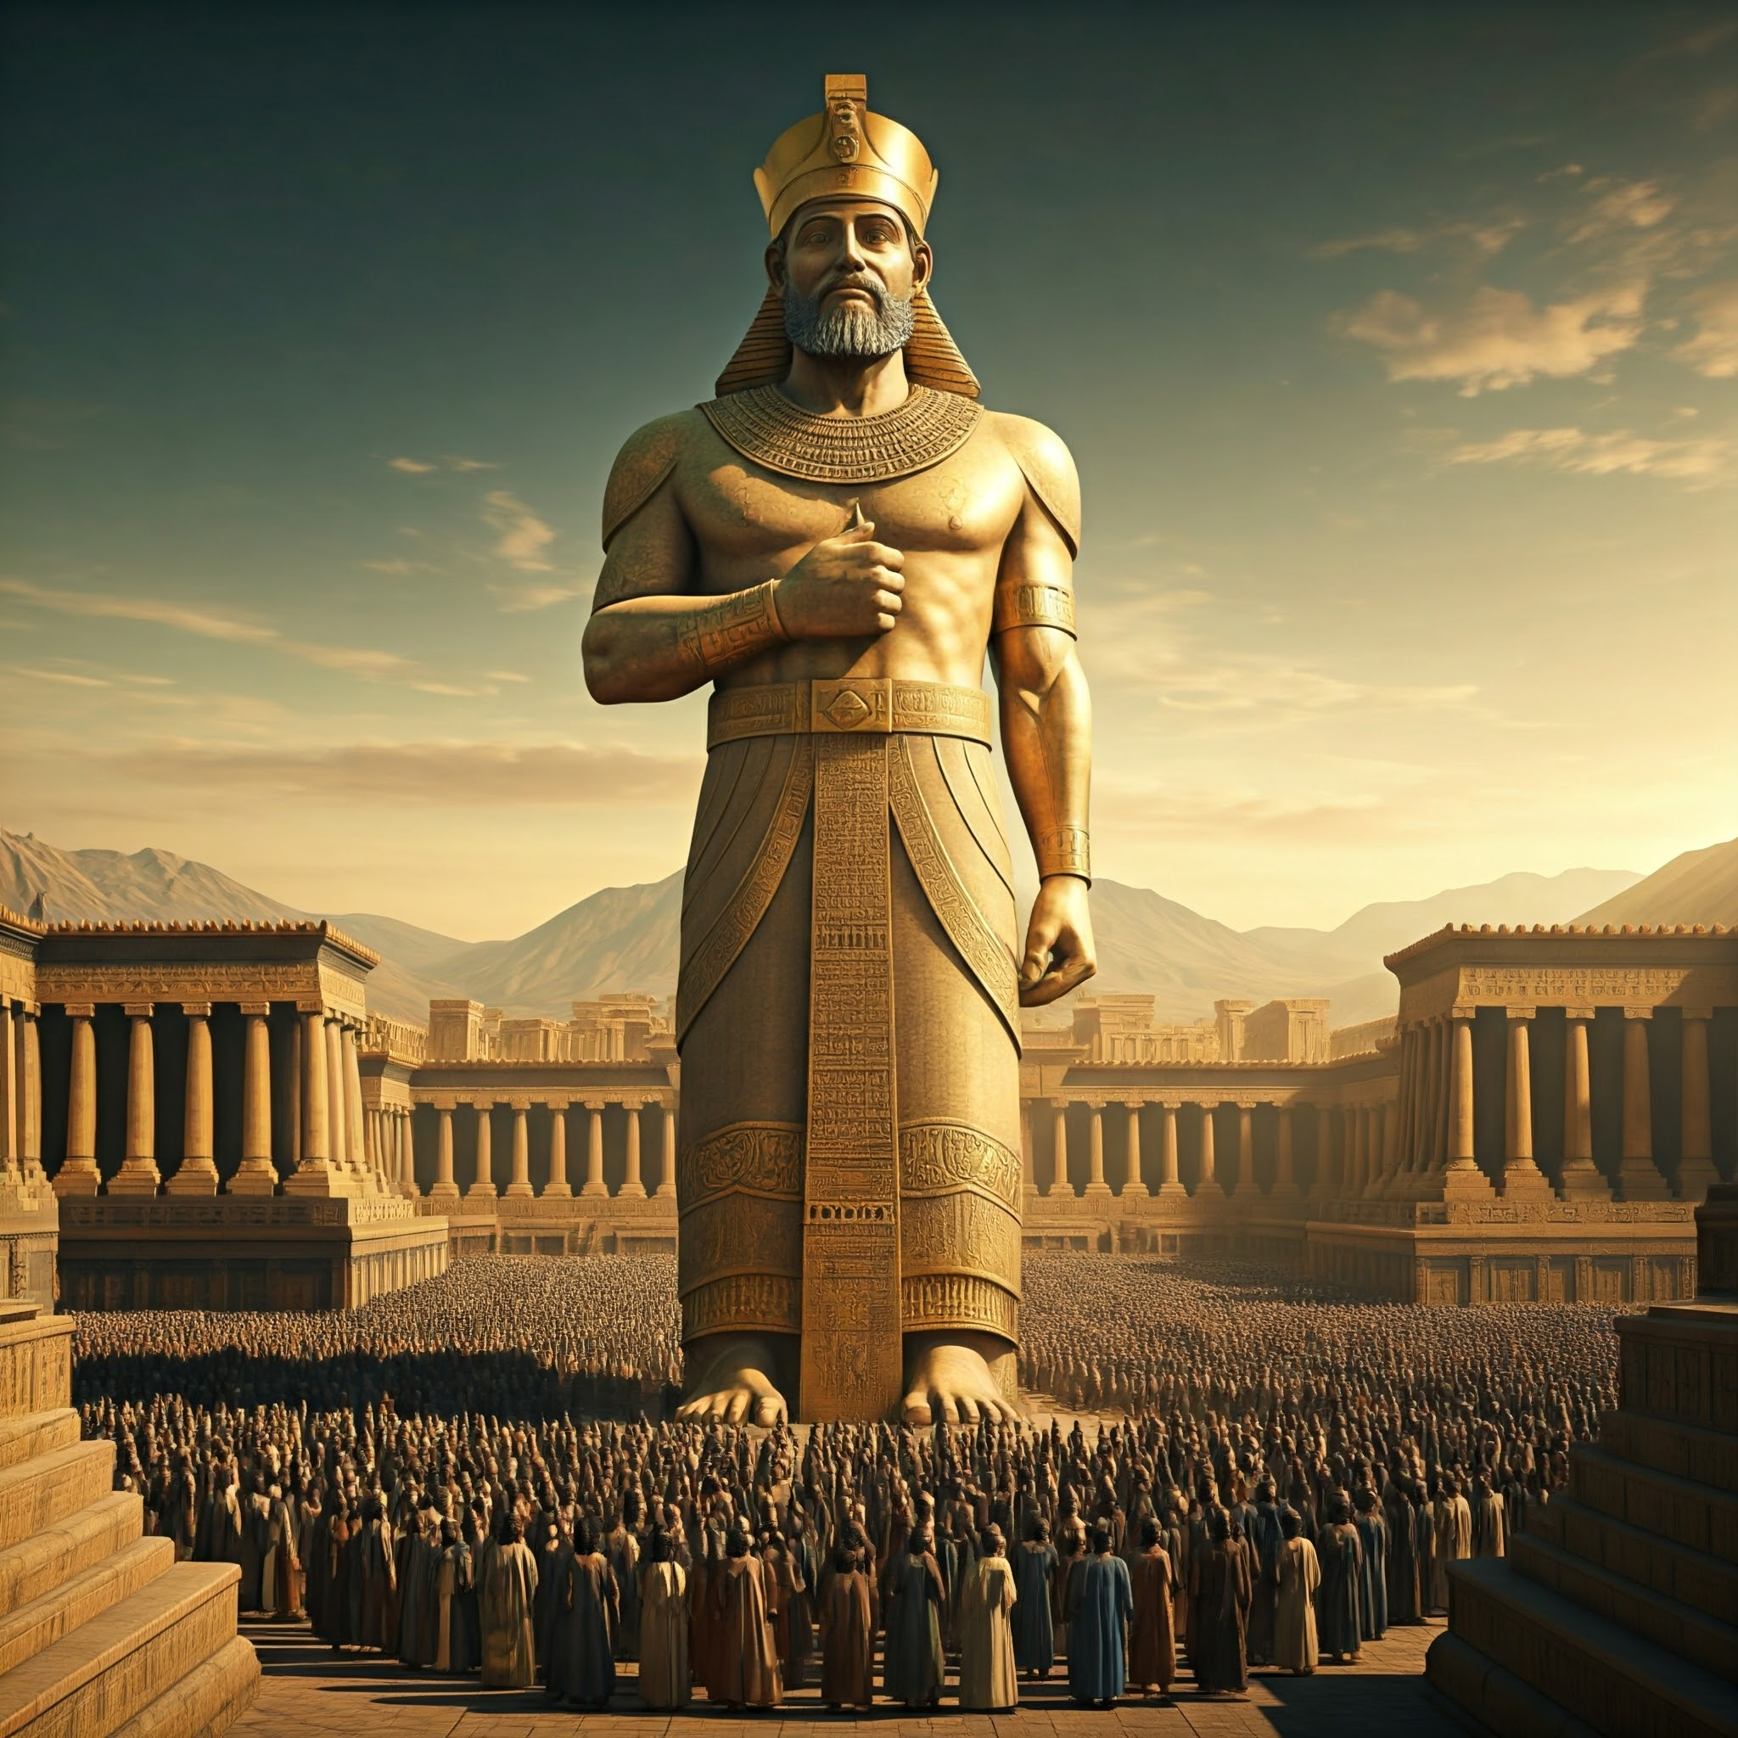
但3:1 尼布甲尼撒王造了一个金像，高六十肘，宽六肘，立在巴比伦省杜拉平原
Daniel 3:1
King Nebuchadnezzar made an image of gold, whose height was sixty cubits and its breadth six cubits. He set it up on the plain of Dura, in the province of Babylon.

Slide 12
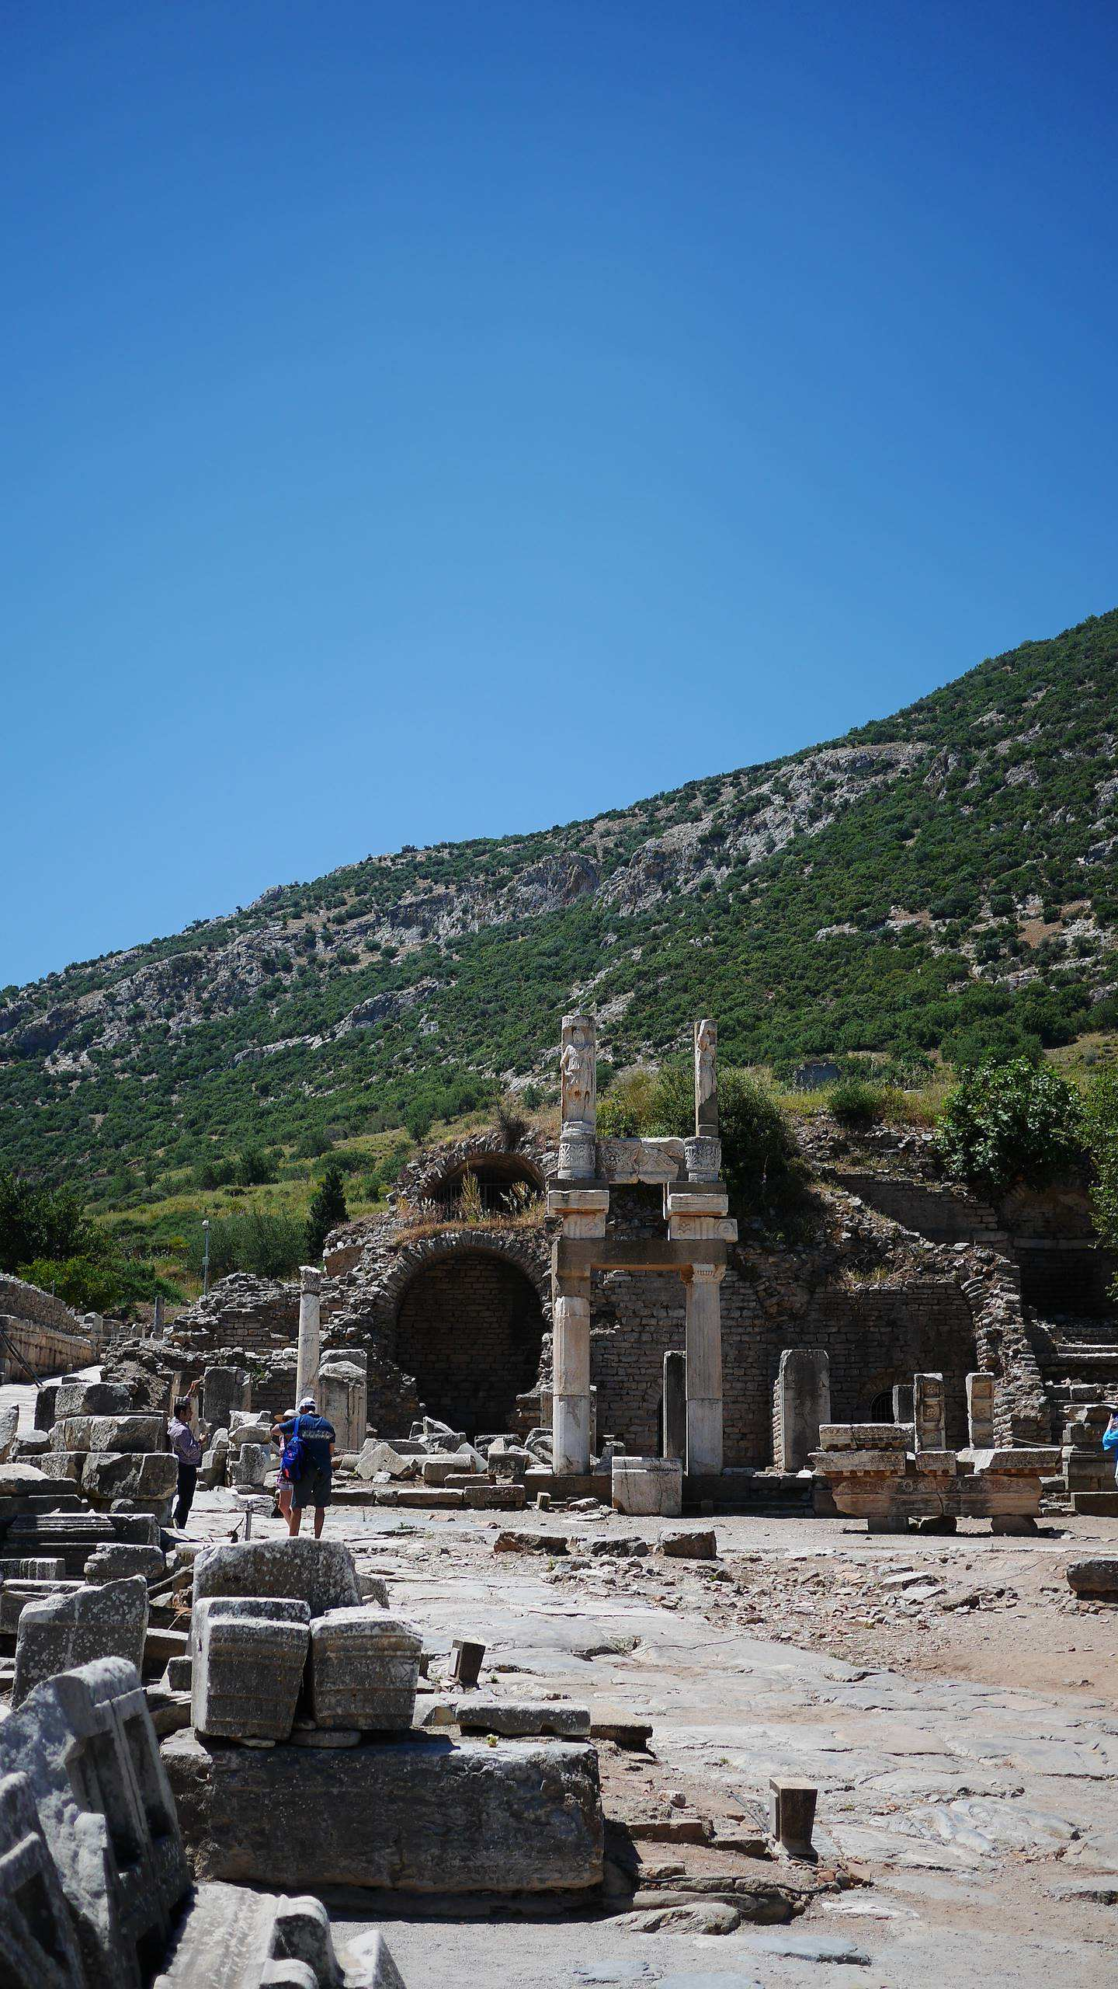
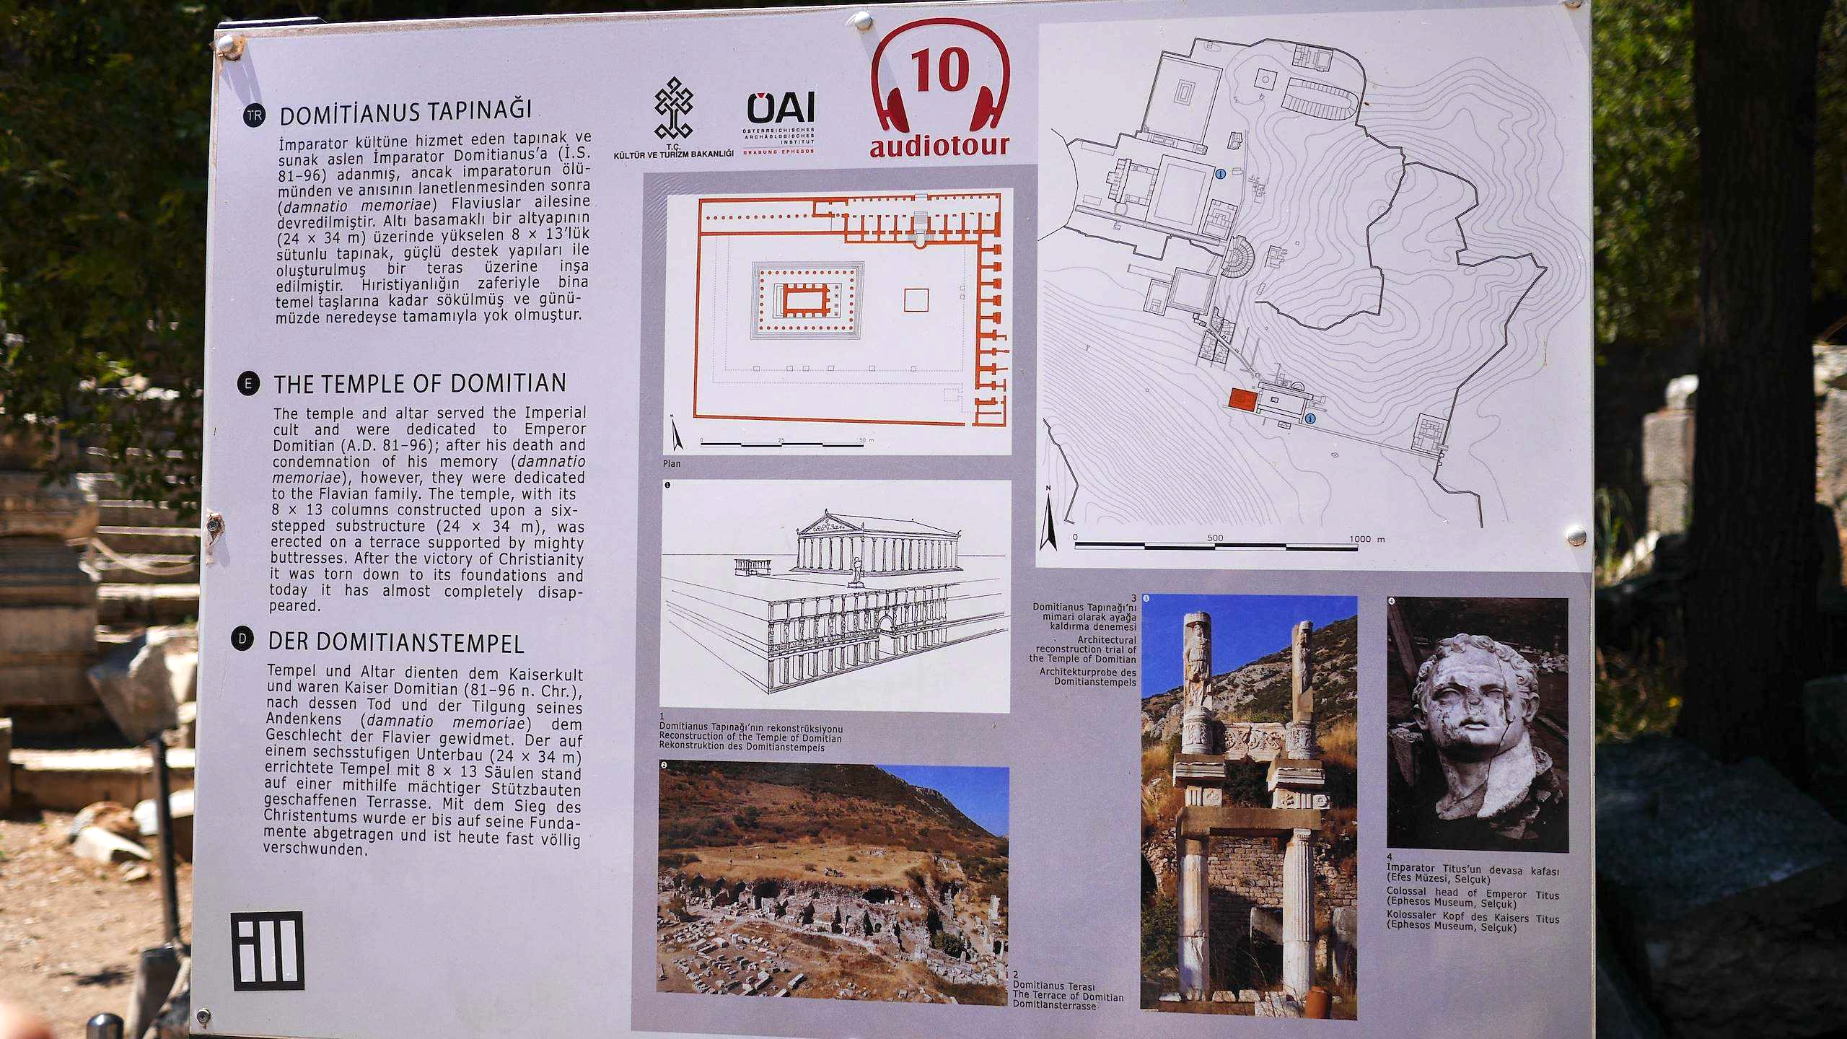
图蜜善 神庙（Temple of Domitian）
以弗所 Ephesus (turkey 土耳其）

Slide 13
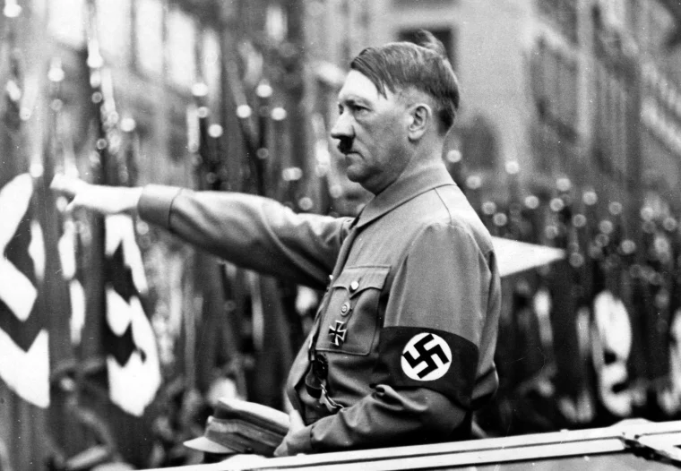
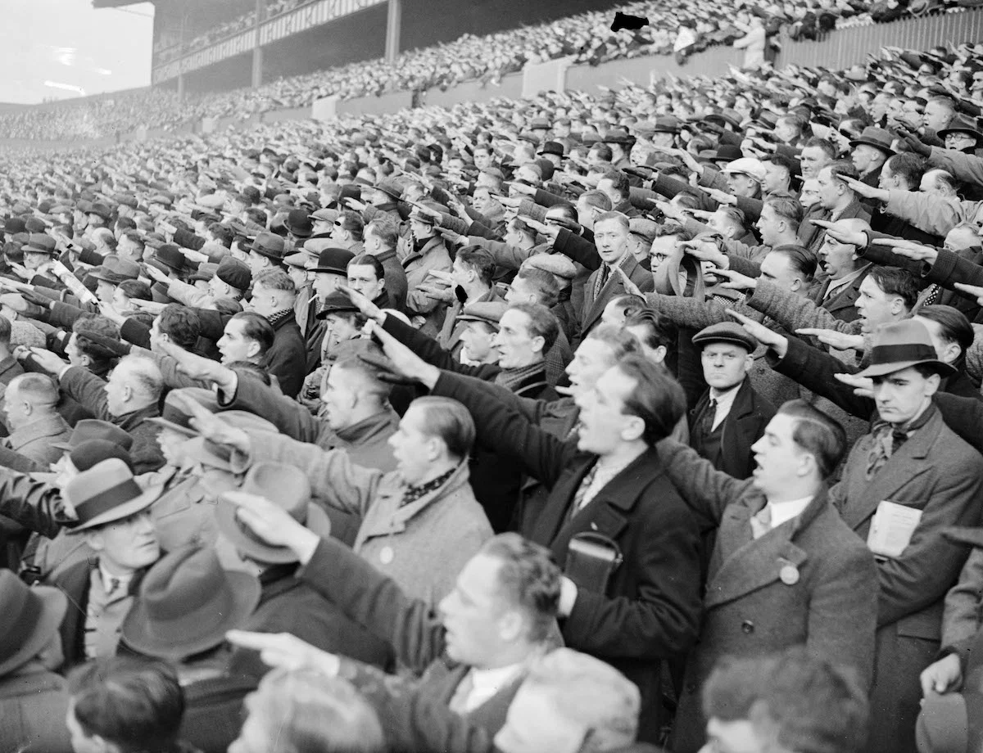

希特勒（Adolf Hitler）是第二次世界大战（1939–1945年）期间纳粹德国的独裁者。
Adolf Hitler was the dictator of Nazi Germany during World War II (1939–1945).
“希特勒万岁”（Heil Hitler）
德国纳粹万字符（卐）
Nazi swastika

Slide 14
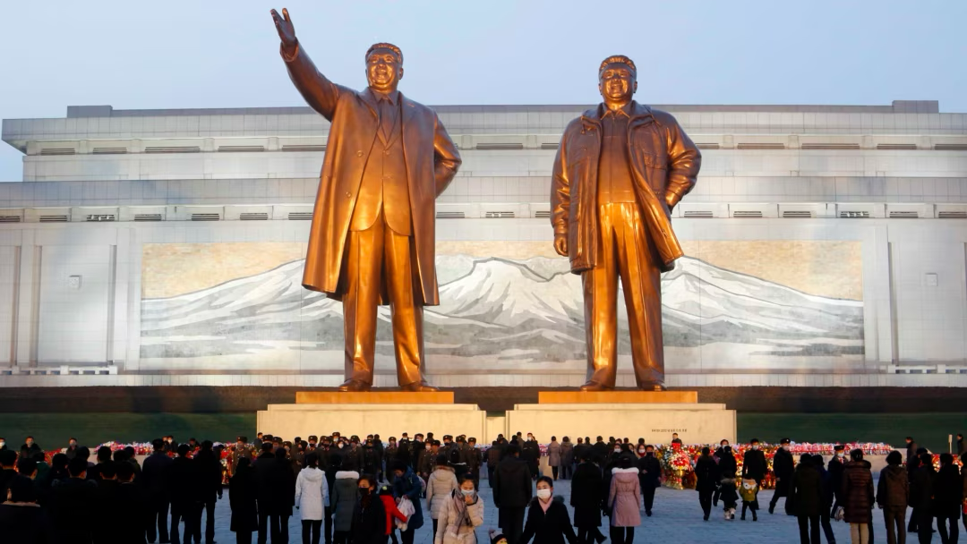
朝鲜
North Korea

Slide 15
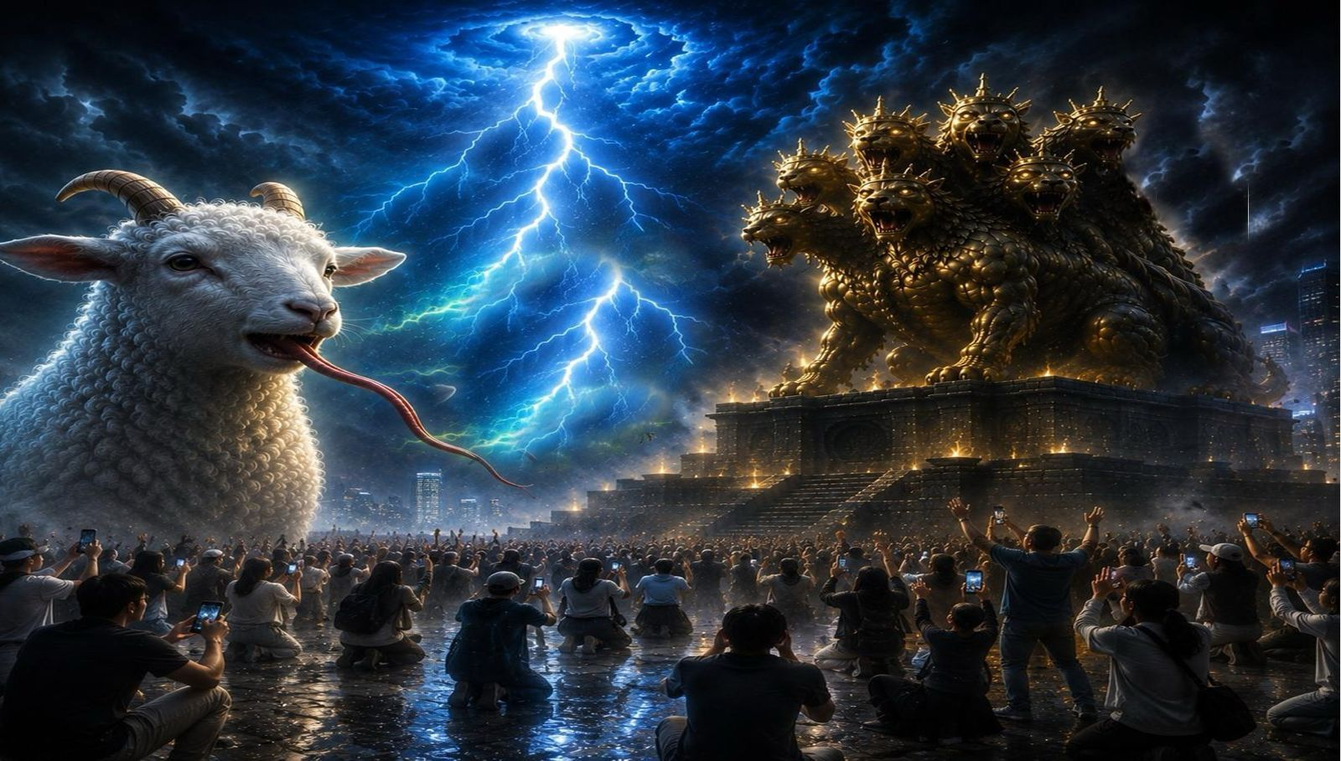
兽的像？
image for the beast ?

Slide 16
兽的像有生气，并且能说话
02
The image of the beast is given breath and is able to speak.

Slide 17
15.又有权柄赐给它，叫兽像有生气，并且能说话，又叫所有不拜兽像的人都被杀害。
15.And it was allowed to give breath to the image of the beast, so that the image of the beast might even speak and might cause those who would not worship the image of the beast to be slain.

Slide 18
龙（撒旦）赐权柄给地兽
The dragon (Satan) gives authority to the beast from the earth.
地兽叫海兽的像有生气并且能说话
The Land beast allowed to give breath to the image of the Sea beast, so that the image might even speak
兽的像
The image of the Sea Beast
海兽
the Sea Beast

Slide 19
像敌
基督
Image of antichrist
海兽
（敌基督）
Sea Beast (antichrist)
兽像
Image of Beast
像有
生气
breath to the image
且能
说话 might even speak

Slide 20

2026年与伪造的“神”沟通的 AI
2026年与伪造的“神”沟通的 AI

Slide 21
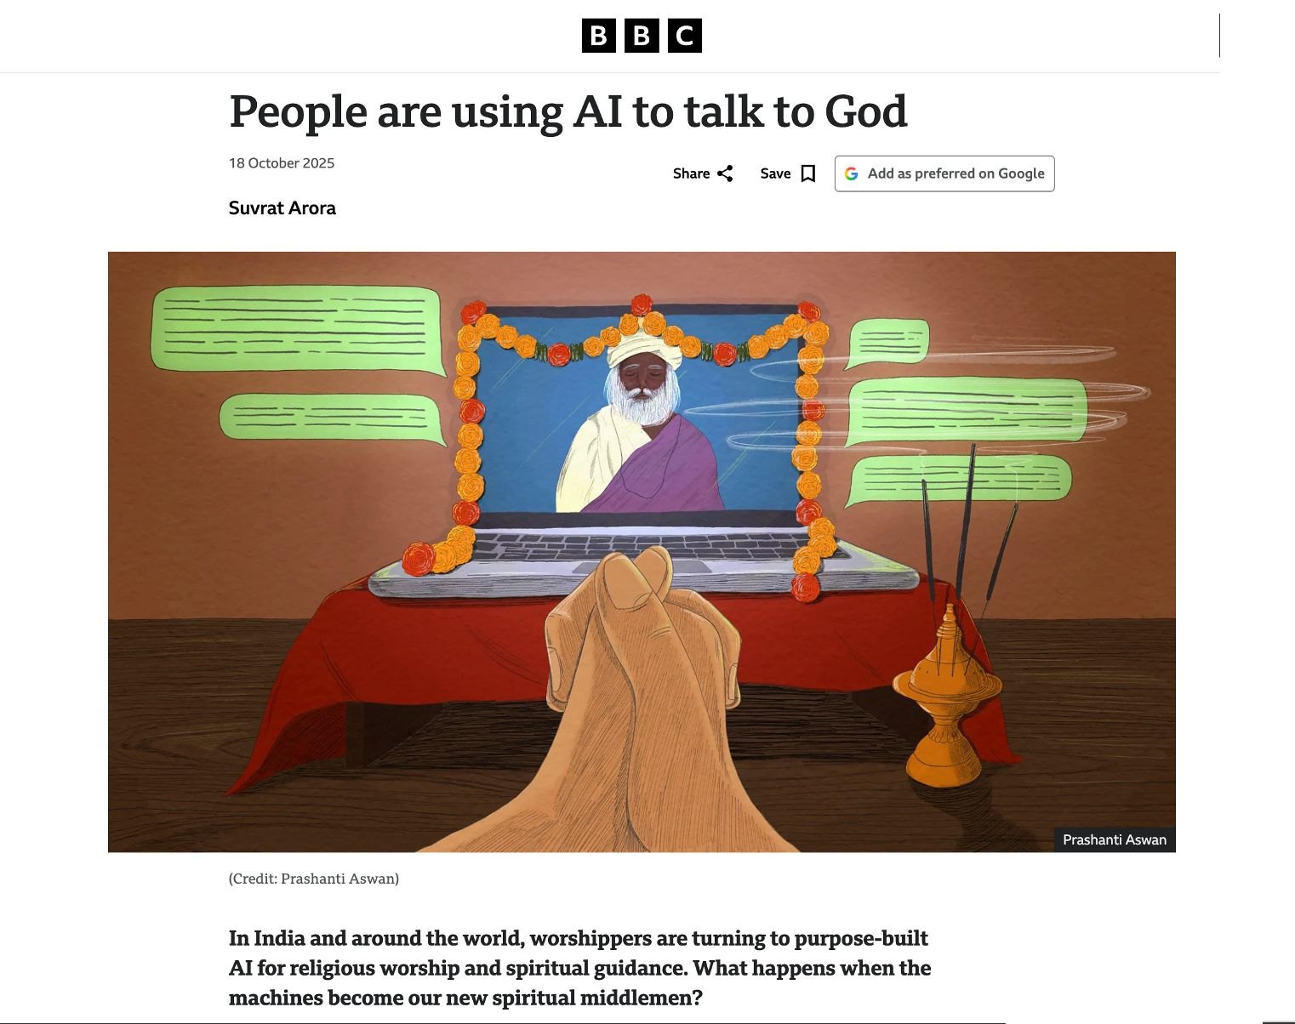

Slide 22
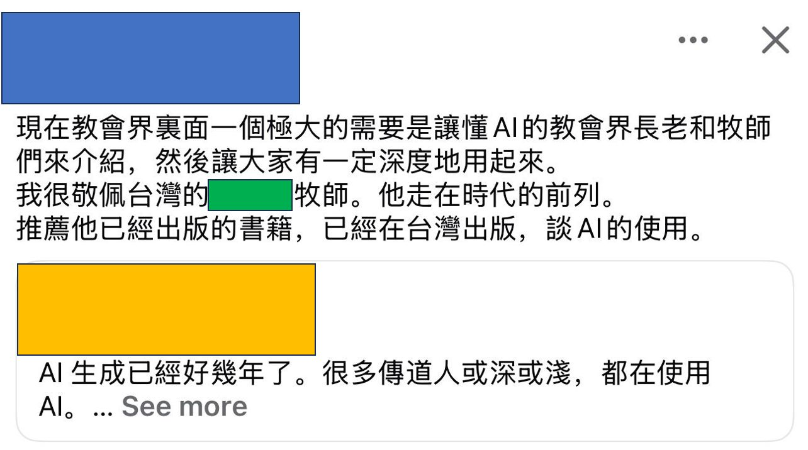

Slide 23


Slide 24


2026年
(顺服、听话、美丽、只鼓励、赞美、绝不批评你，不与你吵架、情绪价值满满)

Slide 25
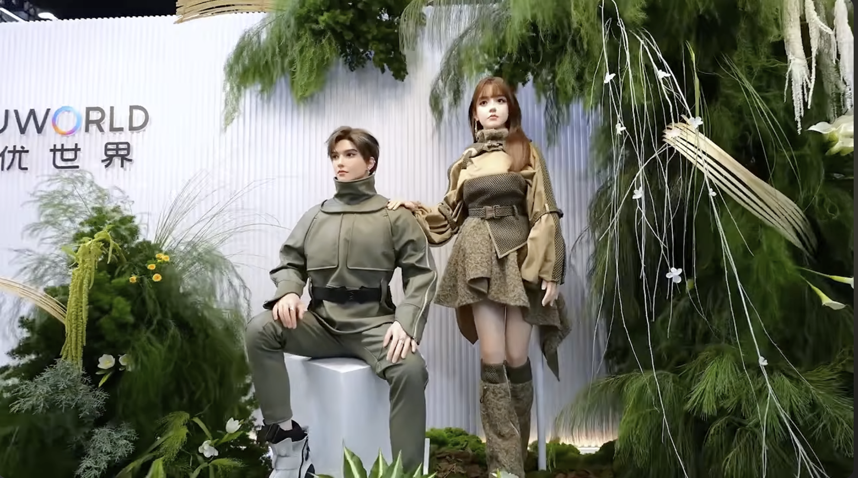
2026年

Slide 26
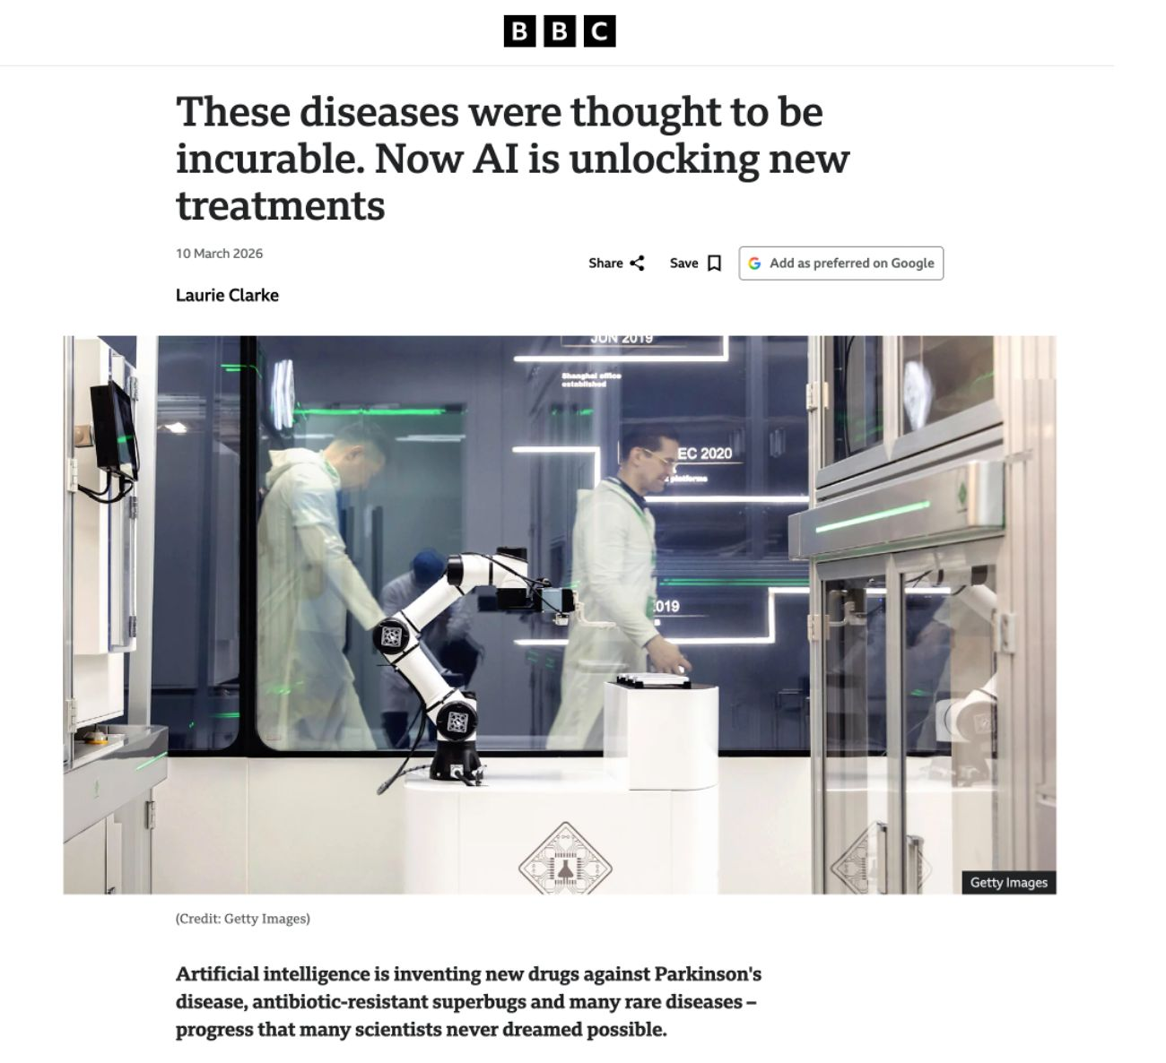
2026年

Slide 27
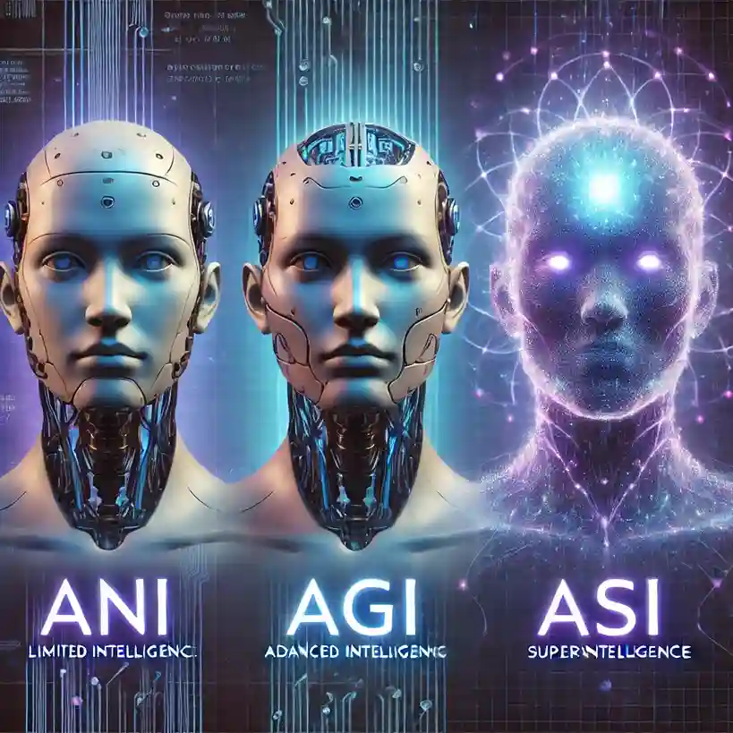

Slide 28
15.又有权柄赐给它，叫兽像有生气，并且能说话，又叫所有不拜兽像的人都被杀害。两角如同羊羔，说话好像龙。12 他在头一个兽面前，施行头一个兽所有的权柄，且叫地和住在地上的人拜那死伤医好的头一个兽。13 又行大奇事，甚至在人面前，叫火从天降在地上。14 他因赐给他权柄在兽面前能行奇事，就迷惑住在地上的人，说：「要给那受刀伤还活著的兽作个像。」
15.And it was allowed to give breath to the image of the beast, so that the image of the beast might even speak and might cause those who would not worship the image of the beast to be slain.

Slide 29
地兽（假先知）
叫不信的人受兽的「印记」
03
The beast from the earth (the false prophet)
causes people to receive the “mark” of the beast.

Slide 30
16.它又叫众人，无论大小贫富，自主的、为奴的，都在右手上或是在额上受一个印记。17.除了那受印记、有了兽名或有兽名数目的，都不得作买卖。
16.Also it causes all, both small and great, both rich and poor, both free and slave, to be marked on the right hand or the forehead,17.so that no one can buy or sell unless he has the mark, that is, the name of the beast or the number of its name.

Slide 31


Slide 32
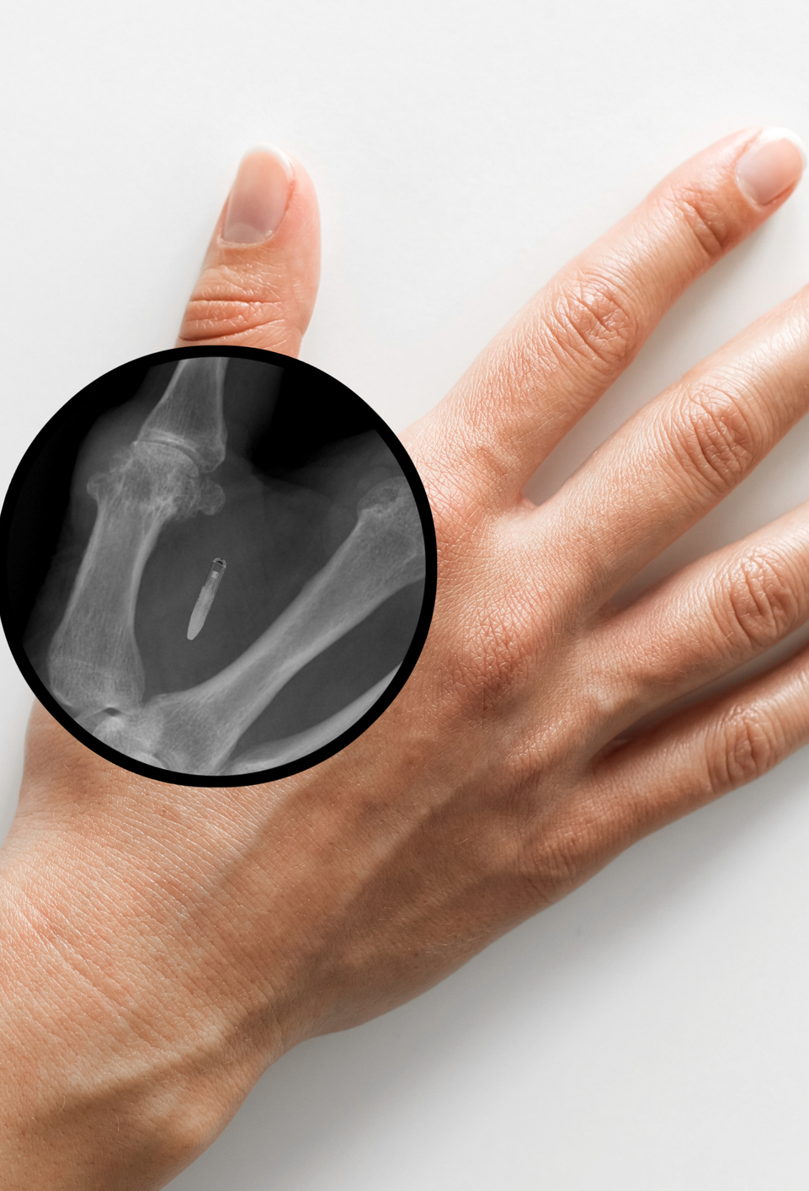
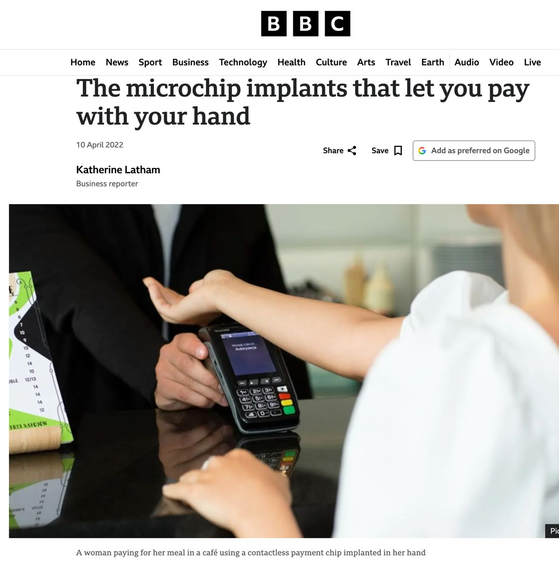

Slide 33

脑机接口
（brain-computer interface, BCI）
截至2026年1月，Neuralink 报告称，全球共有 21名临床试验参与者。瘫痪参与者已经使用其植入式脑机接口来控制电脑，一些参与者还通过神经信号控制辅助机械臂。

Slide 34
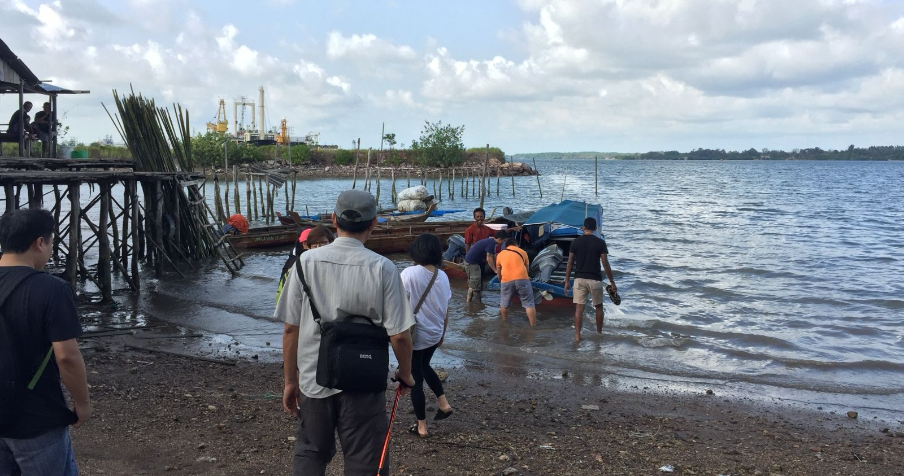

Slide 35
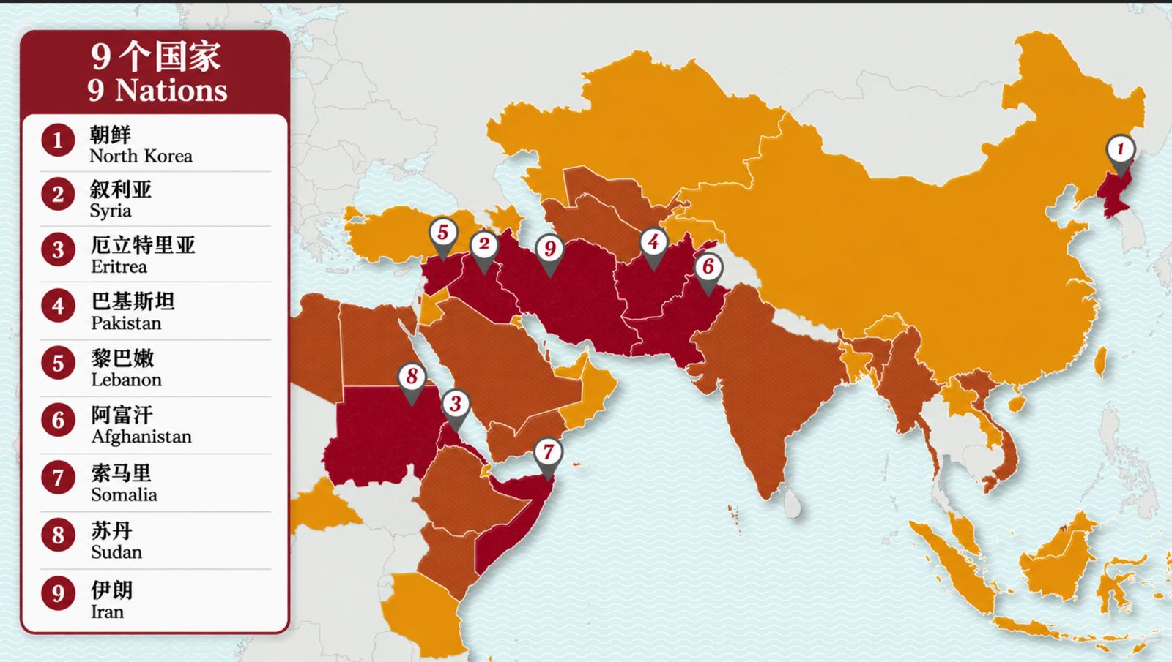

Slide 36
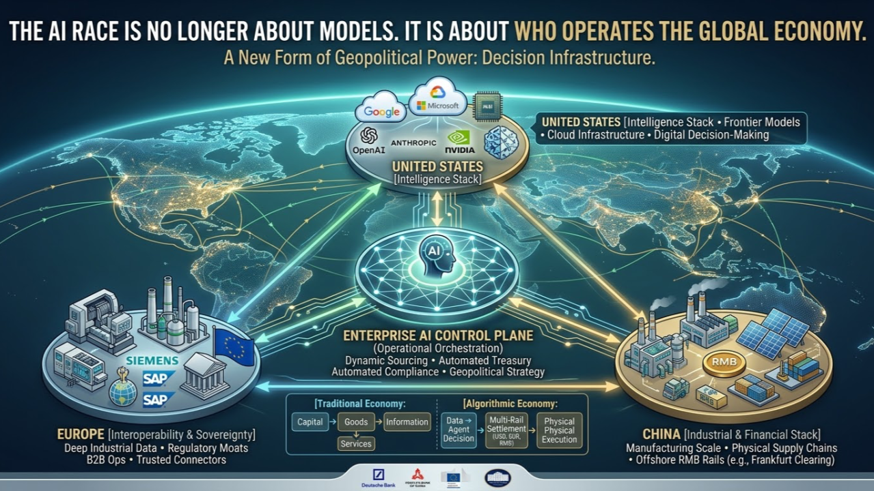
哪一个国家掌控 AI 将掌握未来的经济与金融

Slide 37
海兽（第一只兽）的数目是 6 6 6。
04
The number of the beast from the sea (the first beast) is 666.

Slide 38
18.在这里有智慧。凡有聪明的，可以算计兽的数目，因为这是人的数目，它的数目是六百六十六。我又看见另有一个兽从地中上来有两角如同羊羔，说话好像龙。12 他在头一个兽面前，施行头一个兽所有的权柄，且叫地和住在地上的人拜那死伤医好的头一个兽。13 又行大奇事，甚至在人面前，叫火从天降在地上。14 他因赐给他权柄在兽面前能行奇事，就迷惑住在地上的人，说：「要给那受刀伤还活著的兽作个像。
This calls for wisdom: let the one who has understanding calculate the number of the beast, for it is the number of a man, and his number is 666.

Slide 39
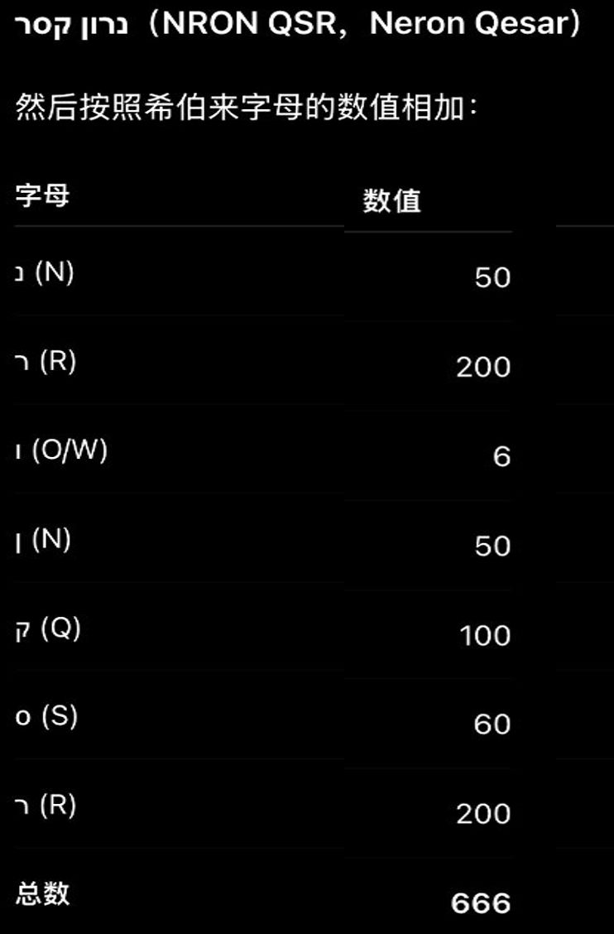

尼禄 凯撒
（Nero Caesar）
AD 37–68

Slide 40
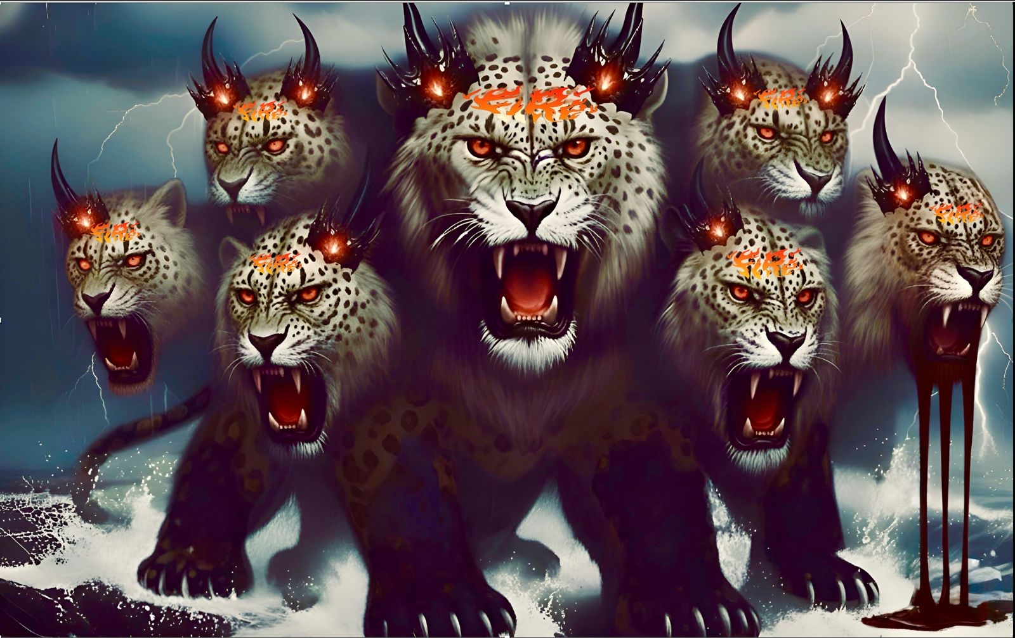
（1）世人都会跟从并敬拜兽
（2）兽会说亵渎话，自称为神
（3）迫害基督徒
1.The people of the world will follow and worship the beast.
2.The beast will speak blasphemous words and claim to be God.
3.The beast will persecute Christians.

Slide 41
徒 14:22 坚固门徒的心，劝他们恒守所信的道；又说：「我们进入神的国，必须经历许多艰难。」兽
Act 14:22 strengthening the souls of the disciples, encouraging them to continue in the faith, and saying that through many tribulations we must enter the kingdom of God.

Slide 42
一些神允许的计划，不是你我能改变的，身为儿女当效法基督坚忍到底
兽
Some things God has sovereignly permitted are beyond our power to change. As His children, we are called to follow Christ’s example and persevere faithfully to the end.

Slide 43

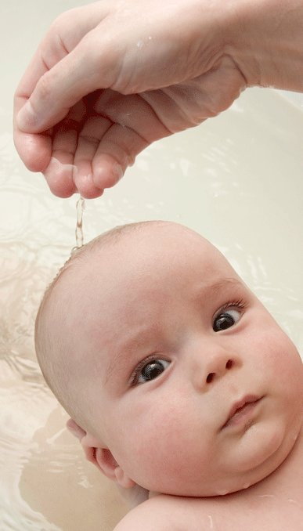
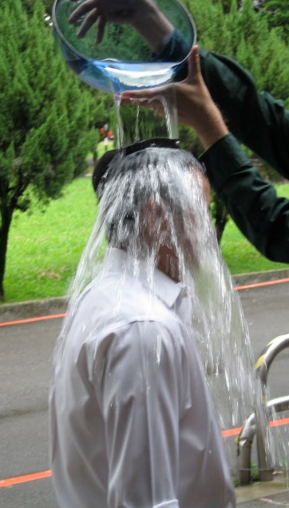
洗礼

Slide 44
马太福音 16:24
於是耶稣对门徒说：
若有人要跟从我，就当舍己，背起他的十字架来跟从我。
Mat 16:24
Then Jesus told his disciples,
“If anyone would come after me, let him deny himself
and take up his cross and follow me.

Slide 45
问：你是否接受耶稣基督是上帝的独生爱子，祂就是上帝？
问：你是否承认自己是罪人，并接受耶稣基督为你的罪钉在十字架上 ？
问：你是否相信耶稣基督赦免你的罪并赐你永生？

Slide 46
问：你是否愿意背起十字架来跟随主耶稣，作主耶稣的门徒？
问：你是否愿意坚守神与你所立的约？一生信主、爱主、顺服主。

Slide 47
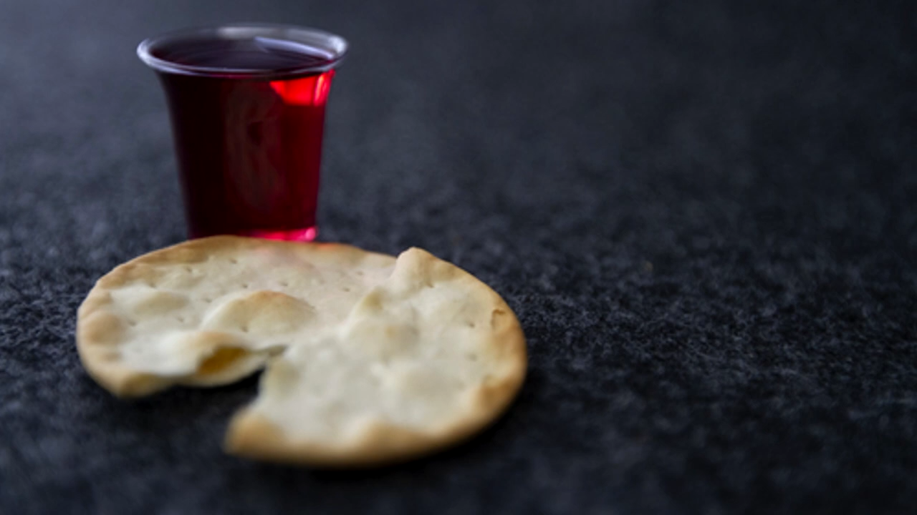
奇异恩典
圣餐

Slide 48
路 22:19
他拿起饼来，感谢了，擘开递给他们，说：“这是我的身体，为你们舍的，你们应当这样行，为的是记念我。”20 饭后，他照样拿起杯来，说：“这杯是用我的血所立的新约，这血是为你们流的。
Luk 22:19 And he took bread, and when he had given thanks, he broke it and gave it to them, saying, “This is my body, which is given for you. Do this in remembrance of me.” 20 And likewise the cup after they had eaten, saying, "This cup that is poured out for you is the new covenant in my blood.

